Slide 1
psi’->gamma chi_cj; chicj->Sigma- anti-Sigma+
Cannot select correct combination in MC (46% miscombination)
Final states : gamma , nbar, neutron, pi+, pi-
Kinematic fit: Loop all the neutral tracks and minimum chisq
Miss neutron 3-momentum
Miss antineutron energy
Mass constraint on nbar pi-
4-momentum constraint on psi’

Slide 2
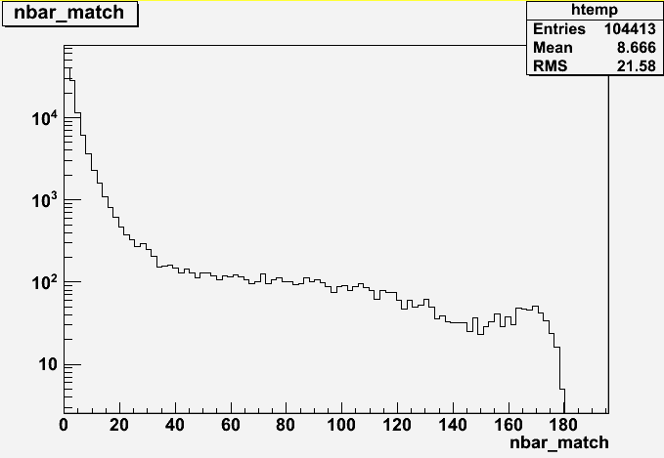
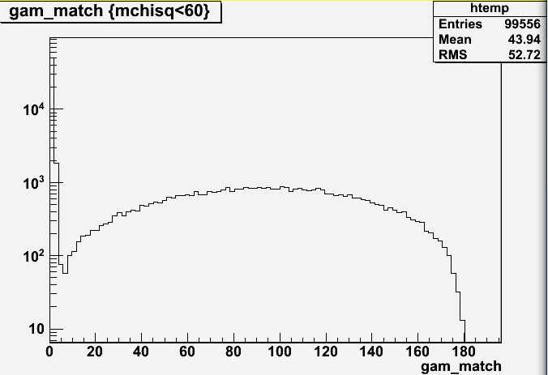
95.2% correctly detected
53.1% correctly detected

Slide 3
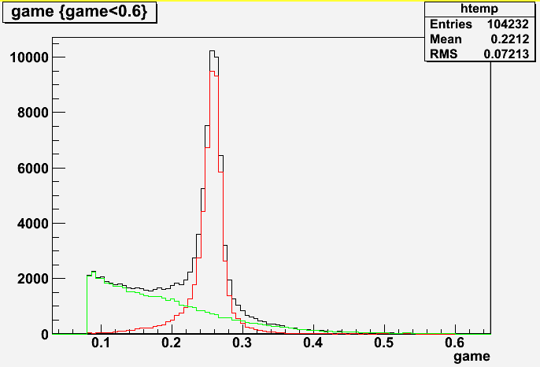
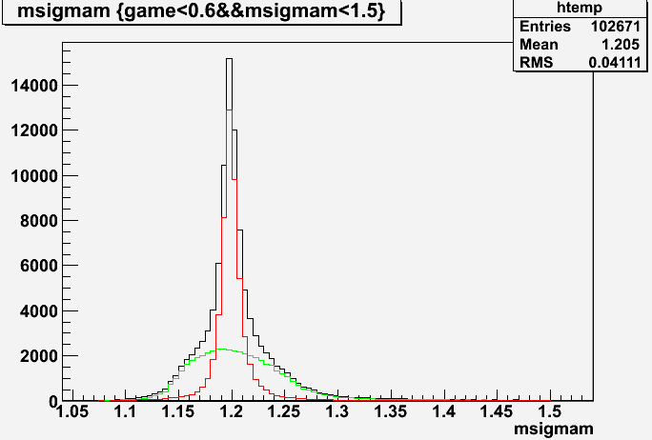

Slide 4
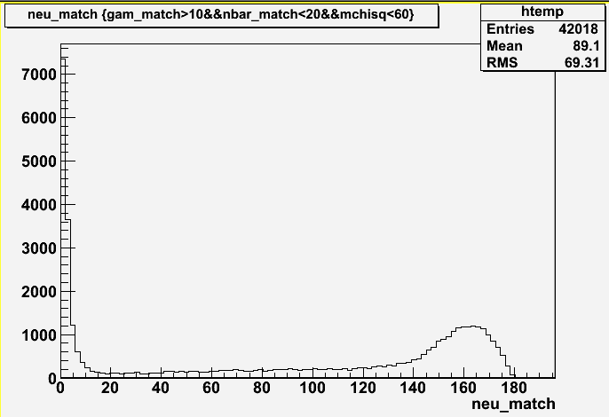
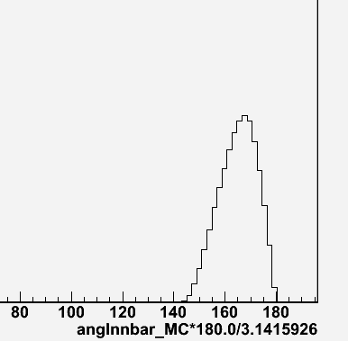
In the left 46% uncorrected combined events
14% are from neutron – photon mis-detect
These are the showers from nbar neighbours
Notes:
1.69696969696969707e-01

Slide 5
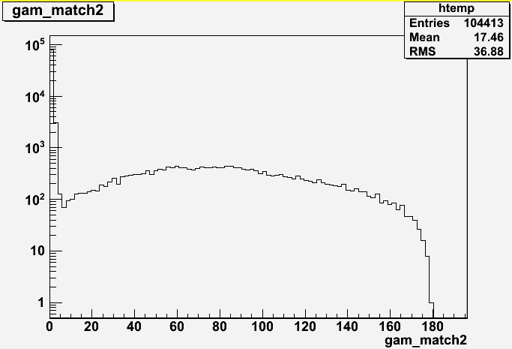
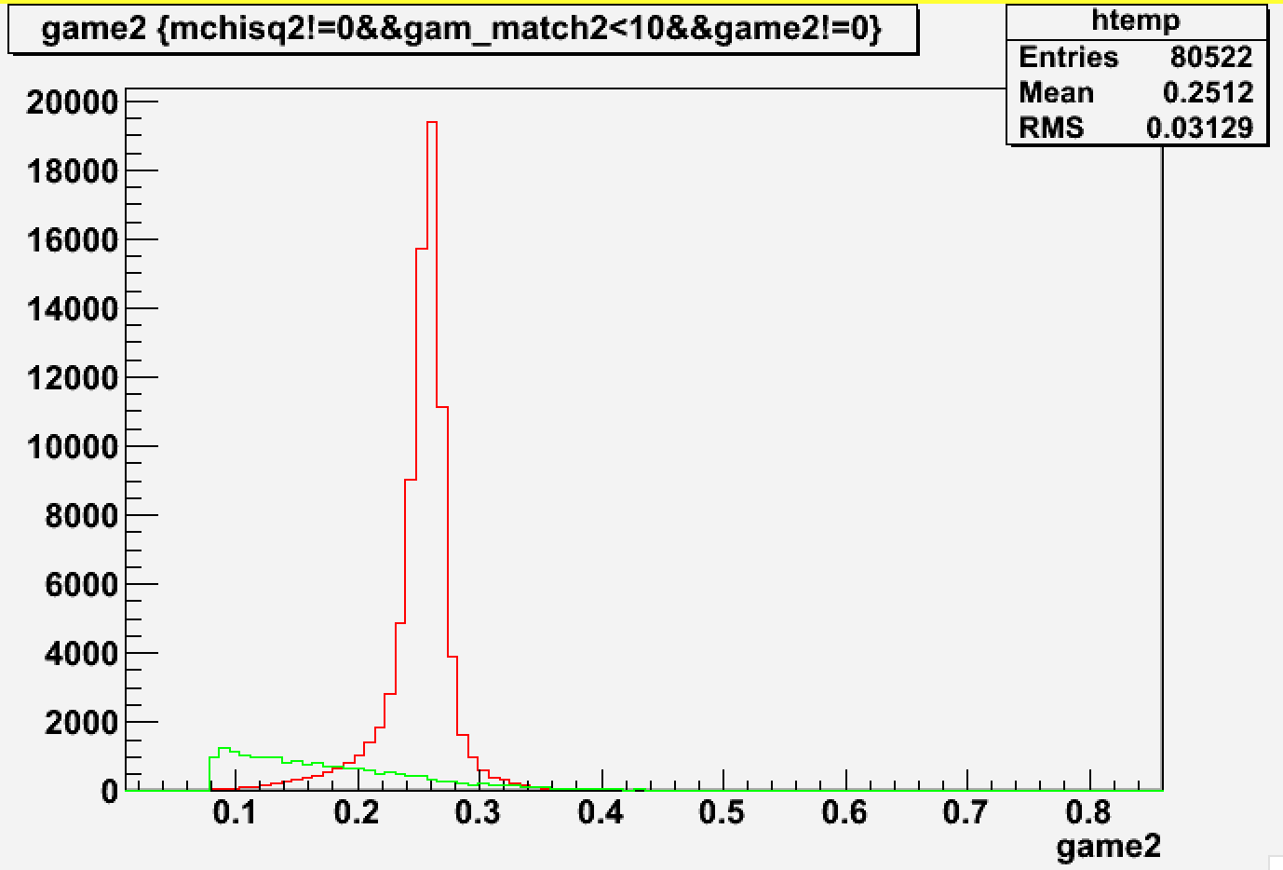
Another kinematic fit is applied: match the best photon with MC-truth
83.1% correctly detected
(photon detection efficiency)
At least we can improve 30% correction combination ratio
Notes:
24.4

Slide 6
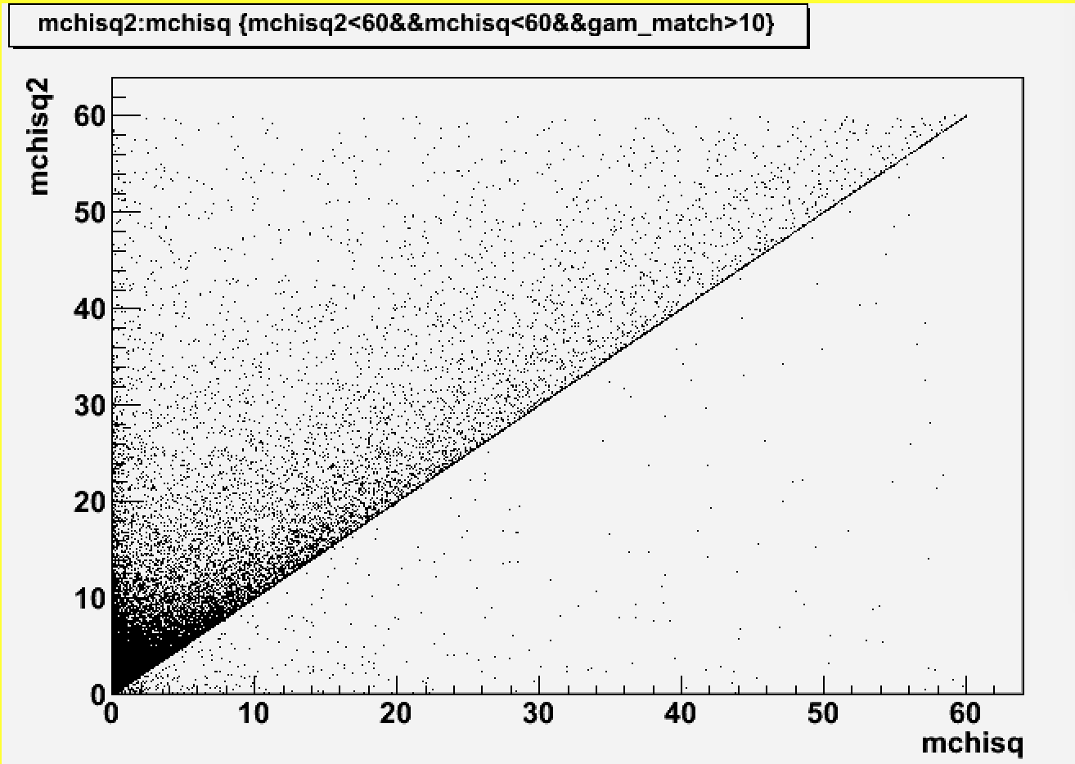

Slide 7
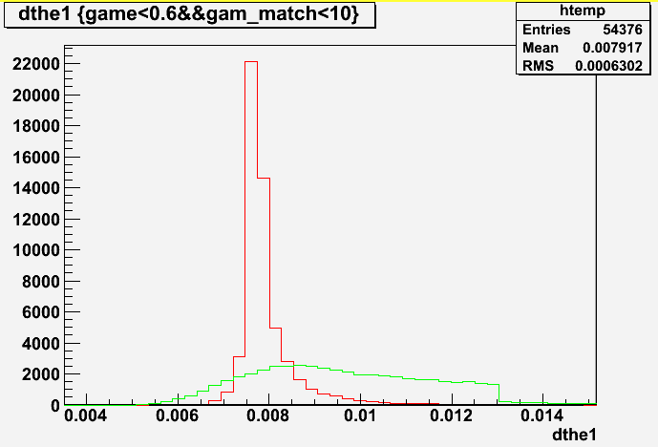
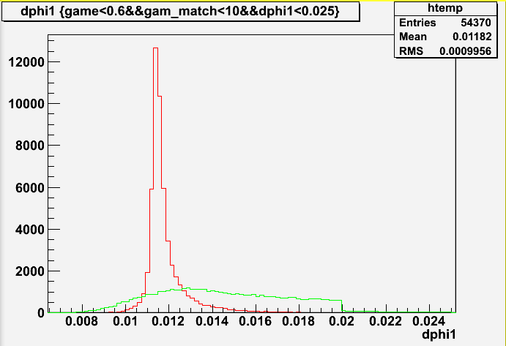
First attempt: change the error matrix, dthe=0.008, dphi=0.012

Slide 8
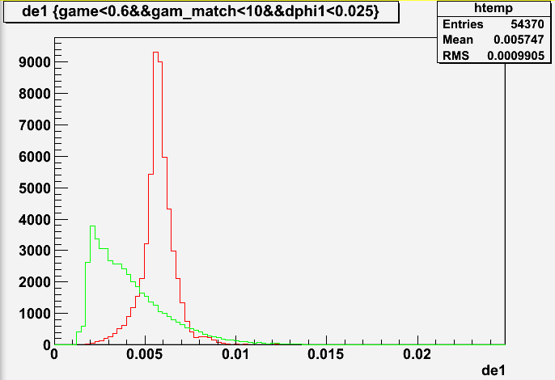
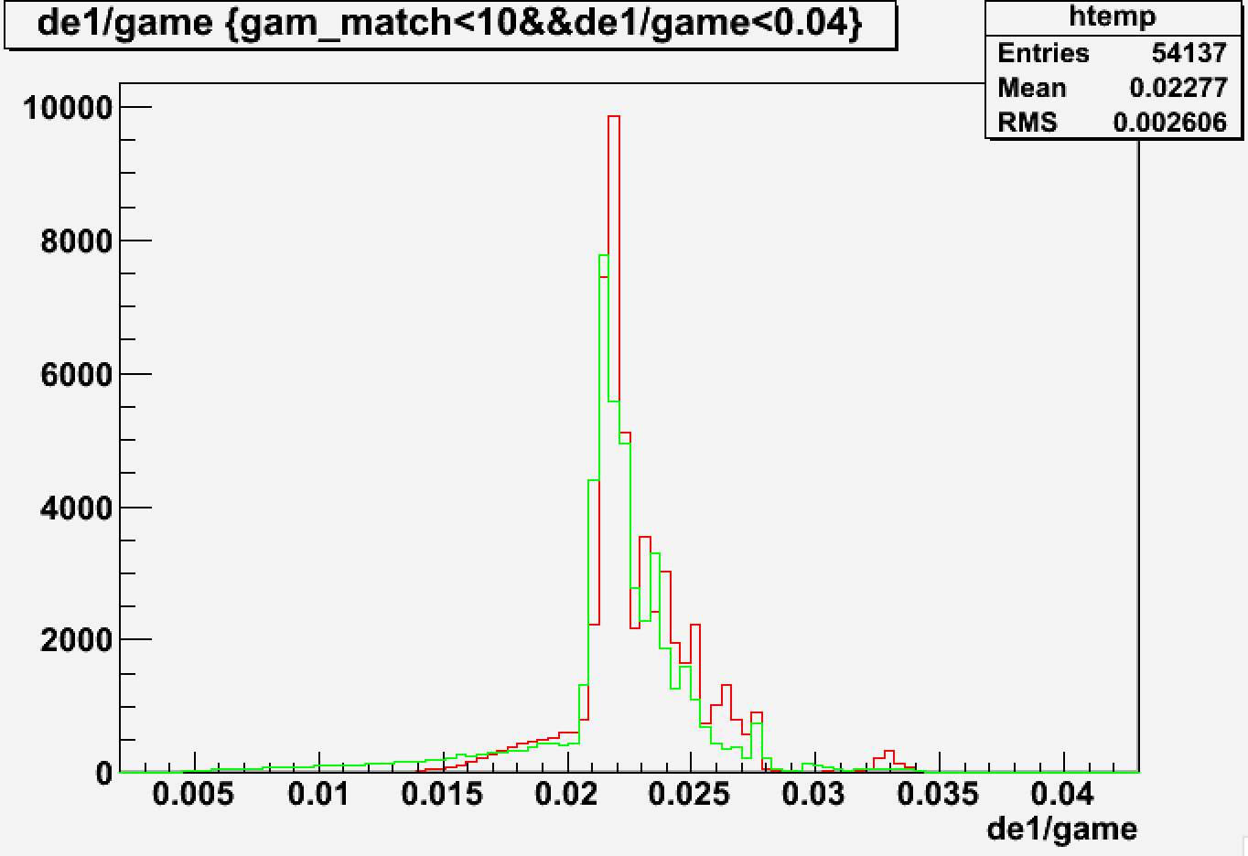

Slide 9
