Slide 1
D+ MC study
Zhouxk
04.09

Slide 2
1. update generator
eta' -> gamma pi+ pi- DIY_Etap2gpipi_box;
#D+ -> K_S0 pi+ pi+ pi- DIYKsPPP;
#D+ -> K_L0 pi+ pi+ pi- DIYKsPPP;
2. add new modes
D+ -> f_0(600) e+ nu_e 0.0 ==> 0.000633 (BESIII)
D+ -> anti-K_10 pi+ 0.0 ==> 0.0153 (BESIII draft)
D+ -> omega pi+ 0.0 ==> 0.00028 (BESIII)
D+ -> omega pi+ pi0 0.0 ==> 0.000086 (suspect)
D+ -> eta eta pi+ 0.0 ==> 0.00277 (BESIII report)
3. remove modes
D+ -> anti-K_2*0 e+ nu_e 0.0033 ==> 0.0
D+ -> anti-K_2*0 mu+ nu_mu 0.0033 ==> 0.0
D+ -> anti-K0 pi+ pi0 0.138 ==> 0.0

Slide 3
4. adjust Brs
D+ -> mu+ nu_mu 0.00038 ==> 0.000374 (BESIII)
D+ -> tau+ nu_tau 0.00116 ==> 0.00102 (BESIII)
D+ -> anti-K0 e+ nu_e 0.0883 ==> 0.086 (BESIII)
D+ -> anti-K*0 e+ nu_e 0.05528 ==> 0.054 (PDG)
D+ -> K- pi+ e+ nu_e 0.00311 ==> 0.0038 (BESIII)
D+ -> pi0 e+ nu_e 0.0405 ==> 0.0363 (BESIII)
D+ -> eta e+ nu_e 0.00133 ==> 0.00107 (BESIII)
D+ -> rho e+ nu_e 0.0022 ==> 0.00187 (BESIII)
D+ -> anti-K0 mu+ nu_mu 0.0940 ==> 0.0872 (BESIII)
D+ -> anti-K*0 mu+ nu_mu 0.05528 ==> 0.054 (PDG)
D+ -> pi0 mu+ nu_mu 0.0405 ==> 0.0342 (BESIII)
D+ -> K_S0 pi+ pi0 0.0 ==> 0.06714 (BESIII)
D+ -> K_L0 pi+ pi0 0.0 ==> 0.08339 (BESIII)
D+ -> anti-K'_10 pi+ 0.054 ==> 0.0406 (BESIII draft)
D+ -> anti-K0 omega pi+ 0.0040 ==> 0.0176 (BESIII report)
D+ -> pi+ pi+ pi- 0.00138 ==> 0.00175 (PDG)
D+ -> f_0(1500) pi+ 0.0011 ==> 0.00048 (PDG)
D+ -> eta pi+ 0.00343 ==> 0.00379 (BESIII)
D+ -> eta' pi+ 0.0044 ==> 0.00512 (BESIII)
D+ -> anti-K0 K+ 0.0057 ==> 0.0064 (BESIII)
D+ -> K+ pi0 0.00024 ==> 0.000232 (BESIII)
D+ -> phi rho+ 0.0038 ==> 0.00096 (BESIII report)
D+ -> phi pi+ pi0 0.0192 ==> 0.00484 (BESIII report)

Slide 4
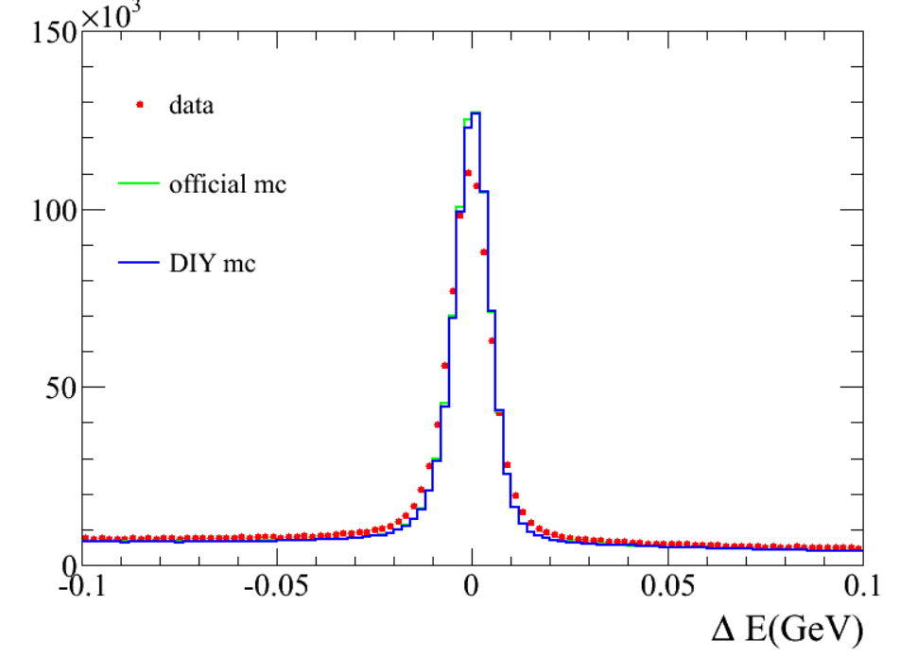
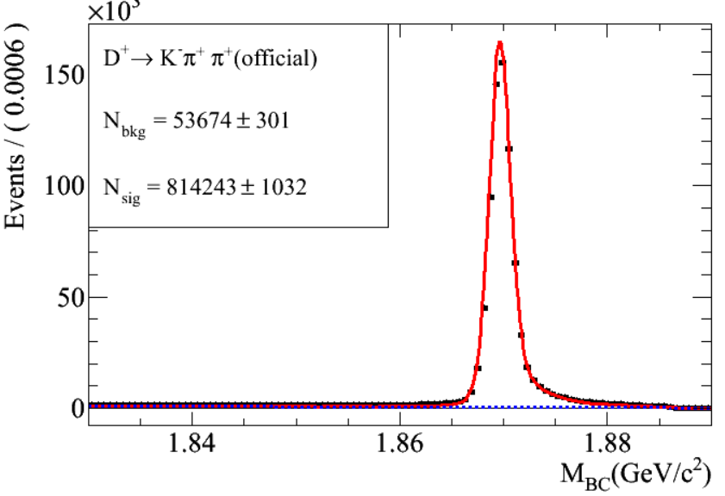
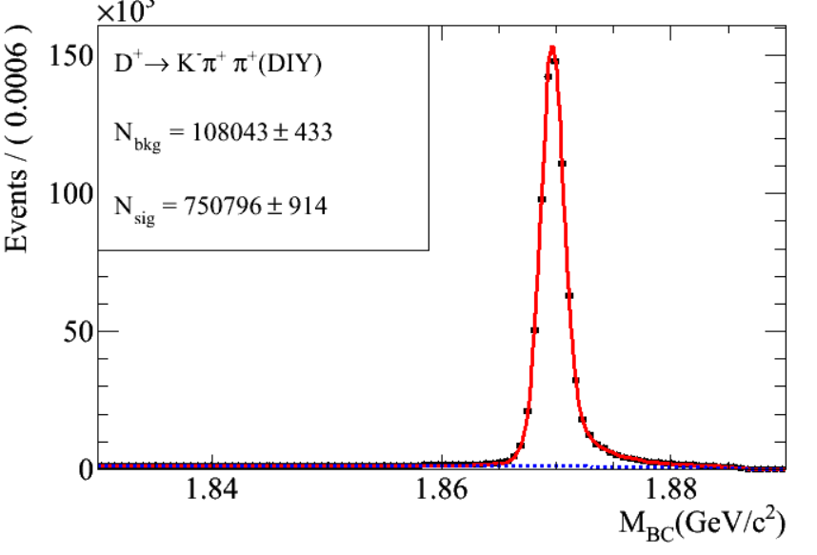
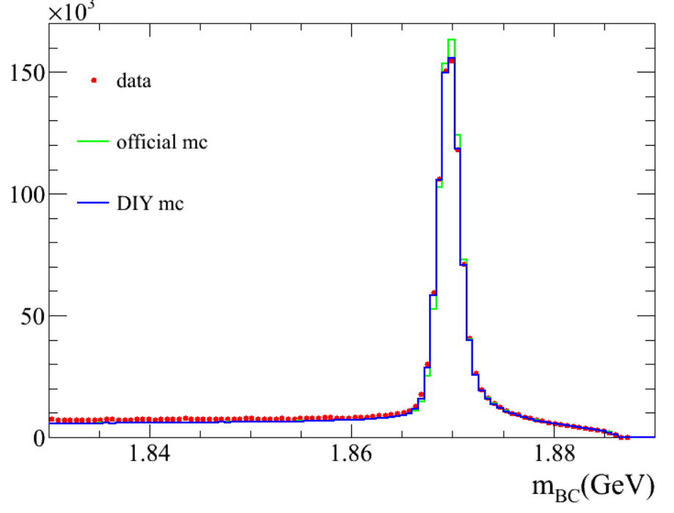
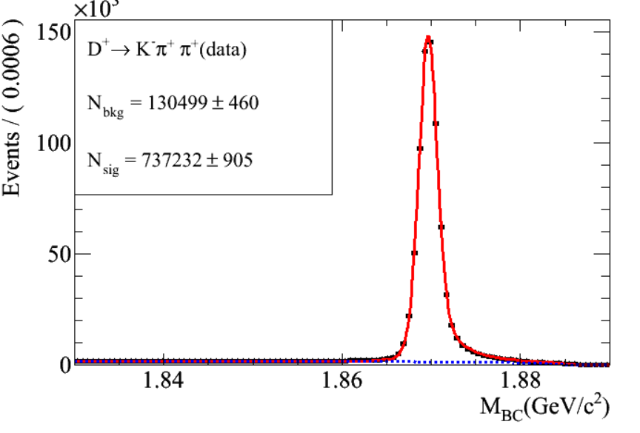
KPiPi
-0.02<deltaE<0.02

Slide 5
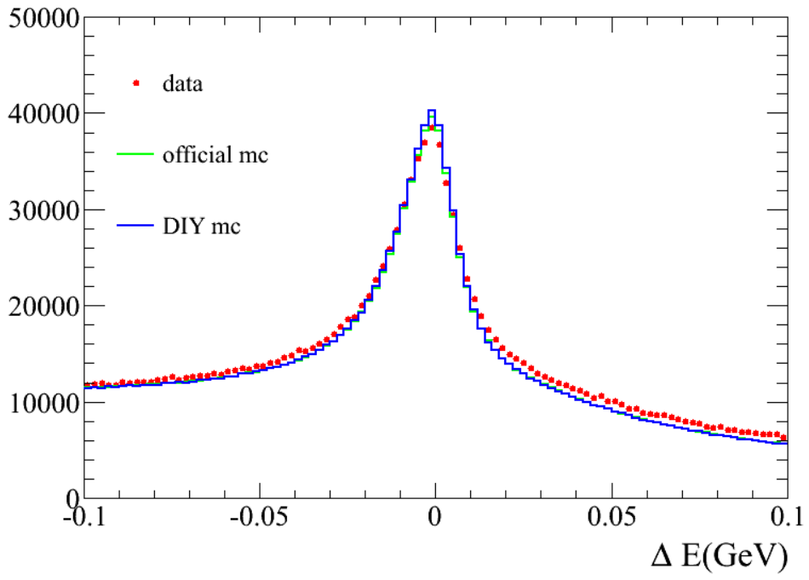
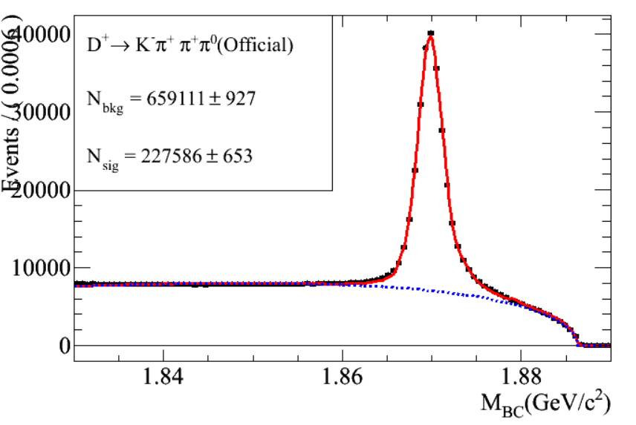
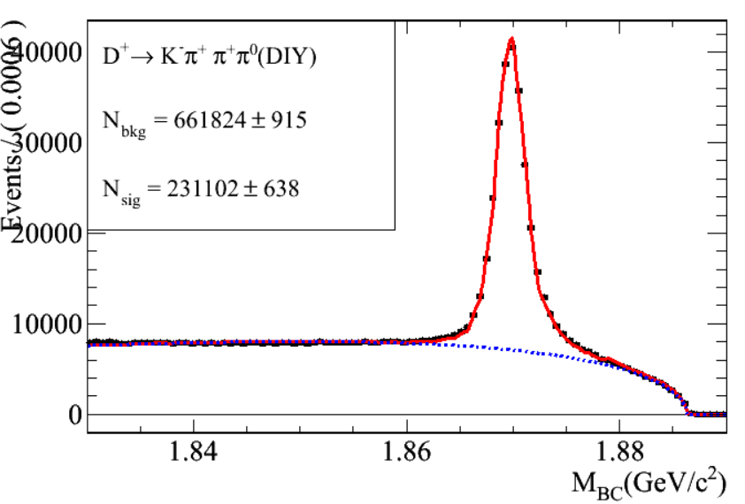
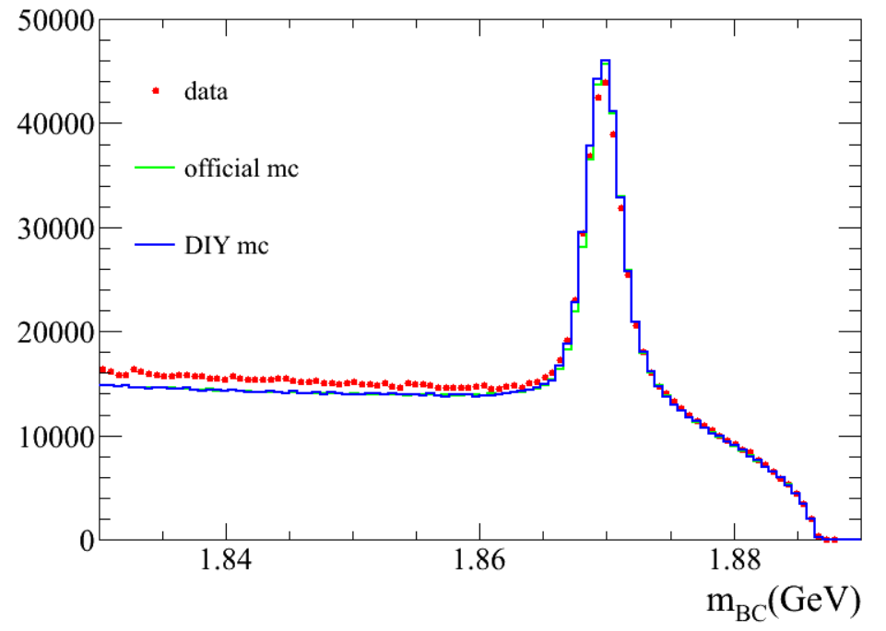
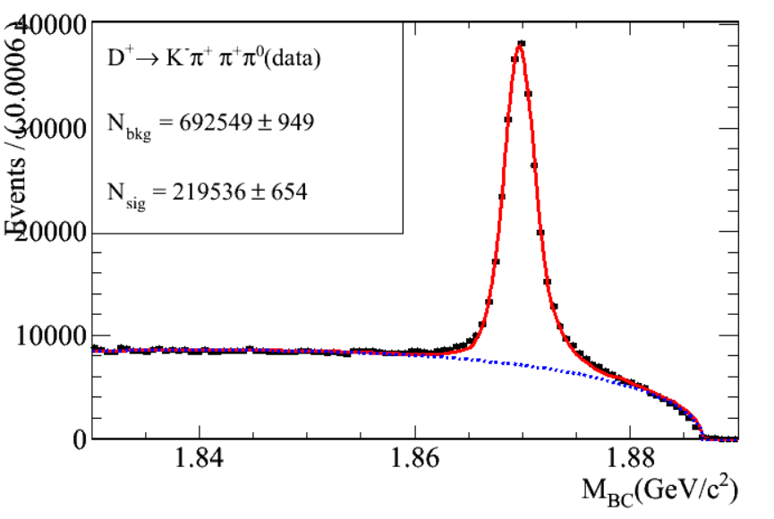
KPiPiPi0
-0.06<deltaE<0.03

Slide 6
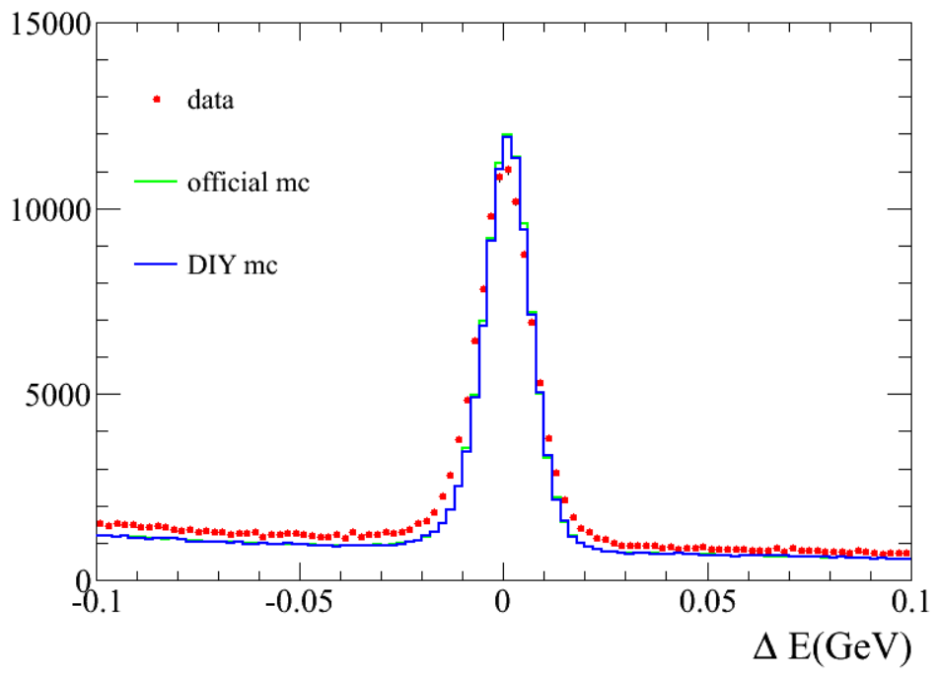
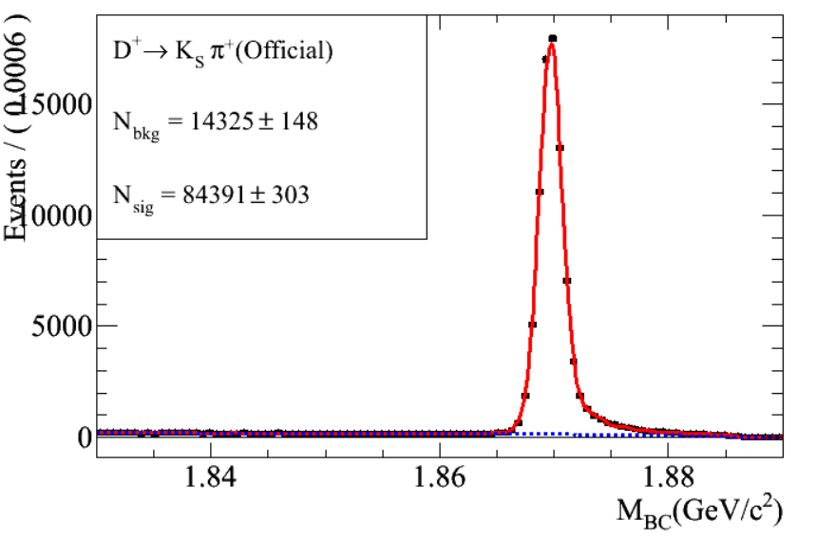
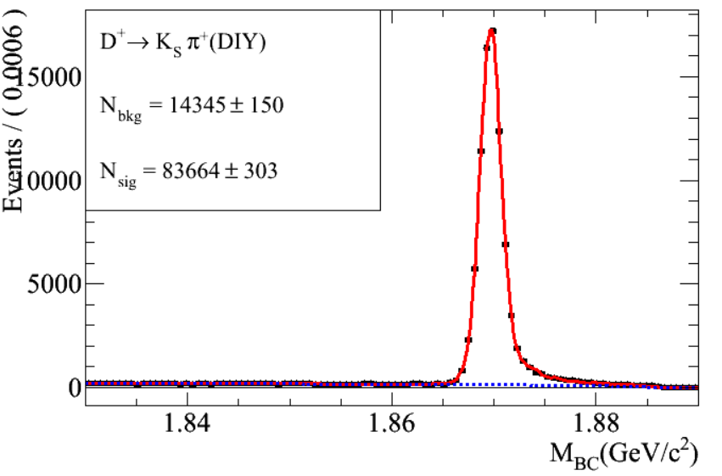
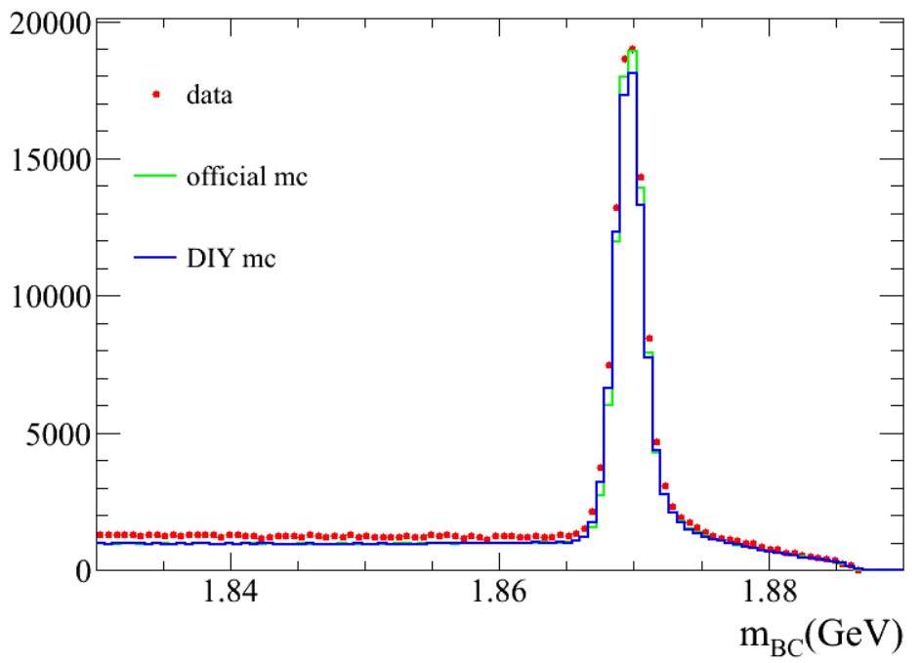
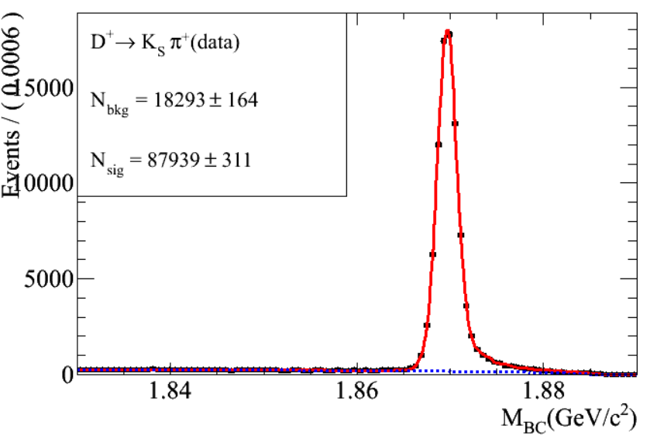
KsPi
-0.02<deltaE<0.02

Slide 7
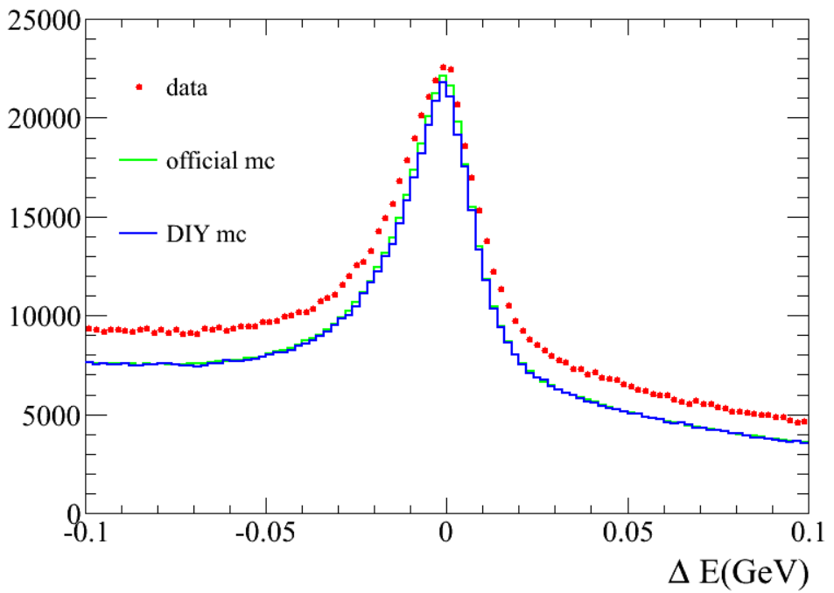
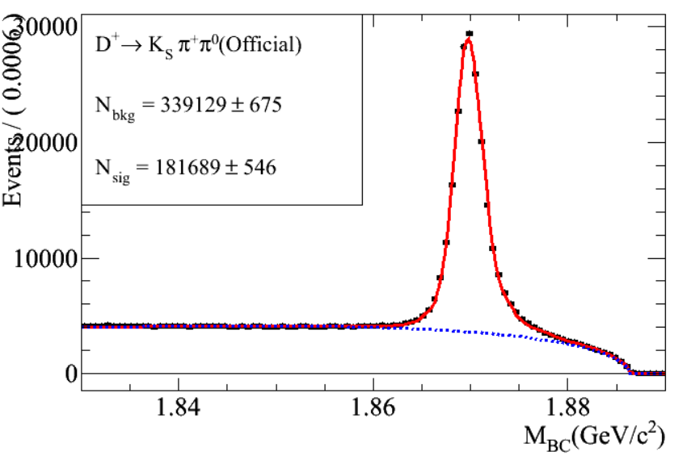
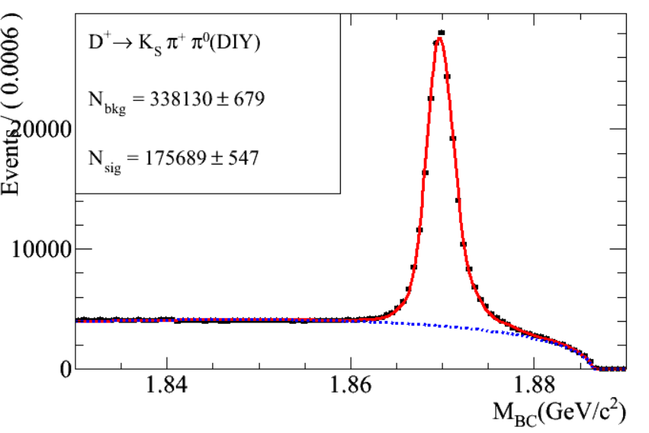
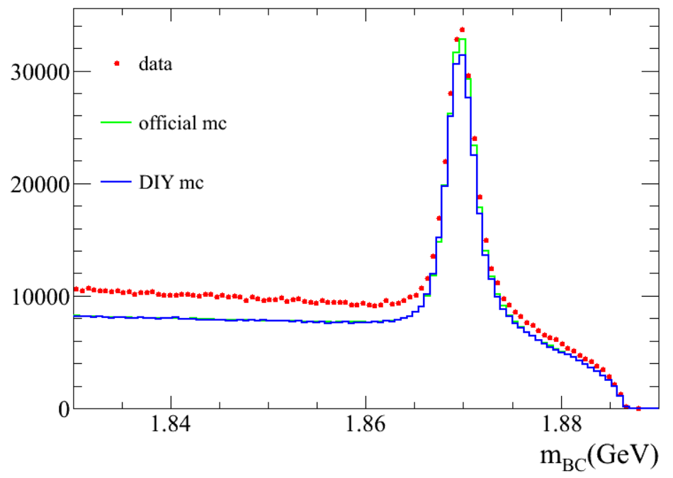
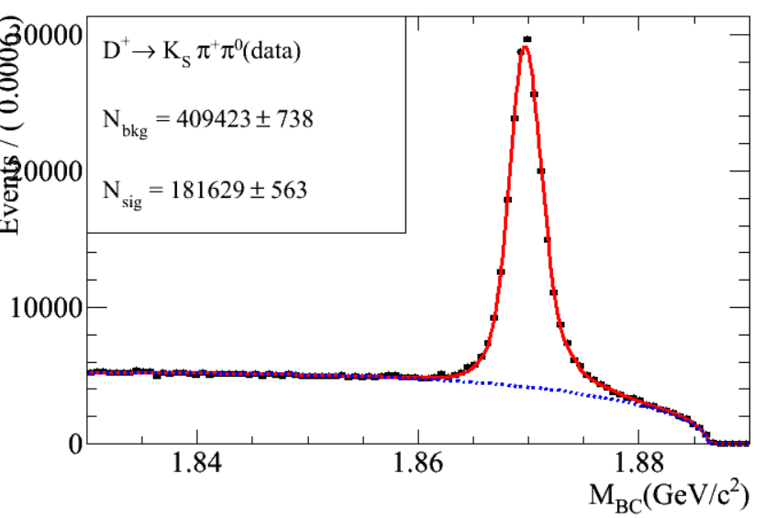
KsPiPi0
-0.06<deltaE<0.03

Slide 8
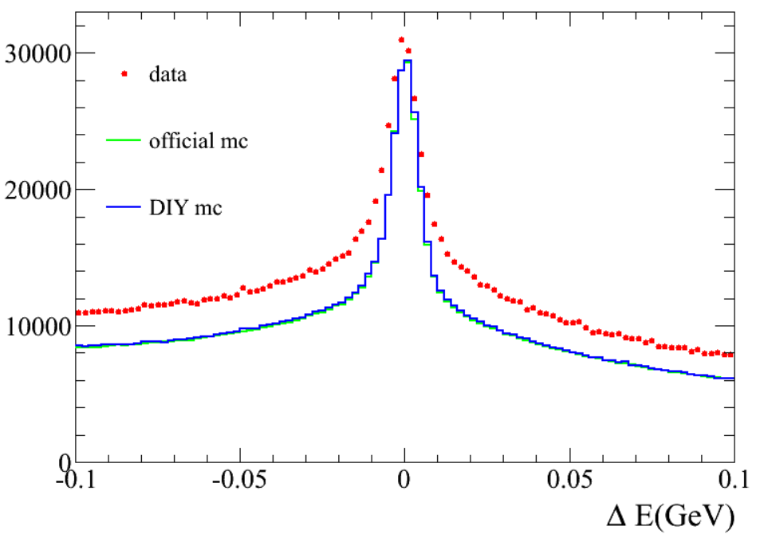
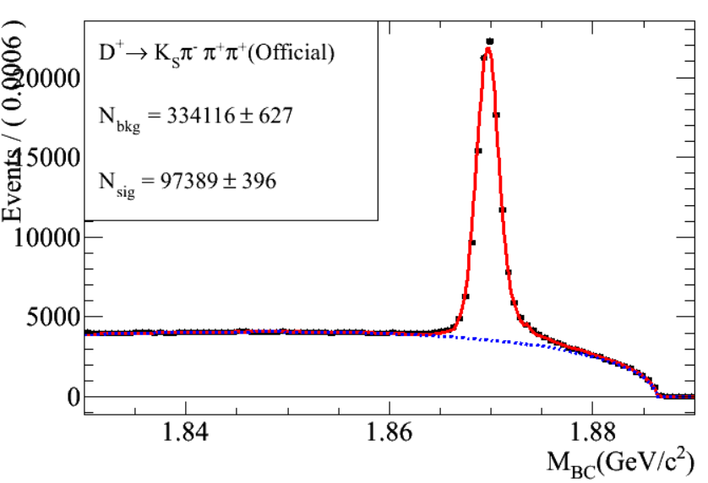
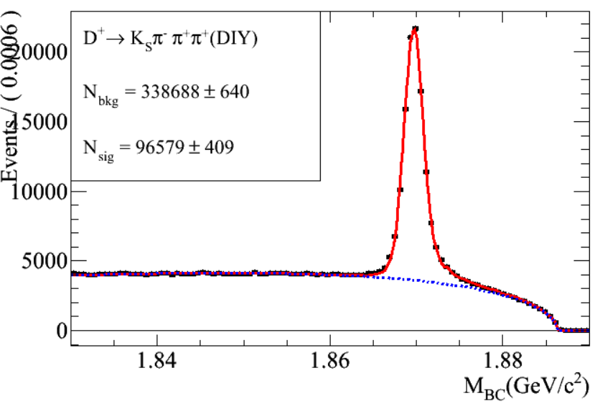
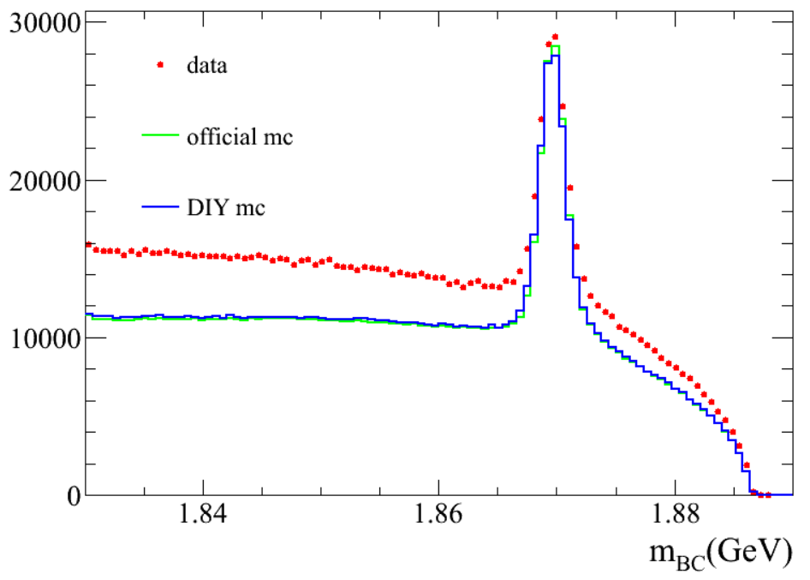
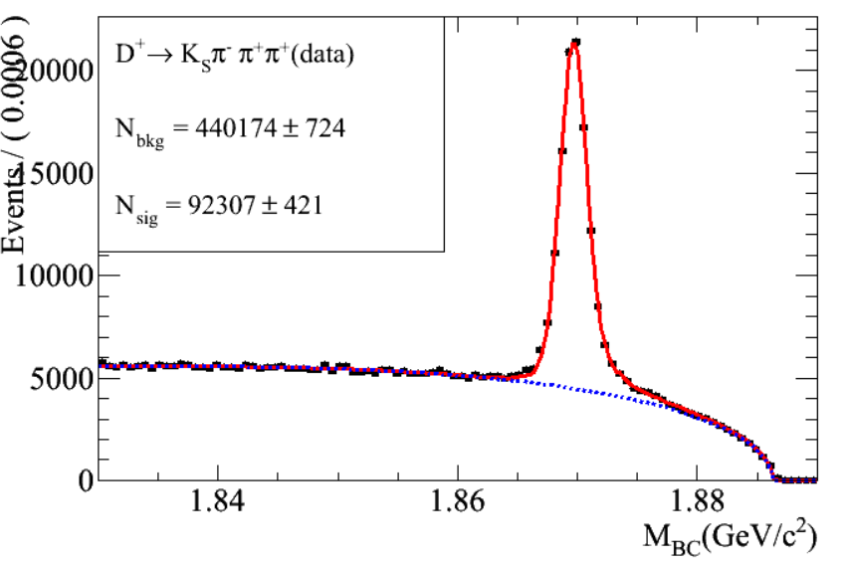
KsPiPiPi
-0.03<deltaE<0.03

Slide 9
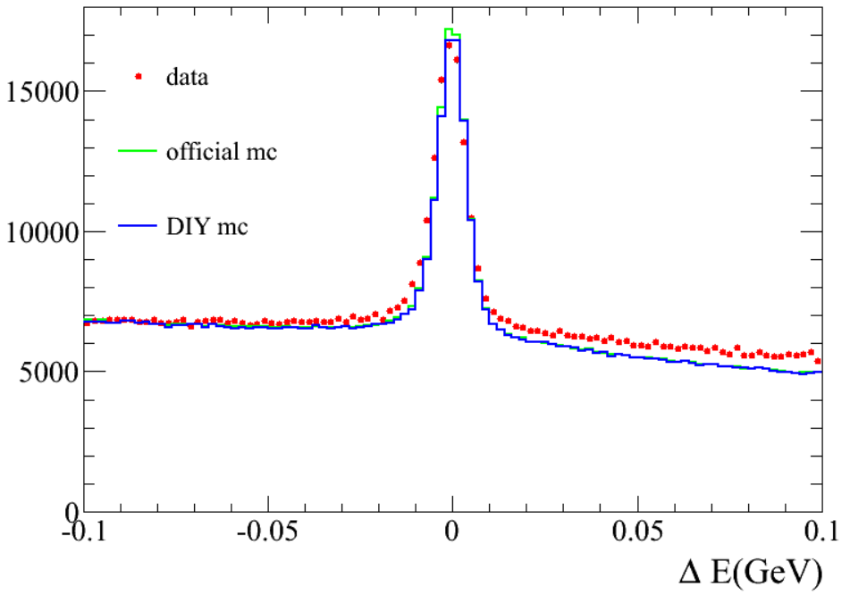
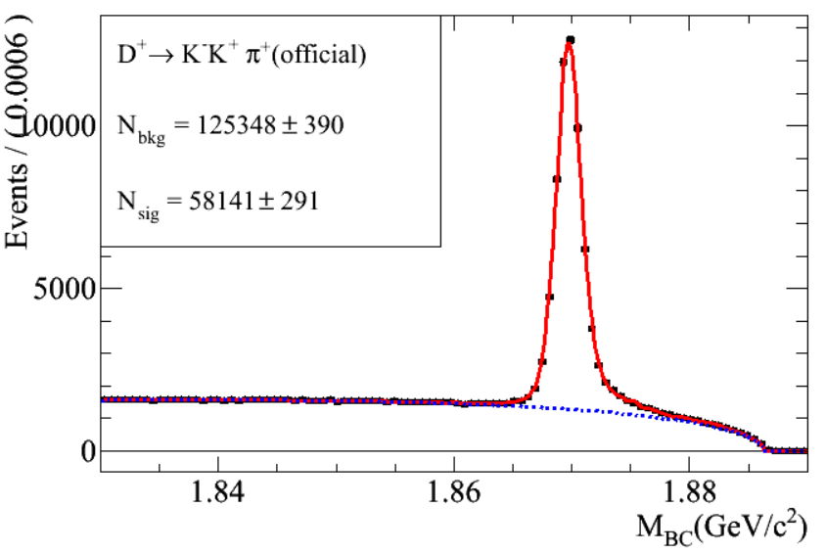
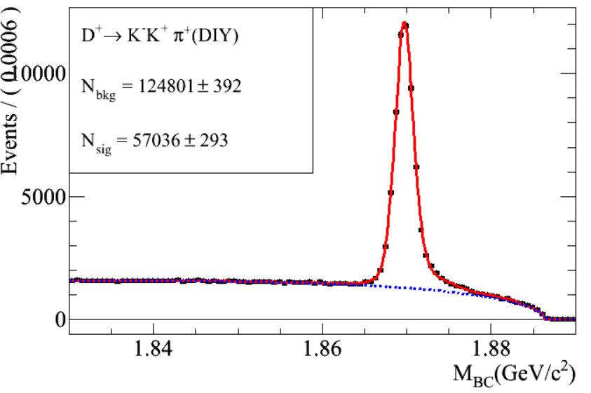
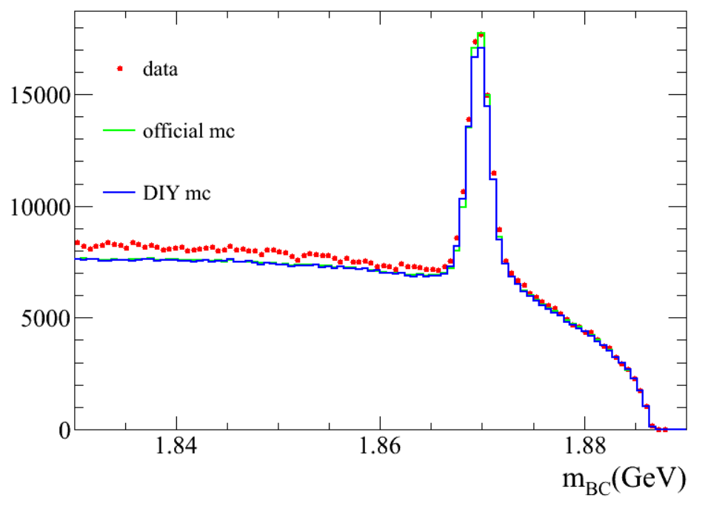
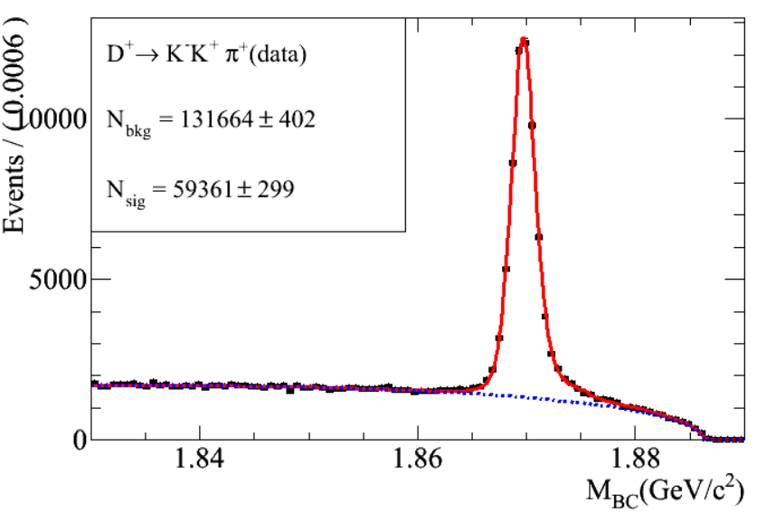
KKPi
-0.02<deltaE<0.02

Slide 10
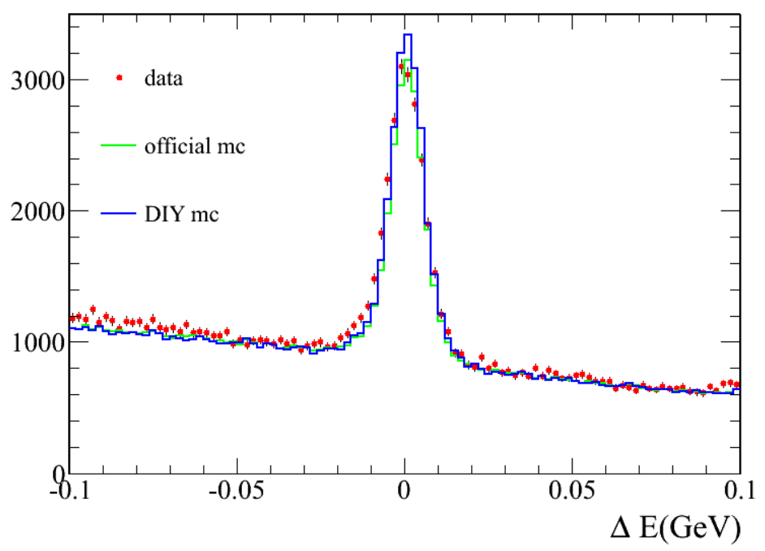
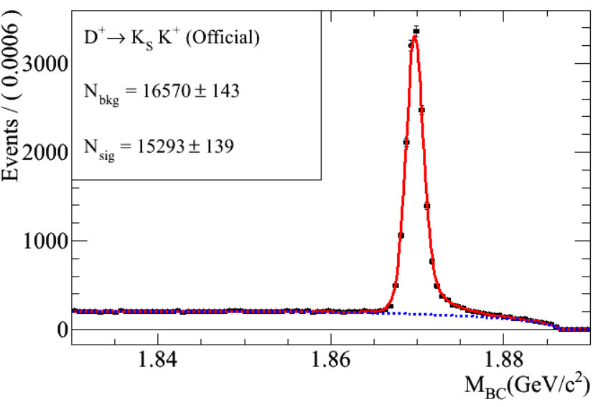
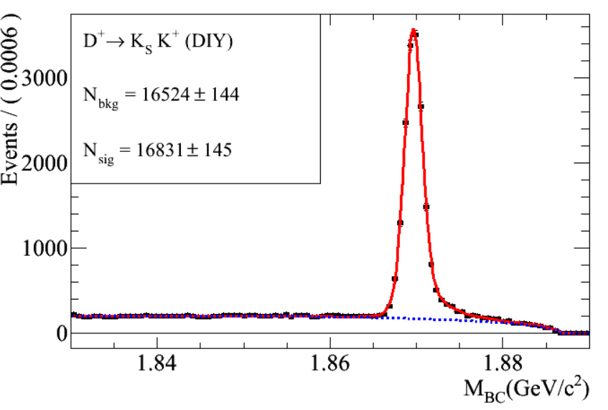
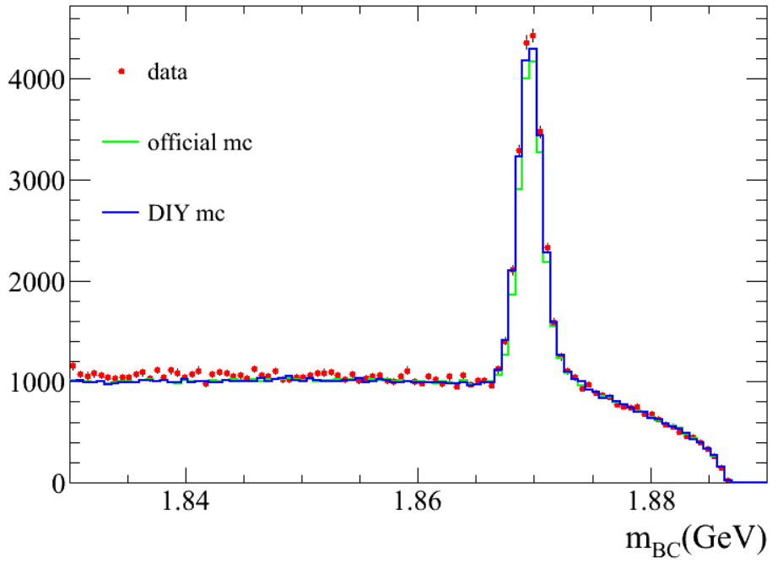
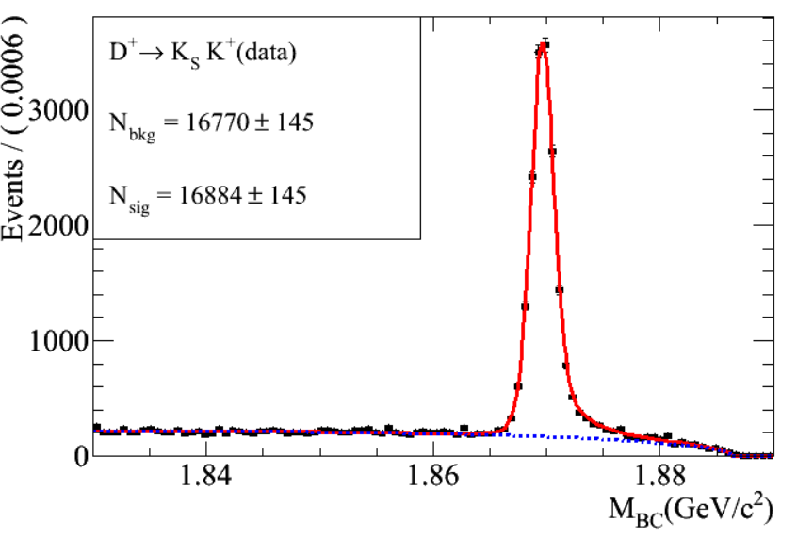
KsK
-0.02<deltaE<0.02

Slide 11
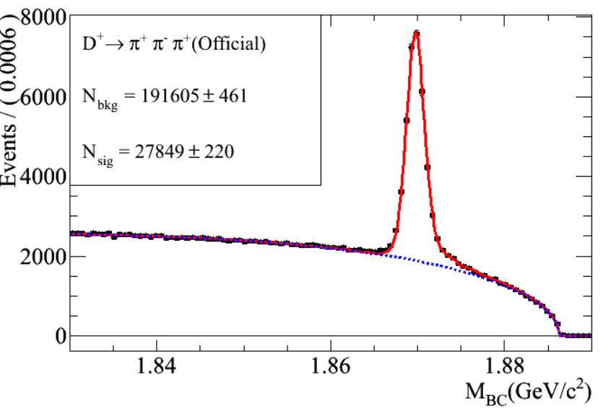
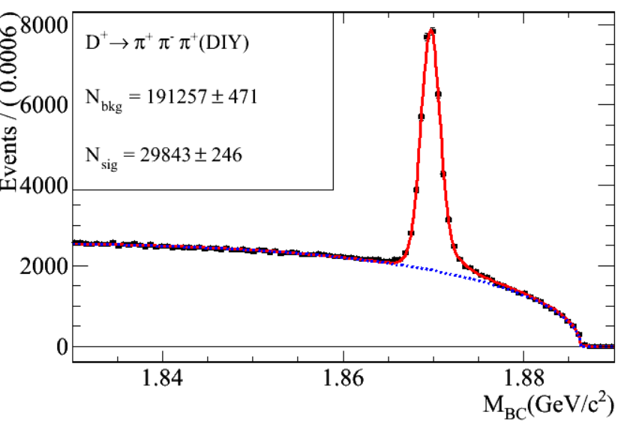
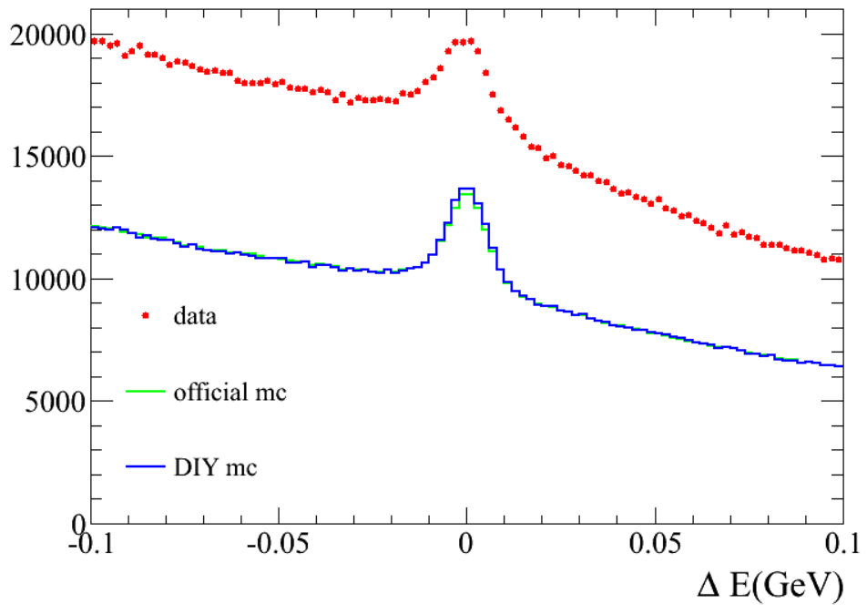
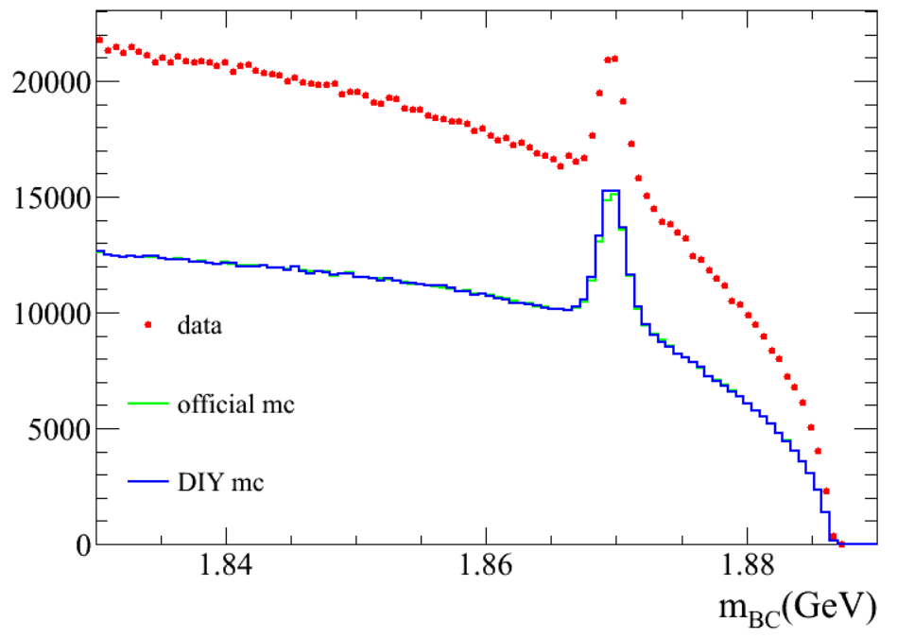
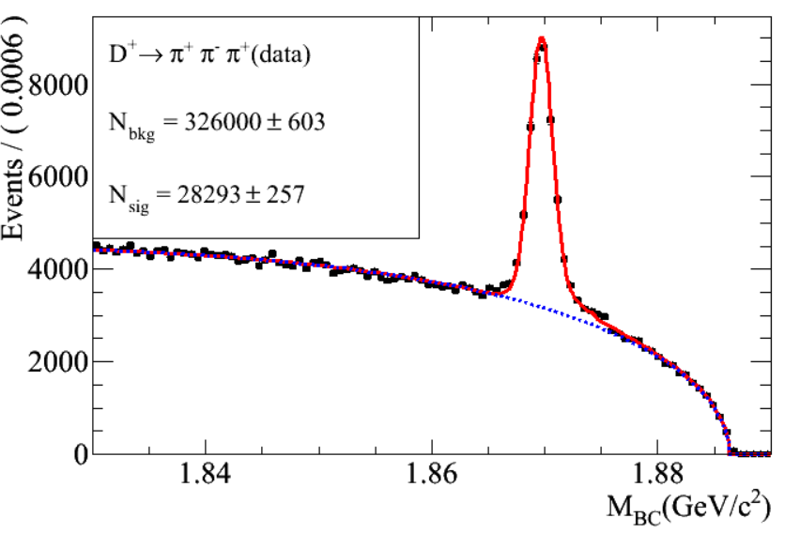
PiPiPi
-0.02<deltaE<0.02

Slide 12
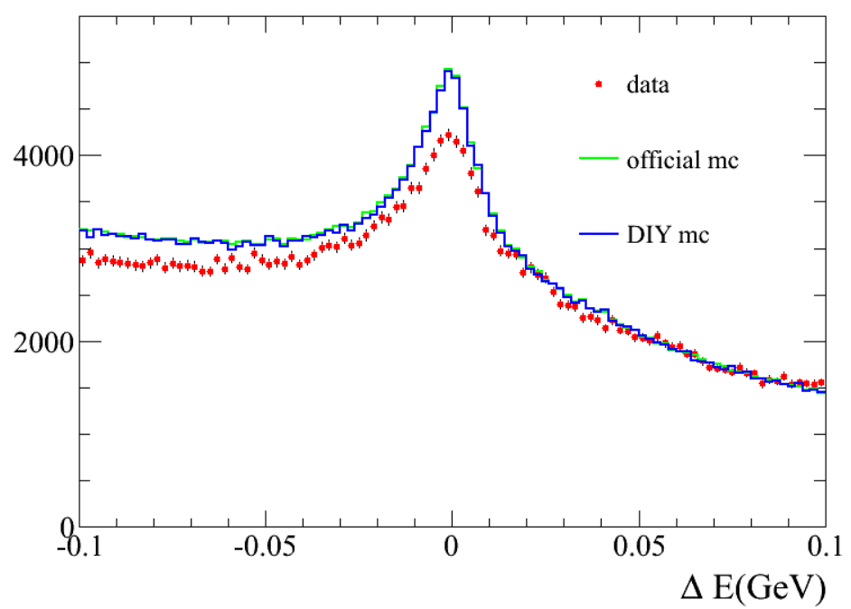
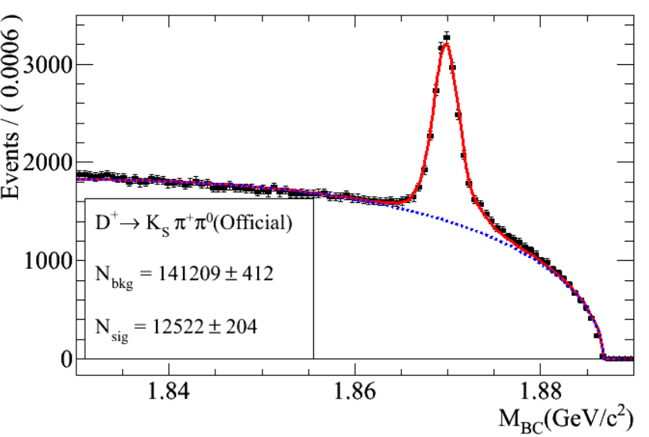
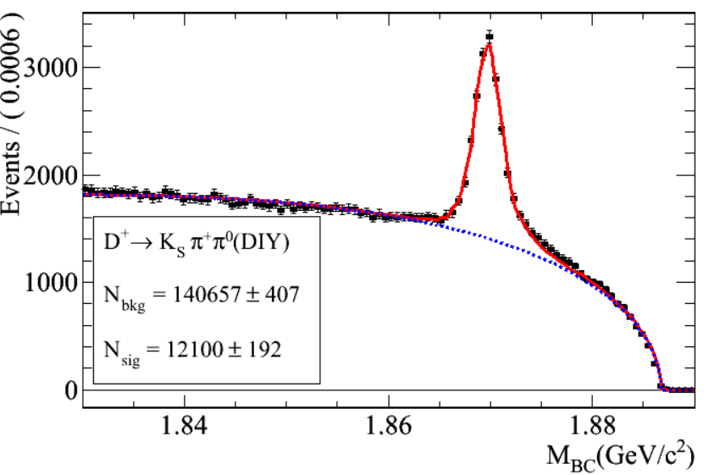
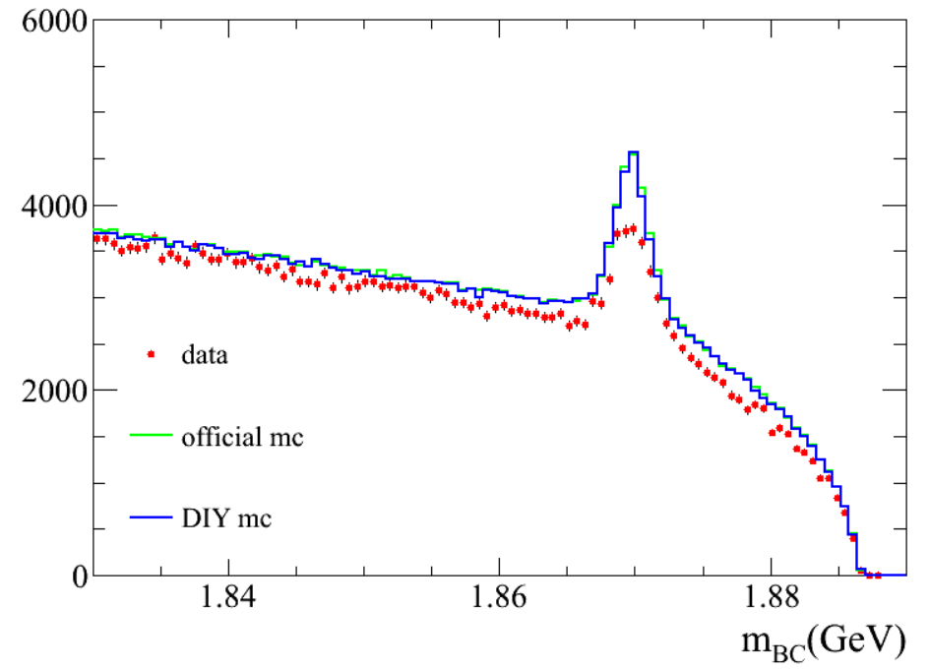
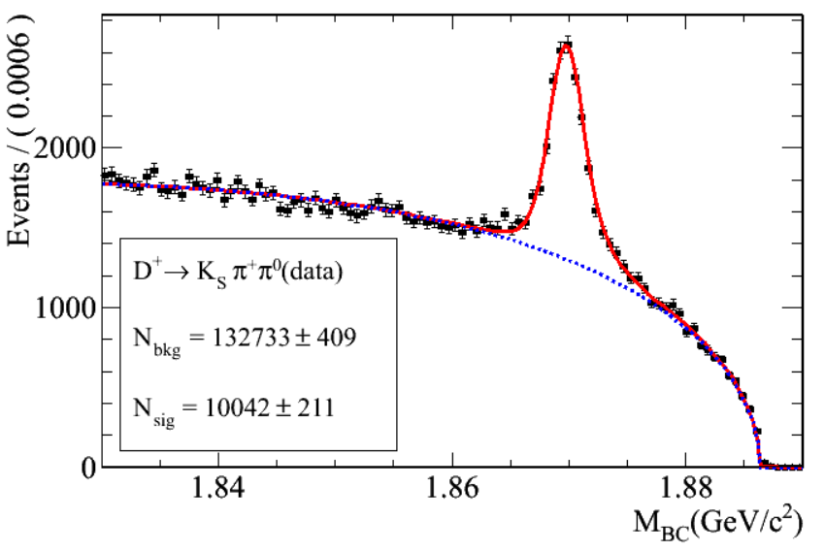
KsKPi0

Slide 13
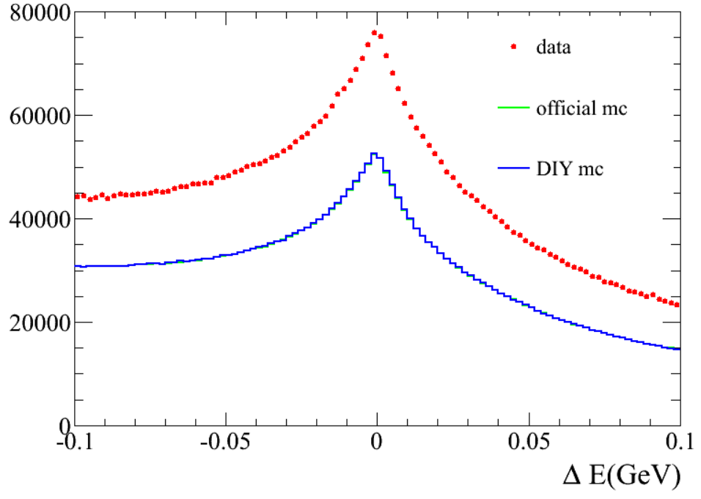
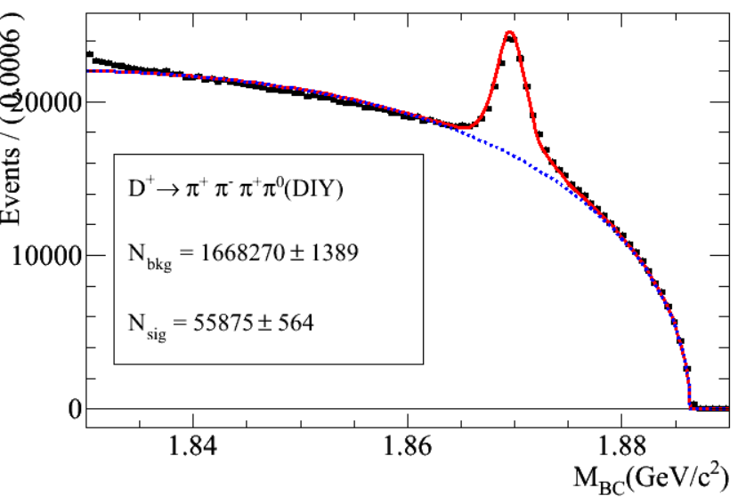
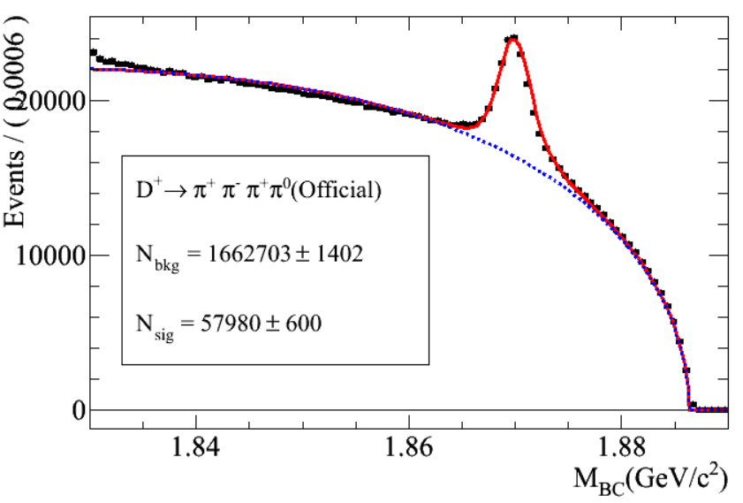
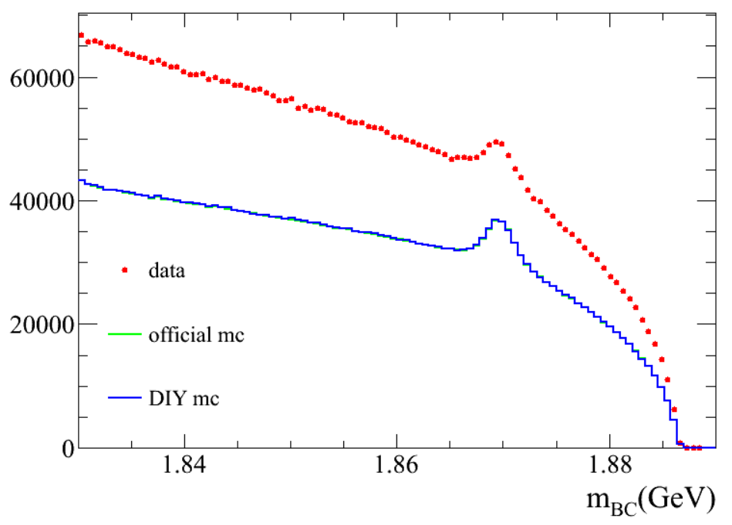
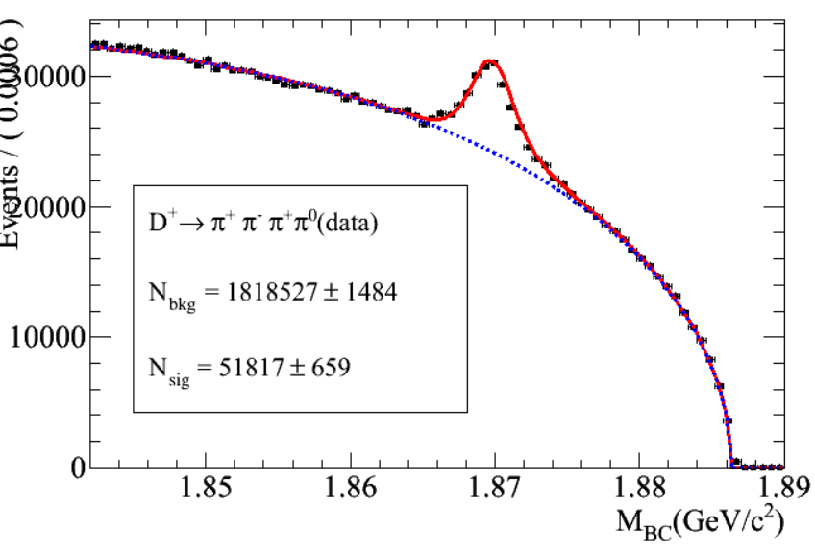
PiPiPiPi0

Slide 14
PiPiPiPiPi

Slide 15
Pieta

Slide 17
Better agreement

Slide 21
D+→3pi
Adjust 3pi resonances
D+ -> pi+ pi+ pi- 0.00138 ==> 0.00175 (PDG)
D+ -> f_0(1500) pi+ 0.0011 ==> 0.00048 (PDG)

Slide 23
D+→3pipi0
D+ -> omega pi+ 0.0 ==> 0.00028 (BESIII)
D+ -> eta pi+ 0.00343 ==> 0.00379 (BESIII)
D+ -> eta' pi+ 0.0044 ==> 0.00512 (BESIII)
Should suppress D+→phipi
Peak around 1.4 & 1.6?

Slide 24
D+→Ks/KL3pi
Not well adjusted

Slide 25
D+→eta3pi

