Slide 1
Weekly report

Slide 2
Event selectiono（4C）
Good Charged Track:
|Vz| < 10.0 && |Vr|< 1.0 && |cosθ|<=0.93;
NGood = 4 && NCharge=0;
PID:
N(π+)=N(π-) = 1; prob_π >prob_K && prob_π >prob_p;
N(K+)=N(K-) = 1; prob_K>prob_p && prob_K>prob_π;
Vertex fit (K+K-π+π-).
4C kinematic fit (K+K- π+π+).
χ21C(K+K- π+π+) < 20;

Slide 3
setup BOSS environment on lxslc
1. BOSS665p01.
2.R-scan data sets:
2014/12/31
2015
2175MeV

Slide 4
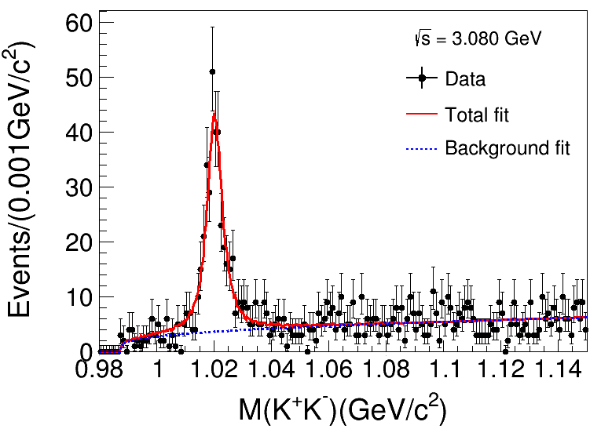
Lxslc6 @3080MeV：L=123.0pb⁻¹
Event
X²_{4C}(K+K-π+ π- ):3080MeV
(1) X²_{4C}(K+K-π+ π- )<20;
(2) ϕ(1020) Fitting :
Signal: Gaussian function Convolute MC shape
Background: Argus function
N_{Signal}=344.3±23.2;

Slide 5
Argus definition

Slide 6
Roofit
Estimate way
– Least square fit ( 𝛘2)
–Maximum Likelihood (ML) Fit
How to fit in ROOT
– Create a parametric function object, TF1(available in ROOT library)
–Set the initial values of the function parameters
– Fit the data object

Slide 7
Minimization
Methods like Minuit based on gradient can get stuck easily in local minima
Stochastic methods like simulated annealing or genetic algorithms can
help to find the global minimum
– (but it can be quite inefficient, e.g. many function calls)
Parameter Errors
A approximation to estimate the confidence level:
-use directly the log-likelihood function and look at the difference from the minimum

Slide 8
purpose
Efficiency
fit successful
1.Make sure functions all right;
2.Fit in Liufang’s criteria;
3.Maybe improve criteria.
To do
1.Code and Roofit checked;
2.debug in Liufang’s criteria→Change resonance state the same with liu;
$$MΓ∗\frac{B_{2}}{{{(Q}_{abc}^{2})}^{2.5}}∗\frac{{{(Q}_{abc}^{2})}^{2.5}}{B_{2}}$$
3.Fit and find a good result;
4..

Slide 9
resonance
<$φf_{J}$|LS>
<$φf_{0}$|01> : phasespace, $f_{0}(980)$, $f_{0}\left(1370\right)$, $σ$, $f_{0}\left(1750\right)$, $f_{0}\left(1500\right)$, $f_{0}\left(1710\right)$,
<$φf_{0}$|21> : $f_{0}(980)$, $f_{0}(1370)$, $σ$, $f_{0}\left(1750\right)$, $f_{0}\left(1500\right)$, $f_{0}\left(1710\right)$,
<$φf_{2}$|01> : $f_{2}(1270)$, $f_{2}(1525)$, $f_{2}(1950)$,
<$φf_{2}$|21> : $f_{2}(1270)$, $f_{2}(1525)$, $f_{2}(1950)$,
<$φf_{2}$|22> : $f_{2}(1270)$, $f_{2}(1525)$, $f_{2}(1950)$,
<$φf_{2}$|23> : $f_{2}(1270)$, $f_{2}(1525)$, $f_{2}(1950)$,
<$φf_{2}$|43> : $f_{2}(1270)$, $f_{2}(1525)$, $f_{2}(1950)$,

Slide 10
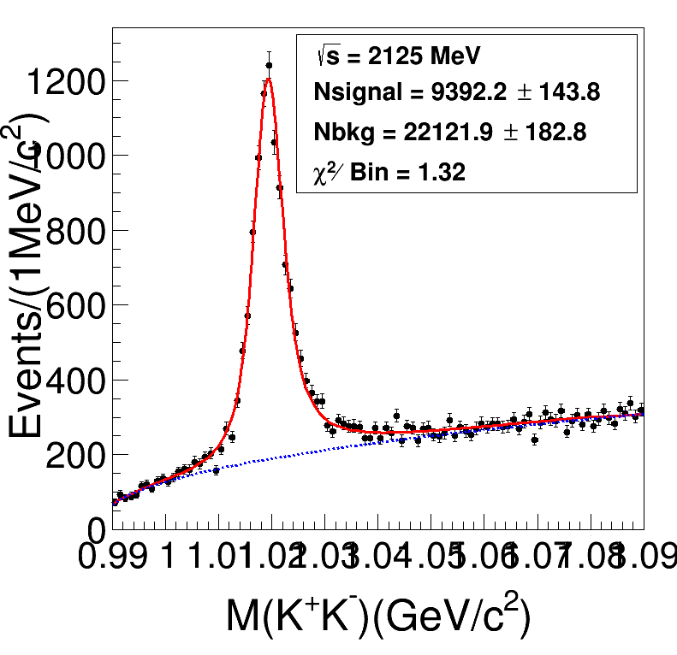
Preliminary Fitting

Slide 11
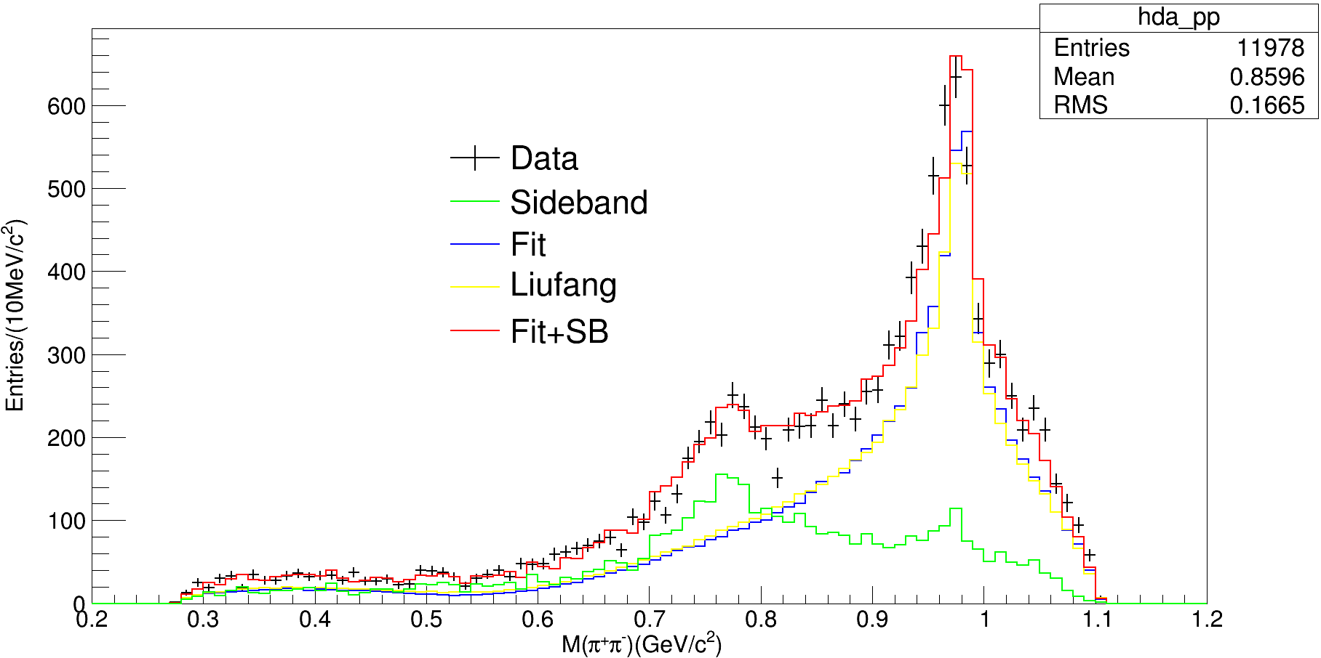
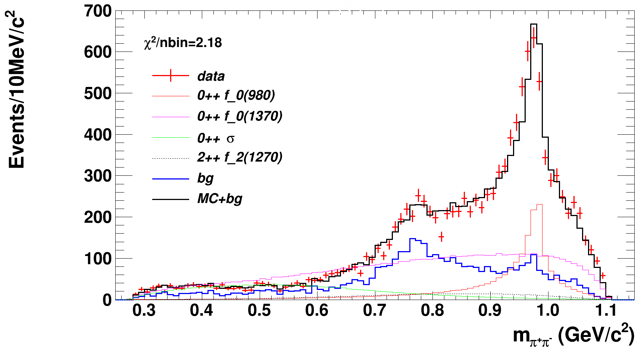
Preliminary Fitting
2scan/OK/scripe115
刘芳画图程序：

Slide 12
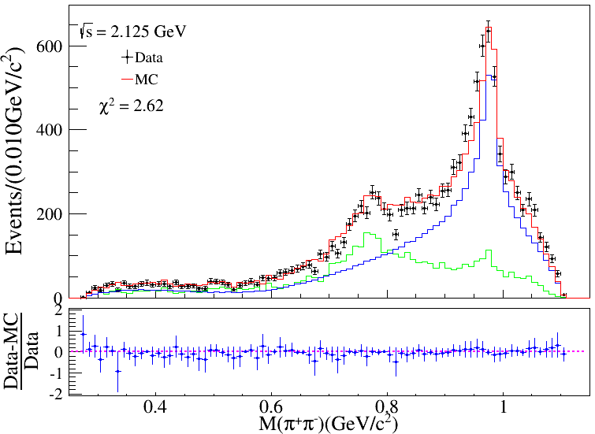
Preliminary Fitting
Liu Fang

Slide 13
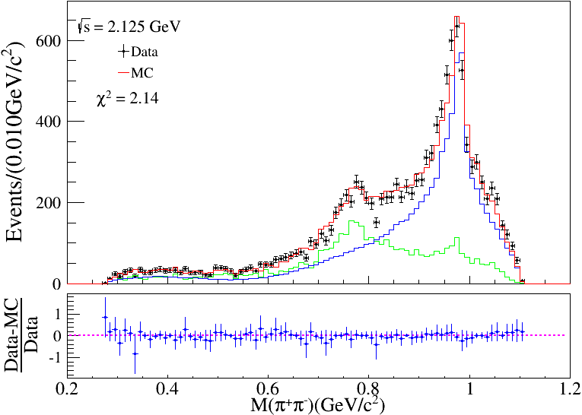
Preliminary Fitting
2scan/OK/scripe115
Tan Yx

Slide 14
Preliminary Fitting
comparation

Slide 15
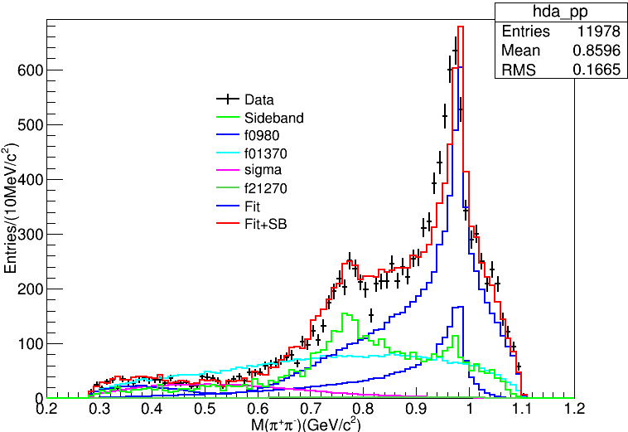
Preliminary Fitting
my result
Sun Yankun result

Slide 16
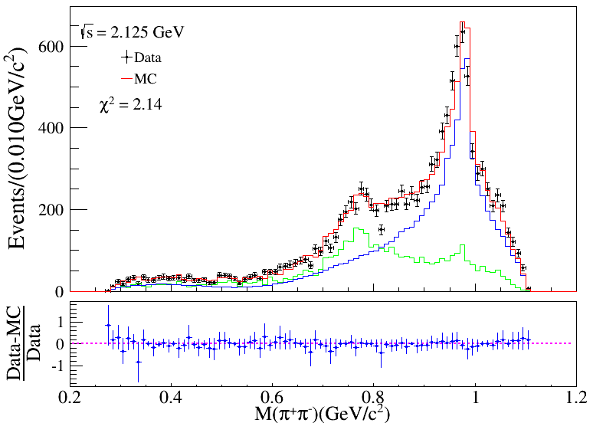
Model
6337M1: 1442; 1628($χ$²2.16); 127($χ$²2.10)
6325M1: 441
6342M2: 2013

Slide 17
Model
6342M2: 2013
6325M1: 441

Slide 18
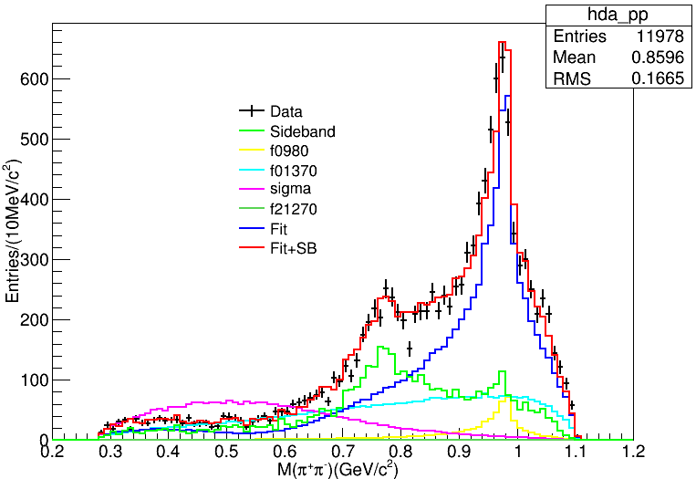
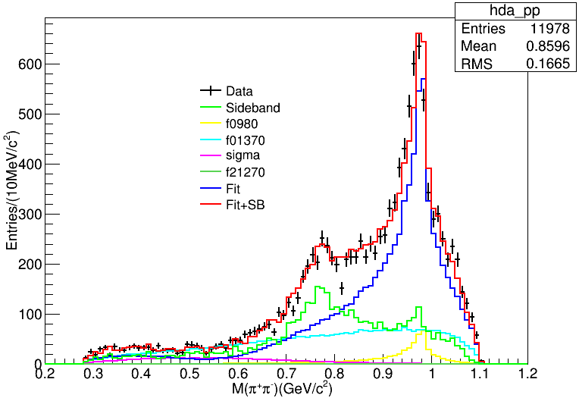
Model
6342M2: 2013
6325M1: 441

Slide 19
Model
 | Liu Fang | 2013(sigma) | 441
$$f_{0}(980)$$ | 19.4% | 8.6% | 11.2%
$$f_{0}(1370)$$ | 59.4% | 53.3% | 76.0%
$$σ$$ | 15.2% | 38.0% | 12.6%
$$f_{0}(2170)$$ | 5.9% | 0.1% | 0.2%
6342M2: 2013
6325M1: 441

Slide 20
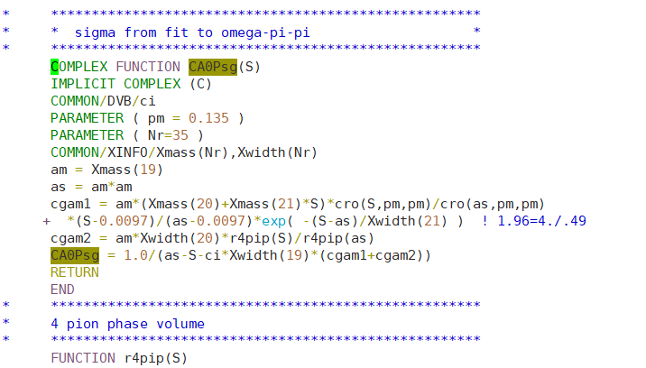
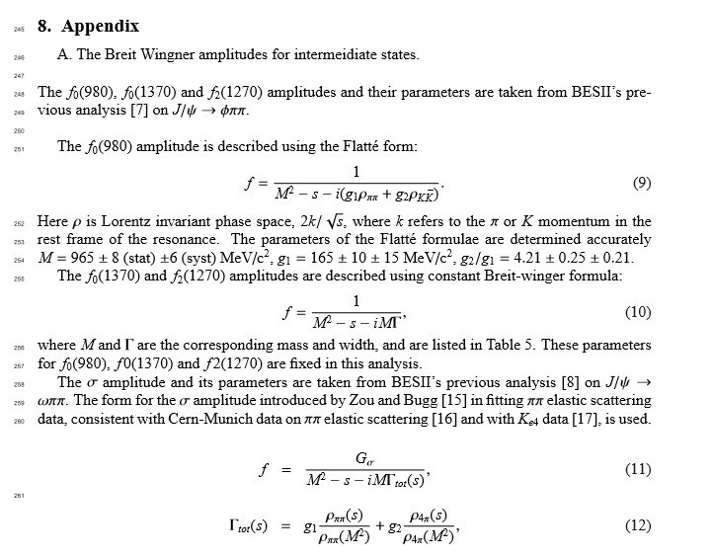
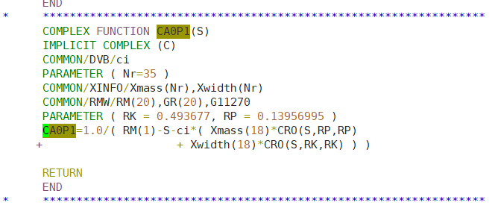
刘芳结果可能存在的问题
注意Pion的质量pm=0.135，为Pi0质量
同一程序内，f0(980)的传播子中pion的质量RP=0.139~，为Pi±的质量

Slide 21
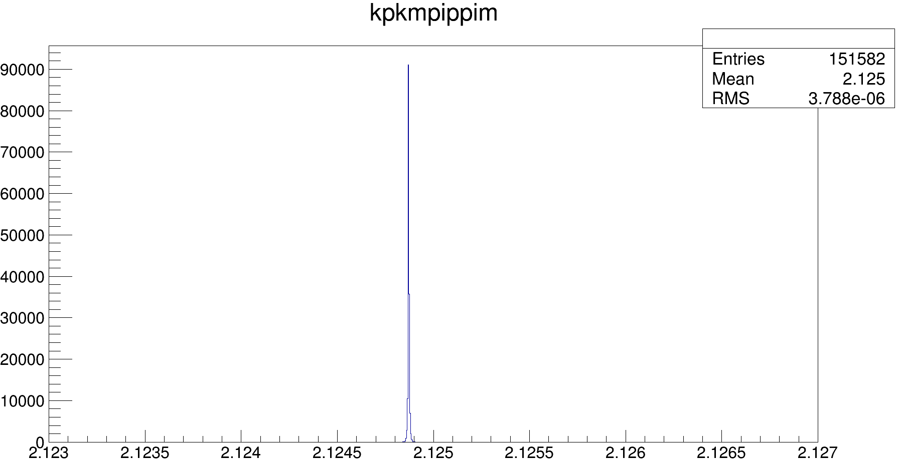
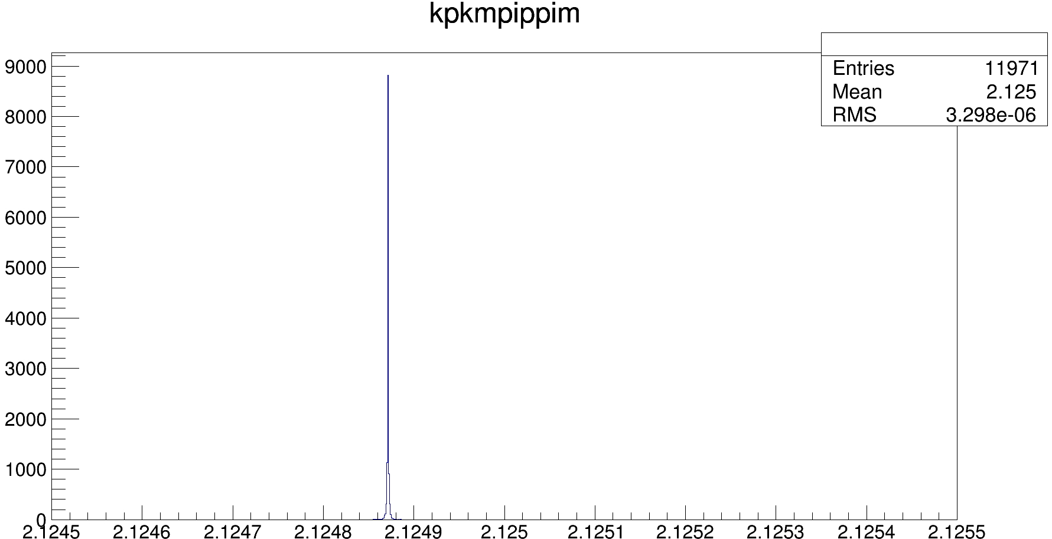

Slide 22
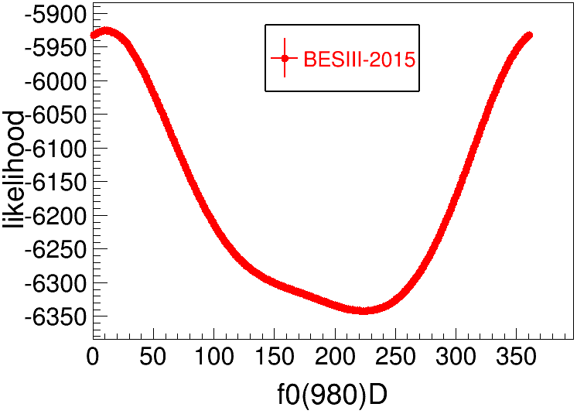
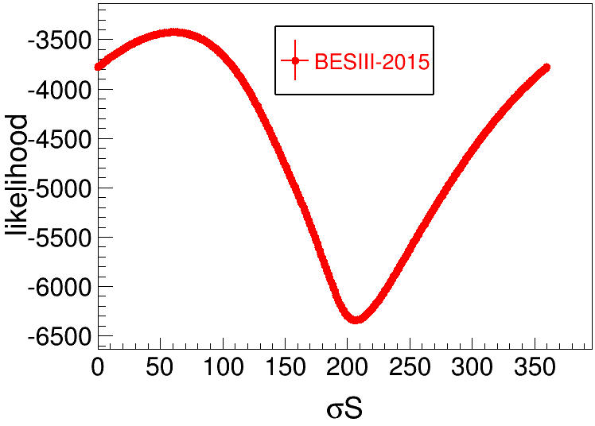
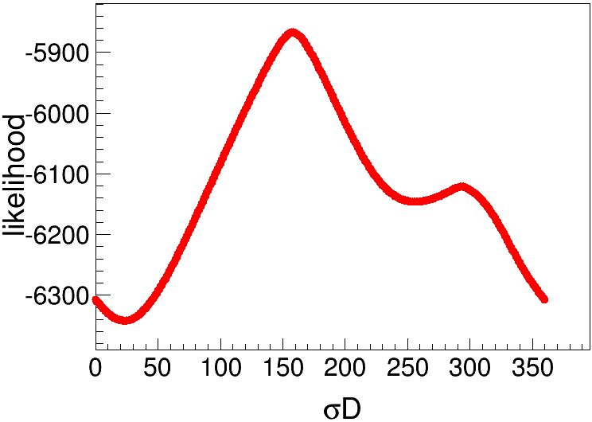
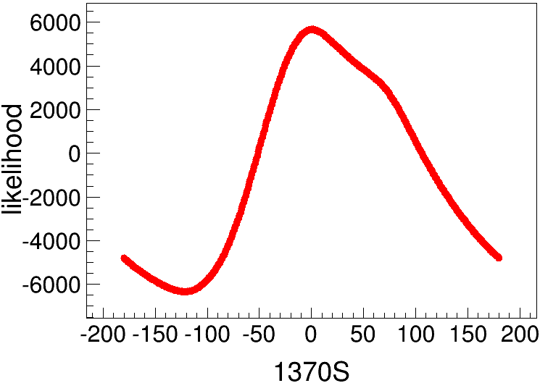
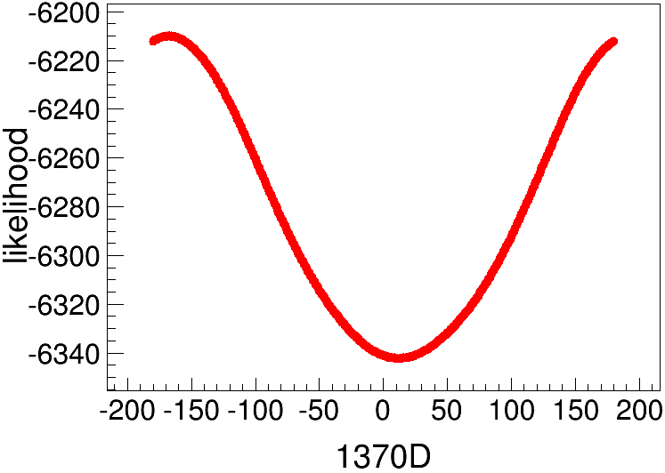
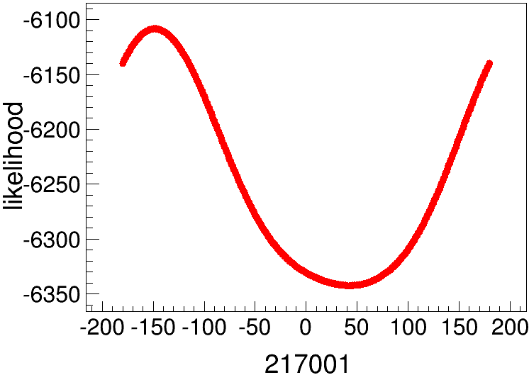
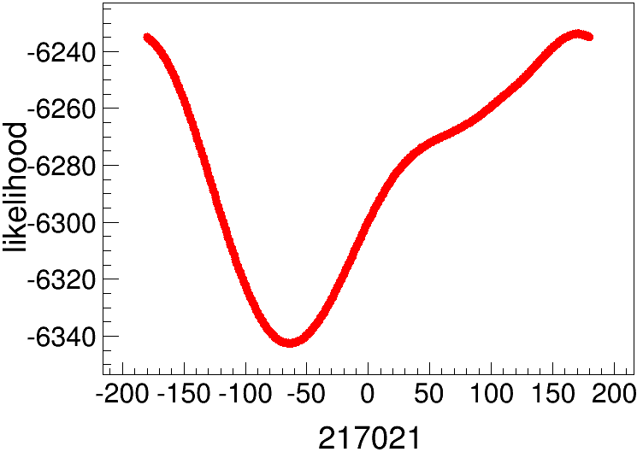
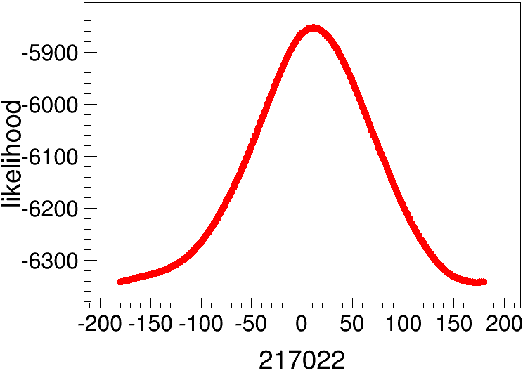
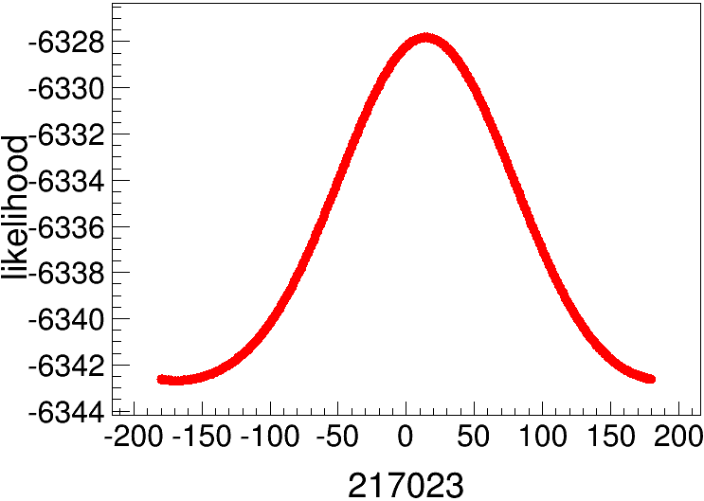
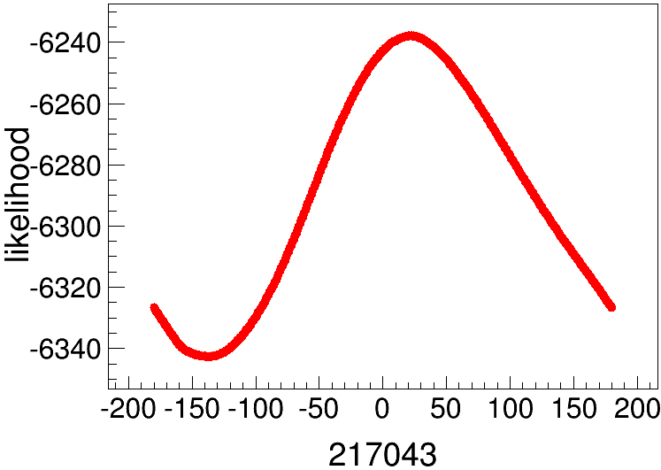

Slide 23
echo $CMTPATH 输出工作目录
/workfs/bes/tanyx/workarea-6.6.5.p01:本地目录
/afs/ihep.ac.cn/bes3/offline/Boss/6.6.5.p01:原始目录
统一对环境package编译的文件：
$TESTRELEASEROOT/cmt/requirements
UserDIY产生子模版：
/afs/ihep.ac.cn/bes3/offline/Boss/6.6.5.p01/Generator/BesEvtGen/BesEvtGen-00-01-96-slc6tag/

Slide 24
产生子目录：$BESEVTGENROOT/
在$TESTRELEASEROOT/cmt/requirements中修改环境默认产生子目录
对UserDIY MC：
在$BESEVTGENROOT/user/中添加振幅公式（UserPWATOTAL.cc 返回振幅的平方）
在$BESEVTGENROOT/src/EvtGen/EvtGenModels/中添加EvtPWATOTAL.hh和EvtPWATOTAL.cc，并修改EvtModelReg.cc
EvtPWATOTAL.hh要修改类名为EvtPWATOTAL，并作为头文件添加在UserPWATOTAL.cc中作为返回值的类名
EvtPWATOTAL.cc要包含头文件EvtPWATOTAL.hh，修改类名EvtPWATOTAL，修改model name
EvtModelReg.cc添加EvtPWATOTAL.hh和modellist：

Slide 25
$BESEVTGENROOT/share中：
pdt.table存有decay card中各种粒子的代码信息
DECAY.DEC存有decay card中各种衰变模式的代码信息
超链接的创建方式：
如在/hepustc/home/tanyx/创建/lustre/bes3/tanyx/（源文件）的超链接
不需要先创建空文件夹，应直接“ln -s /lustre/bes3/tanyx/ lustre”即可

Slide 26
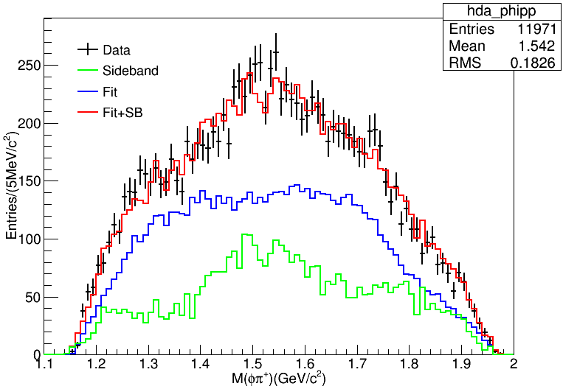
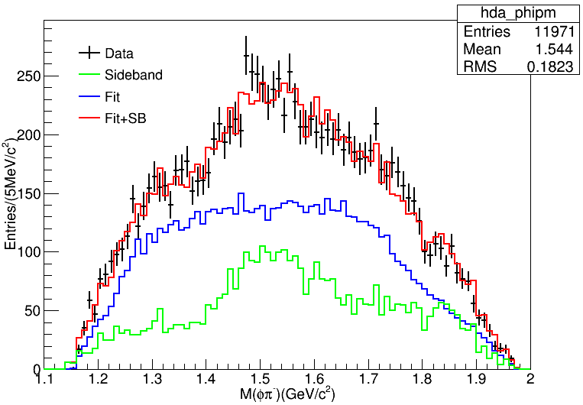
Preliminary Fitting

Slide 27
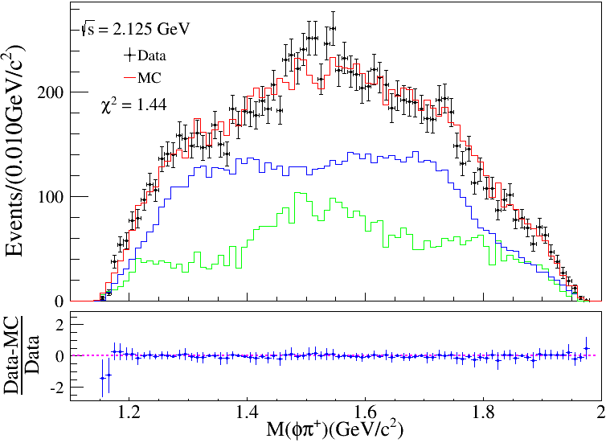
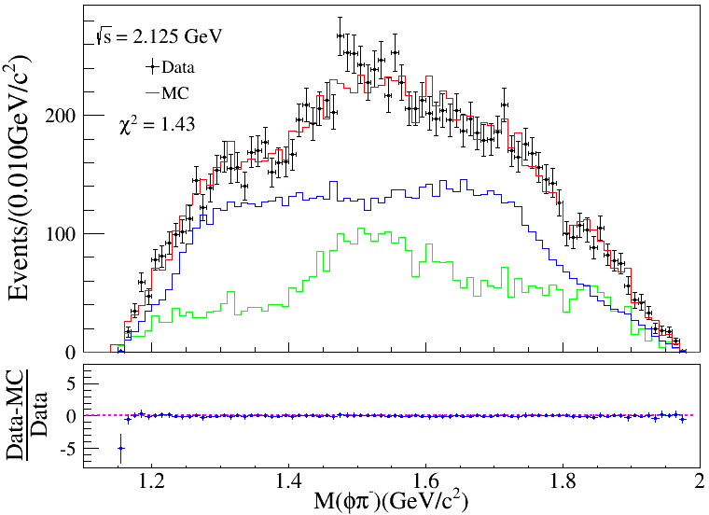
Preliminary Fitting
Bin=90

Slide 28
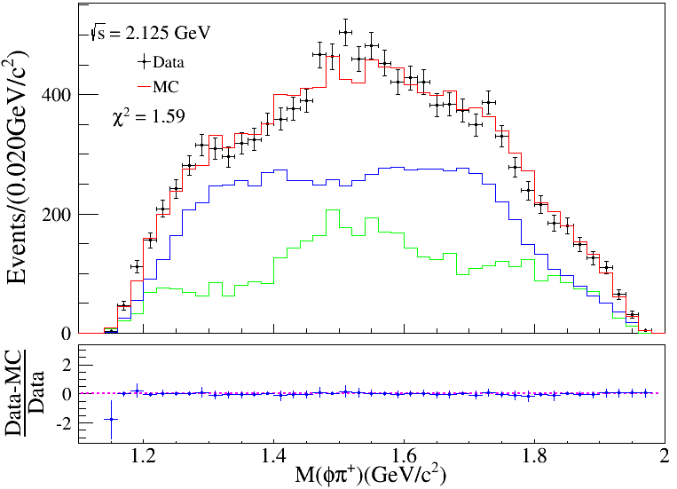
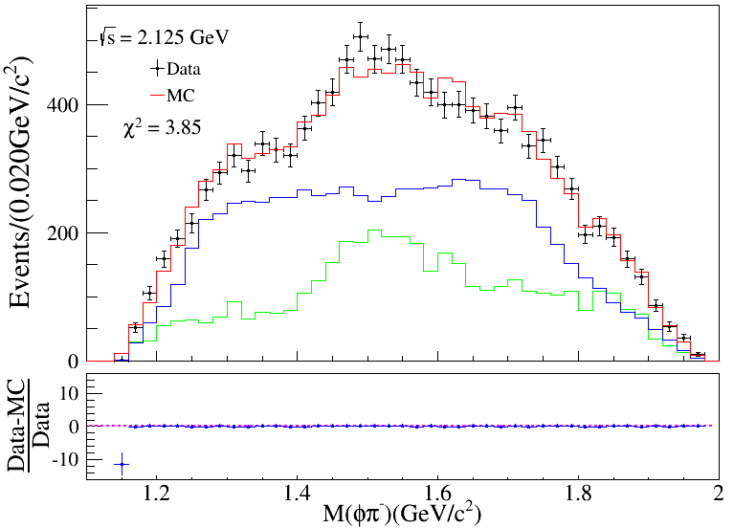
Preliminary Fitting
Bin=45

Slide 29
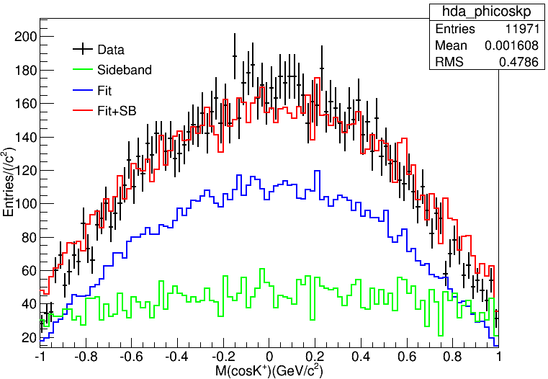
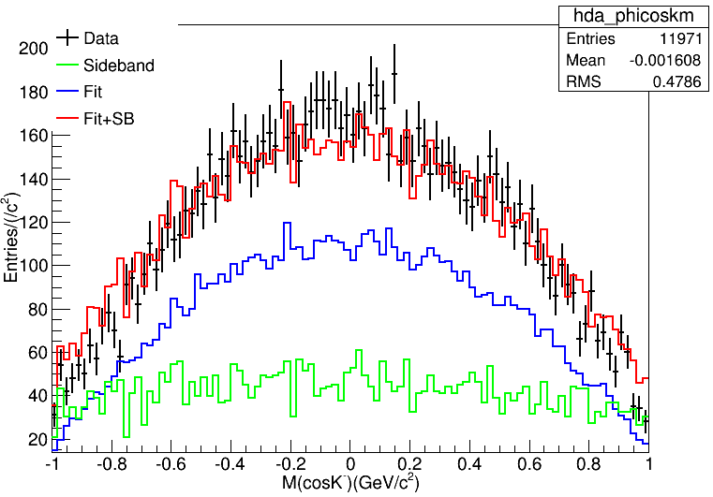
K boost to Phi

Slide 30
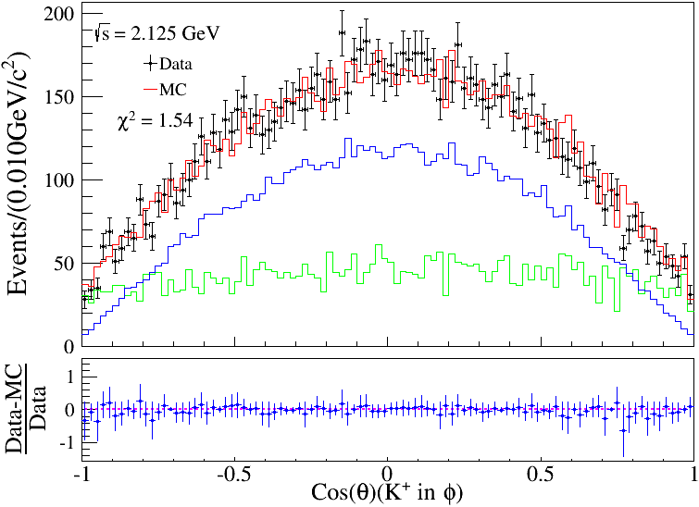
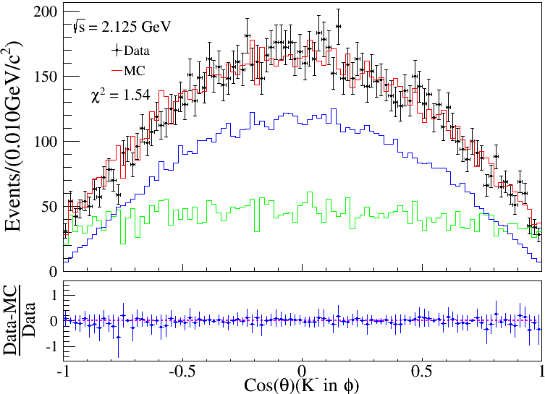
K boost to Phi
Bin=100

Slide 31
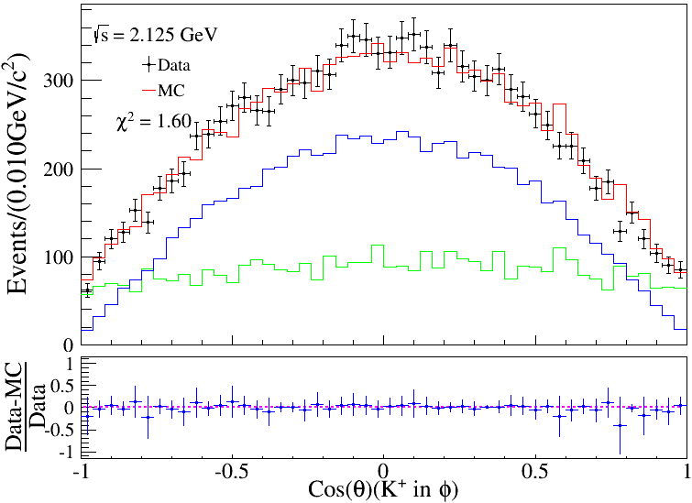
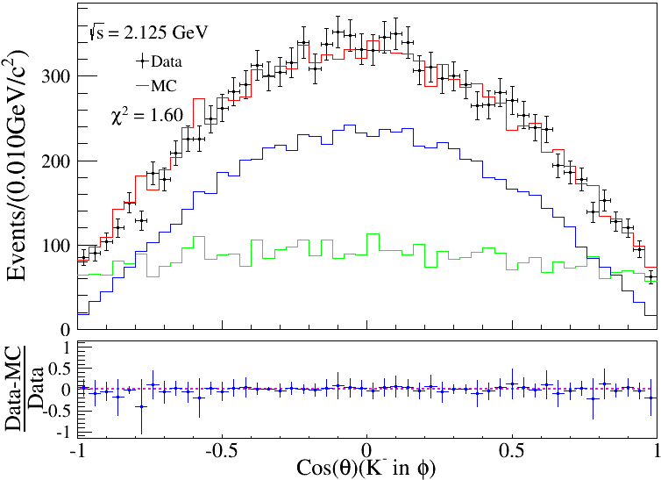
K boost to Phi
Bin=50

Slide 32
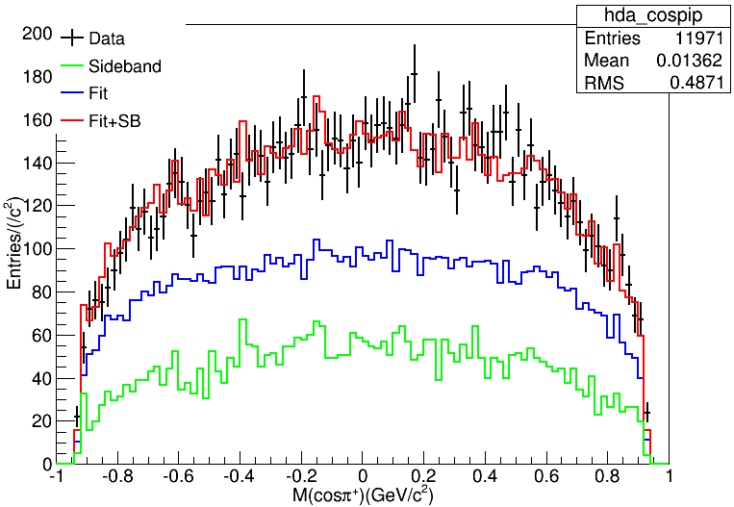
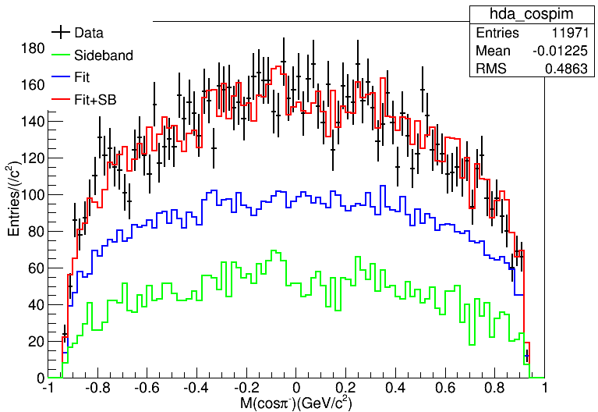
Pion

Slide 33
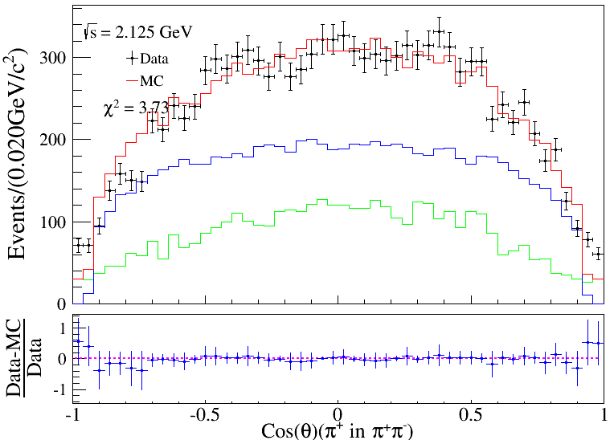
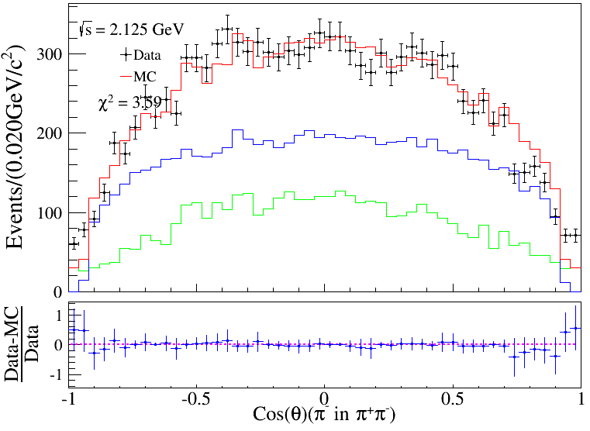
Pion
Bin=50

Slide 34
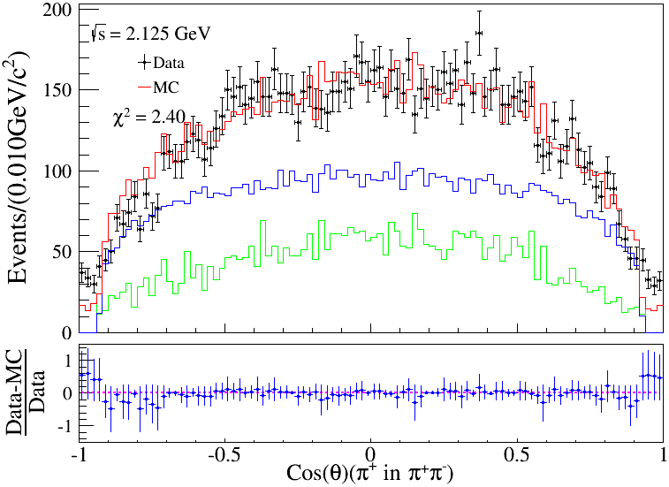
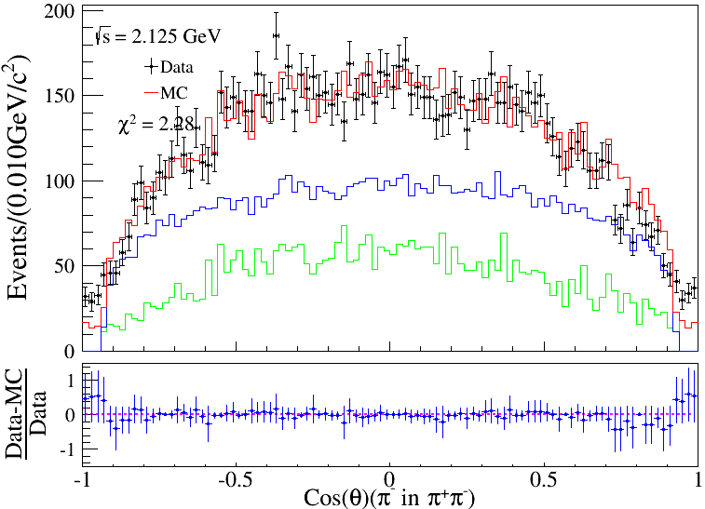
Pion
Bin=100

Slide 35
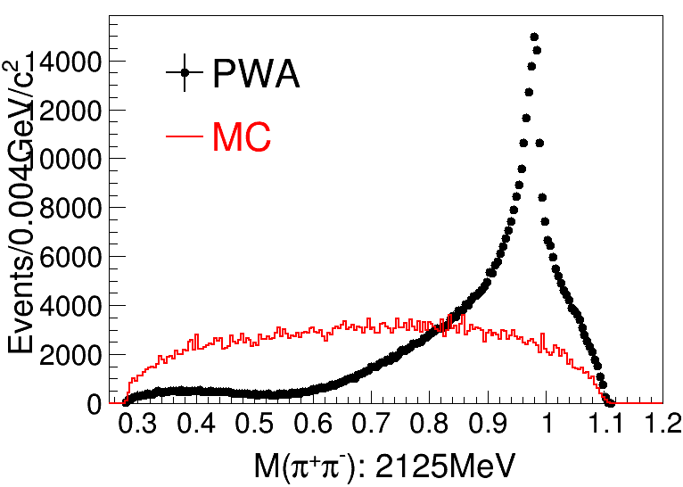
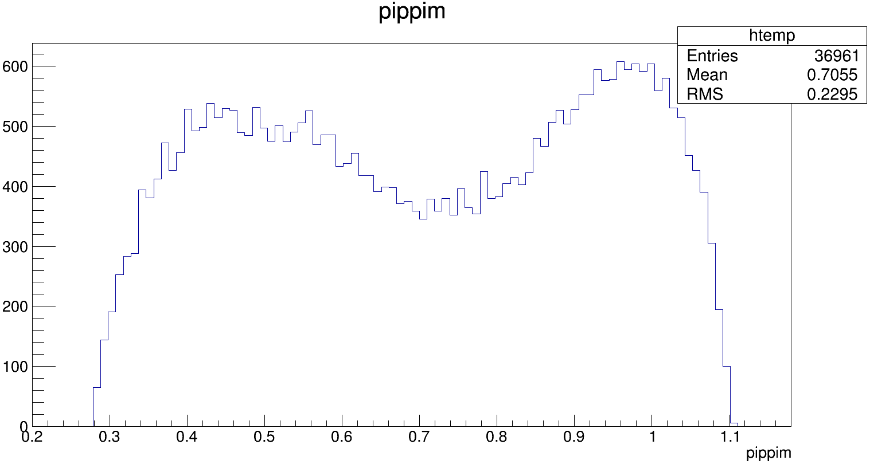
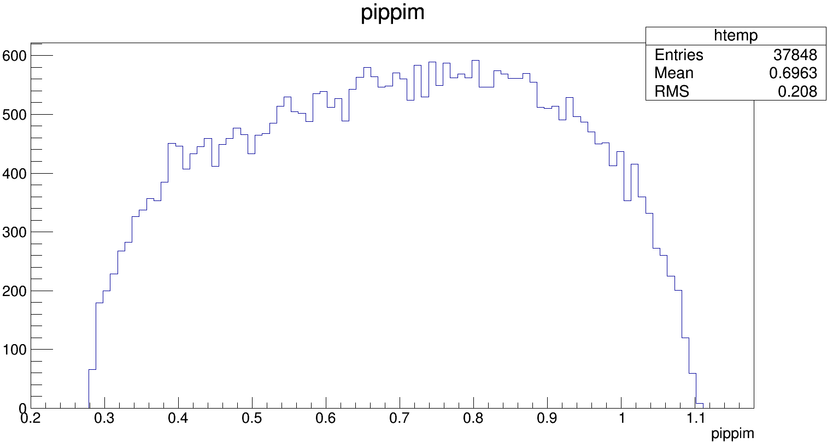
数据
模拟

Slide 36
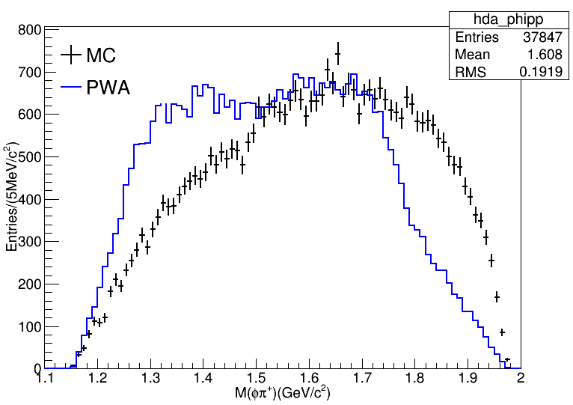
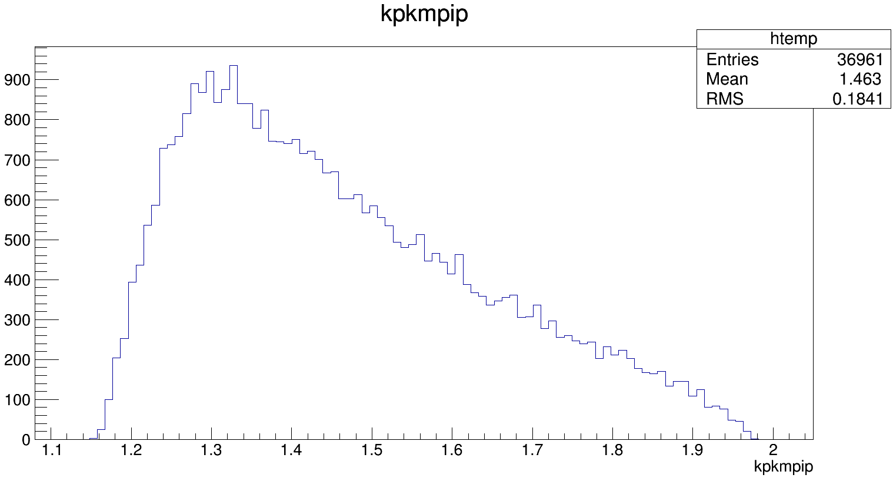
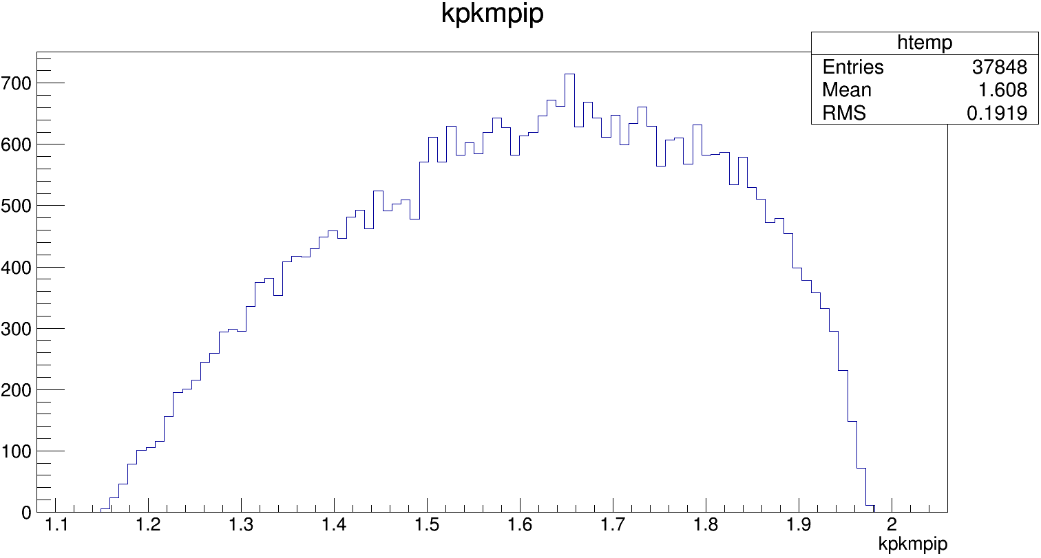
数据
模拟

Slide 37
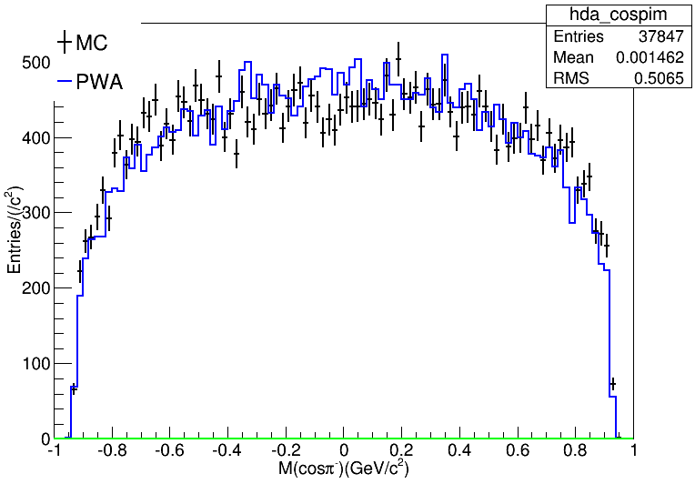
数据
模拟

Slide 38
数据
模拟

Slide 39
数据
模拟

Slide 40
数据
模拟

Slide 41
数据
模拟

Slide 42
数据
模拟

Slide 43
数据
模拟

Slide 44
数据
模拟

Slide 45
数据
模拟

Slide 46
数据
模拟

Slide 47
数据
模拟

Slide 48
Numbers of NGoodCharge

