Slide 1
Study of $D^{0}→K_{S}^{0} ω$
Haoran Zhang

Slide 2
Boss version :
6.6.4p02 $→$ 7.1.0
Data set :
inclusive MC :
$ψ\left(3770\right)→D^{0} \overline{D^{0}} 40X\left(round03+round 04+round15\right)$
$signal MC:$ tag+ $D^{0}→K_{S}^{0}ω$
$D^{0}→Kπ$ round03+round04 30w ,rounde15 30w
$D^{0}→Kππ^{0}$ round03+round04 30w ,rounde15 30w,
$D^{0}→K3π$round03+round04 30w ,rounde15 30w
Data: round03+round04+ rounde15

Slide 3
ST Event selection
Based on DTagAlg-02-04 Package in BOSS 710
Good neutral track selection
Definition of Barrel: | $cosθ$|<0.8
Definition of EndCap: 0.86<|$cosθ$|<0.92
Barrel: E>25MeV
Endcap: E>50MeV
ToF:0<T<14 (50ns)
The opening angle between a candidate shower and the closest charged track should be no less than ${10}^{∘}$ ($\left|dang\right|>$ ${10}^{∘}$ )
Good charged track selection
|Vr| < 1 cm
|Vz| < 10 cm
$\cos{θ<0.93}$
PID
Use SimplePID
$$for π :prob\left(π\right)>0.00 ;prob\left(π\right)>prob\left(K\right)$$
$$for K :prob\left(K\right)>0.00 ;prob\left(K\right)>prob(π)$$
$π^{0} selection$
$χ_{1c}^{2}$<200
The mass of $π^{0}$: $0.115<M_{γγ}<0.150 MeV$
reject candidate if both photons are in endcaps

Slide 4
ST Event selection
$$ΔE=E_{D} −E_{Beam};\left|ΔE\right|<0.1$$
$$M_{BC}=\sqrt{\left({E_{Beam}}^{2} −p_{D}^{2}\right)} ;{1.83<M}_{BC}$$
the $E_{Beam}$is the calibrated beam energy under BOSS7.1.0
(tag :$D^{0}→Kπ$)
$D^{0}reconstruction$
$D^{0}$ reconstructed by the $Kπ$tracks after pid
no vertex fit.
(tag :$D^{0}→Kππ^{0}$)
$D^{0}reconstruction$
$D^{0}$ reconstructed by the $Kπ$tracks after pid and two $γ$ track from $π^{0}$
no vertex fit.
(tag :$D^{0}→K3π$)
veto $K_{S}^{0}→π^{+}π^{−}$
$$\left|m_{π^{+}π^{−}}−m_{K_{S}^{0}}\right|≥0.03$$
$D^{0}reconstruction$
$D^{0}$ reconstructed by the $Kπππ$tracks after pid
no vertex fit.

Slide 5
DT Event selection
$$D^{0}→K_{S}^{0}ω$$
$$second vertex fit of K_{S}^{0}$$
$$χ<100 ,\frac{l}{σ_{l}}>2$$
$$find the charged track pair with minimum χ$$
$$vertex fit of ω$$
do vertex fit to the charged tracks
$$kinematic fit$$
$$2C \left(M_{D^{0}}^{PDG} M_{π^{0}}^{PDG}\right)kinematic fit to$$
$$charged tracks after vertex fit and \text{neutral} \text{track}$$

Slide 6
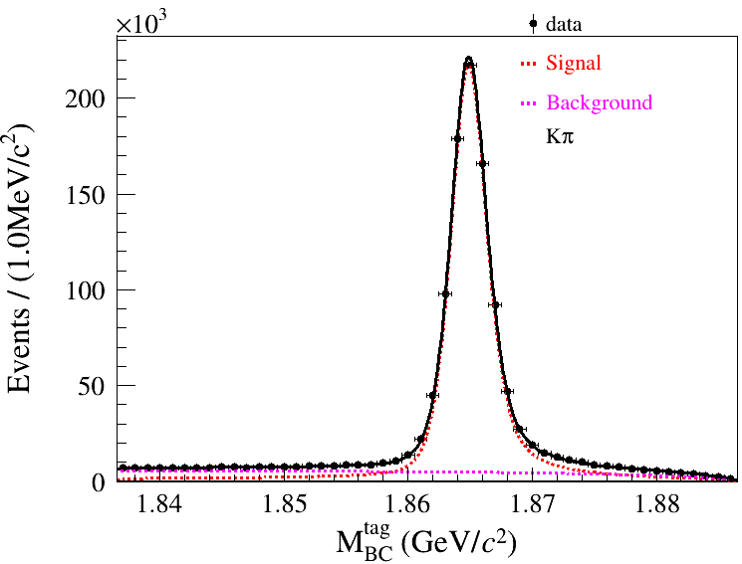
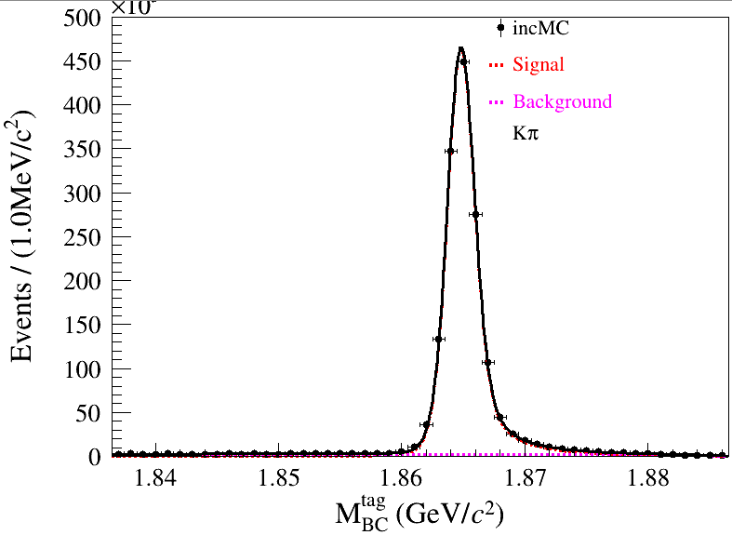
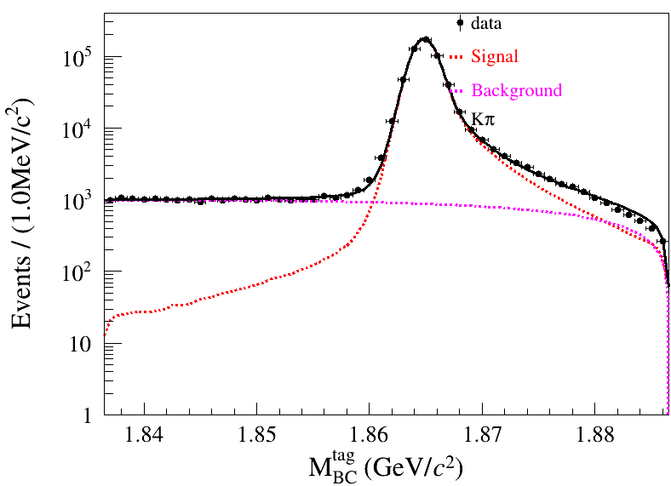
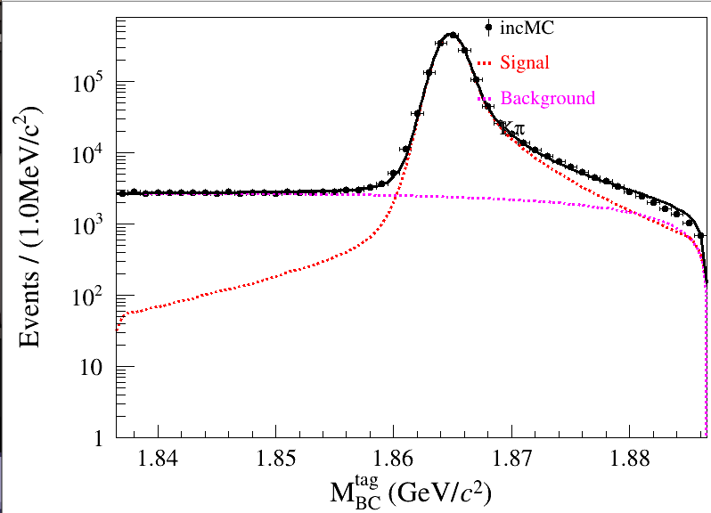
$$ε_{signal} after ST selection , ΔE and M_{bc} cut$$
$$ε_{signal}=\frac{399570}{600000}=66.595\%$$
$N_{event}=539935±766.05$(left,round3+4)
$$N_{event}=1484430±1275.43$$
（right,round15+3+4)
$ΔE cut for single Tag:$
$D^{0}→Kπ:−0.025<ΔE<0.027$(GeV)
$D^{0}→Kππ^{0}:−0.04<ΔE<0.053$ (GeV)
$D^{0}→K3π:−0.02<ΔE<0.024$ (GeV)

Slide 7
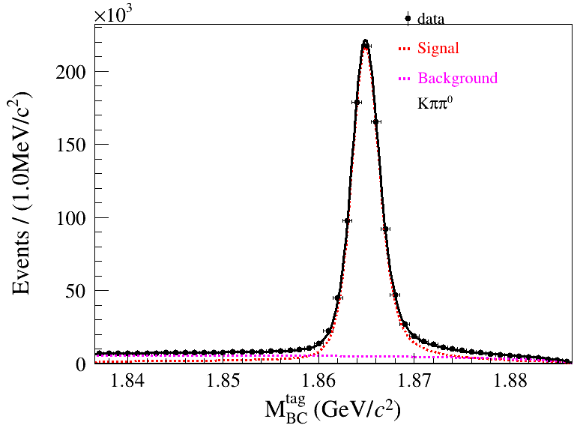
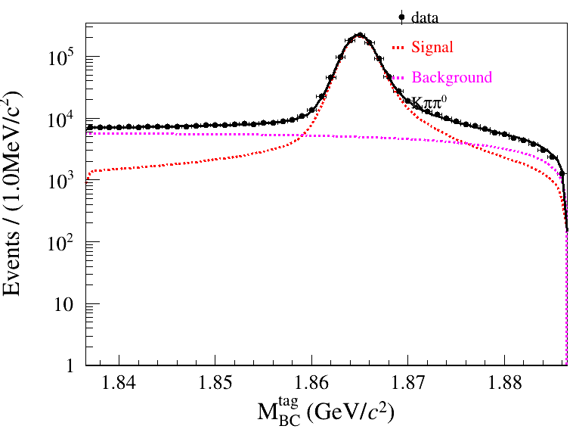
$$ε_{signal} after ST selection , ΔE and M_{bc} cut$$
$$ε_{signal}=\frac{190917}{600000}=31.8195\%$$
$$N_{event}=981701±1175.73$$

Slide 8
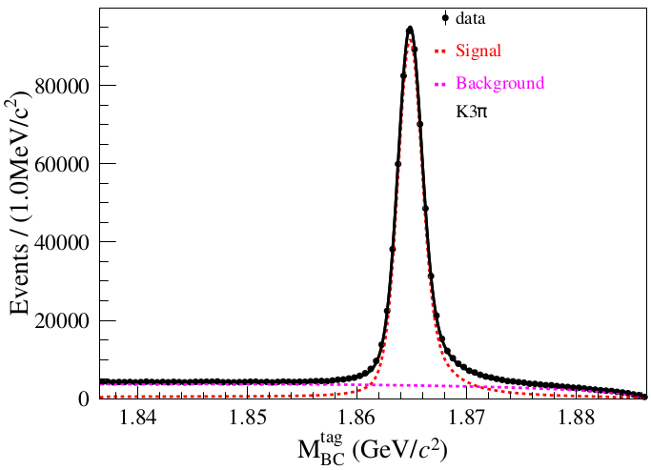
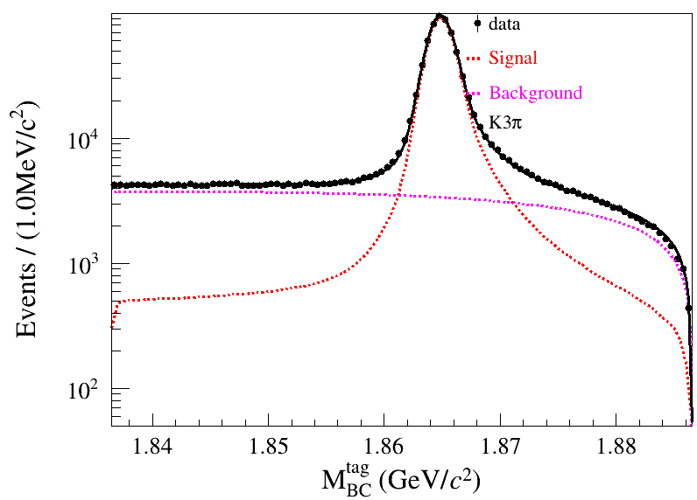
$$ε_{signal} after ST selection , ΔE and M_{bc} cut$$
$$ε_{signal}=\frac{199907}{600000}=33.3178\%$$
$$N_{event}=657790±966.67$$

Slide 9
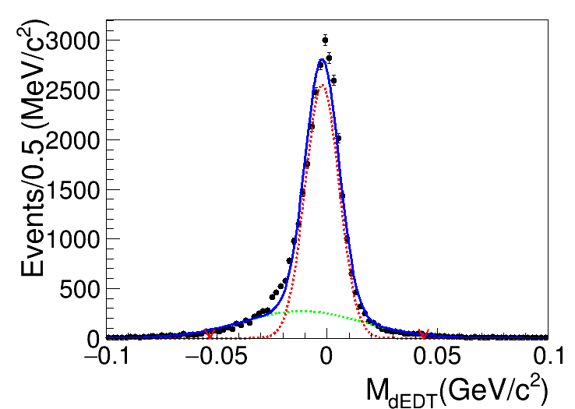
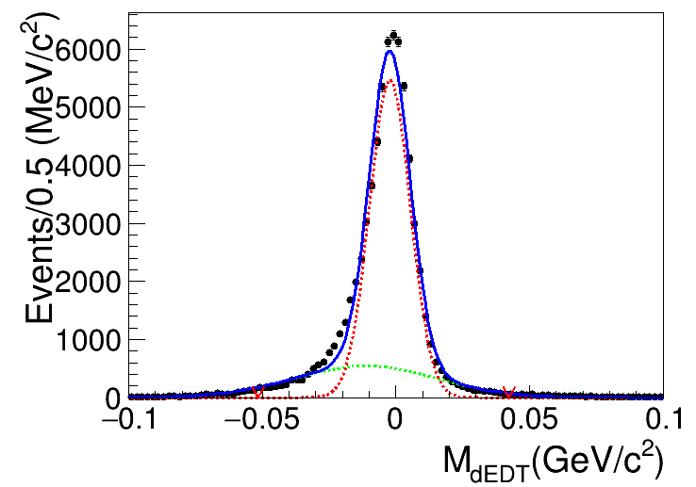
$Tag:D^{0}→Kπ$
$−0.051<ΔE(DT)<0.042$
$Tag:D^{0}→Kππ^{0}$
$−0.053<ΔE(DT)<0.044$

Slide 10
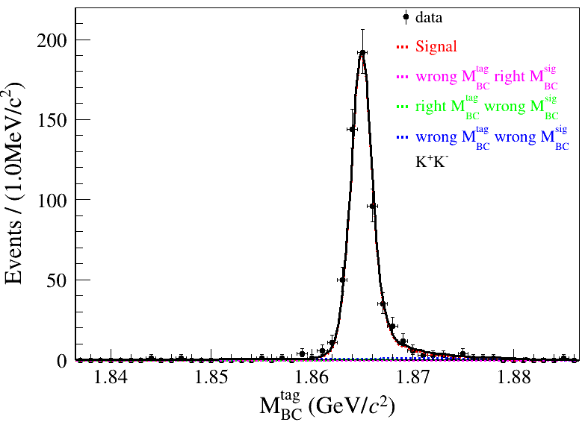
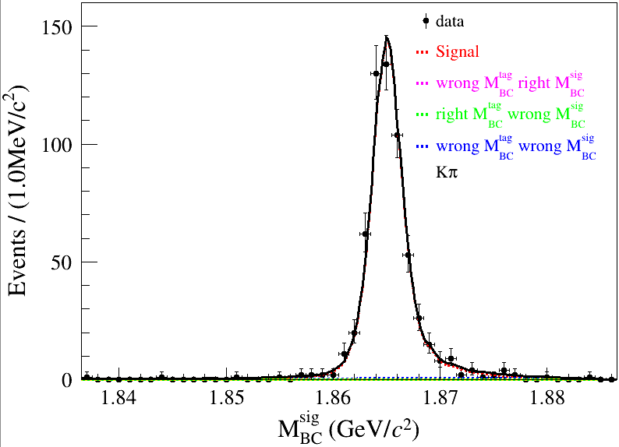
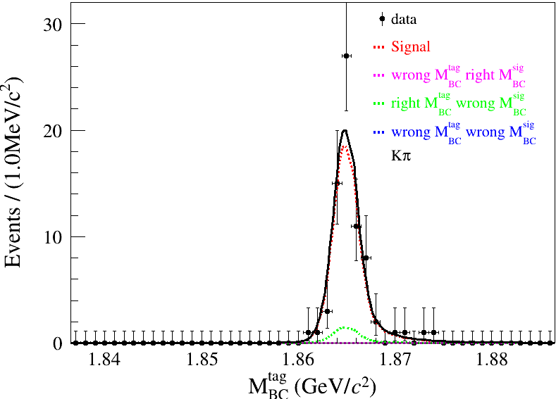
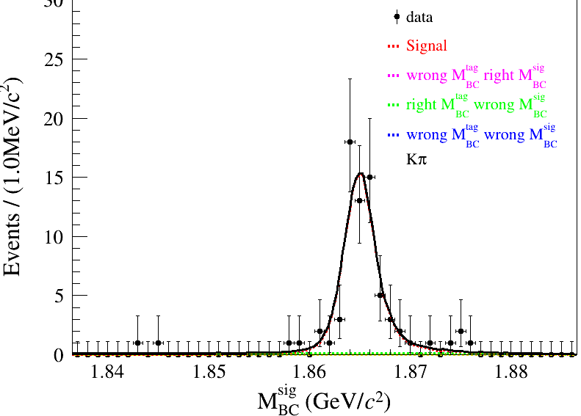
$$N_{DT}^{sigregion}=572.07±24.34$$
$$N_{DT}^{sideband}=66.65±8.34$$

Slide 11
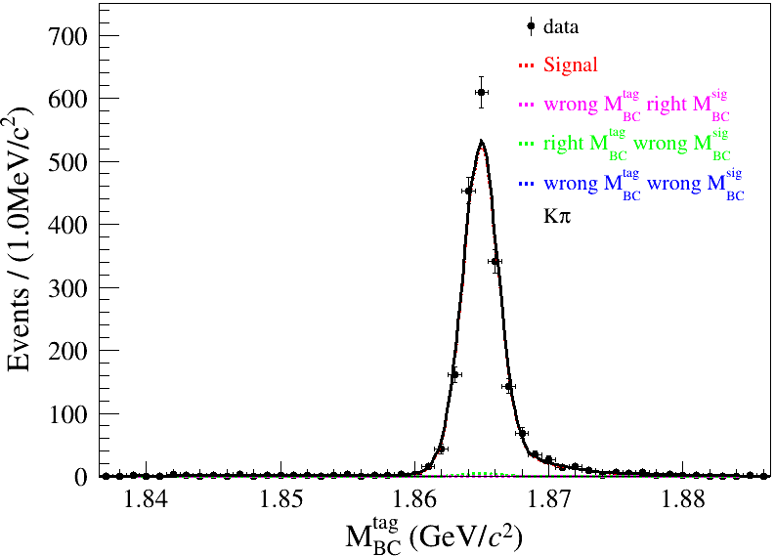
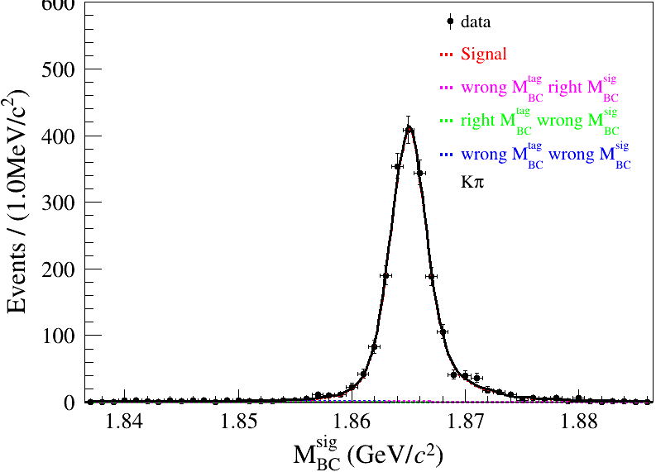
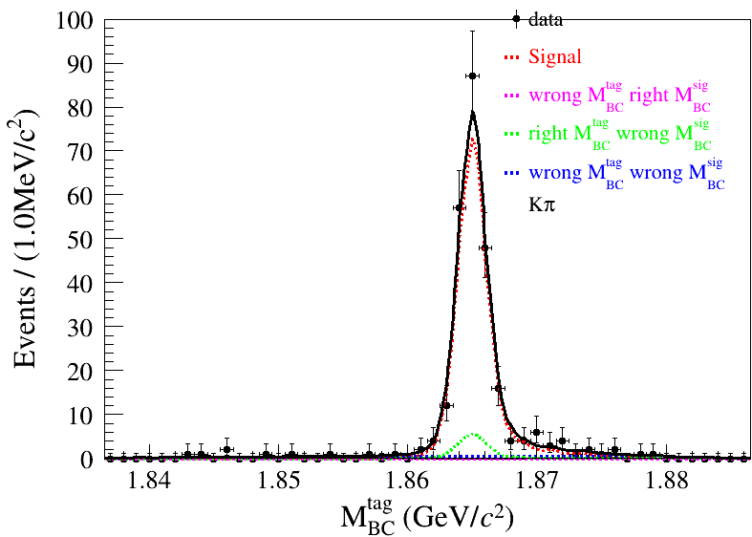
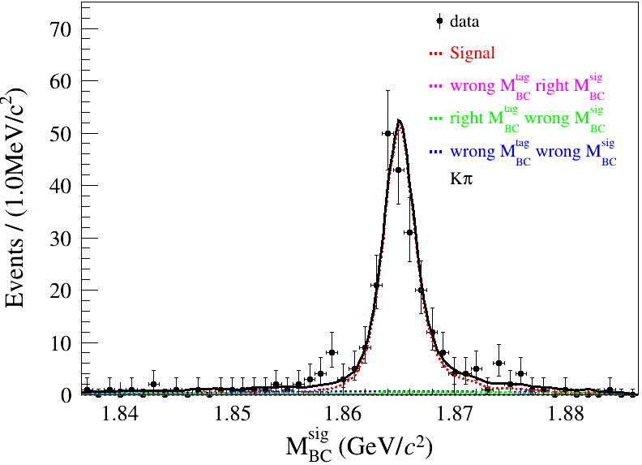
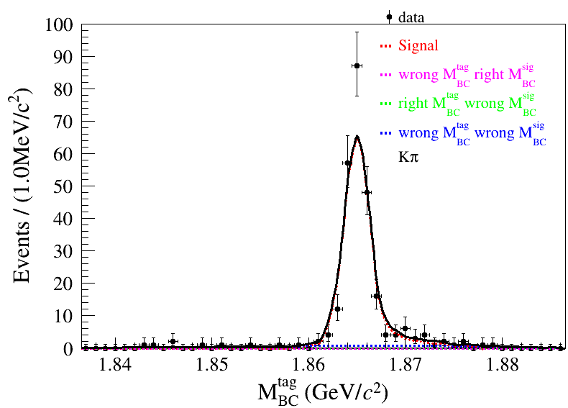
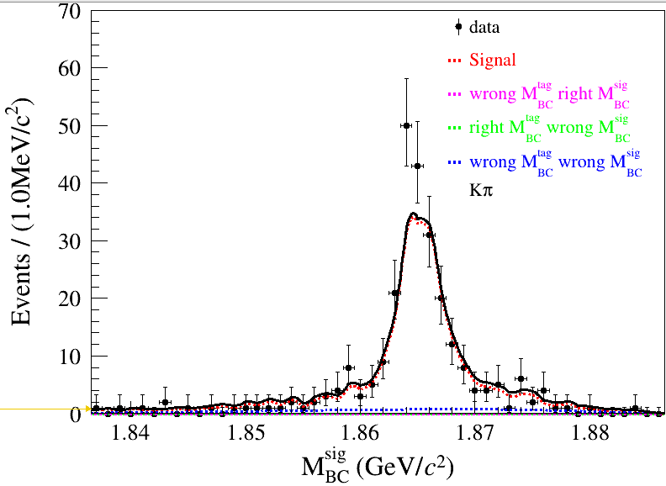
$$N_{DT}^{sigregion}=1937.28±45.06$$
$$N_{DT}^{sideband}=226.07±16.56$$

Slide 12
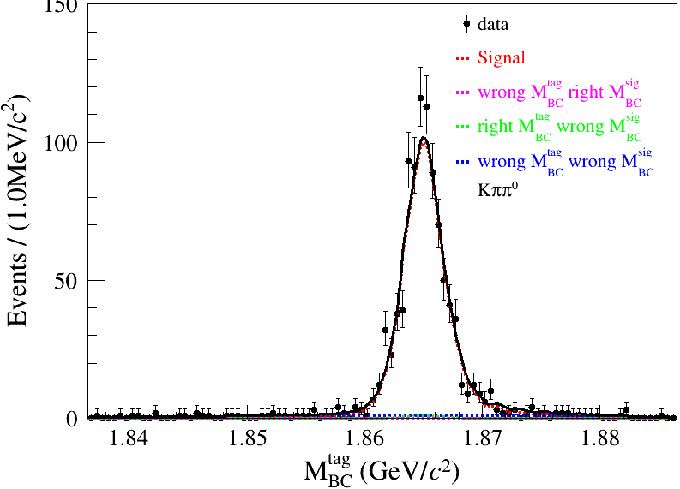
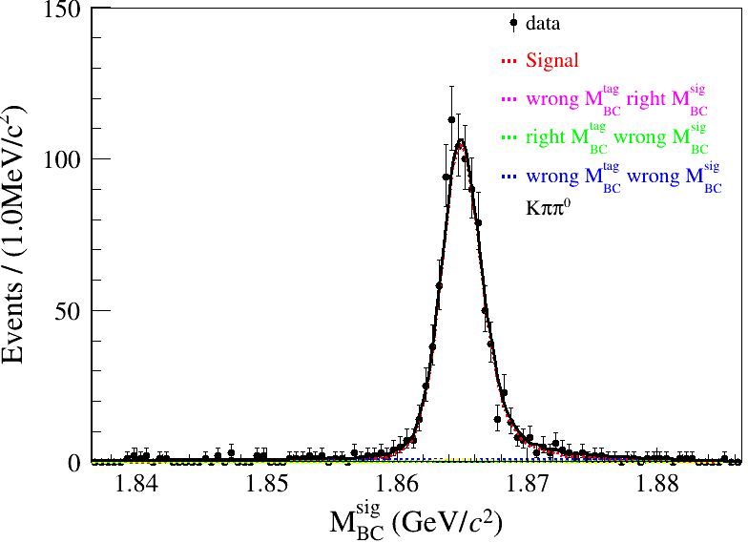
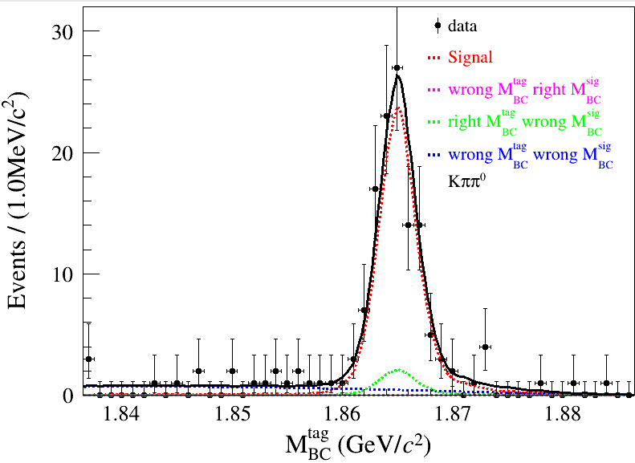
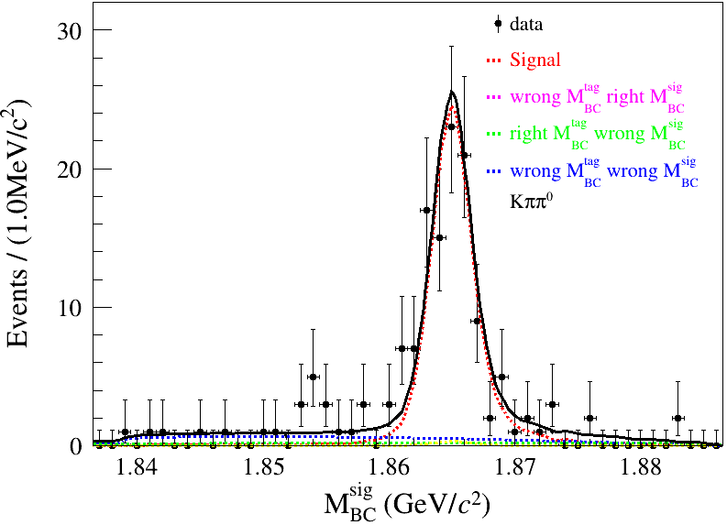
$$N_{DT}^{sigregion}=907.79±28.53$$
$$N_{DT}^{sideband}=109.33±10.49$$

Slide 13
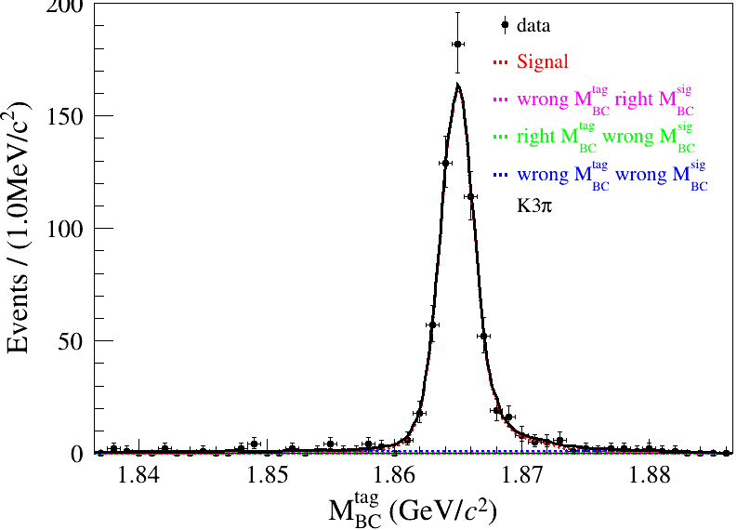
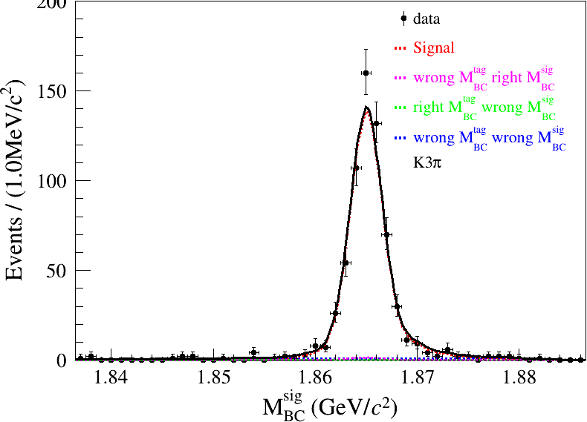
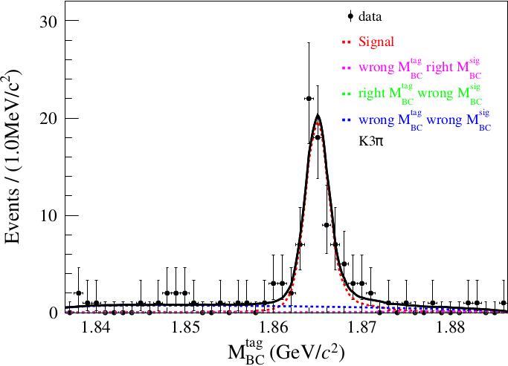
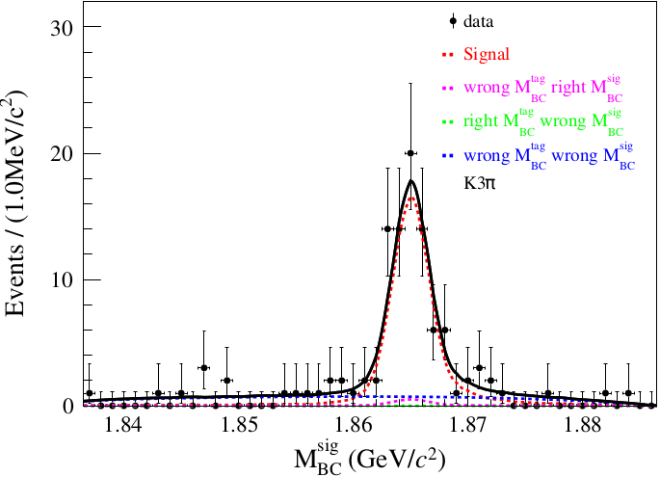
$$N_{DT}^{sigregion}=619.72±25.79$$
$$N_{DT}^{sideband}=76.21±9.65$$

Slide 15
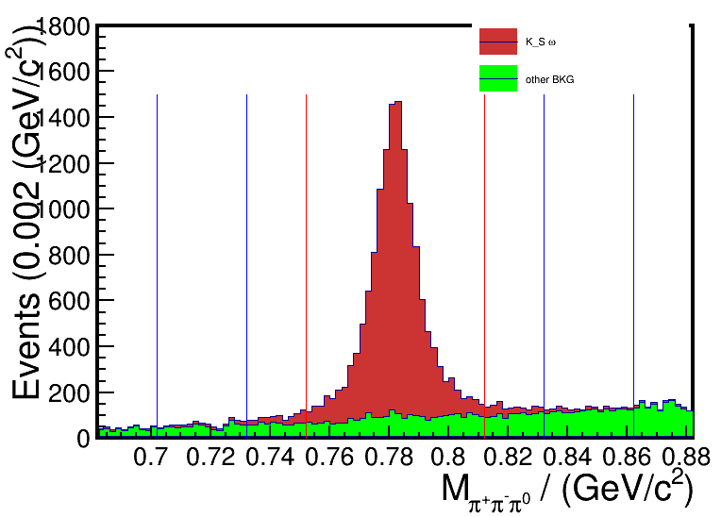
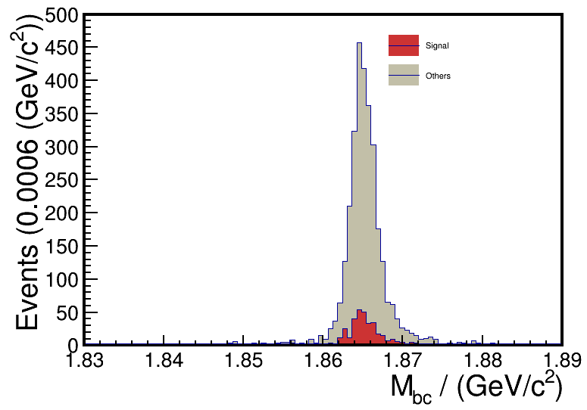
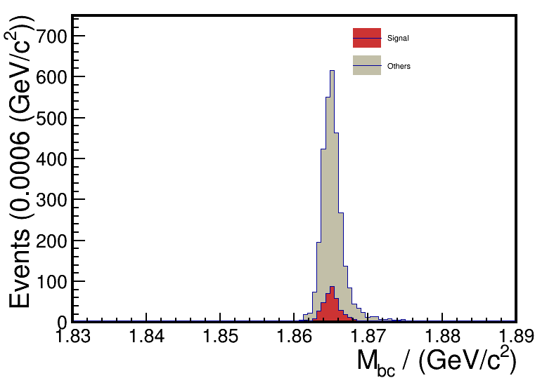
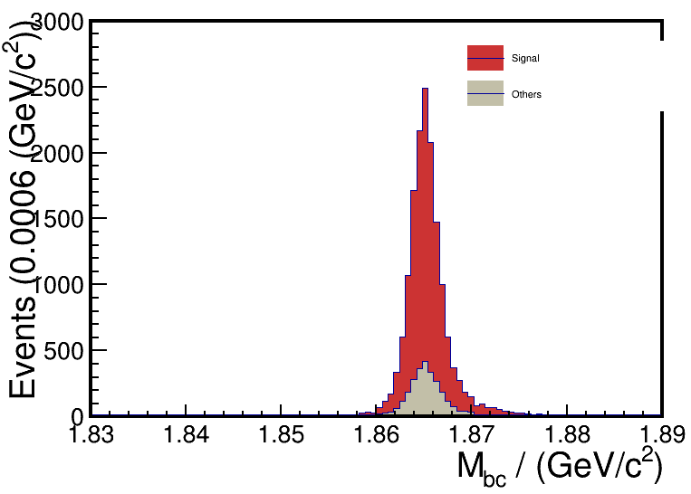
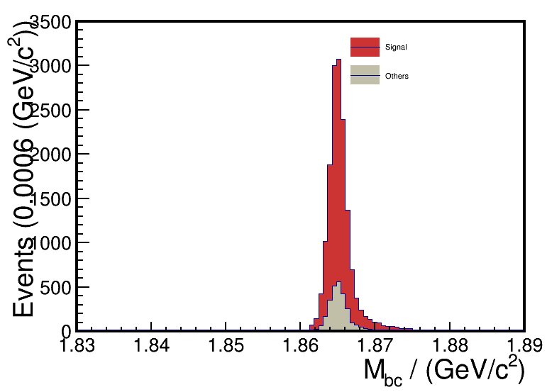
DT
ST
DT
ST

Slide 16
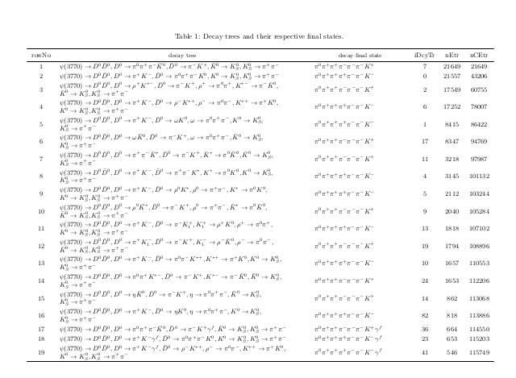
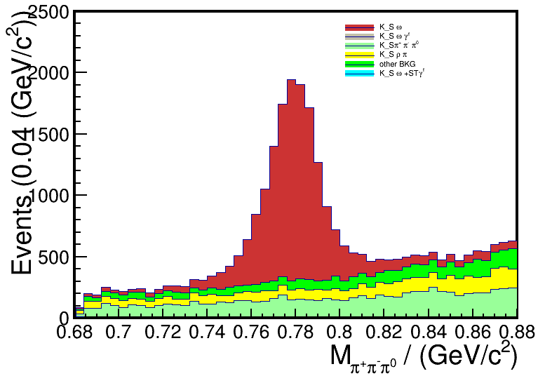
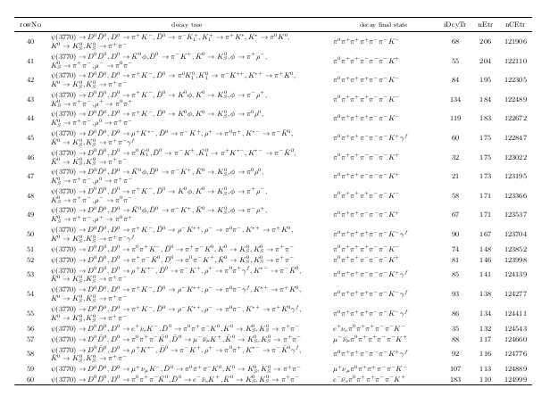
29,30,1,17,

Slide 17
$$Tag Mode :\overline{D^{0}}→K^{+}π^{−}$$ | events | Absolute (%) | Relative(%)
Total | 300000 | 100 | 100
ST selection | 210664 | 70.22 | 70.22
$K_{S}^{0}{ π}^{+}π^{−}π^{0}$selection | 44410 | 14.80 | 21.08
$K_{S}^{0}$ second vertex fit | 44274 | 14.75 | 99.69
Kinematic fit | 42686 | 14.22 | 96.41
$\left|M_{π^{+}π^{−}π^{0}}−M_{ω}^{PDG}\right|<0.1$GeV | 41345 | 13.78 | 96.85
$$Tag Mode :D^{0}→K^{−}π^{+}$$ | events | Absolute (%) | Relative(%)
Total | 300000 | 100 | 100
ST selection | 208585 | 69.52 | 69.52
$K_{S}^{0}{ π}^{+}π^{−}π^{0}$selection | 43741 | 14.58 | 20.97
$K_{S}^{0}$ second vertex fit | 43591 | 14.53 | 99.65
Kinematic fit | 41908 | 13.96 | 96.13
$\left|M_{π^{+}π^{−}π^{0}}−M_{ω}^{PDG}\right|<0.1$GeV | 40479 | 13.49 | 96.59

Slide 18
Cut flow
Signal MC | total | ST selection | DT selection | $K_{S}^{0}$ second vertex fit | Kinematic fit
$$\overline{D^{0}}→K^{+}π^{−}$$ | 300000 | 210664 | 44410 | 44274 | 42686
$$D^{0}→K^{−}π^{+}$$ | 300000 | 208585 | 43741 | 43591 | 41908
$$\overline{D^{0}}→K^{+}π^{−}π^{0}$$ | 300000 | 124029 | 21913 | 21857 | 20767
$$D^{0}→K^{−}π^{+}π^{0}$$ | 300000 | 124461 | 21937 | 21869 | 20867
$$\overline{D^{0}}→K^{+}π^{−}π^{+}π^{−}$$ | 300000 | 124017 | 19047 | 18965 | 17921
$$D^{0}→K^{−}π^{+}π^{−}π^{+}$$ | 300000 | 121954 | 18401 | 18321 | 17353

Slide 19
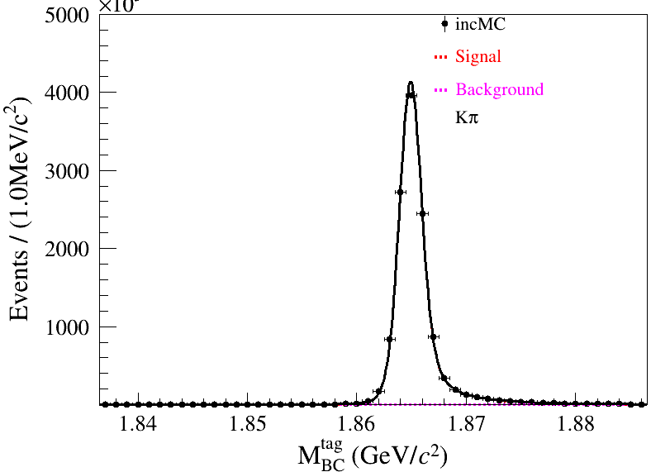
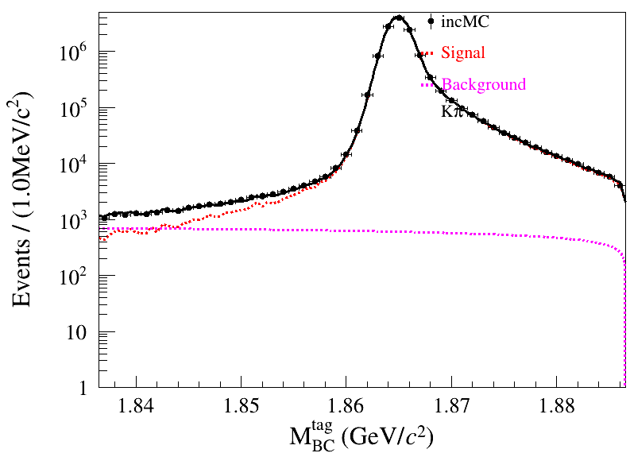
$$inclusive MC$$
$$N_{event}=12210800±3552.8$$

Slide 20
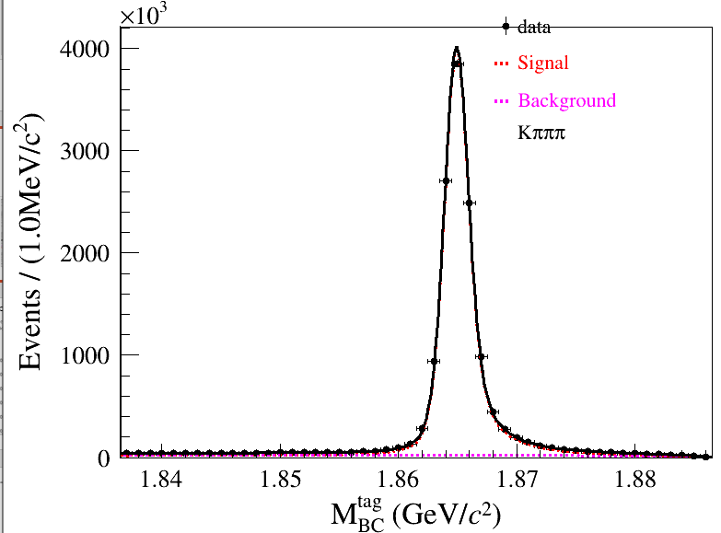
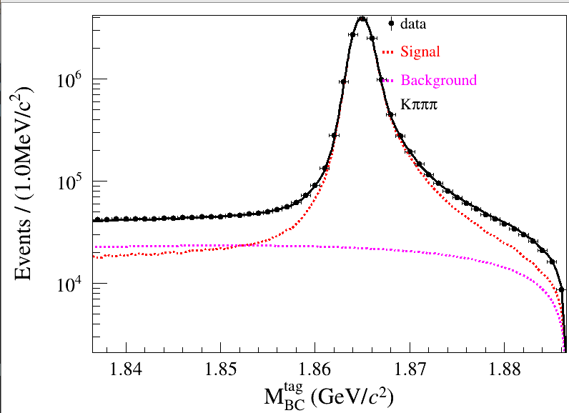
$$inclusive MC$$
$$N_{event}=13357200±4000.6$$

