Slide 1
Optimization of hadronic event selection
Zhen Gao
2016.01.20

Slide 2
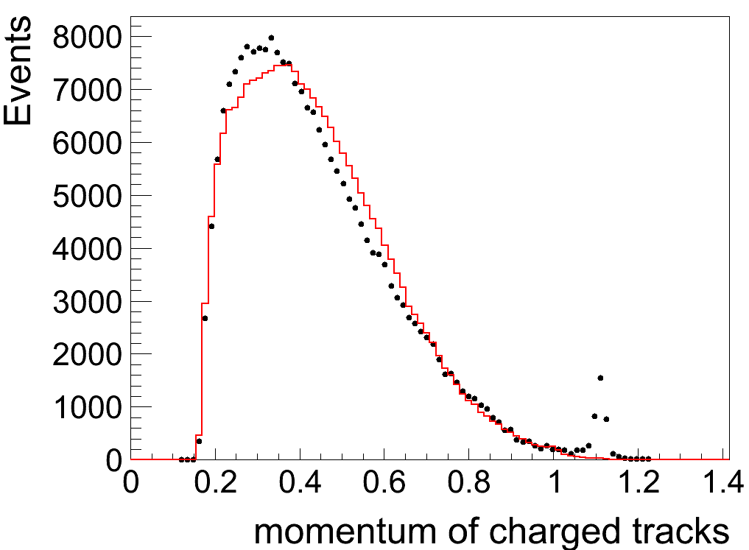
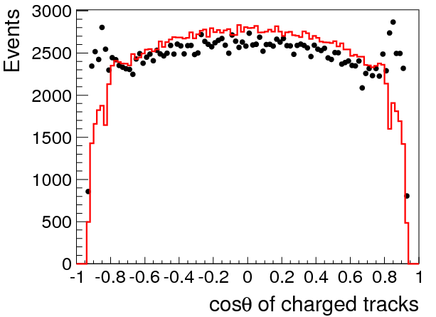
Comparison between data and MC --using R measurement requirement
@2.2324 GeV
@2.2324 GeV
The black dost reflect the distribution of data with all the background removed !
The similar phenomena happen on other energy points !

Slide 3
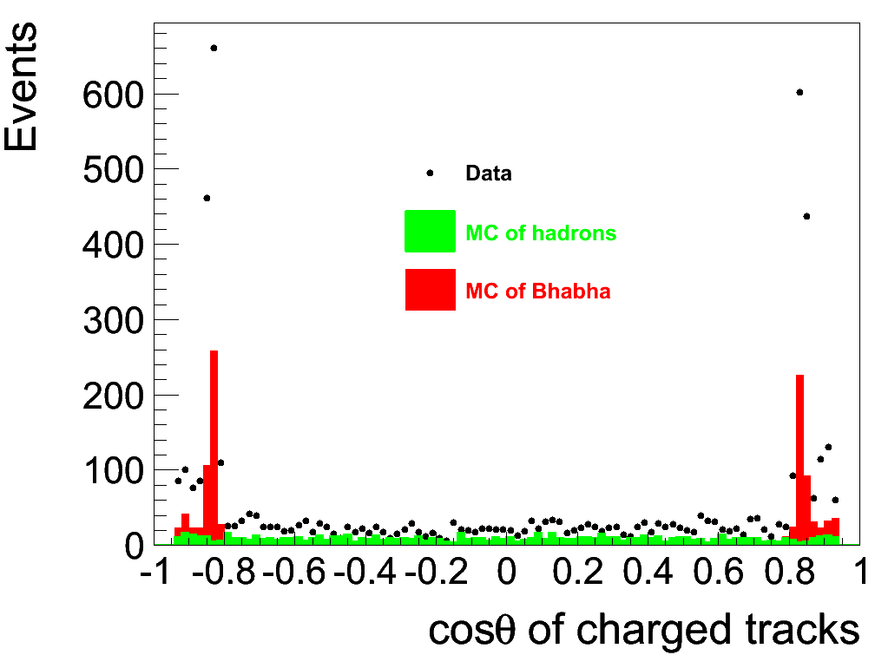
Costheta with p > 0.94*Ebeam

Slide 4
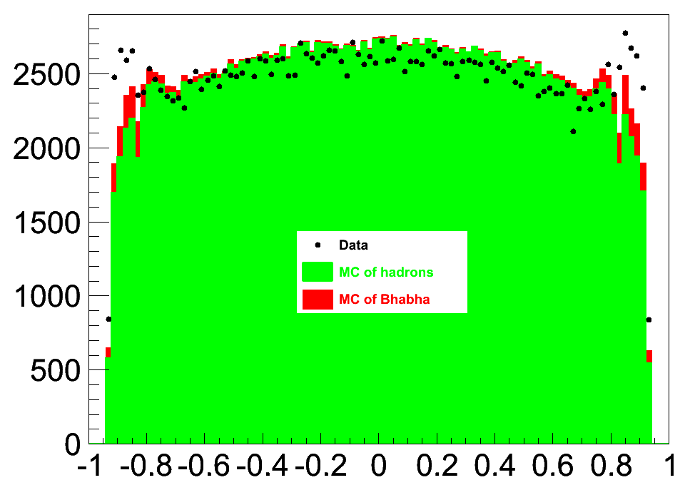
Costheta with p < 0.94*Ebeam

Slide 5
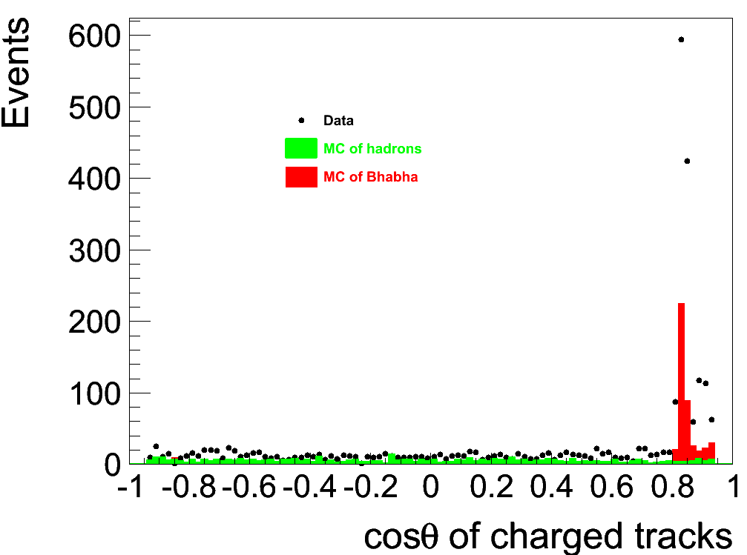
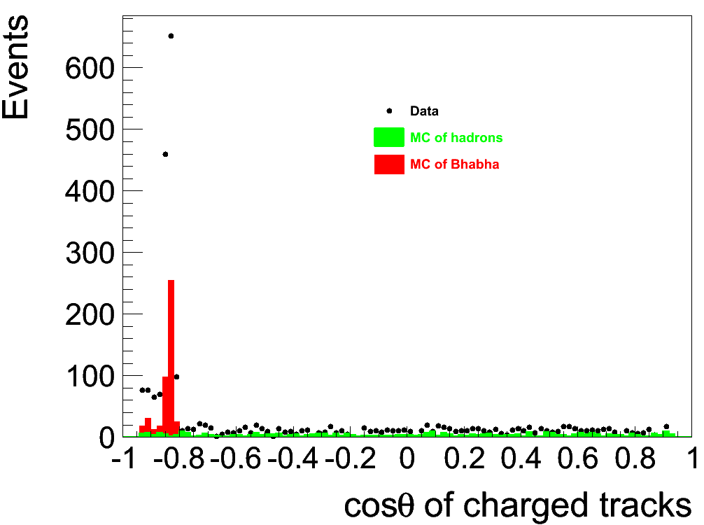
these events are Bhabha !
P > 0.94* Ebeam and the charge of track is 1 (positive tracks)
P > 0.94* Ebeam and the charge of track is -1 (negative tracks)

Slide 6
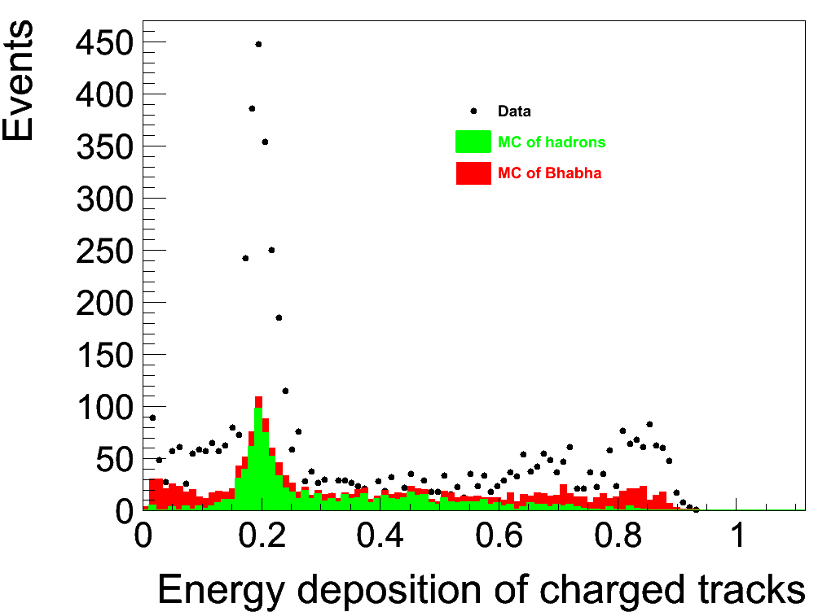
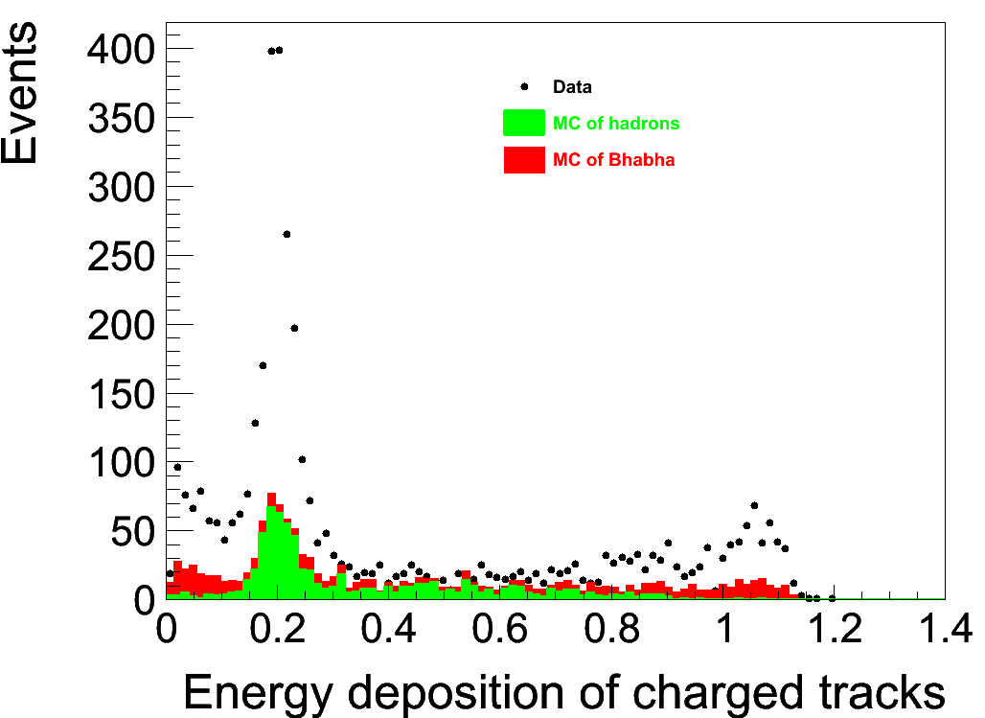
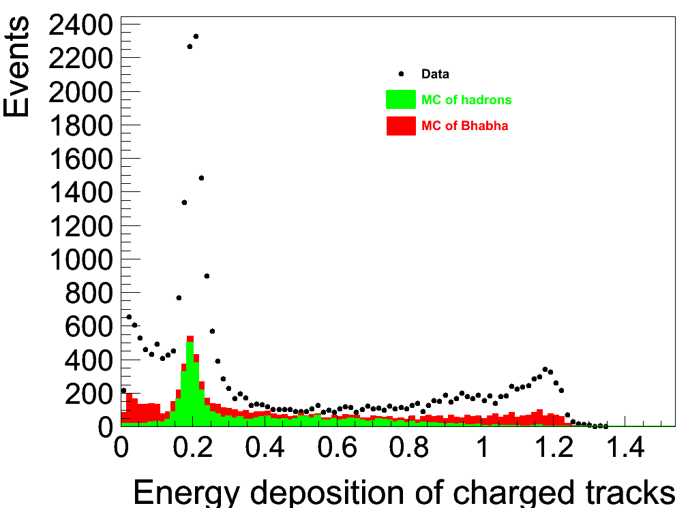
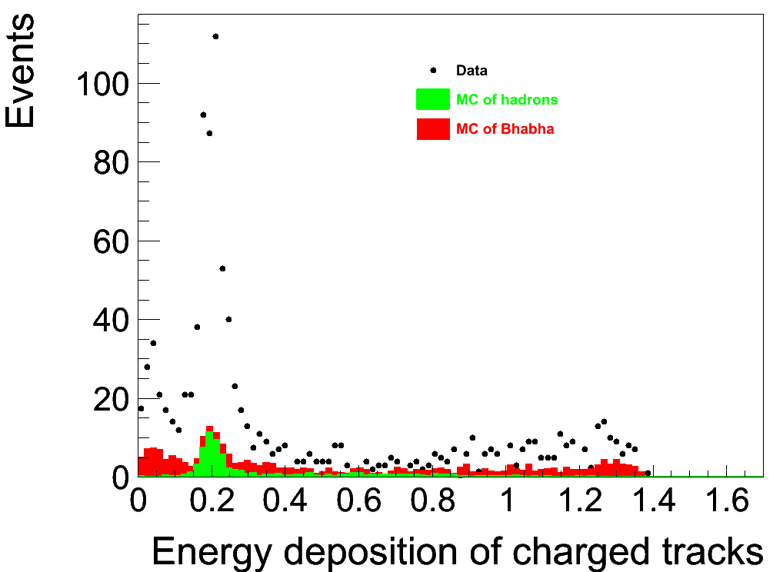
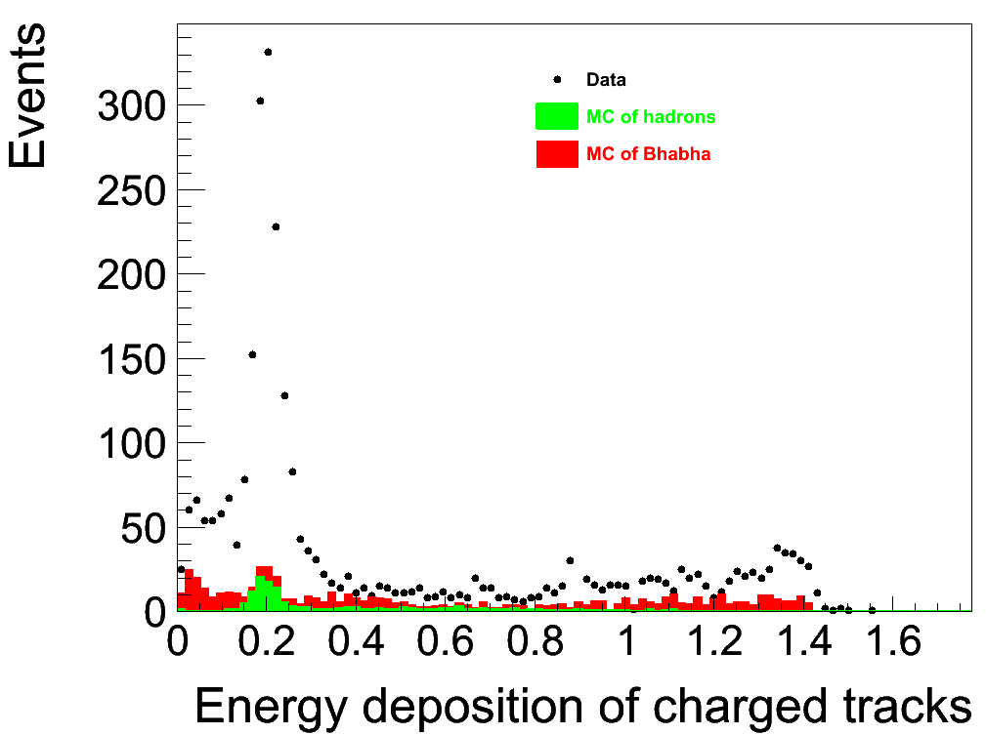
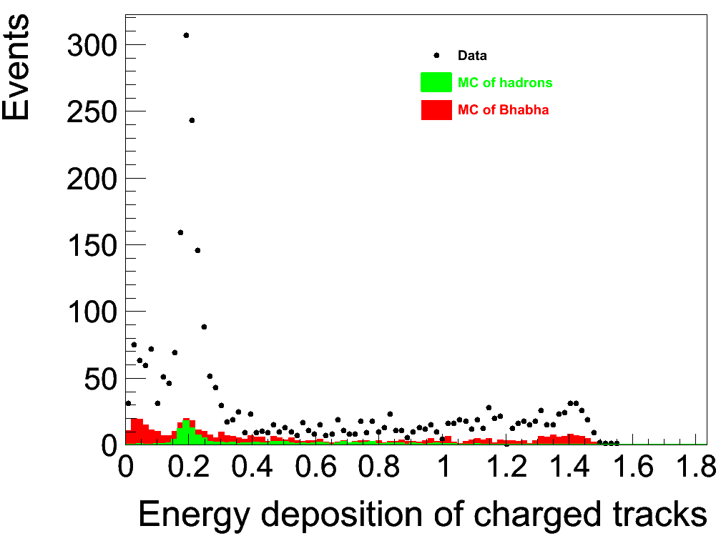
Energy deposition check
@2.2324 GeV
@2.8 GeV
@3.08 GeV
@3.4 GeV
@3.5538 GeV
@3.671 GeV

Slide 7
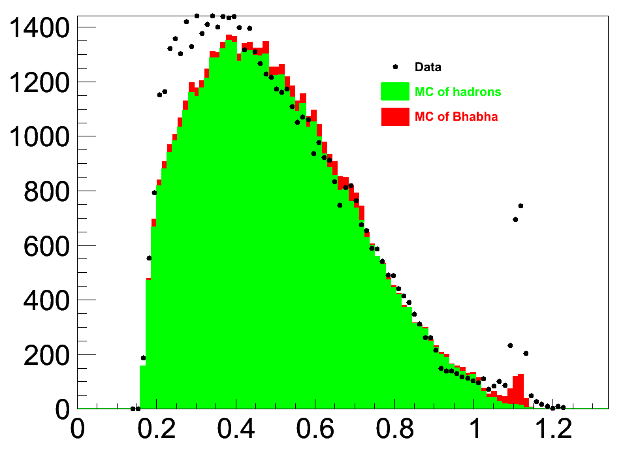
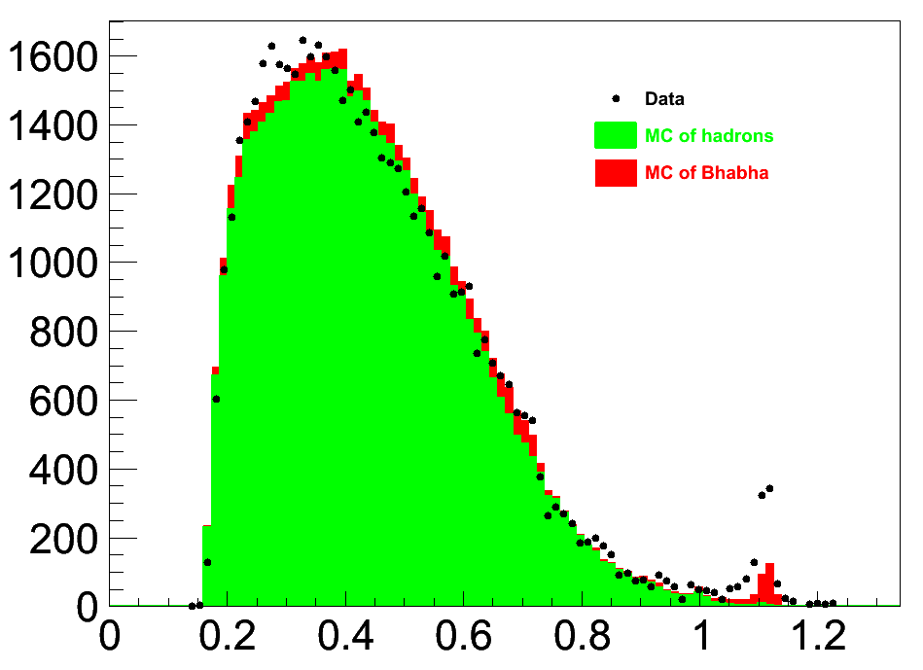
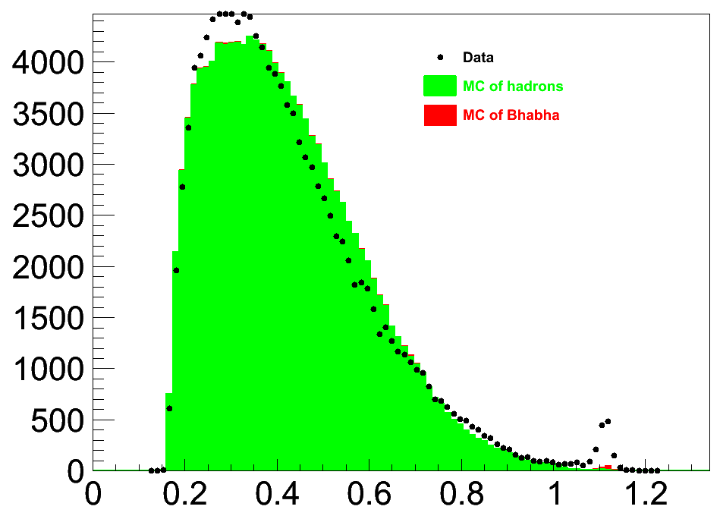
Separated by nGood
nGood == 2
nGood == 3
nGood >= 4

Slide 8
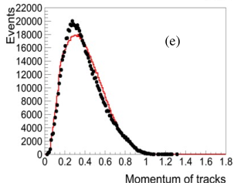
Tuning result
No peak around Ebeam !

Slide 9
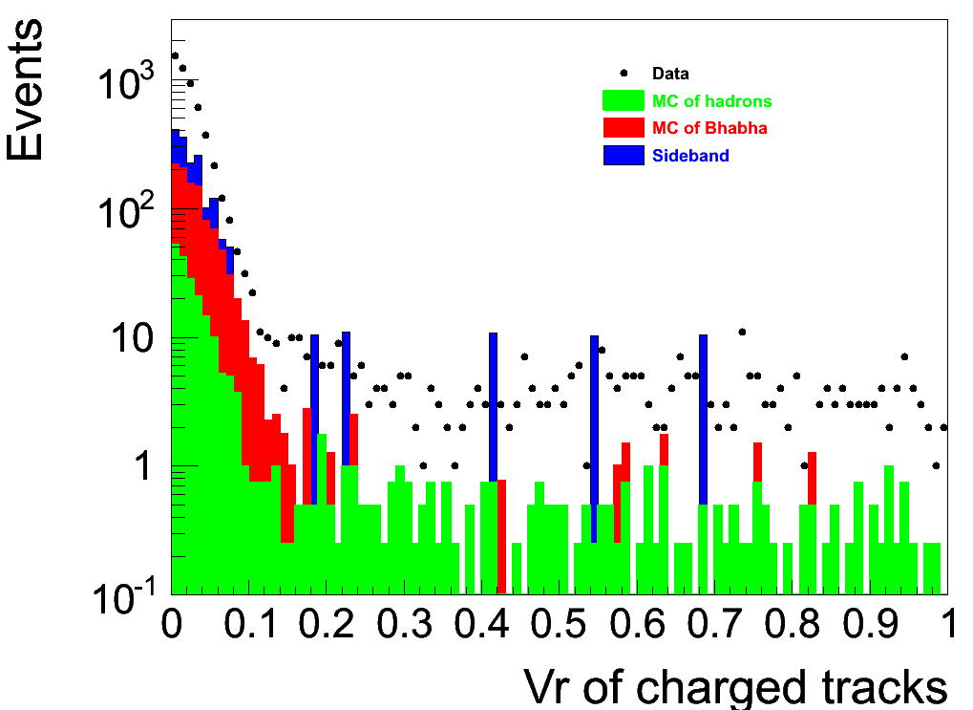
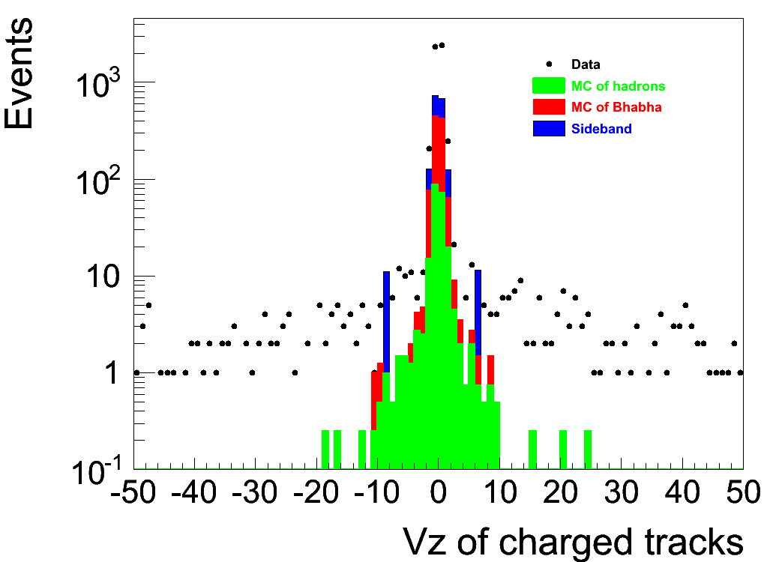
Vr and Vz distributions

