Slide 1
pi0 phi phi

Slide 2
motivation
search for C violation process
J/psi -> pi0 phi phi

Slide 3
Event selection
Good charged tracks
PID
2K+ 2K-
Photon
ngamma >=2
vertex fit 4 K
chisq <50
kmfit
best kmfit to select 2 photon
chisq<50

Slide 4
signal process

Slide 5
pi0 phi K K process

Slide 6
data, mgg in pi0 mass region

Slide 7
data, mgg in pi0 mass side band region

Slide 8
data, mgg in pi0 mass region subtract pi0 sideband

Slide 9
data, mgg in pi0 mass region & subtract pi0 sideband & mKK1 in phi region & subtract phi sideband

Slide 10
MC: pi0 phi K K sub pi0 and phi side band
km chisq <50
check if the previous peak is from pi0 phi K K, No!

Slide 11
MC: pi0 phi K K sub pi0 and phi side band
km chisq 100-200
check if the previous peak is from pi0 phi K K, No!

Slide 12
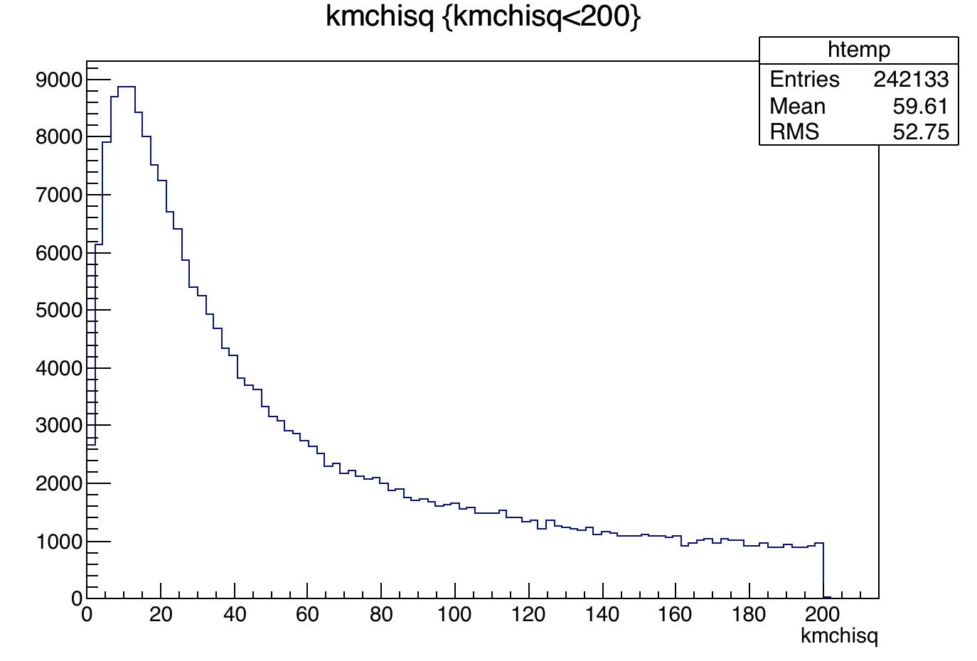
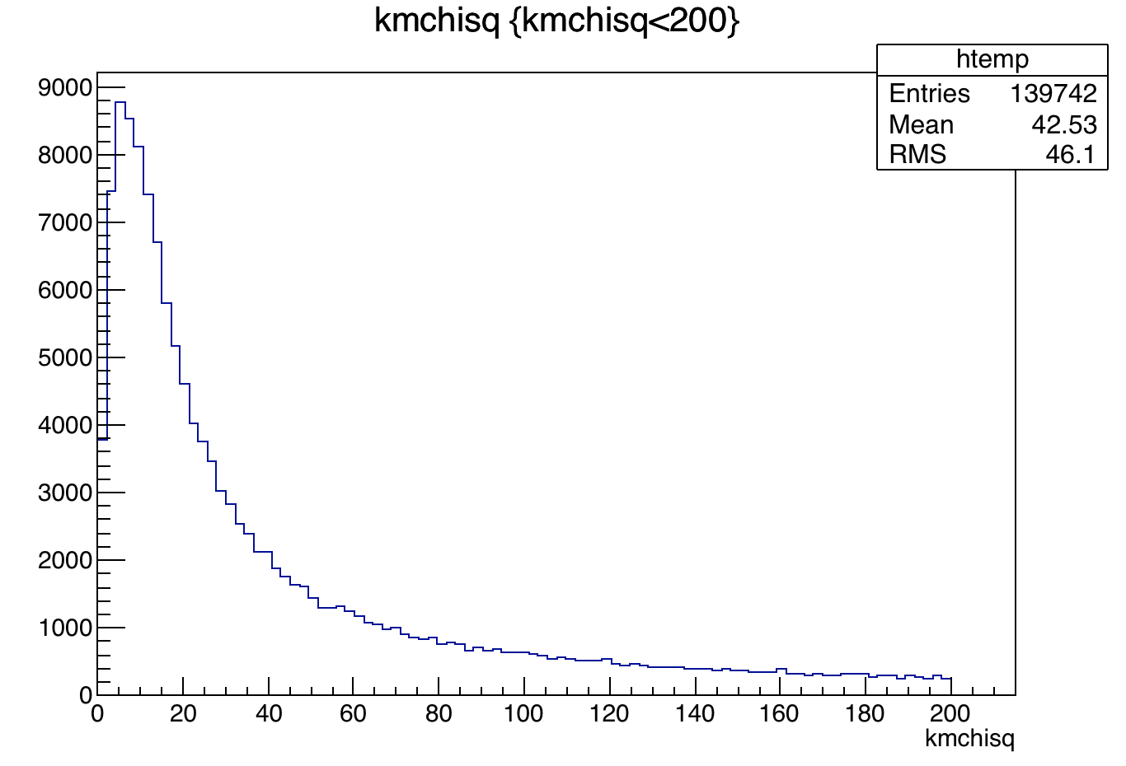
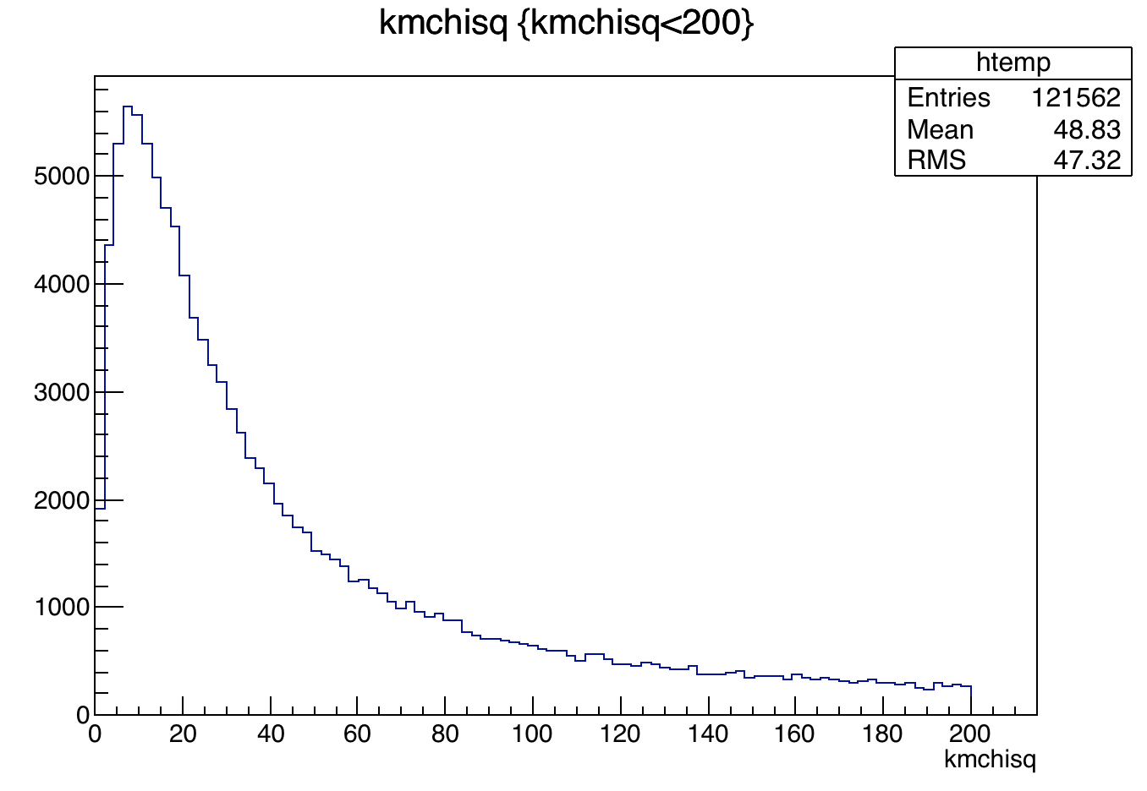
MC: gamma pi0 phi phi
data km chi sq
gamma pi0 phi phi
pi0 phi phi
pi0 phi K K
Use km chisq to select this process

Slide 13
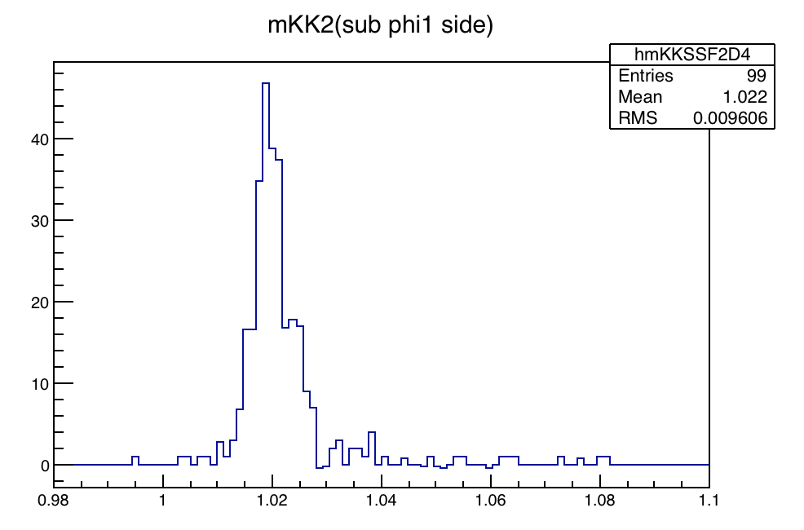
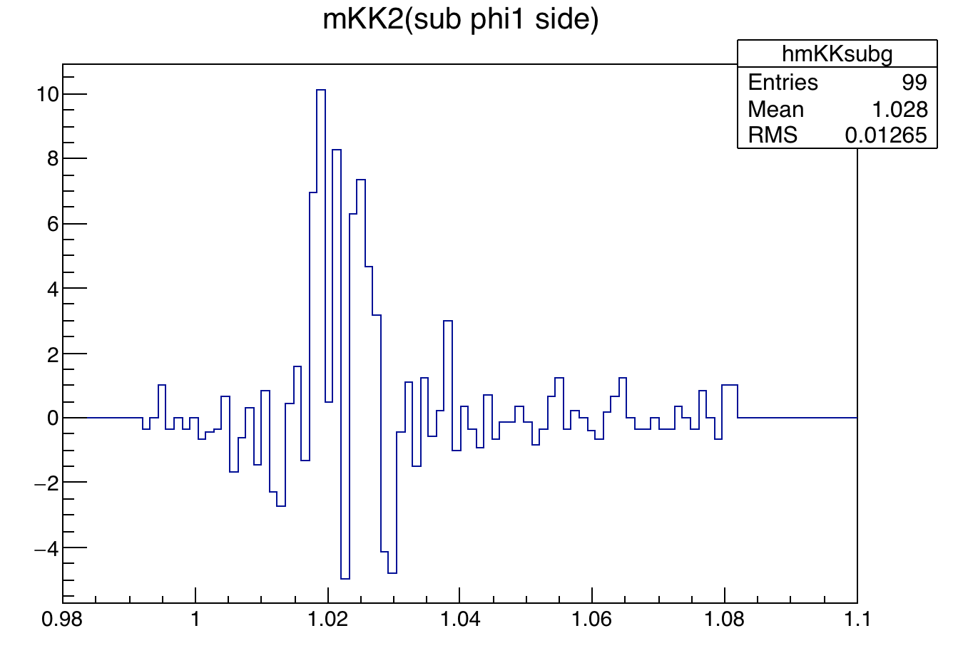
MC subtract km in 100-200, gamma pi0 phi phi subtract MC side
Events in signal region kmchisq in (0,50) is ~1/3 of (100-200), MC determined

Slide 14
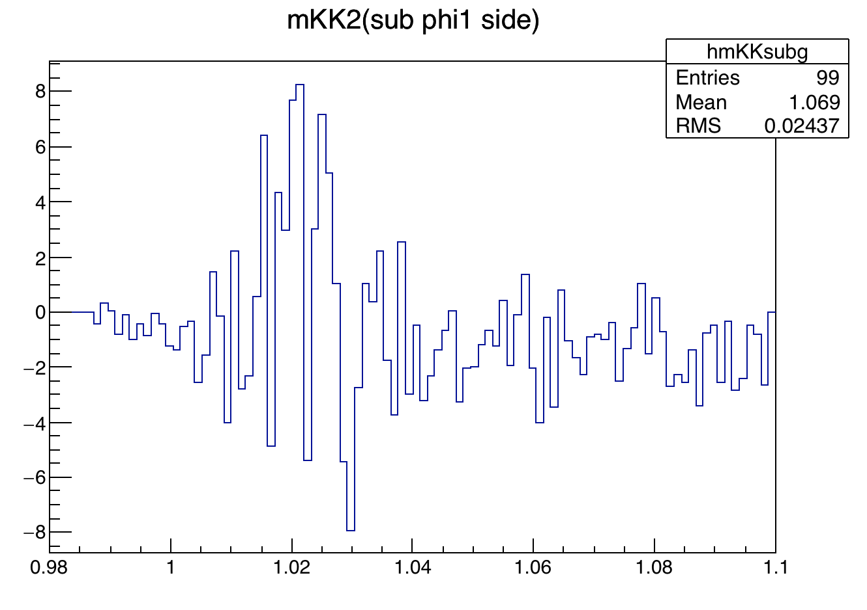
MC subtract km in 100-200, gamma pi0 phi phi subtract data side
sub km chisq side
Events in signal region kmchisq in (0,50) is ~1/3 of (100-200), MC determined

Slide 15
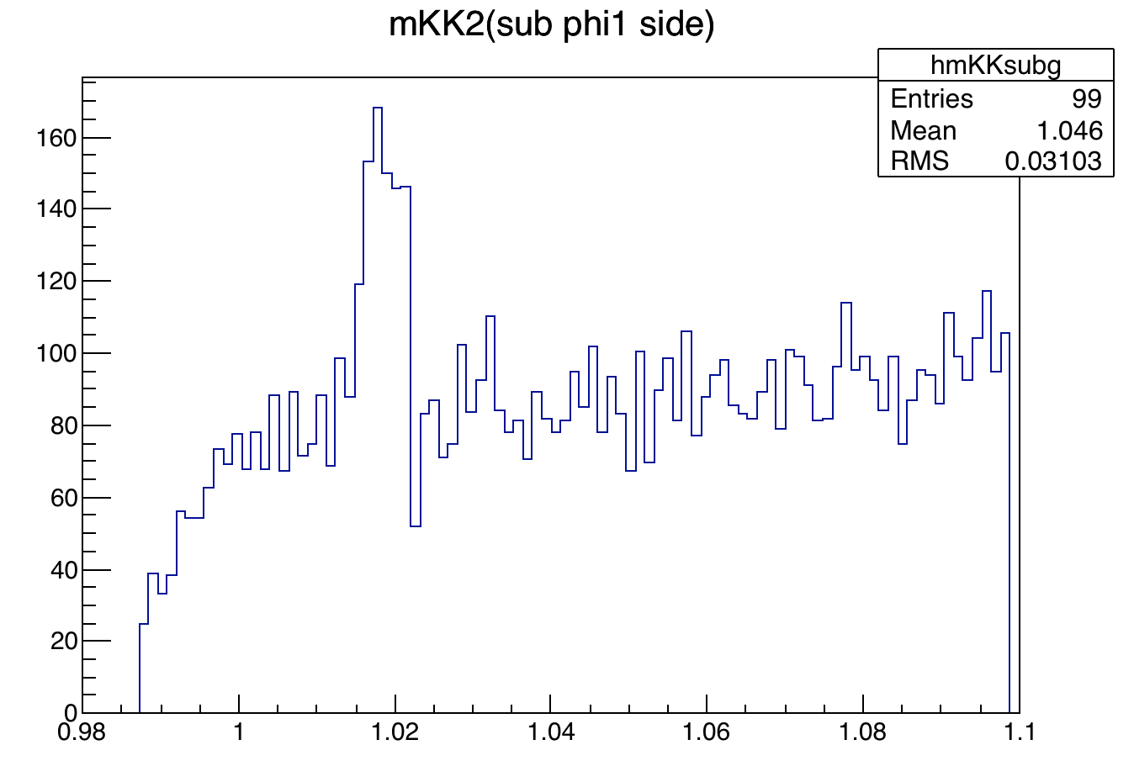
data subtract km in 100-200
Events in signal region kmchisq in (0,50) is ~1/3 of (100-200), MC determined

Slide 16
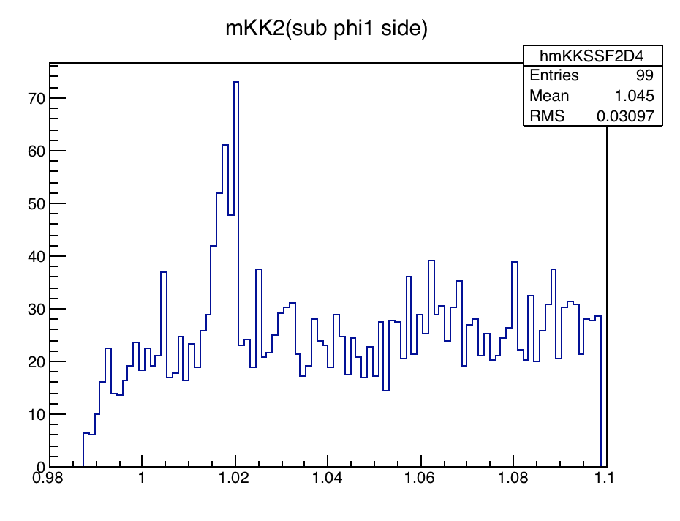
data subtract km in 100-200, data only 09+12
Events in signal region kmchisq in (0,50) is ~1/3 of (100-200), MC determined

