Slide 1
The progress and prospect on charm mixing
BINP
Vitaly Vorobyev
Budker Institute of Nuclear Physics
and
Novosibirsk State University
On behalf of Belle & Belle II Collaborations
2nd international workshop on High Intensity Electron-Positron Accelerator 19th March 2018, UCAS, Beijing

Slide 2
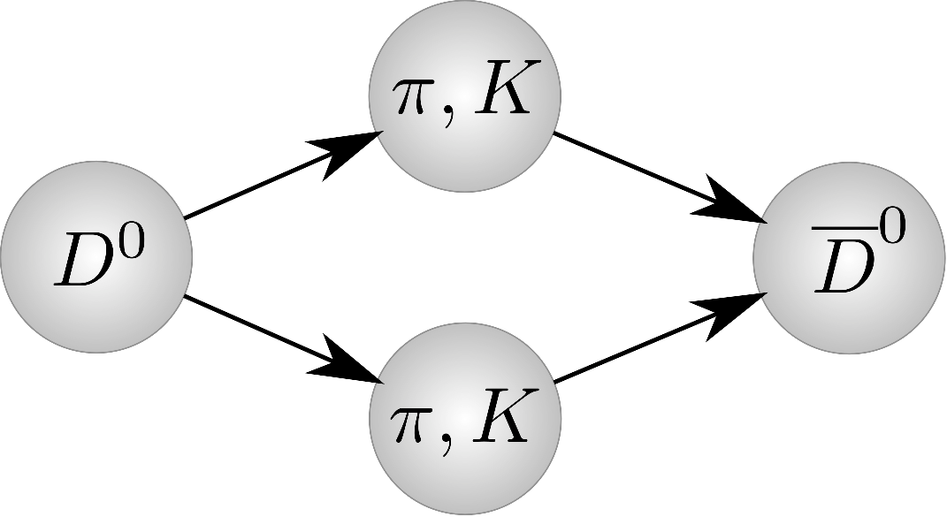
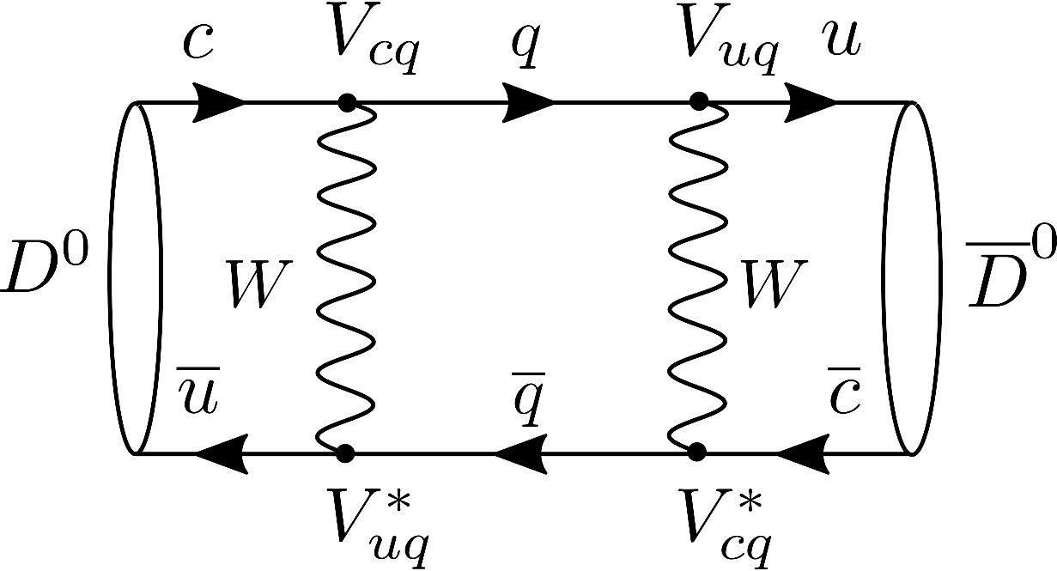
The charm mixing parameters
Charm forms the only neutral meson system with the heavy up quark
Mass eigenstates
$$\left|\left.D_{1,2}\right\rangle \right.=p\left|\left.D^{0}\right\rangle \right.±q\left|\left.{\overline{D}}^{0}\right\rangle \right., {\left|p\right|}^{2}+{\left|q\right|}^{2}=1$$
The charm mixing parameters
$$x≡\frac{m_{2}−m_{1}}{Γ}, y≡\frac{Γ_{2}−Γ_{1}}{2Γ}, Γ≡\frac{Γ_{1}+Γ_{2}}{2}$$
The observable parameter
$$λ_{f}≡\frac{q}{p}\frac{{\overline{𝒜}}_{f}}{𝒜_{f}}, 𝒜_{f}≡\left\langle f | ℋ | D^{0}\right\rangle , {\overline{𝒜}}_{f}≡\left\langle f | ℋ | {\overline{D}}^{0}\right\rangle$$
$𝒞𝒫$ violation
Direct: $\left|\left\langle f | ℋ | D^{0}\right\rangle \right|≠\left|\left\langle 𝒞𝒫\left(f\right) | ℋ | {\overline{D}}^{0}\right\rangle \right|$
In mixing: $\left|q/p\right|≠1$
In interference between mixing and decay: $Im λ_{f}≠0$
Long distances (dominant)
Short distances
The Standard Model expectation
$$x≲y∼\sin^{2}{θ_{C}}×{\left[SU{\left(3\right)}_{f} breaking\right]}^{2}$$
Clear signals of new dynamics:
$y≪x∼1\%$
𝒞𝒫 violation $>{10}^{−3}$

Slide 3
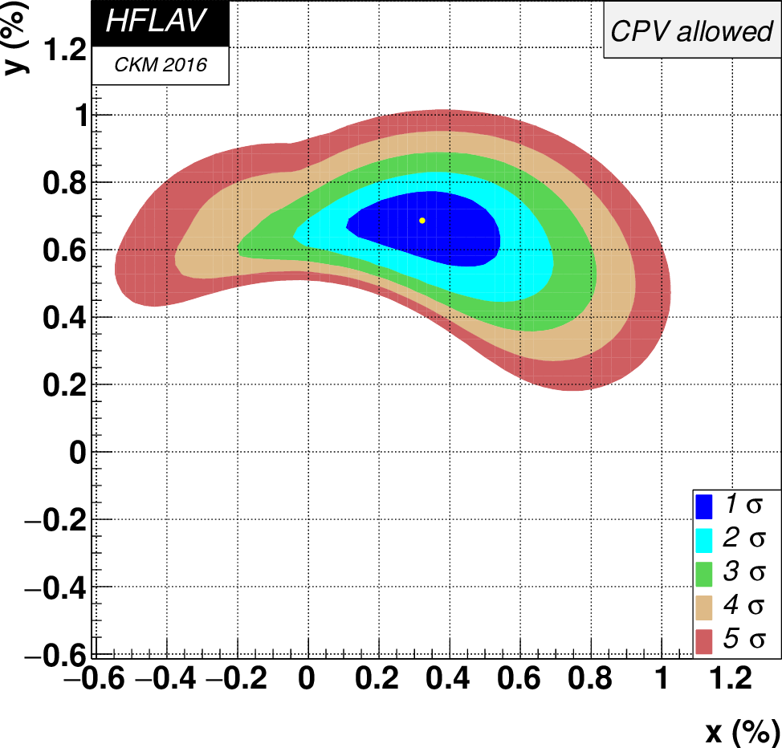
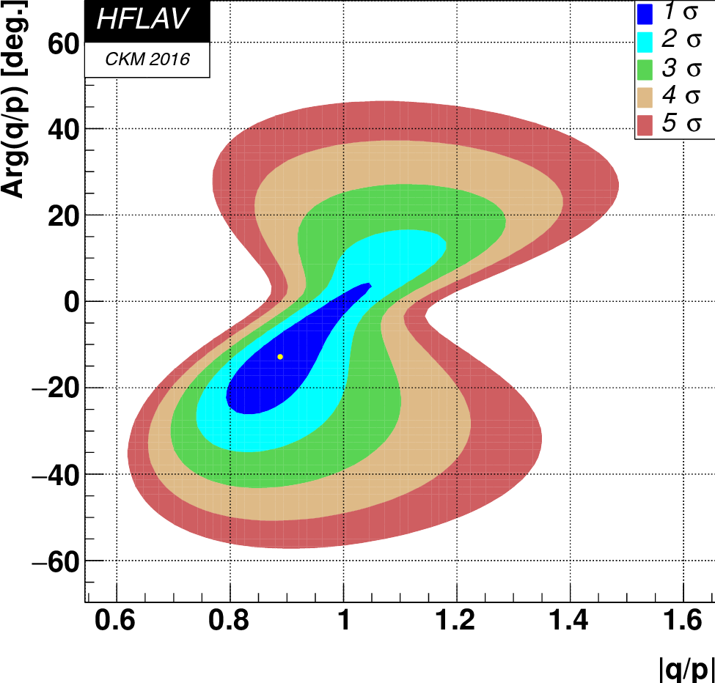
Experimental status
arXiv:1612.07233
$$x=\left(0.32±0.14\right)\%$$
$$y=\left({0.69}_{−0.07}^{+0.06}\right)\%$$
$$\left|q/p\right|={0.89}_{−0.07}^{+0.08}$$
$$\arg\left(q/p\right)={\left(−{12.9}_{−8.7}^{+9.9}\right)}^{∘}$$
No CPV
No mixing
The first evidence by Belle and BaBar
Phys. Rev. Lett. 98, 211802 (2007)
Phys. Rev. Lett. 98, 211803 (2007)
Charm mixing is well established
No $𝒞𝒫$ violation observed in charm yet

Slide 4
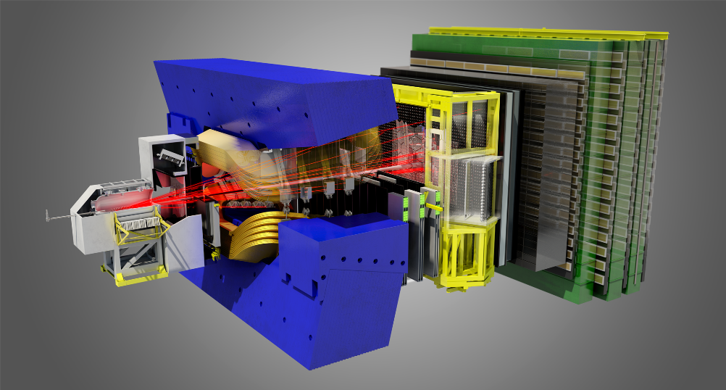
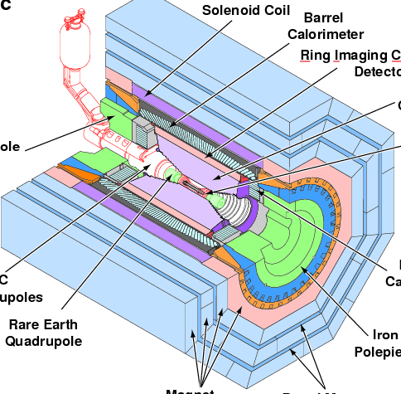
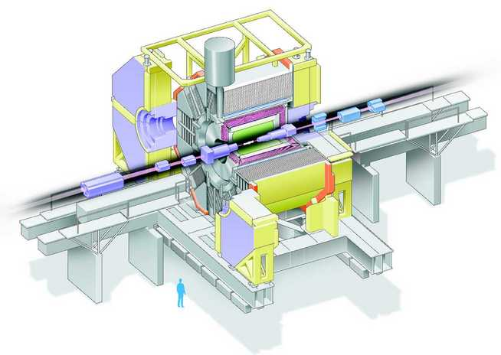
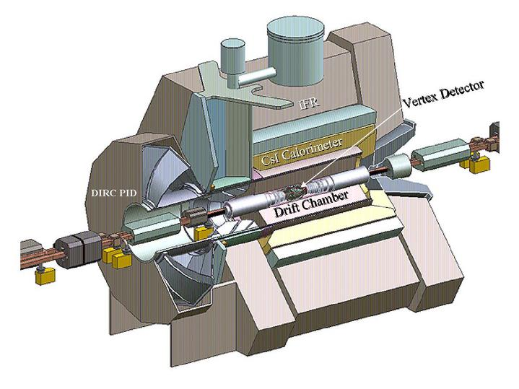
Experimental landscape
$D\overline{D}$ threshold
$pp$ collisions
Asymmetric $e^{+}e^{−} @ Υ\left(4S\right)$
CLEO-c

Slide 5
Charm mixing observables and facilities
Classes of observables (I. Bigi)
Charm production
‘Wrong-sign’ $D^{0}$ decays
Semileptonic
Hadronic ($D^{0}→K^{+}π^{−}$ time ind.)
Coherence
Non-coherent
Non-exponential $D^{0}$decay rate evolutions ($D^{0}→K^{+}π^{−}$ time dep.)
LHCb
Coherent
$B$ factory
CMS boost
Different $D^{0}$ lifetimes in different channels ($D^{0}→h^{+}h^{−}$)
$c$-$τ$ factory
$${\left(γβ\right)}_{D}≫1$$
$${\left(γβ\right)}_{D}∼1$$
$D^{0}$ and ${\overline{D}}^{0}$ produced in $e^{+}e^{−}→D^{0}{\overline{D}}^{0}$ decaying into two seemingly identical final states
$${\left(γβ\right)}_{D}≪1$$

Slide 6
Charm decay rates
Time-dependent
Incoherent
Boost
$$D^{∗±}→Dπ^{±}, B→DX, e^{+}e^{−}→c\overline{c}→D\overline{D}X, pp→c\overline{c}X$$
$${\left|\left\langle f | ℋ | D^{0}\left(t\right)\right\rangle \right|}^{2}=e^{−Γt}{\left|𝒜_{f}\right|}^{2}\left[1−\left(y Reλ_{f}+x Imλ_{f}\right)Γt\right]+𝒪\left(x^{2},y^{2}\right)$$
$${\left|\left\langle f | ℋ | D^{0}\right\rangle \right|}^{2}∝{\left|𝒜_{f}\right|}^{2}\left(1−y Reλ_{f}−x Imλ_{f}\right)+𝒪\left(x^{2},y^{2}\right)$$
LHCb: ${\left(γβ\right)}_{D}≫1$
$B$ factory: ${\left(γβ\right)}_{D}∼1$
$c$-$τ$ factory: ${\left(γβ\right)}_{D}≪1$
Time-integrated
Coherent (at rest)
$$e^{+}e^{−}→D^{\left(∗\right)0}{\overline{D}}^{\left(∗\right)0}, 𝒞+:D^{0}{\overline{D}}^{0}γ, 𝒞−:D^{0}{\overline{D}}^{0}\left(π^{0}\right)$$
$$\left\langle ij | ℋ | D^{0}{\overline{D}}^{0}\right\rangle ∝\left\langle i | ℋ | D^{0}\right\rangle \left\langle j | ℋ | {\overline{D}}^{0}\right\rangle +𝒞\left\langle i | ℋ | {\overline{D}}^{0}\right\rangle \left\langle j | ℋ | D^{0}\right\rangle$$
$${\left|\left\langle ij | ℋ | D^{0}{\overline{D}}^{0}\right\rangle \right|}^{2}∝{\left|𝒜_{i}\right|}^{2}{\left|𝒜_{j}\right|}^{2}\left[{\left|ζ_{𝒞}\right|}^{2}+\left(1+𝒞\right)\left(x Im\left(ξ_{𝒞}^{∗}ζ_{𝒞}\right)−y Re\left(ξ_{𝒞}^{∗}ζ_{𝒞}\right)\right)\right]+𝒪\left(x^{2},y^{2}\right)$$
$$ξ_{𝒞}≡\frac{p}{q}\left(1+𝒞λ_{i}λ_{j}\right), ζ_{𝒞}≡\frac{p}{q}(λ_{j}+𝒞λ_{i})$$

Slide 7
The progress
Selected experimental results

Slide 8
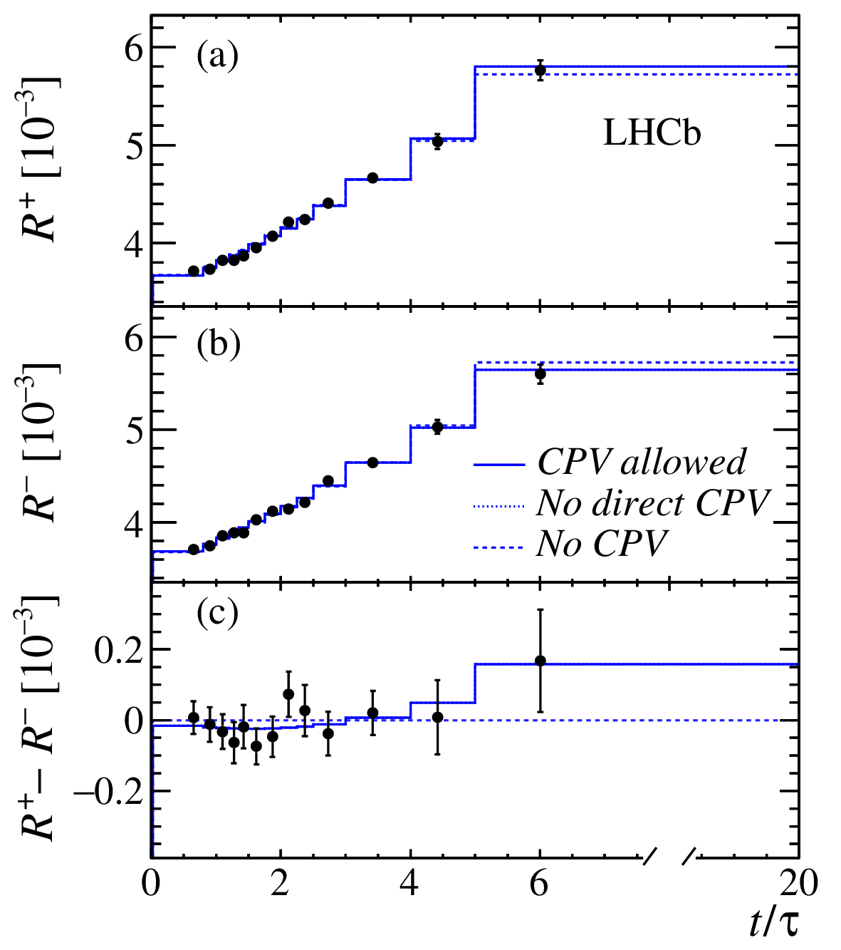
$D^{0}→Kπ$ time-dependent WS
$$R_{D}^{\left(+\right)}≡\frac{Br\left(D^{0}→K^{+}π^{−}\right)}{Br\left(D^{0}→K^{−}π^{+}\right)}$$
$$A_{D}≡\frac{\left(R_{D}^{+}−R_{D}^{−}\right)}{\left(R_{D}^{+}+R_{D}^{−}\right)}$$
$$Γ\left(D^{0}\left(t\right)→f_{WS}\right)=e^{−\frac{t}{τ}}{\left|A_{f}\right|}^{2}\left[R_{D}+\sqrt{R_{D}}y^{′}\frac{t}{τ}+\frac{1}{2}R_{M}{\left(\frac{t}{τ}\right)}^{2}\right]$$
$$x^{′}≡x\cos{δ_{Kπ}}+y\sin{δ_{Kπ}}$$
$$y^{′}≡y\cos{δ_{Kπ}}−x\sin{δ_{Kπ}}$$
$$R_{M}≡\left(x^{2}+y^{2}\right)/2$$
BaBar [1]: $\text{384} fb^{−1}$, $D^{∗+}→D^{0}π^{+}$
$$y^{′}=\left(9.7±4.4±3.1\right)×{10}^{−3}$$
$$R_{D}=\left(3.03±0.19\right)×{10}^{−3}$$
Belle [2]: $\text{976} fb^{−1}$, $D^{∗+}→D^{0}π^{+}$
$$y^{′}=\left(4.6±3.4\right)×{10}^{−3}$$
$$R_{D}=\left(3.53±0.13\right)×{10}^{−3}$$
LHCb [3]: $\text{5} fb^{−1}$, $D^{∗+}→D^{0}π^{+}$
$$y^{′}=\left(5.28±0.45±0.27\right)×{10}^{−3}$$
$${x^{′}}^{2}=\left(0.039±0.023±0.014\right)×{10}^{−3}$$
$$R_{D}=\left(3.454±0.028±0.014\right)×{10}^{−3}$$
$$A_{D}=\left(−0.1±9.1\right)×{10}^{−3}$$
$$1.00<\left|p/q\right|<1.35 @ 68.3\% CL$$
[3]
[3]
$$x^{′2} [{10}^{−3}]$$
[1] Phys. Rev. Lett. 98, 211802 (2007) (BaBar)
[2] Phys. Rev. Lett. 112, 111801 (2014) (Belle)
[3] Phys. Rev. D97, 031101(R) (2018) (LHCb)

Slide 9
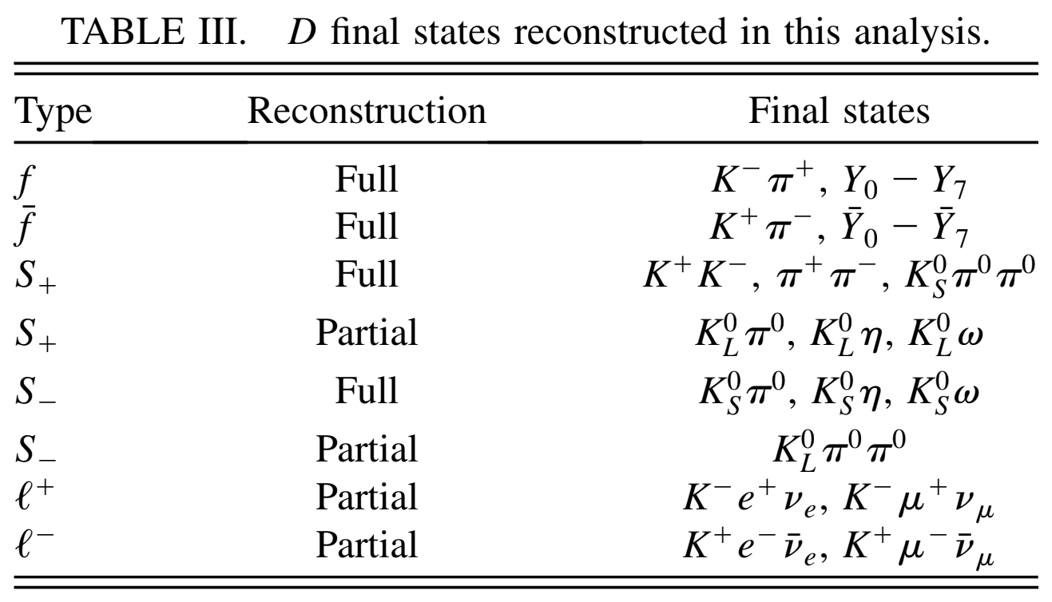
Measurements with quantum correlations
Time-integrated
The method exploits the difference between correlated (double tagged) and uncorrelated (single tagged) decay rates
$𝒞=−1$ correlations
$$Γ\left(i,j\right)∝{\left|\left\langle i | D_{2}\right\rangle \left\langle j | D_{1}\right\rangle −\left\langle i | D_{1}\right\rangle \left\langle j | D_{2}\right\rangle \right|}^{2}+𝒪\left(x^{2},y^{2}\right)$$
CLEO-c [1]: $\text{0.82} fb^{−1} @ ψ(3770)$, fit of $261$ yields
$$y=\left(4.2±2.0±1.0\right)\%$$
$$R_{D}=\left(0.533±0.107±0.045\right)\%$$
$$\cos{δ_{Kπ}}=+0.81±0.22±0.07$$
$$\sin{δ_{Kπ}}=−0.01±0.41±0.04$$
BESIII: $\text{2}\text{.92} fb^{−1} @ ψ(3770)$
$y$ and $R_{D}$ are taken as an external input
$$\cos{δ_{Kπ}=1.02±0.11±0.06±0.01}$$
[1]
[1] Phys. Rev. D86, 112001 (2012) (CLEO-c)
[2] Phys. Lett. B 734, 277 (2014) (BESIII)

Slide 10
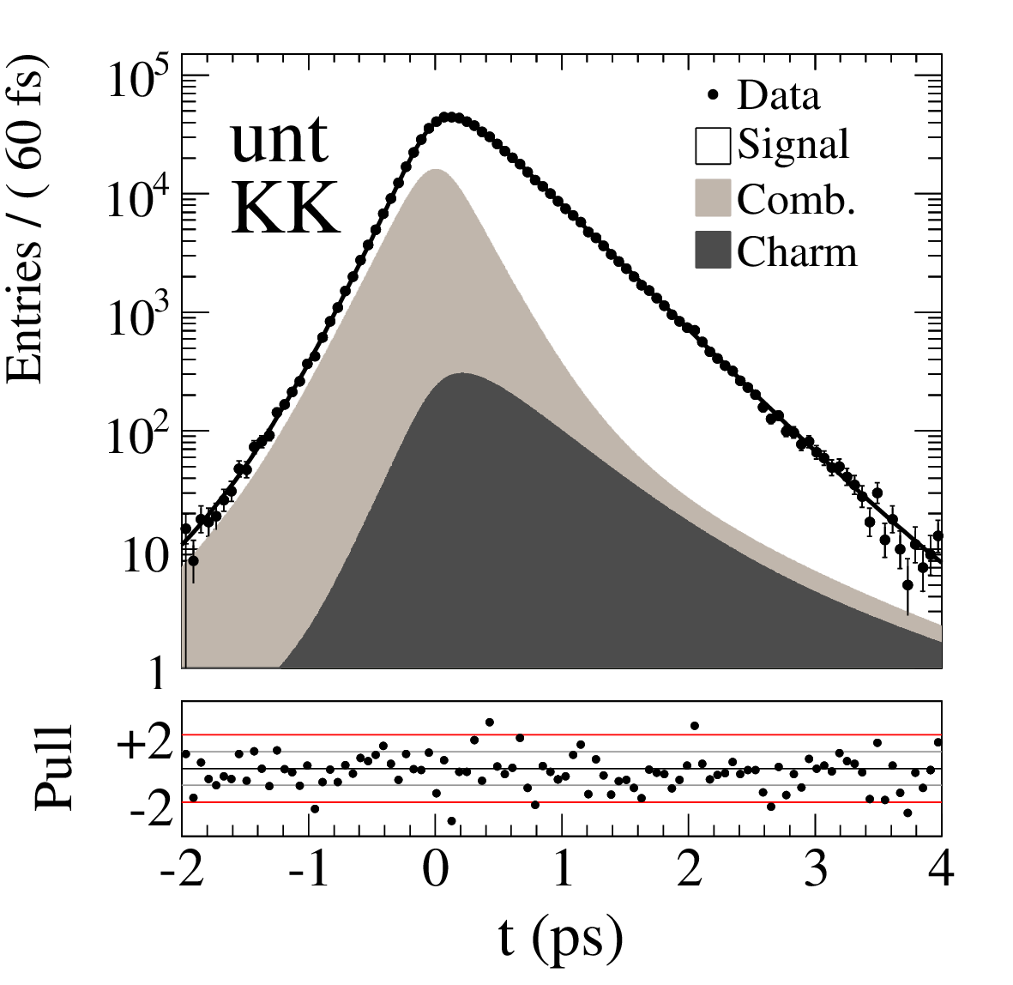
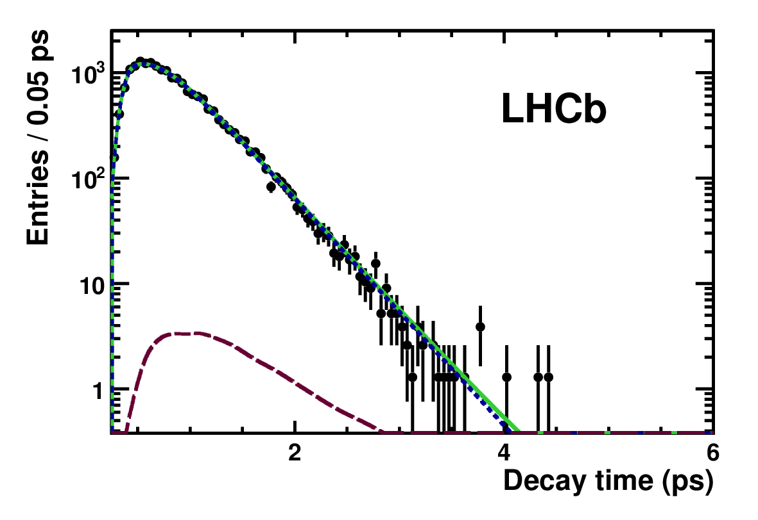
Time-dependent $D^{0}→h^{+}h^{−}$
$$y_{𝒞𝒫}≡η_{𝒞𝒫}\frac{\hat{Γ}\left(D^{0}→f\right)+\hat{Γ}\left({\overline{D}}^{0}→f\right)}{2\hat{Γ}\left(D^{0}→K^{−}π^{+}\right)}−1≈y\cos{φ} −\frac{1}{2}A_{m}x\sin{φ}$$
$$y_{𝒞𝒫}≈\frac{τ\left(D^{0}→K^{−}π^{+}\right)}{τ\left(D^{0}→K^{−}K^{+}\right)}−1$$
LHCb [1]*: $29 pb^{−1}, D^{∗+}→D^{0}π^{+}$
$$y_{𝒞𝒫}=\left(0.55±0.63±0.41\right)\%$$
BaBar [2]: $468 fb^{−1}$, $D^{0}→K^{∓}π^{±}, { K}^{−}K^{+}$, $π^{−}π^{+}$
$$y_{𝒞𝒫}=\left(0.72±0.18±0.12\right)\%$$
Belle [3]: $540 fb^{−1}$, $D^{0}→K^{∓}π^{±}, { K}^{−}K^{+}$, $π^{−}π^{+}$
$$y_{𝒞𝒫}=\left(1.31±0.32±0.25\right)\%$$
[2]
[1]
[1] JHEP 04, 129 (2012) (LHCb)
[2] Phys. Rev. D87, 012004 (2013) (BaBar)
[3] Phys. Rev. Lett. 98, 211803 (2007) (Belle)
*There are many other LHCb publications on $𝒞𝒫$ violation in the $D^{0}→h^{+}h^{−}$ modes

Slide 11
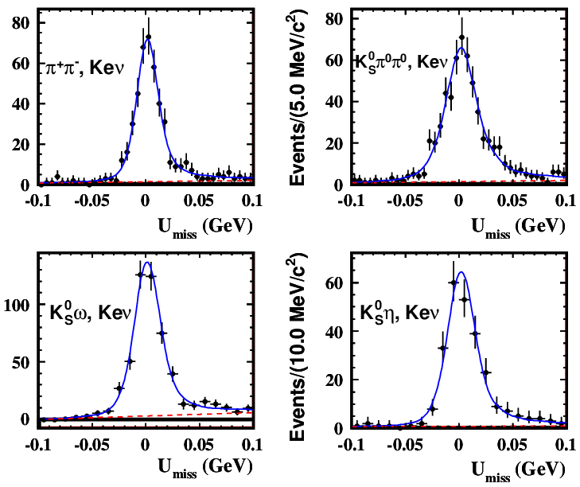
$D^{0}→f_{𝒞𝒫}$ with quantum correlations
$$y_{CP}≈\frac{1}{4}\left(\frac{ℬ\left(D_{𝒞𝒫−}→l\right)}{ℬ\left(D_{𝒞𝒫+}→l\right)}−\frac{ℬ\left(D_{𝒞𝒫+}→l\right)}{ℬ\left(D_{𝒞𝒫−}→l\right)}\right), ℬ\left(D_{𝒞𝒫∓}→l\right)=\frac{N_{CP±;l}}{N_{CP±}}⋅\frac{ε_{CP±}}{ε_{CP±;l}}$$
BESIII [1]:$2.92 fb^{−1} @ 3.773 GeV$
$$y_{𝒞𝒫}=\left(−2.0±1.3±0.7\right)\%$$
Single tag: ${D→f}_{𝒞𝒫}$
Quantum correlated
$${D\overline{D}→f}_{𝒞𝒫}+Klμ$$
Systematic uncertainty has statistical origin
[1] Phys. Lett. B744, 339 (2015)

Slide 12
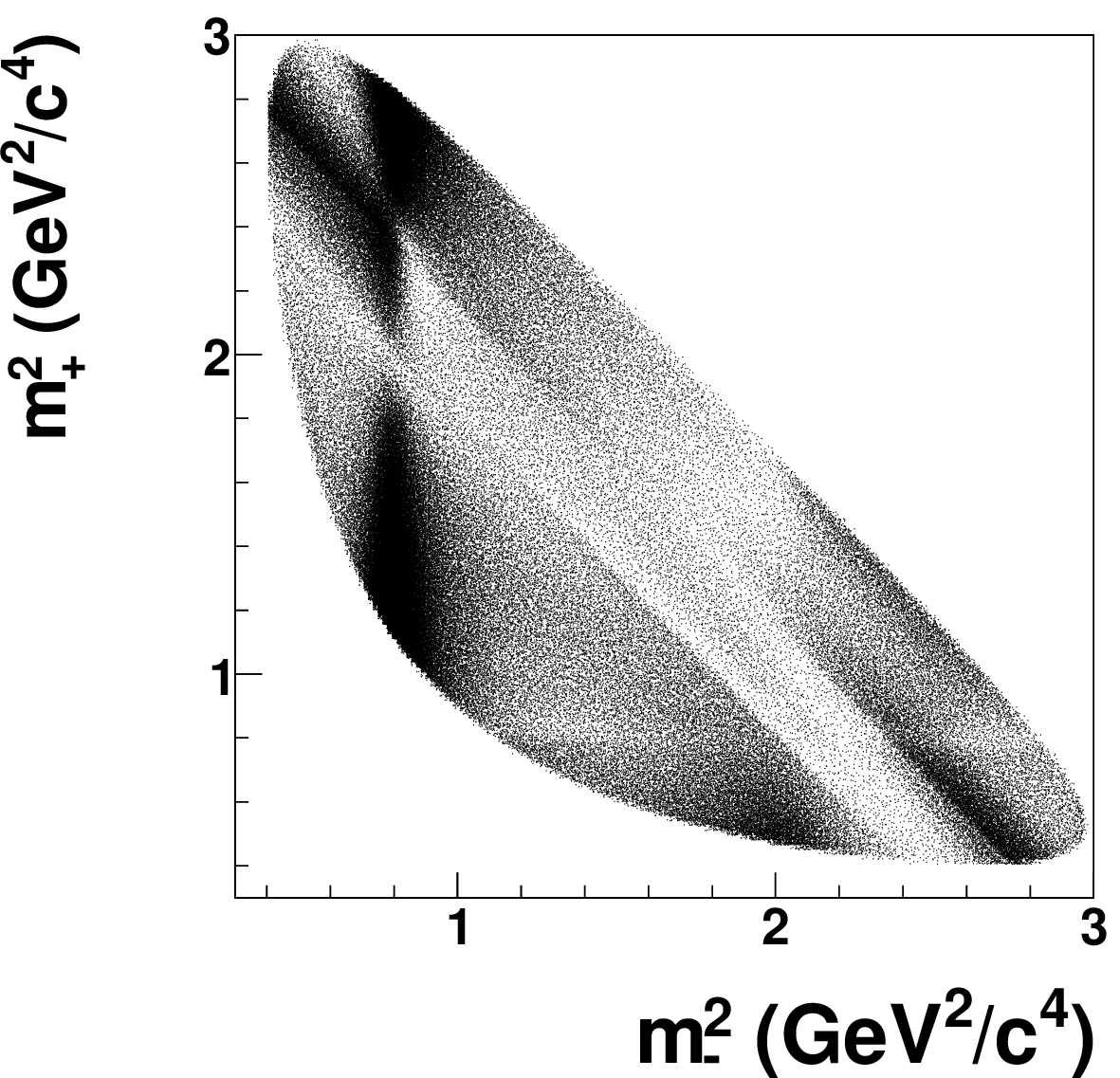
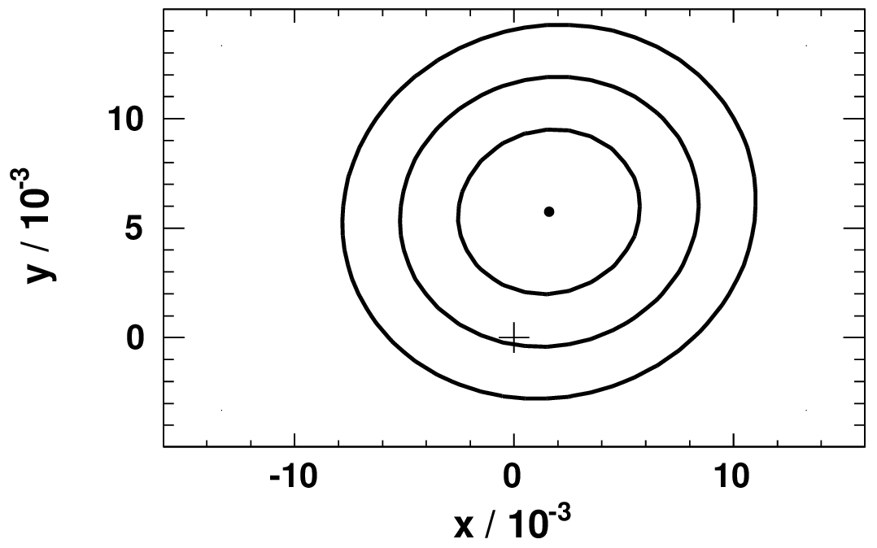
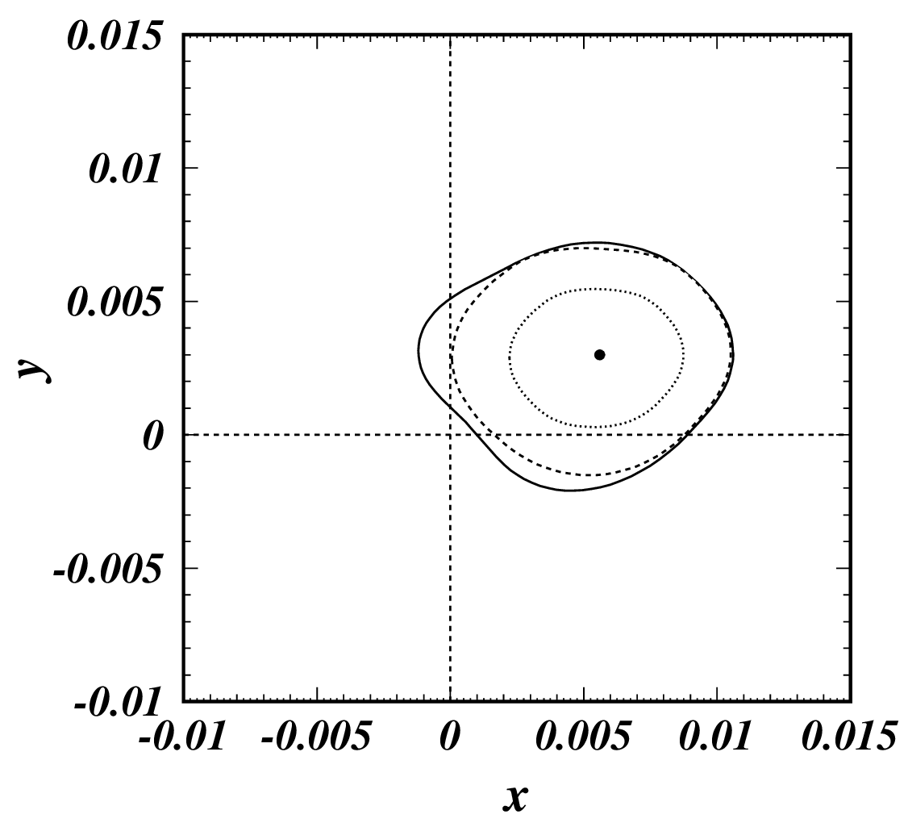
$D^{0}→K_{S}^{0}π^{+}π^{−}$ Dalitz plot analysis
Time-dependent Dalitz plot analysis
$$𝒫_{D}\left(t,m_{+}^{2},m_{−}^{2}\right)≈Γe^{−Γt }\left[{\left|𝒜_{D}\right|}^{2}−Γt Re \left(𝒜_{D}^{∗}𝒜_{\overline{D}}\left(y+ix\right)\right)\right]$$
Sensitivity to the charm mixing parameters due to the strong phase variation over the Dalitz plot
$𝒜\left(m_{+}^{2},m_{−}^{2}\right)$ from a $D^{0}→K_{S}^{0}π^{+}π^{−}$ decay model
BaBar [1]: $\text{468.5} fb^{−1}$, $D^{∗+}→D^{0}π^{+}$
$$x=\left(0.16±0.23±0.12±0.08\right)\%$$
$$y=\left(0.57±0.20±0.13±0.07\right)\%$$
Belle [2]: $\text{921} fb^{−1}$, $D^{∗+}→D^{0}π^{+}$
$$x=\left(0.56±0.19±0.08±0.08\right)\%$$
$$y=\left(0.30±0.15±0.05±0.07\right)\%$$
$$\left|q/p\right|=0.90±0.16±0.05±0.06$$
$$\arg\left(q/p\right)={\left(−6±11±3±4\right)}^{∘}$$
The most precise single measurement of the charm mixing parameters
[1]
[2]
[1] Phys. Rev. Lett. 105, 081803 (2010) (BaBar)
[2] Phys. Rev. D89, 091103 (2014) (Belle)

Slide 13
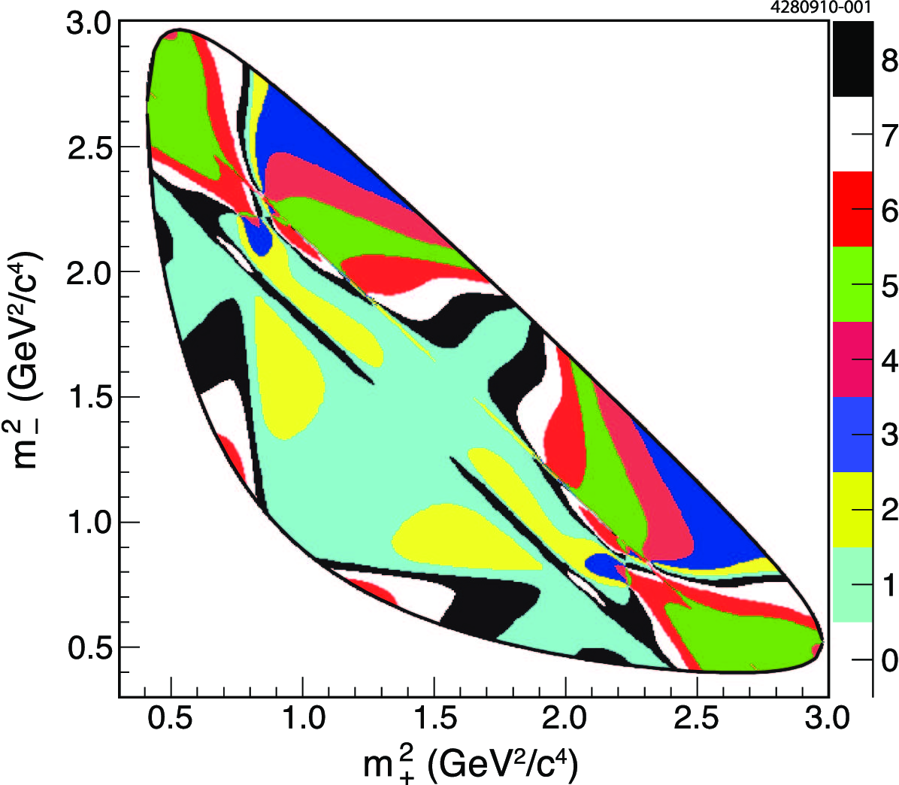
Model-independent Dalitz plot analysis
A way to eliminate (difficult to control) model dependency of a multibody decay analysis
[3]
Binned time-dependent Dalitz plot analysis [1,2]
$$𝒫_{D}\left(t,i\right)∝e^{−Γt }\left[K_{i}−Γt\sqrt{K_{i}K_{−i}}\left(C_{i}y+S_{i}x\right)\right]$$
$$𝒫_{\overline{D}}\left(t,i\right)∝e^{−Γt }\left[K_{−i}−Γt\sqrt{K_{i}K_{−i}}\left(C_{i}y−S_{i}x\right)\right]$$
$C_{i}$ and $S_{i}$ are measured in coherent $D^{0}{\overline{D}}^{0}$ pair decays [3]
CLEO-c [3]
LHCb [4]: $1.0 fb^{−1} @ 7 TeV$, $D^{∗+}→D^{0}π^{+}$
$$x=\left(−0.86±0.53±0.17\right)\%$$
$$y=\left(+0.03±0.46±0.13\right)\%$$
$$Z_{i}=\frac{\int_{D_{i}}{𝒜_{D}^{∗}𝒜_{\overline{D}} dm_{+}^{2}dm_{−}^{2}}}{\sqrt{\int_{D_{i}}{{\left|𝒜_{D}\right|}^{2}dm_{+}^{2}dm_{−}^{2}}⋅\int_{D_{i}}{{\left|𝒜_{\overline{D}}\right|}^{2}dm_{+}^{2}dm_{−}^{2}}}}$$
$$C_{i}=Re Z_{i},{ S}_{i}=Im Z_{i}$$
[1] Phys. Rev. D68, 054018 (2003)
[2] Phys. Rev. D82, 034033 (2010) (Bondar et al.)
[3] Phys. Rev. D82, 112006 (2010) (CLEO-c)
[4] JHEP 04, 033 (2016) (LHCb)
The first model-independent measurement of the charm mixing parameters

Slide 14
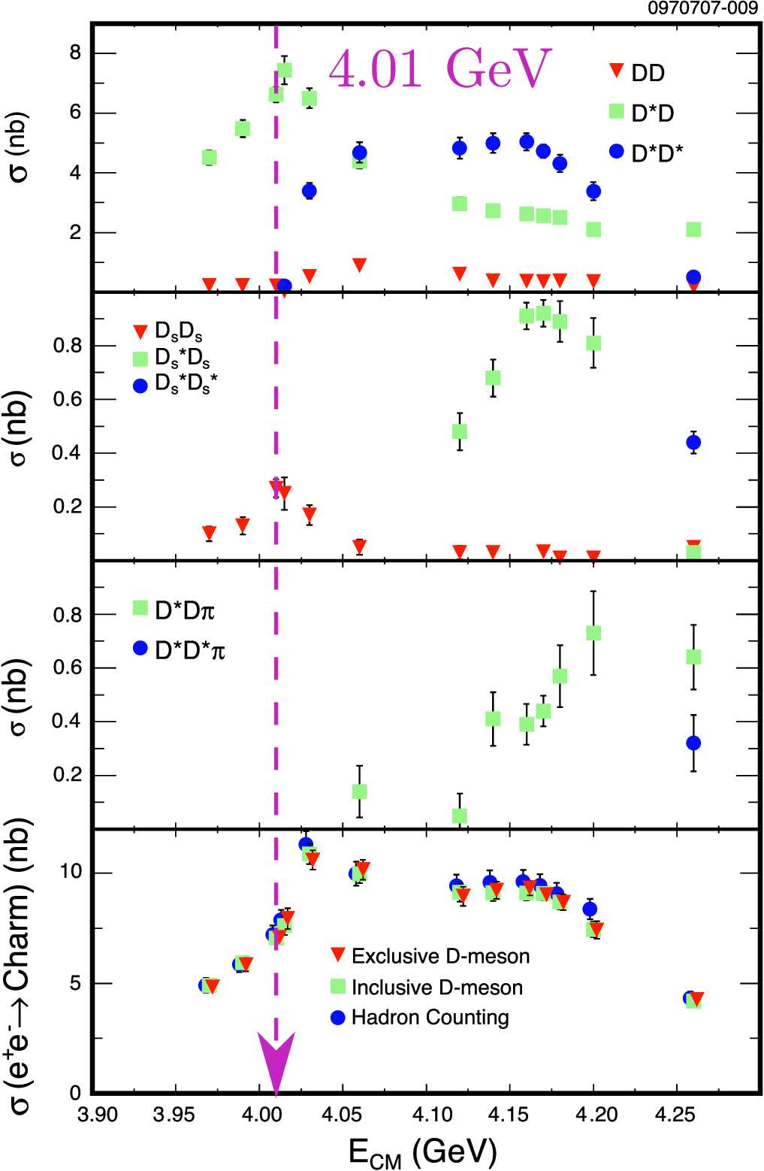
$D^{0}→K_{S}^{0}π^{+}π^{−}$ with quantum correlations
Coherent $𝒞=±1$ and non-coherent decays
$$e^{+}e^{−}→ψ\left(4040\right)→D{\overline{D}}^{∗}$$
Coherent $𝒞=−1$: $D^{0}{\overline{D}}^{∗0}→D^{0}{\overline{D}}^{0}π^{0}$
$$M_{ij}^{−}=K_{i}K_{−j}+K_{−i}K_{j}−2\sqrt{K_{i}K_{−j}K_{−i}K_{j}}\left(C_{i}C_{j}+S_{i}S_{j}\right)$$
Coherent $𝒞=+1$: $D^{0}{\overline{D}}^{∗0}→D^{0}{\overline{D}}^{0}γ$
$$M_{ij}^{+}=K_{i}K_{−j}+K_{−i}K_{j}−2\sqrt{K_{i}K_{−j}K_{−i}K_{j}}\left(C_{i}C_{j}+S_{i}S_{j}\right)$$
$$+2K_{j}\sqrt{K_{i}K_{−i}}\left(yC_{i}−xS_{i}\right)+2K_{−j}\sqrt{K_{i}K_{−i}}\left(yC_{i}+xS_{i}\right)$$
$$+2K_{i}\sqrt{K_{j}K_{−j}}\left(yC_{j}−xS_{j}\right)+2K_{−i}\sqrt{K_{j}K_{−j}}\left(yC_{j}+xS_{j}\right)$$
Incoherent $D^{−}D^{∗+} →D^{−}D^{0}π^{+}$
$$K_{i}^{′}=K_{i}+\sqrt{K_{i}K_{−i}}\left(yC_{i}+xS_{i}\right)$$
Measurement of the charm mixing and the phase parameters in a single experiment
CLEO-c [2]
[1] Phys. Rev. D82, 034033 (2010)
[2] Phys. Rev. D80, 072001 (2009) (CLEO-c)

Slide 15
The prospects
Estimates and expectations

Slide 16
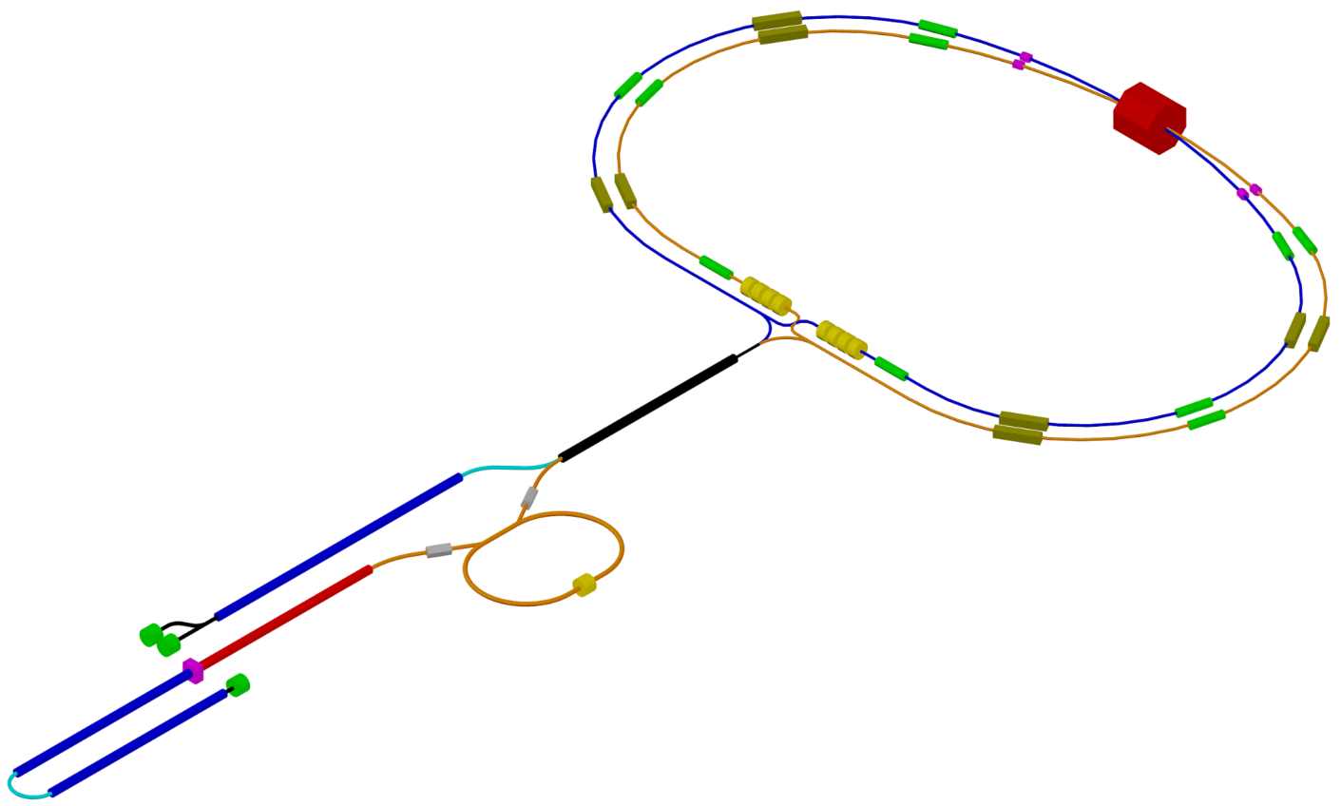
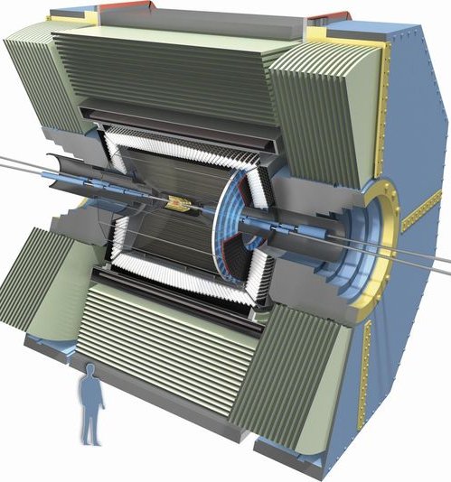
Future landscape
Super $c$-$τ$ factory
$$ℒ={10}^{35} {cm}^{−2}s^{−1}$$
Detector upgrade
Trigger improvements
Operation at higher luminosity (tens of $pp$ interactions per event)
Increased hermeticity and $K_{S}^{0}$ efficiency
Improved IP and $D$ vertex resolution, $K$/$π$ separation and $π^{0}$ reconstruction
Added PID and $μ$ ID in end caps
HIEPA
BINP Super 𝑐-𝜏 factory
w.r.t. Belle

Slide 17
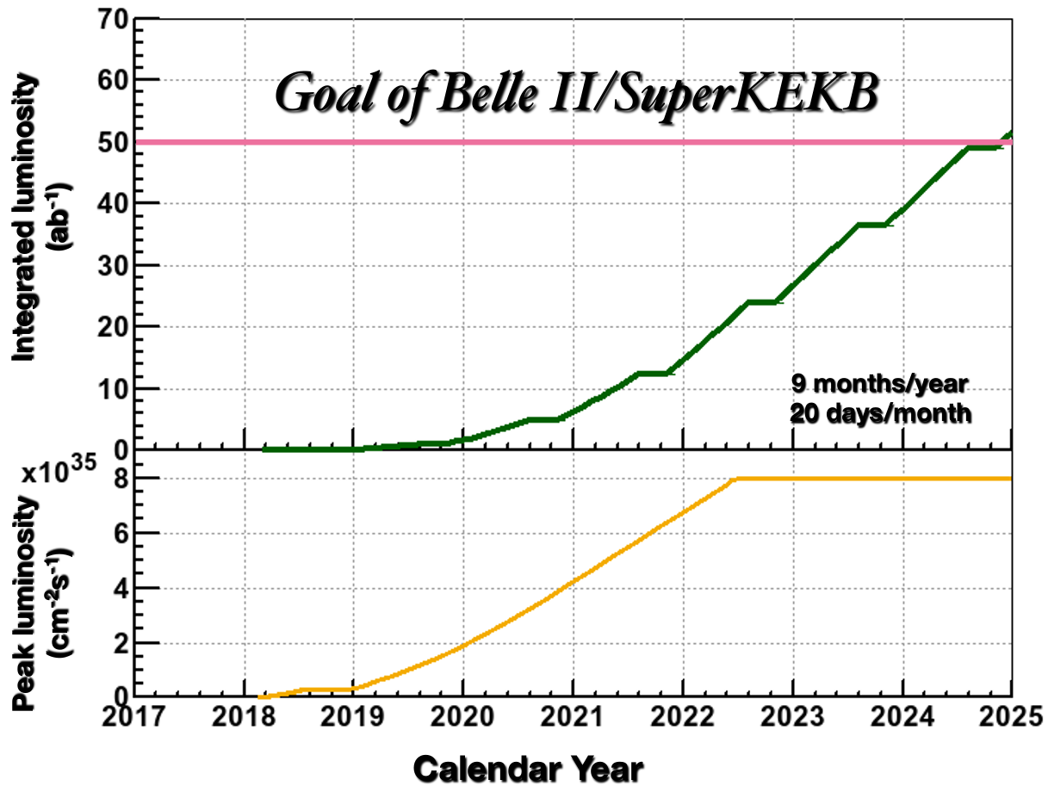
Timescale

Slide 18
Charm production
$σ\left(pp→D^{0}X\right) @ 13 TeV≈2 mb$
$σ\left(e^{+}e^{−}→c\overline{c}\right) @ Υ\left(4S\right)≈1.3 nb$
$σ\left(e^{+}e^{−}→c\overline{c}\right) @ ψ\left(3770\right)≈6 nb$
Parameter | Belle+BaBar ($1.5 ab^{−1}$) | Belle II ($50 ab^{−1}$) | LHCb ($5 fb^{−1}$) | LHCb (5$0 fb^{−1}$) | Super $c$-$τ$ ($10 ab^{−1}$)
Decay time
Incoherent decays
Coherent decays
$N\left(D^{0}→K^{−}π^{+}\right)$ untagged, ${10}^{6}$ |  |  |  | $40000$ [1] | $$100$$
$N\left(D^{∗+}→D^{0}π^{+}, D^{0}→K^{−}π^{+}\right)$, ${10}^{6}$ | $2.5$ [2] | $140$ [2] | $100$ [1] | $7000$ [1] | $20$*
$N\left(D^{+}→K^{−}π^{+}π^{+}\right)$, ${10}^{6}$ | $1.2$ [3] | $$40$$ | $150$ [1] | $11000$ [1] | $$200$$
$N\left(D_{s}^{+}→φπ^{+}\right)$, ${10}^{6}$ | $$0.5$$ | $$17$$ | $13$ [1] | $1000$ [1] | $$40$$
* Expected yield of $ψ\left(3770\right)→D^{0}{\overline{D}}^{0}→\left(K^{−}π^{+}\right)\left(K^{+}π^{−}\right)$ is shown for a Super $c$-$τ$ factory
[1] LHCb Collaboration, Eur. Phys. J. C73, 2373 (2013) «Implications of LHCb measurements and future prospects»
[2] Physics at Super B Factory, arXiv:1002.5012 [hep-ex]
[3] Phys. Rev. Lett. 102, 221802 (2009)

Slide 19
Future precision
Parameter | Belle II [1] $$@ 50 {ab}^{−1}$$ | LHCb [2] $$@ 50 fb^{−1}$$ | Super $c$-$τ$ $$@ 10 ab^{−1}$$
WS semileptonic
$$R_{M}$$ | $$𝒪\left(5×{10}^{−5}\right)$$ | $$𝒪\left(5×{10}^{−7}\right)$$ | ?
$D→Kπ$ WS decays
$$y, {10}^{−4}$$ |  |  | $$5$$
$$y^{′}, {10}^{−4}$$ | $$4$$ | $$2$$
$$\cos{δ_{Kπ}}$$ |  |  | $$5×{10}^{−3}$$
$$R_{D}, {10}^{−5}$$ | $$10$$ | $$0.2$$ | $$1$$
$$A_{D}, {10}^{−4}$$ | $$3$$ | ? | ?
$D→h^{+}h^{−}$ (𝒞𝒫 eigenstates)
$$y_{𝒞𝒫}, {10}^{−4}$$ | $$4$$ | $$0.4$$ | $$4$$
$$A_{Γ}, {10}^{−4}$$ | $$3$$ | $$𝒪\left(0.1\right)$$ | ?
$D^{0}→K_{S}^{0}π^{+}π^{−}$ Dalitz plot analysis
$$x, {10}^{−4}$$ | $$8$$ | $$1.7$$ | $$𝒪\left(1\right) [3]$$
$$y, {10}^{−4}$$ | $$5$$ | $$1.9$$ | $$𝒪\left(1\right) [3]$$
$$\left|q/p\right|$$ | $$0.06$$ | $$0.04$$ | $$𝒪\left(0.01\right) [3]$$
$$\arg\left(q/p\right)$$ | $$4^{∘}$$ | $$3^{∘}$$ | $$𝒪\left(1^{∘}\right) [3]$$
An order of magnitude precision improvement can be achieved in the next decade
The numbers shown are very approximate. Analysis of systematic uncertainties is needed
[1] “Physics at Super $B$ Factory”, arXiv:1002.5012 [hep-ex], talk by M. Staric @ KEK FF 2014
[2] “Implications of LHCb measurements and future prospects”, Eur. Phys. J. C73, 2373 (2013)
[3] A. Bondar et al., Phys. Rev. D82, 034033 (2010)

Slide 20
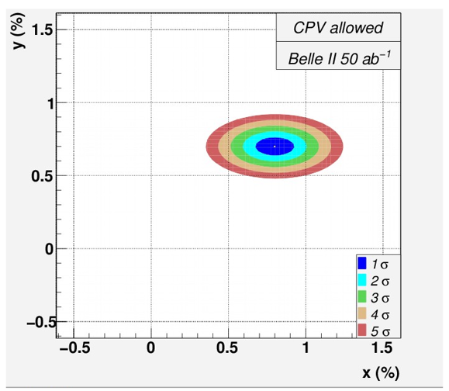
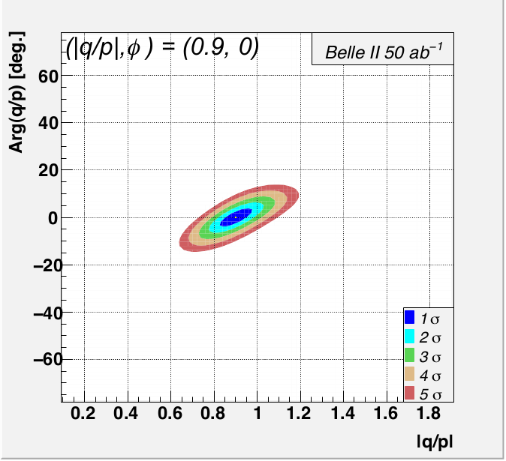
Global fit for Belle II @ $50 {ab}^{−1}$
Alan Schwartz, IXth CKM UT Workshop (Dec. 1, 2016)
No mixing
No CPV
Current fit
Year $2025$

Slide 21
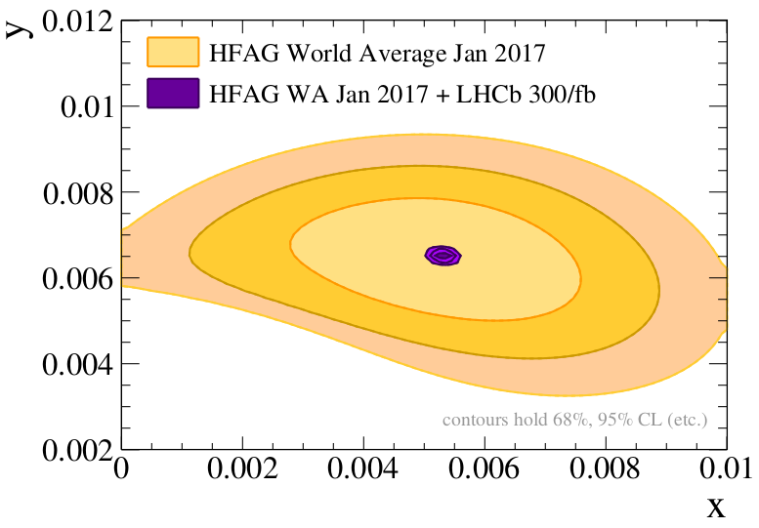
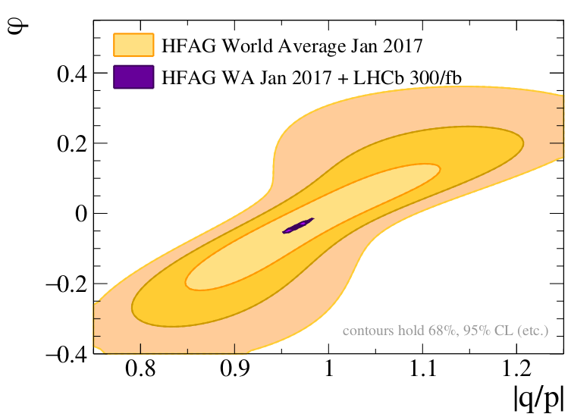
Global fit for LHCb Upgr. Phase II @ $300 {fb}^{−1}$
CERN-LHCC-2017-003 (Feb. 8, 2017)
Year $2035$+

Slide 22
Conclusions
Precise measurement of the charm mixing is a fundamental test of the SM
The existing measurements are consistent with the SM expectations
LHCb and Belle II are going to
measure the charm mixing parameters at the precision level of $𝒪\left({10}^{−4}\right)$
access 𝒞𝒫 violation in charm at the SM values ($A_{Γ}∼{10}^{−5}$)
A Super $c$-$τ$ factory with $ℒ={10}^{35} {cm}^{−2}s^{−1}$ is competitive for the charm mixing measurement
Measurements with quantum correlations will play an important role for the future charm mixing measurements

