Slide 1
Trigger efficiency study

Slide 2
Trigger channel
Channel | condition
0 | NEClus.GE.1, NETOF.GE.1, STrk_BB
1 | NBClus.GE.1, NBTOF.GE.2, NLtrk.GE.2
3 | BTOF_BB, LTrk_BB
4 | Etot_L, NBTOF.GE.1, NLtrk.GE.1
5 | NBClus.GE.1, NBTOF.GE.1, NLtrk.GE.2
8 | NClus.GE.1, BEtot_H
11 | NClus.GE.2, Etot_M

Slide 3
Trigger efficiency study
Pure neutral trigger, depend on Channel [8]&[11].
Total deposition energy dependent trigger efficiency is needed.
Control samples:
$p\overline{p}$, Trigger channel 3 (BTOF_BB, LTrk_BB) is requested
inclusive (N_{good}>2prong), Trigger channel 5 (NBClus.GE.1, NBTOF.GE.1, NLtrk.GE.2) is requested
Trigger efficiency：
$$ε_{trigger(8,11)}=\frac{N_{(sel,nclus≥2, trigdata[8]=1||tridata\left[11\right]=1)}}{N_{(sel, nclus≥2)}}$$
$$ε_{trigger(11)}=\frac{N_{(sel,nclus≥2, tridata\left[11\right]=1)}}{N_{(sel, nclus≥2)}}$$
$$ε_{trigger(8)}=\frac{N_{(sel,nclusb≥1, trigdata[8]=1)}}{N_{(sel, nclusb≥1)}}$$

Slide 4
Trigger efficiency from $p\overline{p}$
Selection of control sample
two charged tracks, identified as proton
|cos$θ|<0.8$
Momentum window applied
Data samples:
2015 R-scan data
2012 Jpsi data

Slide 5
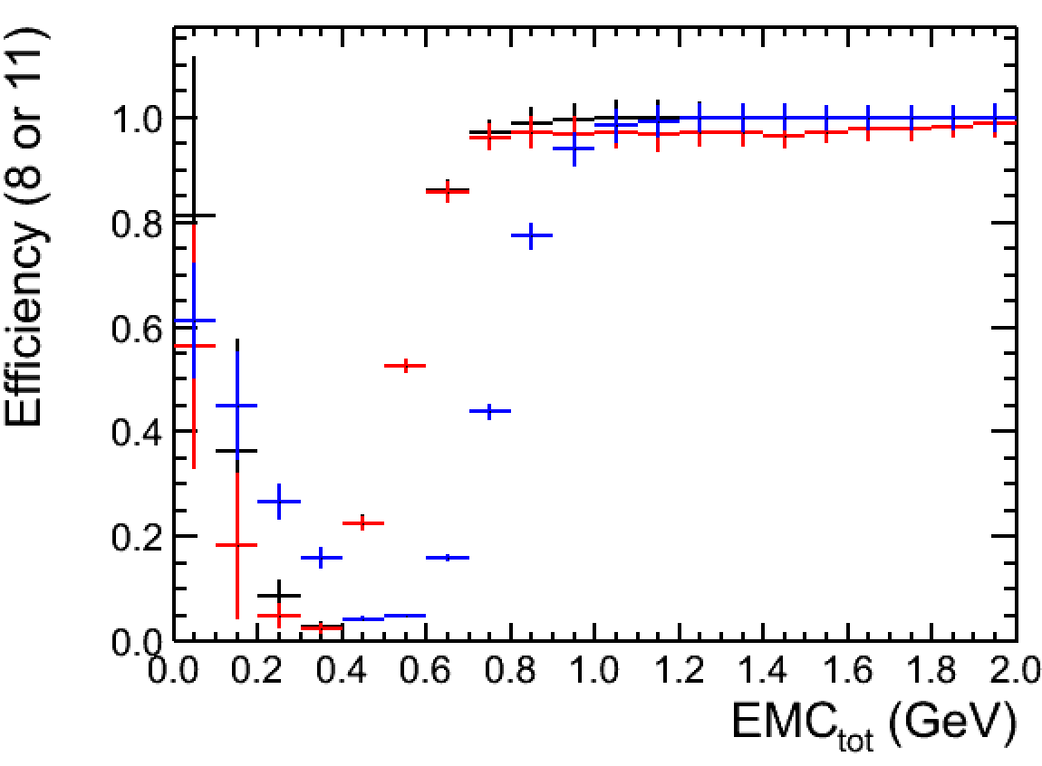
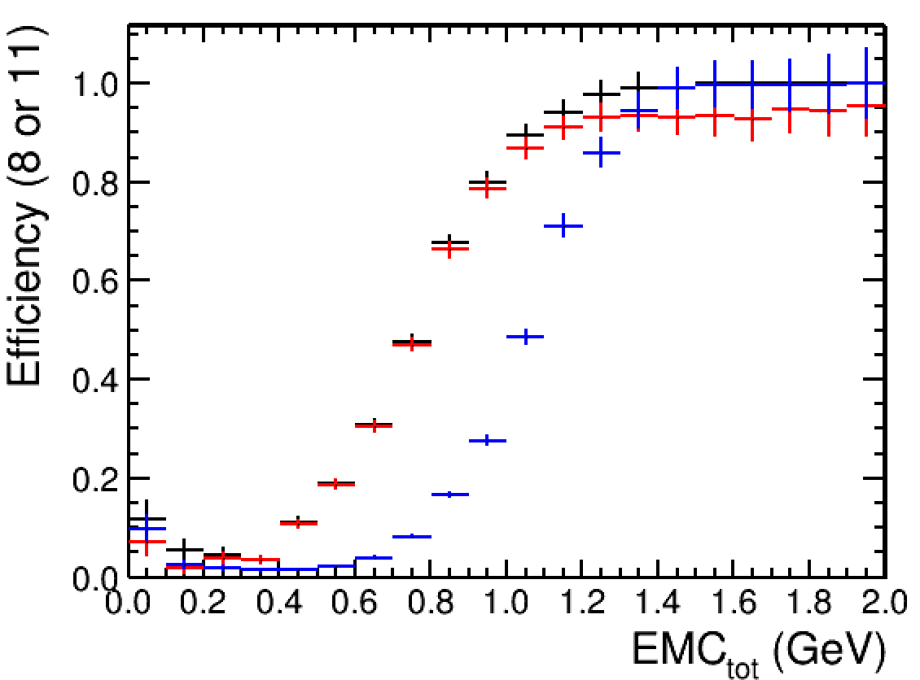
Trigger efficiency from $p\overline{p}$
Jpsi data set
[120410, 120526]
Rscan + 2.125 GeV
[141231, 150620]
black dot: trigger efficiency of channel8 and channel11 (Nclust>=2)
red dot: trigger efficiency of channel11 (Nclust>=2)
blue dot: trigger efficiency of channel 8 (Nclust in barrel >=1)

Slide 6
Trigger efficiency from inclusive final states
Selection of control sample
more than 2 charged tracks, at least one proton, one kaon or one pion
Data sets
all the data set since 2009 to 2017

Slide 7
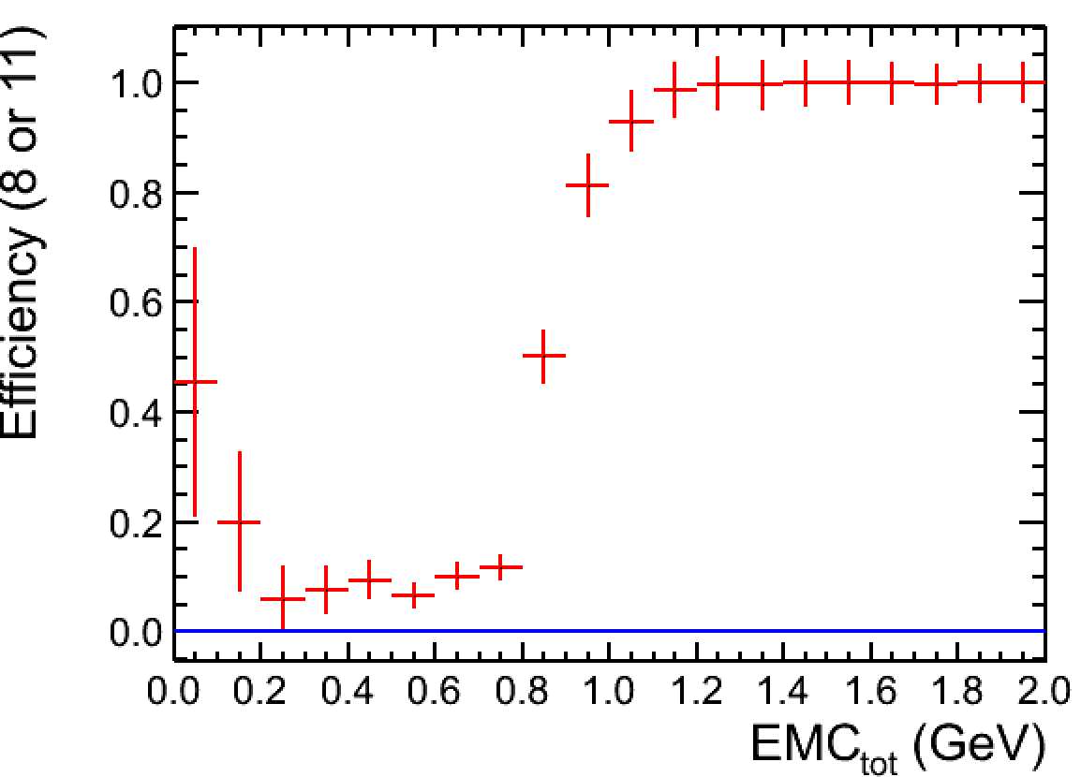
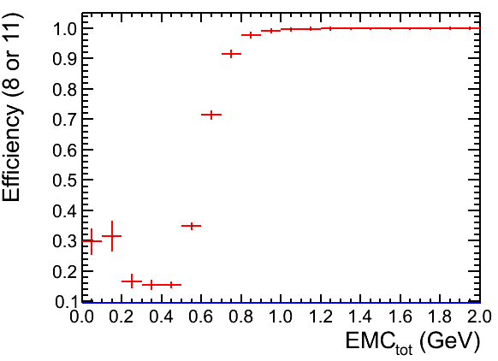
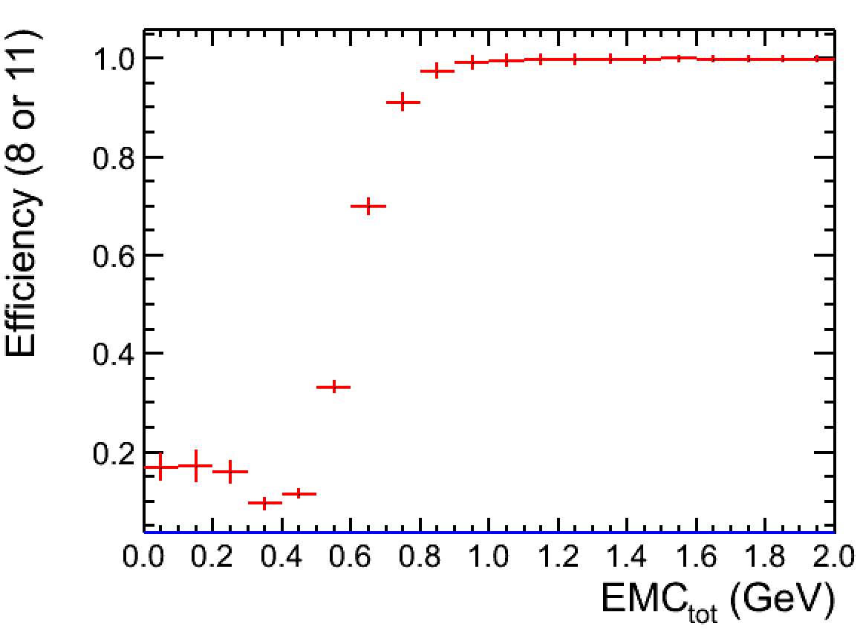
Trigger efficiency from inclusive final states
3.650 GeV
[090526, 090603]
Jpsi data set
[090612, 090728]
4.040 GeV
[110504, 110603]
The knee point appears at 0.8 GeV since J/psi data taking in 090612.

Slide 8
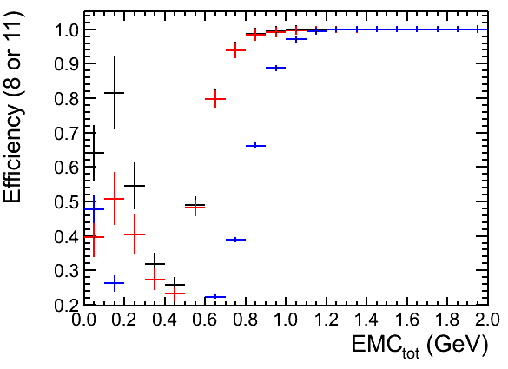
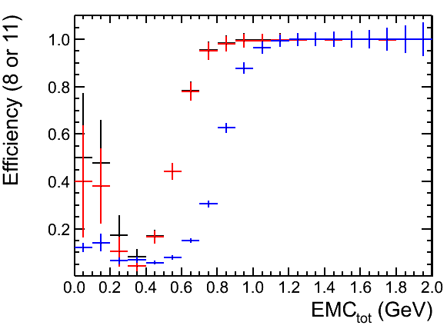
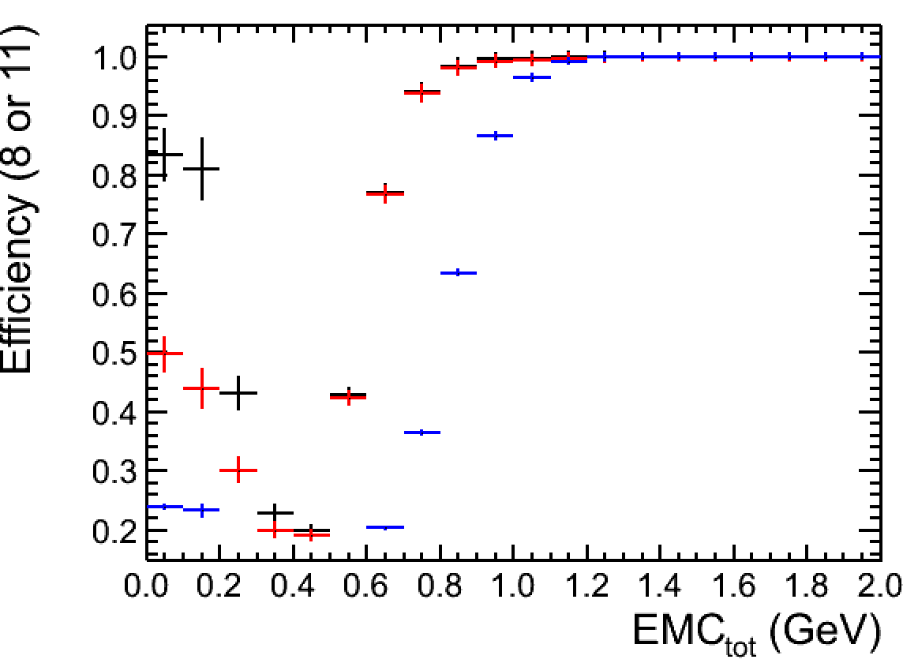
Trigger efficiency from inclusive final states
Jpsi data set
[120410, 120526]
rscan data set
[120608, 120616]
xyz data set
[121215, 130512]
Different energy points shows the same performance on trigger efficiency

Slide 9
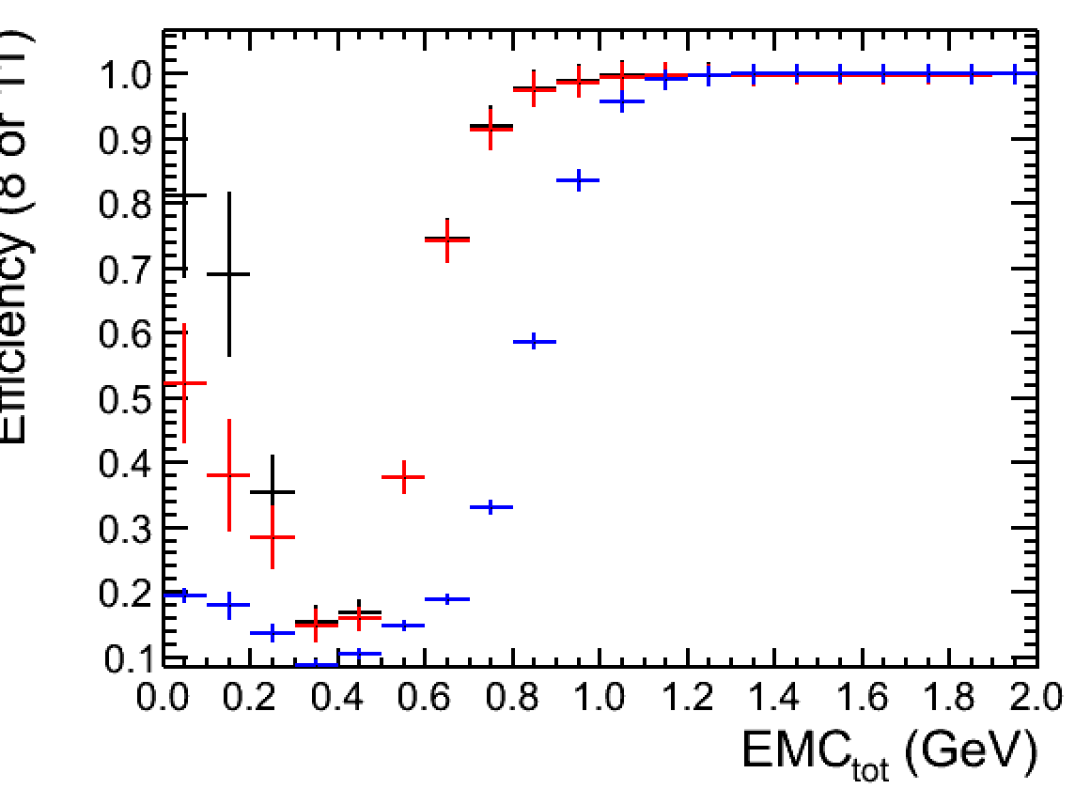
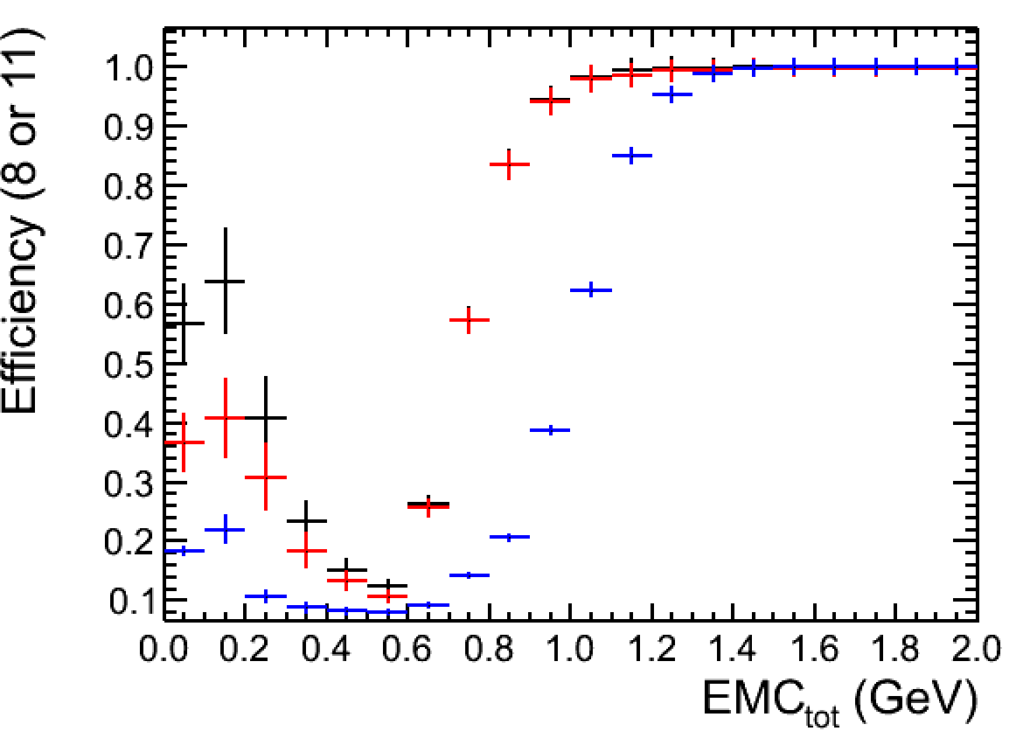
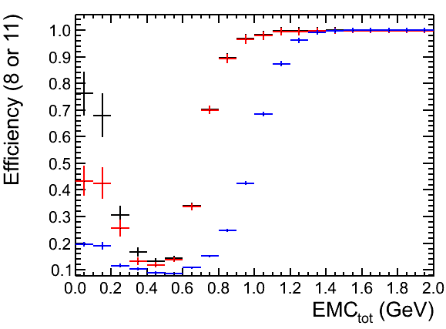
Trigger efficiency from inclusive final states
3.65 GeV
[130605, 130606]
rscan data set
[131210, 140131]
4.6 GeV
[140205, 140311]
There seems to be a change made since rscan data taking at [3.85, 4.6] GeV,
otherwise it is hard to understand the different knee point which is above 1.0 GeV

Slide 10
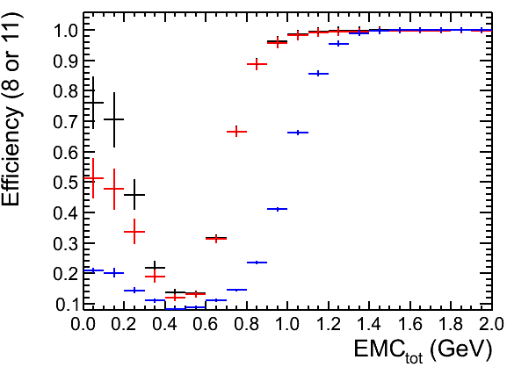
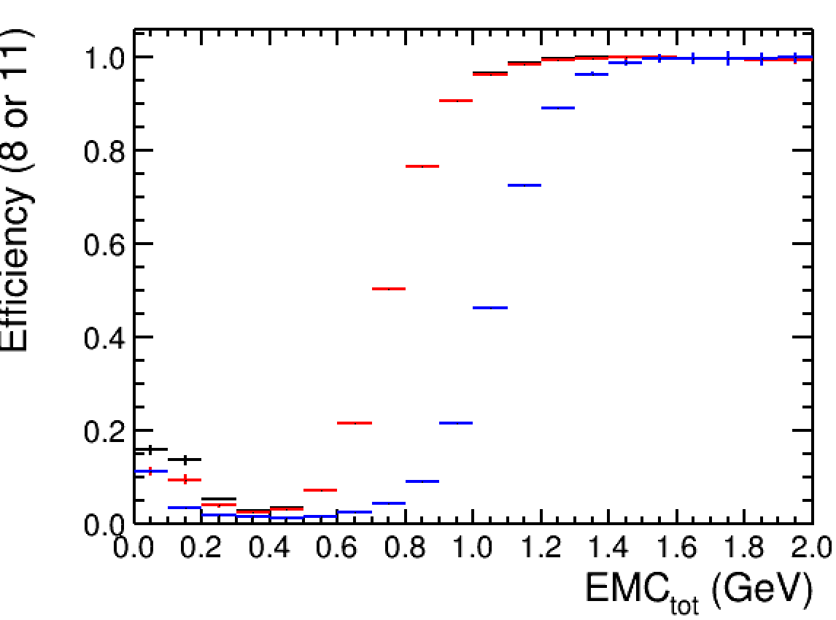
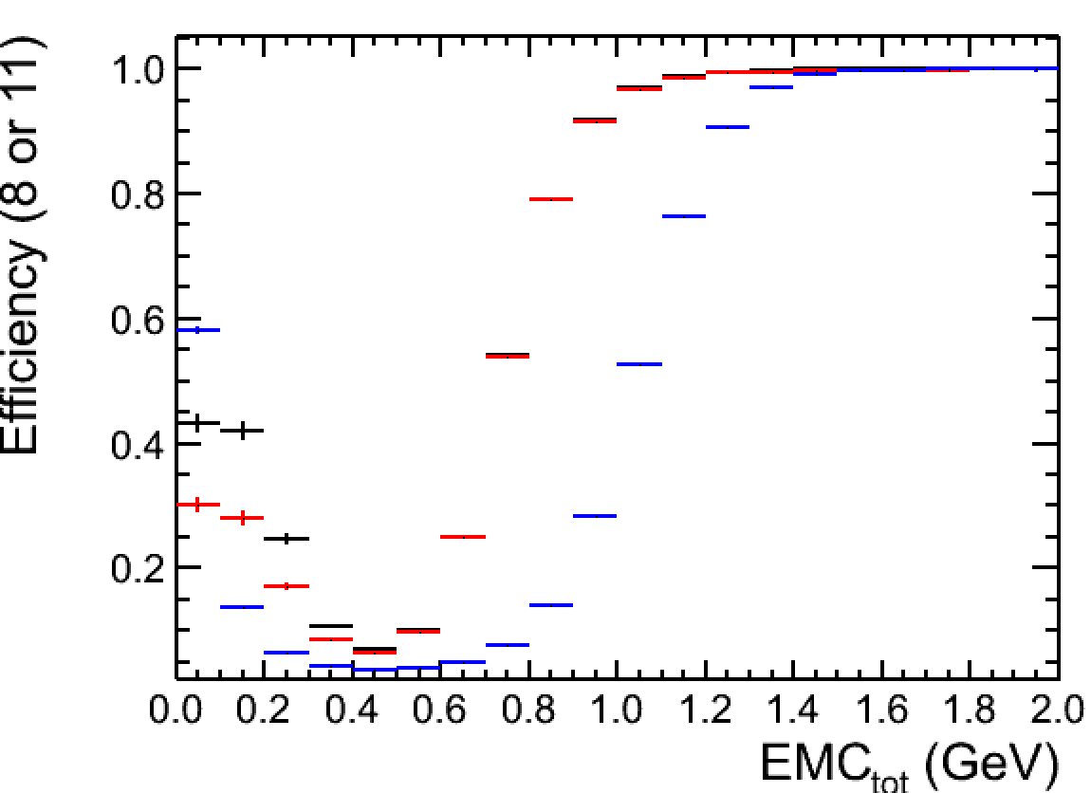
Trigger efficiency from inclusive final states
xyz data set
[140312, 140529]
2.125 GeV
[150501, 150620]
rscan data set
[141231, 150430]

Slide 11
Backup

Slide 12
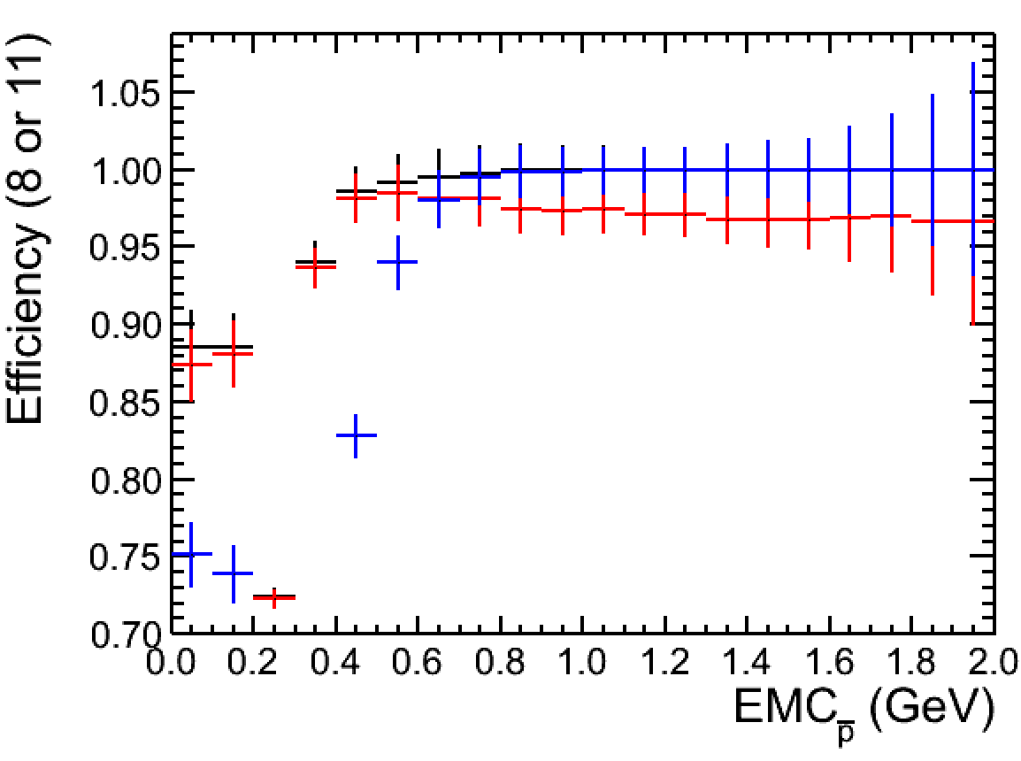
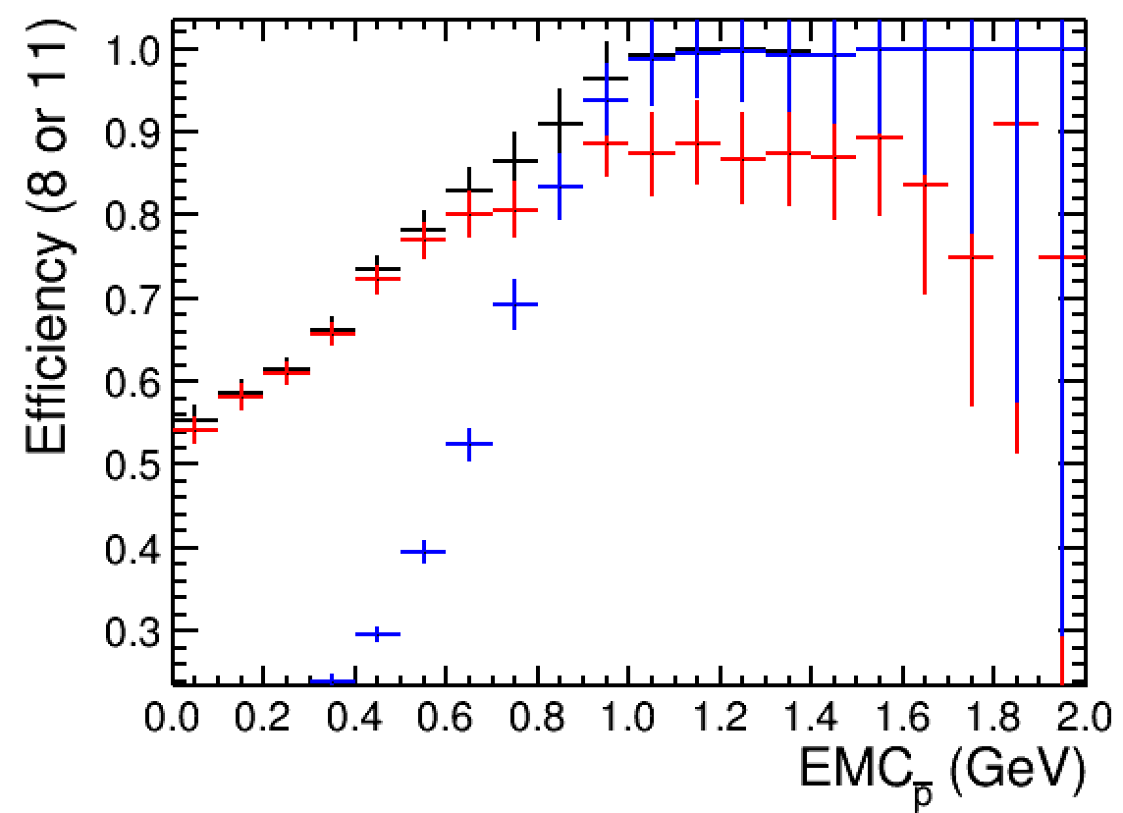
Trigger efficiency from $p\overline{p}$
Jpsi data set
[120410, 120526]
Rscan + 2.125 GeV
[141231, 150620]

