Slide 1
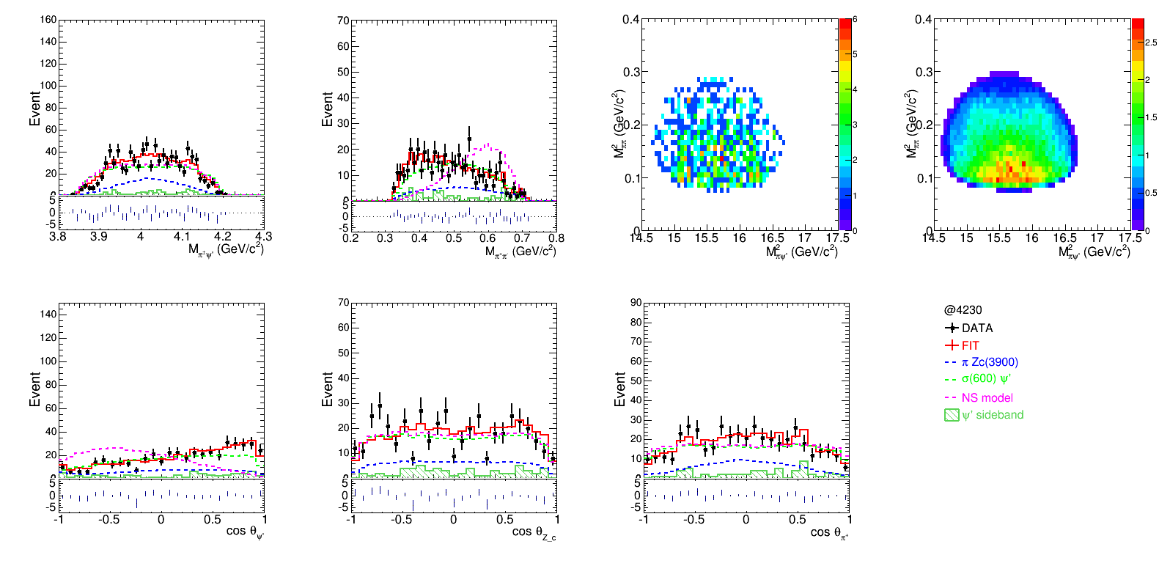

Slide 2
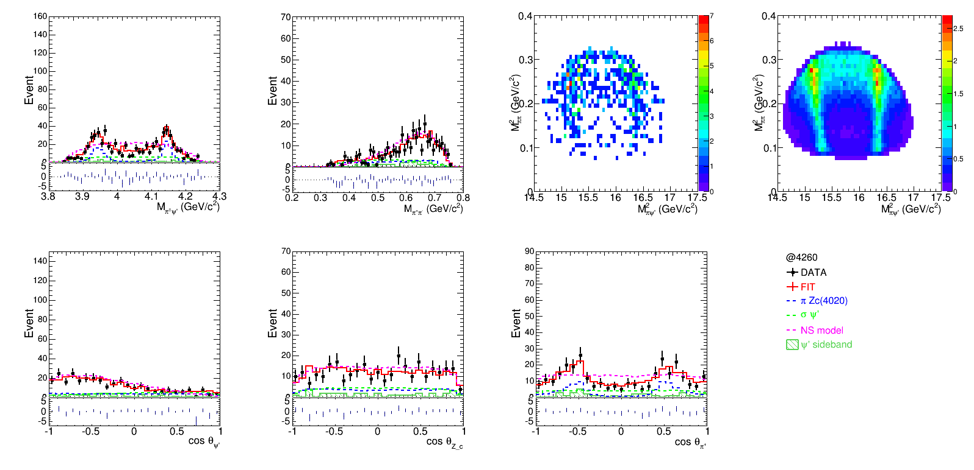

Slide 3
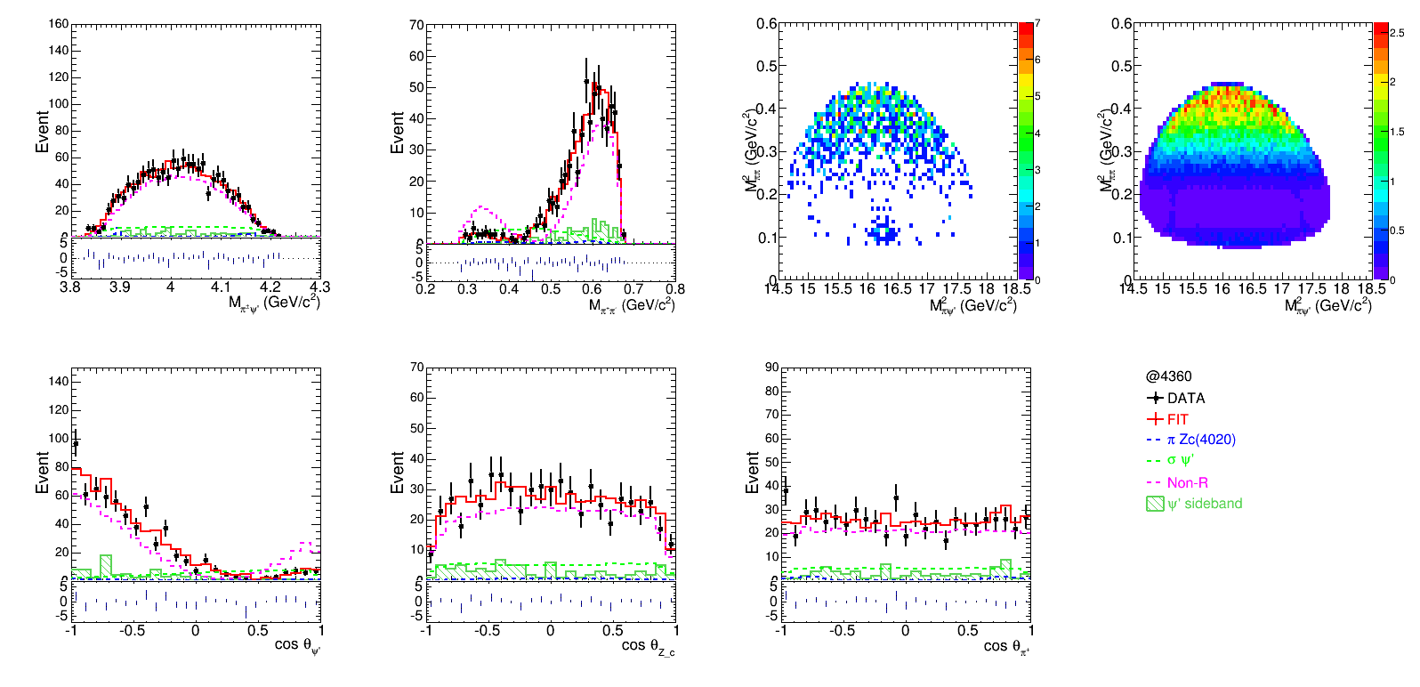

Slide 4
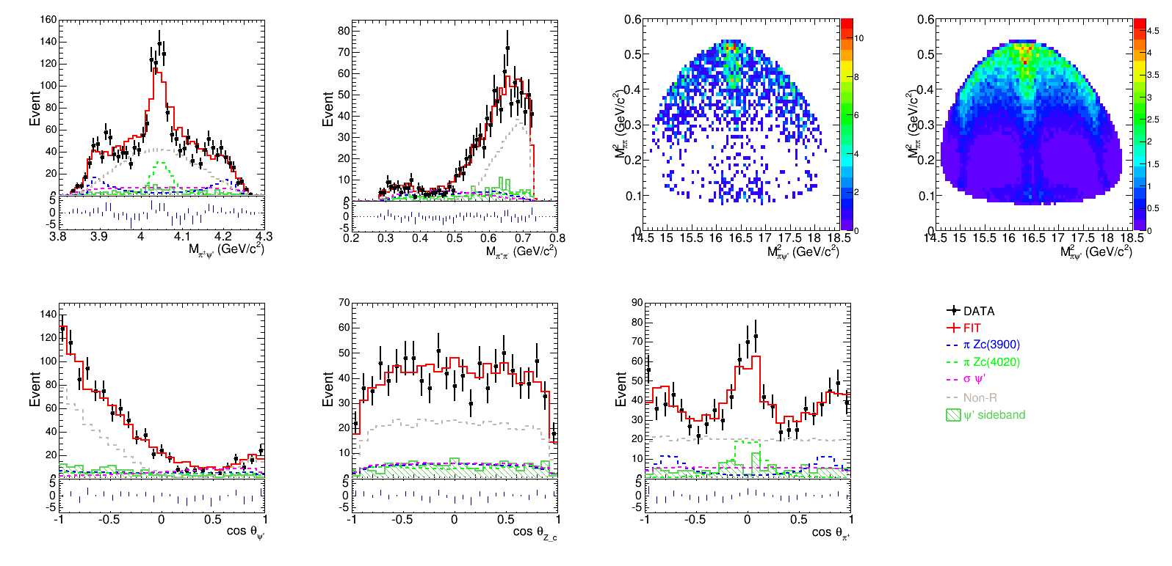

Slide 10
 | Charged mode |  | Neutral mode
 | Lxh weight | PWA | Lxh weight | PWA
4180 | 0.463 | 0.455 | 0.349 | 0.277
4230 | 0.458 | 0.458 | 0.342 | 0.312
4260 | 0.486 | 0.471 | 0.304 | 0.292
4360 | 0.491 | 0.472 | 0.378 | 0.378
4420 | 0.450 | 0.412 | 0.363 | 0.340

Slide 11
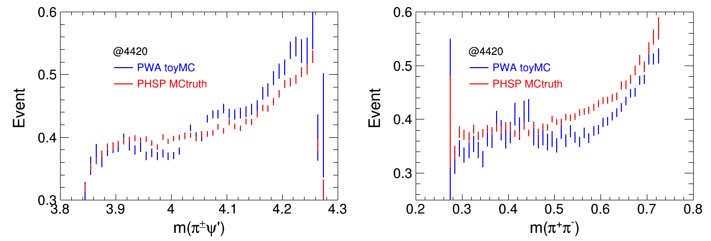
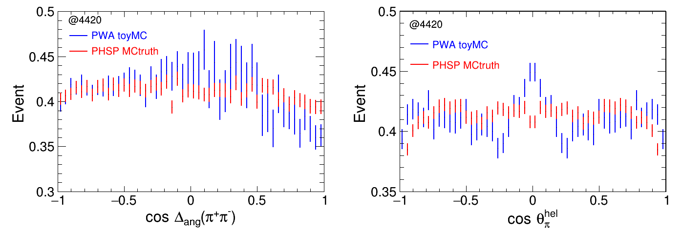

Slide 14
Relative efficiency
 |  |  | 6 charged tracks |  |  |  | 5 charged tracks
 | nGood=5/6 | Pid | Total | Vertex fit | 4C | 5C | Total | Vertex fit | 1C | 2C
Phsp | 0.824 | 0.907 | 0.610 | 0.964 | 0.713 | 0.841 | 0.390 | 0.973 | 0.901 | 0.776
Weight | 0.826 | 0.911 | 0.631 | 0.965 | 0.748 | 0.864 | 0.369 | 0.972 | 0.907 | 0.792
Pwa | 0.830 | 0.909 | 0.627 | 0.964 | 0.712 | 0.838 | 0.373 | 0.972 | 0.897 | 0.774
0.5<mpipi<0.7
 |  |  | 6 charged tracks |  |  |  | 5 charged tracks
 | nGood=5/6 | Pid | Total | Vertex fit | 4C | 5C | Total | Vertex fit | 1C | 2C
Phsp | 0.831 | 0,910 | 0.620 | 0.965 | 0.731 | 0.844 | 0.380 | 0.973 | 0.907 | 0.786
Weight | 0.831 | 0.911 | 0.629 | 0.965 | 0.754 | 0.856 | 0.371 | 0.973 | 0.912 | 0.794
Pwa | 0.833 | 0.910 | 0.625 | 0.964 | 0.724 | 0.830 | 0.375 | 0.971 | 0.902 | 0.778

Slide 15
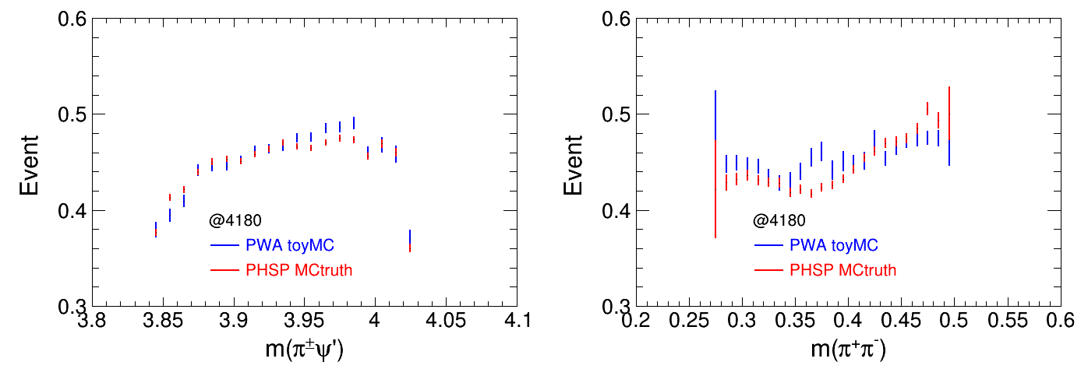
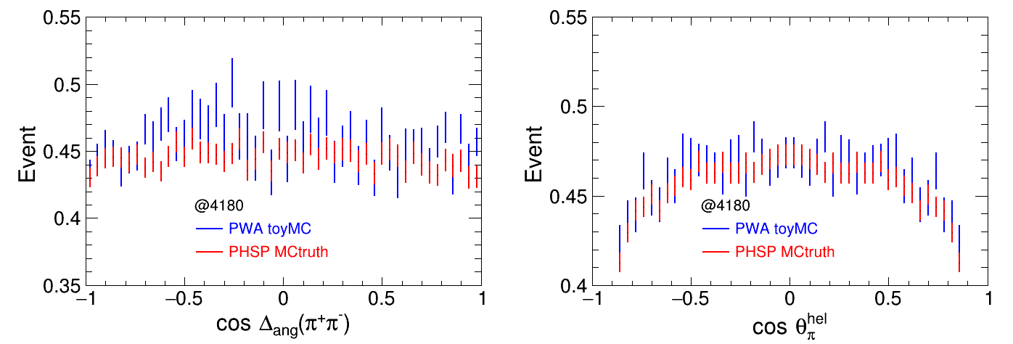

Slide 16
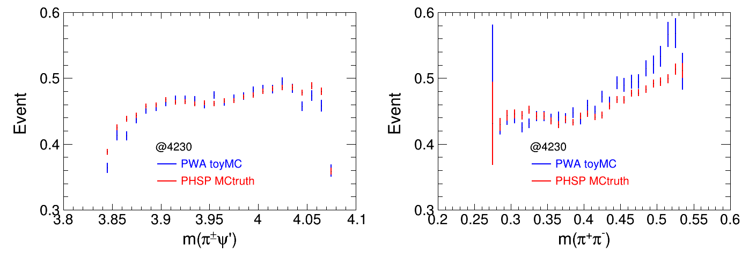
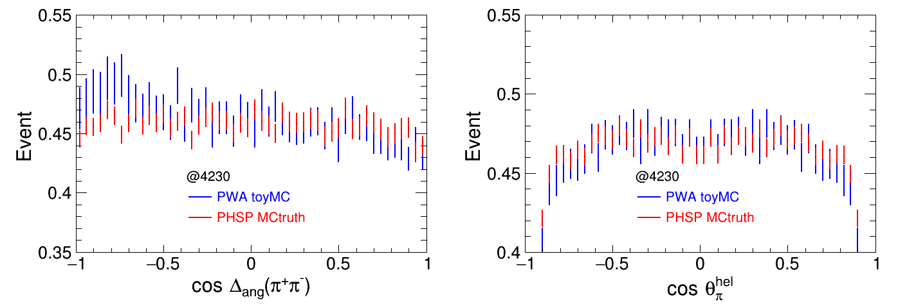

Slide 17
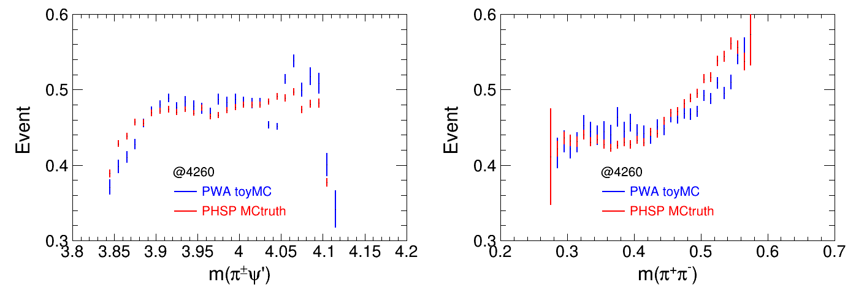
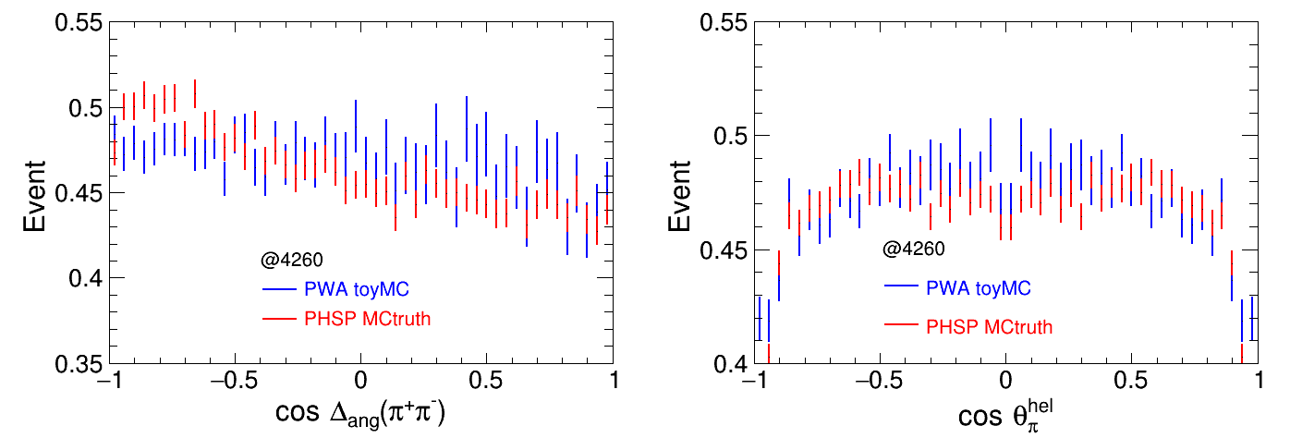

Slide 18
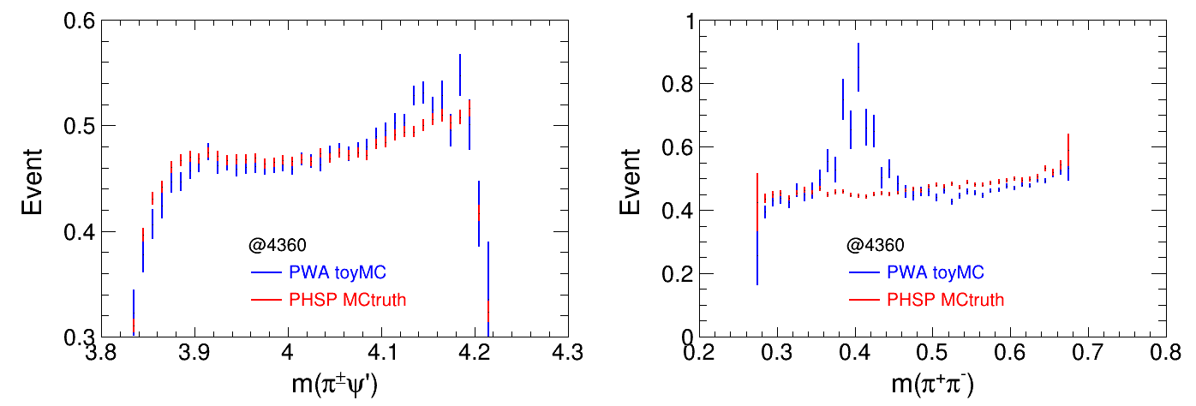
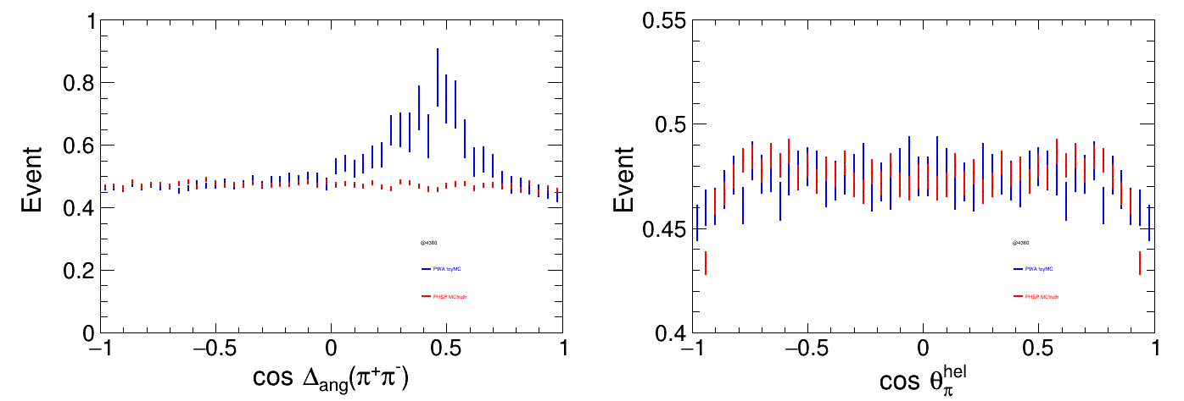

Slide 20
 | Charged mode |  | Neutral mode
 | Lxh weight | PWA | Lxh weight | PWA
4180 | 0.463 | 0.455 | 0.349 | 0.277
4230 | 0.458 | 0.458 | 0.342 | 0.312
4260 | 0.486 | 0.471 | 0.304 | 0.292
4360 | 0.491 | 0.472 | 0.378 | 0.378
4420 | 0.450 | 0.412 | 0.363 | 0.340

Slide 21
Relative efficiency
 |  |  | 6 charged tracks |  |  |  | 5 charged tracks
 | nGood=5/6 | Pid | Total | Vertex fit | 4C | 5C | Total | Vertex fit | 1C | 2C
Phsp | 0.824 | 0.907 | 0.610 | 0.964 | 0.713 | 0.841 | 0.390 | 0.973 | 0.901 | 0.776
Weight | 0.826 | 0.911 | 0.631 | 0.965 | 0.748 | 0.864 | 0.369 | 0.972 | 0.907 | 0.792
Pwa | 0.830 | 0.909 | 0.627 | 0.964 | 0.712 | 0.838 | 0.373 | 0.972 | 0.897 | 0.774
0.5<mpipi<0.7
 |  |  | 6 charged tracks |  |  |  | 5 charged tracks
 | nGood=5/6 | Pid | Total | Vertex fit | 4C | 5C | Total | Vertex fit | 1C | 2C
Phsp | 0.831 | 0,910 | 0.620 | 0.965 | 0.731 | 0.844 | 0.380 | 0.973 | 0.907 | 0.786
Weight | 0.831 | 0.911 | 0.629 | 0.965 | 0.754 | 0.856 | 0.371 | 0.973 | 0.912 | 0.794
Pwa | 0.833 | 0.910 | 0.625 | 0.964 | 0.724 | 0.830 | 0.375 | 0.971 | 0.902 | 0.778

Slide 22
Phsp MC without weighting

Slide 23
Phsp MC with weighting

Slide 24
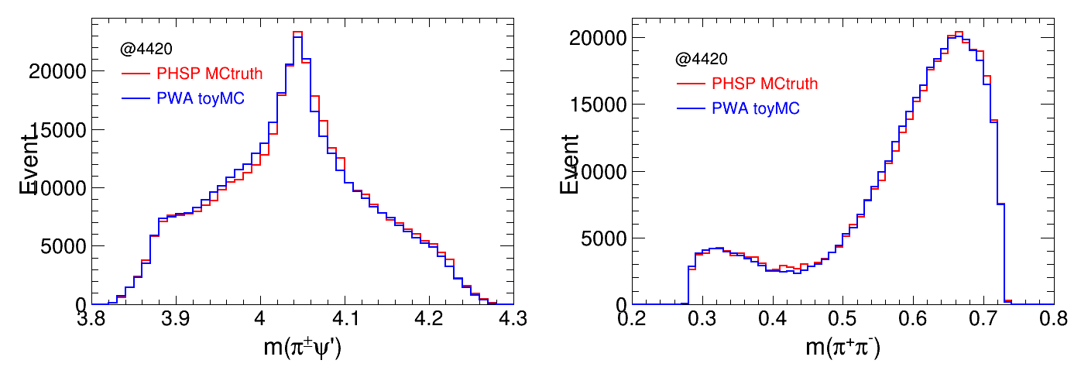
Instead of using data sample, use pwa MC to weight the phsp MC
Distributions of MC truth before cuts

Slide 25
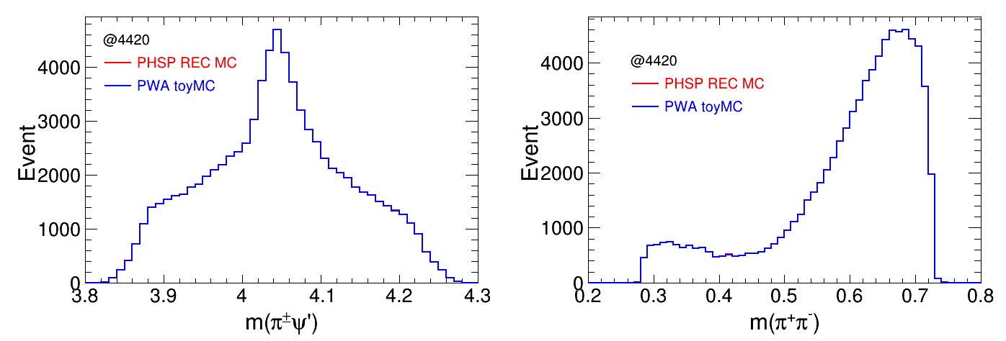
Distributions of MC truth after cuts

Slide 27
Instead of using mass spectrum, use invariant amplitude to weight the phsp MC
 | 2D mass weight | Amp weight | PWA | Relative eff 1(%) | Relative eff 2(%)
4230 | 0.458 | 0.458 | 0.458 | 0 | 0
4260 | 0.486 | 0.484 | 0.471 | 3.2 | 3.2
4360 | 0.491 | 0.489 | 0.472 | 4.0 | 3.6
4420 | 0.450 | 0.435 | 0.412 | 9.2 | 5.6

