Slide 1
Injection facility for Novosibirsk Super Charm Tau Factory
Dmitriy Berkaev
Budker Institute of Nuclear Physics SB RAS

Slide 2
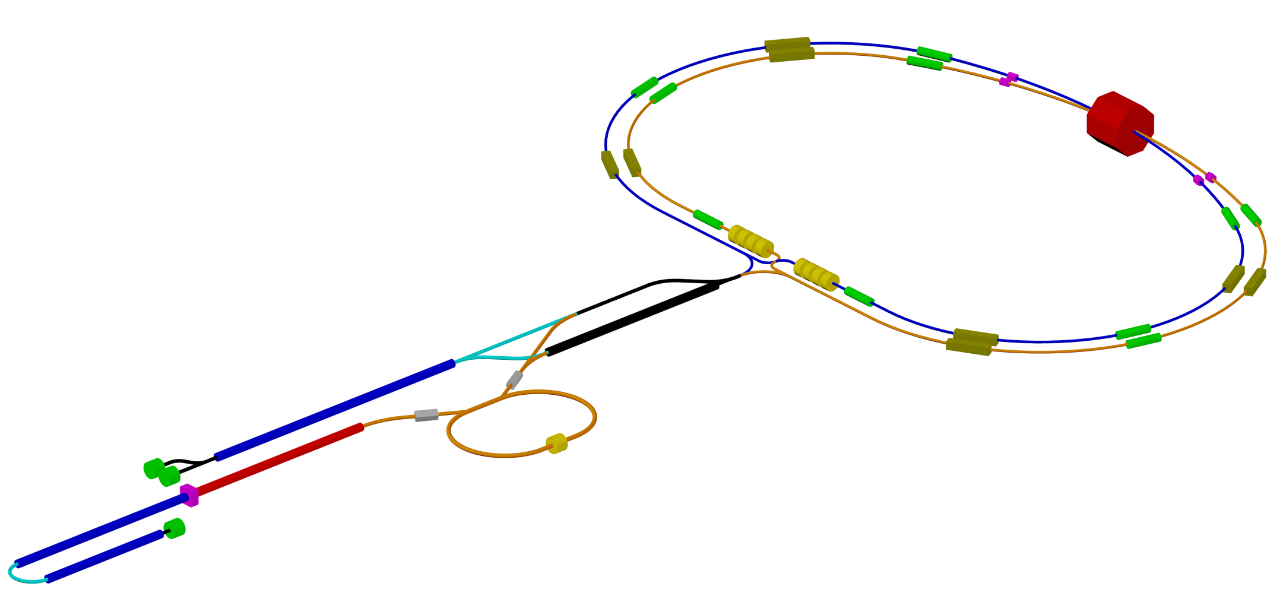
Super-CT Project
RF photogun: beam charge is 1 nC, laser length is 266 nm, laser energy is up to 3 mJ, laser pulse length is not more 10 ps, metallic cathode, beam energy is at least 5 MeV, beam energy spread for
total charge is not more 0.5%, rms beam length is about 1 mm (3 ps)
Accelerating structure: TW, constant impedance (geometry), length is 3 m, quasi-constant electric field distribution, energy gain is 22 MeV/m, beam energy per structure is 66 MeV
Klystron: peak power is 50 MW, repetition rate is 50 Hz, pulse length is up to 5 μs
RF module: 1 klystron, 2 accelerating strictures, electric field amplitude is 27 MV/m, gap between structures is 1 m
Thermionic gun: pulse length is up to 10 ns, peak current is about 8 A
Damping
Wiggler
Crab
Sext
IP
Damping
Wiggler
Crab
Sext
Siberian
Snake
e- 1.5 GeV Linac
AS – 24
Klystrons – 12
Length – 96 m
Drift channel for 1.5 GeV mode
RF System
Polarized e- Gun
1 GeV Linac
AS – 16
Klystrons – 8
Length – 72 m
Damping
Wiggler
Compressor
Damping
Wiggler
e- Photogun
1 nC, 3 ps
ΔE/E ~ 0.5 %
(total charge)
Debuncher
Damping Ring
e+ 1 – 1.5 GeV
e+ 1.5 GeV Linac
AS – 24
Klystrons – 12
Length – 96 m
Thermionic
Gun
Total number of accelerating structures: 104
Klystron number: 52
Total length of the linacs: ~440 m
e- 1 GeV + 1.5 Gev Linacs
AS – 16 + 24
Klystron – 8 + 12
Length – 72 m + 96 m

Slide 3
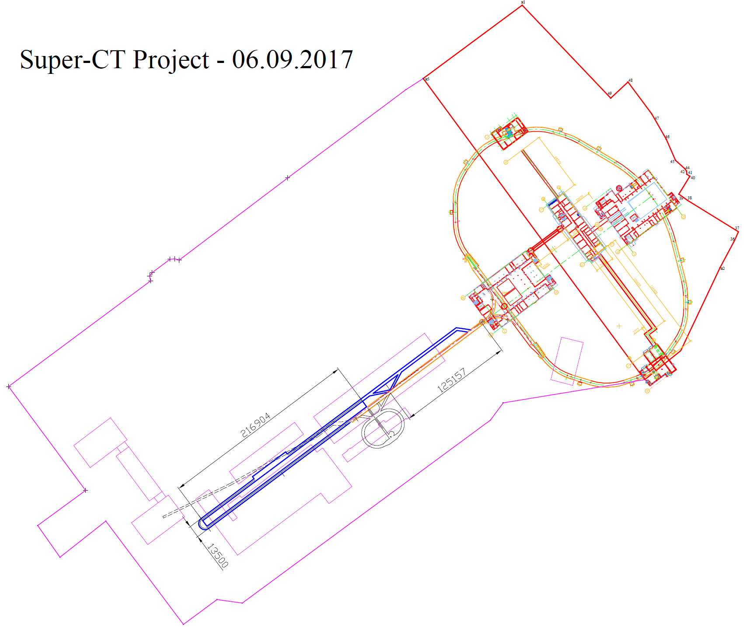
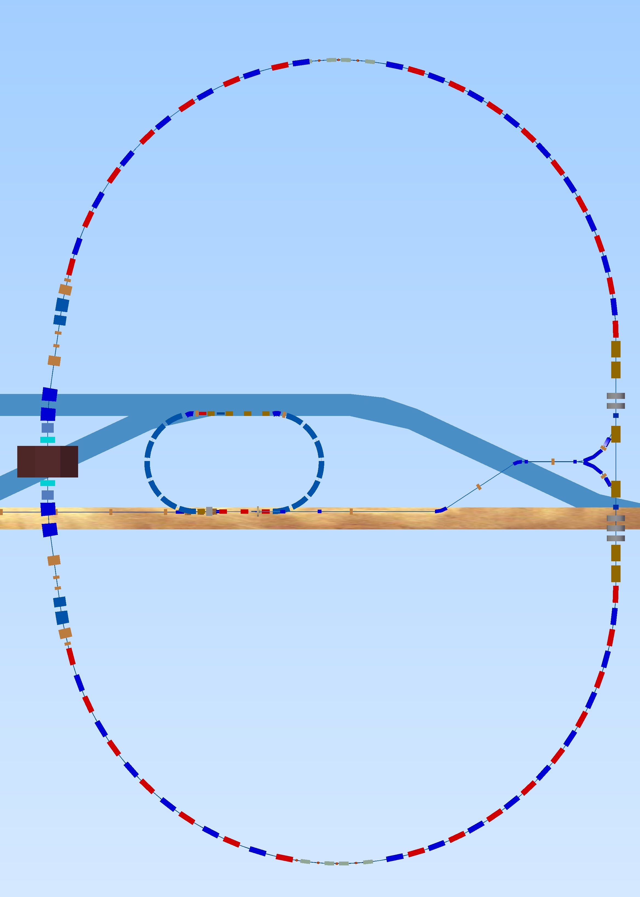
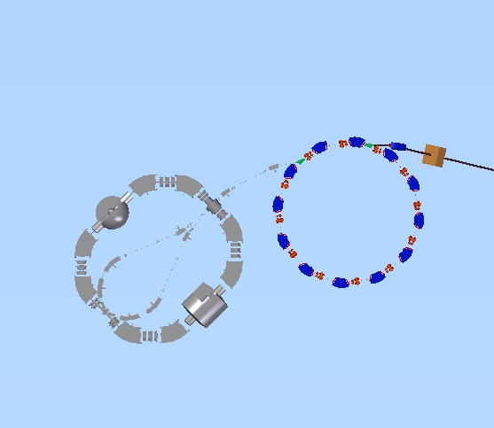
Location of the new Facility
BINP Main Building
VEPP-4M
Collider
VEPP-2000
Collider
SCT Factory
SCT Injector

Slide 4
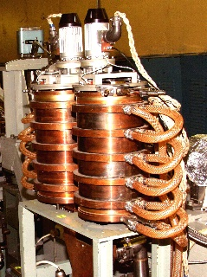
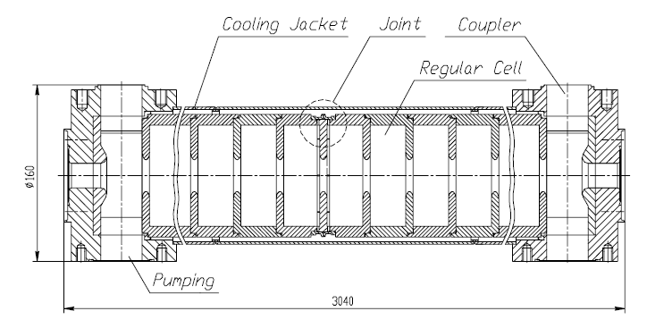
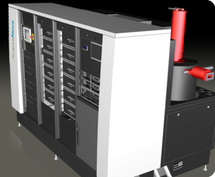
Accelerating Module
RF Load
Acceleration
Structure
SLED
RF Amplifier
Control Module
Modulator
Klystron
23 MeV/m
134 MeV/module

Slide 5
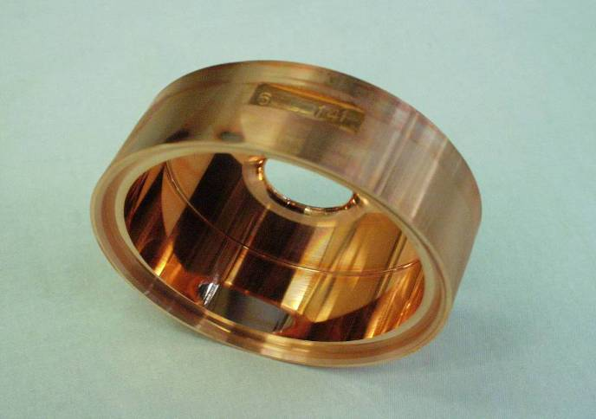
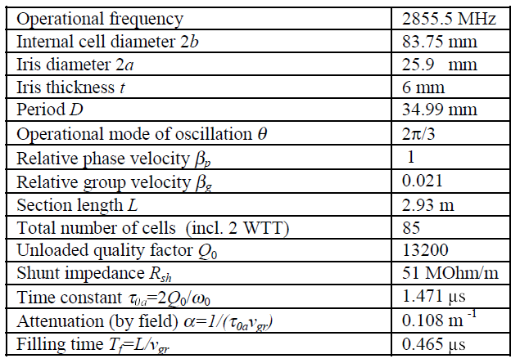
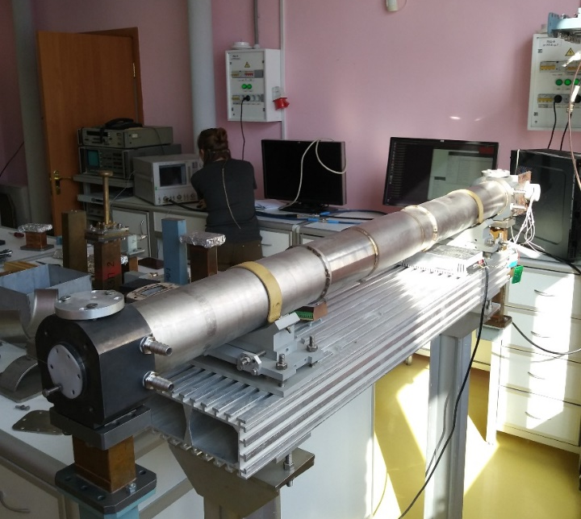
Accelerating Structure
Accelerating Cell
Total number of accelerating structures: 104
The Structure at the Testing Stand (2018)

Slide 6
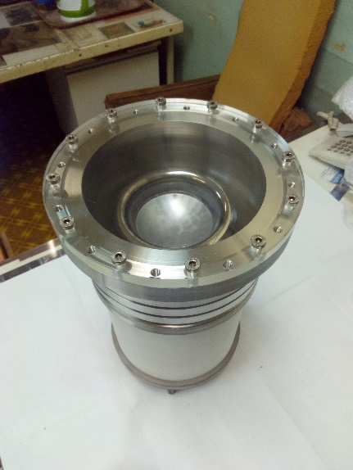
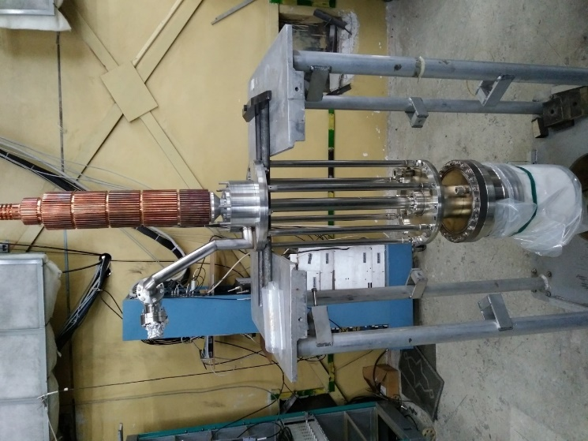
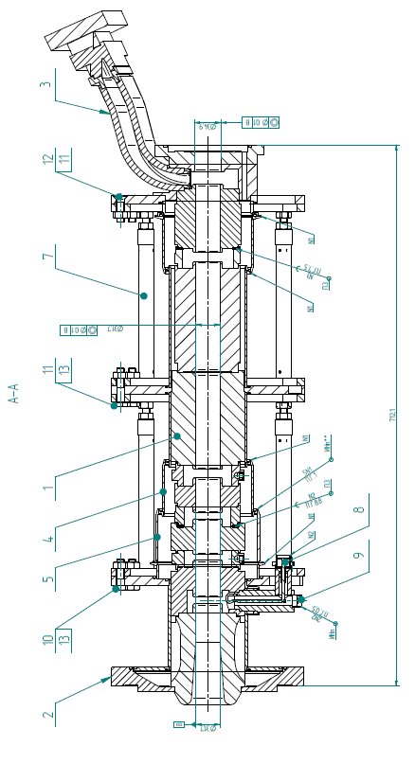
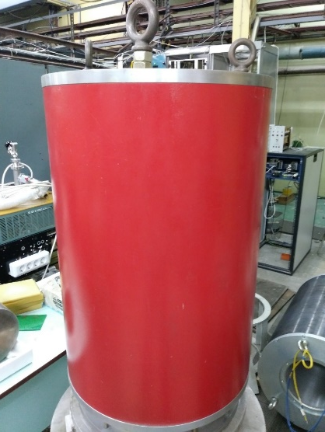
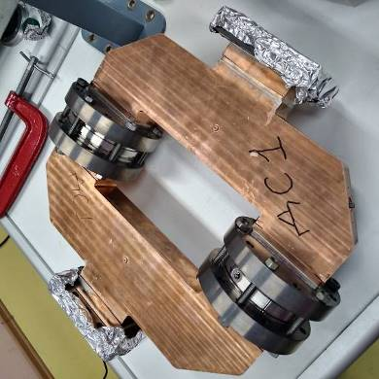
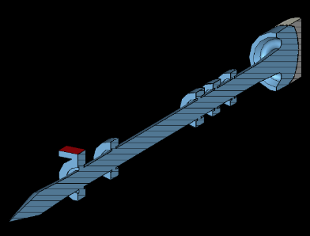
“5045 SLAC” Klystron
Cathode Module
Drift Tube with Collector
Resonators
Focusing Solenoid
Parameters:
50 MW
2856 MHz
5 mks
50 Hz
Klystron number: 52
RF Windows

Slide 7
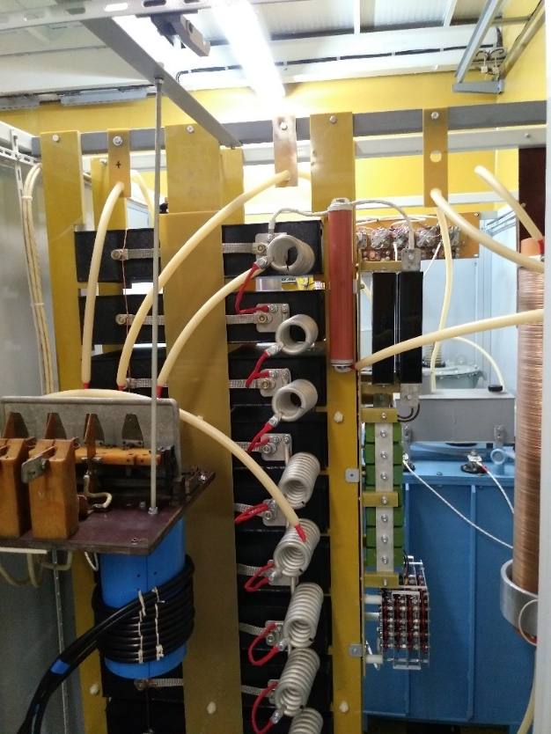
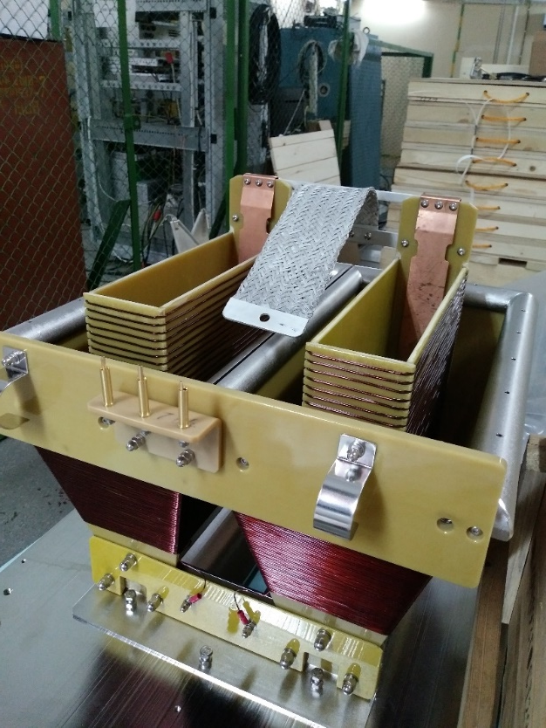
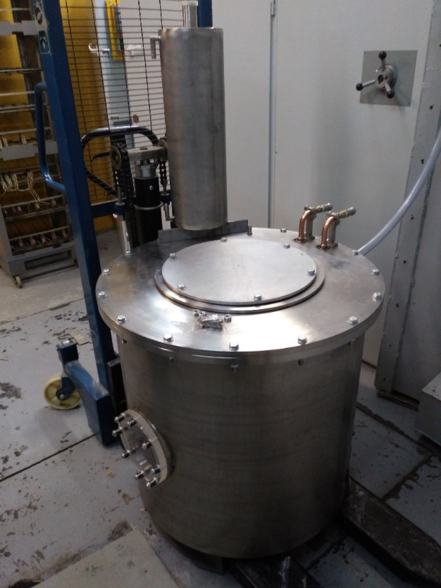
Modulator
Modulator number: 52
High Voltage Module
HV Transformer
HV Transformer Tank

Slide 8
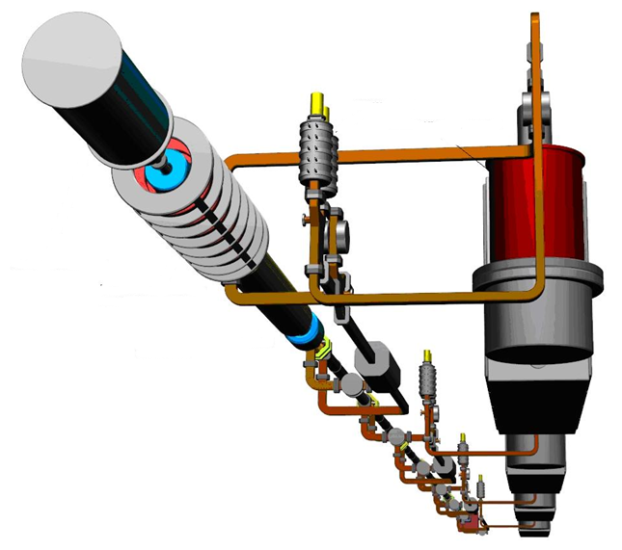
Start of the acceleration…
e⁻ gun
SLED
Klystron
Compressor (buncher)
module with solenoid
Modulator
First section
with solenoid

Slide 9
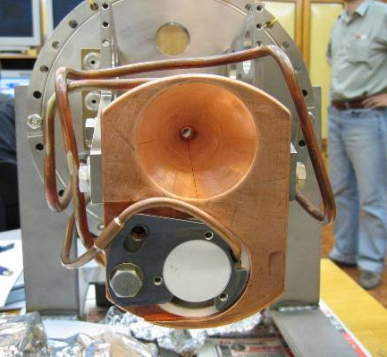
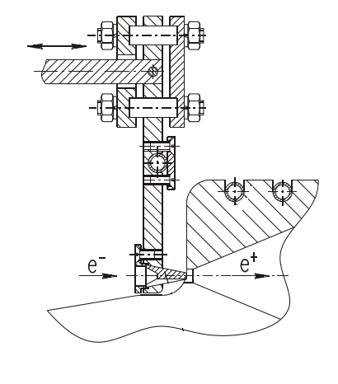
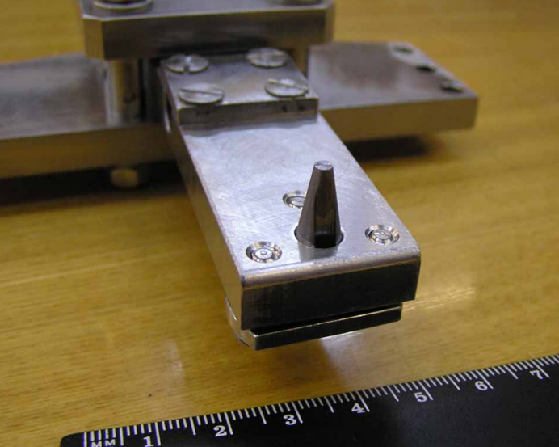
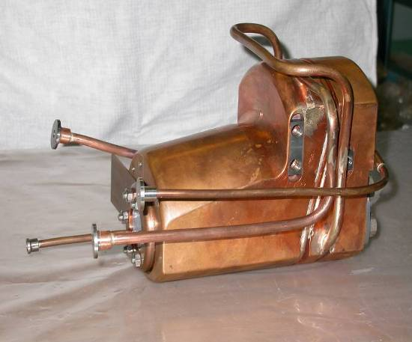
Conversion system
Positron
Production
Target
Flux Concentrator

Slide 10
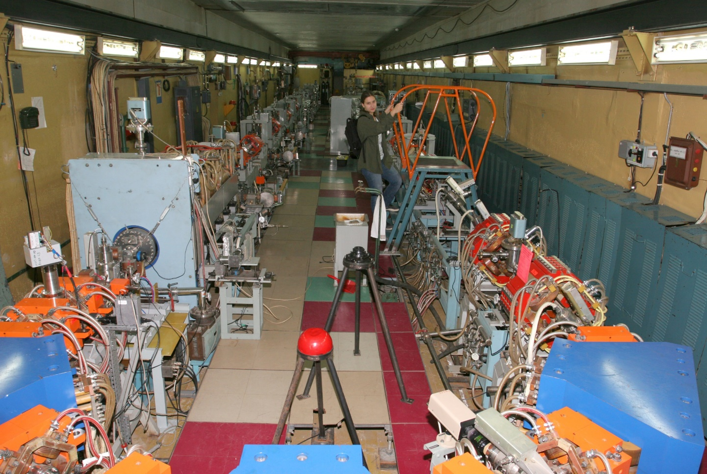
VEPP-5 Injection Complex at BINP
In operation and since the end of 2015 provides both e⁺ and e⁻ to VEPP-2000 and VEPP-4M colliders
Number of е⁻ at the conversion system per pulse – 3.5∙10¹⁰
Energy of е⁻ at the conversion system – 270 MeV
Energy of e⁺ at the end of Linac – 400 MeV
Number of e⁺ per pulse at the end of Linac – 3.5∙10⁹

Slide 11
Super-CT Project Injector
2*10¹¹ electrons/positrons per second
@ the energy of 1.5 – 2.5 (3) GeV
Damping
Wiggler
Crab
Sext
IP
Damping
Wiggler
Crab
Sext
Siberian
Snake
e- 1.5 GeV Linac
AS – 24
Klystrons – 12
Length – 96 m
Drift channel for 1.5 GeV mode
RF System
Polarized e- Gun
1 GeV Linac
AS – 16
Klystrons – 8
Length – 72 m
Damping
Wiggler
Compressor
Damping
Wiggler
e- Photogun
1 nC, 3 ps
ΔE/E ~ 0.5 %
(total charge)
Debuncher
Damping Ring
e+ 1 – 1.5 GeV
e+ 1.5 GeV Linac
AS – 24
Klystrons – 12
Length – 96 m
Thermionic
Gun
Total number of accelerating structures: 104
Klystron number: 52
Total length of the linacs: ~440 m
e- 1 GeV + 1.5 Gev Linacs
AS – 16 + 24
Klystron – 8 + 12
Length – 72 m + 96 m

