Slide 1
Progress on 2017-07-04
Energy from 2.3864 GeV to 3.08 GeV, for anti-neutron, use EMC+TOF, for neutron, use EMC only.
TMVA will be applied for signal/background distinguish.
Efficiency will be obtained from control sample not generated MC.

Slide 2
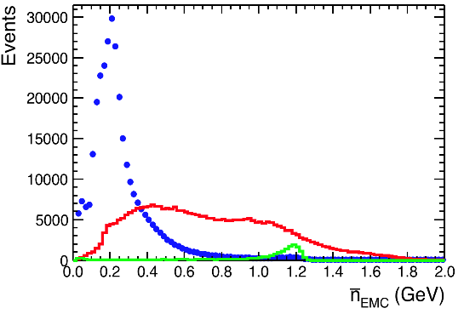
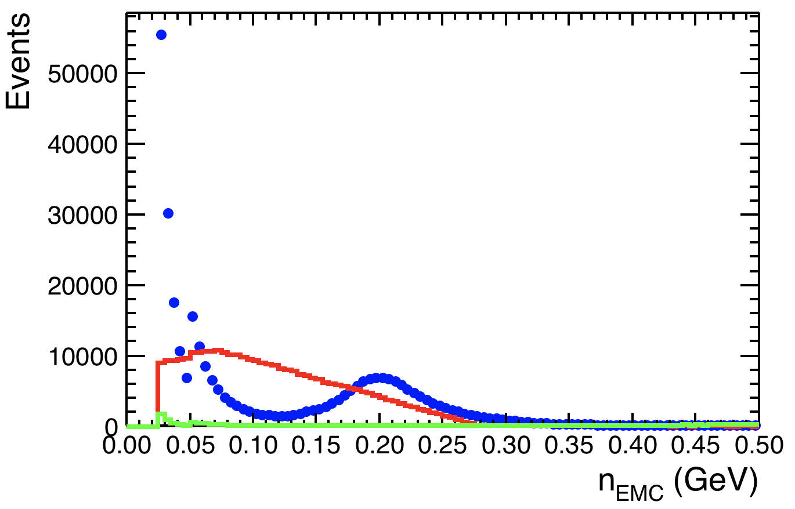
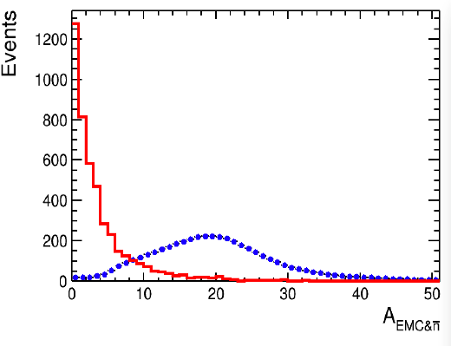
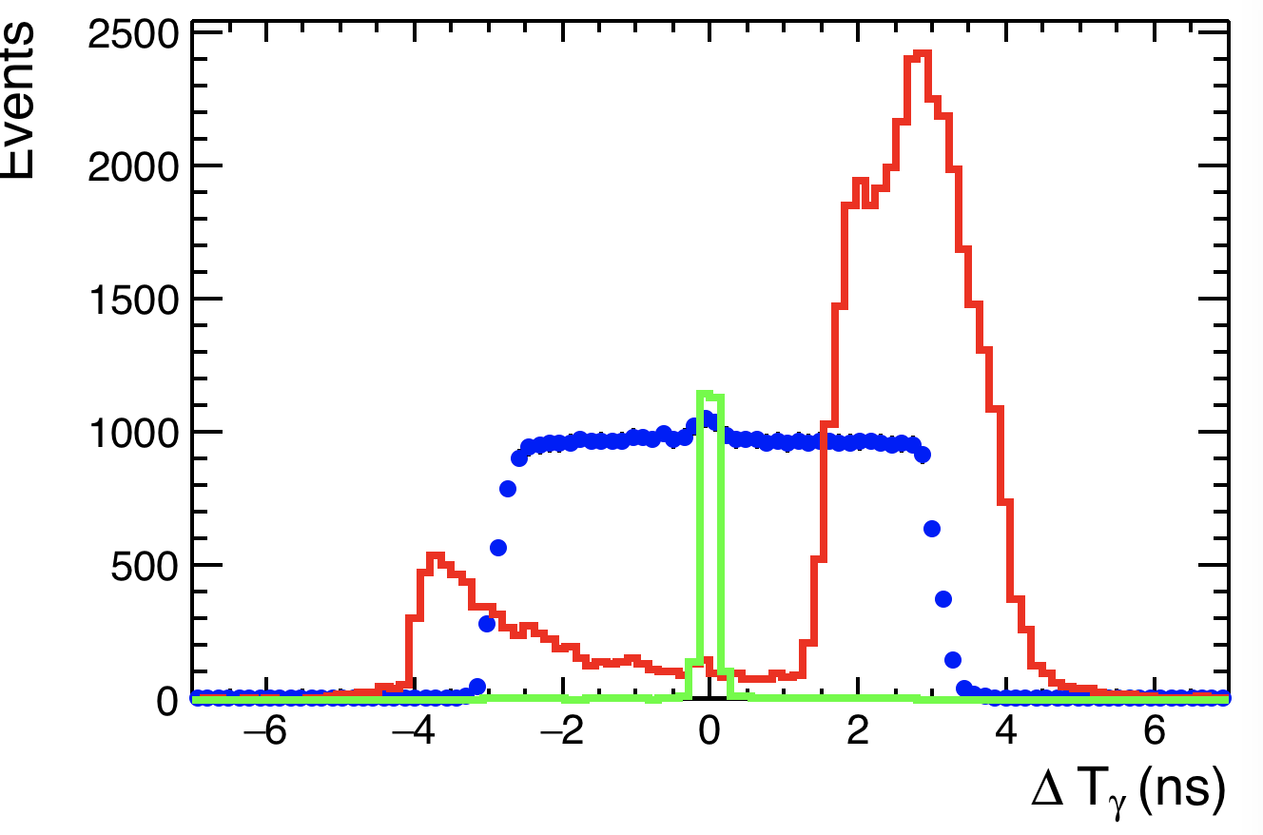
Pre-selection
Number of charged tracks equals to 0
$\overline{n}$ shower candidate: most energetic shower, with tof information required
n shower candidate: The second energetic shower outside the $\overline{n}$ cone in ${90}^{°}$
Other selections
${\overline{n}}_{EMC}$: energy deposition in calorimeter, ${\overline{n}}_{EMC}$>0.5 GeV
$n_{EMC}$: energy deposition in calorimeter, 0.6<$n_{EMC}$<0.5 GeV
$A_{EMC\&\overline{n}}$: angle between $P_{EMC}$ 3-momentum and direction of $\overline{n}$: $A_{EMC\&\overline{n}}<20^{°}$
ΔT_{γ}: time difference for photon hypothesis, |ΔT_{γ}|<0.5 ns

Slide 3
Further selection
TMVA is applied for further selection, with the variables all from track level.
In TMVA (BDT booked):
Signal:
n and $\overline{n}$ are selected from $J/ψ→pnπ$
Since at 2.396 GeV, β=0.62
In control sample, we require β of recoiled pπ vector in region [0.6, 0.65]
Total number of events: 40541
Background:
Method1: treat survived data as background, since S/B is extreamly low
Total number of events: 1053502
Method2: a combined data set with QED + hadronic + beam asso. Events
Number of beam asso. Events = data – QED – hadronic Events
Method3: treat survived data with opening angle between n and $\overline{n}$ less than 170 degree: 1052458

Slide 4
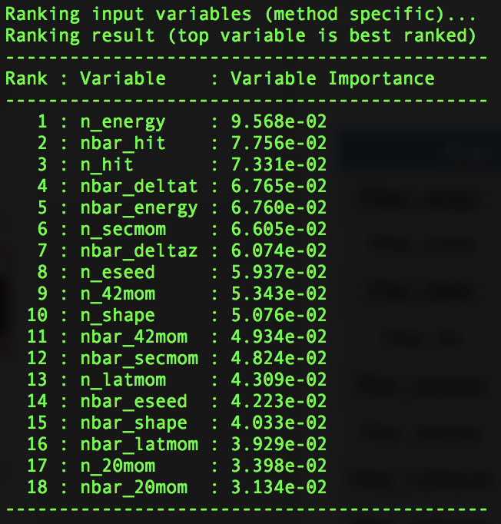
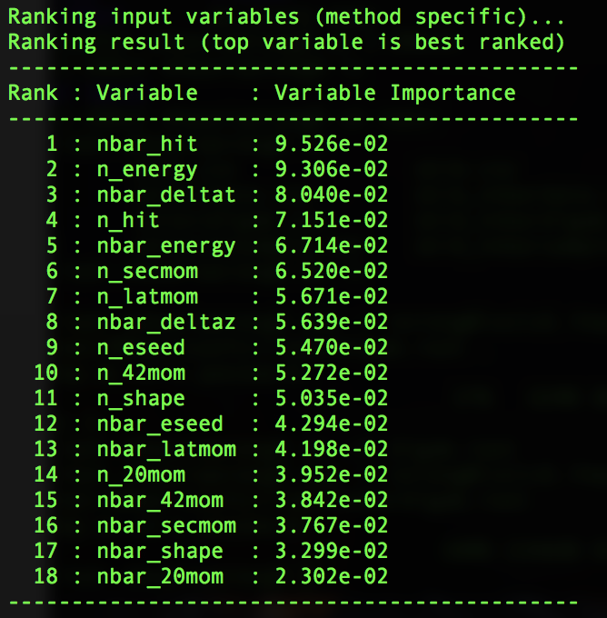
Input variables_m1
Emc based |  | Tof based
Nbar_nergy | N_nergy | Nbar_ΔT_{nbar}
Nbar_eseed | N_eseed | Nbar_Δz
Nbar_shape | N_shape
Nbar_hit | N_hit
Nbar_secmom | N_secmom
Nbar_latmom | N_latmom
Nbar_A20mom | N_A20mom
Nbar_A42mom | N_A42mom

Slide 5
Input variable_m2

Slide 6
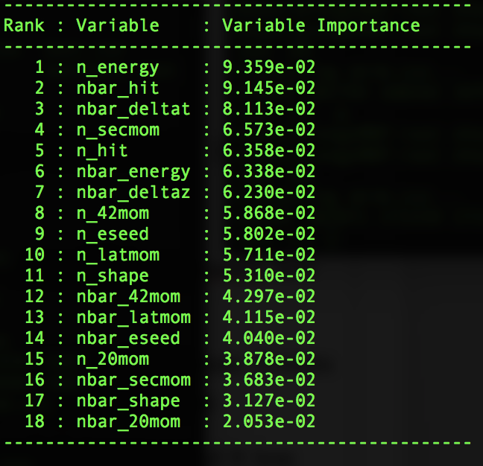
Input variable_m3

Slide 7
Variable Comparisons_m1

Slide 8
Variable Comparisons_m1

Slide 9
Variable Comparisons_m1

Slide 10
Variable Comparisons_m2

Slide 11
Variable Comparisons_m2

Slide 12
Variable Comparisons_m2

Slide 13
Output classification_m1

Slide 14
Variable Comparisons_m3

Slide 15
Output classification_m3

Slide 16
Optimal cut value_m1

Slide 17
Optimal cut value_m1

Slide 18
Optimal cut value_m3

Slide 19
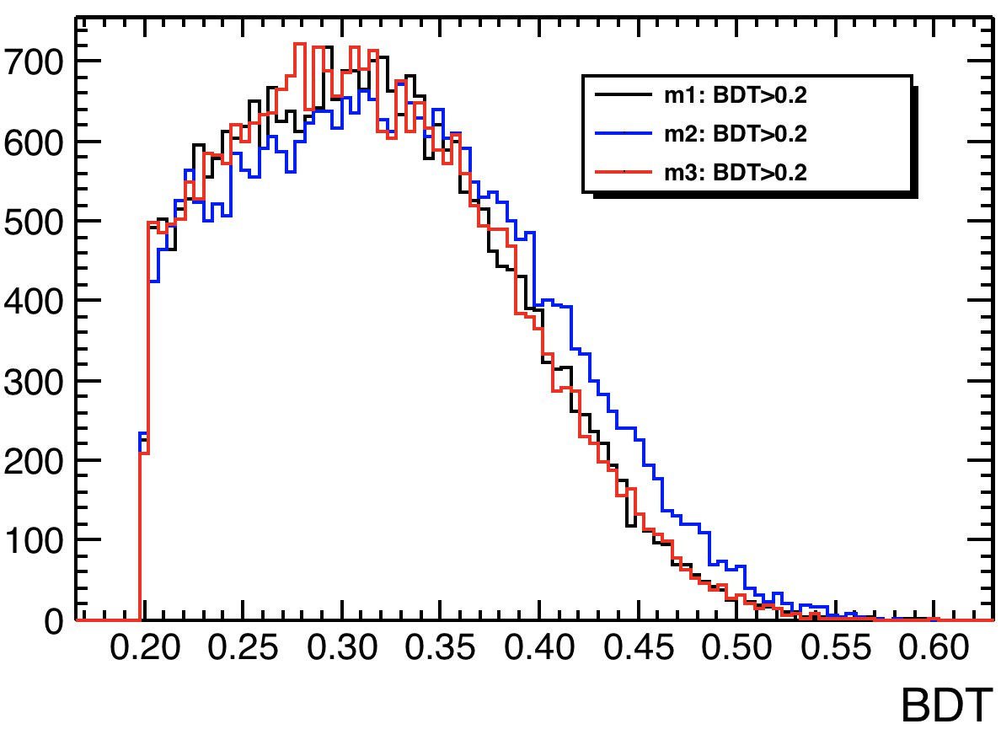
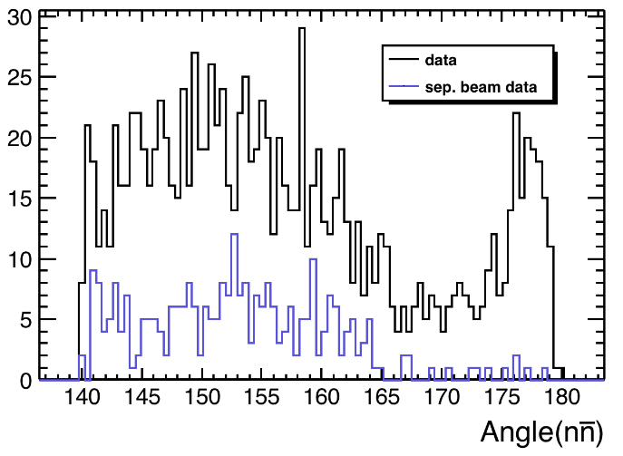
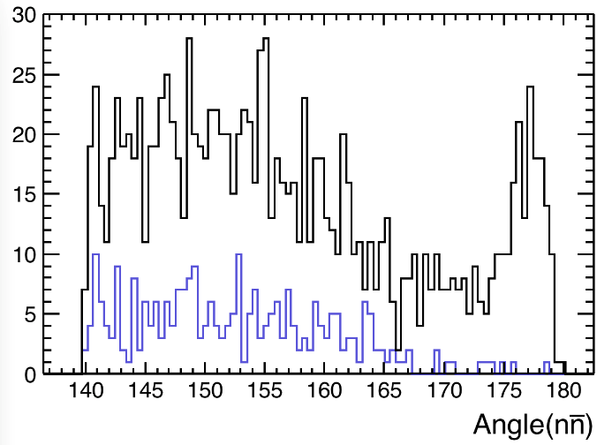
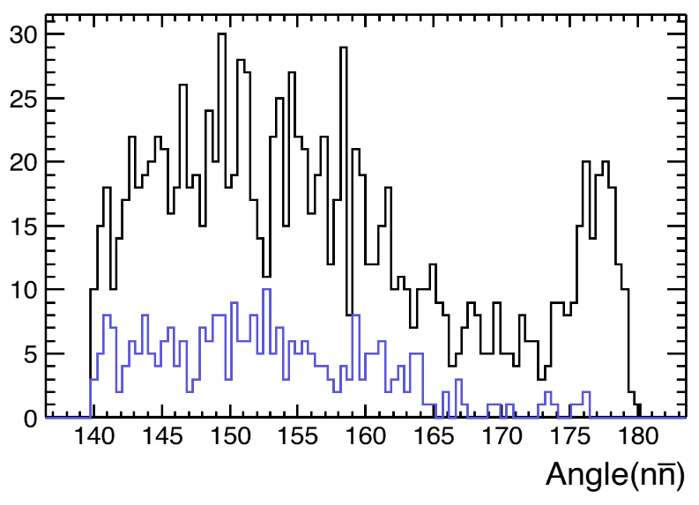
Comparison of three BDT training
data
sample

Slide 20
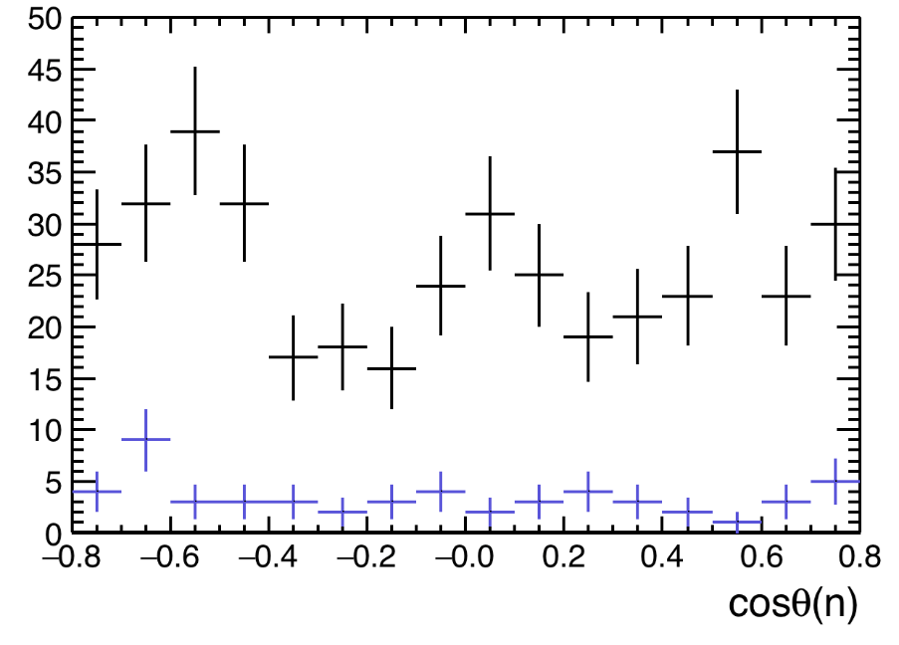
Angular distribution (m1)

Slide 21
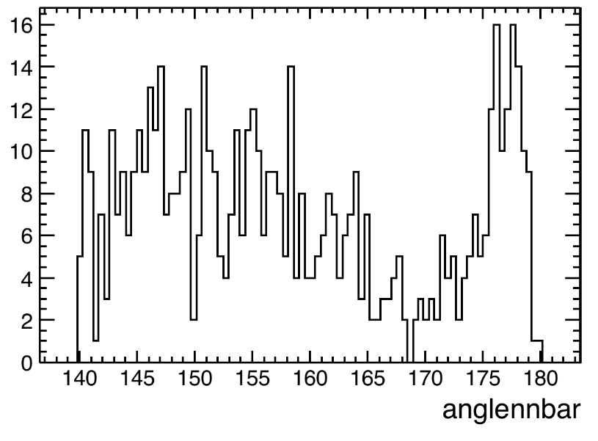
After selection in data

Slide 22
Efficiency
76.0%
Number of charged tracks equals to 0
$\overline{n}$ shower candidate
n shower candidate
Other selections
${\overline{n}}_{EMC}$: energy deposition in calorimeter, ${\overline{n}}_{EMC}$>0.5 GeV
$n_{EMC}$: energy deposition in calorimeter, 0.06<$n_{EMC}$<0.5 GeV
$A_{EMC\&\overline{n}}$: angle between $P_{EMC}$ 3-momentum and direction of $\overline{n}$: $A_{EMC\&\overline{n}}<20^{°}$
ΔT_{γ}: time difference for photon hypothesis, |ΔT_{γ}|>0.5 ns
BDT selection
80.5% * 51.7%
37.3%
66.4%
79.3%
98.2%
70.7%
Final 4.3%
Notes:
0.8966*0.7688*0.5276*0.705*0.986*0.87*0.423*0.791

Slide 23
Progress till 2017-07-25

Slide 24
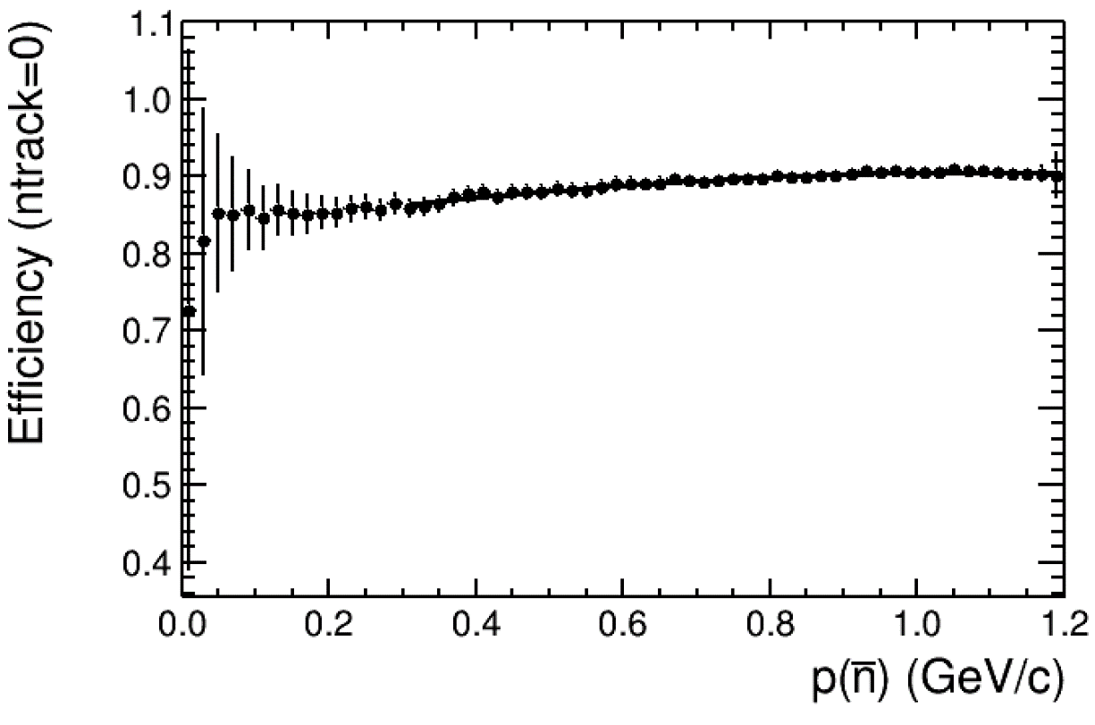
Momentum dependent efficiency (I)
Number of charged tracks in J/psi-> p+ nbar pi-equals to 0
0.827+0.135x-0.052x*x-0.005x*x*x

Slide 25
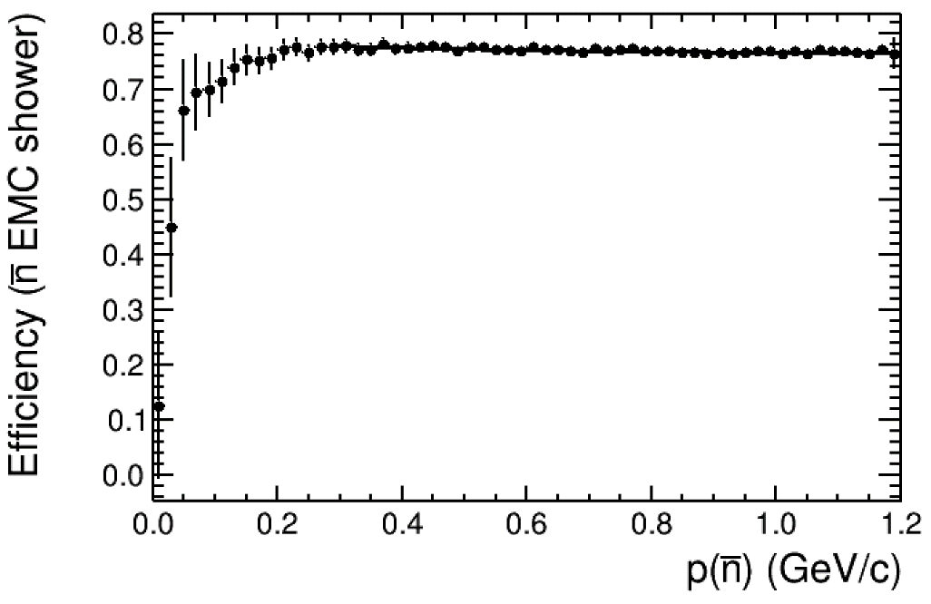
Momentum dependent efficiency(II)
$\overline{n}$ shower candidate: EMC valid, the most energetic shower
0.788-0.040x+0.019x*x
The matched angle is set at 20 degree. Different match angle will be performed to obtain the uncertainty
(if match angle<15, 0.728+0.025x-0.011x*x)

Slide 26
Momentum dependent efficiency(III)
$\overline{n}$ shower candidate: tof information required
0.616-0.178x+0.078x*x

Slide 27
Momentum dependent efficiency(IV)
${\overline{n}}_{EMC}$: energy deposition in calorimeter, ${\overline{n}}_{EMC}$>0.5 GeV
0.506+0.336x-0.0915x*x

Slide 28
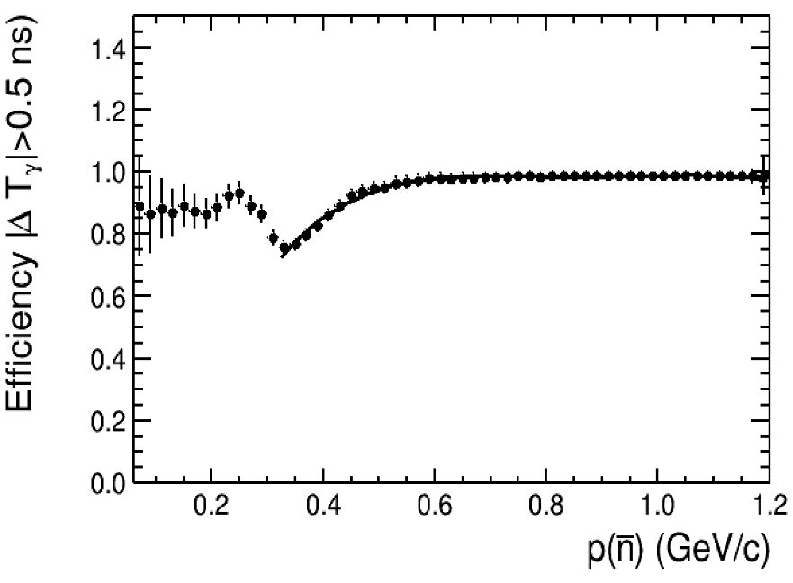
Momentum dependent efficiency(V)
ΔT_{γ}: time difference for photon hypothesis, |ΔT_{γ}|>0.5 ns
-0.891+8.923x-15.700x*x+12.112*x*x*x-3.456*x^4

Slide 29
Momentum dependent efficiency(VI)
Number of charged tracks in J/psi-> pbar n pi+ equals to 0
0.842+0.431x-0.908x*x+0.505x*x*x

Slide 30
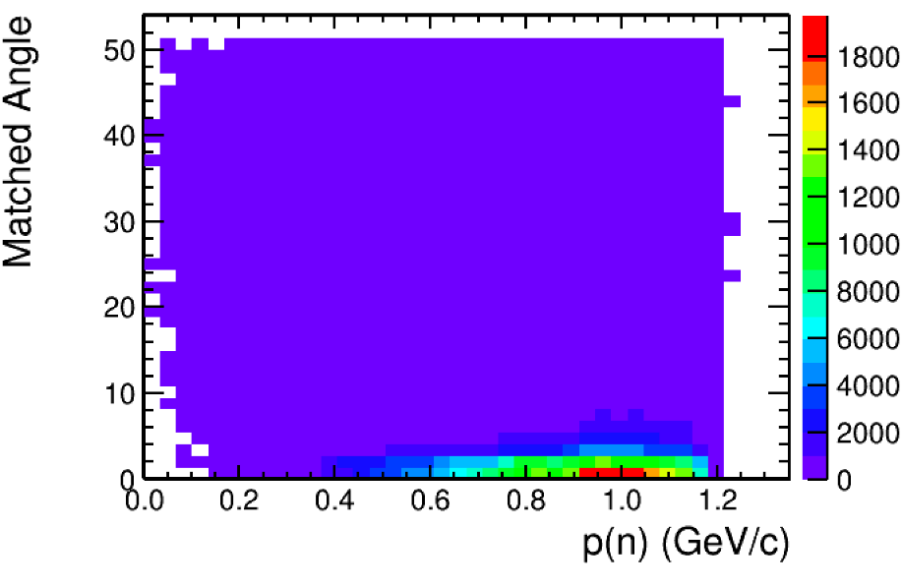
Momentum dependent efficiency(VII)
n shower candidate: EMC valid
-0.625+3.117x-3.125x*x+1.1135x*x*x

Slide 31
Momentum dependent efficiency(VIII)
$n_{EMC}$: energy deposition in calorimeter, 0.06<$n_{EMC}$<0.5 GeV
-0.415+0.935*x+4.375*x*x-6.493*pow(x,3)+2.489*pow(x,4)

Slide 32
Total efficiency curve before BDT
Notes:
0.8966*0.7688*0.5276*0.705*0.986*0.87*0.423*0.791=0.736

Slide 33
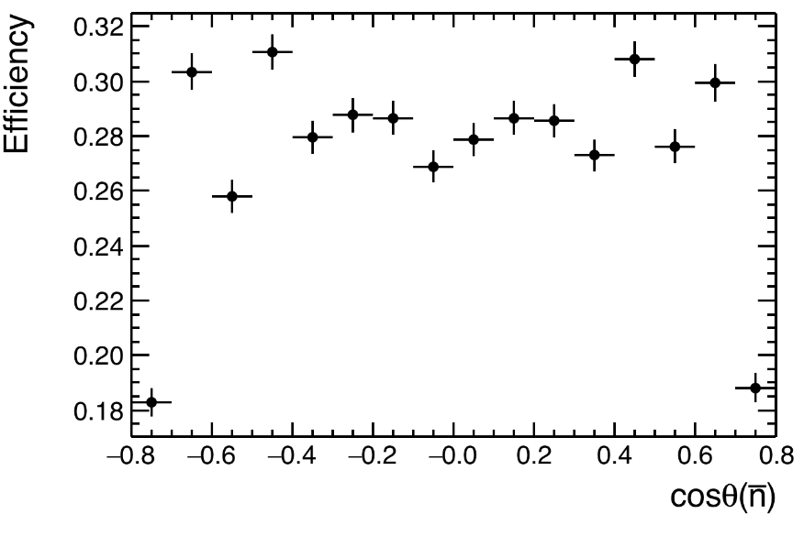
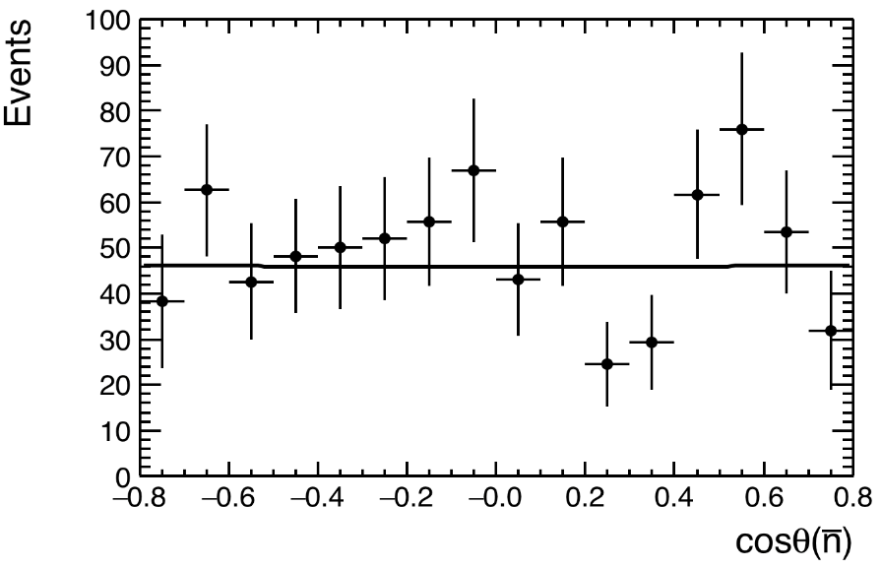
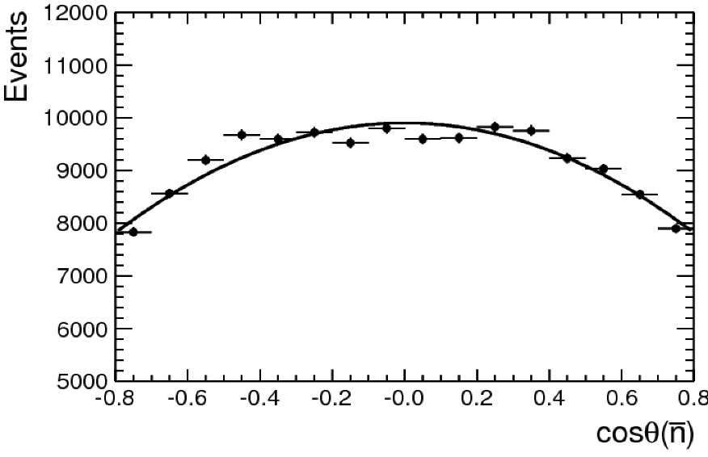
Angular dependent efficiency for nbar at 2.396 GeV
(1+0.015x*x)
(1-0.329x*x)

Slide 34
Fit result
nsig = 232 +/- 17

Slide 35
Cross section calculation
Efficiency : 0.073*0.707
Correction from angular:
$f_{1}=\frac{\int_{−0.8}^{0.8}{\left(1−0.329\cos^{2}θ\right)dcosθ}}{\int_{−1}^{1}{\left(1+0.015\cos^{2}θ\right)dcosθ}}=0.74$
Cross section:
(232+/-17)/(0.073*0.707*0.74*66.9)=90.8+/-6.7
(here we don’t include ISR correction, because, in data, we only select Born events, while in MC, the sample do not contain ISR events at all)

Slide 36
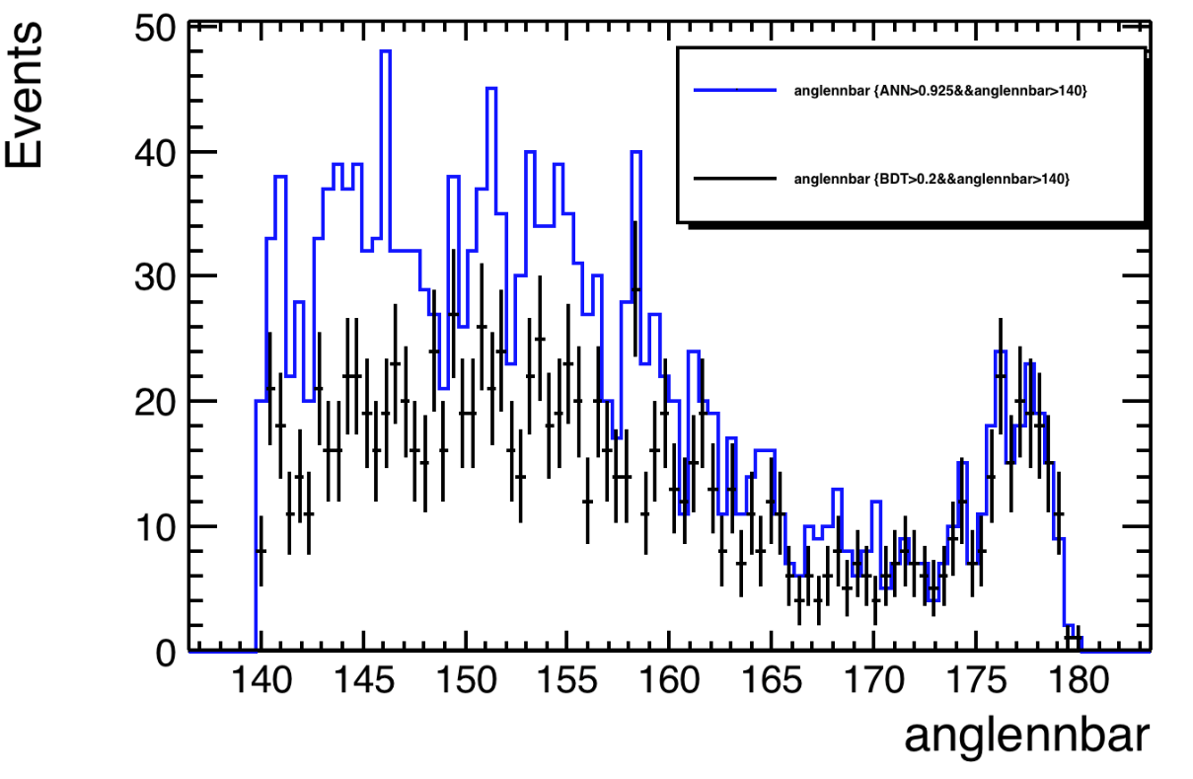
An cross check by using MLP

Slide 37
1. use MC to validate the efficiency
2. cut another deposition energy threshold
3. use the largest opening angle as neutron candidate
Skim data runNo, event

Slide 38
2.3864

