Slide 1
BEC: paper investigation
2022.07.06

Slide 2
Paper involved:
Phys.Rev.D 39 (1989) 1:
Phys. Rev. Lett. 105 (2010) 032001:
Rep. Prog. Phys 66 (2003) 481:

Slide 3
Phys.Rev.D 39 (1989) 1:
Electron-positron reaction.
Based data sets collected with MARKII detector, operating at SPEAR and PEP storage ring.
Four data sets used, in different regions of energy, and with different production mechanisms.
Both BEC between pairs and triplets of like sign charged pions studied.
BEC in pion pairs using two-dimensional distributions in components of $Q^{2}$ is studied, to investigate the shape of the pion emitter.

Slide 4
Parameterization of BEC I
Pairs: cause it is not feasible to accurately calculate the $P(k_{1})$ and $P(k_{1})$, one use the ratio of the like pair distribution to a reference pair distribution to study BEC, fitted by a Gaussian:
Triplets:
Simplify:

Slide 5
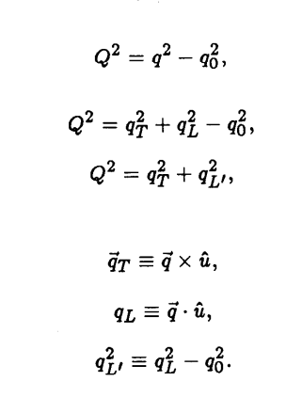
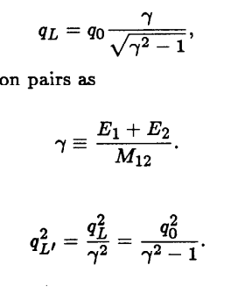
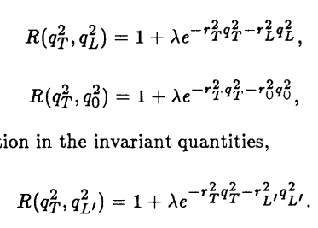
Parameterization of BEC II
Two-dimension: ,

Slide 6
Data samples
5 GeV
Detector:

Slide 7
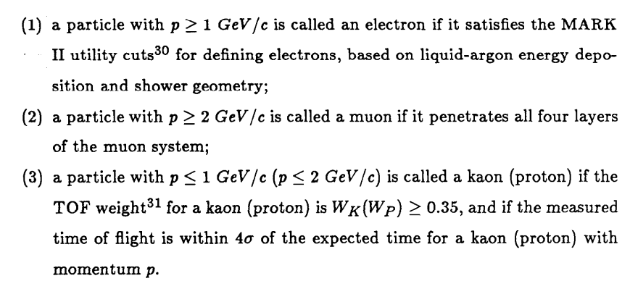
Track and event selection I
Reduce distant decay of , such as $K_{s}^{0}$ and $Λ$

Slide 8
Track and event selection II

Slide 9
Selection result

Slide 10
Study and reference sample
Pairs: Unlike charged pairs (UCP), resonance.
Mix of different events.
Triplets: Unlike charged pairs (UCP), resonance, containing pair correlation ($±±∓$)
Mix of different events.

Slide 11
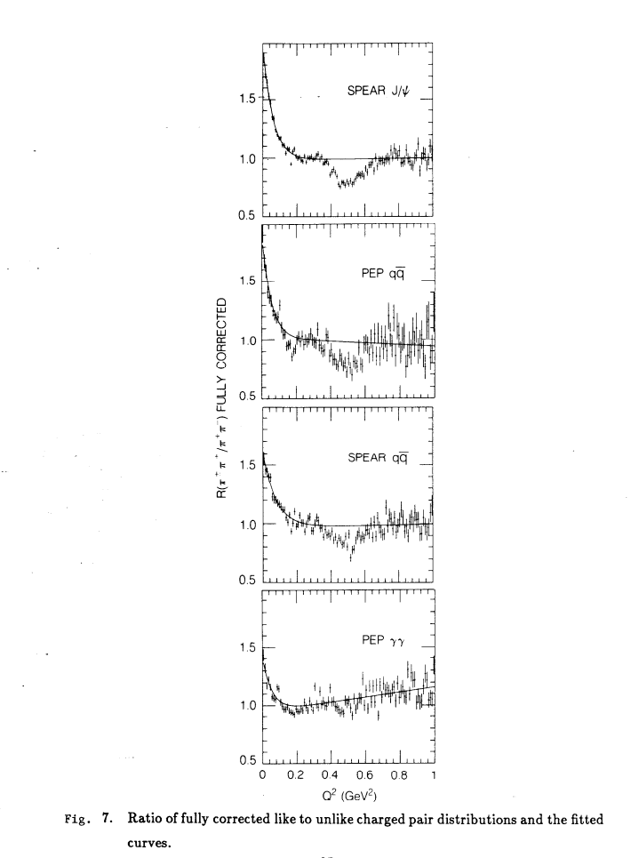
Correlation function: (pairs)
Correction of strong interaction: two like sign pions, at low relative momentum, are in an s-wave I=2 state, experiencing a repulsive strong reaction. Suzuki estimates it will reduce the lambda by ~15%.
Correction of Coulomb interaction: Gamow factor. lambda increase by 11-13%, r is unaffected.
Pion misidentification: increase the lambda by ~20-25%, r is unaffected.
Long-range momentum correlations:

Slide 12
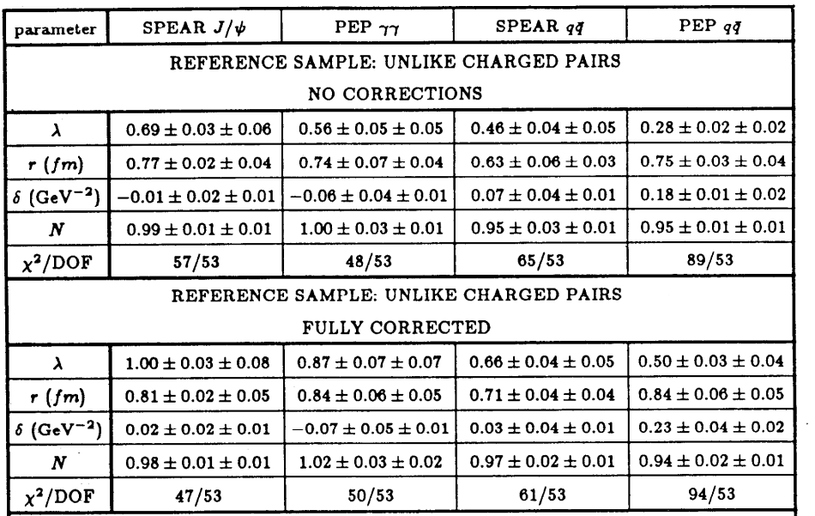
Parameters UCP:
lambda of SPEAR qqabr suppressed by charmed mesons, and PEP qqbar suppressed by charmed and bottom mesons

Slide 13
Parameters MIX:

Slide 14
Correlation function: (triplets)

Slide 15
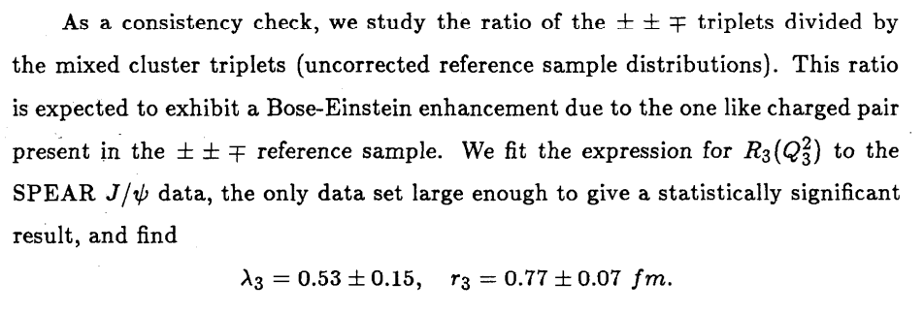
Parameters

Slide 16
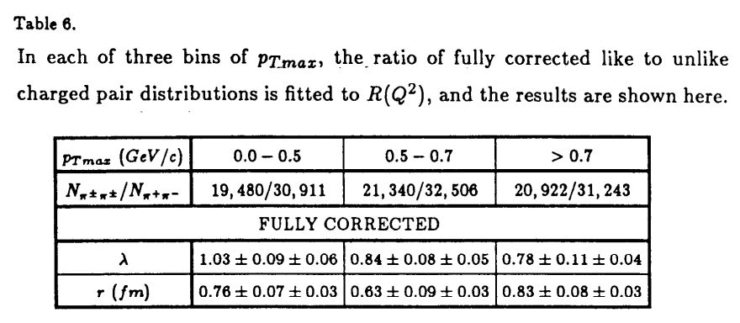
BEC in PEP $γγ$ pairs

Slide 17
BEC in components of $Q^{2}$

Slide 18
Other tests

Slide 19
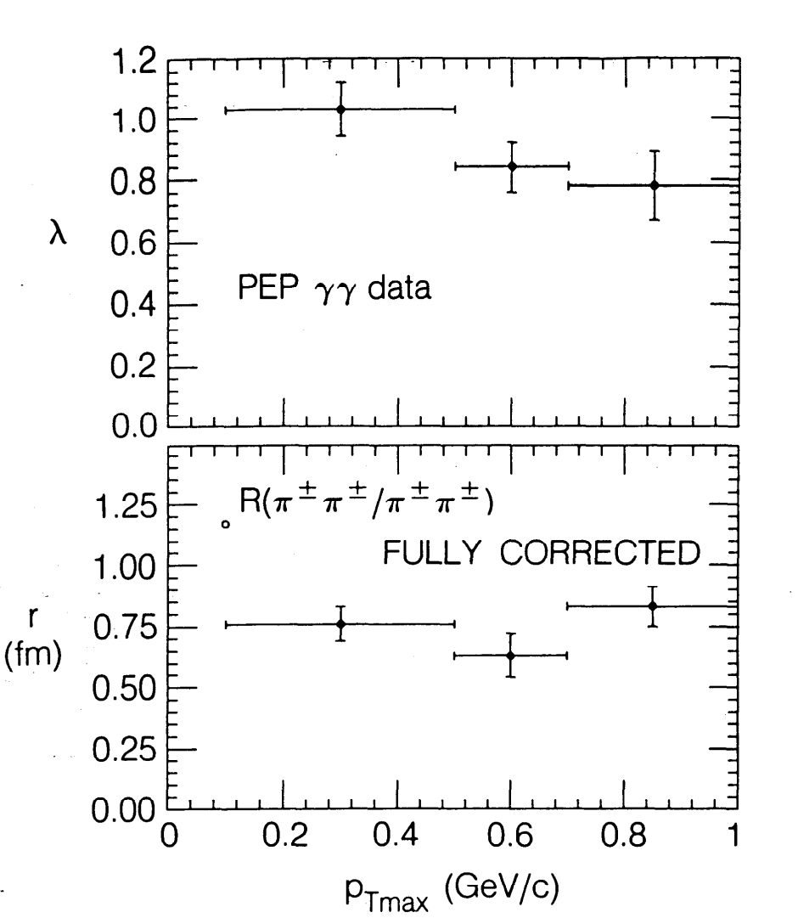
Summary I

Slide 20
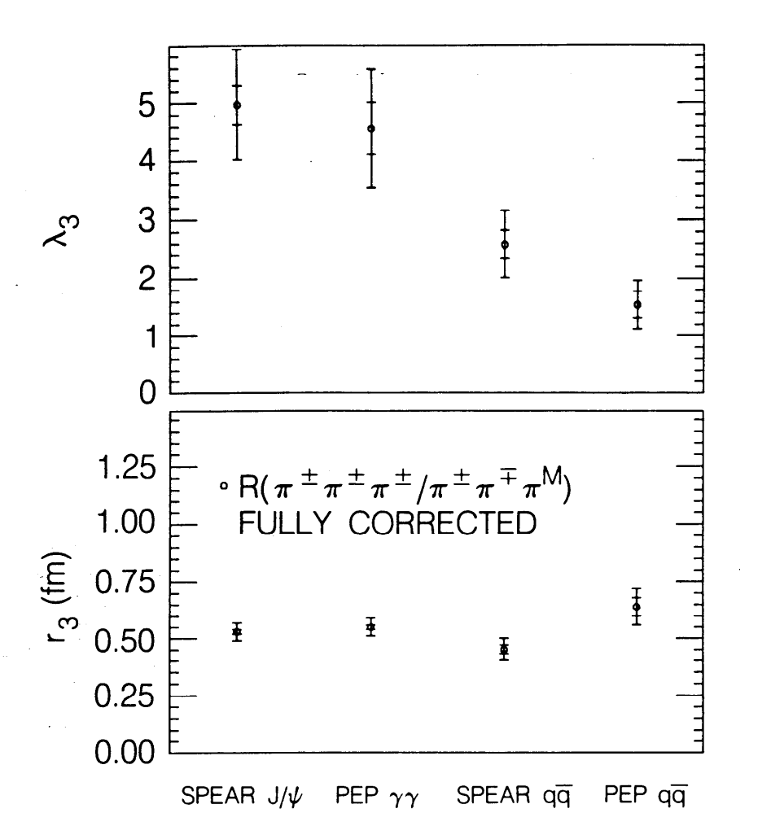
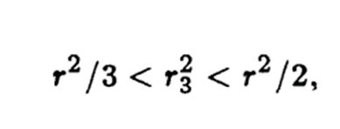
Summary II

Slide 21
Phys. Rev. Lett. 105 (2010) 032001
Proton-proton reaction.
Based data sets collected with CMS detector, operating at LHC.
Two data sets used: 0.9 and 2.36 TeV
BEC in pairs of charged pion studied.
Seven kinds of reference samples were used.
Dependence of BEC parameters on multiplicity studied.

Slide 22
Parameterization of BEC and event selection

Slide 23
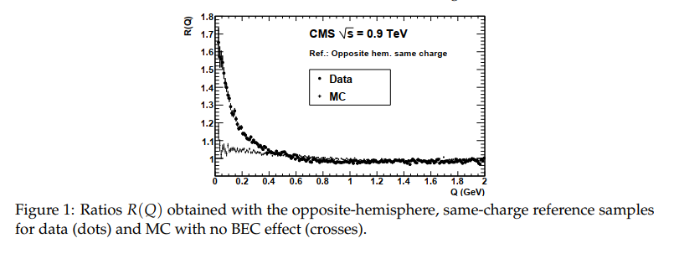
Several study details

Slide 24
Result of two data sets with seven different reference samples

Slide 25
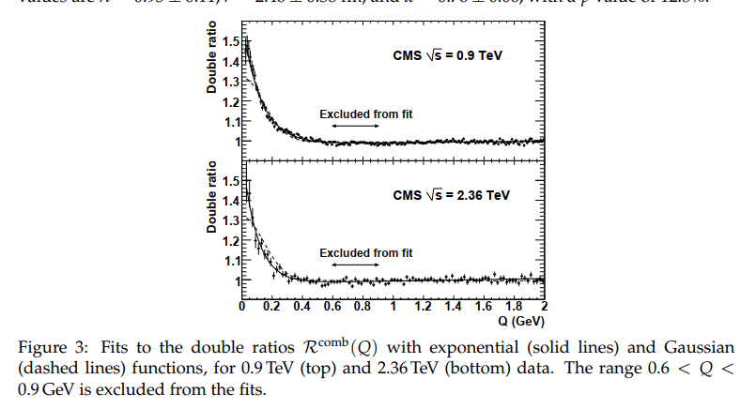
Combined sample

Slide 26
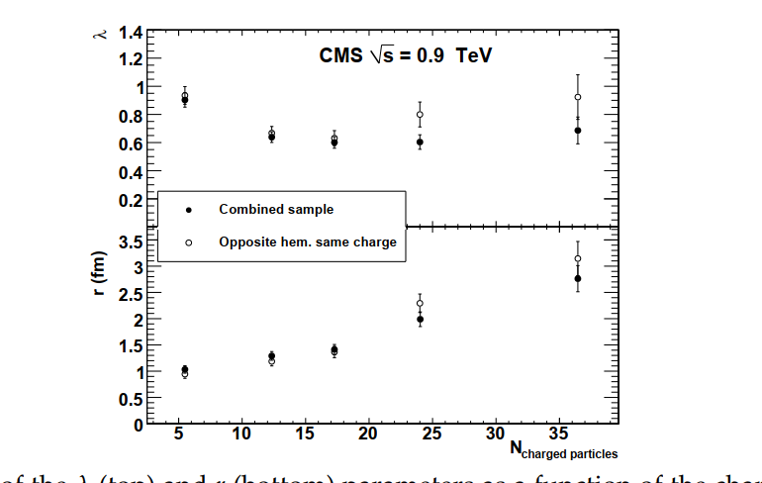
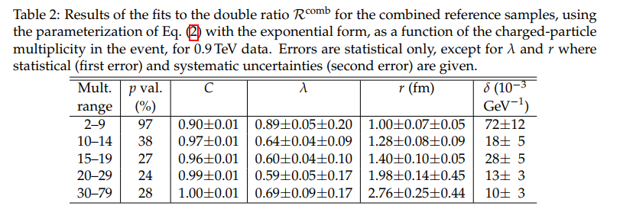
Dependence of r on the charged-particle multiplicity

Slide 27
Plan
Read another two papers.
Event selection on data sets at 2.125 GeV and furthermore, other data sets.
From simple to complex:
Pairs to triplets.
Charged to neutral.
Pipi to KK, pp, or event LambdaLambdabar and gammagamma
BEC to FDC
Overall signal to parameter dependence (multiplicity, c.m. energy, reaction mechanism)
One-dimension to two(three)-dimensions.
etc

