Slide 1
DD cross section_v2

Slide 2
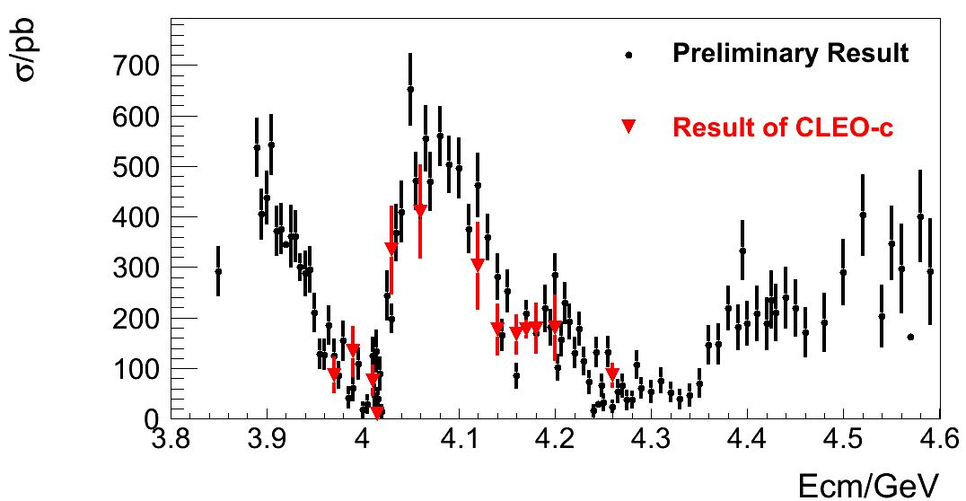
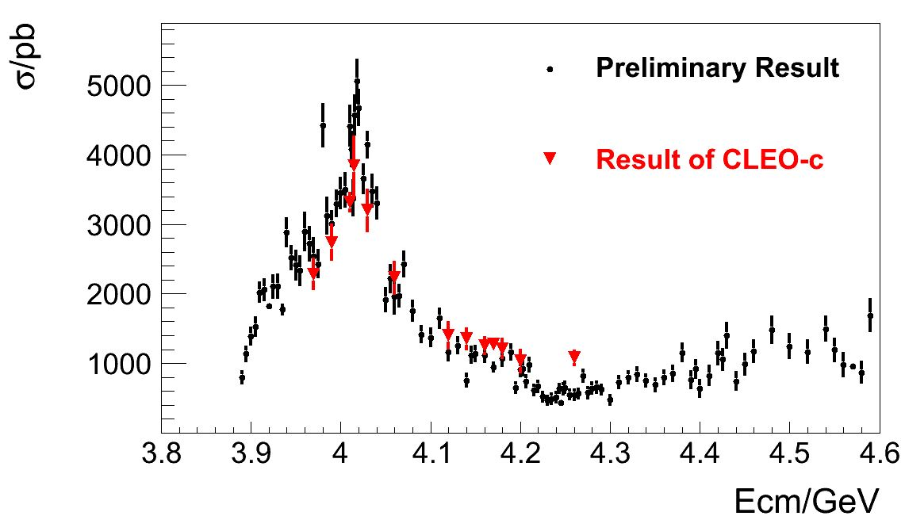
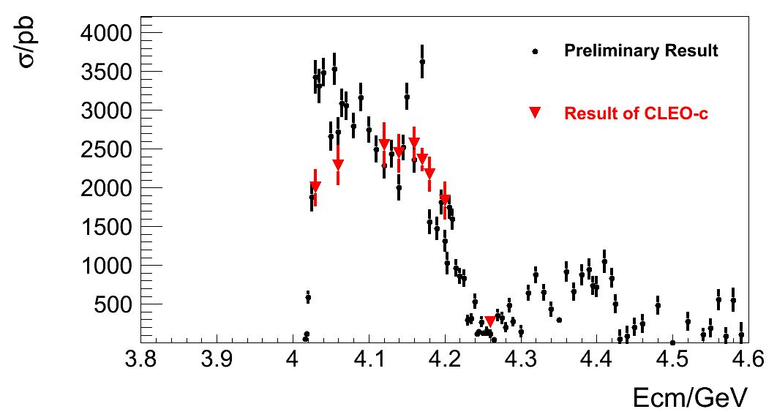
①
②
1.D⁰D⁰bar
2.D⁰*D⁰bar
3.D⁰*D⁰*bar
③

Slide 3
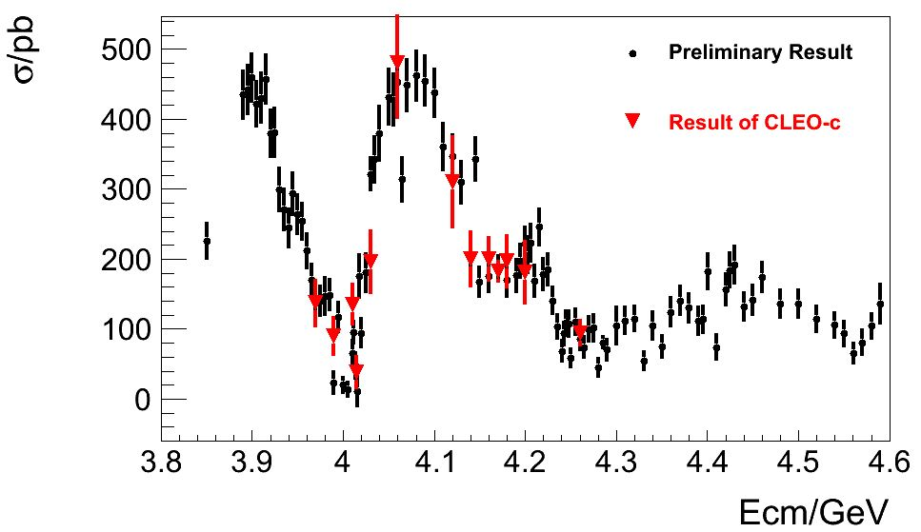
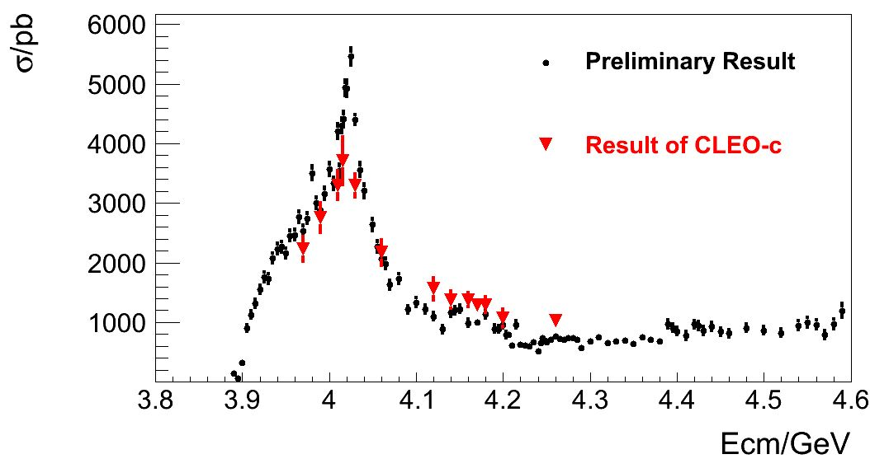
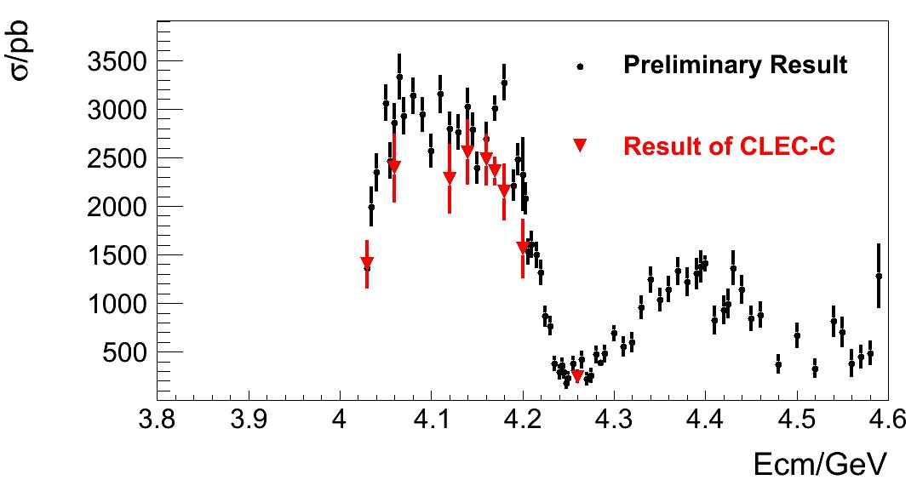
①
②
1.D⁺D⁻
2.D⁺*D⁻
3.D⁺*D⁻*
③

Slide 4
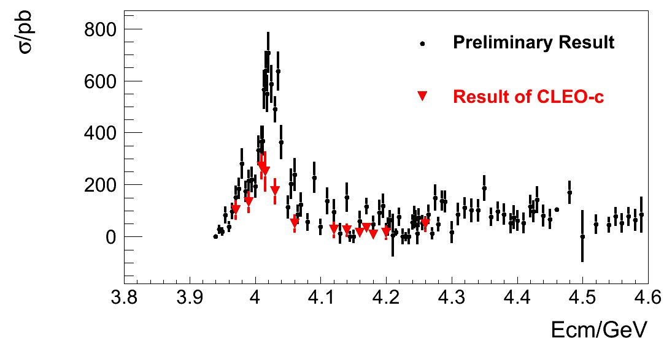
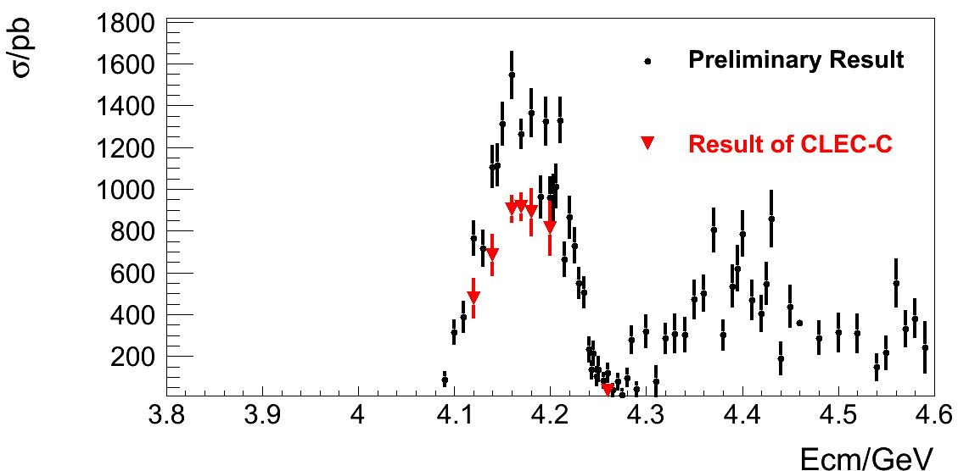
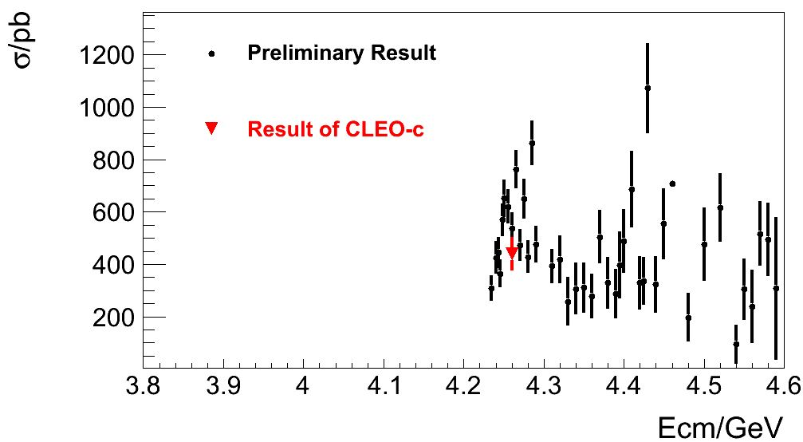
①
②
1.Ds⁺Ds⁻
2.Ds⁺*Ds⁻
3.Ds⁺*Ds⁻*
③

