Slide 1
Measurement of $γ χ_{c0,1,2}→ Σ^{−}{\overline{Σ}}^{+}$ at BESIII
Irshad Muzaffar 勤奋
University of Science and Technology of China

Slide 2
Boss Version and Data Sample
Boss Version:
Boss 664p03
Data Sets:
Real Data 2012 , Run No. {-25388,0,-27090}
Use KKMC Event Generator for MC sample.
400M Inclusive Monte Carlo sample.
For Signal MC generated 1M Events.
Decay Chain :
$ψ\left(2S\right)→ γχ_{c0}$in P2GC0, For $χ_{c0}→ Σ^{−}\overline{Σ^{+}} in PHSP;$
$Σ^{−}→ {nπ}^{−}$ and $\overline{Σ^{+}}→ \overline{n}π^{+}$are in PHSP.

Slide 3
Event Selection
For Good Charged Track:
$\left|V_{z}\right|<30cm$, $\left|V_{r}\right|<10cm$and $|Cosθ|≤0.93$
$N_{Good }=2 and$Net charge for two charge tracks is zero.
For PID : dE/dX + TOF
${Prob}_{π }> {Prob}_{p },{Prob}_{π }> {Prob}_{k }{and N}_{π^{−}}=N_{π^{+} }$= 1
For Neutral Track:
$E_{barrel}>25MeV;E_{endcap}>50MeV$
$0≤TDC≤14(×50ns$)
At least 2 photons tracks Ngam>=2 (1 gamma, 1 for antineutron).
The most energetic shower consider as $\overline{n}$ candidate. $E_{\overline{n}}$> 0.2 GeV.
For Further Slection :
Do Kinematics fit 5C

Slide 4
Kinematic Fit
One loop all the photons (remove the move antineutron)
Kmfit->AddTrack(0, pi+)
Kmfit->AddTrack(1, pi-)
Kmfit->AddTrack(2, gamTrk)
Kmfit->AddMissTrack(3, nbar_mass, nbarTrk) // miss 1 freedom, p
Kmfit->AddMissTrack(4, n_mass) //miss px, py, pz
Kmfit->AddResonance(0, sigma-, 0, 3) // 1 constraint
Kmfit->AddFourMomentum(1, ecms) // 4 constraint
Mass (n+pi+), Mass(recoil_gam)
Rules: constraint > missing freedom

Slide 5
The most energetic -> antineutron (proved it by matching with mc truth)
The photon -> didn’t detected but have information in EMC.
The neutron -> ignore it at all

Slide 6
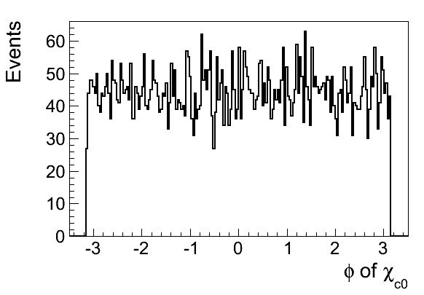
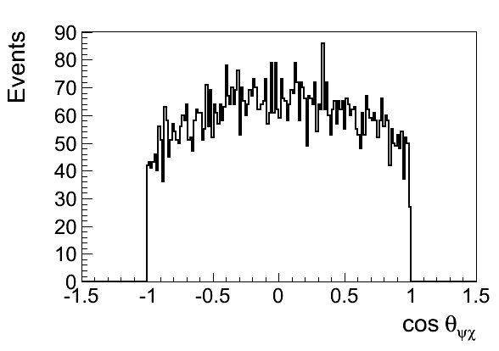
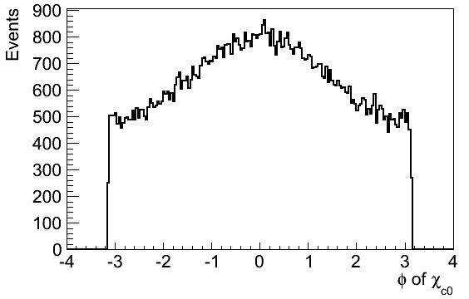
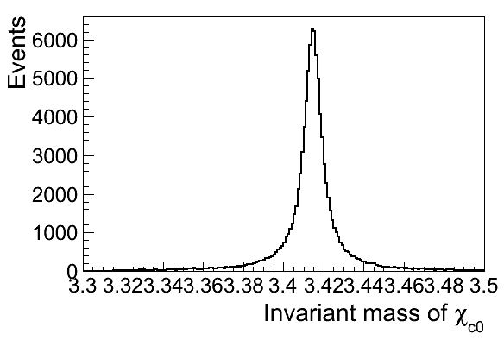
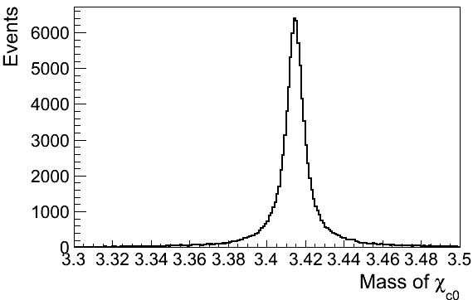
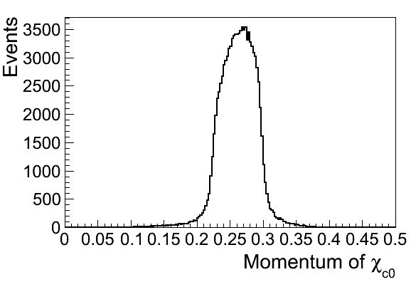
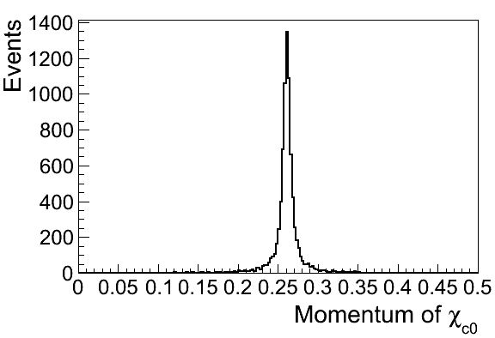
Mc Truth Information of Chic0

Slide 7
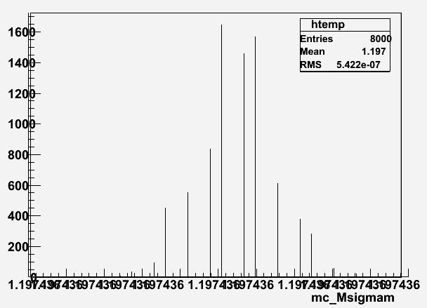
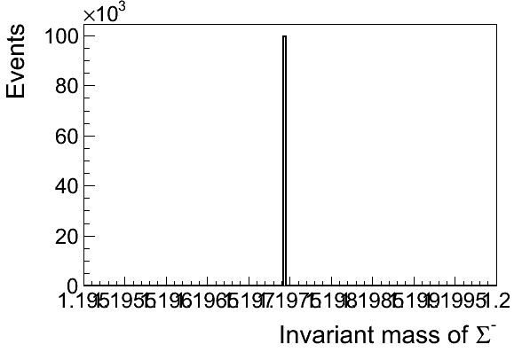
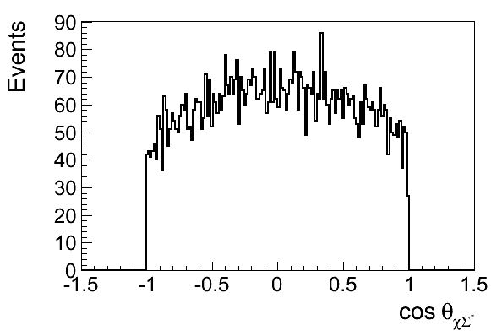
MC truth information of $Σ^{−}$

Slide 8
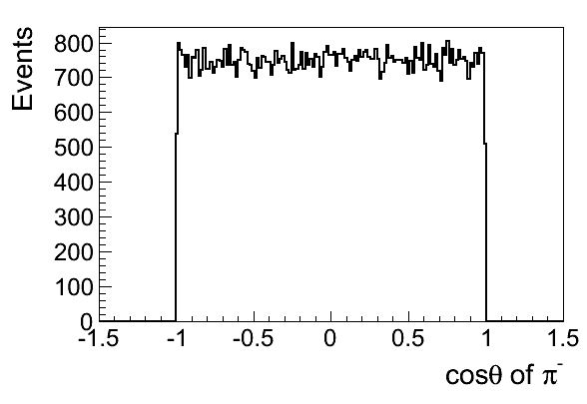
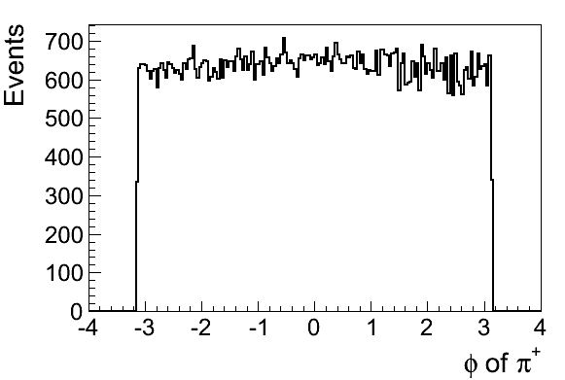
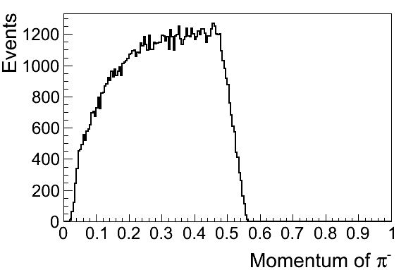
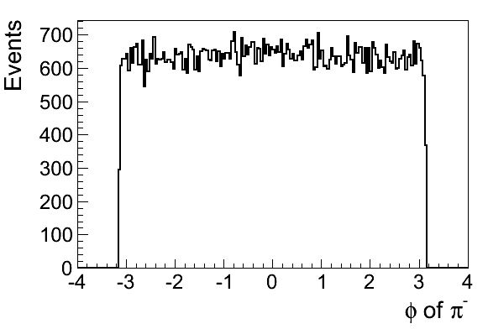
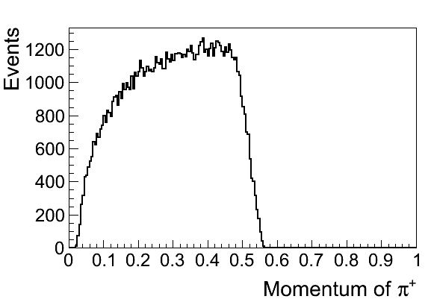
For pip and pim

Slide 9
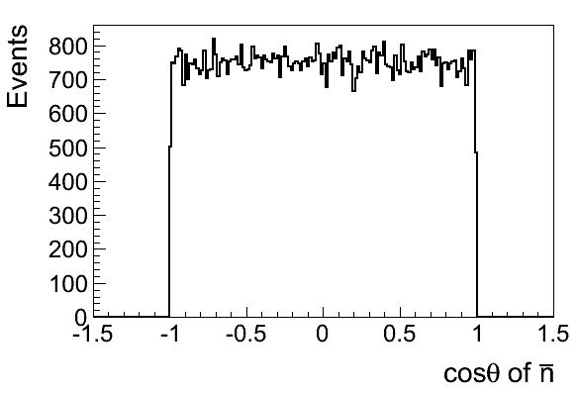
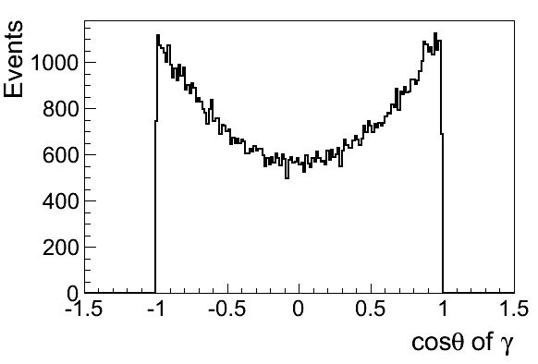
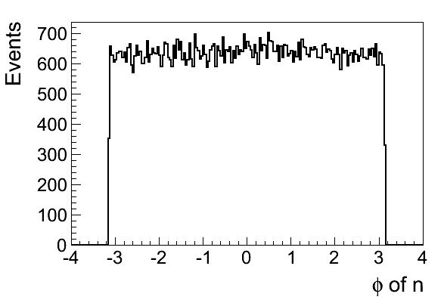
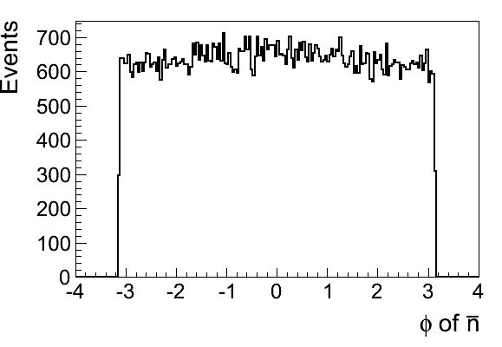
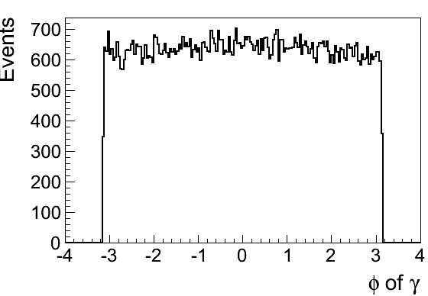
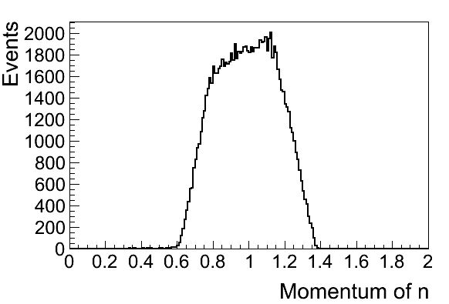
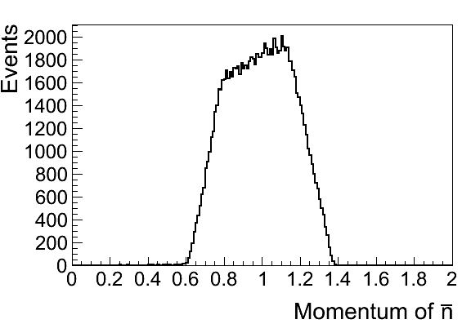
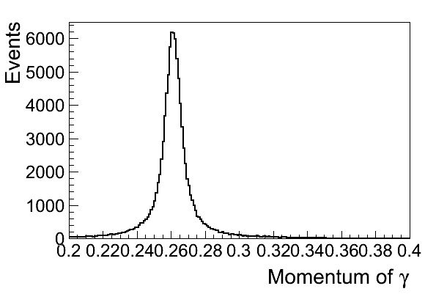
Distribution of Neutron, Anti-Neutron and Gamma

Slide 10
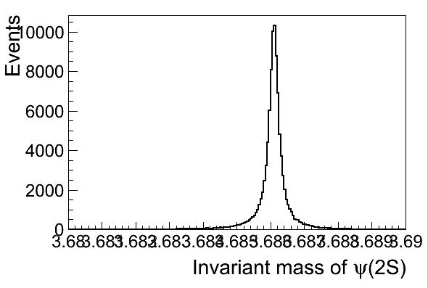
Invariant Mass of Psip,Chic0,and Sigmam

Slide 11
Chi-Square Distribution

Slide 12
Invariant Mass of Chic0

Slide 13
Invariant Mass of Sigma minus

Slide 14
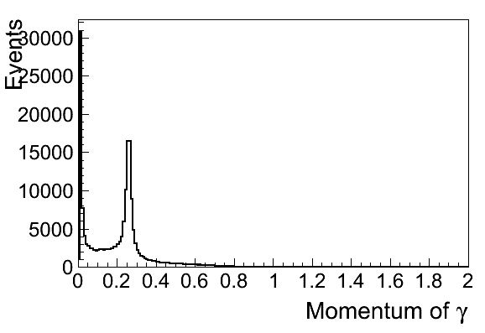
Momentum of Gamma before and after kmfit

Slide 15
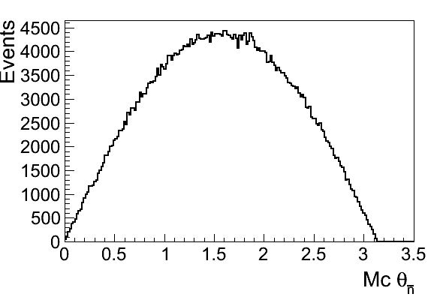
Theta Distribution of nbar

