Slide 1
STCF Beam Background Simulation
USTC
Zhujun Fang
On behalf of STCF group
18/11/2020

Slide 2
Outline
STCF MDI design
Beam background sources
Background simulation results
Discussion and conclusion

Slide 3
Outline
STCF MDI design
Beam background sources
Background simulation results
Discussion and conclusion

Slide 4
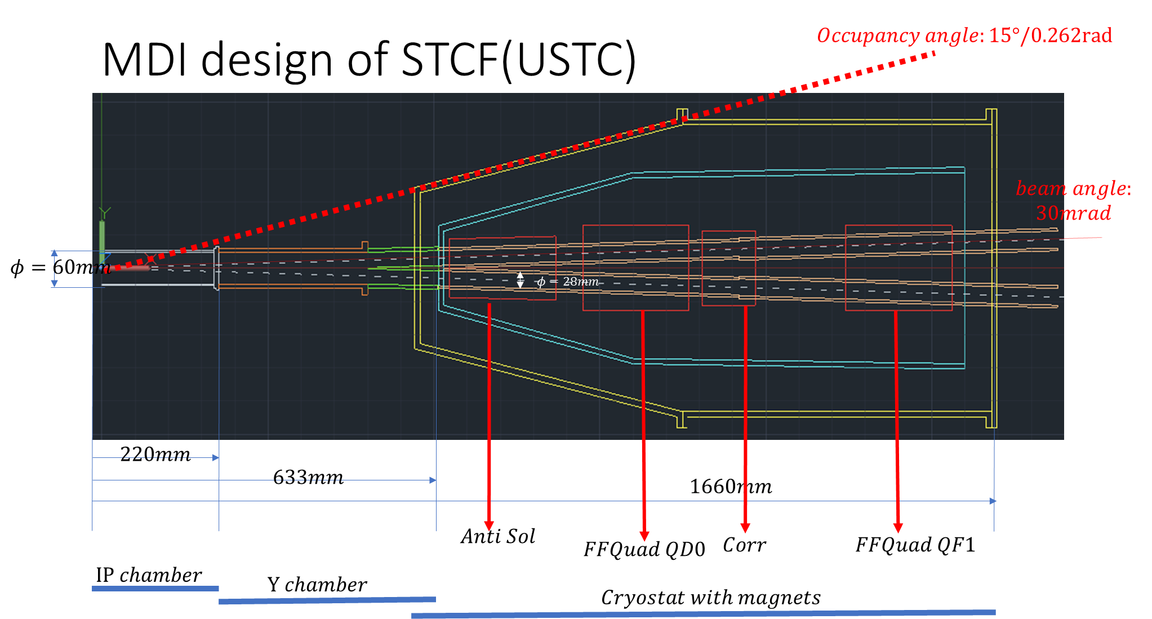
STCF MDI design
half
Designed by Huangchao Shi

Slide 5
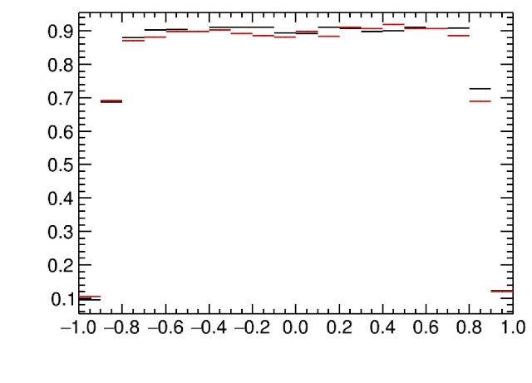
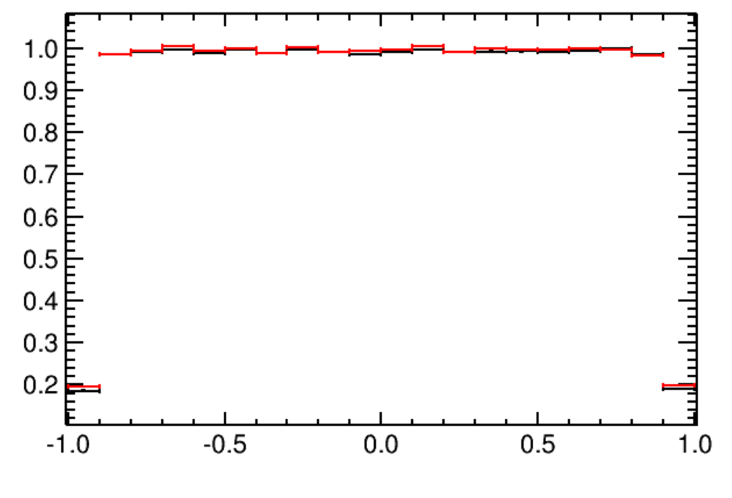
Optimization of MDI parameters
Beryllium pipe diameter:
30 mm: momentum resolution for low-pt particles
60 mm: background level and manufacturing difficulty
Track eff. for pion
30 mm
60 mm
Detector occupancy:
[15°, 165°]: slightly higher tracking efficiency 1.6%($π$),2.6%(p)
[20°, 160°]: more volume for tungsten shield
Track eff. for proton

Slide 6
STCF MDI design
Important parameters:
Beam pipe
Beryllium pipe: D=60 mm
Y-chamber: z=0.5 m, cross angle=60 mrad
Beam pipe: D=28 mm, limited by SCM
Magnet
QD0: z=0.9 m
QF0: z=1.4 m
Occupancy angle of MDI: 15 degree
half

Slide 7
Outline
STCF MDI design
Beam background sources
Background simulation results
Discussion and conclusion

Slide 8
Beam background sources
Beam energy 2.0 GeV
Luminosity-related background:
Radiative Bha-Bha e⁺e⁻ →e⁺e⁻γ(nγ)
high-energy e± , θ>4.47 mrad, σ=2.99 mb
gamma, θ>4.47 mrad, E_{γ}>1 MeV, σ=2.99 mb, n=0.3573
Two photon processes e⁺e⁻ → γ∗γ∗→e⁺e⁻e⁺e⁻
low-energy e±, no E_{e±} threshold, σ=5.15 mb
Beam-related background:
Touschek/Coulomb scattering/Bremsstrahlung
high-energy e±

Slide 9
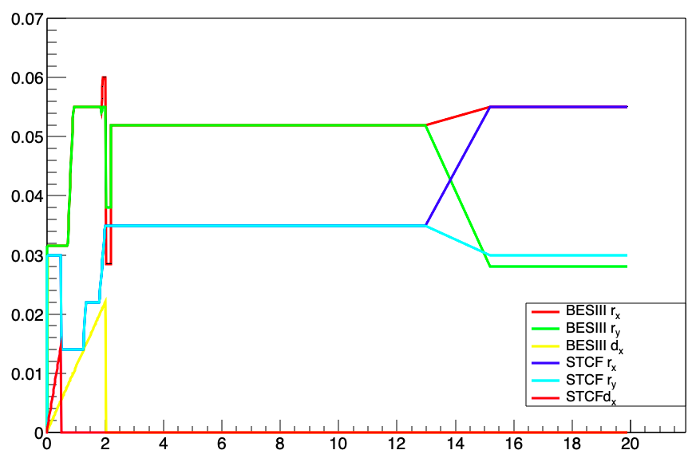
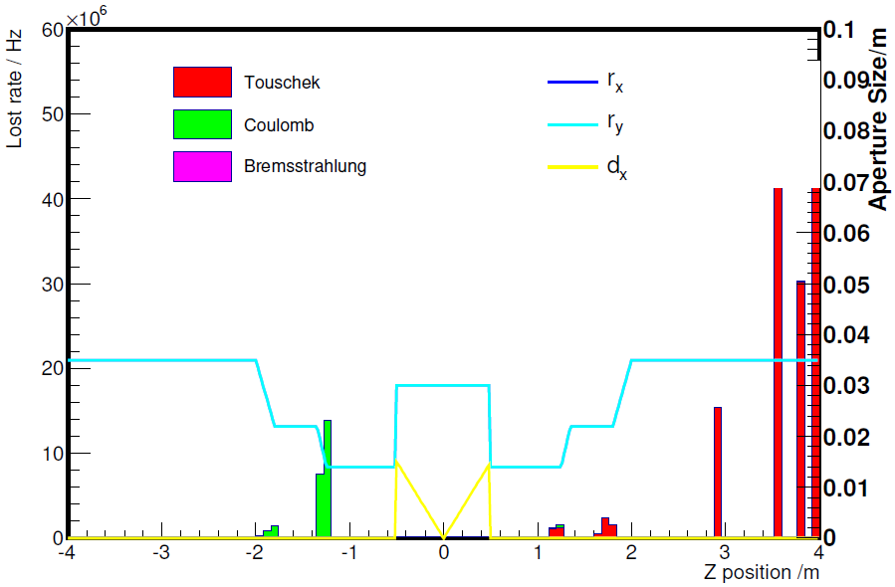
Beam background sources
The pipe diameter of STCF and BES III
Particle loss distribution in STCF
Diameter (m)
Out of detector system
Aperture reduce
QD0 & QF0
Distance from IP (m)
 | Touschek | Coulomb | Bremstrahlung
BESIII | 16.3MHz | 6.0MHz | 0.8MHz
STCF | 35.9MHz | 109.2MHz | 1.1MHz
Belle2 LER | 71.6MHz | 55.2MHz | 1.0MHz

Slide 10
Beam background sources
Luminosity-related background: determined by cross section and luminosity.
Beam-related background: simulated by SAD.
 | RBB e± | RBB γ | Two photon process | Touschek effect | Coulomb Scattering | Bremsstrahlung
Cross section (mb) | 2.99 | 2.99, n=0.3573 | 5.15 | / | / | /
Luminosity | 1×10³⁵ /cm²/s
Particle rate (Hz) | 5.98×10⁸ | 1.07×10⁸ | 1.03×10⁹ | 1.12×10⁹ | 2.09×10⁸ | 2.1×10⁶
The generator files for luminosity-related and beam-related backgrounds are introduced into Geant4 simulations.

Slide 11
Outline
STCF MDI design
Beam background sources
Background simulation results
Discussion and conclusion

Slide 12
Detector and electronic system
R (cm)
MUC-B
MUC-E
Note: all the detector sub-system has its own electronic system.
Shield
Solenoid
ECAL-E
ECAL-B
PID-B
PID-E
Shielding
MDC
MDI
Z (cm)
Inner tracker

Slide 13
Electronic system definition
Chip construction:
Upper: 600 μm Copper (Metal package layer)
Medium: 100 μm Silicon (core of chips)
Lower: 500 μm Copper (Metal package layer)
PCB Substrate: 2 mm FR4
Electronic system setting:
Determined by detector design
Inner tracker: at the edge
MDC: at the endcap
PID-E: with MCP-PMT

Slide 14
TID simulation result
Total Ionizing Dose (TID) shows the absorbed dose rate of the detectors and electronics.
R (cm)
Gy/y
TID: directly simulated by Geant4
Pixel division: 1 cm³
Each pixel is the mean of the whole ring
Highest TID value: inner tracker
Z (cm)

Slide 15
TID simulation result
Detector | Inner-1 | Inner-2 | Inner-3 | MDC | PID-B | PID-E
TID (Gy/year) | 40.92 | 14.88 | 11.43 | 8.59 | 2.12 | 0.96
Max TID | 103.25 | 27.75 | 20.01 | 25.48 | 0.66 | 23.79
Detector | ECAL-B | ECAL-E | MUC-B-RPC | MUC-B-PS | MUC-E-RPC | MUC-B-PS
TID (Gy/year) | 0.29 | 0.28 | 0.034 | 0.0048 | 0.020 | 0.062
Max TID | 1.72 | 33.26 | 0.18 | 0.14 | 0.42 | 0.23
Electronics | Inner-1-ele | MDC-ele | PID-B-ele | PID-E-ele
TID (Gy/year) | 50.63 | 3.15 | 1.81 | 0.75
Max TID | 60.17 | 3.04 | 1.65 | 6.55
Electronics | ECAL-B-ele | ECAL-E-ele | MUC-B-ele | MUC-E-ele
TID (Gy/year) | 0.04 | 1.02 | 0.027 | 0.34
Max TID | 0.86 | 40.49 | 0.081 | 2.76
Maximum TID value: 40-50 Gy/year
for detector and electronic system

Slide 16
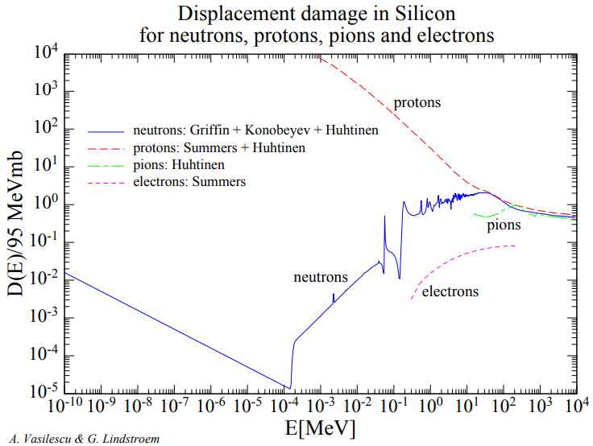
NIEL damage simulation
NIEL damage by various particles should be equivalent to1 MeV neutron.
Neutron: elastic scattering (primary)
Proton: coulomb scattering (primary)
Silicon displacement damage threshold: 21 eV
Kinetic energy threshold of n&p: 158 eV
Physical list: QGSP_BERT_HP
Secondary particles are also involved in the count.

Slide 17
NIEL damage simulation
In Geant4, the NIEL damage value could be simulated by the following steps:
Simulate particles (type, E_{k})
Equivalent to 1 MeV neutron (threshold)
Data count
Counts
threshold
log₁₀ (Particle Energy) (MeV)

Slide 18
NIEL damage simulation result
R (cm)
1 MeV n/cm²/y
Secondary proton has the most contribution to NIEL value.
Hydrogen-rich volume has higher value (MUC PS detector).
Highest NIEL damage: MUC PS
Z (cm)

Slide 19
NIEL damage simulation result
Volume | PID-B | PID-E | ECAL-B | ECAL-E | MUC-B-PS
NIEL damage (n/cm²/y) | 8.99×10⁹ | 4.71×10⁹ | 1.4×10¹⁰ | 7.54×10⁹ | 5.09×10¹¹
Max NIEL | 8.05×10⁹ | 1.30×10¹⁰ | 5.37×10⁹ | 1.33×10¹⁰ | 3.42×10¹¹
Volume | Inner-1-ele | Inner-2-ele | Inner-2-ele | MDC-ele | PID-B-ele
NIEL damage (n/cm²/y) | 1.13×10¹⁰ | 1.59×10¹⁰ | 3.25×10¹⁰ | 6.28×10⁹ | 7.19×10⁹
Max NIEL | 9.55×10⁹ | 1.45×10¹⁰ | 2.16×10¹⁰ | 1.52×10¹⁰ | 6.13×10⁹
Volume | PID-E-ele | ECAL-B-ele | ECAL-E-ele | MUC-B-ele | MUC-E-ele
NIEL damage (n/cm²/y) | 2.81×10⁹ | 1.58×10⁹ | 1.35×10⁹ | 1.61×10⁸ | 4.51×10⁸
Max NIEL | 5.35×10⁹ | 3.04×10⁹ | 1.43×10¹⁰ | 2.59×10¹¹ | 1.27×10⁹
Maximum NIEL damage value:
Below 10¹² 1 MeV n/cm²/y for detector
Below 10¹¹ 1 MeV n/cm²/y for electronics

Slide 20
Counting rate simulation result
R (cm)
Hz/cm²
Secondary particles were also considered.
Highest total counting rate: MDC
Highest counting rate per cm²: inner tracker
Detailed detector responses are researched by each groups based on this result.
Z (cm)

Slide 21
Counting rate simulation result
Detector | Inner-1 | Inner-2 | Inner-3 | MDC
Total background Counting rate (Hz) | 5.60×10⁶ | 6.47×10⁶ | 1.20×10⁷ | 3.44×10⁹
Max counting rate (Hz/cm²) | 7.64×10³ | 1.76×10³ | 2.09×10³ | 5.63×10³
Detector | PID-B | PID-E | ECAL-B | ECAL-E
Total background Counting rate (Hz) | 1.73×10⁸ | 1.16×10⁸ | 2.11×10⁹ | 7.49×10⁸
Max counting rate (Hz/cm²) | 9.20×10² | 2.59×10³ | 1.10×10³ | 6.73×10³
Detector | MUC-B-RPC | MUC-B-PS | MUC-E-RPC | MUC-B-PS
Total background Counting rate (Hz) | 6.16×10⁶ | 1.14×10⁷ | 3.73×10⁶ | 2.61×10⁷
Max counting rate (Hz/cm²) | 6.54×10⁰ | 2.76×10⁰ | 2.14×10² | 9.32×10¹
Maximum counting rate:
10⁹ Hz level for detector sub-systems

Slide 22
Outline
STCF MDI design
Beam background sources
Background simulation results
Discussion and conclusion

Slide 23
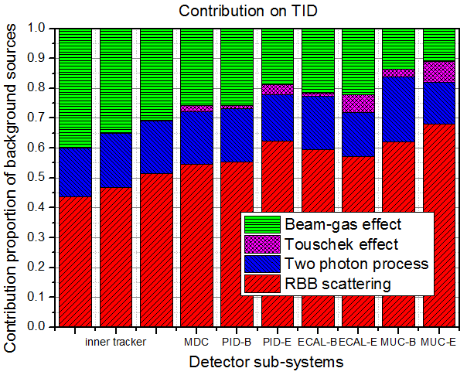
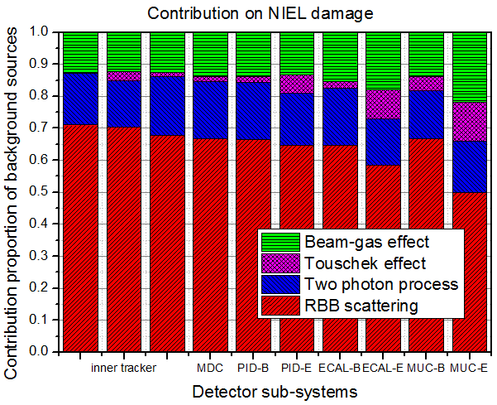
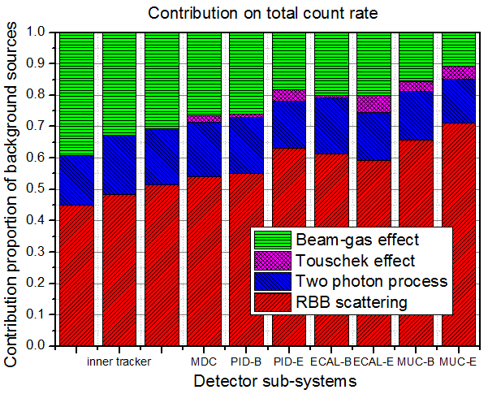
Discussion: contributions
The luminosity-related background contributes more than 60% of the TID/NIEL damage/Total counting rate.
RBB scattering makes the major contributions.

Slide 24
Discussion: more shield?
Fewer background counting rates in PID and ECAL are required.
More shield (tungsten layer between MDI and detector)?
Occupancy angle: 20°
Geant4 simulations:
2 cm W -> 60% counting rate decrease
~4 cm W shield
half

Slide 25
Conclusion
In the simulation of STCF background:
TID: all the detectors and electronics has a absorbed dose below ~50 Gy/y.
NIEL damage: for all detectors and electronics, the equivalent NIEL damage is in magnitude of 10¹¹ 1 MeV n/cm²/y (for silicon).
Counting rate: highest total count rate appears in MDC, with 10⁹ Hz.
More than about 60% of the TID/NIEL damage/Total counts come from the luminosity-related contributions, with the luminosity of 10³⁵ /cm²/s.
More tungsten shield is under designed.

Slide 26
THANKS

Slide 27
补充讨论与说明
与BINP相比，我们模拟的TID分布图基本一致，NIEL damage分布图普遍低近2个数量级，COUNT分布图除MDC外数量级基本对应。
NIEL damage差异原因：
BINP的NIEL damage采用FLUKA模拟，直接给出硅等效1MEV中子系数分布（SI1MEVNE，单位cm⁻²）；我们采用Geant4模拟，统计进入各体积内的初级/次级粒子种类及动能，按照实验数据计算等效中子系数，再平均给该pixel所在位置的面积（单位cm⁻²）。计算过程不同但应都无误。
Geant4计算NIEL有一个缺陷：只能进行精确的弹性/非弹性碰撞、核反应的模拟，对于库仑散射模拟很差，故直接获取NIEL值再计算damage不可行（质子贡献会少算很多），只能通过粒子统计等效计算。

Slide 28
补充讨论与说明
TOTAL COUNT差异原因：
我们统计产生有效信号的hit/track，可认为是count；BINP统计的是经过某个体积的粒子数，因此不能直接对比。气体探测器（MDC）对γ的探测效率很低，在Geant4中很少有有效能量沉积的记录，是造成此处差异的主因。
同时，γ穿透整个MDC会在多个pixel上产生粒子数记录，而Geant4通常只记录1个step（未发生反应），使上述差异扩大。即使我们在G4上调整统计方式为粒子数计数，也不能达到BINP的统计效果。

Slide 29
补充讨论与说明
BINP模拟的粒子cut为能量cut，对于探测器区域，e±的ECUT为1 MeV，γ和其余粒子为0.1 MeV。
我们采用Geant4的粒子cut是射程/能量混合cut，目前所用物理表（QGSP_BERT_HP）采用700 μm的射程cut，但对e±、γ具有最低能量cut 990 eV。故：
在Gold/Tungsten等重元素材料中，我们的cut略高于BINP，e±为1.5-1.6 MeV，γ为0.102 MeV；
在其余轻元素材料（占探测器体积绝大部分）中，我们的cut显著低于BINP，e±为1-100 keV，γ为1-10 keV。
我们目前模拟cut选择基本合理。

