Slide 1
Gravitational waves observation in LIGO
Li Deng
2020.6.17

Slide 2
OUTLINE
Gravity and gravitational waves
Basic forces and gravity
Gravitational waves in universe
LIGO technology
Laser Interferometer
Avoid noise
LIGO’s construction and working
Analysis of recent running
Further research and frontier

Slide 3
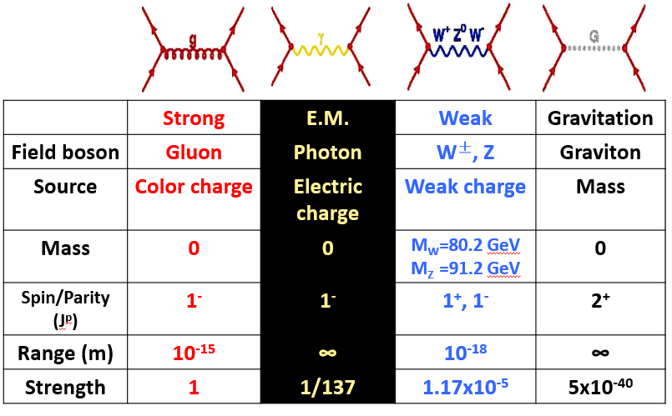
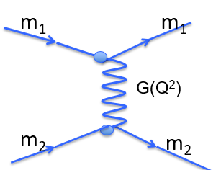
Basic forces and gravity
Basic forces and graviton:
Quantum physics believes that gravity is interacted by graviton. Graviton is one of the field particles. Like other three basic forces, gravity is described as the exchange of graviton between matters. However, at atom length, graviton is so weak, it’s impossible to detect it by present particle detectors.

Slide 4
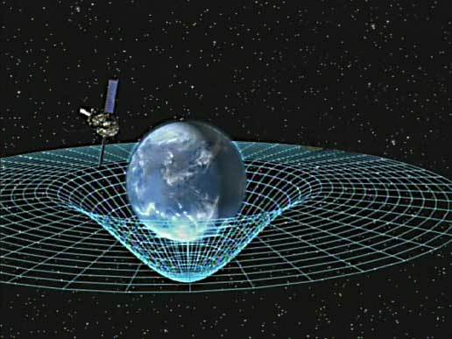
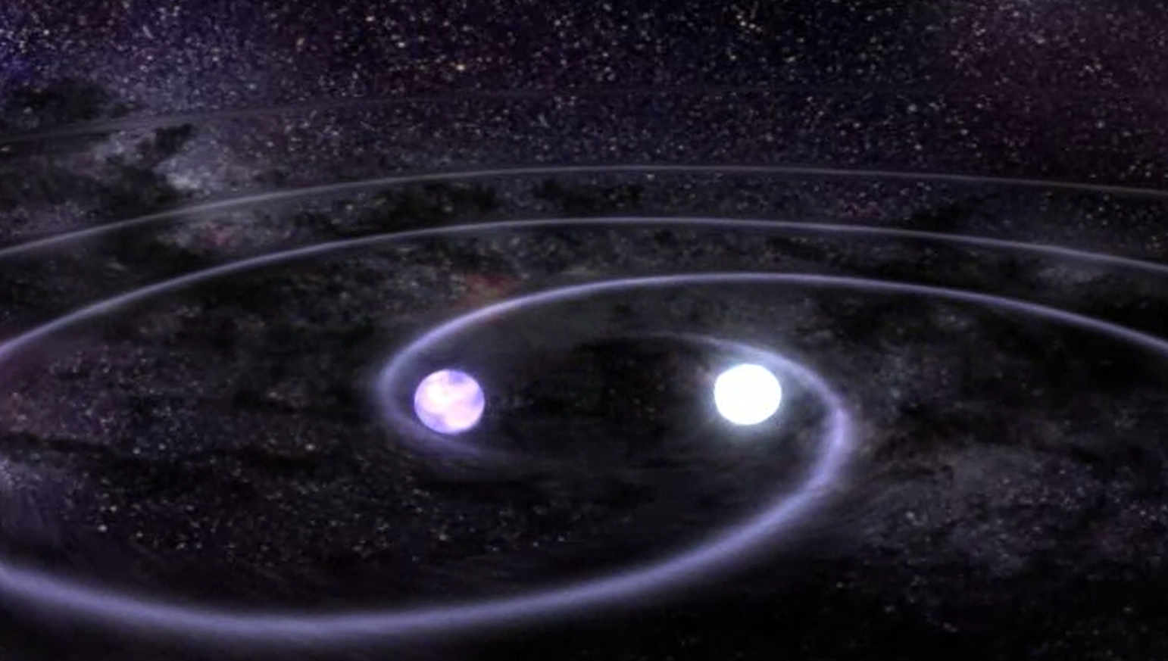
Gravity in general relativity:
Matter/energy tells space-time how to curve, and space-time tells matter/energy how to move!
As the result of general relativity Lorentz invariance, gravitational wave (GW) describes the spreading of this curve, like the water wave in a lake. It contains the information when it occurs, and it’s possible to detect some strong GW. So this is the most effective way to study gravity at present.

Slide 5
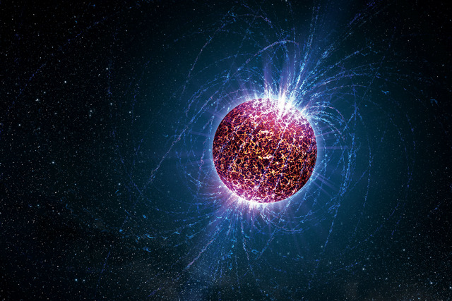
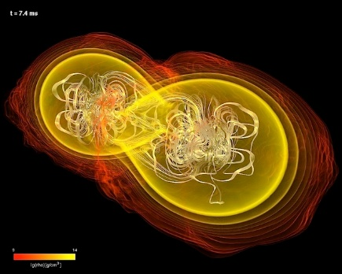
Gravitational waves in universe
Sources and types of GW in universe:
Continuous Gravitational Waves
Compact Binary Inspiral Gravitational Waves
Stochastic Gravitational Waves
Burst Gravitational Waves
Single spinning massive object
GW is in same frequency and amplitude
Binary Neutron Star (BNS), Binary Black Hole (BBH)
and Neutron Star-Black Hole Binary (NSBH)
So far, all of the GW LIGO has detected fall into this
Presume that many small gravitational waves are passing by from all over the Universe
all the time, and that they are mixed together at random
It is possible that at least part of this stochastic signal may originate from the Big Bang
A search for the unexpected.

Slide 6
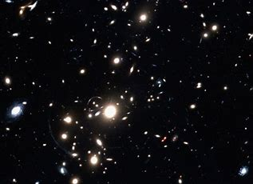
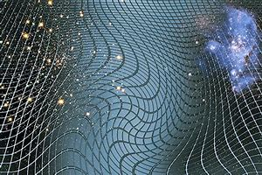
Significance of GW observation in astronomy：
GW observation detects the curve of the space-time, it is not related to electromagnetic interaction. Comparing to traditional methods, GW observation is the ear of a human, they can help us understand the universe from different view.
Traditional cosmic observation uses the electromagnetic interaction, including optics and cosmic rays analysis method, gives us the direct view of the universe, like the eye of a human.

Slide 7
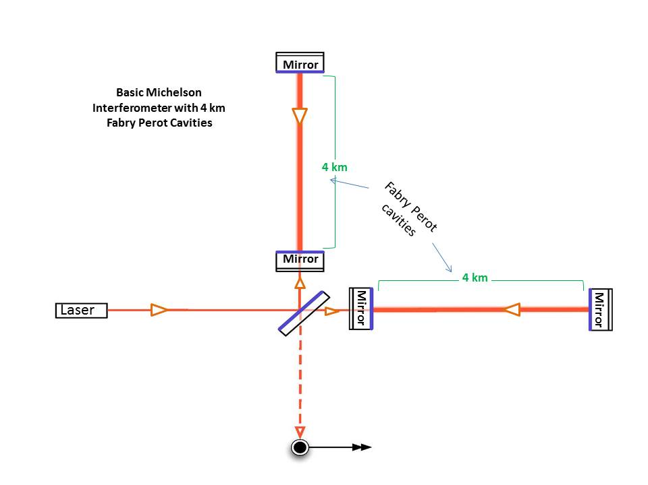
LIGO technology
Laser Interferometer
Basic Michelson Interferometers:
Mirrors at the ends of the arms reflect light in order to create an interference pattern called 'fringes'
A device called a photo detector measures these fringes, revealing minute details of the objects or phenomenon being studied
GW is thousands of billions smaller when it arrives us (1000 times smaller than the nucleus of an atom). So much more arm length and laser power are required, in order to be sensitive with such a tiny shake. Also, all possible noise or error should be carefully considered, this is the key problem of GW observation.

Slide 8
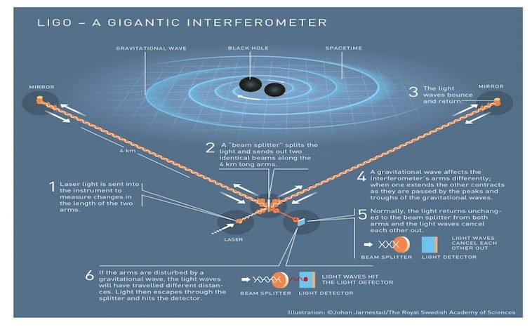
LIGO (Laser Interference Gravitational-Wave Observation)

Slide 9
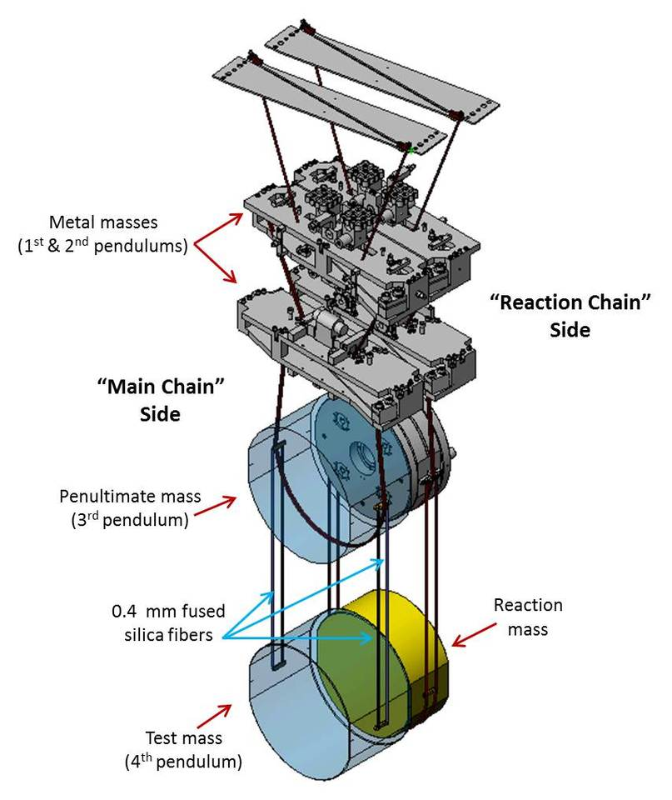
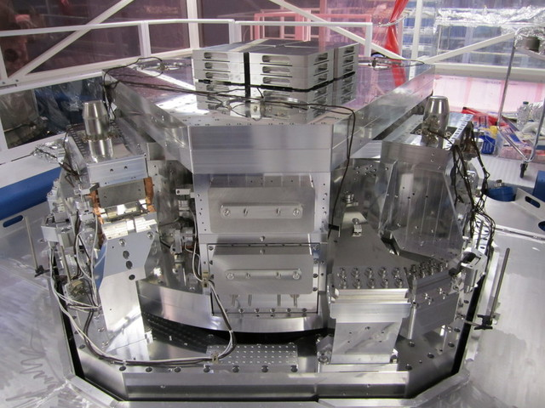
Avoid noise
Seismic isolation
Active Damping
Passive Damping
The Internal Seismic Isolation (ISI) system consists of devices that sense ground movements and then deliberately perform counter movements to eliminate them, keeping the instrument motion-free.
LIGO’s passive damping system holds the all-important mirrors perfectly still through a 4-stage pendulum called a "quad".
Noise canceling
Instruments perfectly fixed

Slide 10
Operating in a ultra-high vacuum
- Even just a few molecules of air can create noise which masks the tiny changes in distance between mirrors we seek to detect.
- Dust will drift into the path of the laser, or worse, onto a mirror.
The tubes were heated to between 150 C and 170 C for 30 days to drive out residual gas molecules
Turbo-pump vacuums (like little jet engines that create suction instead of thrust) sucked out the bulk of the air contained in the tubes
Ion pumps then extract individual remaining gas molecules by electrically charging them and then attracting them away with opposite charge, like a magnet. Since the metal inside the vacuum chamber is always emitting some gaseous molecules ("outgassing"), these pumps operate continuously in order to maintain the pristine vacuum inside the tubes.
It took 40 days to remove all 10,000 m³ of air and other residual gases from each of LIGO’s vacuum tubes to reach an air pressure one-trillionth of an atmosphere.

Slide 11
LIGO’s construction and working
Granted funding in 1990, and started working in 2001.
Initial LIGO (iLIGO) operated for 9 years but never detected gravitational waves, it is retired in 2010.
Construction of Advanced LIGO’s (aLIGO) upgraded components began in 2008. Construction, preparation, installation, and testing of aLIGO took 7 years (from 2008 to 2015).
For LIGO's first observing run in 2015, the LIGO Lab will provide 35 MSU (million service units) worth of computing cycles/time. The amount of computing time is expected to grow by a factor of 10 to around 400 MSU by the time LIGO has completed its third observing run.

Slide 12
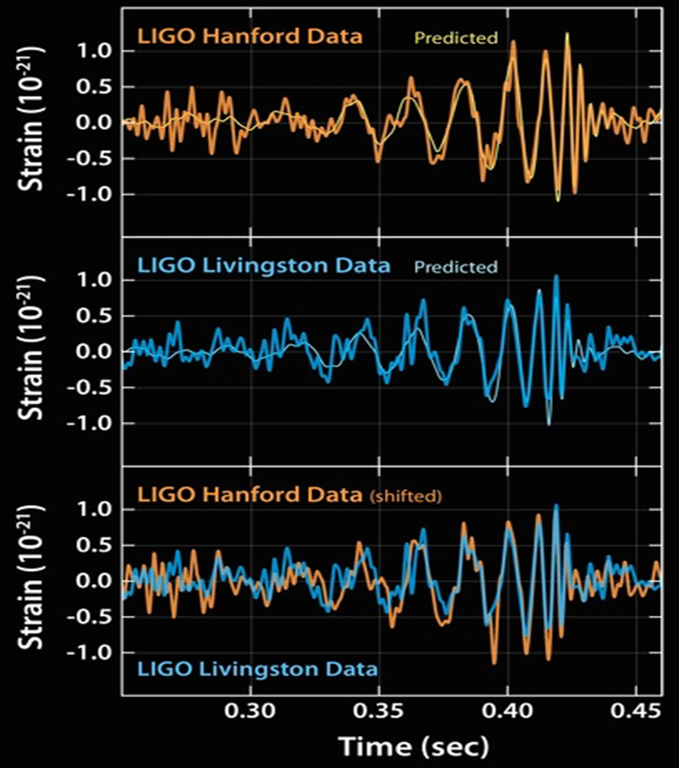
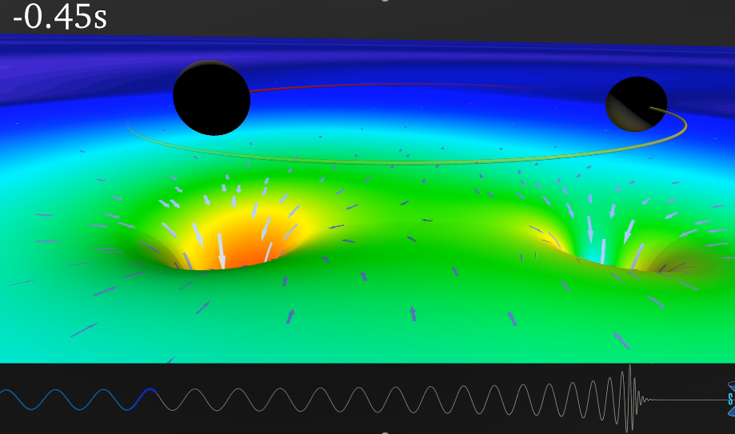
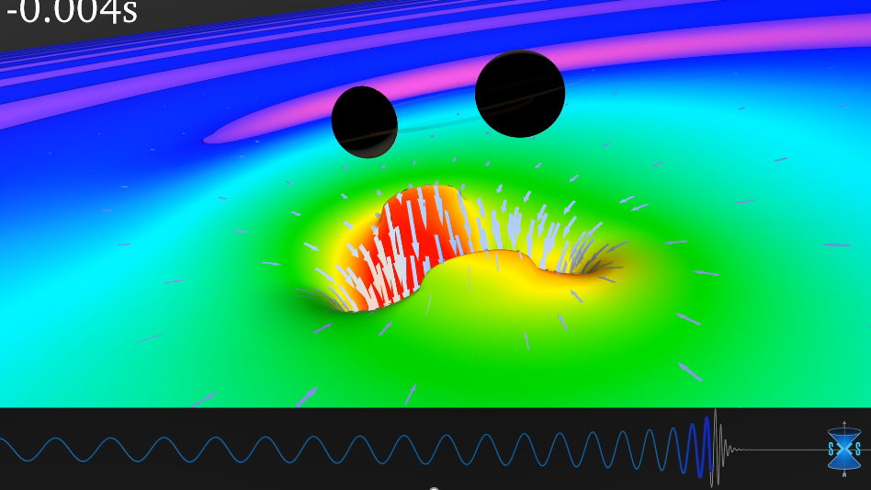
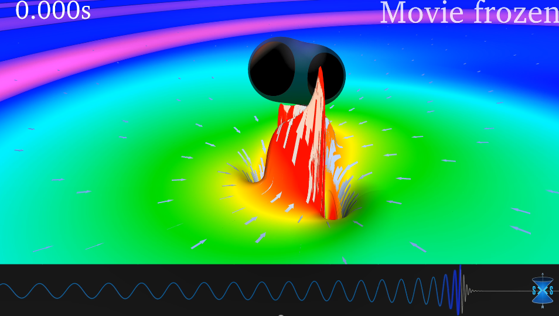
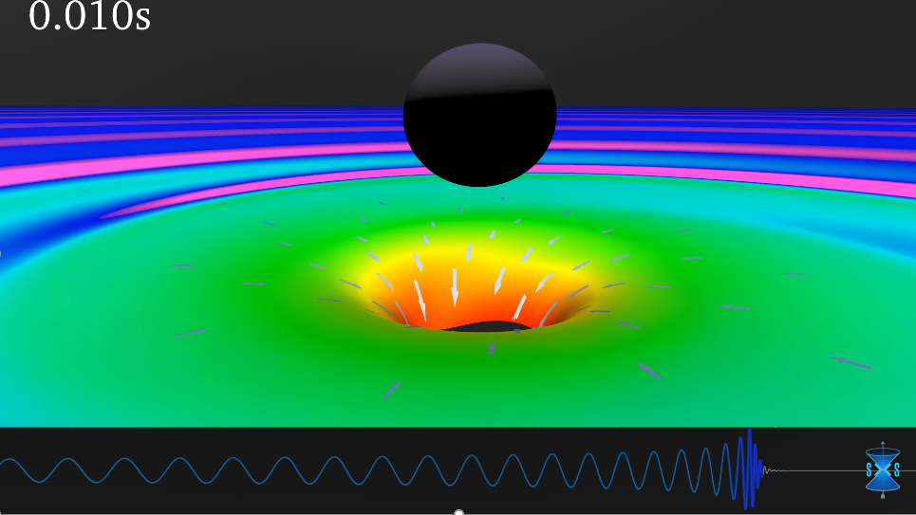
Analysis of recent running
When GW arrives, the interference image will change. We can get wave shape from this change.
Further analysis needs to compare experiment data with theoretical simulation to confirm what types of cosmic events we detect, and other physics information we are interested in (mass of the objects, distance between them and us).
Result: Two black holes collision, each about 30 times the mass of our sun, lying 1.3 billion light-years away.
Computer simulation GW
of two black holes collision:

Slide 13
Further research and frontier
Changed component | Initial LIGO | Advanced LIGO
Mirrors (aka Test Masses) | 25cm (9.8in) across 10cm (3.9in) thick 11kg (22lb) | 34cm (13.4in) across 20cm (7.8in) thick 40kg (88lb)
Suspension | Single pendulum | Quadruple pendulum
 | Metal wires | Glass fibers
Seismic Isolation | Passive only | Passive + active
Although LIGO can already detect some GW data, it’s sensitivity is not enough to detect more GW events we care about. So the improvement of it is important. Ultimately, the goal is to make LIGO 10 times more sensitive than its initial instrument.
On the other hand, LIGO is not only used to confirm prediction, we hope it can observe new physics. Searching for unknown gravitational waves requires being utterly open-minded. If we don’t know what we’re looking for, it’s really hard to find it. While this makes searching for burst gravitational waves difficult, detecting them has the greatest potential to reveal revolutionary information about the Universe, also about basic physics.

Slide 14
Thank you!

