Slide 1
0νββ实验中钼酸盐晶体光热两相读出方法的可行性研究
ββ衰变研讨会， 2014年12月6日，合肥
调研
刘衍文，彭海平，张云龙，汪晓莲, 许咨宗
中国科学技术大学

Slide 2
ββ 衰变核素和实验
核素 | 丰度 (%) | Q_{ββ} (keV) | 实验
⁴⁸Ca(钙) | 0.187 | 4272 | Candles
⁷⁶Ge(锗) | 7.73 | 2039 | Gerda, Majorana Demonstrator
⁸²Se(硒) | 8.73 | 2996 | SuperNEMO
¹⁰⁰Mo(钼) | 9.8 | 3034 | MOON,AMoRE
¹¹⁶Cd (镉) | 7.5 | 2813 | Cobra
¹³⁰Te(碲) | 34.08 | 2527 | COURE,Cobra,SNO+
¹³⁶Xe(氙) | 8.86 | 2458 | EXO,NEXO,NEXT,KamLAND-Zen

Slide 3
CaMoO₄: Advanced Mo-based Rare process Experiment
Timeline:
2002 Idea and try to grow CMO in Korea
2003 better CMO
2004 CMO test [conference talk at VIETNAM 2004]
2007 CMO R&D in Cryogenic temperature
2008 1kg of ⁴⁰Ca¹⁰⁰MoO₄
2009 AMORE Collaboration formed
2010-2011 Characterization of CMO&background
2012 Russia group funded for CMO production
2013 AMoRE project funded
H.J. Kim, AMoRE talk at MEDEX’13 conference, Prague

Slide 4
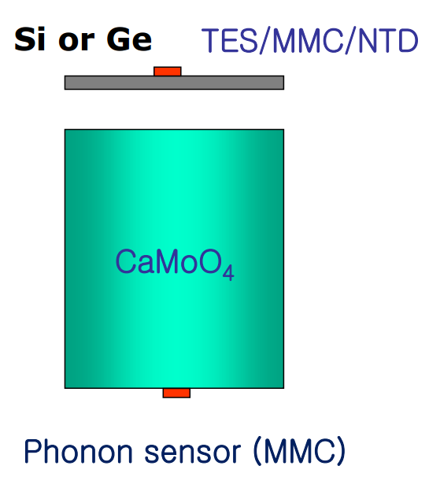
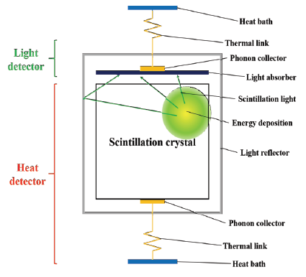
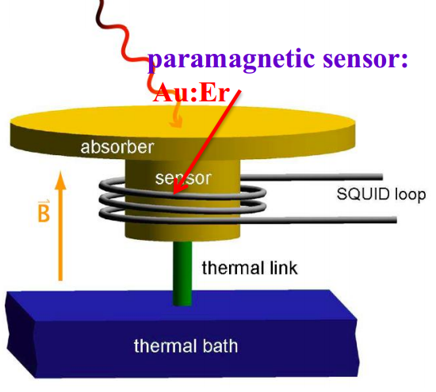
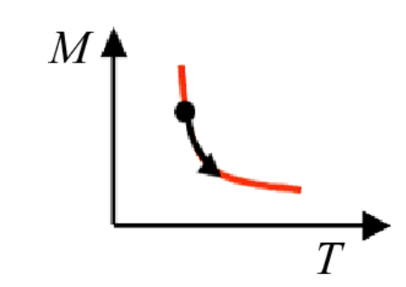
AMoRE
Metallic Magnetic Calorimeter
1 keV = 10⁹ spin flips

Slide 5
Y. S. Yoon, talk at
8th APCTP-BLTP JINR Joint workshop

Slide 6
Energy resolution MMC
钍

Slide 7
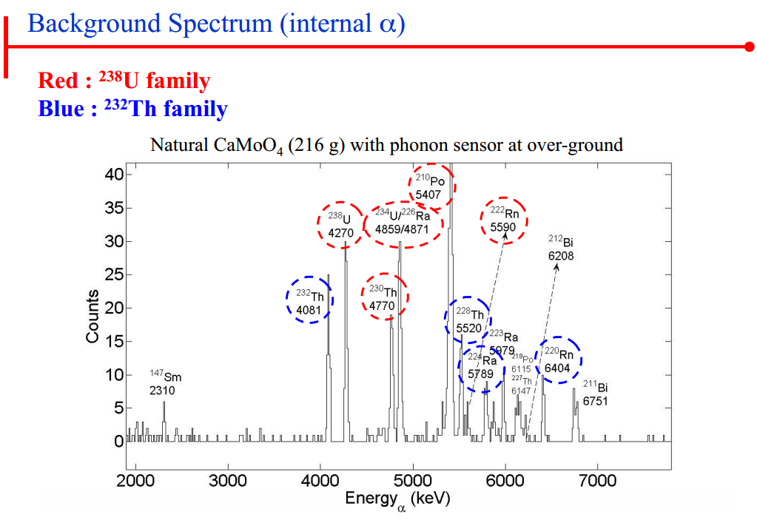

Slide 9
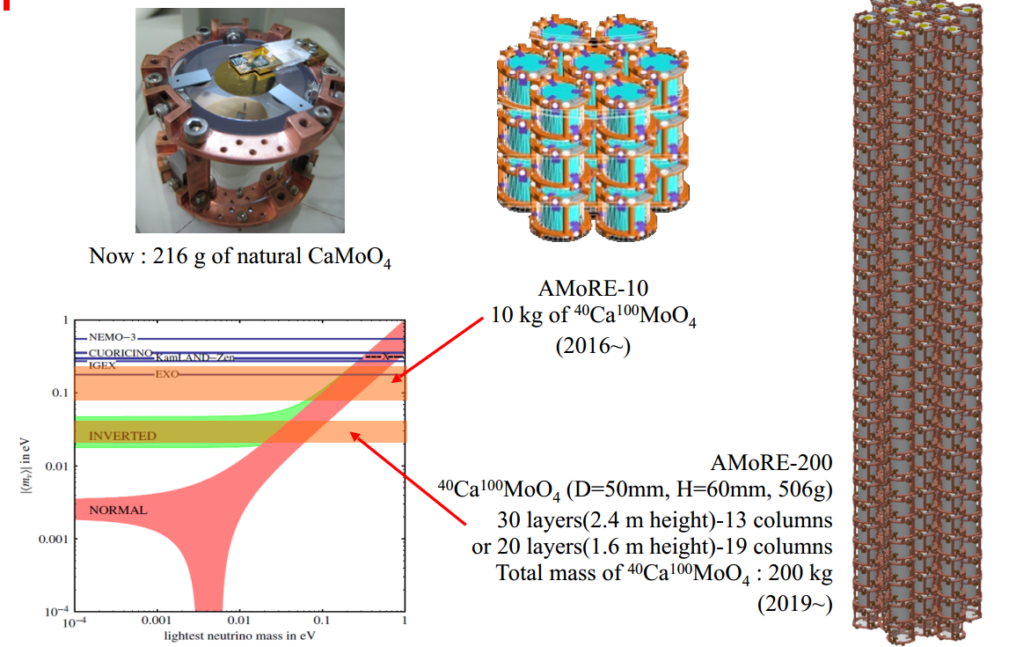

Slide 10
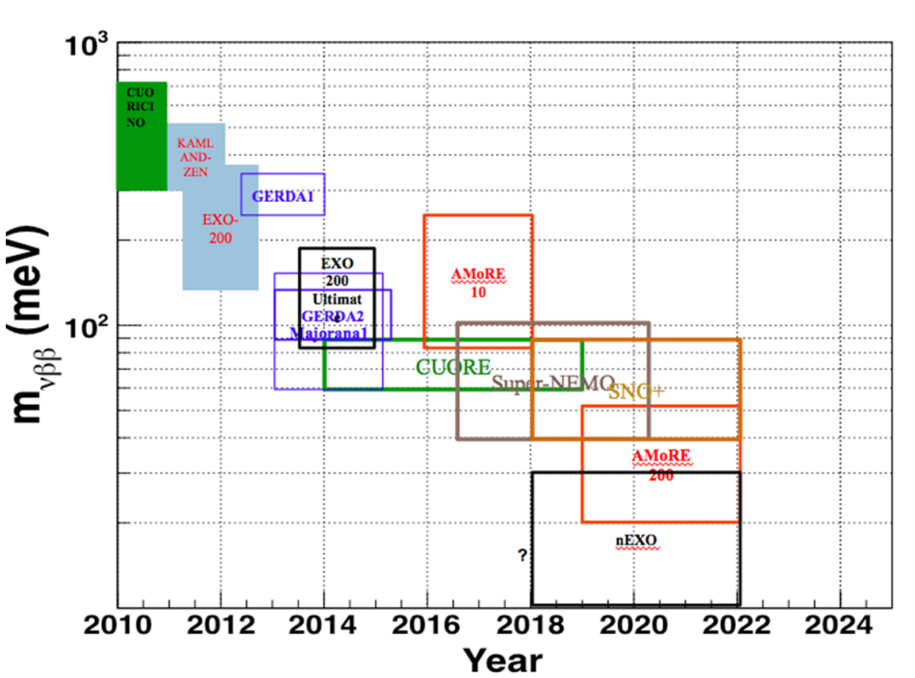

Slide 11
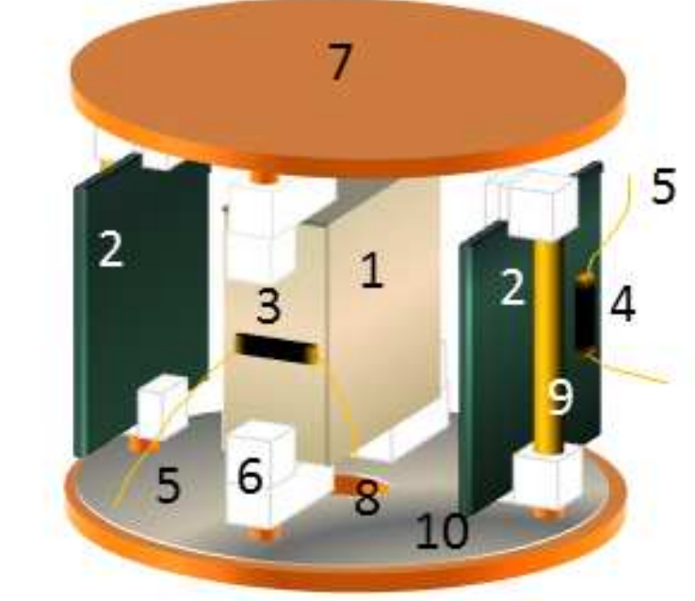
1. ZnMoO4 : 15x15x5 mm
2. Ge light detectors
3. NTD thermistor
4. NTD thermistor
5. Golden wires
6. PTFE holder for ZnMoO4
7. Copper support
8. Alpha source
9. Support of light detector
10. Light reflector
arXiv:1112.3672v1

Slide 12
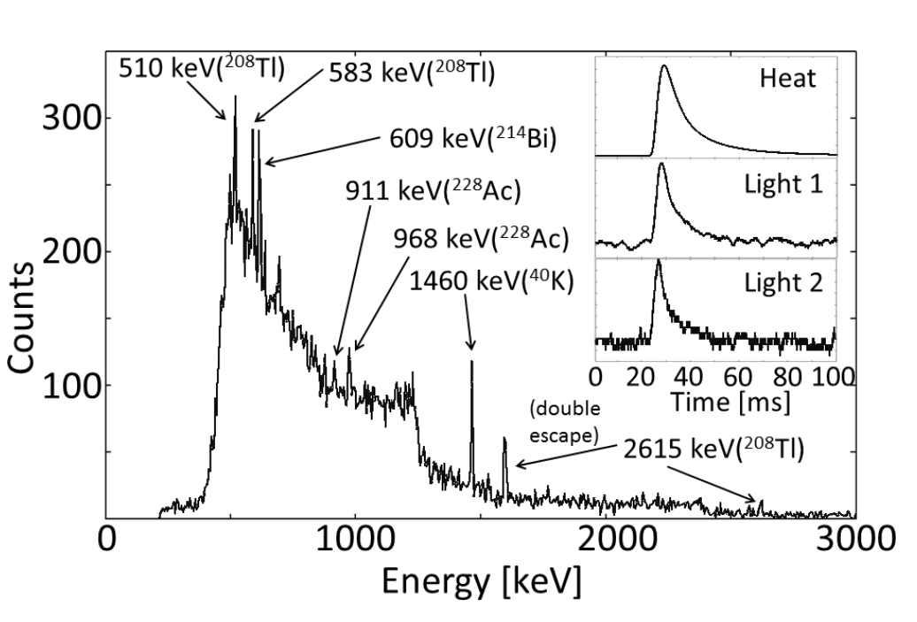
Heat channel : several peaks of environmental gamma peaks.
Inset shows good heat-light coincidence.

Slide 13
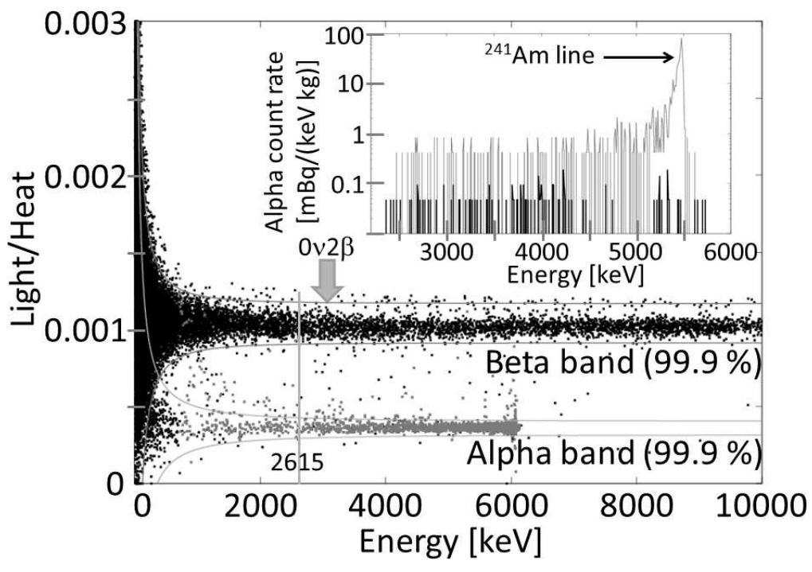
Above ground : β/α separation

Slide 14
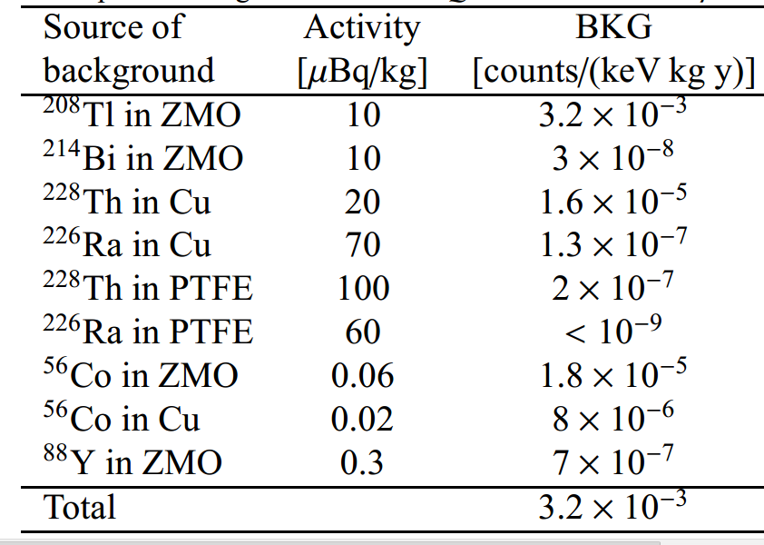
Background simulation(underground)
Total background in region of interest : 4×10⁻⁴ counts/(keV kg year) for enriched crystal
For natural crystal: a factor of 4 less

Slide 15
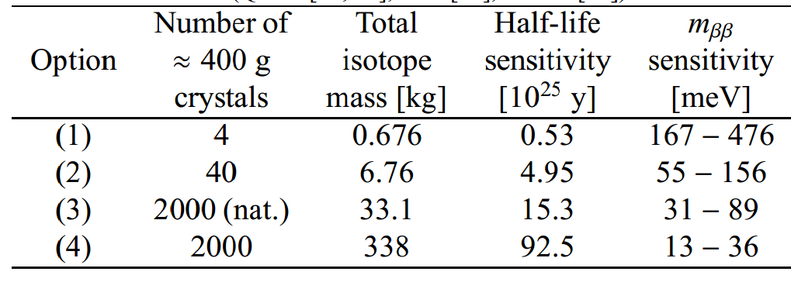
Expected sensitivity
live time = 5 years
Enrichment level: 97%, [option(3) natural]
6 keV signal window, 90% efficiency
Range for m_{ββ}for different Nuclear Matrix Element (QRPA,ISM, IBM)

Slide 16
总结与设想
¹⁰⁰Mo Q值和丰度上综合考虑是不错的核素
合肥物质科学研究院张庆礼：ZnMoO₄生长应该可行。
光/热双相读出可以有效区分β/γ和α信号，
MMC+SQUID (σ = 10 keV @²⁰⁸ Tl 2615 keV peak )
NTD (similar resolution ,CUORE, FWHM~6keV@2615keV)
吨级ZnMoO4：半衰期灵敏度10²⁶ 年量级，对应Majorana 中微子平均质量几十meV.
科大计划 ：
2015-2020 ：晶体研究 (光热读出，本底研究)，建立毫K实验平台（HE-3稀释制冷系统，TES温度传感器和相关读出电子学研发和制作）o(kg) 的原型样机。
2020-2025: o(100 kg)
2025-2030: o(1000kg)
谢谢！

