Slide 1
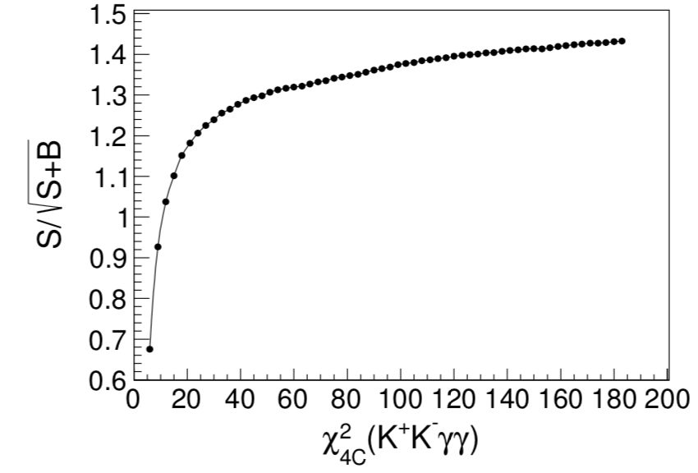
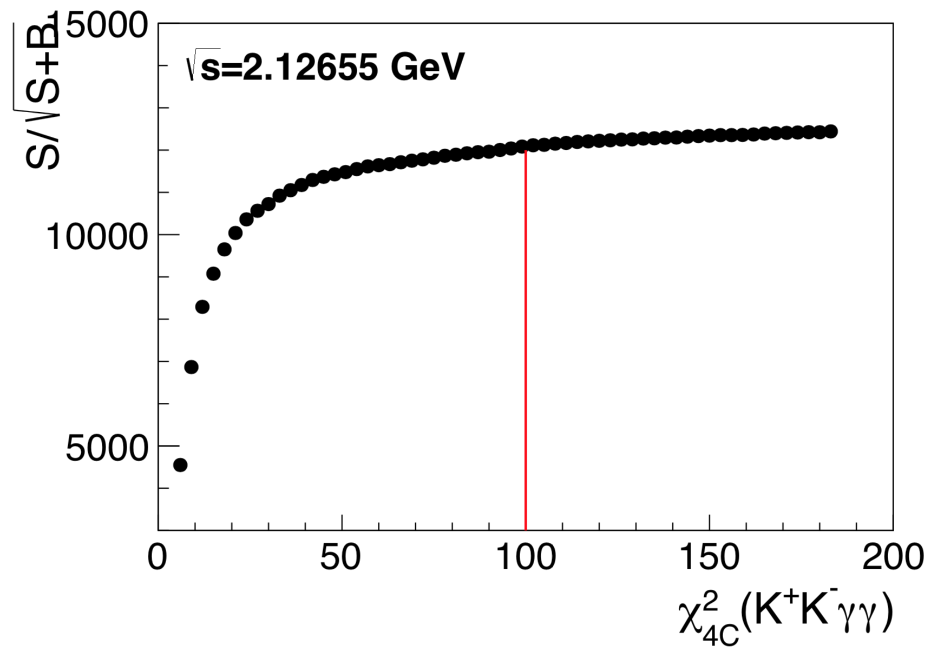
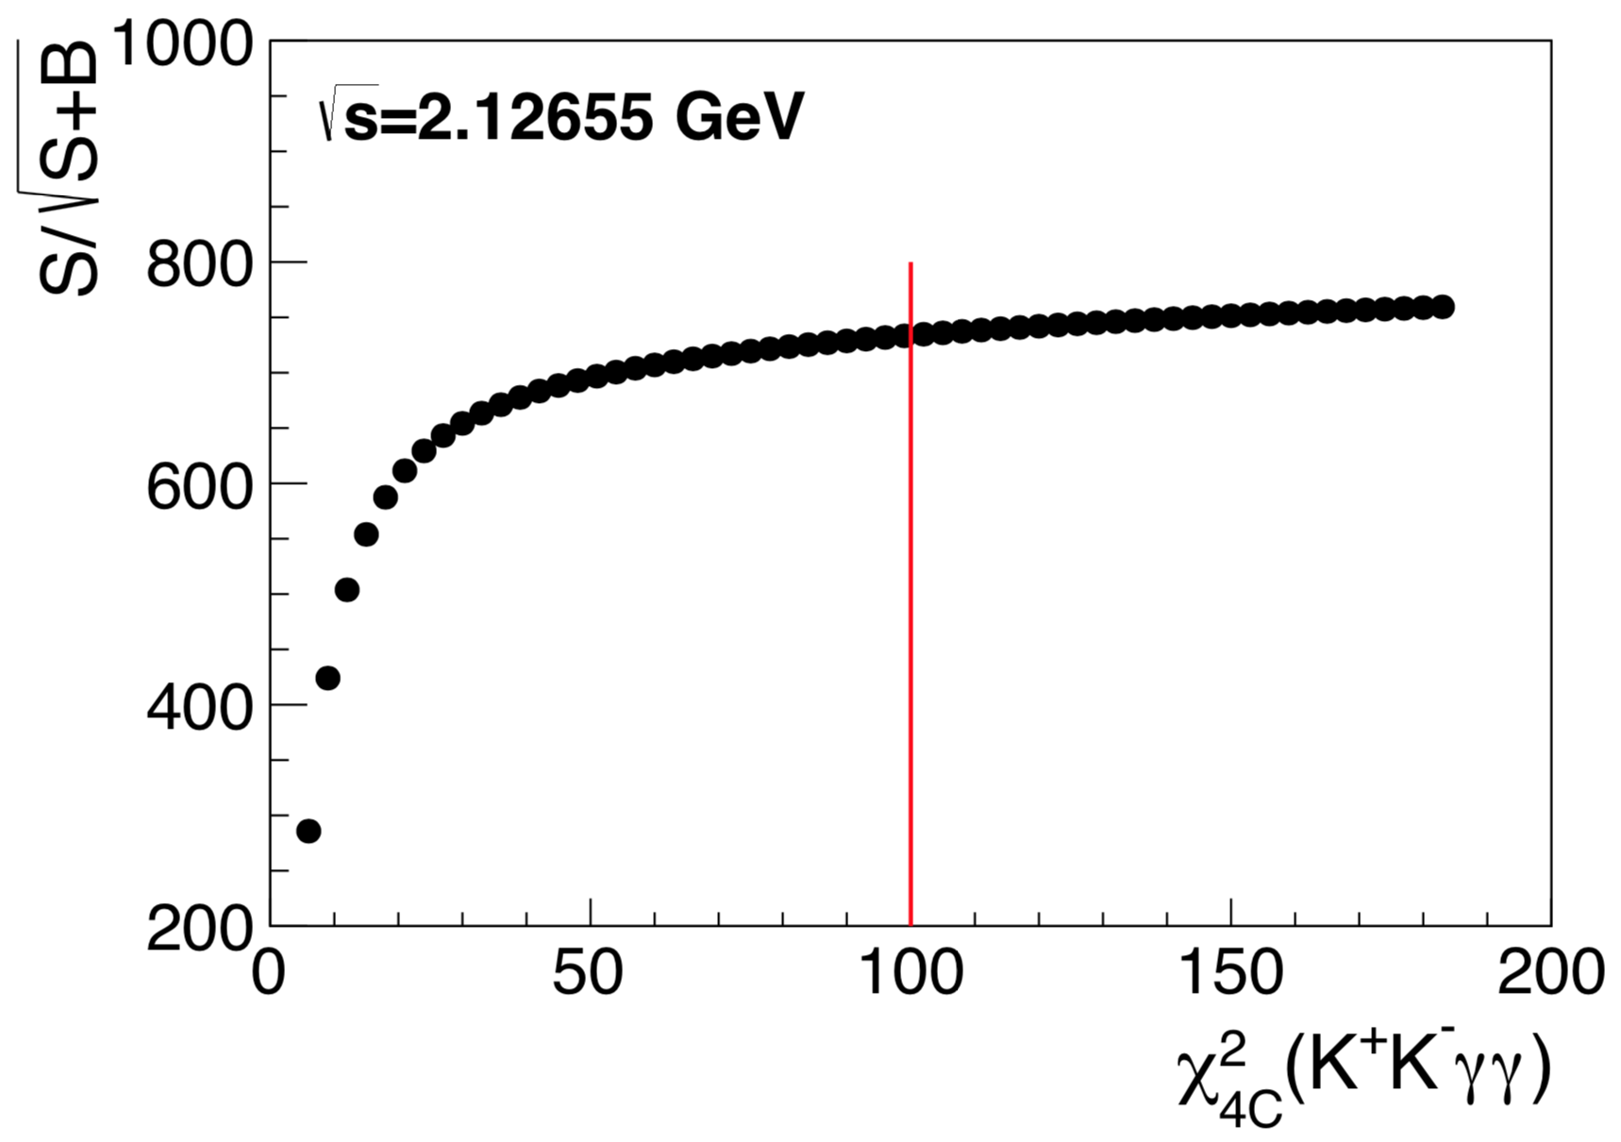

Slide 2
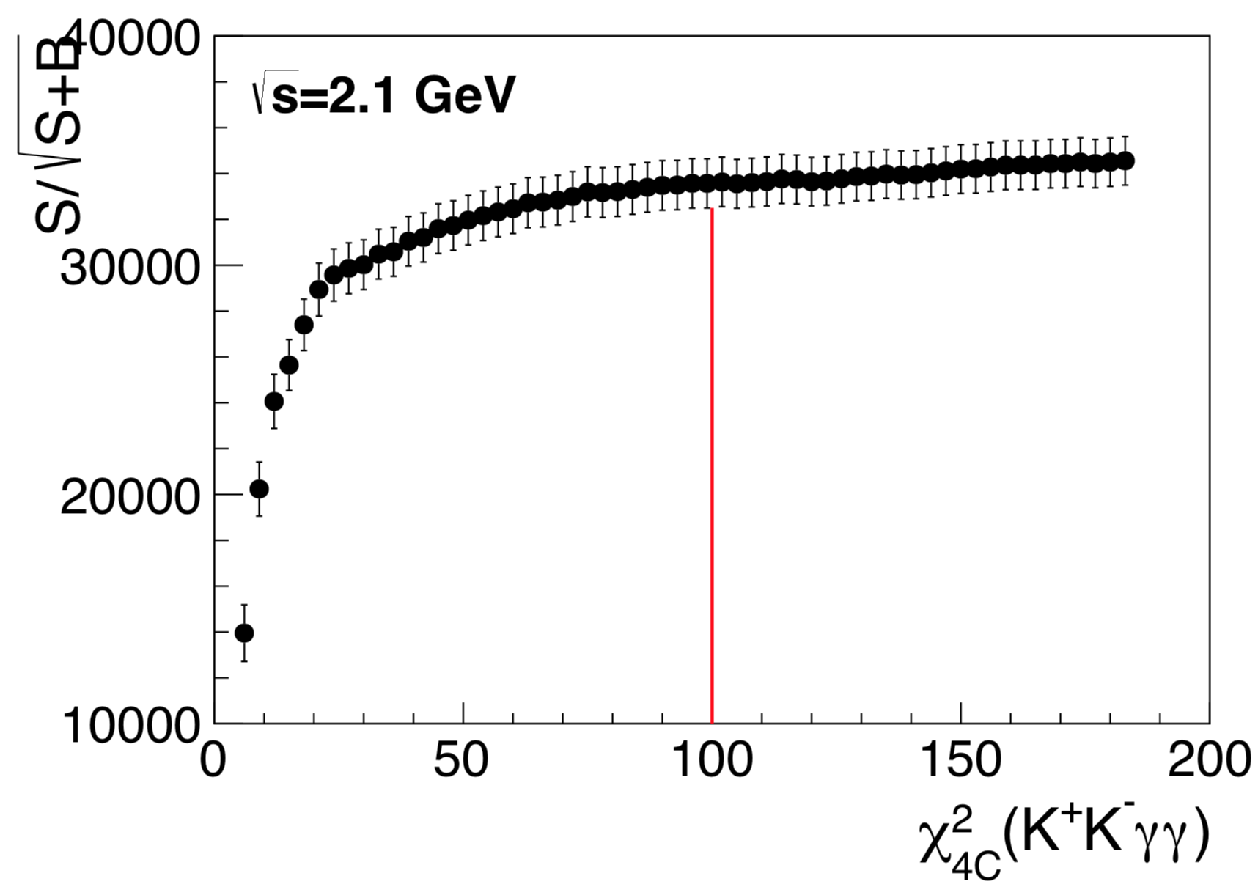
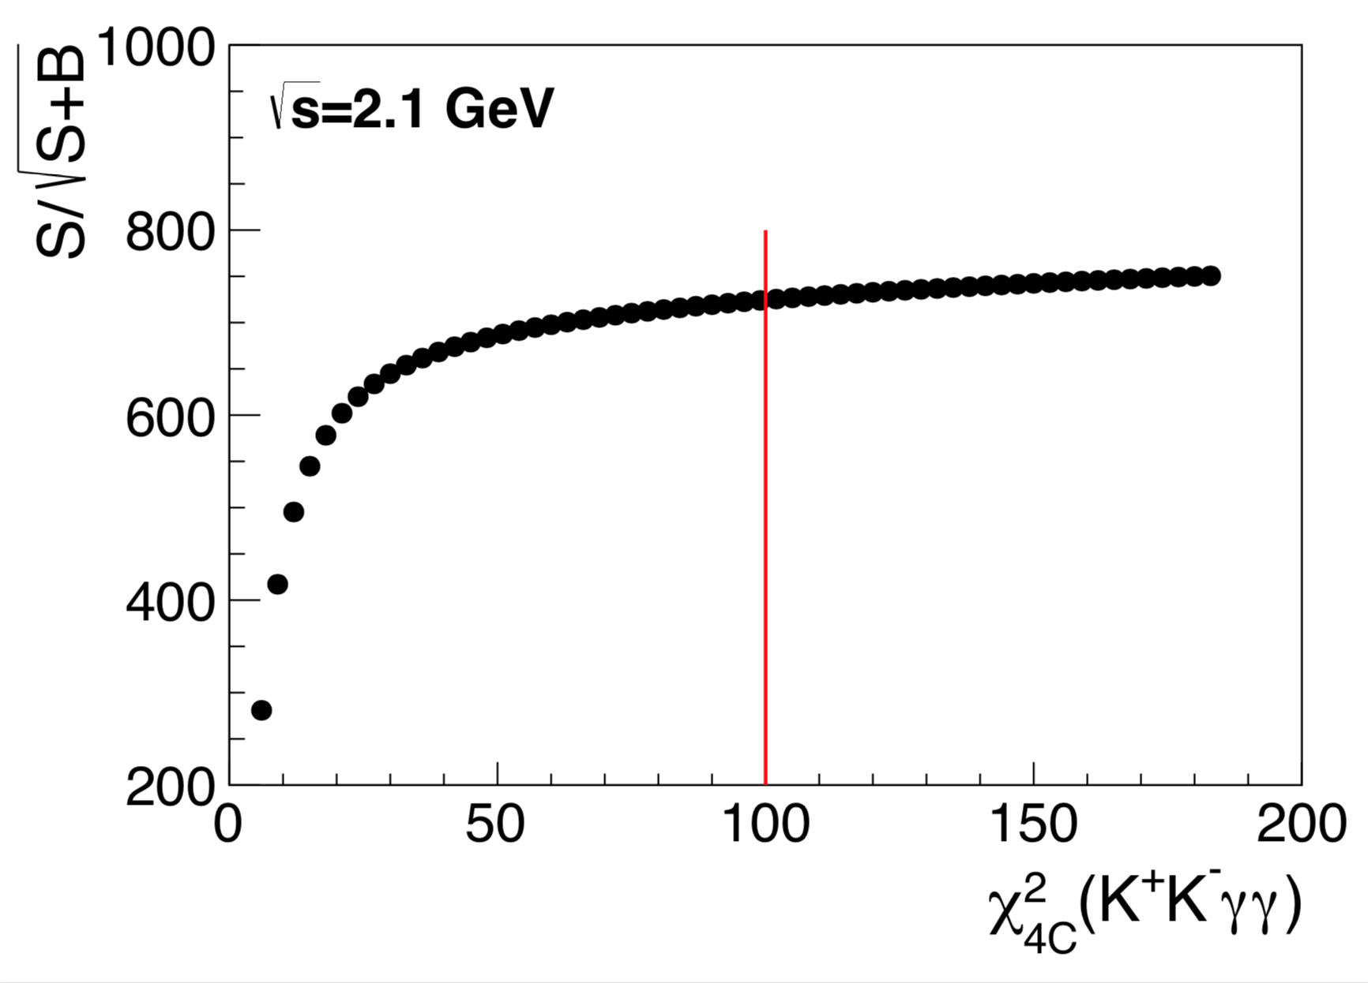
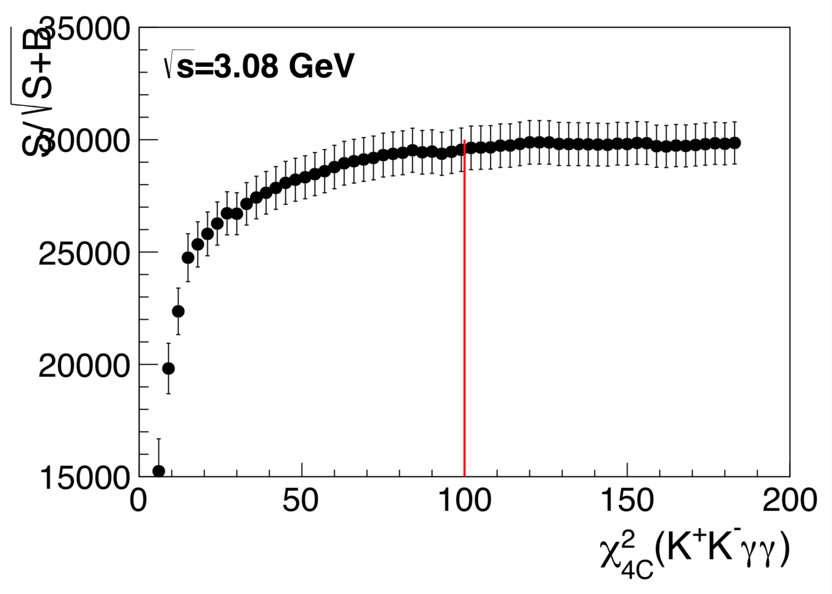
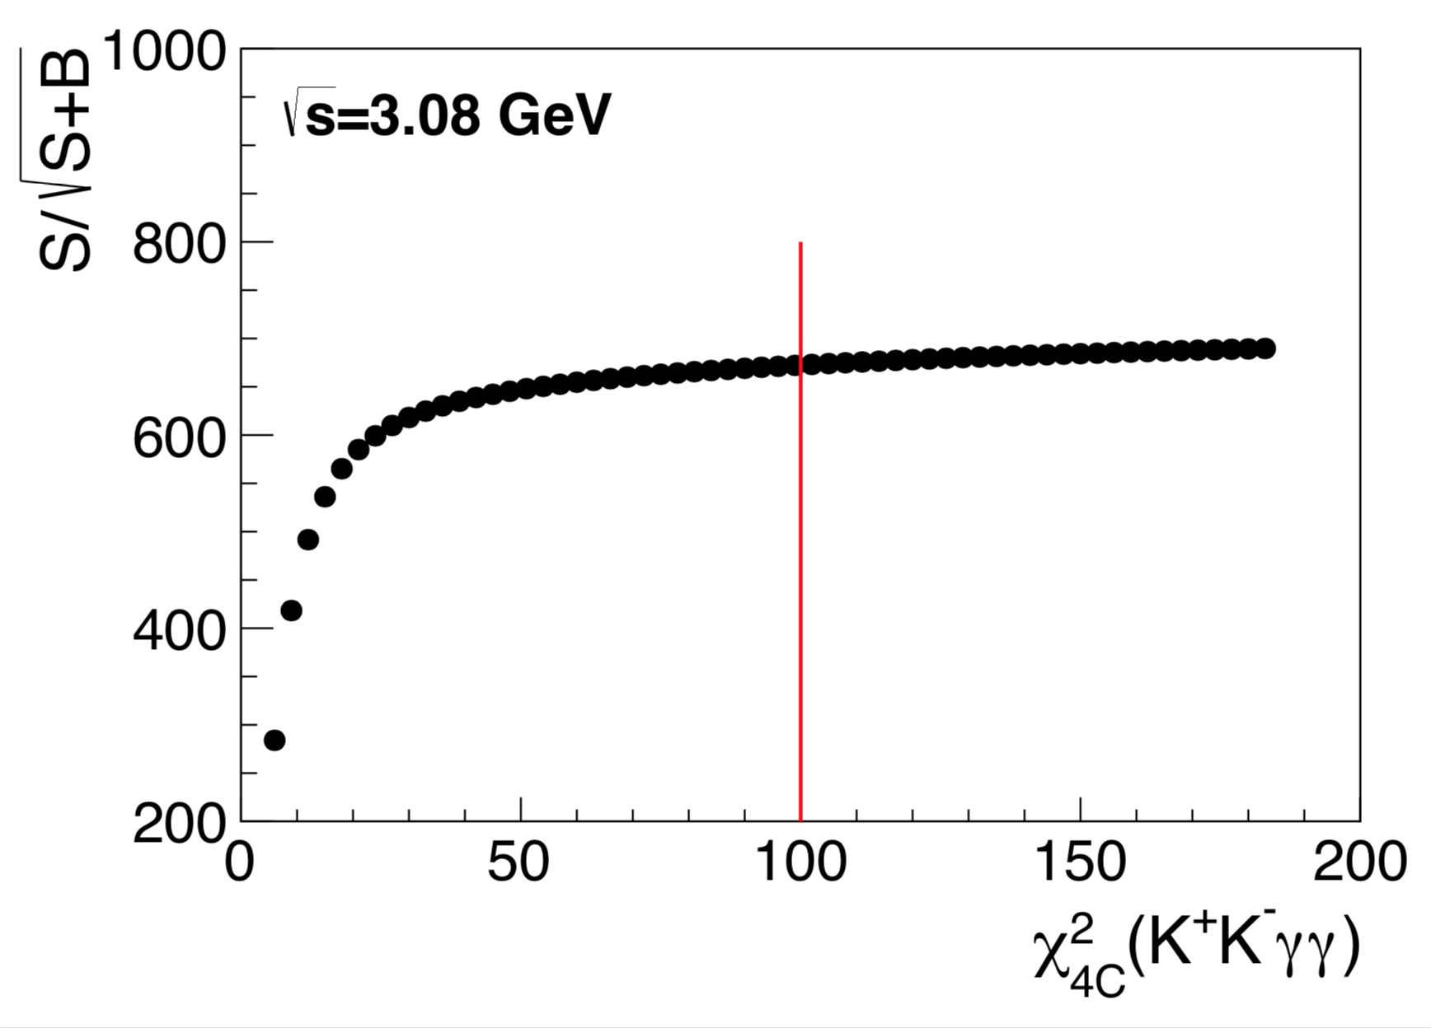

Slide 5
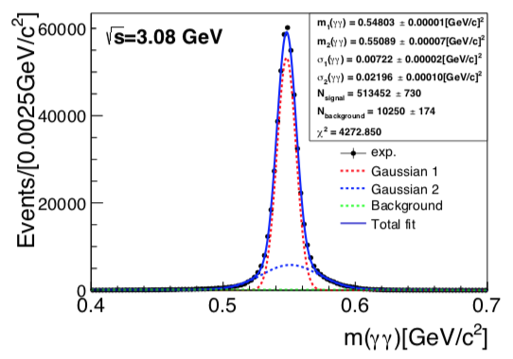
2 0.552912 2.57554e-05 0.0144943 3.41923e-05
2.05 0.551901 2.39026e-05 0.0138072 3.6475e-05
2.1 0.551431 2.2196e-05 0.0131956 3.54372e-05
2.125 0.551301 2.19268e-05 0.0132336 3.53774e-05
2.15 0.551486 2.21849e-05 0.0133343 3.51168e-05
2.175 0.551942 2.41163e-05 0.014204 3.49756e-05
2.2 0.552014 2.53067e-05 0.0144923 3.65179e-05
2.2324 0.551892 2.5914e-05 0.0145013 3.80858e-05
2.3094 0.550405 2.16122e-05 0.0130273 3.9712e-05
2.3864 0.550813 2.2463e-05 0.01355 3.84134e-05
2.396 0.550753 2.23261e-05 0.0135201 3.85632e-05
2.6444 0.550162 2.28814e-05 0.0134928 4.39381e-05
2.6464 0.550271 2.31288e-05 0.0135578 4.43397e-05
2.9 0.549438 2.31476e-05 0.0130644 4.88751e-05
2.95 0.549524 2.35847e-05 0.01309 5.00314e-05
2.981 0.549273 2.32625e-05 0.0128256 5.04374e-05
3 0.549336 2.35409e-05 0.012947 5.09051e-05
3.02 0.549252 2.34395e-05 0.0129551 5.08844e-05
3.08 0.548745 2.21995e-05 0.0126766 5.26714e-05

