Slide 1
USTC-IME LGAD design and performance
Xiangxuan Zheng, May 13th
On behalf of USTC HGTD Sensor Group
University of Science and Technology of China

Slide 2
Overview
Introduction
HGTD (High-Granularity Timing Detector)
USTC-IME 2.X LGAD
Measured result of USTC-IME 2.X LGAD
Radiation hardness
On wafer/Large Array IV&CV
Collected charge and time resolution from beta-scope
Inter-pad gap distance by testbeam (fill factor)
Inter-pad resistance and capacitance (checked for cross-talk)
Conclusion

Slide 3
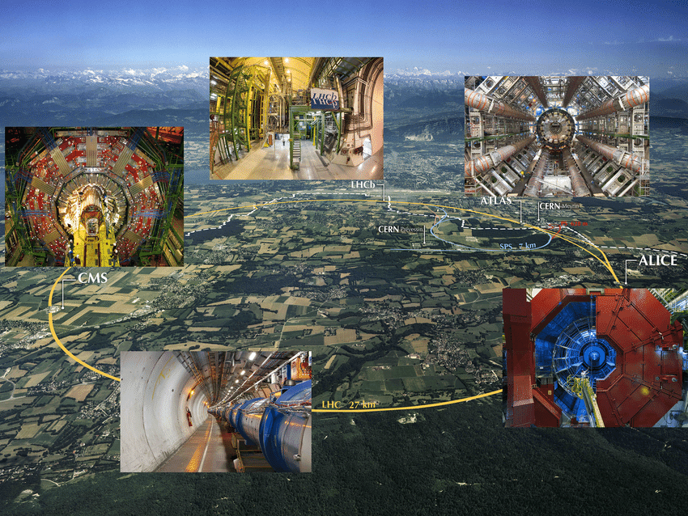
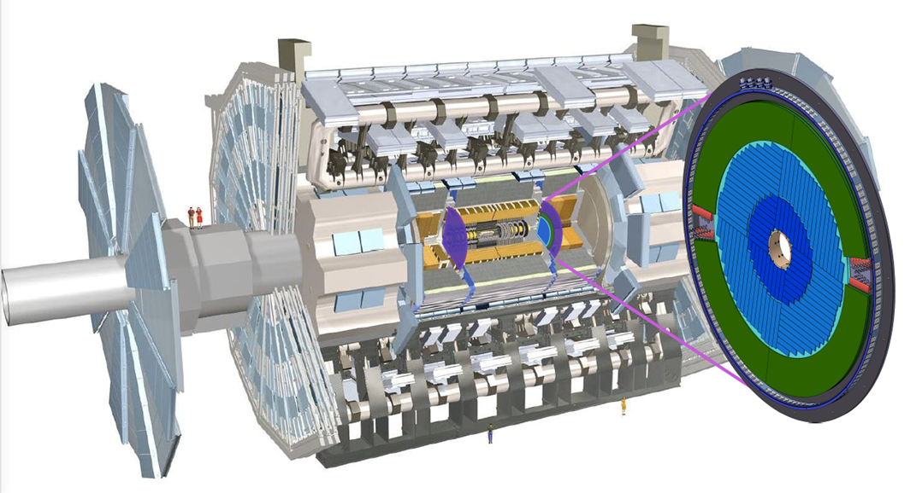
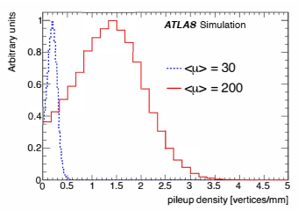
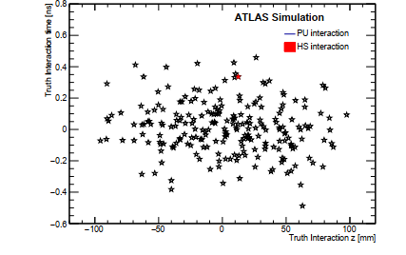
ATLAS HGTD project
LHC (Large Hadron Collider) → HL-LHC (high-luminosity phase of LHC) in 2028 → pileup vertex densities ↑
ATLAS (one of the 4 major experiments at the LHC at CERN) → upgrade its detectors
The HGTD (High-Granularity Timing Detector) is chosen for the ATLAS Phase II upgrade.
The time information be used as another dimension for identifying the hard-scattering vertex at the HL-LHC.
HGTD should withstand the non ionizing radiation levels throughout the HL-LHC operations.
This determines sensors’ lifetime
Because of its good timing performance and radiation hardness, LGAD (Low Gain Avalanche Detector) has been chosen as the sensor.
ATLAS Detector in LHC
Position of the HGTD within ATLAS
Run-2
HL-LHC
Local pileup vertex densities at generator level
truth interactions in a single bunch crossing in the z–t plane
3

Slide 4
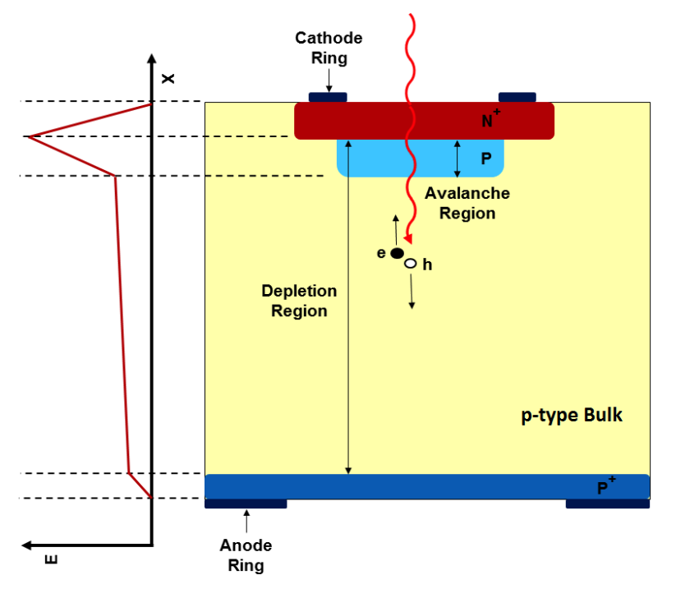
Low Gain Avalanche Detector
LGADs are n-in-p silicon detectors containing an extra highly-doped p-layer (gain layer) below the n-p junction.
The high electric field in gain layer region will accelerate the drifting electrons and generate avalanches.
With a proper design of gain layer, the LGAD can achieve promising S/N and time resolution.
Designed parameters:
Active thickness: 50 μm
Pad size: 1.3 x 1.3 ${mm}^{2}$
Hit efficiency: > 95%
Radiation tolerance: 2.5e15 $n_{eq}$ ${cm}^{−2}$, 1.5 MGy
1 LGAD pad
15x15 LGAD sensor

Slide 5
USTC’s roadmap on LGAD R&D with IME
 | USTC-1.0 | USTC-1.1 | USTC-2.0 | USTC-2.1
Propose | First attempt | Improved the process technology, same layout as 1.0 | New layout, mainly for yield study and issues fix | Same layout as 2.0, fast iteration
Performance | Few sensors can work (VBD ~250V, VGL 40V) | ~30% can work (VBD ~300V) | > 99% small sensors and ~35% 15x15 sensors can work, GR leakage disappeared. VBD lowered (~100-170V). | >99% small sensors and ~35% 15x15 sensors can work. Better uniformity, VBDs in idea range (~150-240V). Performance verified in β/Laser/TB and individual institute (JSI)
Problem | Almost all sensors have large current (VBD < 10V) | Almost all sensors have large GR current | Too low VBD for some wafers.

Slide 6
Design requirement and challenge
Characteristics of LGAD | Requirement | Test method
Radiation hardness | 1. Use c-factor to present the radiation hardness 2. Other parameters should meet the requirement at 2.5e15 $n_{eq}$ ${cm}^{−2}$ irradiation fluence. | Measure CV at different fluences to calculate c-factor to present the radiation hardness
Yield |  | On-wafer IV test
Uniformity | < 5% for V@2µA | Large-Array IV&CV test
Collected charge | > 4fC | beta-scope test
Time resolution | < 40ps (start), < 70 ps (end of lifetime)
Fill factor | Inter-pad gap distance < 100 µm | Test-beam
Quality of the pad isolation | Inter-pad resistance > 1 GΩ | Inter-pad IV&CV test

Slide 7
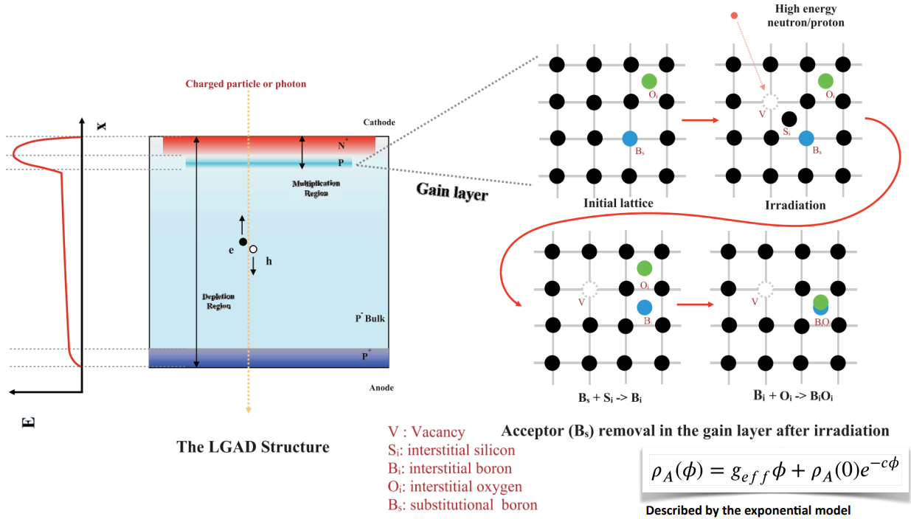
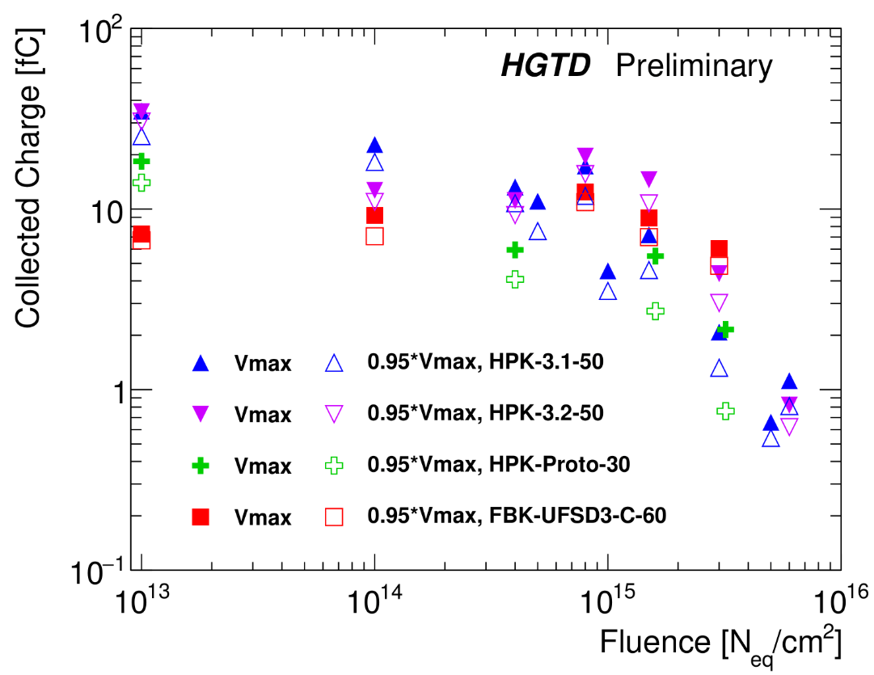
Radiation hardness of LGAD
Radiation hardness Yield Uniformity CC & $σ_{t}$ Fill factor Pad isolation
The BiOi generated after irradiation will reduce the effective doping concentration and detector’s gain.
The c-factor is used to describe LGAD’s radiation hardness (degradation rate of the gain layer).
The Ci + Oi -> CiOi would compete with Bi + Oi -> BiOi => Borons are protected!
Collect charge vs radiation fluence

Slide 8
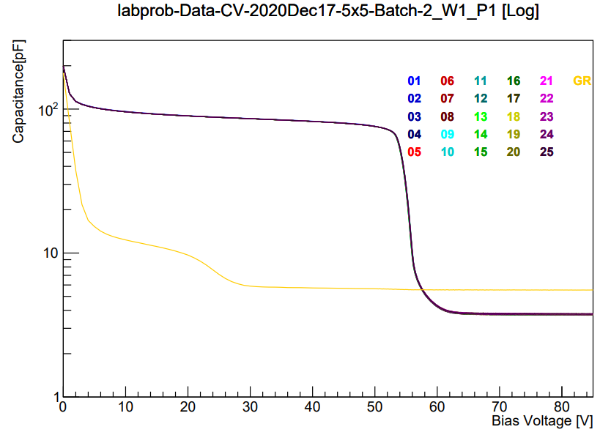
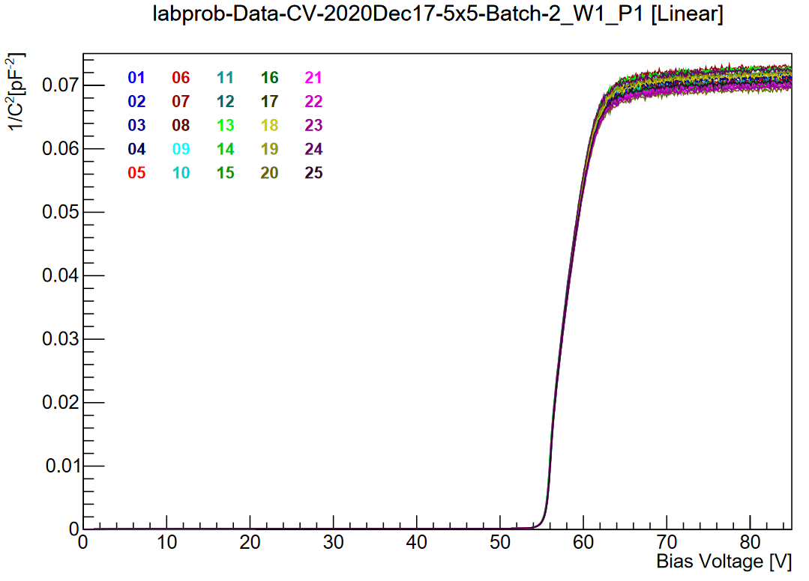
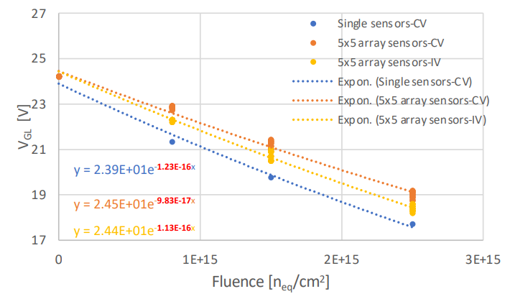
Use VGL to calculate c-factor
Radiation hardness Yield Uniformity CC & $σ_{t}$ Fill factor Pad isolation
VGL: gain layer depletion voltage
VFD: fully depletion voltage
VFD
C-V curve
$C^{−2}$-V curve
VGL
Use extrapolating line segments to extract VGL and VFD from CV.
Use the VGL at different fluences to fit the function and get the c-factor

Slide 9
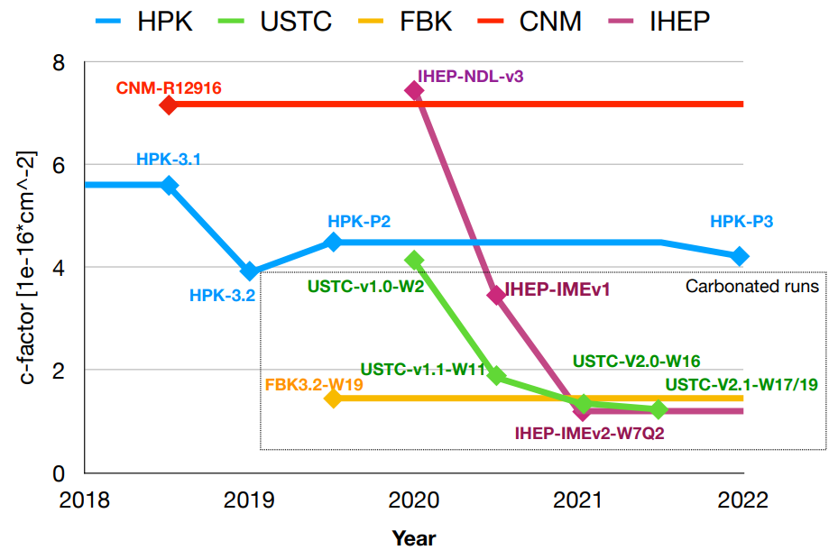
Evolution of the c-factor from different vendors
Radiation hardness Yield Uniformity CC & $σ_{t}$ Fill factor Pad isolation
c-factor measured with CV method on the most promising wafer (rad. hard) for each vendors’ run.
With the carbon in the gain layer, the USTC LGAD prototypes show promising radiation hardness compared to other vendors.

Slide 10
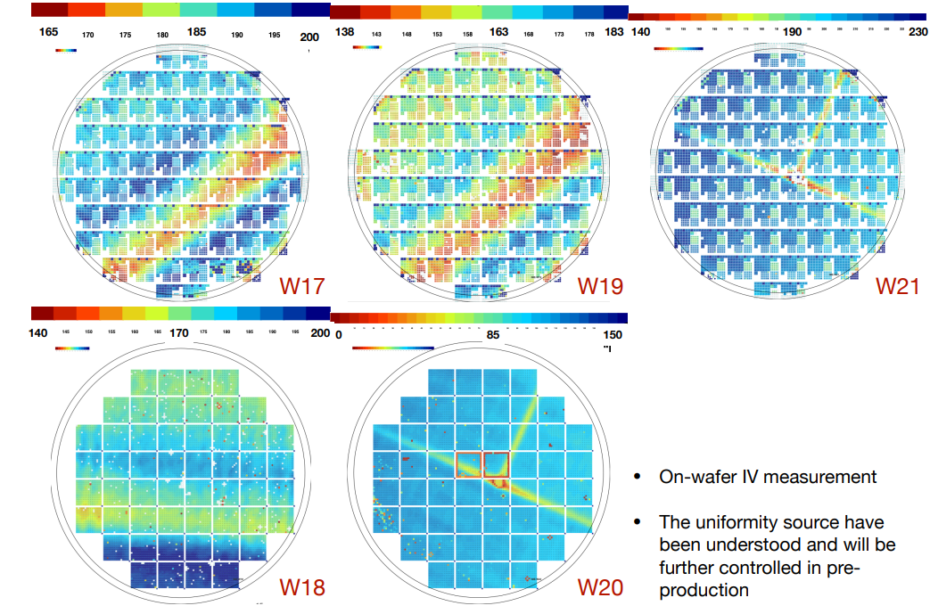
On wafer I-V
Radiation hardness Yield Uniformity CC & $σ_{t}$ Fill factor Pad isolation
Production of large array sensors is a big challenge for process technology.
The VBD distribution is used to check the yield and uniformity.
Before irradiated, most sensors’ VBD are 150 ~ 240 V
VBD: breakdown voltage

Slide 11
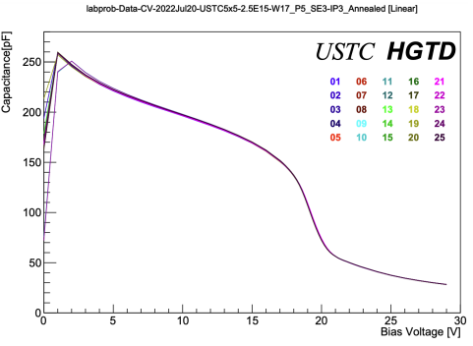
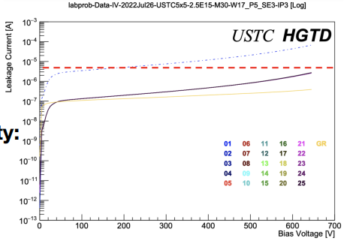
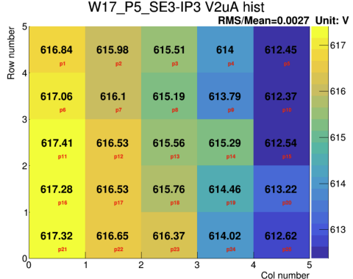
IV&CV of irradiated 5x5 sensor
Radiation hardness Yield Uniformity CC & $σ_{t}$ Fill factor Pad isolation
GR and all pads grounded
T: 20 ℃ for CV, -30 ℃ for IV
W17@2.5e15 $n_{eq}$ ${cm}^{−2}$
CV curve
VGL uniformity: 0.14%
The uniformity of VGL and V@2µA is smaller than 1%, which meet the HGTD specification (5% for V@2µA)
IV curve
V@2µA uniformity: 0.27%

Slide 12
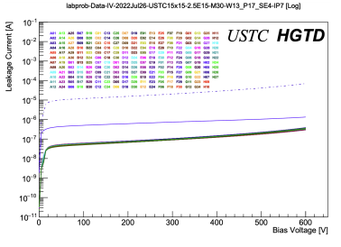
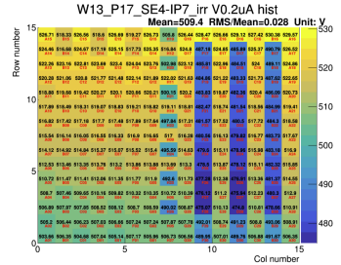
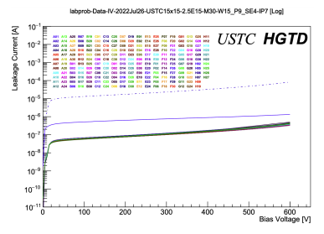
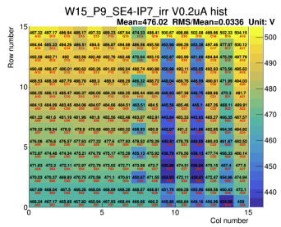
IV of irradiated 15x15 sensor
Radiation hardness Yield Uniformity CC & $σ_{t}$ Fill factor Pad isolation
GR and all pads grounded
T: -30 ℃
Step: 5.0 V
For the W13 and W15, the uniformity of V@2µA are both smaller than 5%.
W13@2.5e15 $n_{eq}$ ${cm}^{−2}$
V@2µA uniformity: 2.8%
W15@2.5e15 $n_{eq}$ ${cm}^{−2}$
V@2µA uniformity: 3.36%

Slide 13
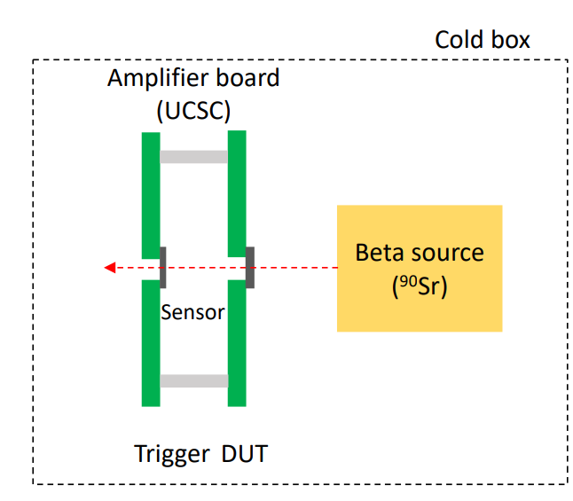
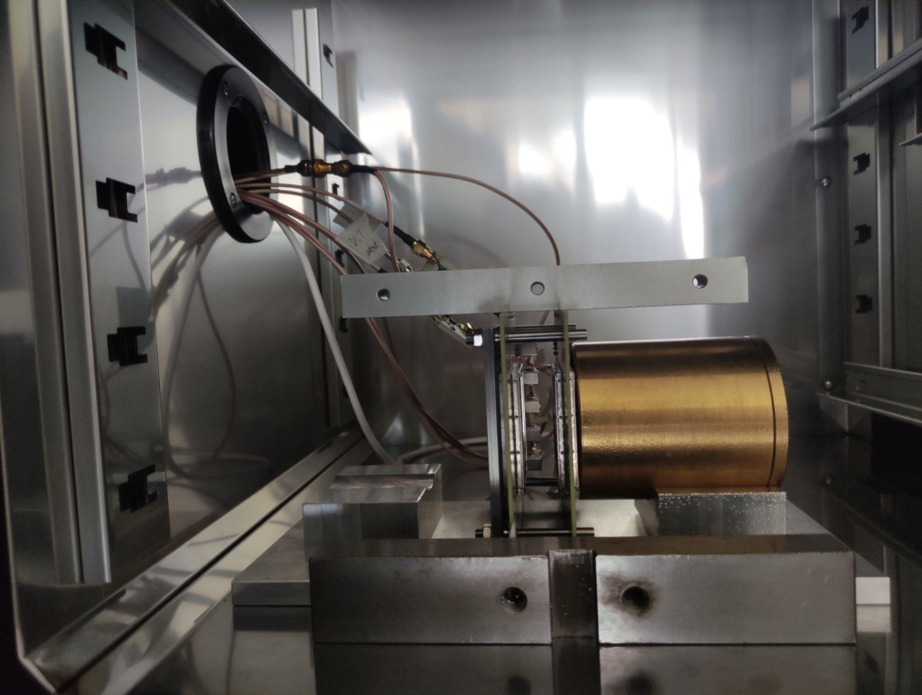
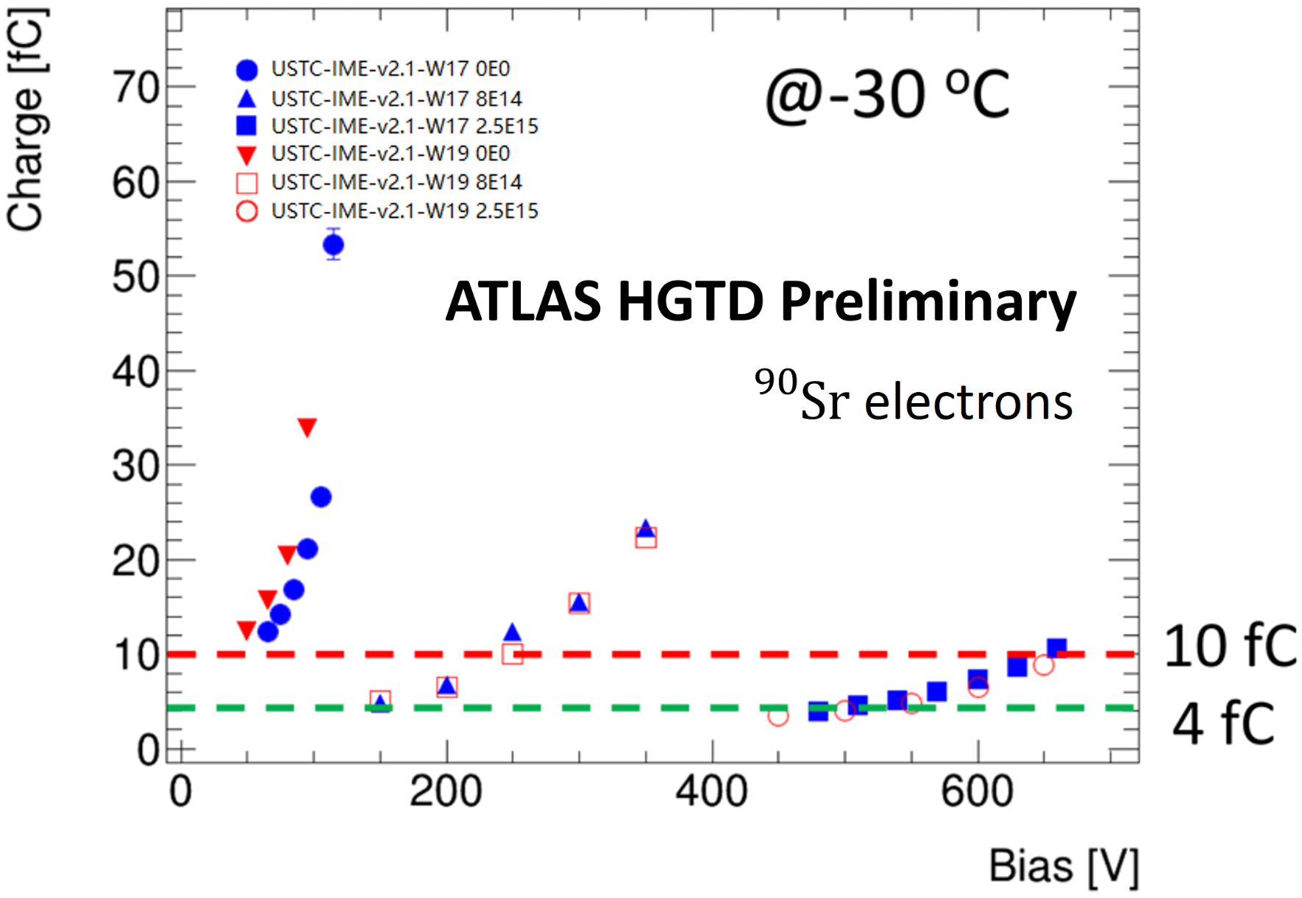
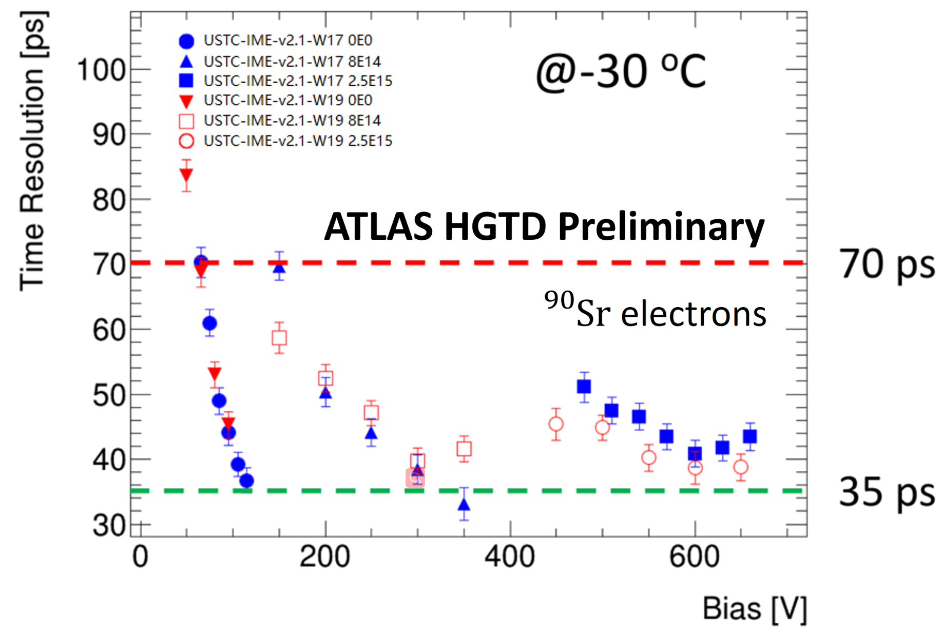
Collected charge and time resolution from Beta-scope result
Radiation hardness Yield Uniformity CC & $σ_{t}$ Fill factor Pad isolation
The β-scope test for W17/W19 have been carried out at USTC and JSI.
The results show the W17/W19 LGADs’ $σ_{t}$ can reach 50 ps and collected charge can > 4fC with bias voltage below 500 V after 2.5E15 fluences.
The result have fulfilled the radiation hardness requirement of HGTD.

Slide 14
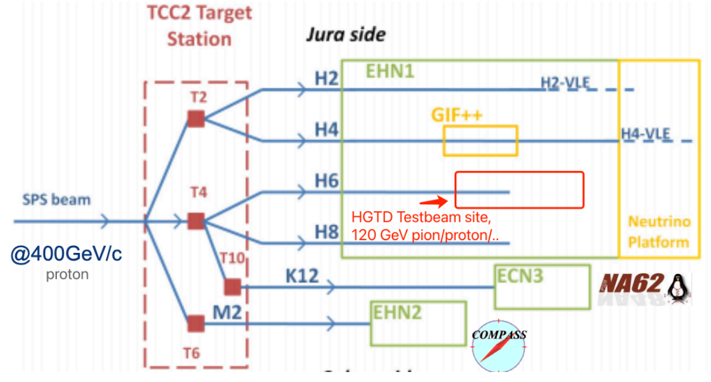
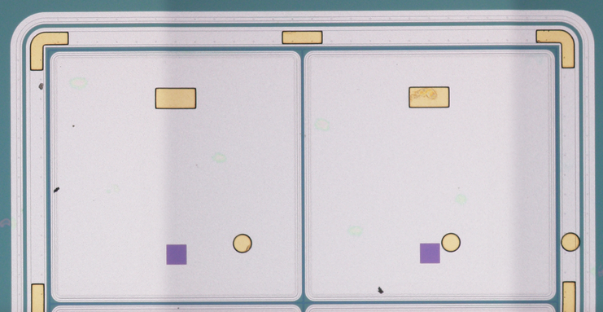
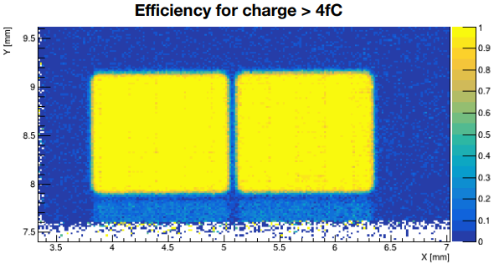
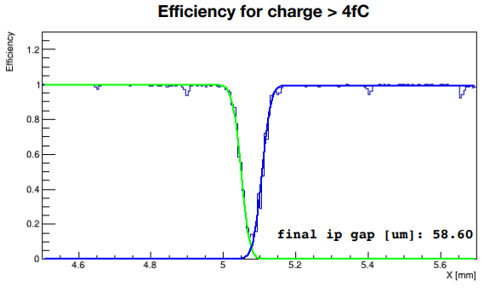
Inter-pad gap measured by testbeam
Radiation hardness Yield Uniformity CC & $σ_{t}$ Fill factor Pad isolation
Sensor | Bias (V) | IP measured (µm)
W19 2x2 IP3 | 155 | 59
 | 145 | 63
 | 135 | 65
W17 2x2 IP3 | 170 | 60
 | 160 | 59
 | 150 | 62
Use a continuous 120GeV pion beam to hit the sensor.
The SPS testbeam show ~60 µm inter-pad gap for IP3 sensors.

Slide 15
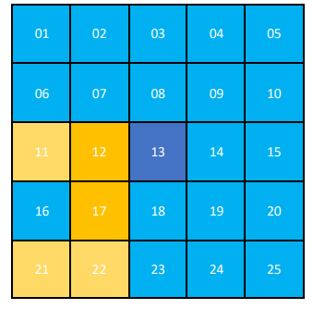
Inter-pad resistance
Radiation hardness Yield Uniformity CC & $σ_{t}$ Fill factor Pad isolation
The inter-pad resistance and capacitance is a in-direct measurement of the cross-talk influence. (Quality of the pad isolation)
1 nA
GR and all pads grounded
T: -30 ℃
Step: 5.0 V
W17@2.5e15 $n_{eq}$ ${cm}^{−2}$
Apply negative high voltage to sensor’s backside.
Apply 0 or 1 V to center pad, GR and other pads grounded.
Measure the current of other pads and get the current difference.
The current between two pads is lower than 1 nA which means that the resistance is larger than 1 GΩ. This means the sensors meet the HGTD requirement.

Slide 16
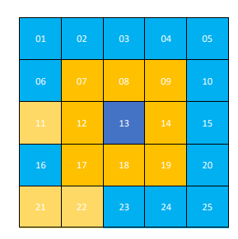
Inter-pad capacitance
Radiation hardness Yield Uniformity CC & $σ_{t}$ Fill factor Pad isolation
Frequency: 1 kHz
VAC: 0.51 V
GR and all pads grounded
T: 10 ℃
Step: 1.0 V
W17@2.5e15 $n_{eq}$ ${cm}^{−2}$
Apply negative high voltage to sensor’s backside.
Measured the inter-pad capacitance between the center pad and the other pads.
After irradiated, the inter-pad capacitance can be smaller than 0.5 pF at appropriate bias voltage.
The test result of the inter-pad resistance and capacitance have showed the cross-talk won’t affect the sensor’s performance.

Slide 17
Conclusion
LGAD: a novel detector with good time resolution and high radiation hardness.
The USTC-IME V2.1 LGAD are well characterized in different test:
All parameters indicate they meet the HGTD specification.
The pre-production (USTC-IME-V3.0) is on-going with all changes adapted to the latest HGTD requirement.
Characteristics | Performance
Radiation hardness | c-factor of W17 can reach 1.23×${10}^{−16}$ ${cm}^{2}$
Breakdown voltage | 150 ~ 240 V @pre-irrad.
Large array uniformity | For 5x5, uniformity of VGL and V@2µA < 5% @2.5e15. For 15x15, uniformity of V@2µA < 5% @2.5e15
Inter-pad gap | ~60 µm gap @IP3 achieved
Time resolution | 35 ps @pre-irrad. , 50 ps @2.5e15
Collected charge | > 50 fC @pre-irrad. , > 4 fC @2.5e15
Inter-pad resistance | > 1 GΩ @2.5E15
Inter-pad capacitance | < 0.5 pF @2.5e15

Slide 18
Relative Paper
Radiation hardness characterization of low gain avalanche detector prototypes for the high granularity timing detector
Performance of LGAD sensors with carbon enriched gain layer produced by USTC
Performance in beam tests of Carbon-enriched irradiated Low Gain Avalanche Detectors for the ATLAS High Granularity Timing Detector

Slide 19
backup

Slide 20
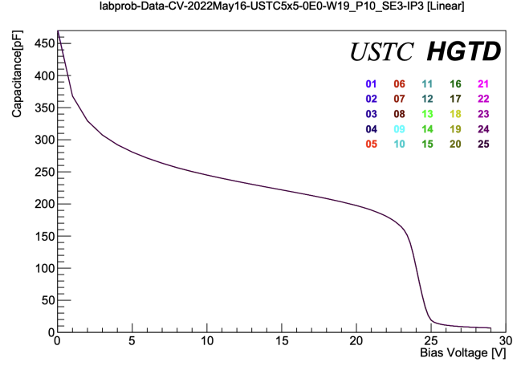
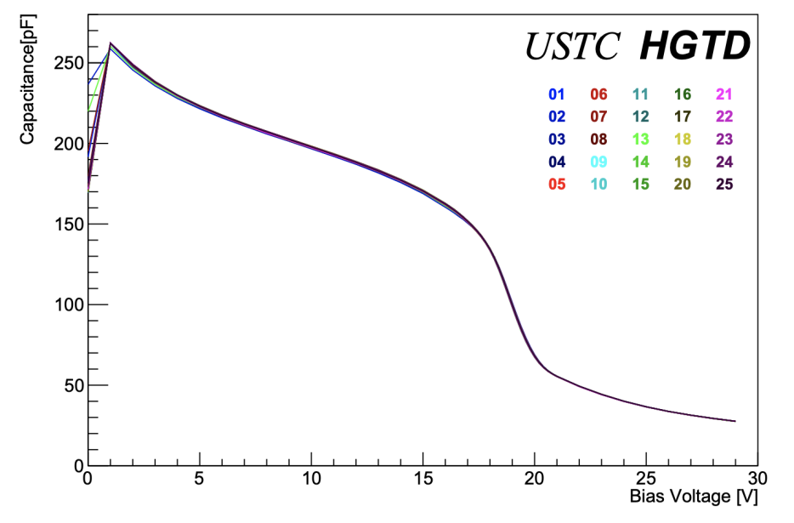
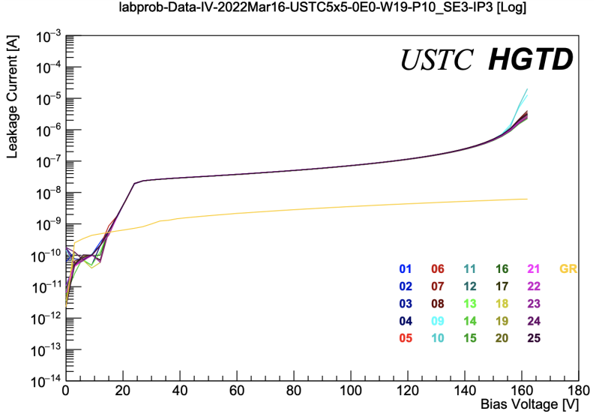
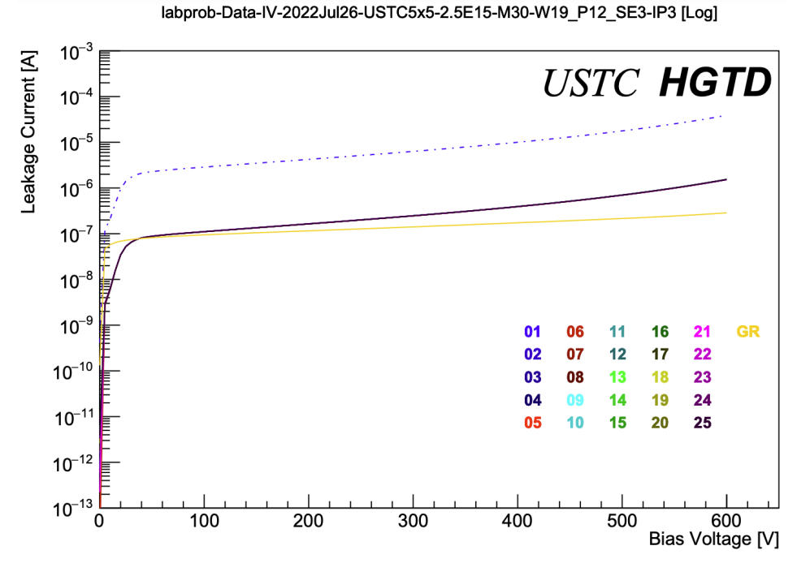
CV&IV before&after irradiated
CV
20℃
un-irradiated
CV
20℃
2.5e15
IV
20℃
un-irradiated
IV
-30℃
2.5e15

Slide 21
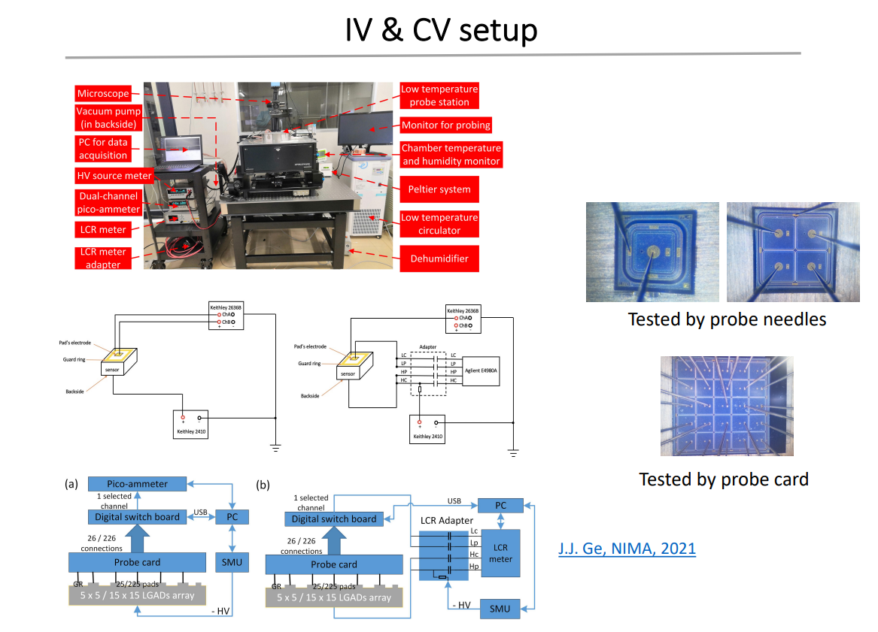
J.J. Ge, NIMA, 2021

Slide 22
C.H.Li, NIMA, 2022

Slide 23
Test-beam setup

