Slide 1
A Momentum Correction Using $J/ψ→Λ\overline{Λ}→p\overline{p}π^{+}π^{−}$

Slide 2
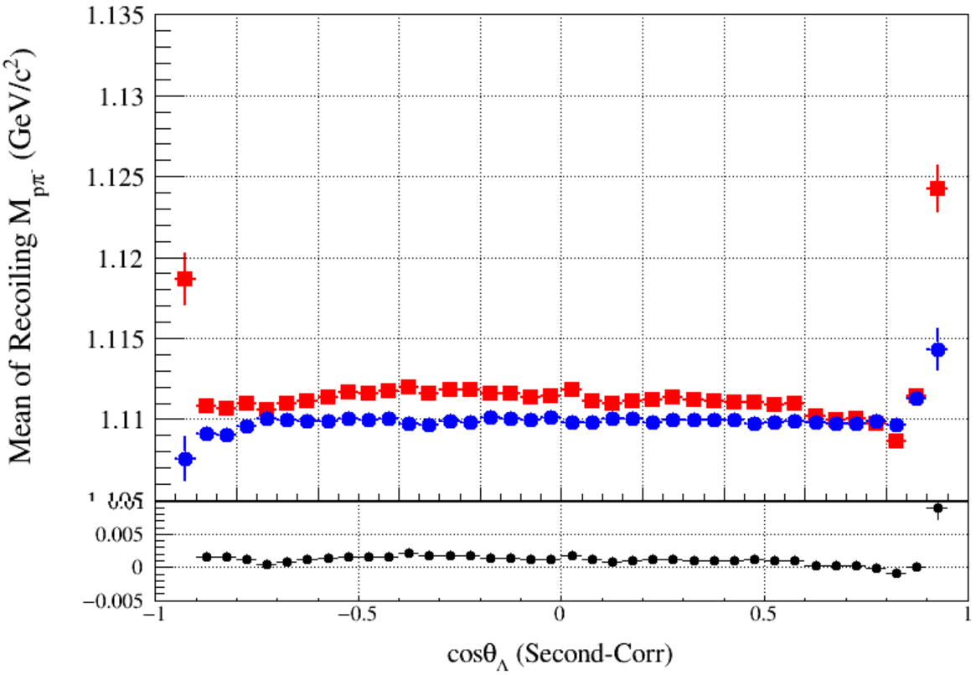
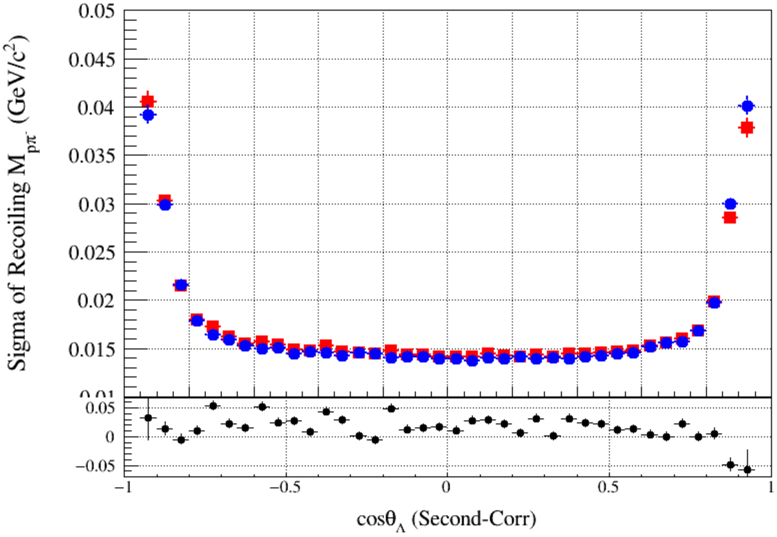
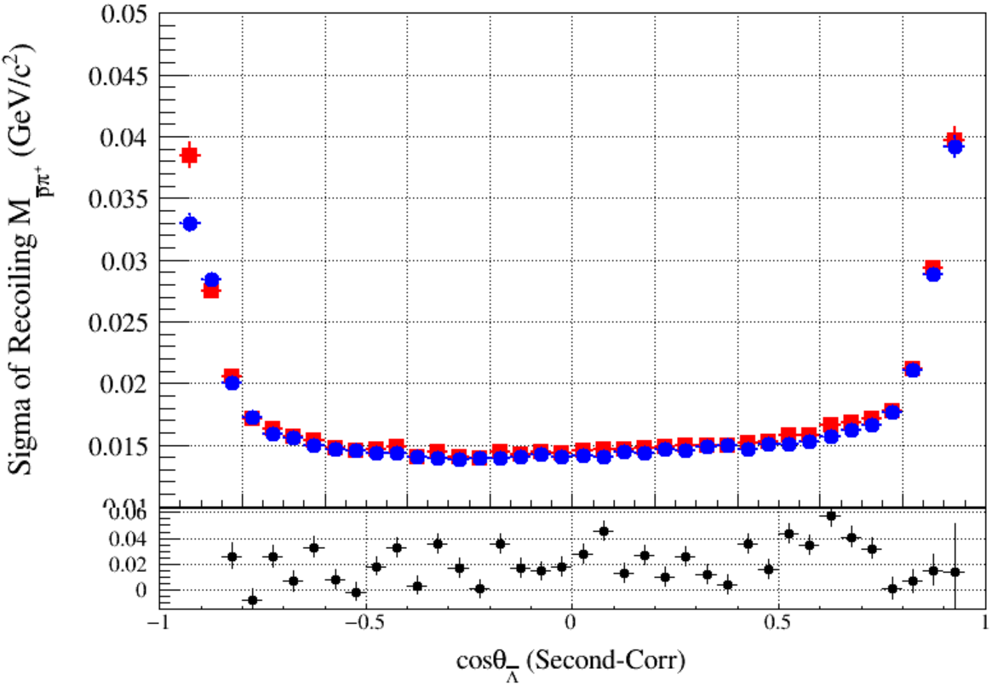
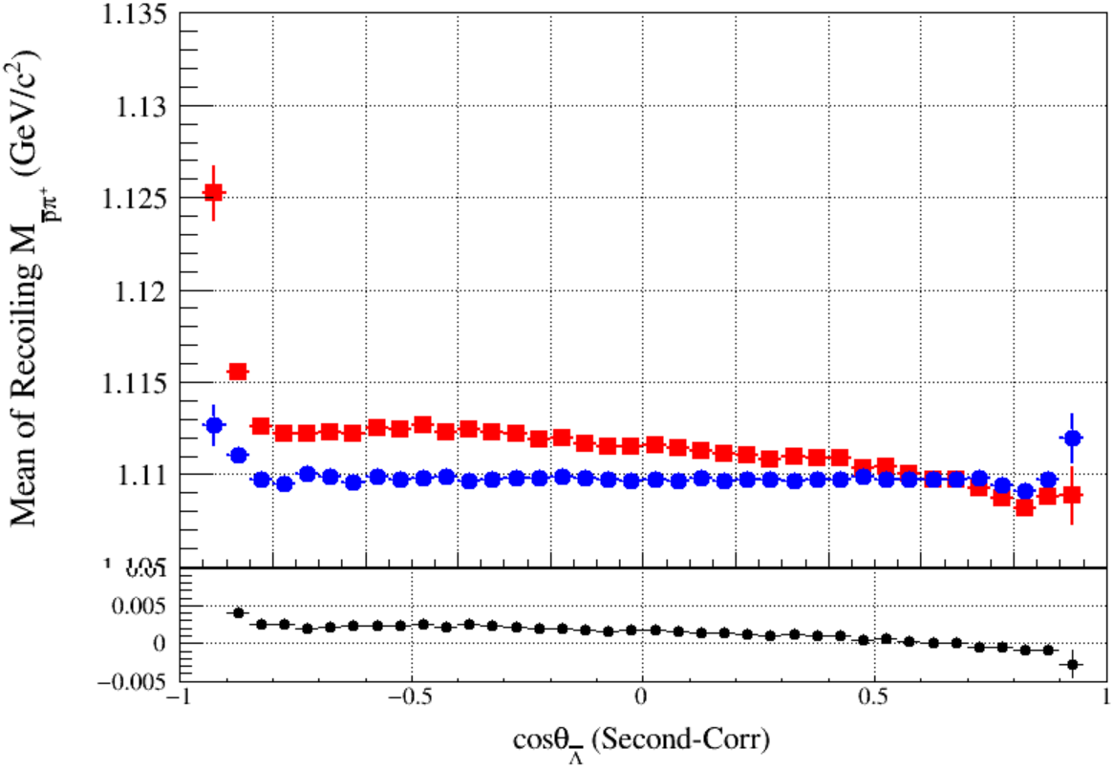
Problems
Correction factor:
$$μ(p_{t},cosθ)=\frac{RMS{\left(p^{Kal}−p^{4c}\right)}_{data}}{{RMS\left(p^{Kal}−p^{4c}\right)}_{MC}}$$
For each Charged Tracks:
$p^{corr}=p^{truth}+\left(p^{Kal}−p^{truth}\right)∗μ(p_{t},cosθ)$
To do vertex fit, kinematic fit ……

Slide 3
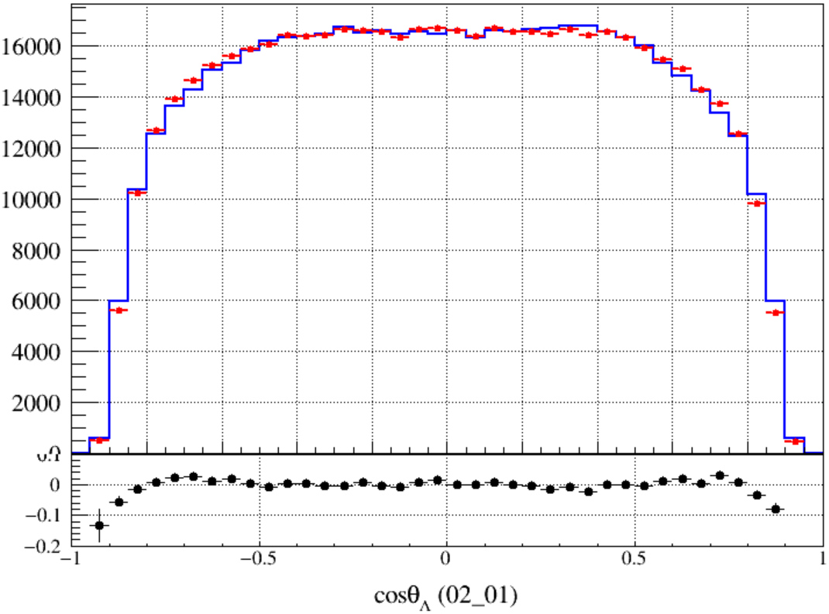
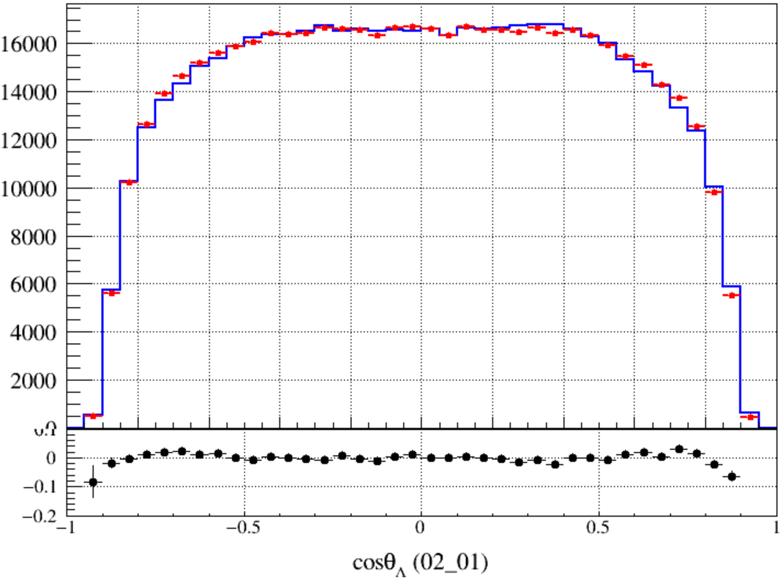
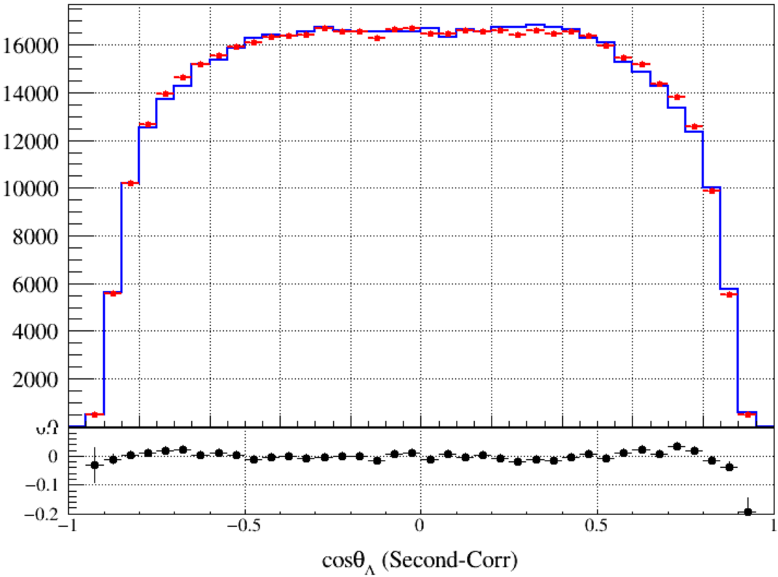
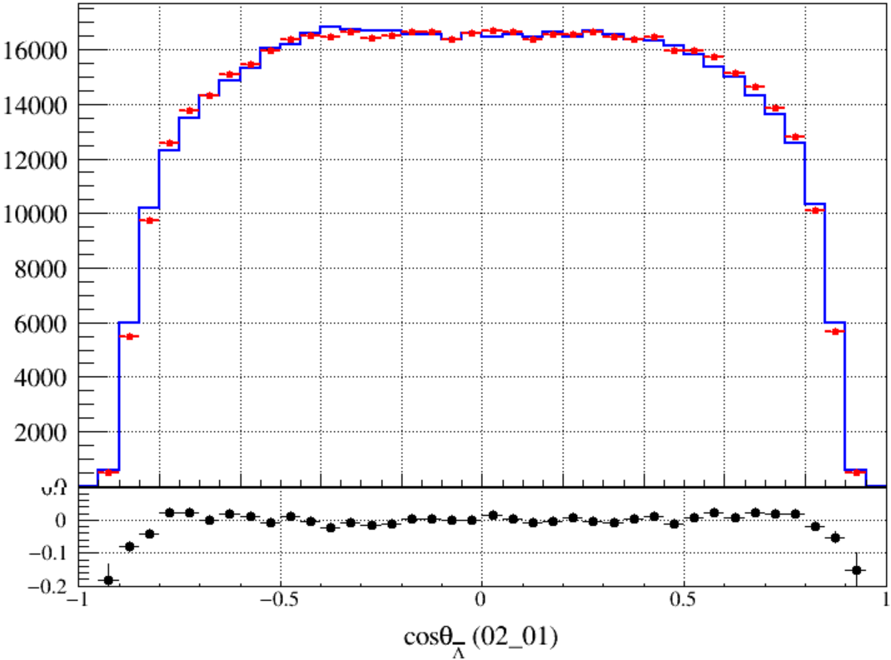
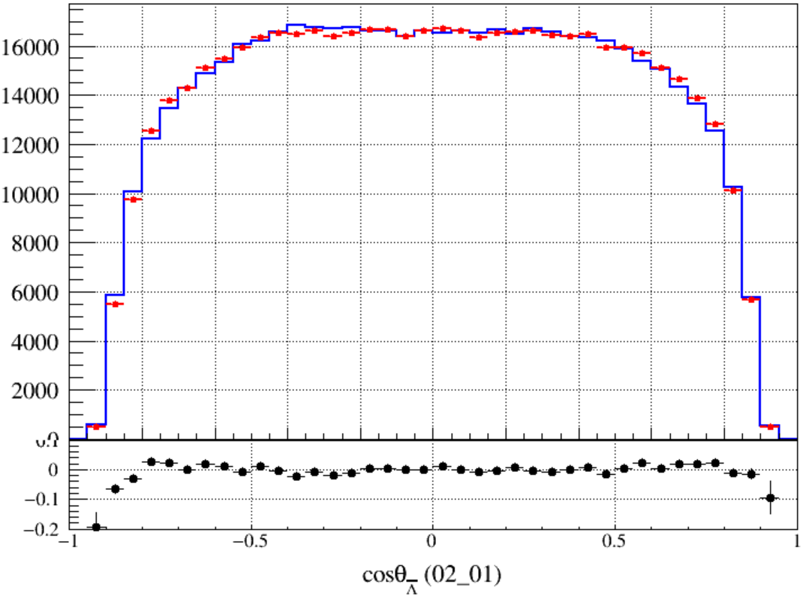
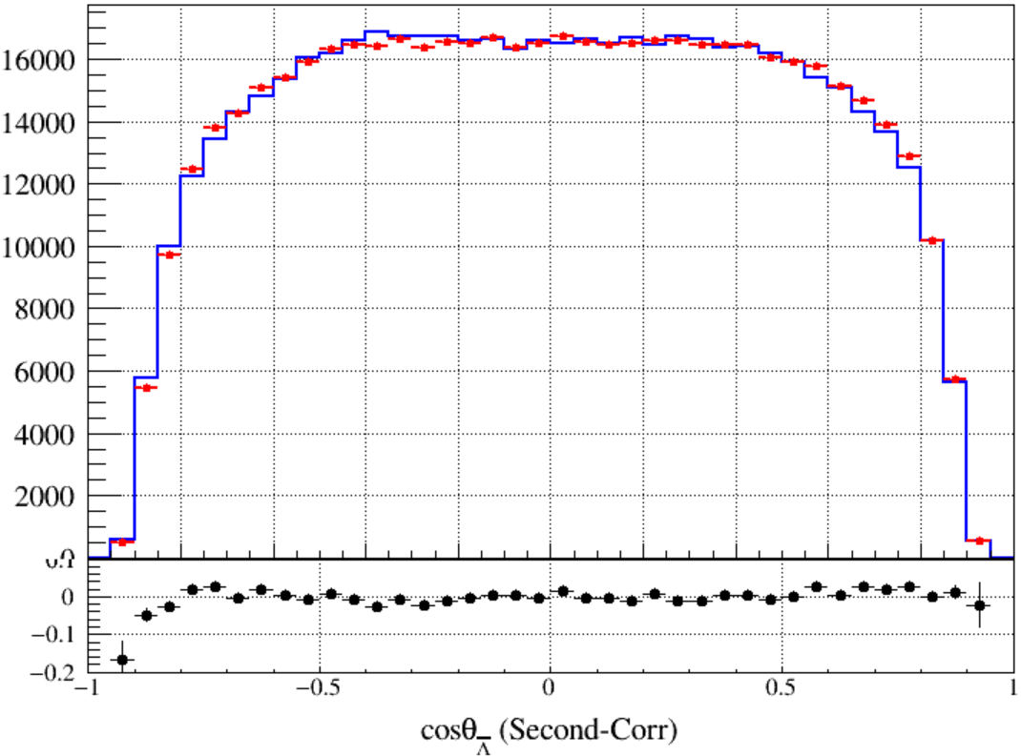
Original
First-Corr
Sec-Corr

Slide 4
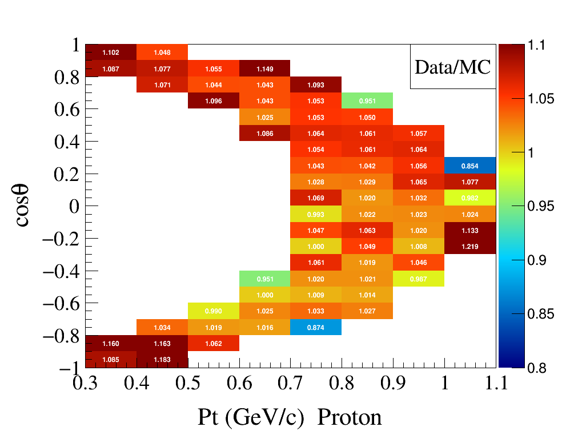
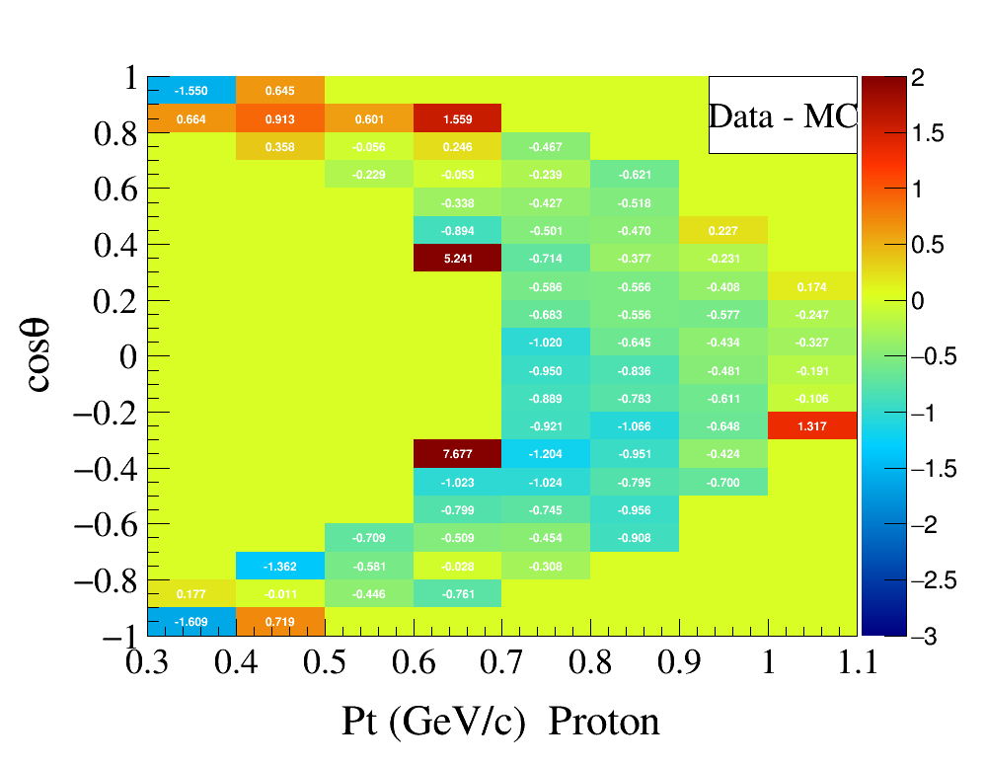
New Correction of MC
Resolution Correction factor:
$$μ_{res}(p_{t},cosθ)=\frac{RMS{\left(p^{Kal}−p^{4c}\right)}_{data}}{{RMS\left(p^{Kal}−p^{4c}\right)}_{MC}}$$
Mean shift correction:
$$μ_{shift}\left(p_{t},cosθ\right)=Mean{\left(p^{Kal}−p^{4c}\right)}_{data}−{Mean\left(p^{Kal}−p^{4c}\right)}_{MC}$$
Notes:
/ustcfs/BES3User/2021/ypei/BESIII/Lambda/WriteMemo/Check/STLamcos/JianyuCode/resolution/AfterCorr

Slide 5
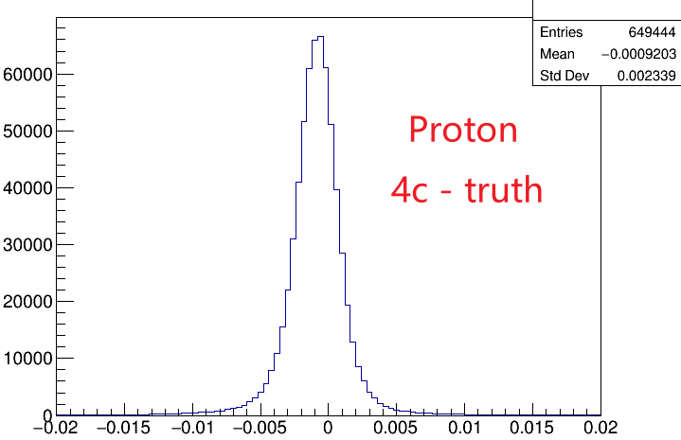
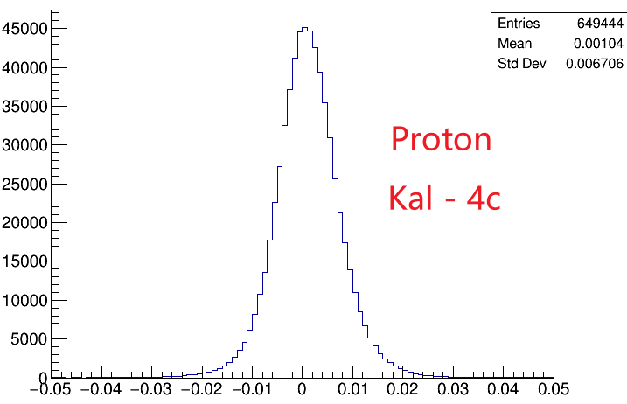
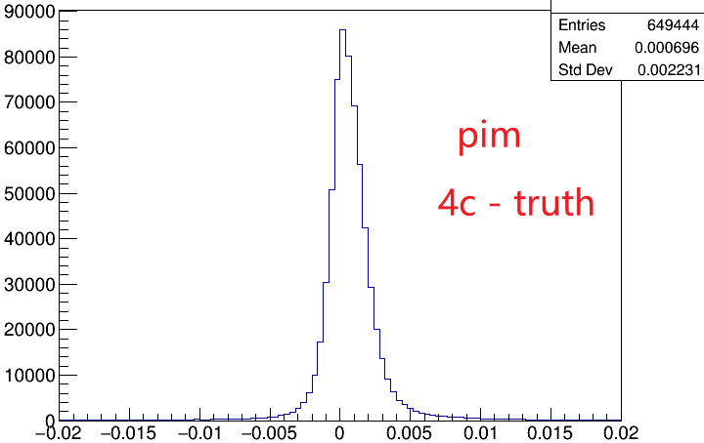
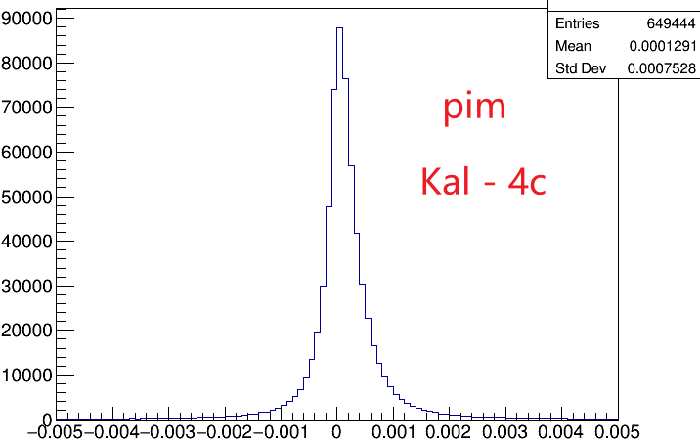
New Correction of MC
$$μ_{res}(p_{t},cosθ)=\frac{RMS{\left(p^{Kal}−p^{4c}\right)}_{data}}{{RMS\left(p^{Kal}−p^{4c}\right)}_{MC}}$$
$$μ_{shift}\left(p_{t},cosθ\right)=Mean{\left(p^{Kal}−p^{4c}\right)}_{data}−{Mean\left(p^{Kal}−p^{4c}\right)}_{MC}$$
For each Charged Tracks of MC:
$p^{corr}=p^{truth}+\left(p^{Kal}−p^{truth}\right)∗μ_{res}\left(p_{t},cosθ\right)+ μ_{shift}\left(p_{t},cosθ\right)×μ_{res}\left(p_{t},cosθ\right)$
$p_{sec}^{corr}=p^{truth}+\left(p^{corr}−p^{truth}\right)∗μ_{res}^{sec}\left(p_{t},cosθ\right)+ μ_{shift}^{sec} \left(p_{t},cosθ\right)×μ_{res}^{sec}\left(p_{t},cosθ\right)$
To do vertex fit, kinematic fit ……
$$μ=−0.9$$
$$σ=2.3$$
$$μ=1.0$$
$$σ=6.7$$
$$μ=0.70$$
$$σ=2.2$$
$$μ=0.13$$
$$σ=0.75$$
Notes:
/ustcfs/BES3User/2021/ypei/BESIII/Lambda/WriteMemo/Check/STLamcos/JianyuCode/resolution/AfterCorr

Slide 6
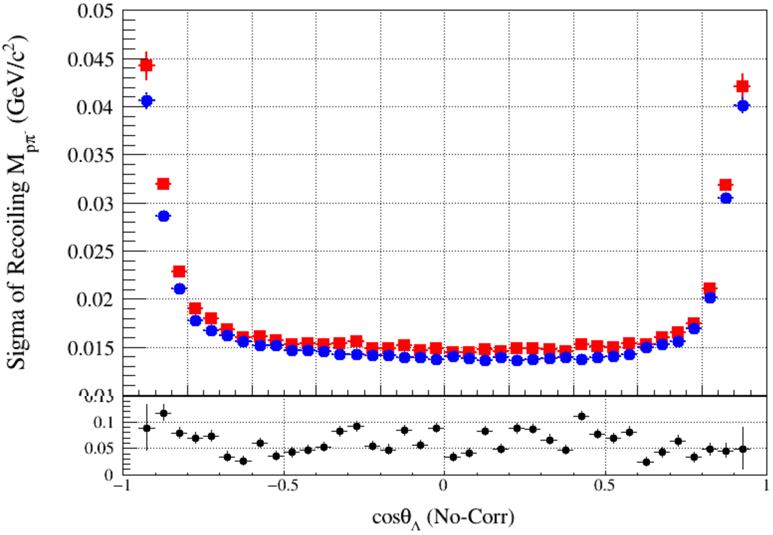
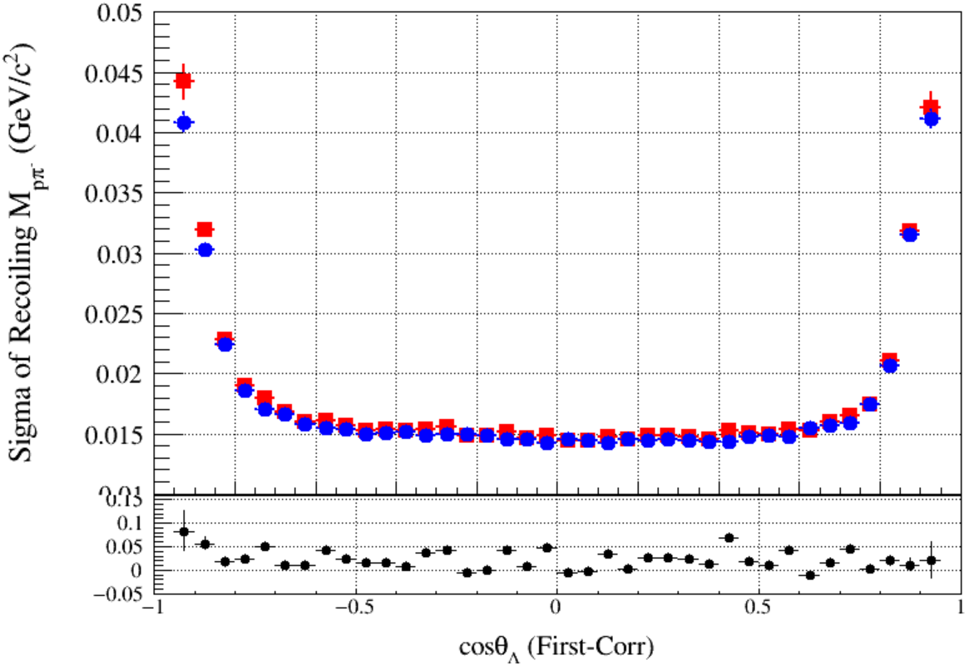
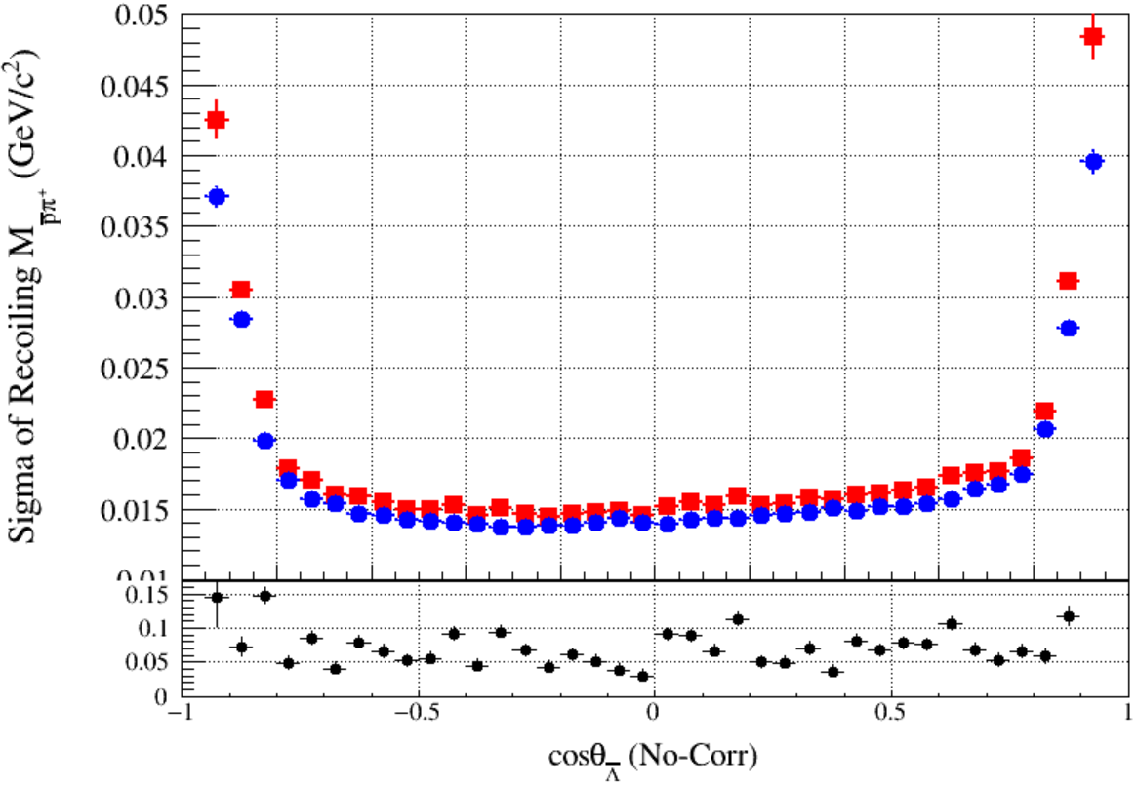
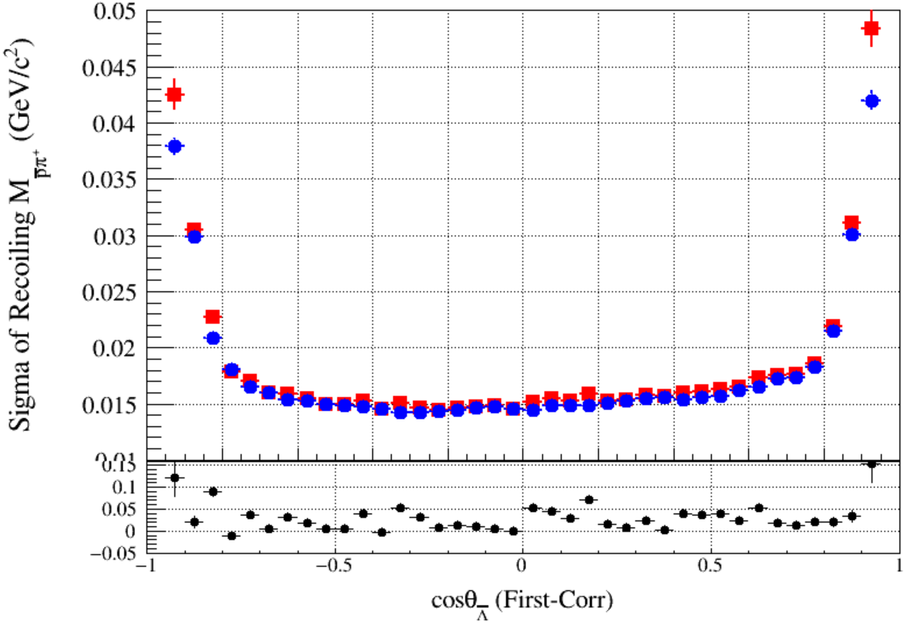
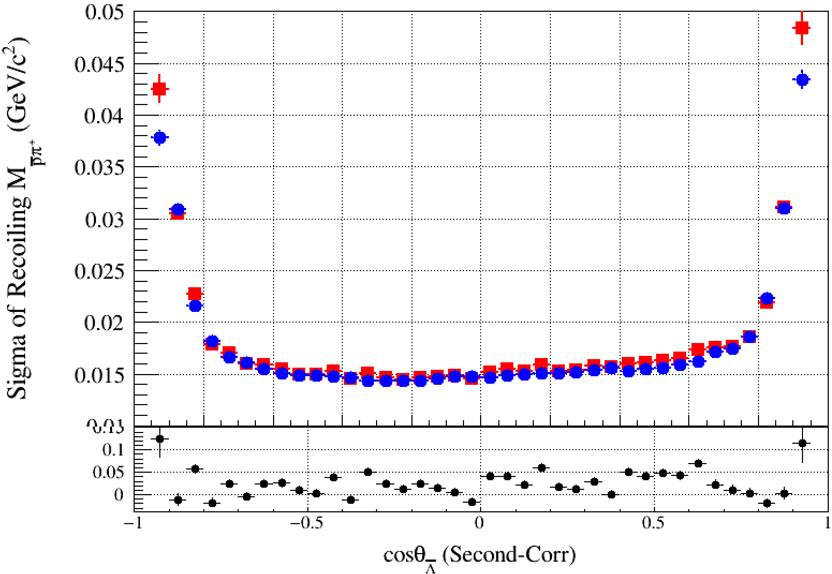
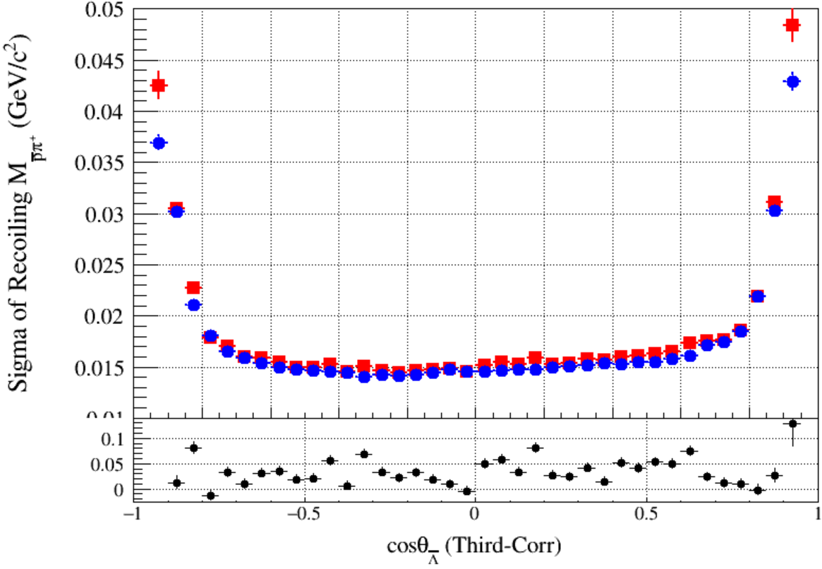
Compare (RMS of $M_{pπ}^{recoil}$)
Original
First-Correction
Second-Correction
Third-Correction
Notes:
/ustcfs/BES3User/2021/ypei/BESIII/Lambda/WriteMemo/Check/STLamcos/JianyuCode/resolution/AfterCorr

Slide 7
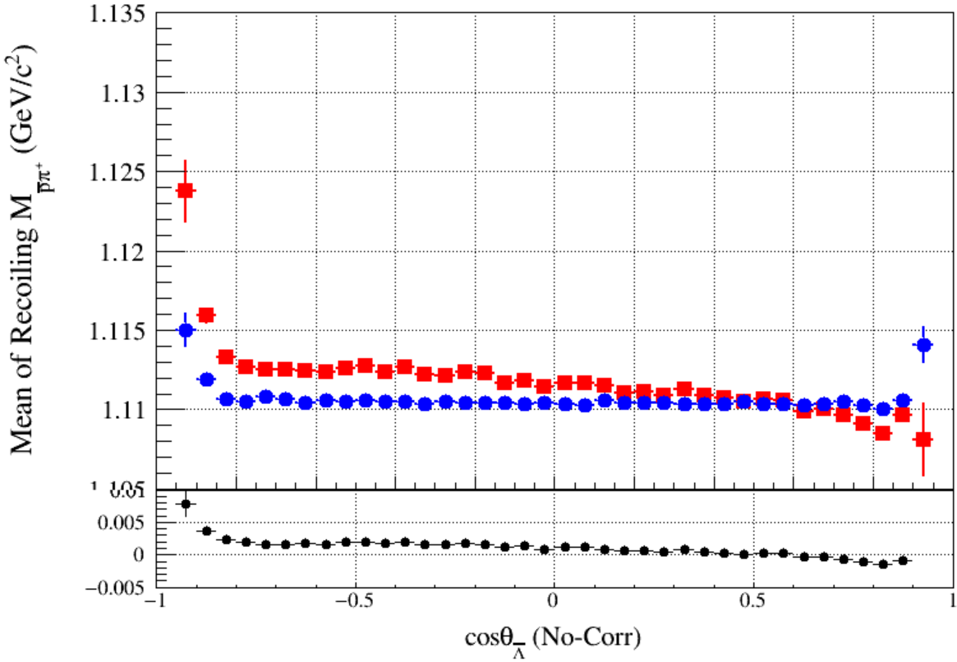
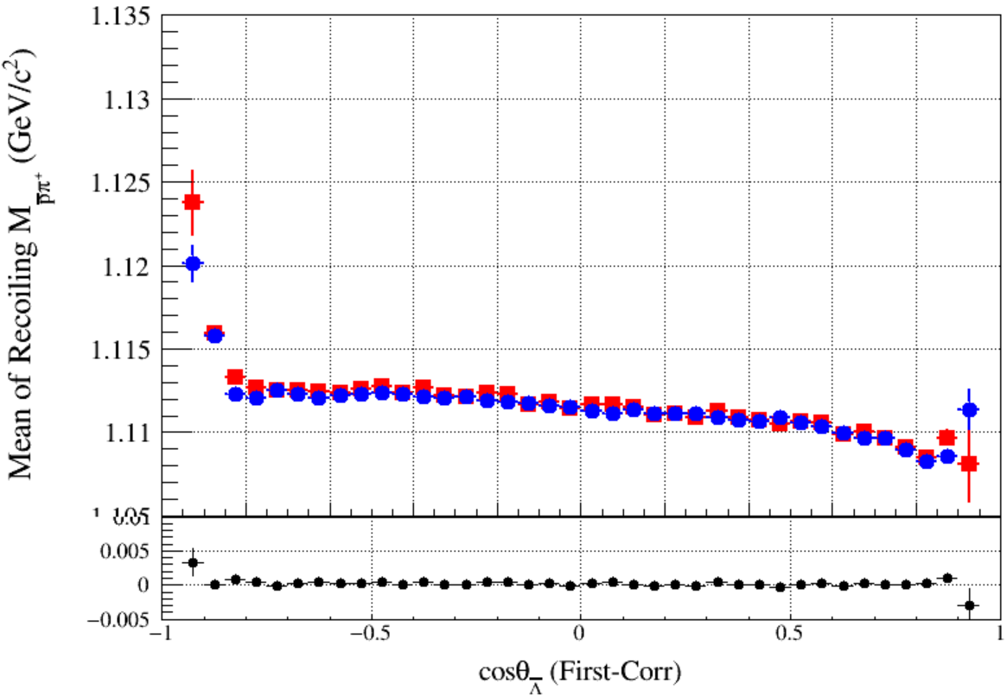
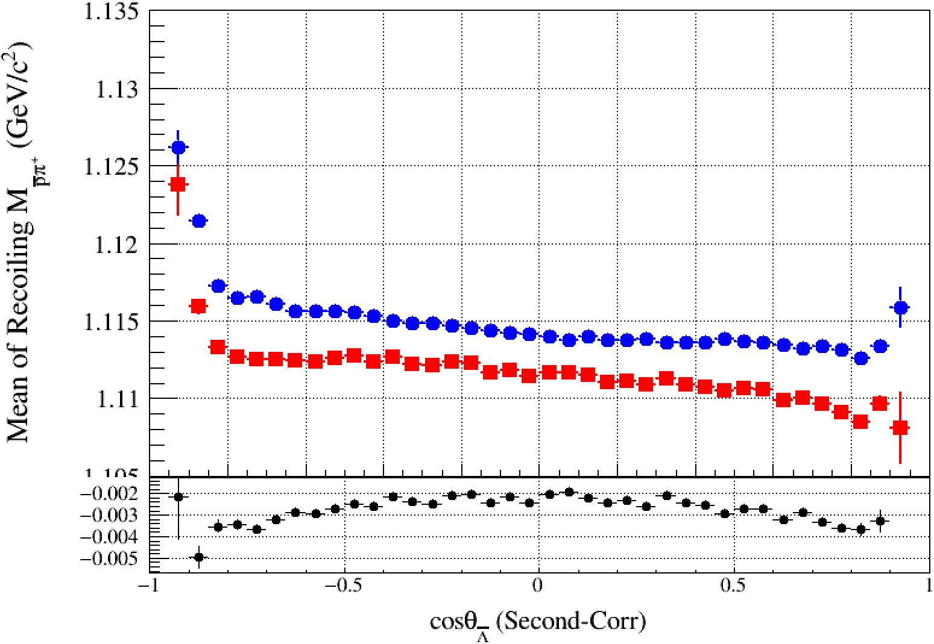
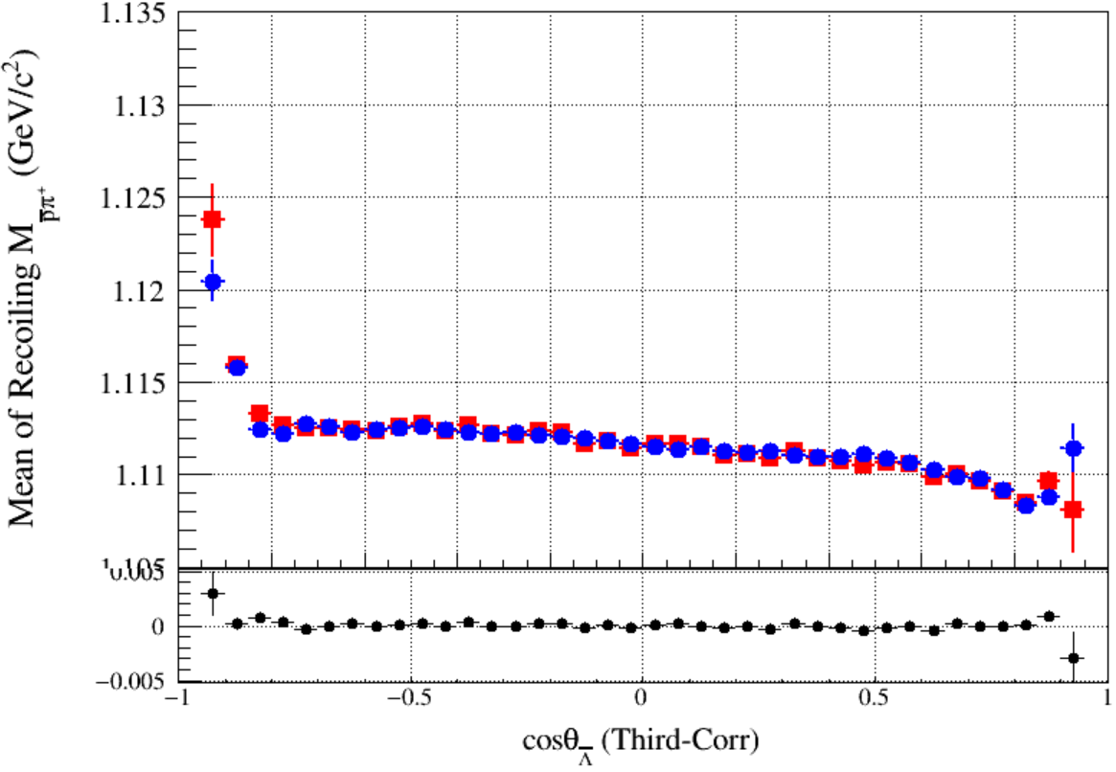
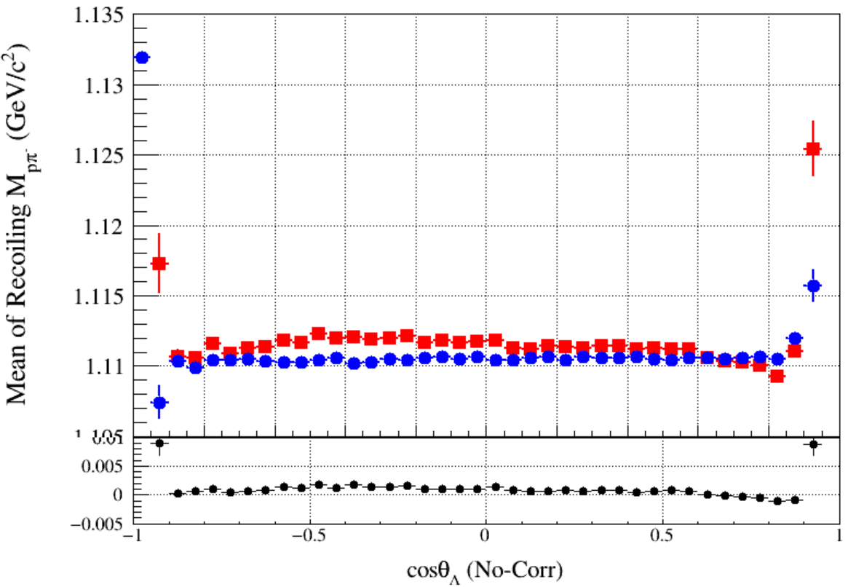
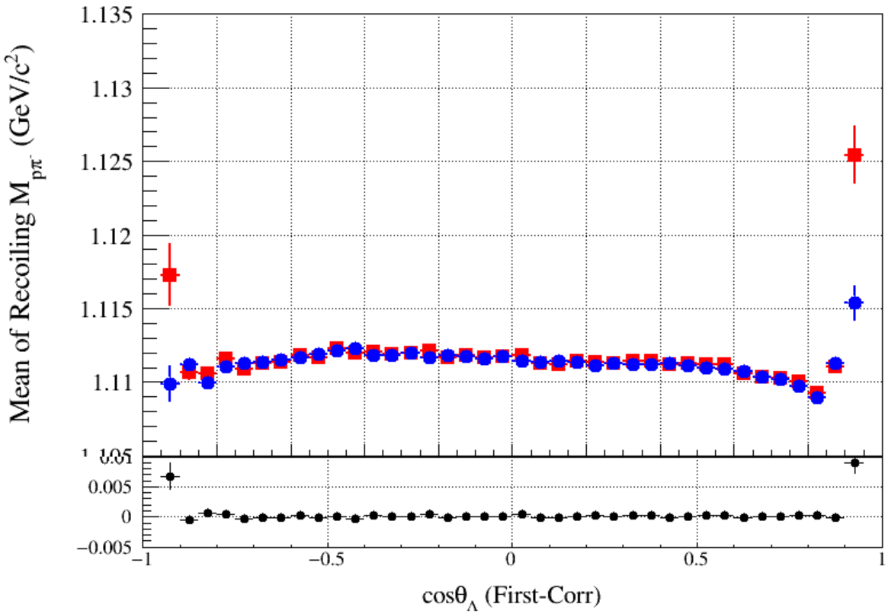
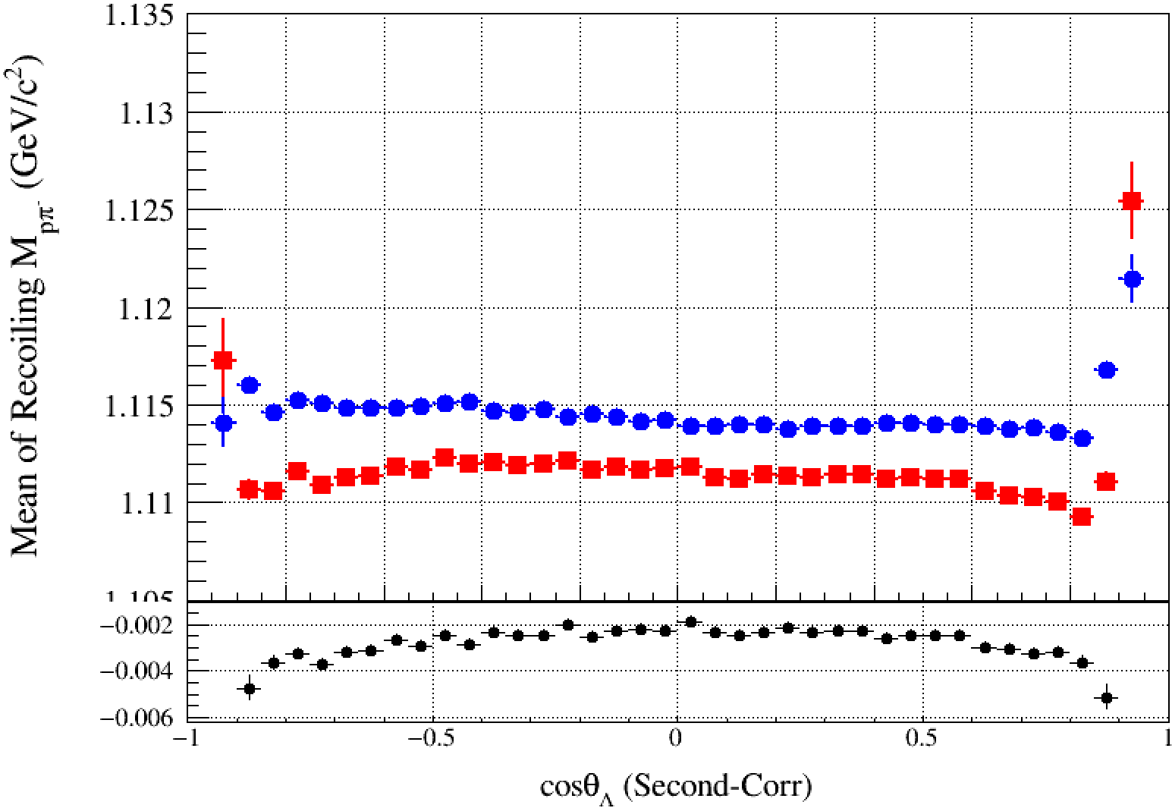
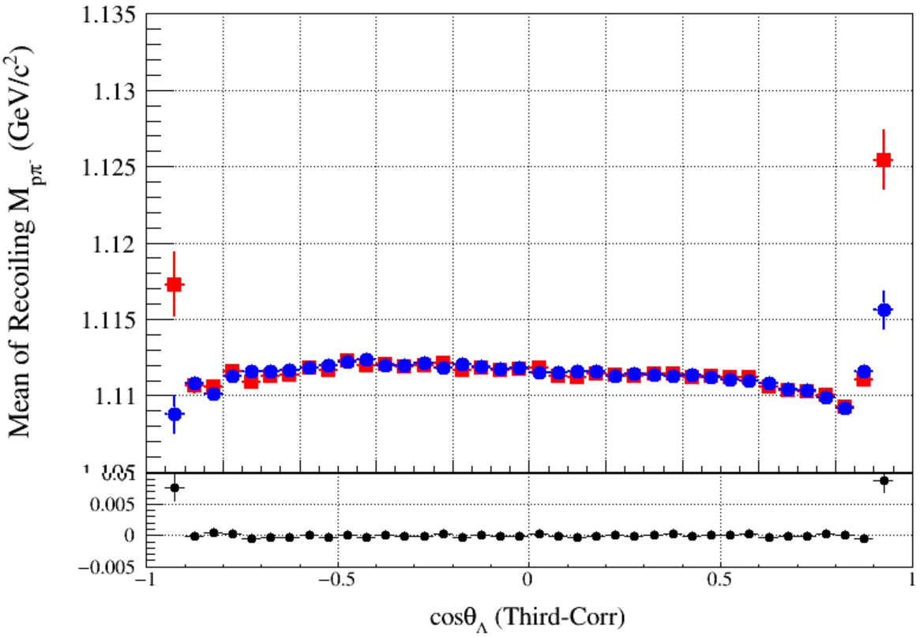
Compare (Mean of $M_{pπ}^{recoil}$)
Original
First-Correction
Second-Correction
Third-Correction
Notes:
/ustcfs/BES3User/2021/ypei/BESIII/Lambda/WriteMemo/Check/STLamcos/JianyuCode/resolution/AfterCorr

Slide 8
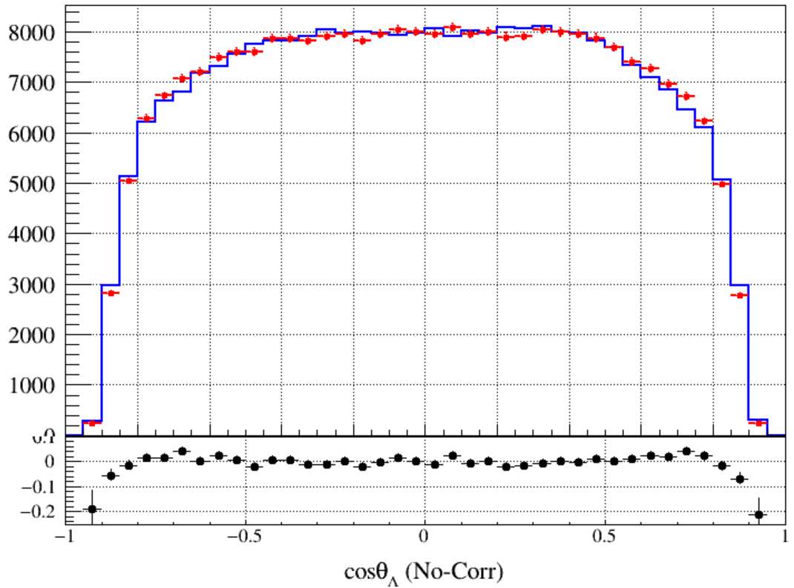
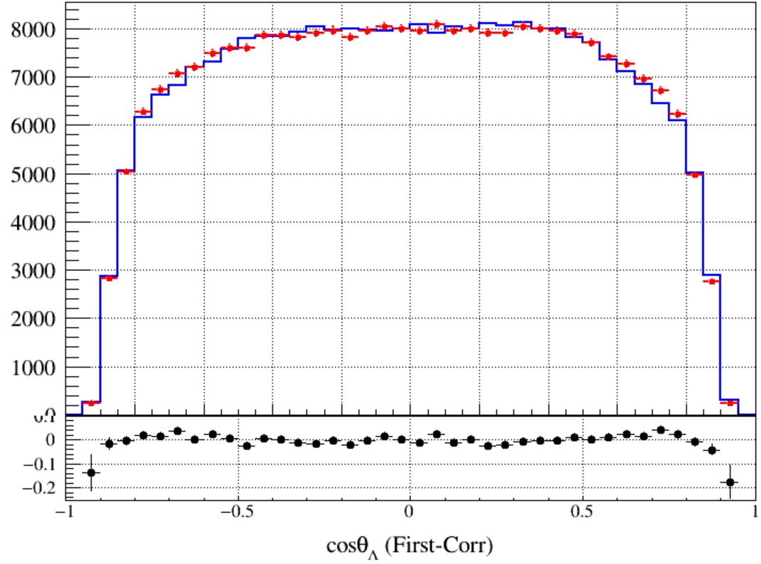
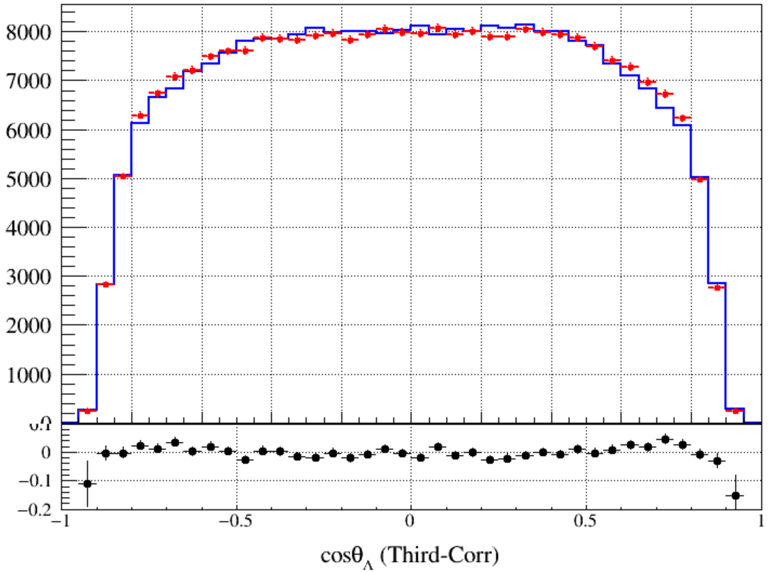
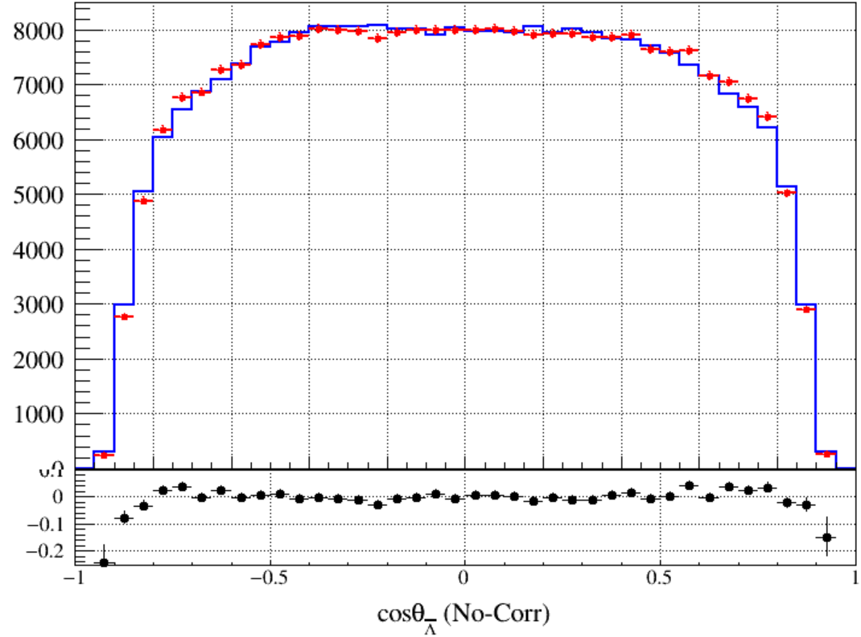
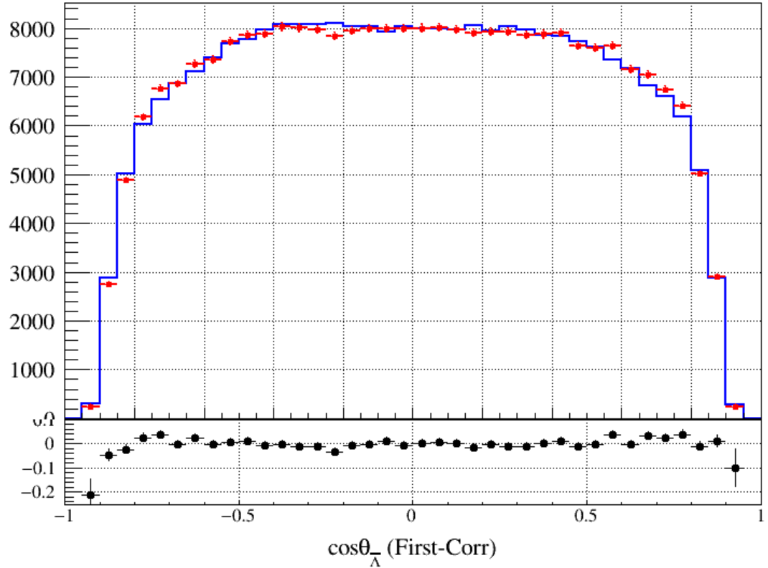
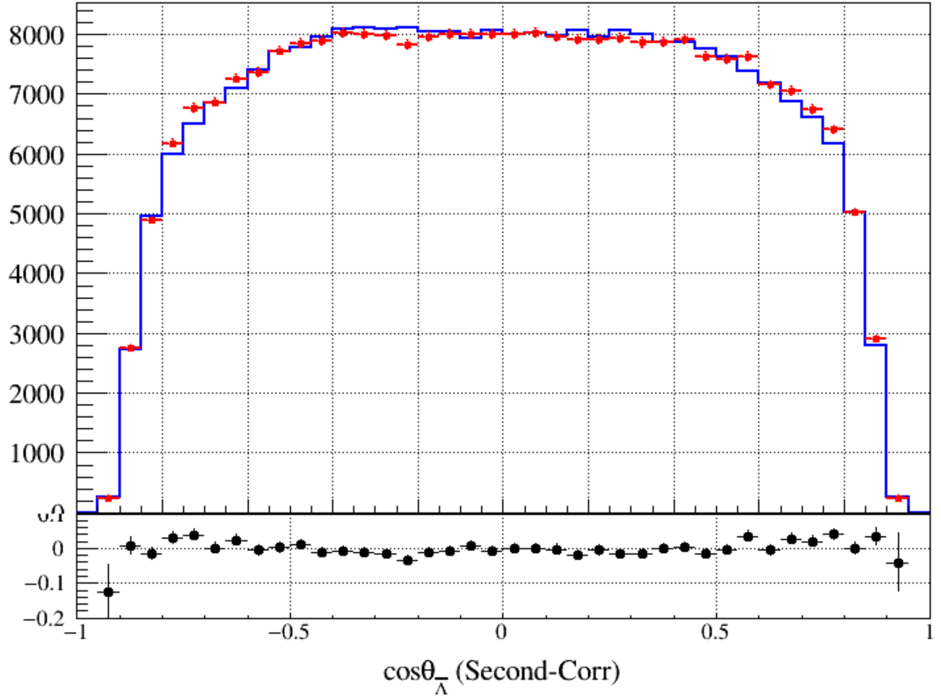
Compare ($cosθ, 3σ$ Mass Window)
Original
First-Correction
Second-Correction
Third-Correction
Notes:
/ustcfs/BES3User/2021/ypei/BESIII/Lambda/WriteMemo/Check/STLamcos/JianyuCode/resolution/AfterCorr

Slide 9
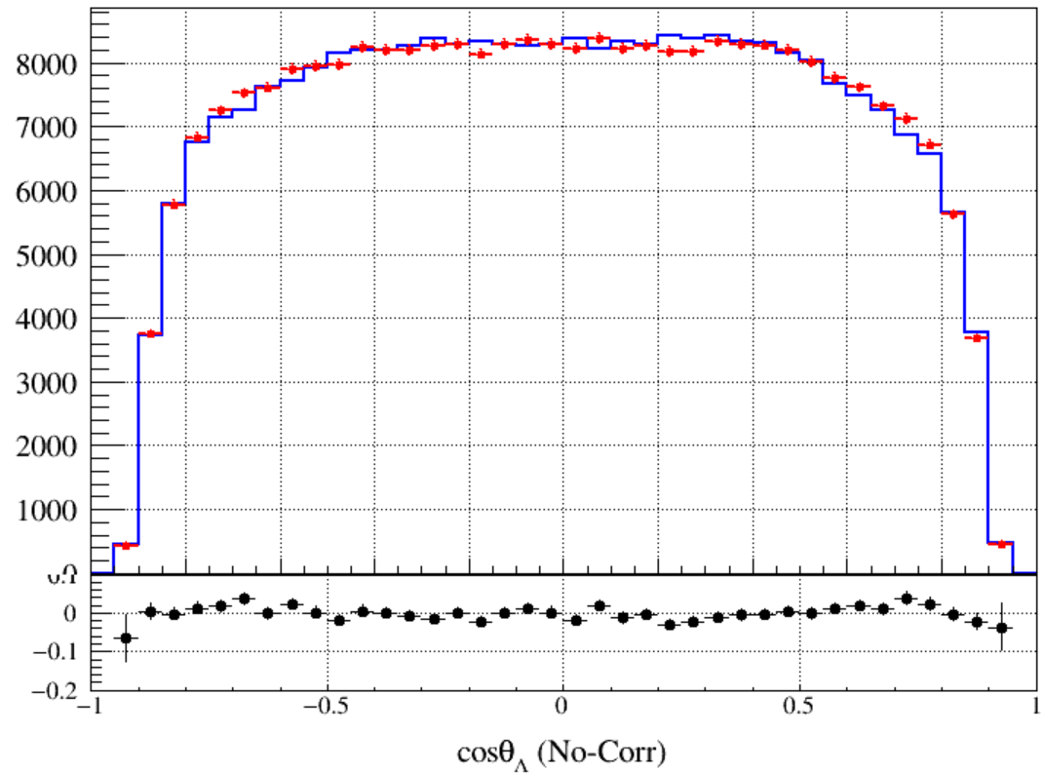
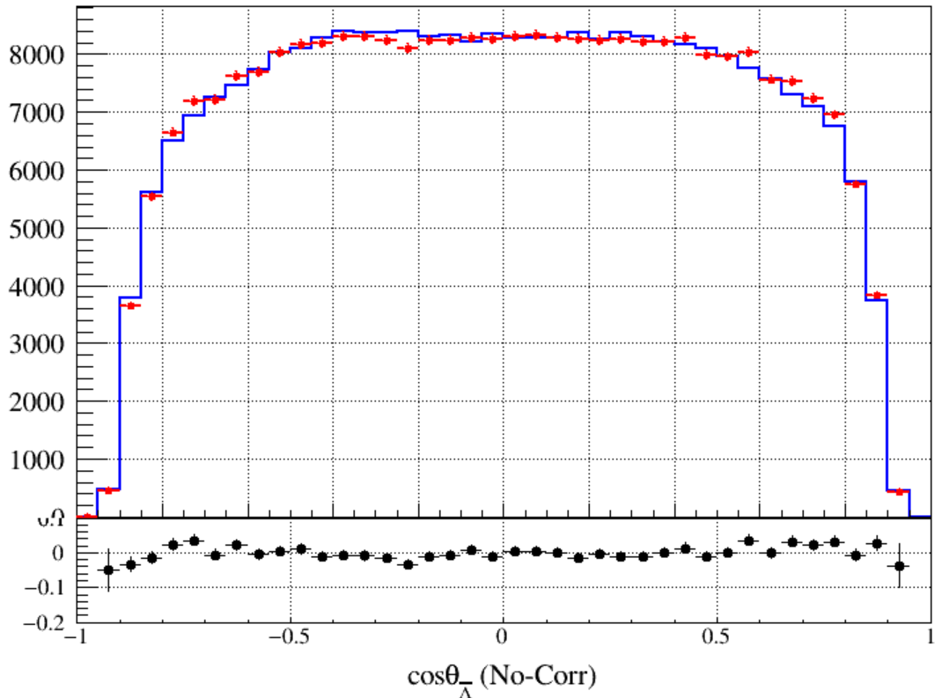
No Mass Window && No Correction

Slide 10
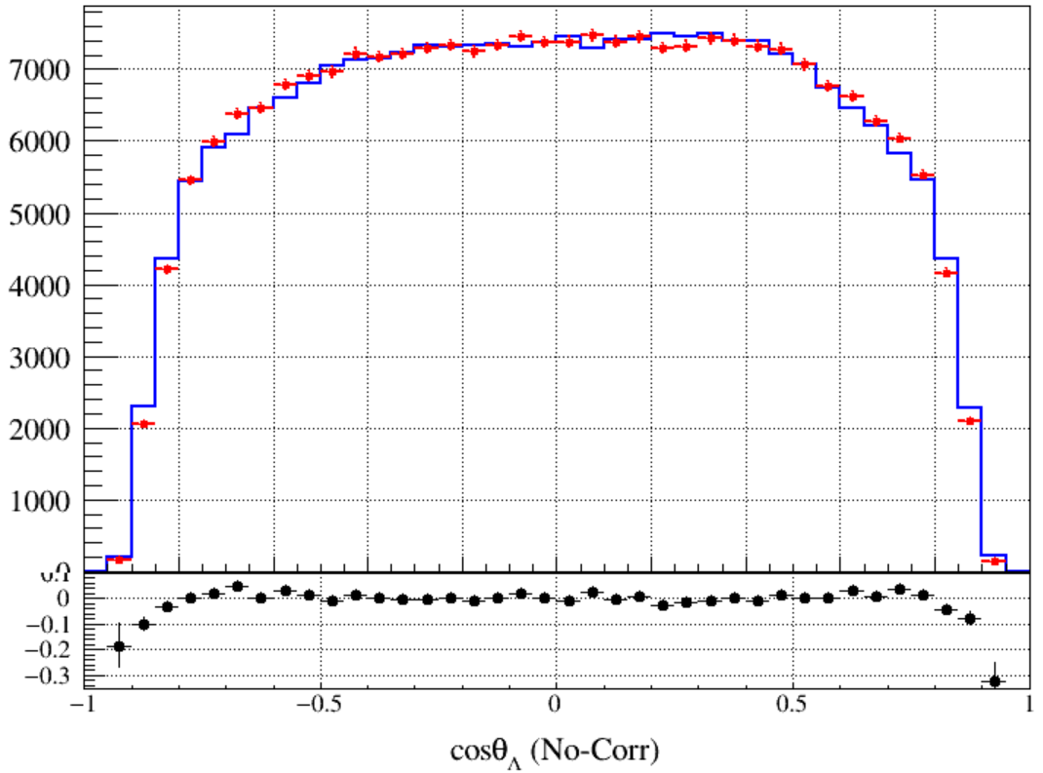
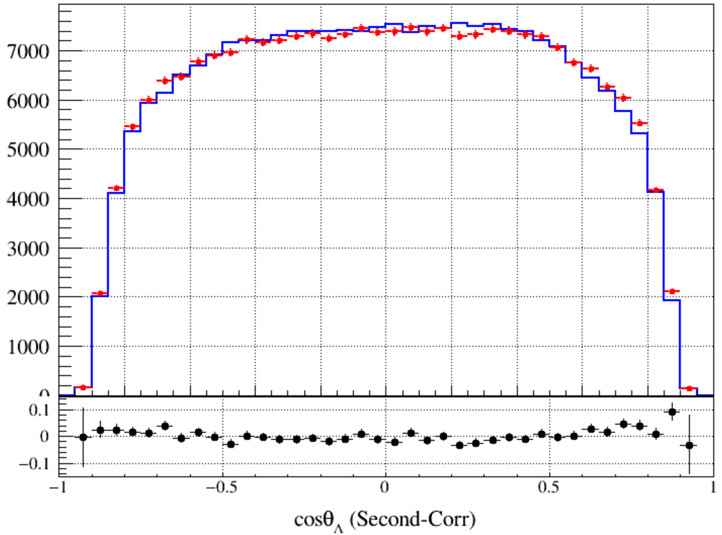
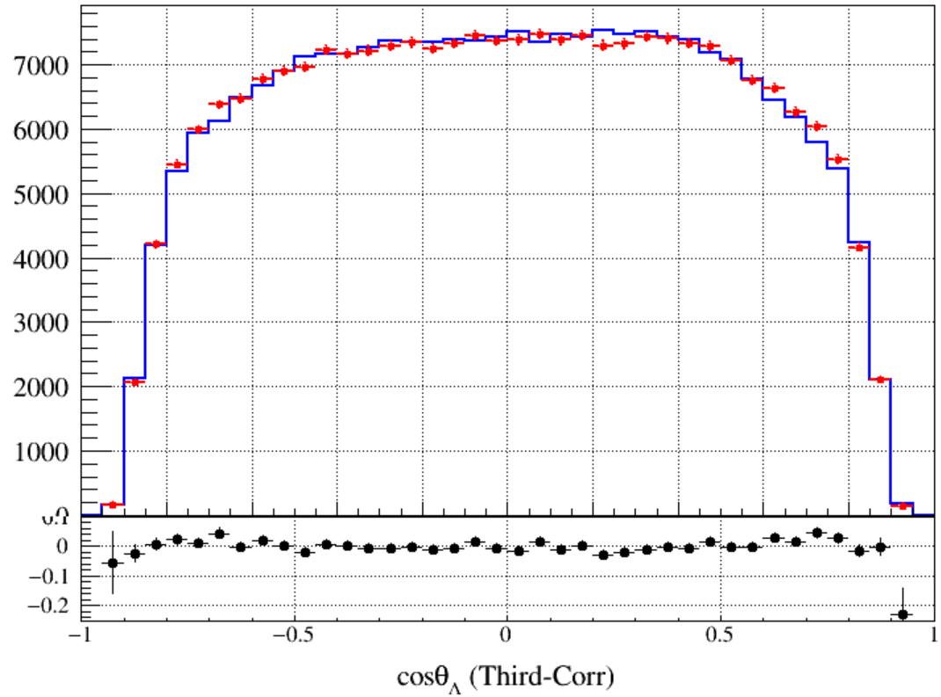
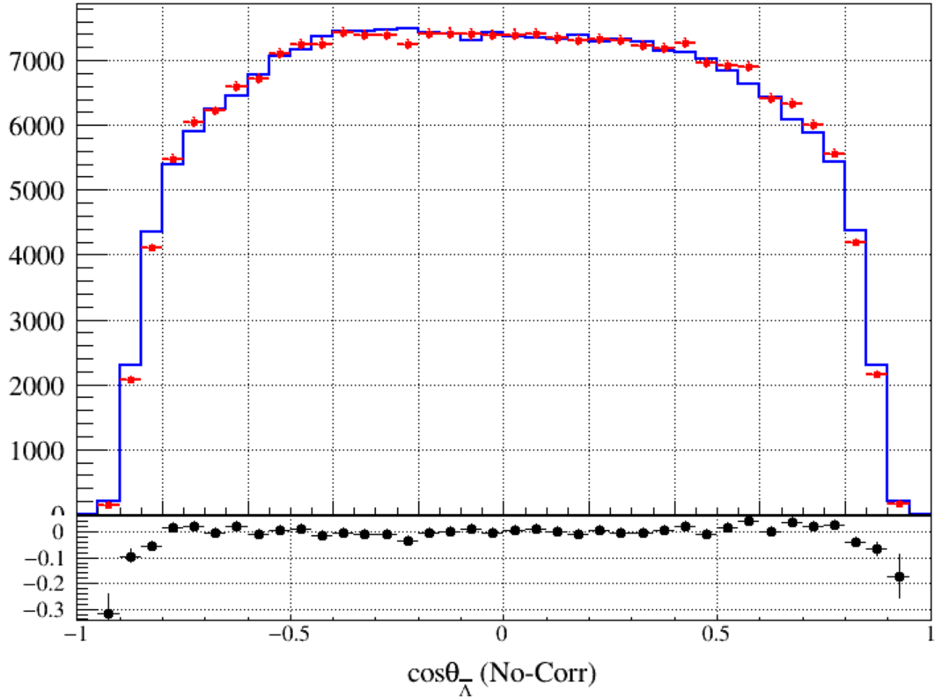
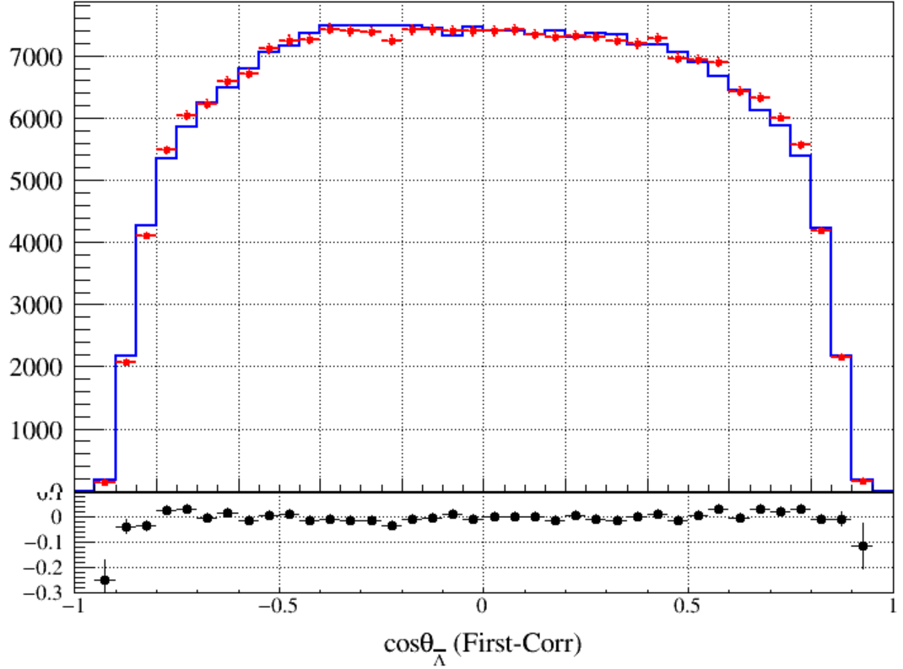
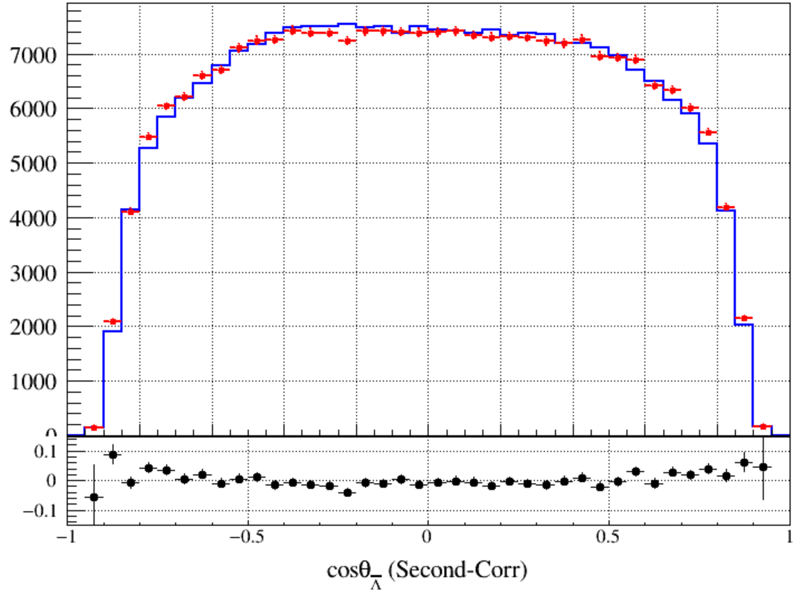
Compare ($cosθ, 2σ$ Mass Window)
Original
First-Correction
Second-Correction
Third-Correction
Notes:
/ustcfs/BES3User/2021/ypei/BESIII/Lambda/WriteMemo/Check/STLamcos/JianyuCode/resolution/AfterCorr

Slide 11
backup

Slide 12
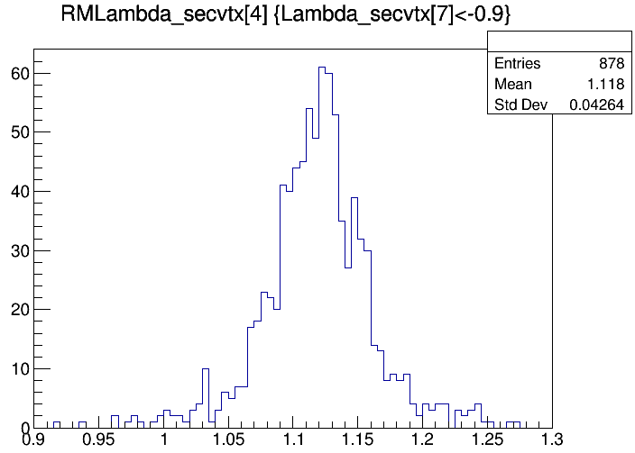
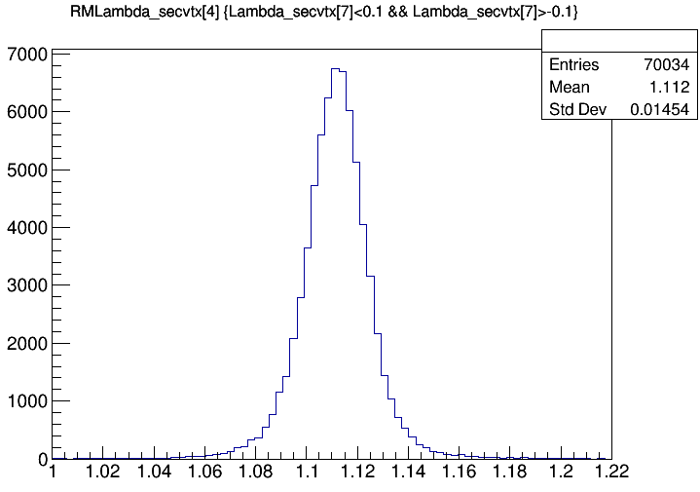
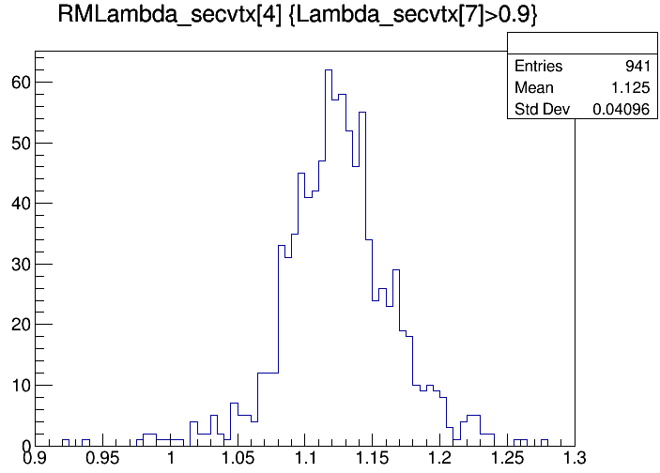
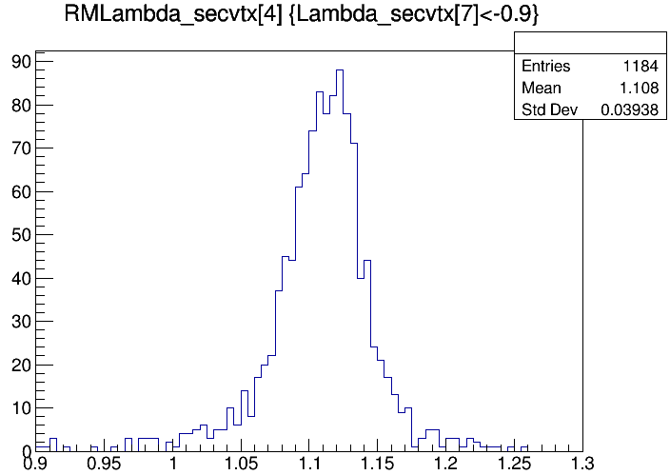
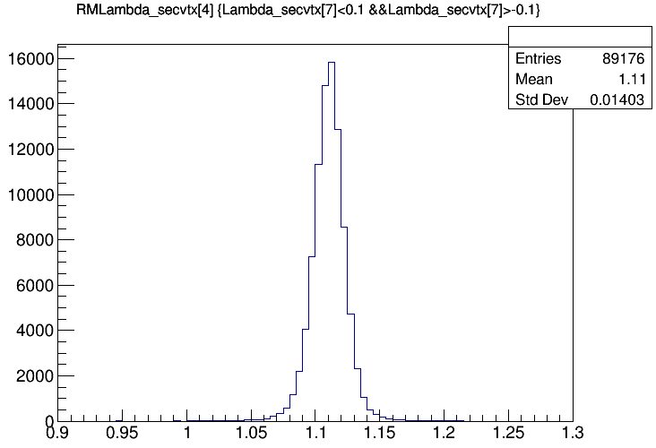
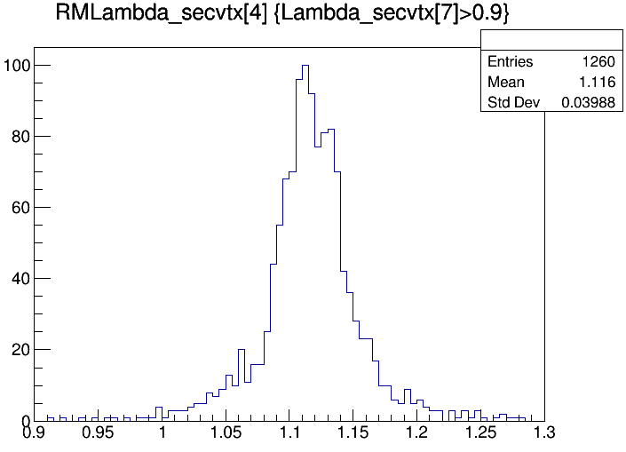
Something Wrong in $cosθ_{Λ}→1$ and $cosθ_{\overline{Λ}}→−1$
Bkg = 0.48%
Data
MC
Inclusive
Notes:
/ustcfs/BES3User/2021/ypei/BESIII/Lambda/WriteMemo/Check/STLamcos/JianyuCode/AnaVersionRoot/result_Data_Ver_02_01/root

Slide 13
$$μ_{shift}\left(p_{t},cosθ\right)=Mean{\left(p^{Kal}−p^{4c}\right)}_{data}−{Mean\left(p^{Kal}−p^{4c}\right)}_{MC}$$
Original
First-Correction
Second-Correction
No Shift
New Corr

Slide 14
Compare
VertexFit
VertexFitRefine

Slide 15
Constant Mass Window
Cos-dep Mass Window

Slide 16
Use a MC Sample to Check Correction Method
Divide the MC sample into two parts:
The one is treated as a pseudo-data which is given a random shake
Another is used to correct the pseudo-data by the above method
For pseudo-data:
Resolution and mean of 4 charged tracks is needed.
Scale the resolution and mean. ($R_{1}=R_{2}=1.2$)
$$res=RMS\left(p^{kalTrk}−p^{tru}\right), mean=Mean\left(p^{kalTrk}−p^{tru}\right)$$
$$p_{shake}=p_{kal}+RandGaus[\left(R_{1}−1\right)×mean, \sqrt{R_{2}^{2}−1}×res]$$
Notes:
/ustcfs/BES3User/2021/ypei/BESIII/Lambda/WriteMemo/Check/STLamcos/JianyuCode/resolution/CheckCorr/pseuData

Slide 17
Compare (RMS of $M_{pπ}^{recoil}$)
Original
First-Correction
Second-Correction
Notes:
/ustcfs/BES3User/2021/ypei/BESIII/Lambda/WriteMemo/Check/STLamcos/JianyuCode/resolution/CheckCorr

Slide 18
Compare (Mean of $M_{pπ}^{recoil}$)
Original
First-Correction
Second-Correction
Notes:
/ustcfs/BES3User/2021/ypei/BESIII/Lambda/WriteMemo/Check/STLamcos/JianyuCode/resolution/CheckCorr

Slide 19
Original
First-Corr
Sec-Corr
Notes:
/ustcfs/BES3User/2021/ypei/BESIII/Lambda/WriteMemo/Check/STLamcos/JianyuCode/resolution/CheckCorr

