Slide 1
Measurement of $γ χ_{c0,1,2}→γΣ^{−}{\overline{Σ}}^{+}$ at BESIII
Irshad Muzaffar 勤奋
Supervisors: Prof. Huang Guangshun 黄光顺 , Dr. Zhou Xiaorong 周小蓉
Department of Modern Physics
University of Science and Technology of China

Slide 2
Outline
Motivation
Data Analysis
Event Selection
Background Study (Next Plan)
Comparison between Data and MC
Systematic Uncertainty
Fit results
Summary

Slide 3
Motivation
Measurement of $χ_{cJ}$ baryonic decays, know more about $χ_{cJ}$ decay properties.
Study of $χ_{cJ}$ → $Σ^{−}{\overline{Σ}}^{+}$to test color octet mechanism (COM).

Slide 4
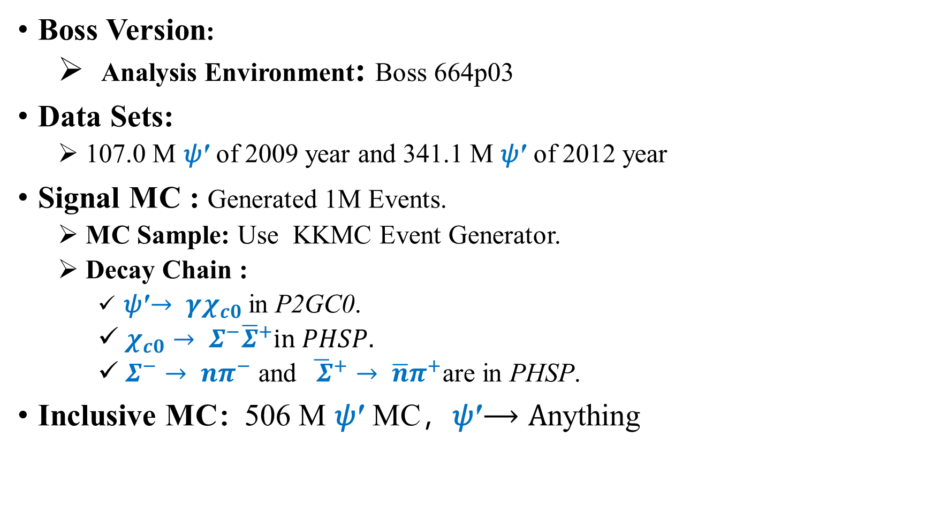
Data Sets and MC Samples
Boss Version:
Analysis Environment: Boss 664p03
Data Sets:
107.0 M 𝜓′ of 2009 year and 341.1 M 𝜓′ of 2012 year
Signal MC : Generated 1M Events.
MC Sample: Use KKMC Event Generator.
Decay Chain :
𝜓′$→ γχ_{c0}$in P2GC0.
$χ_{c0}→ Σ^{−}{\overline{Σ}}^{+}in PHSP.$
$Σ^{−}→ {nπ}^{−}$ and ${\overline{ Σ}}^{+}→ \overline{n}π^{+}$are in PHSP.
Inclusive MC：506 M 𝜓′ MC，𝜓′$⟶A$nything

Slide 5
Event Selection
Good Charged Tracks:
$\left|V_{z}\right|<30cm$, $\left|V_{r}\right|<10cm$and $|Cosθ|≤0.93$ , p>1.0 GeV/c
$N_{Good }=2 and \sum{Q_{i}}$= 0.
PID : dE/dX + TOF
${Prob}_{π }> {Prob}_{p },{Prob}_{π }> {Prob}_{k }{and N}_{π^{−}}=N_{π^{+} }$= 1
Good Neutral Tracks:
$E_{barrel}>25MeV;E_{endcap}>50MeV$
$0≤time≤14(unit:×50ns$)
At least 2 photons tracks $N_{γ}≥2$ (1 for Gamma, 1 for Anti-Neutron).
The most energetic shower consider as $\overline{n}$ candidate, $E_{\overline{n}}$> 0.2 GeV.
Further Slection :
Vertex Fit ($Σ^{−}{\overline{Σ}}^{+}$) :
Do Kinematics Fit 1C :$γ χ_{c0,1,2}→γΣ^{−}{\overline{Σ}}^{+}$
For N_{γ} ≥ 2: Minimum χ²_{1C}($γΣ^{−}{\overline{Σ}}^{+}$) is chosen

Slide 6
Background Analysis

Slide 7
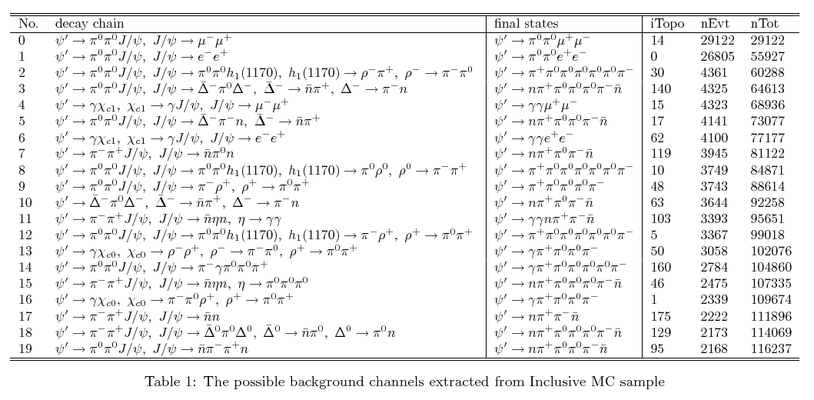
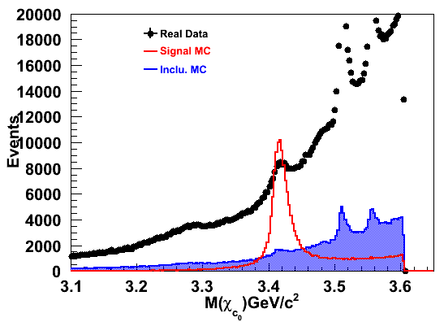
Background channel Extracted from Inclusive MC Sample
Invariant Mass of Chic0
z

Slide 8
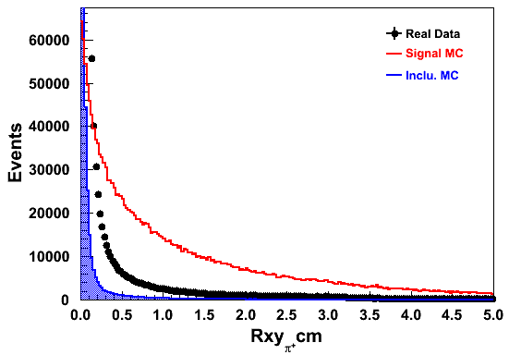
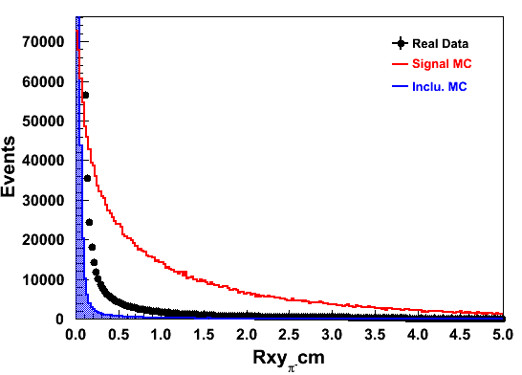
Rvxy for pi+ and pi-

Slide 9
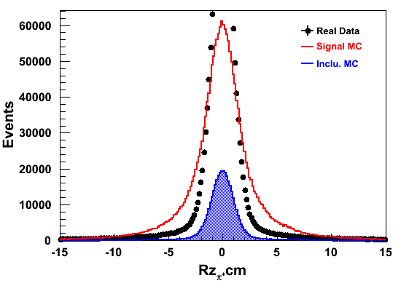
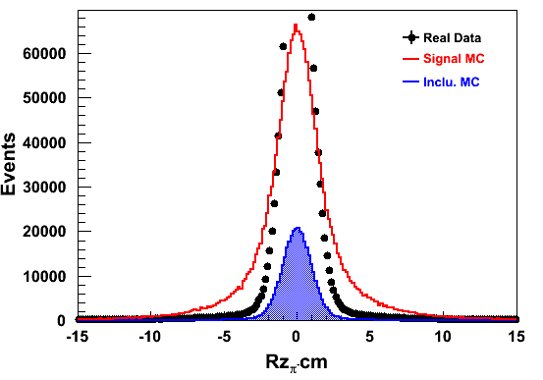
Rvz for pi+ and pi-

Slide 10
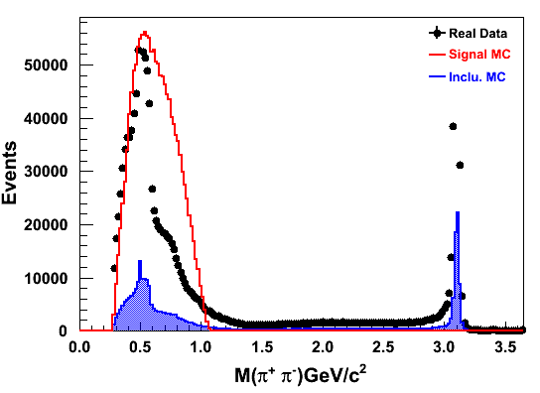
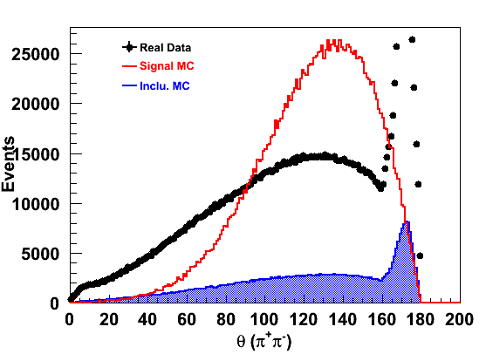
Invariant Mass of pi+ and pi-
Opening Angle of pi+ and pi-
Peak around ks
Peak around J/psi

Slide 11
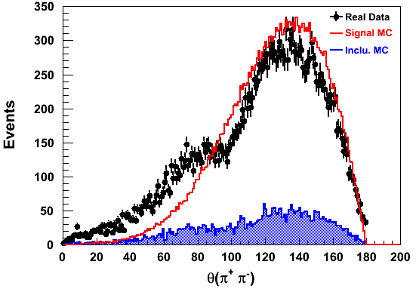
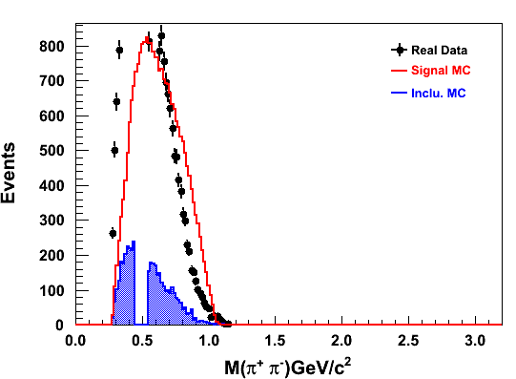
Event Selection for Minimized the Background
Event Selection :
$\left|M_{recoil}\left(π^{+}π^{−}\right)−M_{J/ψ} \right|>0.01 GeV$
$\left|M_{recoil}\left(π^{+}π^{−}\right)\right|>2.5 GeV$
|$M_{π^{+}π^{−}}−M_{ks}$ |$>0.05GeV$
${ ψ }^{′}→ π^{+}π^{−}J/ψ$ and ${ψ }^{′}→ π^{o}π^{o}J/ψ$ :
Opening Angle of pi+ and pi-
Invariant Mass of pi+ and pi-

Slide 12
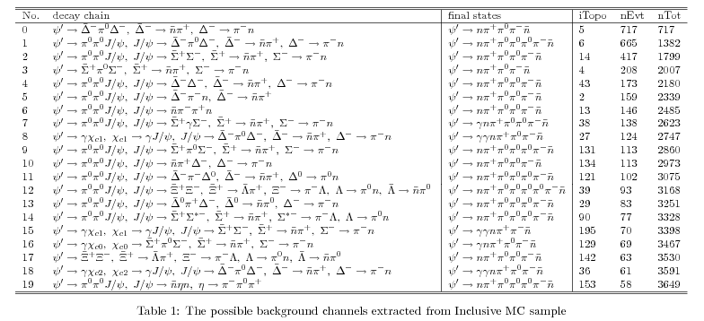
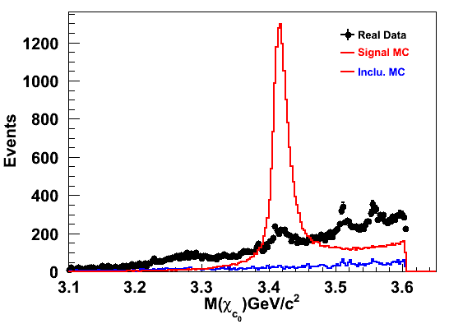
Invariant Mass of Chic0
Chic2
Chic1
Chic0

Slide 13
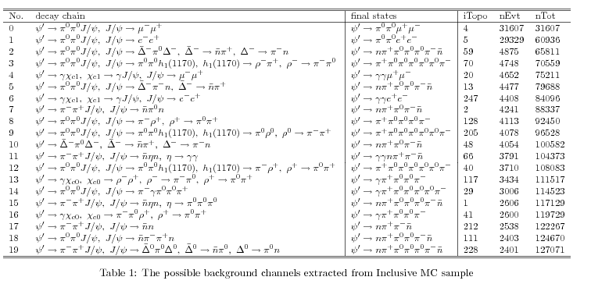
How I can get rid of all the neutrals J/psi background channels

