Slide 1
Study of $e^{+}e^{−}$→$K^{+}K^{−}π^{0}$
Jian Zu, Yateng Zhang, Wenbiao Yan
University of Science and Technology of China

Slide 2
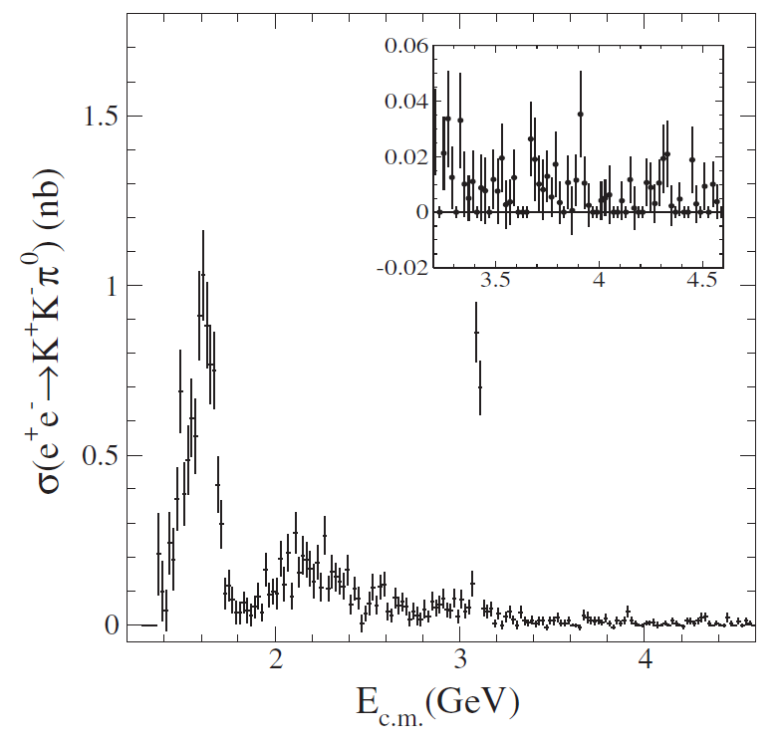
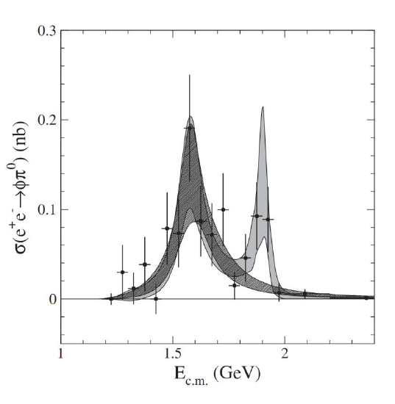
Motivation
BaBar have measured the cross section ${e^{+}e^{−}→K}^{+}K^{−}π^{0}$.
Structure around 2.1 GeV.
$e^{+}e^{−}→φπ^{0}$: Search for exotic iso-vector state.
Result above 2.0 GeV ?

Slide 3
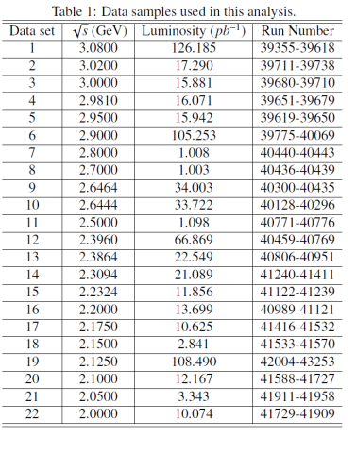
Data sets and MC simulation
Boss Version: 6.6.5.p01
R-scan Data: 2.0 ~ 3.08 GeV
MC samples
20 K $e^{+}e^{−}$→$K^{+}K^{−}π^{0}$ signal MC
1M inclusive MC samples at 2.125 GeV

Slide 4
Event Selection
Charged Tracks:
|Vr|<1.0 cm && |Vz|<10.0 cm && |cosθ|<0.93;
Ngood==2 && Ncharge==0;
PID:
Kaon: Prob(K) > Prob(P) && Prob(K) > Prob(𝛑);
N(K⁺)=N(K⁻)=1;
Good Photon:
E > 25 MeV (barrel) or E> 50 MeV(endcap) ;
𝜽𝒎𝒊𝒏(𝛄,charge) ≥ 20° ;
0<=TDC<=14;
N𝜸≥2;
4C kinematic fit : (2γ𝑲⁺𝑲⁻)
$χ^{2}<70$

Slide 5
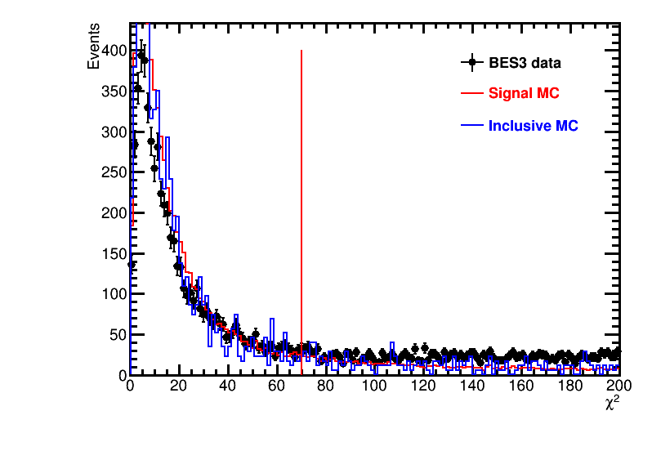
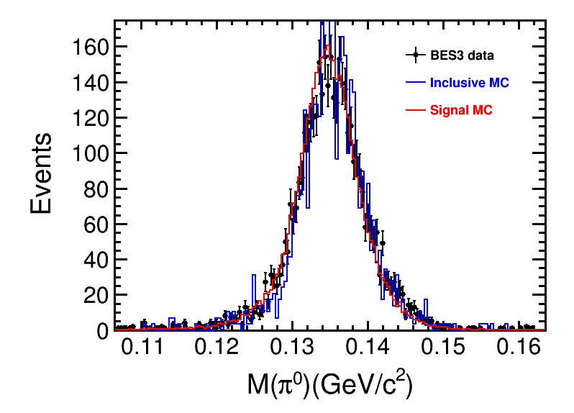
Event Selection
2.125
$$χ^{2}≤70$$
$$\left|M\left(π^{0}\right)−M0\left(π^{0}\right)\right|≤5σ$$

Slide 6
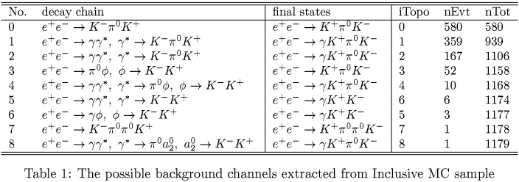
Background Analysis
2.125
Background: 10/1179 ≈ 0.848%

Slide 7
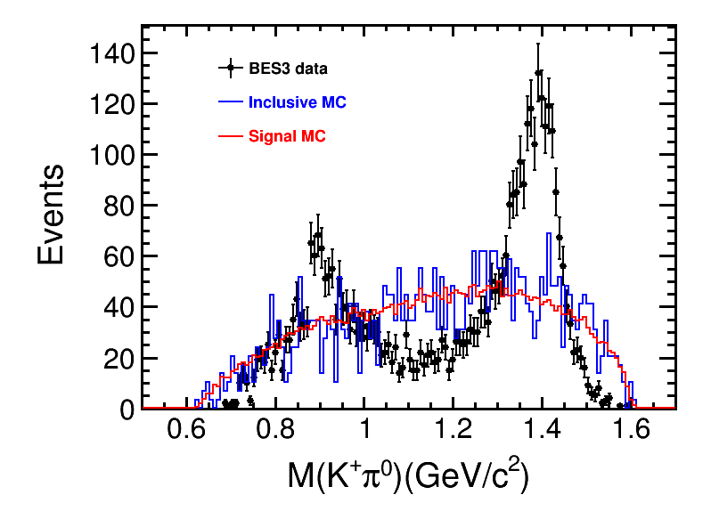
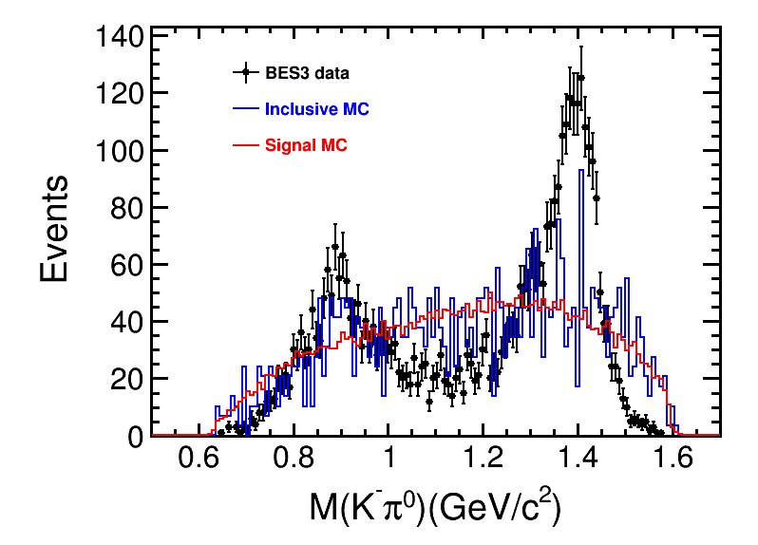
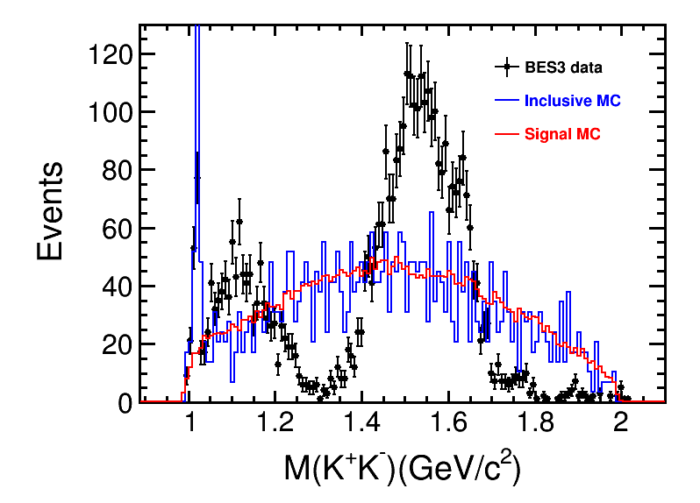
Two body invariant mass of K⁺ K⁻ π⁰
2.125
MC can not described the data!

Slide 8
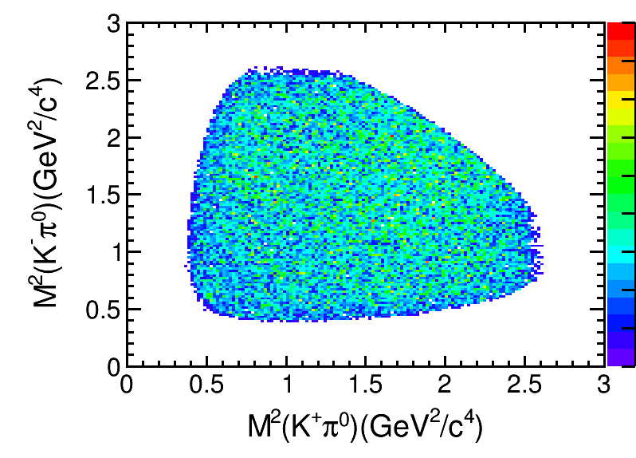
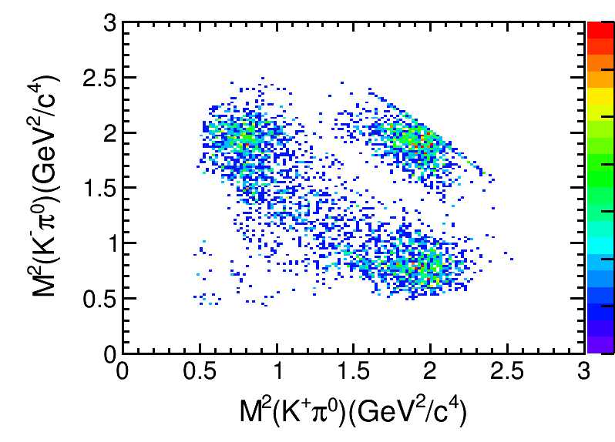
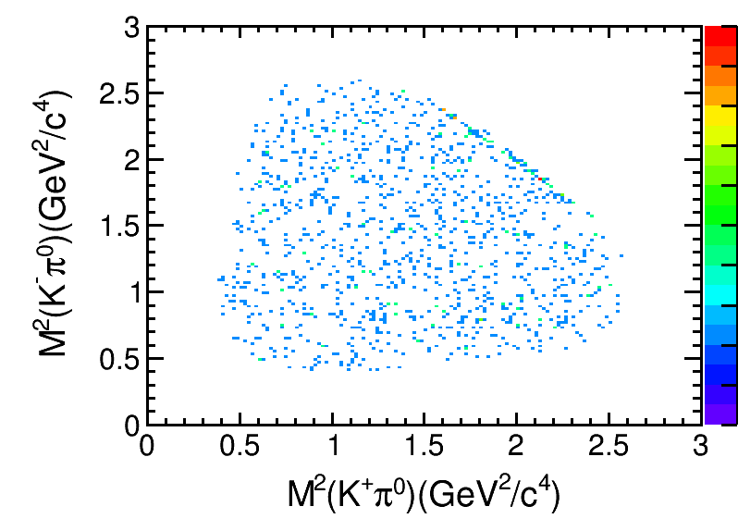
Extract efficiency
Signal MC
data
Inclusive MC

Slide 9
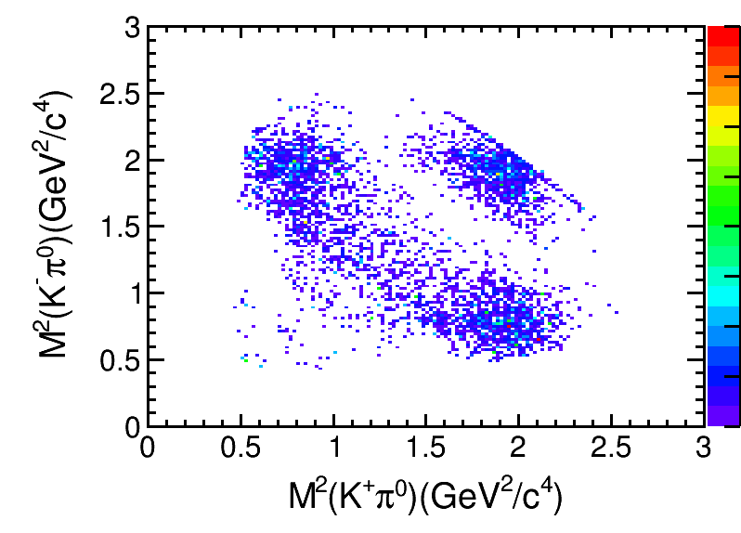
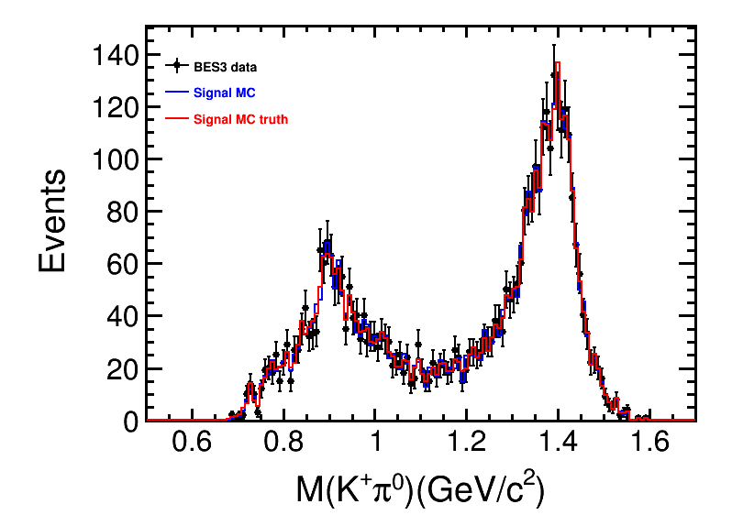
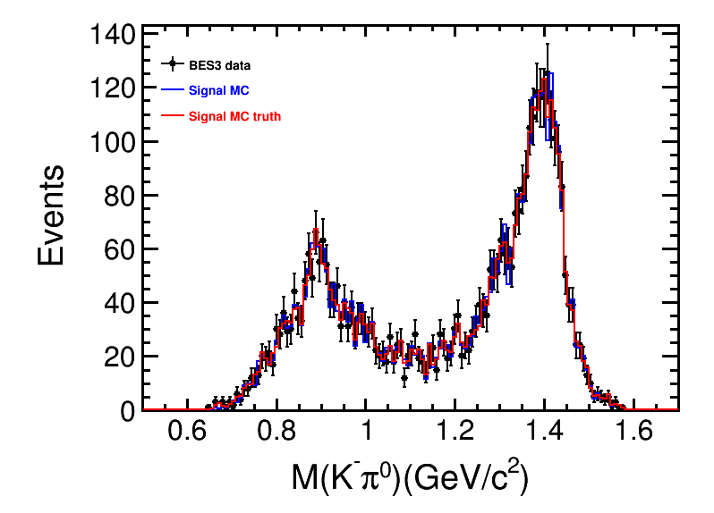
Extract efficiency
2.125
Weighted distribution
Weighted efficiency:
$$ε=\frac{\sum_{i=1}^{N_{generate}}{ω_{i}}}{\sum_{i=1}^{N_{select}}{ω_{i}}}$$
$ε=0.282910$ at 2.125 GeV
Signal MC with weights

Slide 10
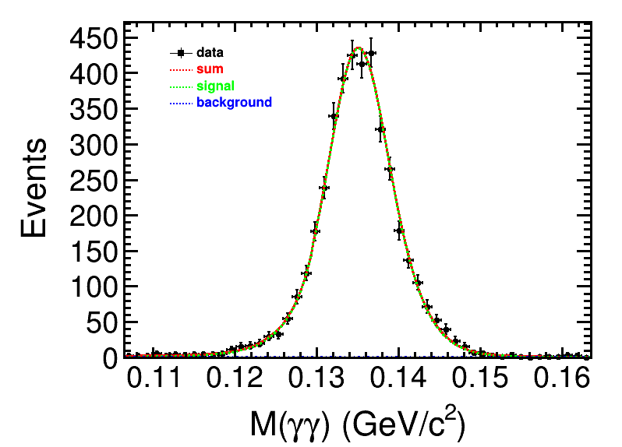
Extract signal events
2.125
Fitting function:
signal : MC shape $⊗$ Gauss
bkg : 1^{or} Chebychev
N_{data} = 4020.48 ± 65.0564

Slide 11
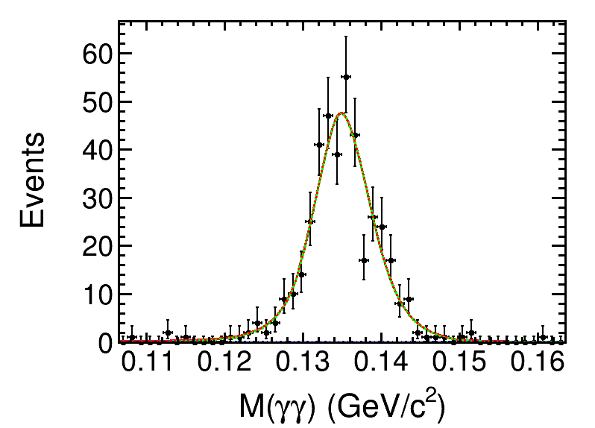
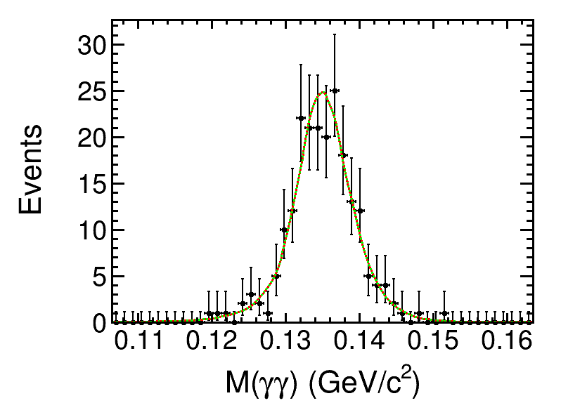
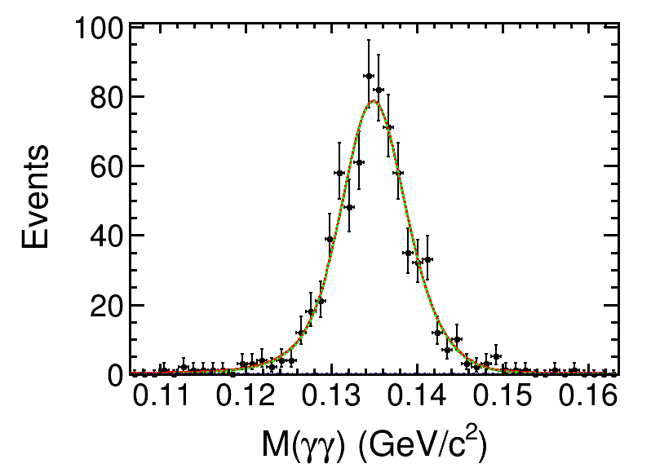
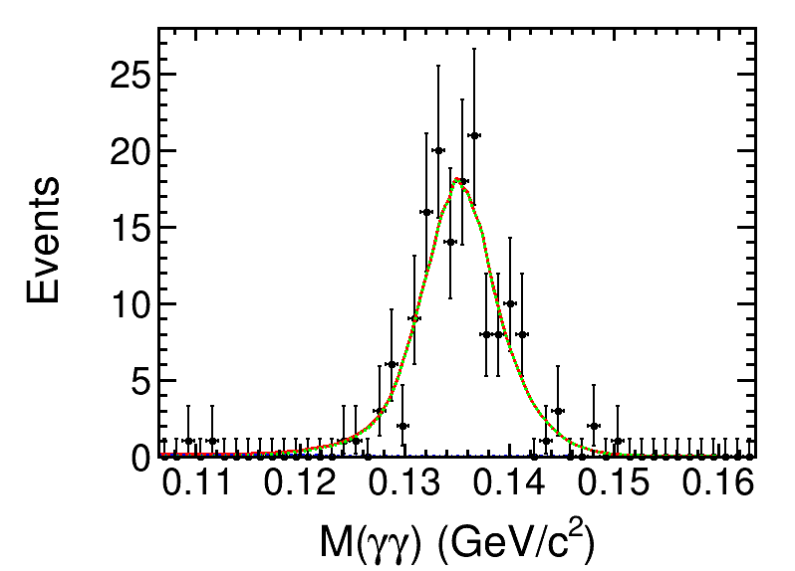
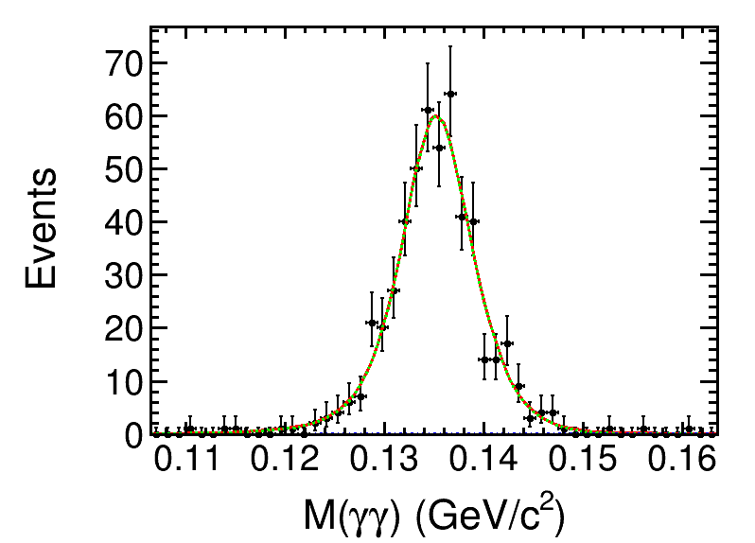
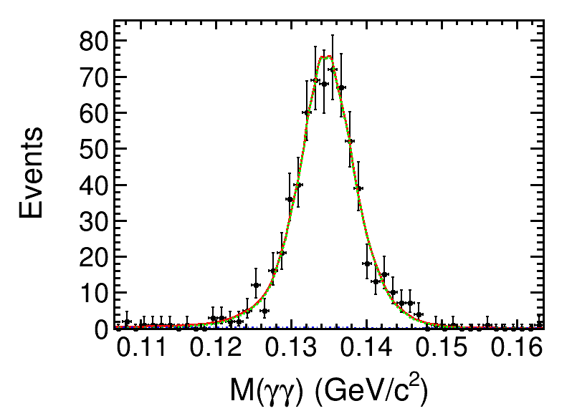
Results at other energies
$$\sqrt{s}=2.000GeV$$
$$\sqrt{s}=2.050GeV$$
$$\sqrt{s}=2.100GeV$$
$$\sqrt{s}=2.150GeV$$
$$\sqrt{s}=2.175GeV$$
$$\sqrt{s}=2.200GeV$$

Slide 12
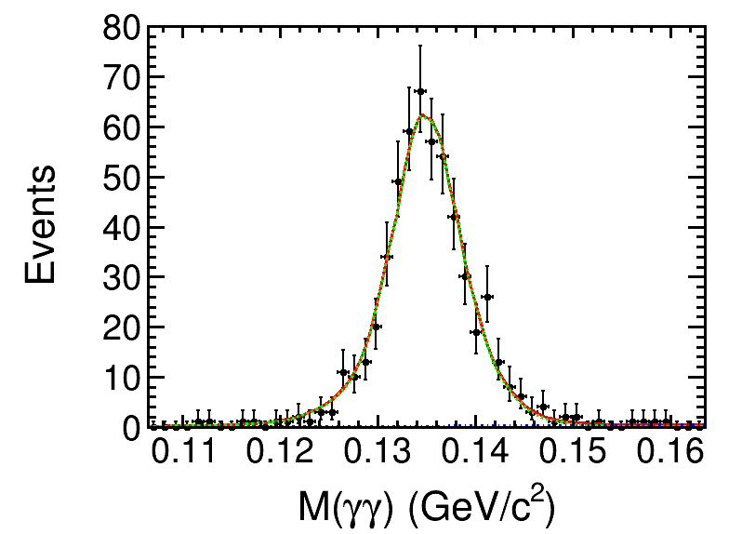
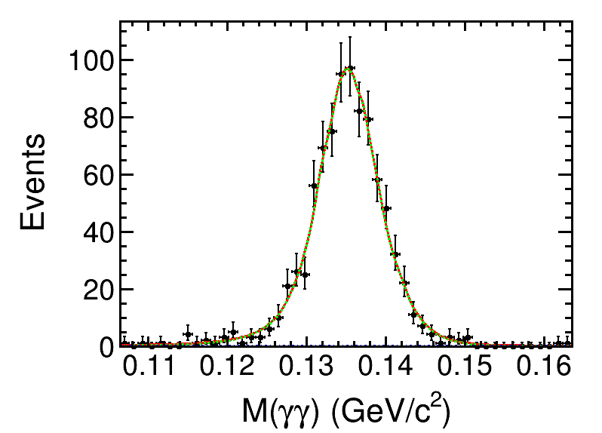
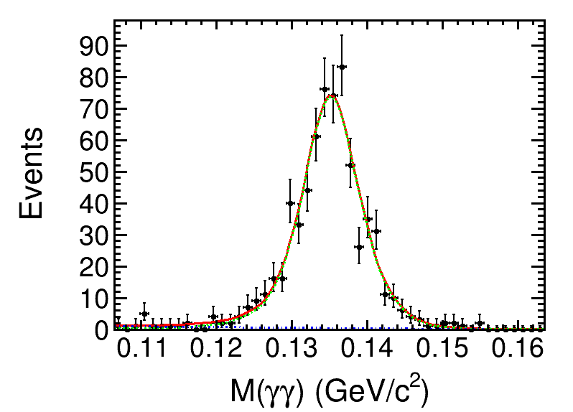
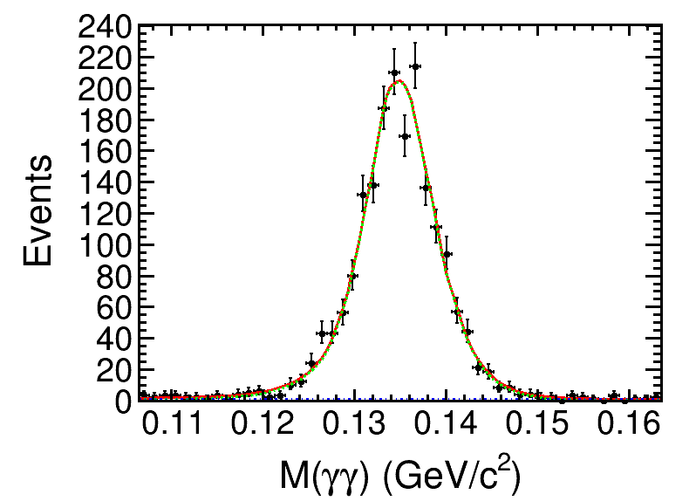
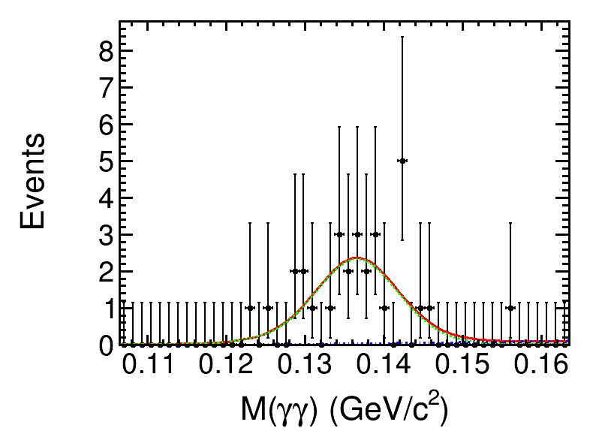
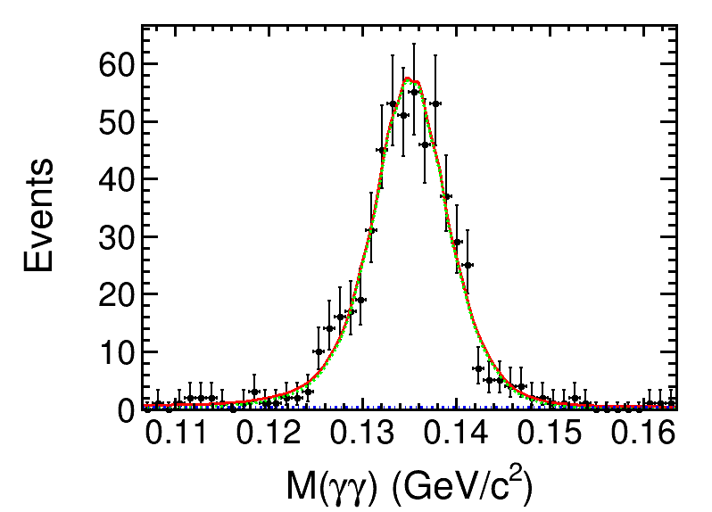
Results at other energies
$$\sqrt{s}=2.2324GeV$$
$$\sqrt{s}=2.3094GeV$$
$$\sqrt{s}=2.3864GeV$$
$$\sqrt{s}=2.396GeV$$
$$\sqrt{s}=2.500GeV$$
$$\sqrt{s}=2.6444GeV$$

Slide 13
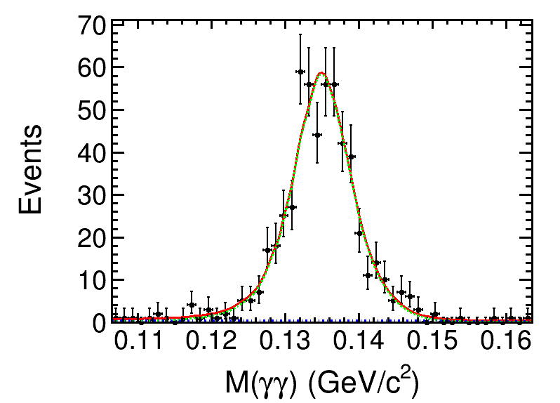
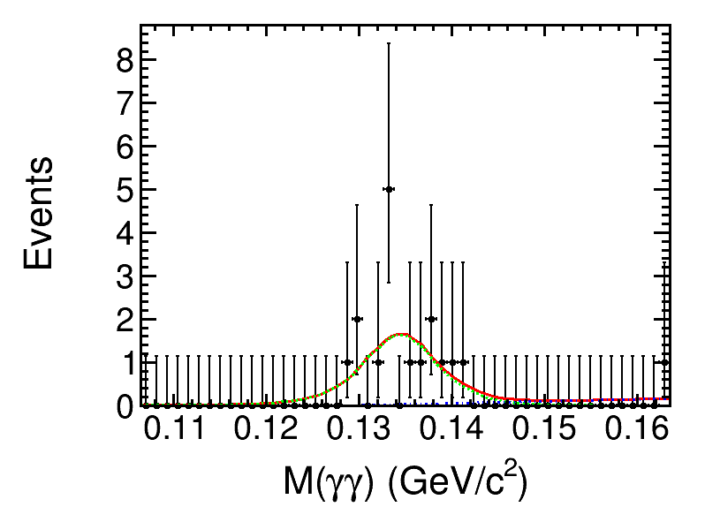
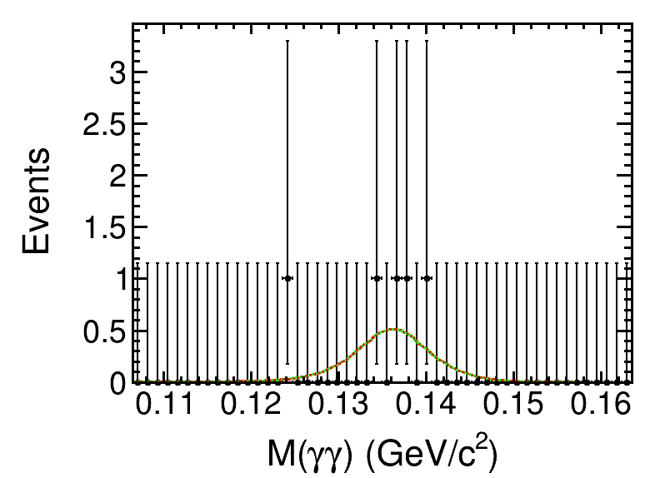
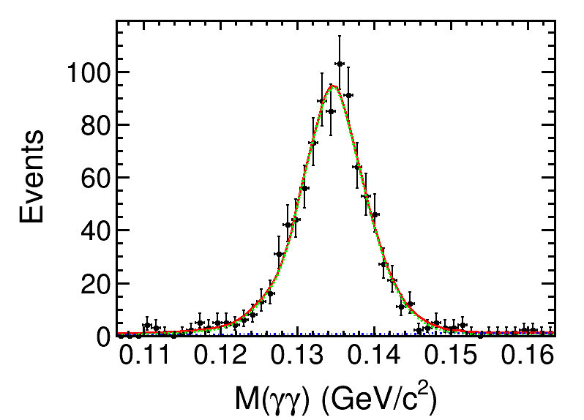
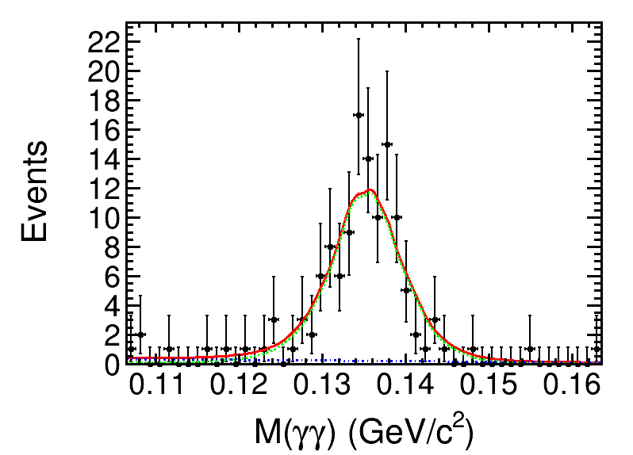
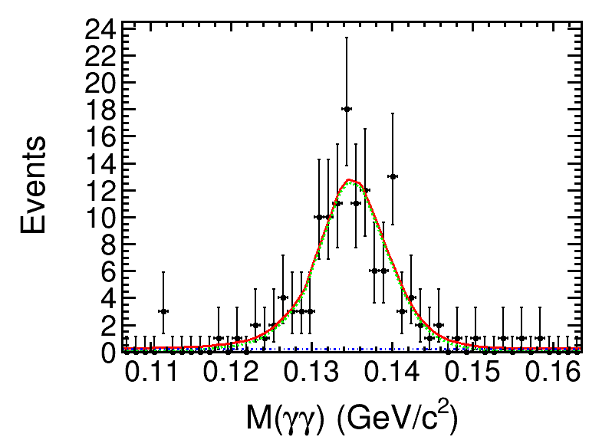
Results at other energies
$$\sqrt{s}=2.6464GeV$$
$$\sqrt{s}=2.700GeV$$
$$\sqrt{s}=2.800GeV$$
$$\sqrt{s}=2.900GeV$$
$$\sqrt{s}=2.950GeV$$
$$\sqrt{s}=2.981GeV$$

Slide 14
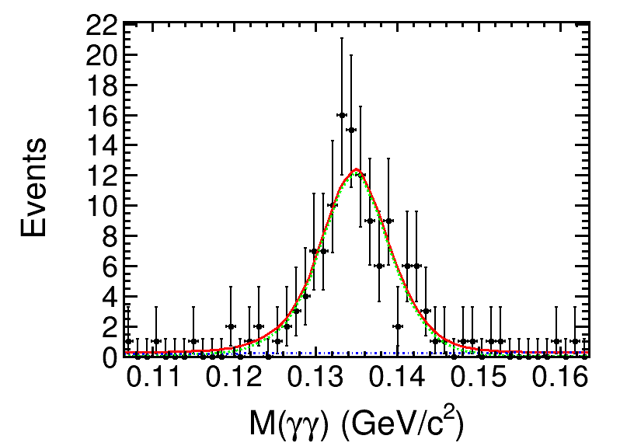
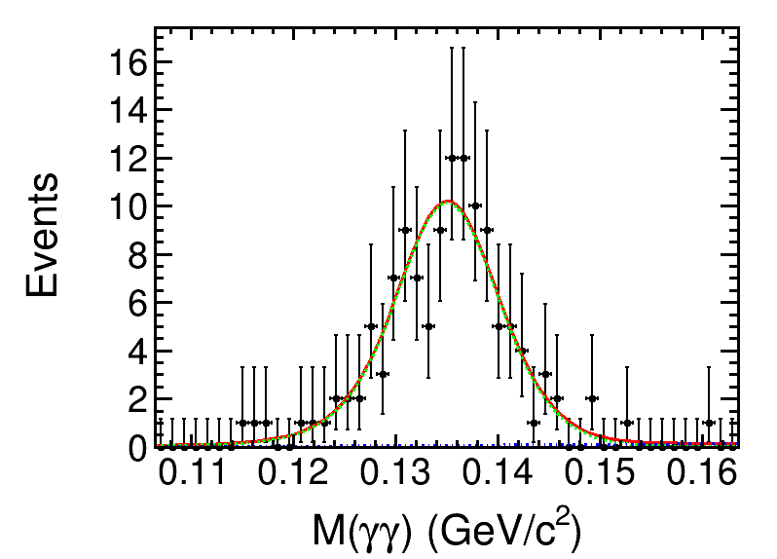
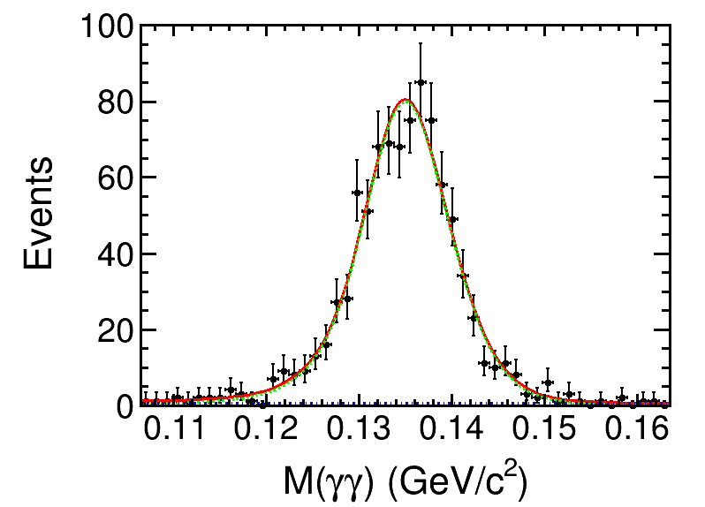
Results at other energies
$$\sqrt{s}=3.000GeV$$
$$\sqrt{s}=3.020GeV$$
$$\sqrt{s}=3.080GeV$$

Slide 15
Calculate cross section
$$σ=\frac{N_{data}}{\left(1+δ\right)ISR⋅(1+δ)V⋅ε⋅Br⋅ℒ}$$
$N_{data}$ : number of events from the fit of M(π⁰) distributions.
$\left(1+δ\right)$ : correction factors from ISR and vacuum polarization.
$ε$ : selection efficiency calculated by weights.
$Br$ : branch fraction of π⁰→γγ from PDG.
$ℒ$ : integrated luminosity.

Slide 16
cross sections
Energy | L | Ndata | ISR | VR | efficieny | cross
2125 | 108.49±0.02±0.94 | 4.02E+03 | 1.06197 | 1.03926 | 0.282910 | 120.101
2000 | 10.074±0.005±0.067 | 4.04E+02 | 1.13135 | 1.03689 | 0.228387 | 151.604
2050 | 3.343±0.003±0.027 | 2.08E+02 | 1.091452 | 1.03752 | 0.245574 | 226.409
2100 | 12.167±0.006±0.085 | 7.17E+02 | 1.068642 | 1.03888 | 0.261914 | 204.971
2150 | 2.841±0.02±0.94 | 1.52E+02 | 1.057962 | 1.03961 | 0.319028 | 154.195
2175 | 10.625±0.006±0.091 | 5.11E+02 | 1.056512 | 1.0399 | 0.328721 | 134.625
2200 | 13.699±0.007±0.092 | 6.45E+02 | 1.057248 | 1.04018 | 0.324629 | 133.372
2232 | 11.856±0.007±0.087 | 5.35E+02 | 1.061292 | 1.04051 | 0.357371 | 115.811
2309 | 21.089±0.009±0.143 | 8.52E+02 | 1.082307 | 1.04094 | 0.279313 | 129.864
2386 | 22.549±0.01±0.176 | 6.58E+02 | 1.115015 | 1.04096 | 0.279569 | 90.968
2396 | 66.869±0.017±0.475 | 1.84E+03 | 1.119686 | 1.04097 | 0.274159 | 86.980

Slide 17
cross sections
Energy | L | Ndata | ISR | VR | efficieny | cross
2500 | 1.098±0.002±0.009 | 2.90E+01 | 1.175231 | 1.04054 | 0.280780 | 77.770
2644 | 33.722±0.013±0.216 | 5.37E+02 | 1.259165 | 1.03939 | 0.296682 | 41.514
2646 | 34.003±0.013±0.282 | 5.38E+02 | 1.260242 | 1.03938 | 0.290953 | 42.005
2700 | 1.034±0.002±0.007 | 1.56E+01 | 1.291281 | 1.03874 | 0.259765 | 43.716
2800 | 1.008±0.002±0.007 | 4.99E+00 | 1.347755 | 1.03683 | 0.248825 | 14.419
2900 | 105.253±0.025±0.905 | 9.17E+02 | 1.400654 | 1.03284 | 0.278058 | 21.927
2950 | 15.942±0.01±0.143 | 1.16E+02 | 1.42471 | 1.02886 | 0.274015 | 18.358
2981 | 16.071±0.01±0.095 | 1.26E+02 | 1.437955 | 1.02461 | 0.280170 | 19.246
3000 | 15.881±0.01±0.11 | 1.22E+02 | 1.444923 | 1.02067 | 0.204441 | 25.792
3020 | 17.29±0.011±0.123 | 1.20E+02 | 1.450865 | 1.01446 | 0.263634 | 18.133
3080 | 126.185±0.029±0.921 | 8.78E+02 | 1.408645 | 0.914869 | 0.256281 | 21.315

Slide 18
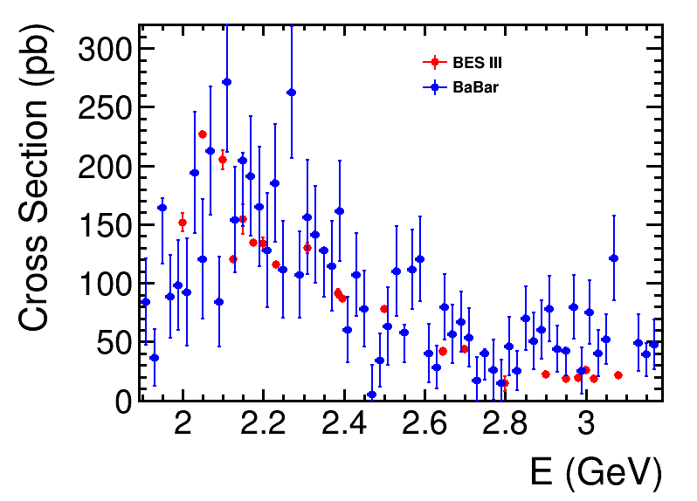
cross sections

Slide 19
Summary
Cross section $e^{+}e^{−}$→$K^{+}K^{−}π^{0}$ have been measured for R-Scan data.
They are consistent with BaBar results, but with much improved precision.
Next to do
Study the intermediate states process $e^{+}e^{−}→φπ^{0}$.
Prepare the thesis .
Thanks very much

