Slide 1
2D Optimization of Delta E Updated June 5,2019

Slide 2
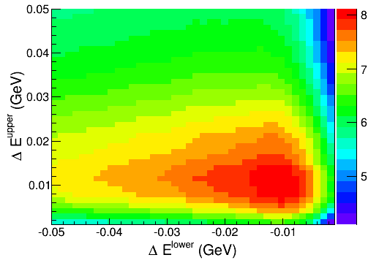
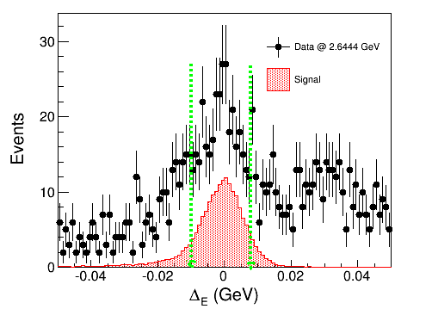
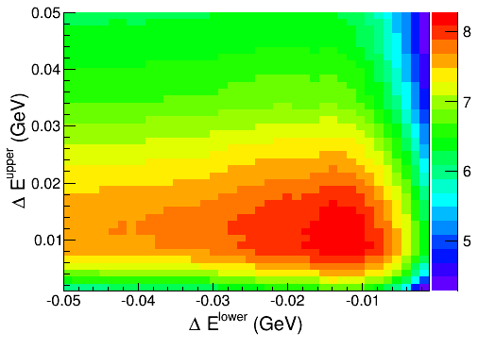
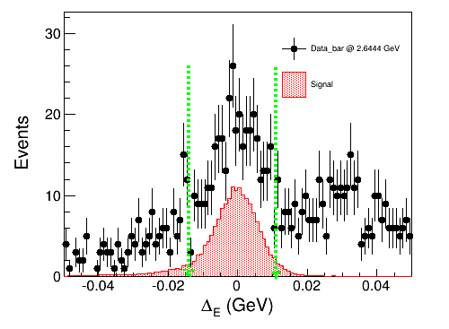
2D Optimization of Delta E
Sigma0
Anti-Sigma0

Slide 3
Background Study for Sigma0

Slide 4
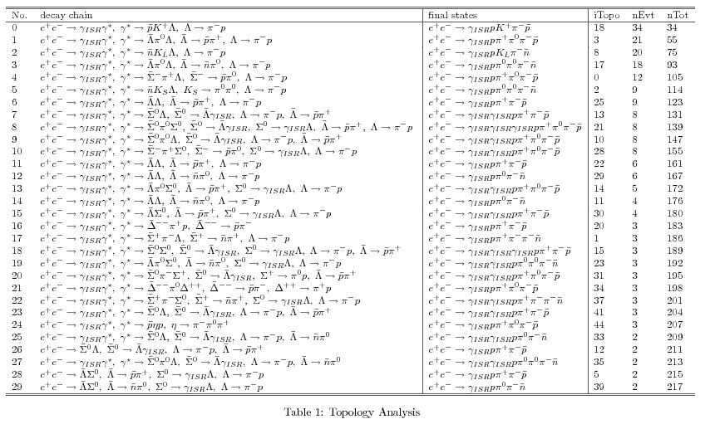
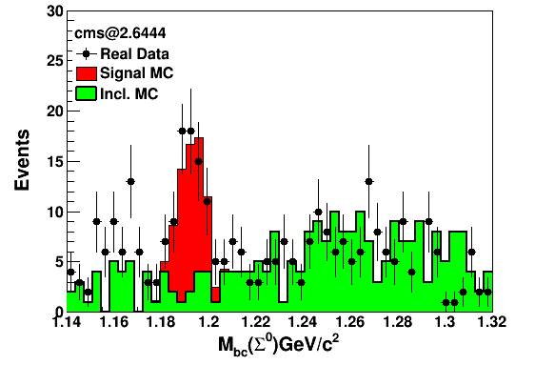
After Removing Signal Channel in Inclusive MC
Why ??

Slide 5
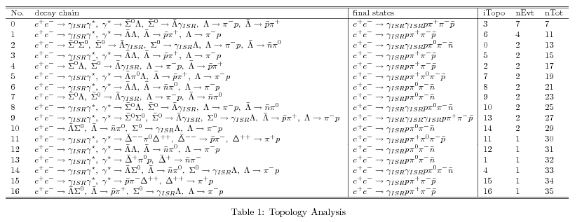
Mbc [1.14, 1.18]

Slide 6
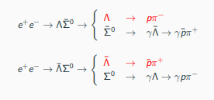
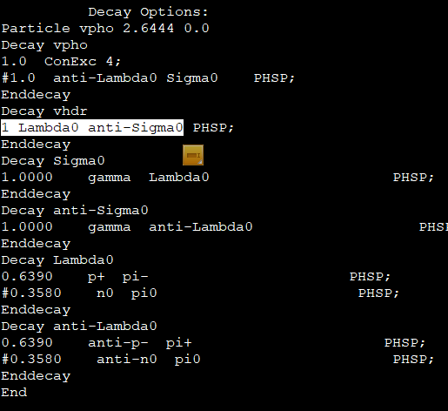
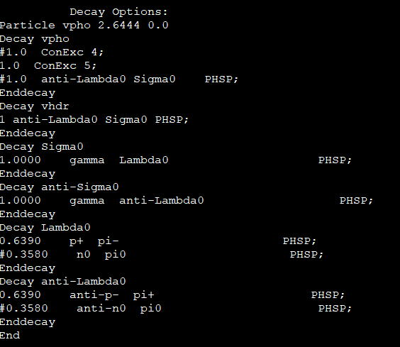
Generate the Exclusive sample for Background Study
Generated 100k exclusive MC sample for two decay Chanel.
Generated MC sample according to these decay cards.
1.
2.
We cannot suppress this background in the data. So we have to fix the background shape either from lamba0 sigma0 and lambda0 anti-sigma0 . But you can see that from topology the main background events comes from lambda0 anti-sigma0 channel. So we have to use decay card No.1 to fix the background events.
From Zhanghao

Slide 7
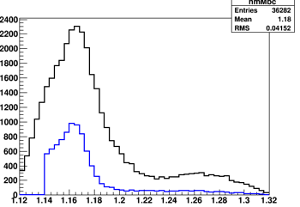
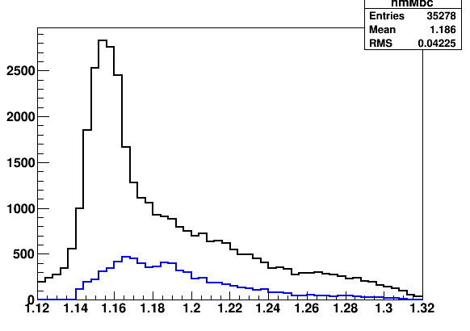
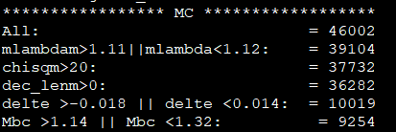
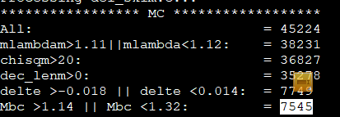
Scaling the background Events
Decay Card 1.
Decay Card 2.
Peaking
Flat almost
Remarks:
Since you can see that decay card 1 described peaking background within the region [1.14, 1.18]GeV
Normalized the Number of survived Background Events:
$$\begin{matrix}N_{norm}=\frac{N_{sur.}}{f_{S.F}}; f_{S.F}= \frac{N_{gen.}}{\left.σ^{Born}\left(nb\right)∗L_{int.}(pb^{−1})∗Br(Λ→pπ\right)} \\ f_{S.F}=\frac{{10}^{5}}{25.7∗33.72∗63.9\%∗63.9\%}=283 \\ N_{norm.}=\frac{9254}{283}=32.7\end{matrix}$$
Zhanghao

Slide 8
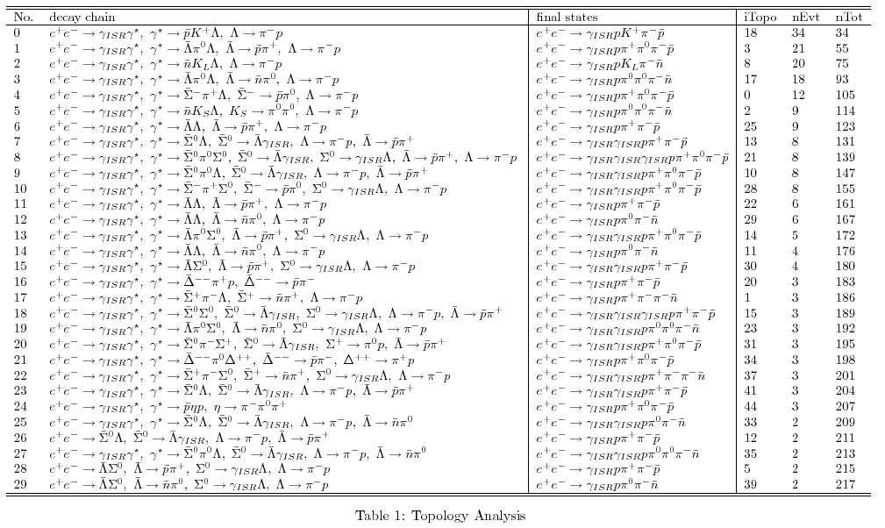
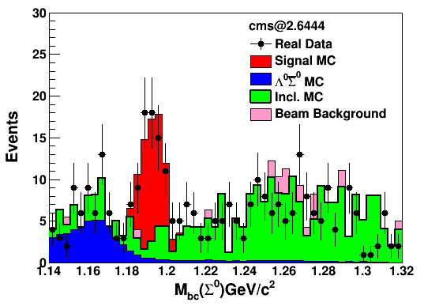
Inclusive MC Study
Removing the inclusive channel lamba0 anti-sigma0
Few events survived for beam associated background, so we can ignore.

Slide 9
Background Study for Anti-Sigma0

Slide 10
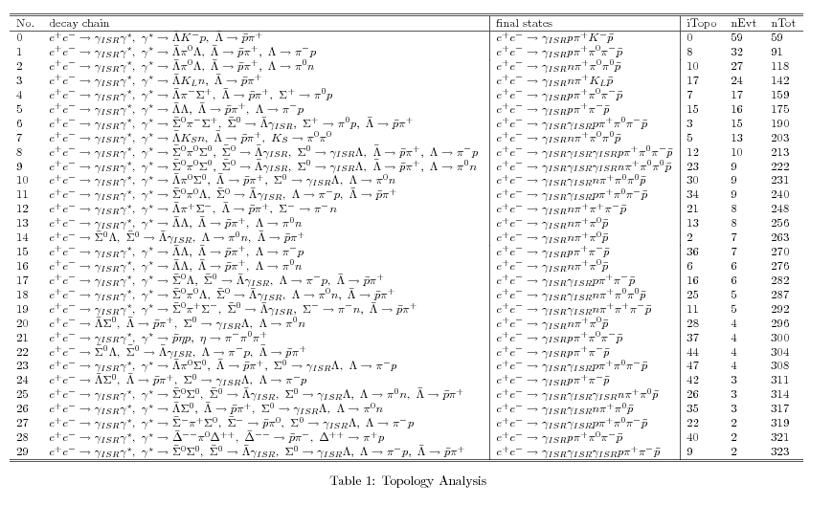
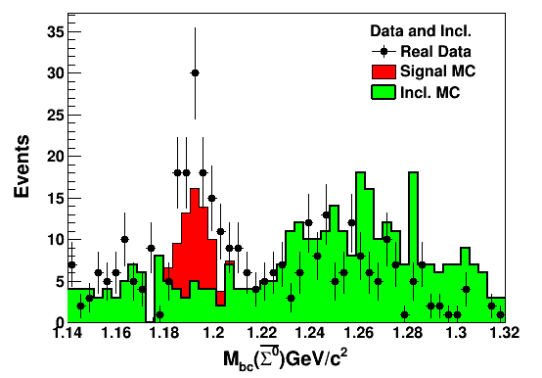
After Removing Signal Channel in Inclusive MC
No peaking background have seen.
Background channel distributed smoothly under Anti-sigma0

Slide 11
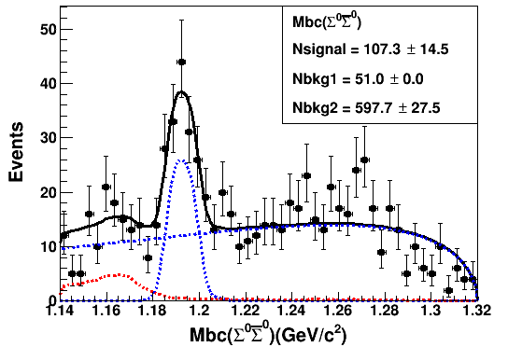
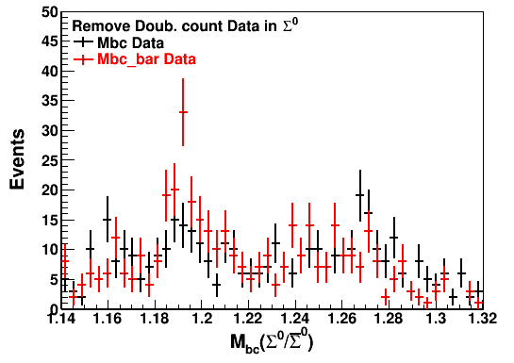
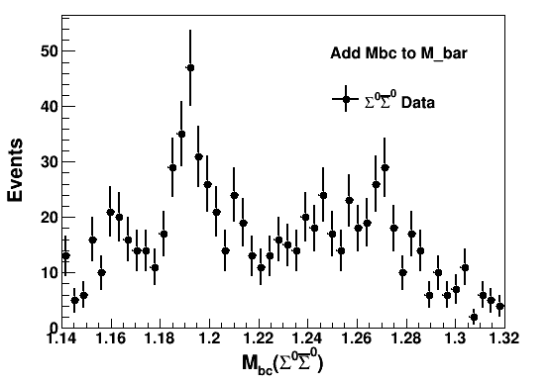
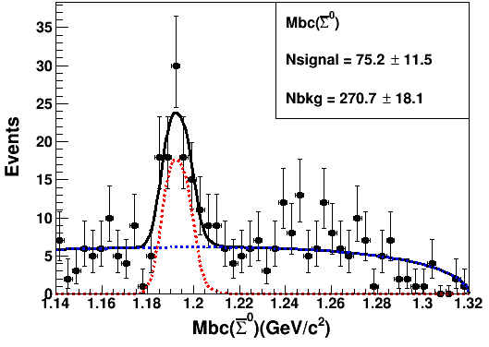
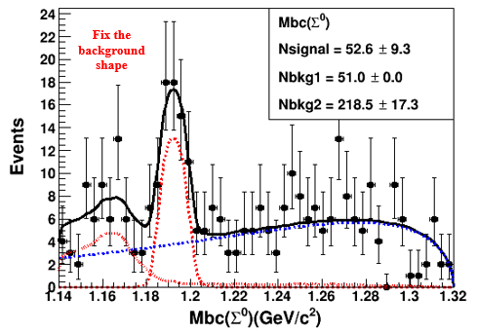
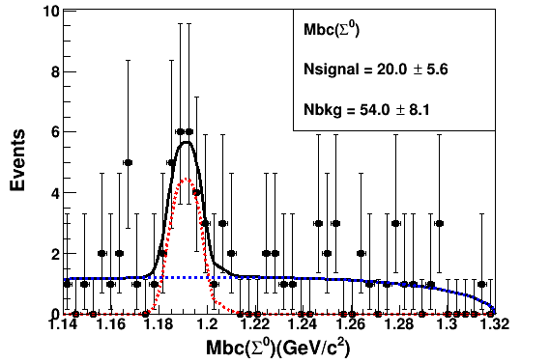
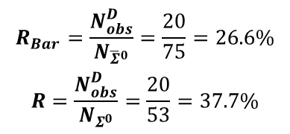
Double Counting Test On Data
Fit combine data Points
Signal Yield for Anti-Sigma0
Signal Yield for Sigma0
Double counting Events in Both
Double Counting Rata in Data
$$\begin{matrix}R_{Bar}=\frac{N_{obs}^{D}}{N_{{\overline{Σ}}^{0}}}=\frac{20}{75}=26.6\% \\ R=\frac{N_{obs}^{D}}{N_{Σ^{0}}}=\frac{20}{53}=37.7\%\end{matrix}$$

Slide 12
Summary
Double counting rate is not same because of different background shape in sigma0 and anti-sigma0.
Difference is also due to different MC efficiencies and statistical fluctuations in data.
Due to limited statistics, we will calculate the double counting test by considering all energy points instead of each energy point in future.
For the background study, we should generate e+e- → Lambda anti-sigma0+c.c→ Anything, since the background not only comes from Lambda->p pi, but also Lambda-> n pi0 and others.
Thanks

Slide 13
Backup

Slide 14
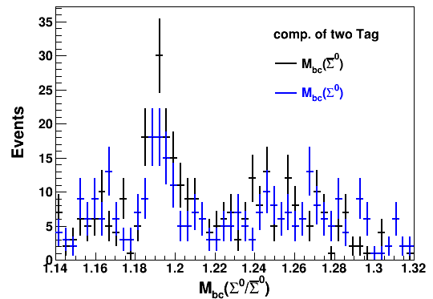
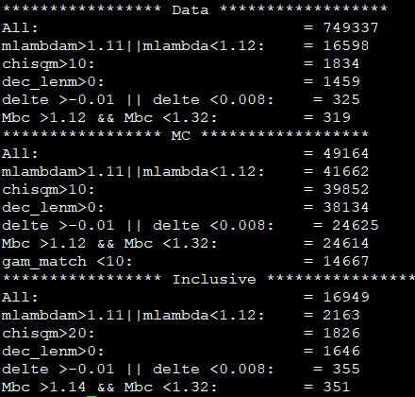
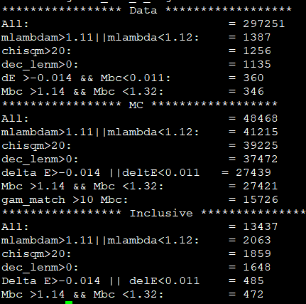
Mbc Distributions for Sigma0 /Anti-Sigma0
Real Data
Rate of cut of flow sigma0
Rate of cut of flow Anti-sigma0

