Slide 1
Index | Cut | Low | High | Step
0 | $$L/σ_{L}>2$$ | 0 | 9 | 1
1 | $$χ_{sec}^{2}<15$$ | 2 | 20 | 2
2 | $$\left|M\left(pπ\right)−M^{PDG}\left(Λ\right)\right|<0.008$$ | 0.0015 | 0.015 | 0.0015
3 | $$\left|M_{Recoil}\left(pπ\right)−M_{Recoil}^{central}\left(pπ\right)\right|<0.0415$$ | 0.014 | 0.14 | 0.014
4 | $$χ_{kmfit}^{2}<50$$ | 10 | 100 | 10
5 | $$\left|M\left(n\right)−M^{central}\left(n\right)\right|<0.0135$$ | 0.0045 | 0.02475 | 0.00225

Slide 2
Parameter Estimation
Maximum likelihood fit method is used to estimate the decay parameters.
$N_{sig}:$ Events of data
$N_{bkg}:$ Events of background in signal region
$N_{BKG}:$ Events of a sample to estimate the background (mDIY exclusive MC)
$𝒲\left(ξ_{i},α\right):$ angular distribution
$𝒞:$ Normalization factor, estimated by mDIY Toy MC
$N_{Toy}:$ Events of mDIY toy MC
$α:$ Pending decay parameters of data
$α^{′}:$ Known decay parameters of toy MC
Notes:
/ustcfs/BES3User/2021/ypei/BESIII/Lambda/WriteMemo/FurtherEventSelection/nbarpi0/TopoSummary

Slide 3
Data Sets of Fit
Data: 2009+2012+2018+2019 (10B events, $nπ^{0}$ and $\overline{n}π^{0}$)
Signal MC: 50x data events
MC integration ($𝒞^{−1}$): matched events;
BKG Likelihood ($\frac{1}{N_{BKG}}\sum_{i=1}^{N_{BKG}}{ln𝒲(ξ_{i},α)}$): unmatched events;
BKG estimation in signal region ($N_{bkg}$): $sig shape ⨂{Gauss}+bkg shape$ to fit data
Notes:
/ustcfs/BES3User/2021/ypei/BESIII/Lambda/WriteMemo/FurtherEventSelection/nbarpi0/TopoSummary

Slide 4
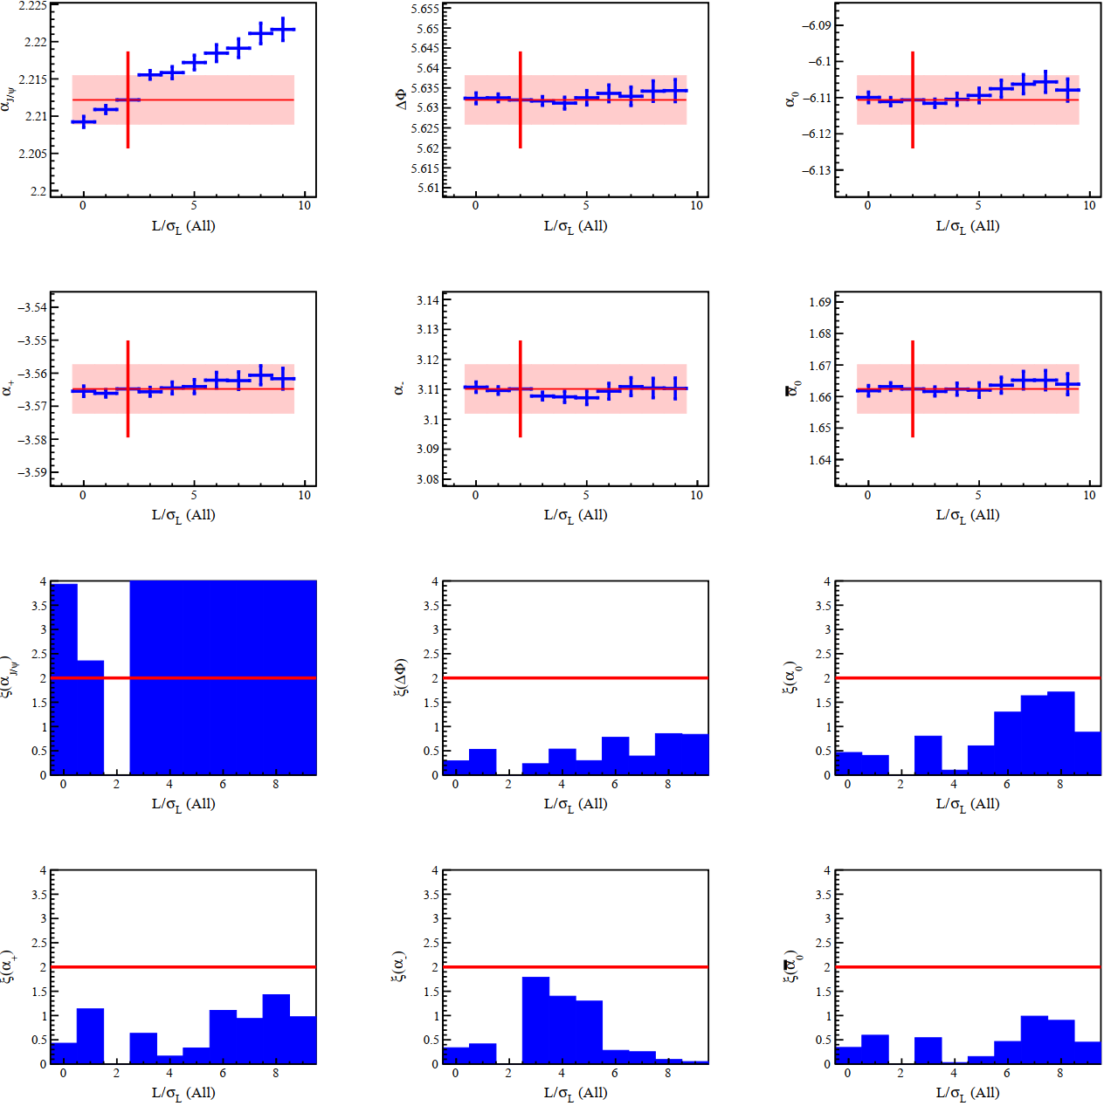
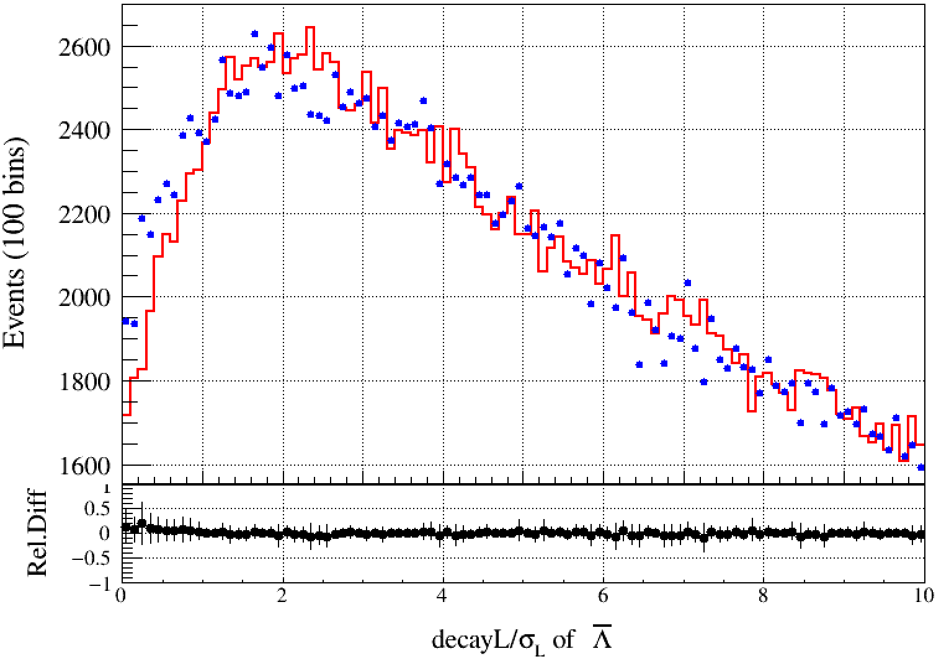
$$L/σ_{L}$$
Nominal value at $L/σ_{L}>2, α±σ_{α}$
Vary this cut from 0 to 9 with step 1, repeat same angular fit. $α^{i}±σ_{α}^{i}$
Uncorrelated Error:
$$σ_{uncorr}=\sqrt{|σ_{α}^{2}−{σ_{α}^{i}}^{2}|}$$
Significance $ξ$
$$ξ=\frac{α−α^{i}}{σ_{uncorr}}$$

Slide 5
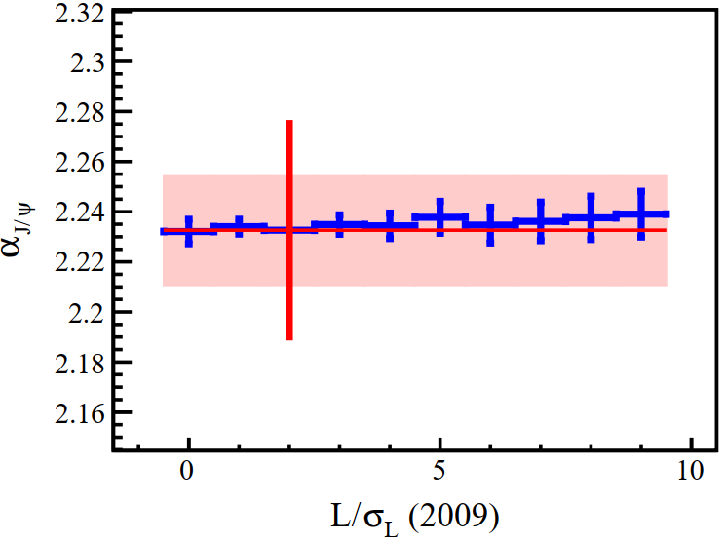
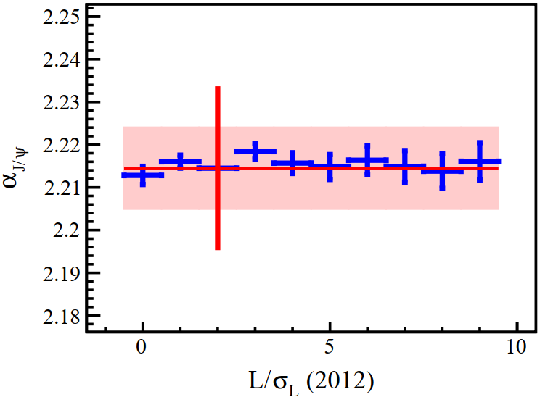
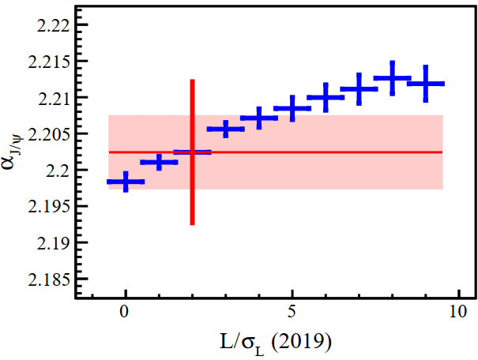
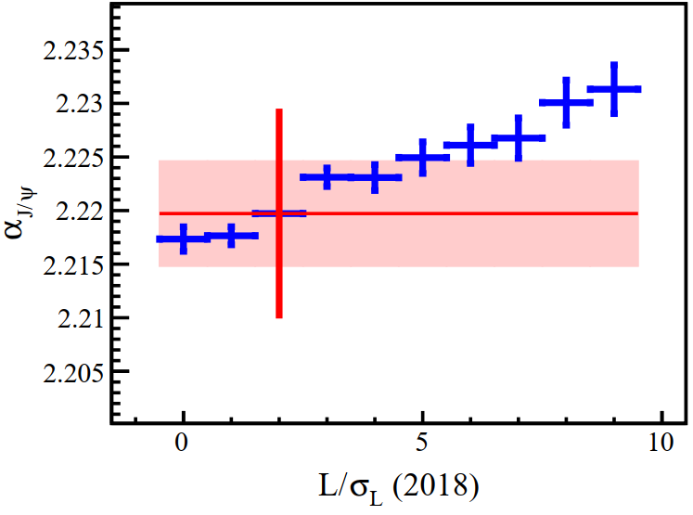
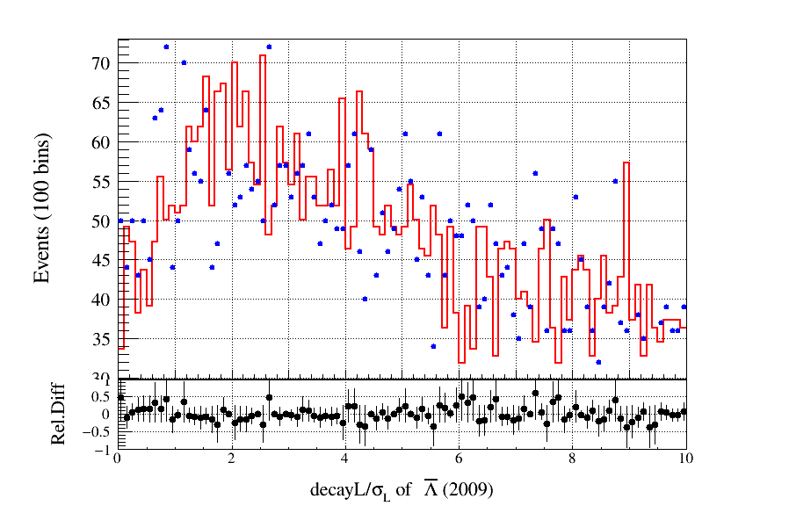
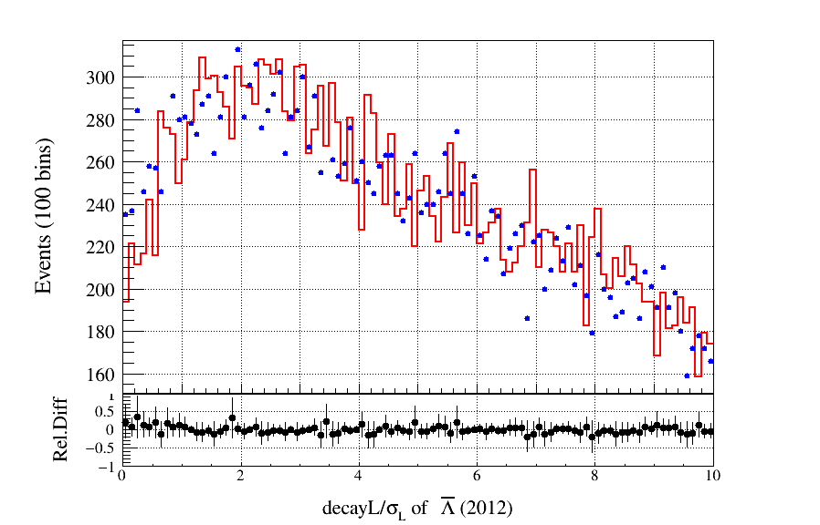
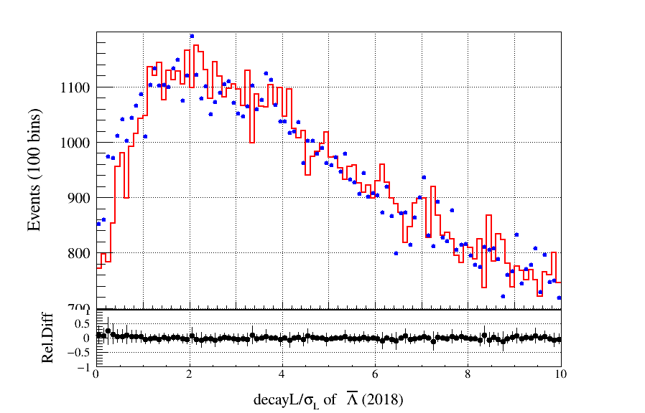
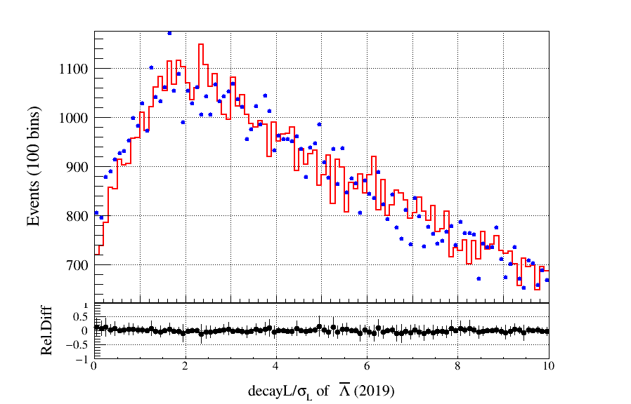
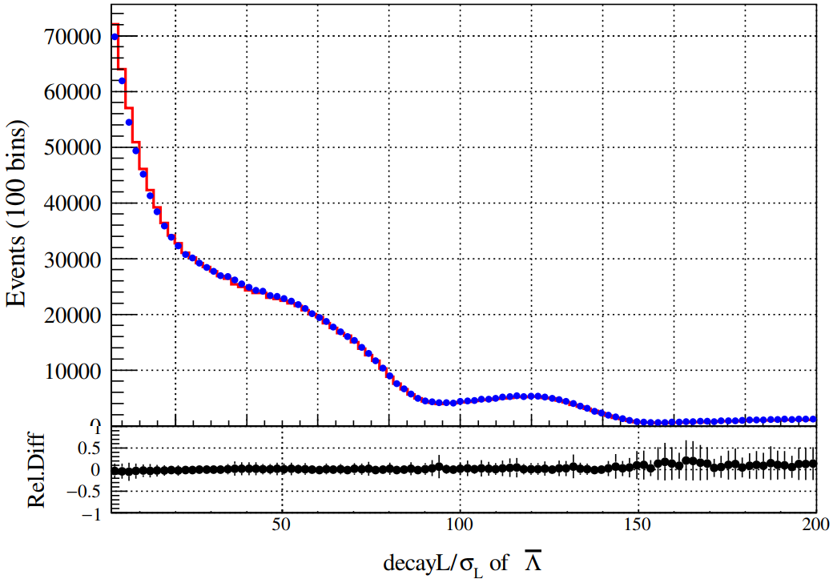

Slide 6
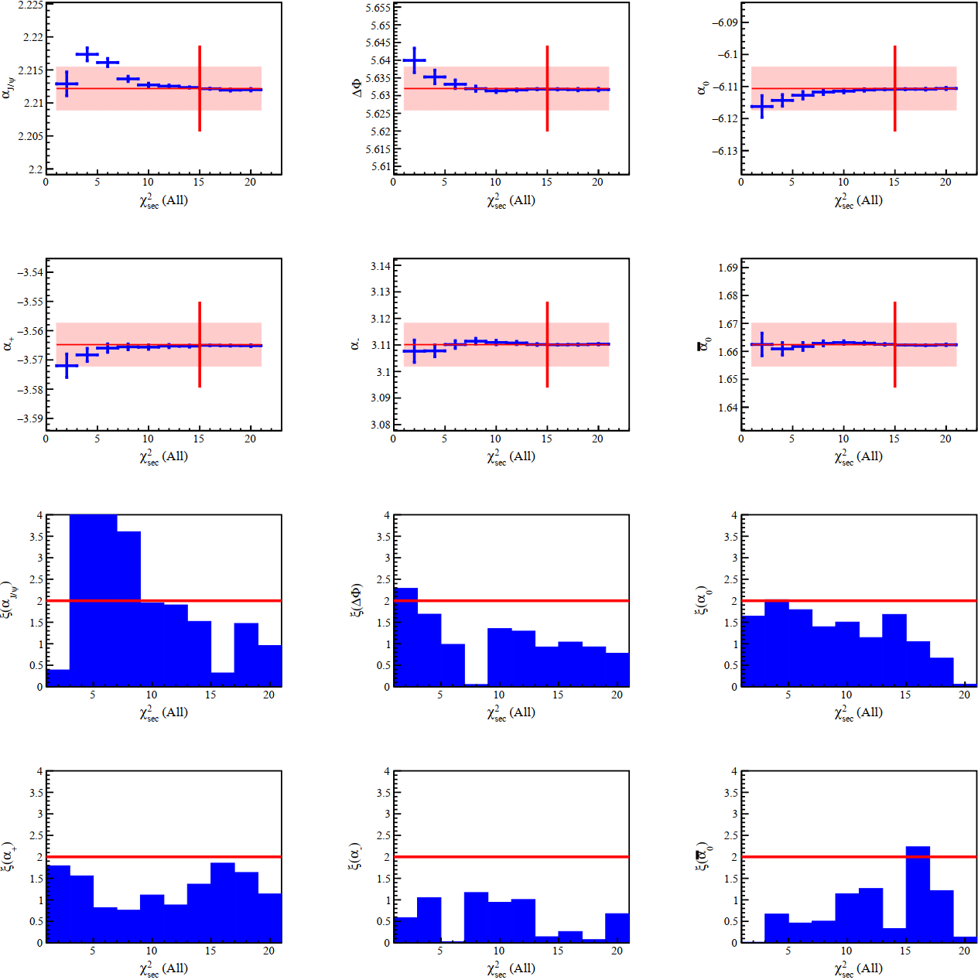
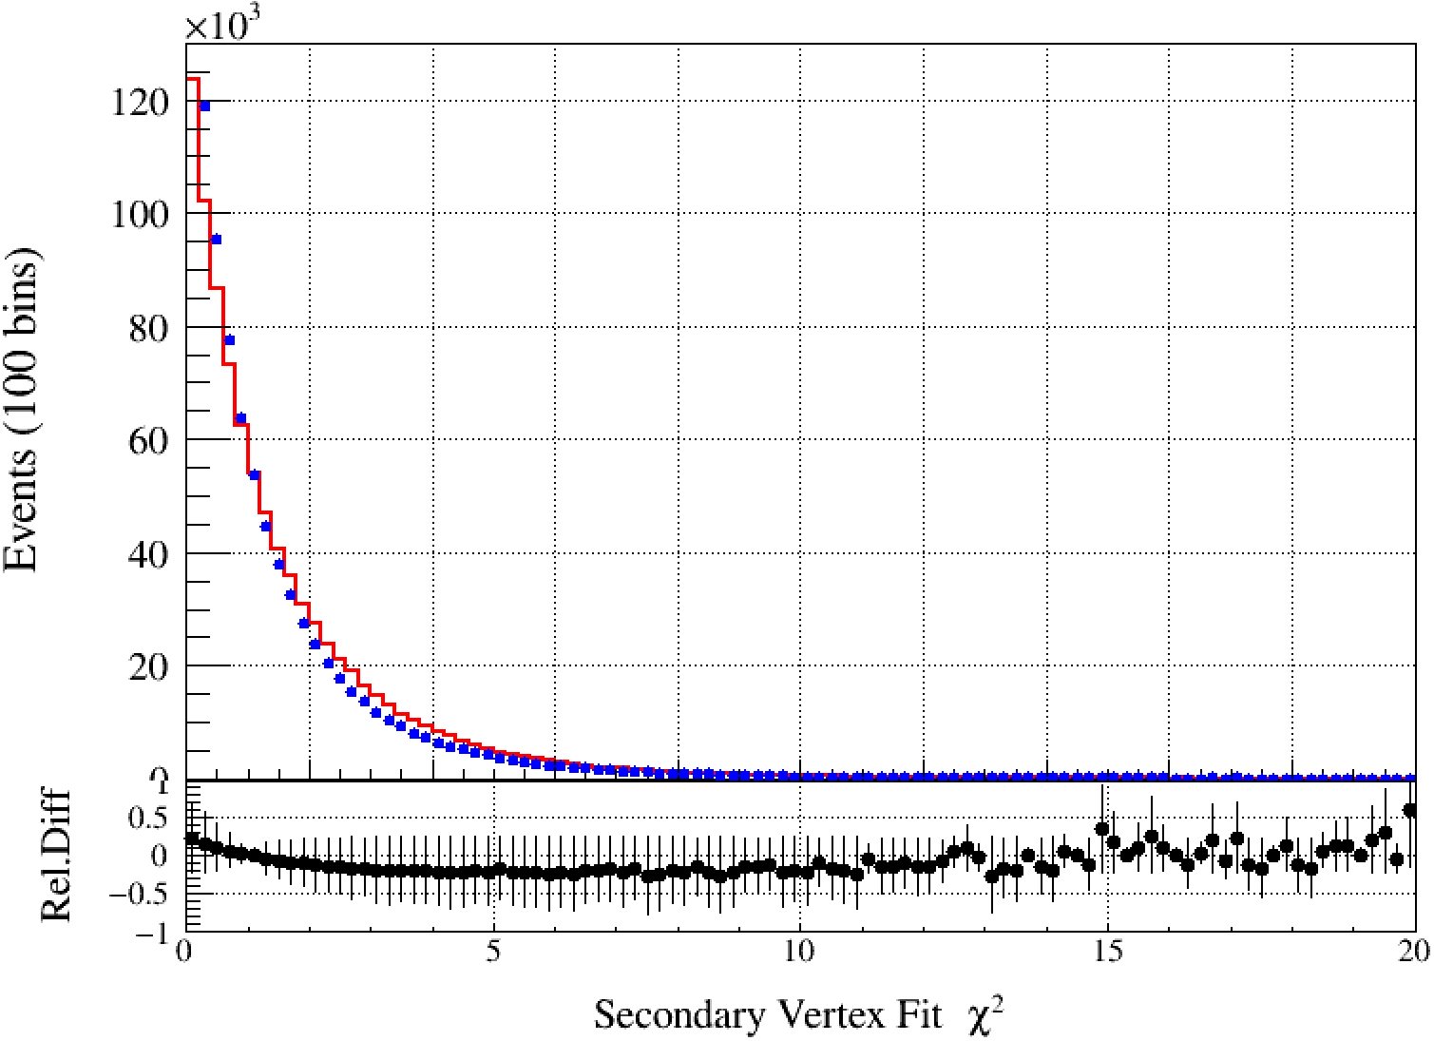
$$χ_{sec}^{2}$$
Nominal value at $χ_{sec}^{2}<15, α±σ_{α}$
Vary this cut from 2 to 20 with step 2, repeat same angular fit. $α^{i}±σ_{α}^{i}$
Uncorrelated Error:
$$σ_{uncorr}=\sqrt{|σ_{α}^{2}−{σ_{α}^{i}}^{2}|}$$
Significance $ξ$
$$ξ=\frac{α−α^{i}}{σ_{uncorr}}$$

Slide 7
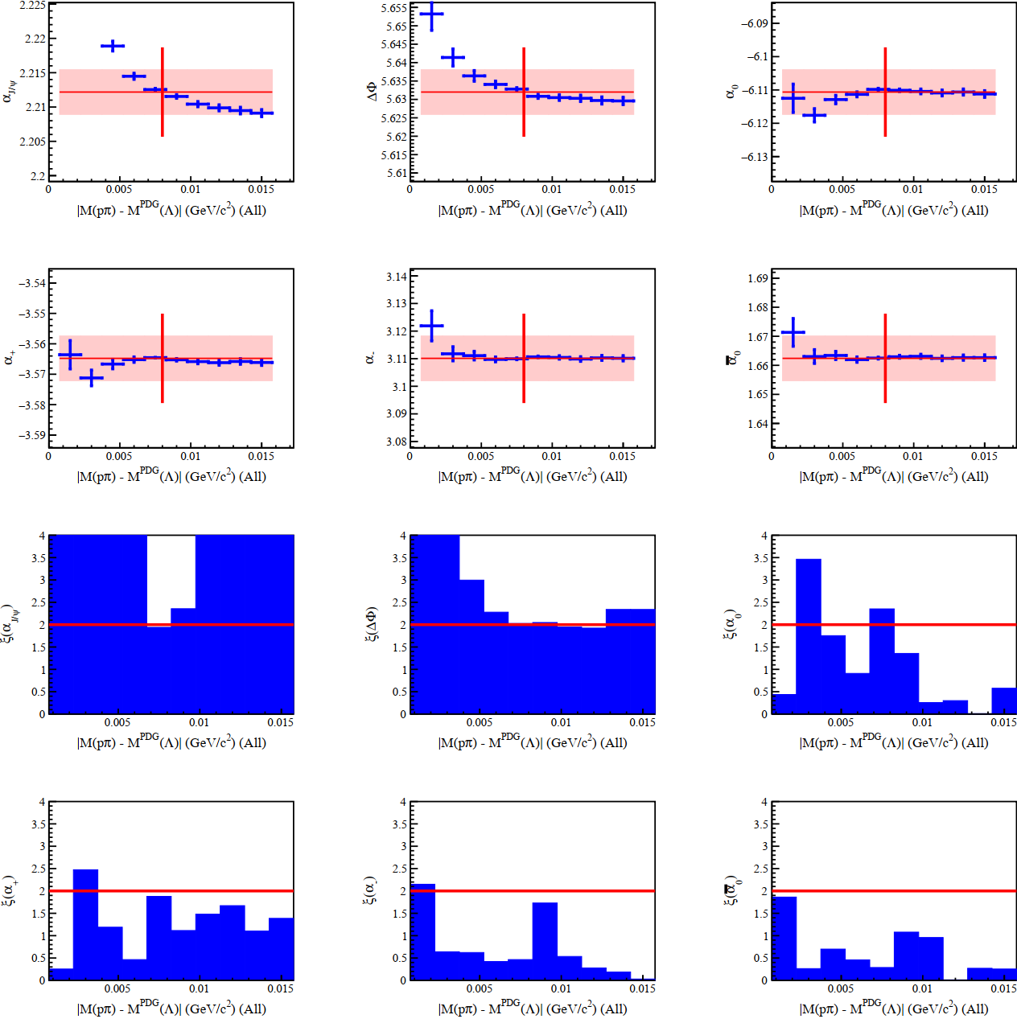
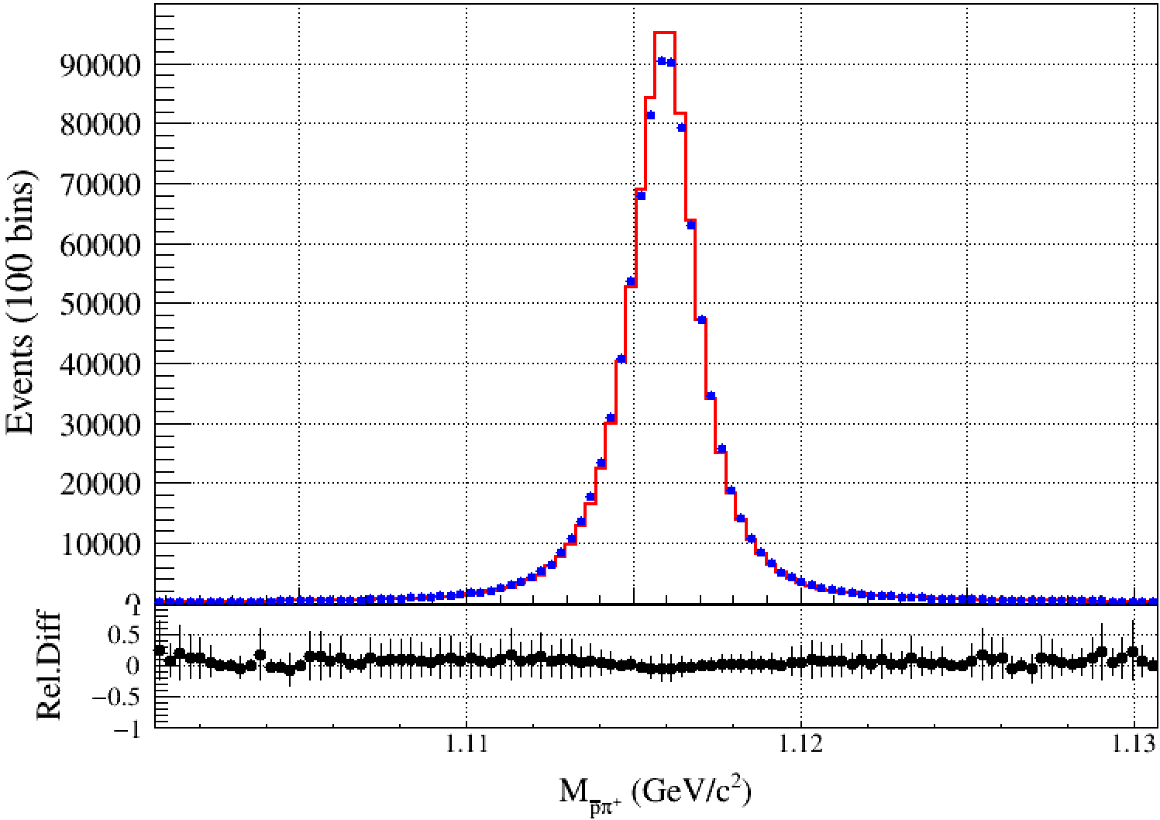
$M(pπ)$ Mass Window
Nominal value at $\left|M\left(pπ\right)−M_{PDG}\left(Λ\right)\right|<8\text{MeV}/c^{2}, α±σ_{α}$
Vary this cut from 1.5 $\text{MeV}/c^{2}$ to 15 $\text{MeV}/c^{2}$ with step 1.5 $\text{MeV}/c^{2}$, repeat same angular fit. $α^{i}±σ_{α}^{i}$
Uncorrelated Error:
$$σ_{uncorr}=\sqrt{|σ_{α}^{2}−{σ_{α}^{i}}^{2}|}$$
Significance $ξ$:
$$ξ=\frac{α−α^{i}}{σ_{uncorr}}$$

Slide 8
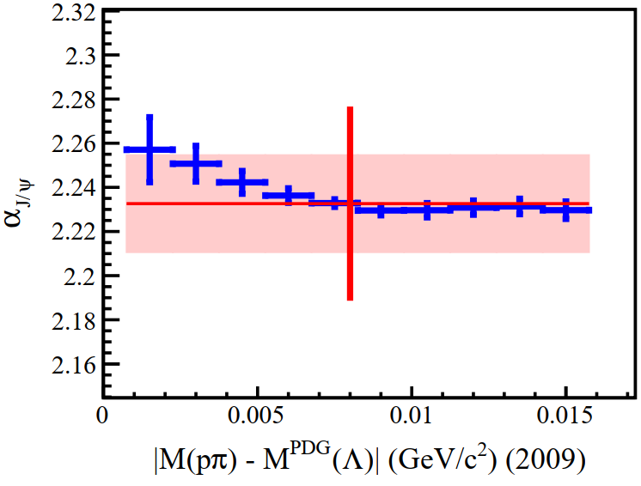
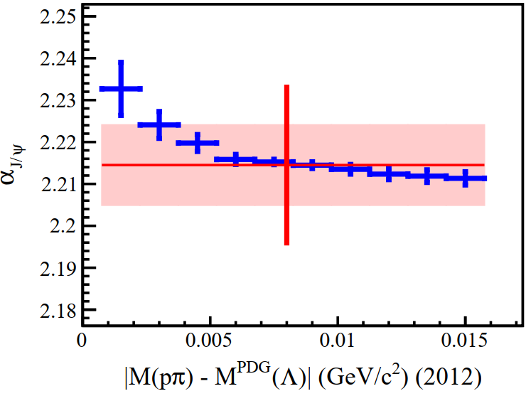
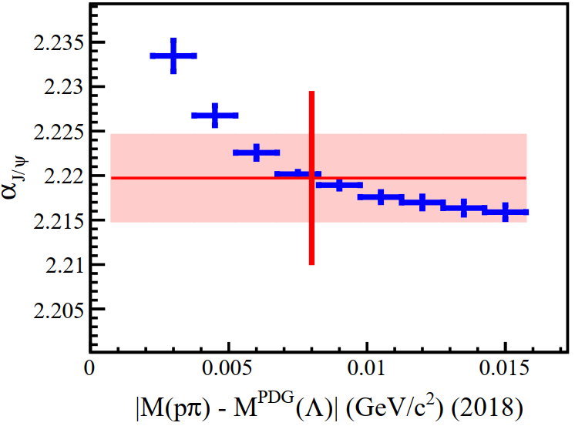
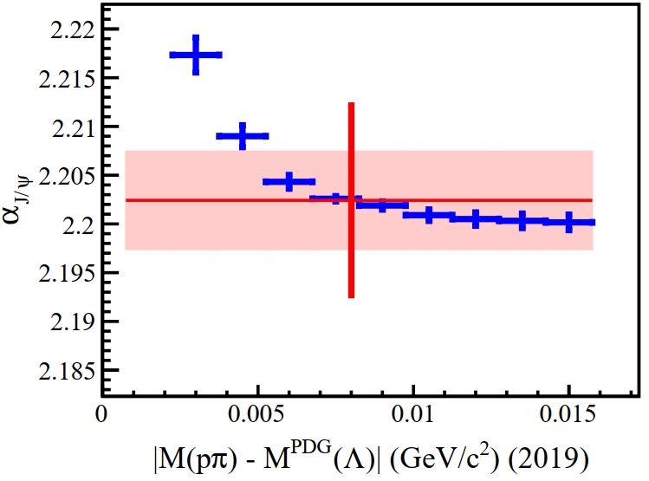
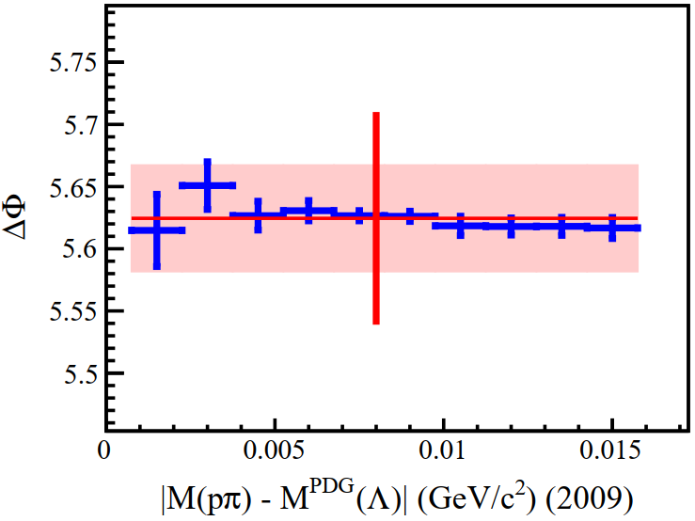
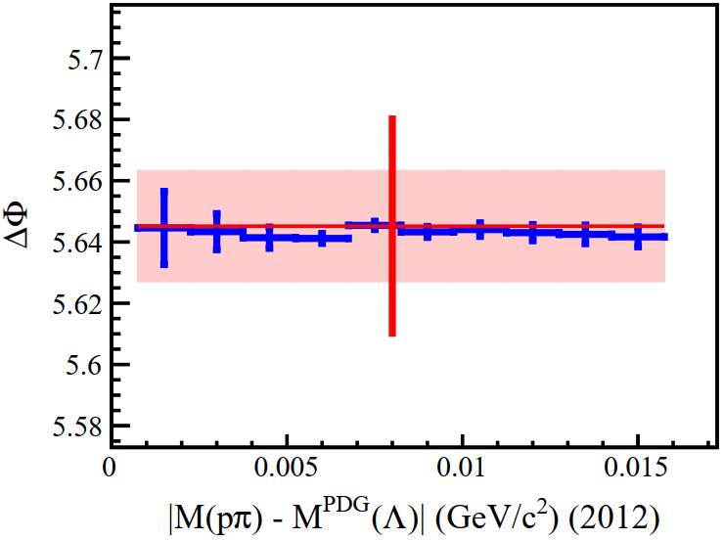
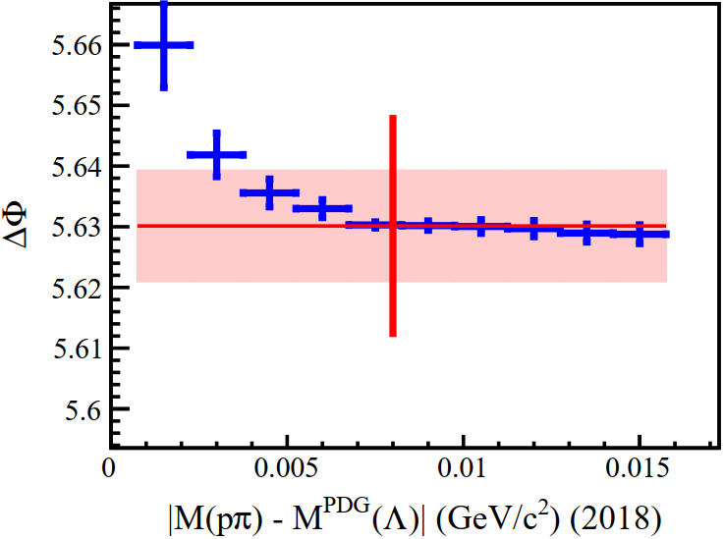
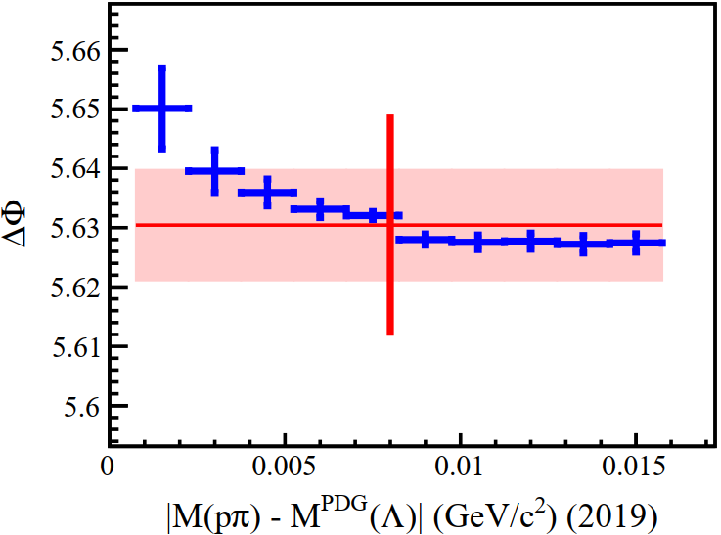
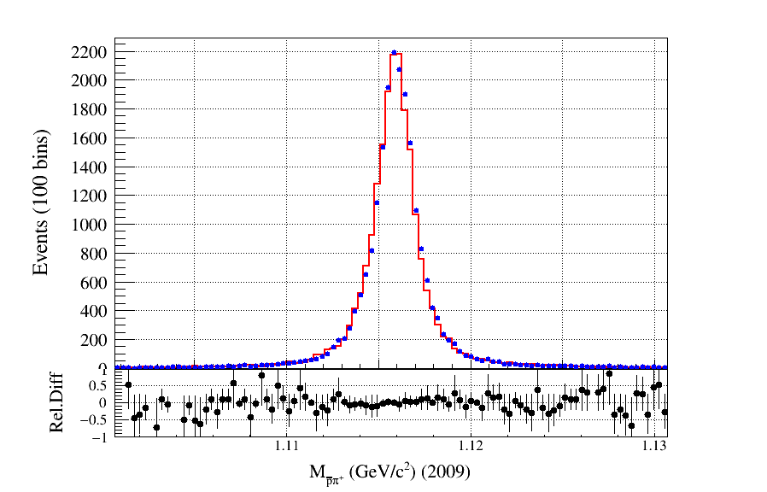
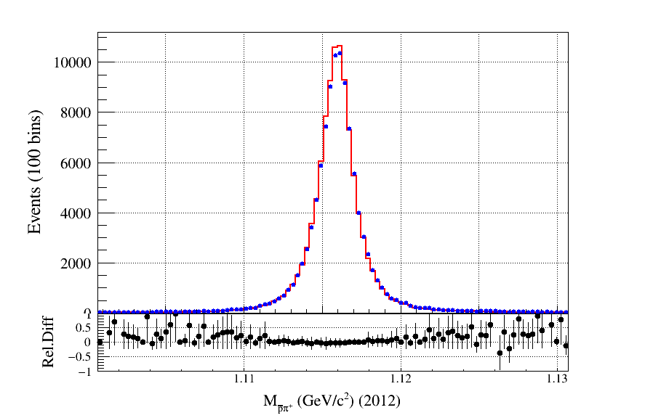
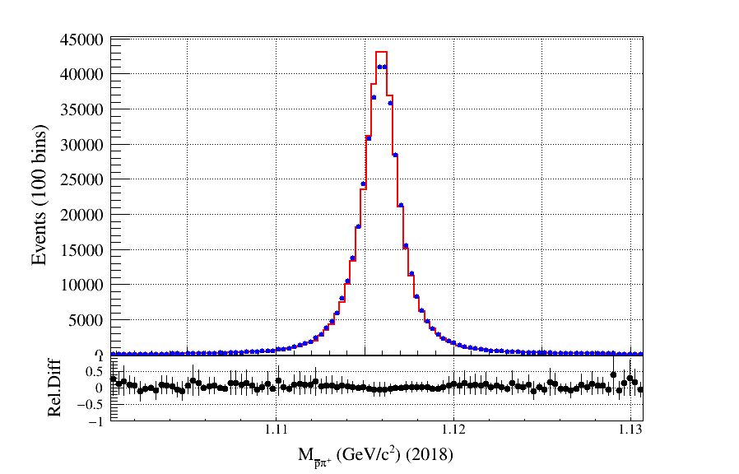
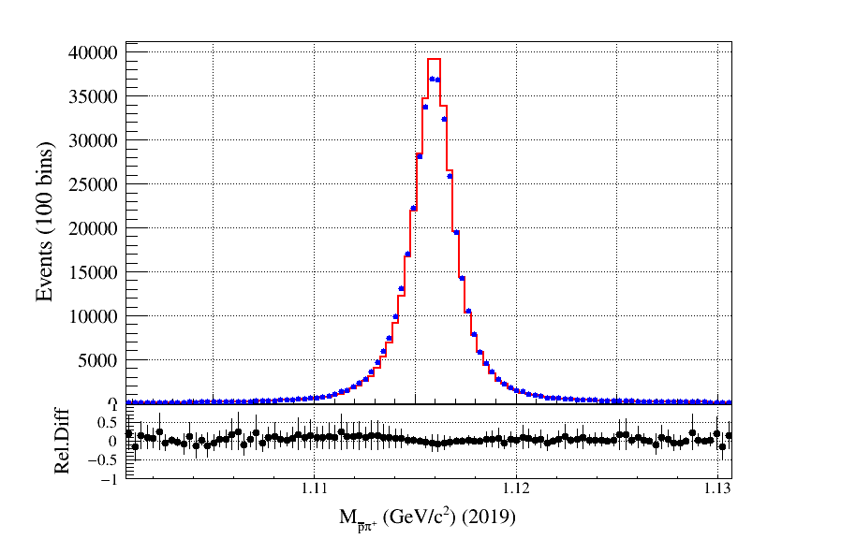

Slide 9
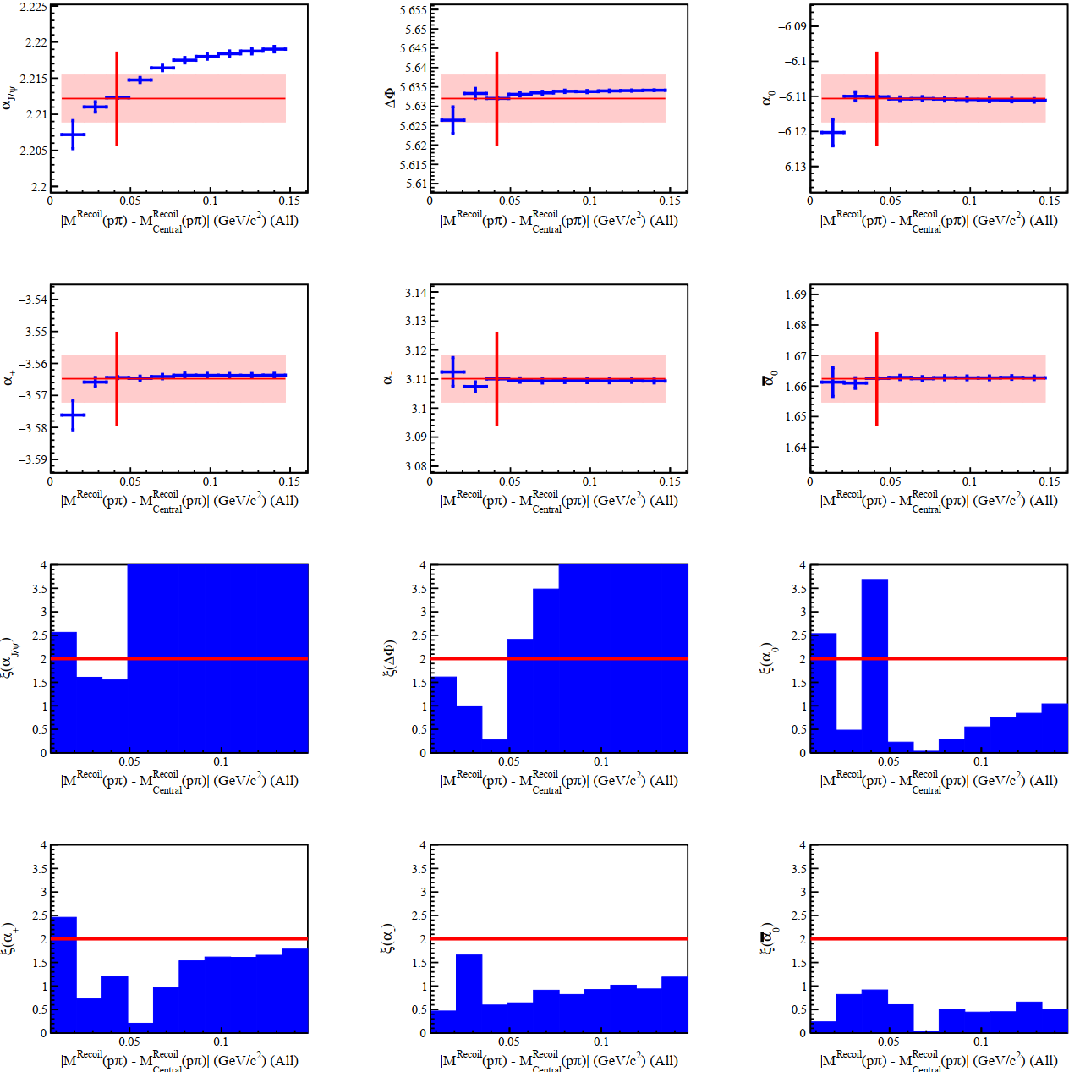
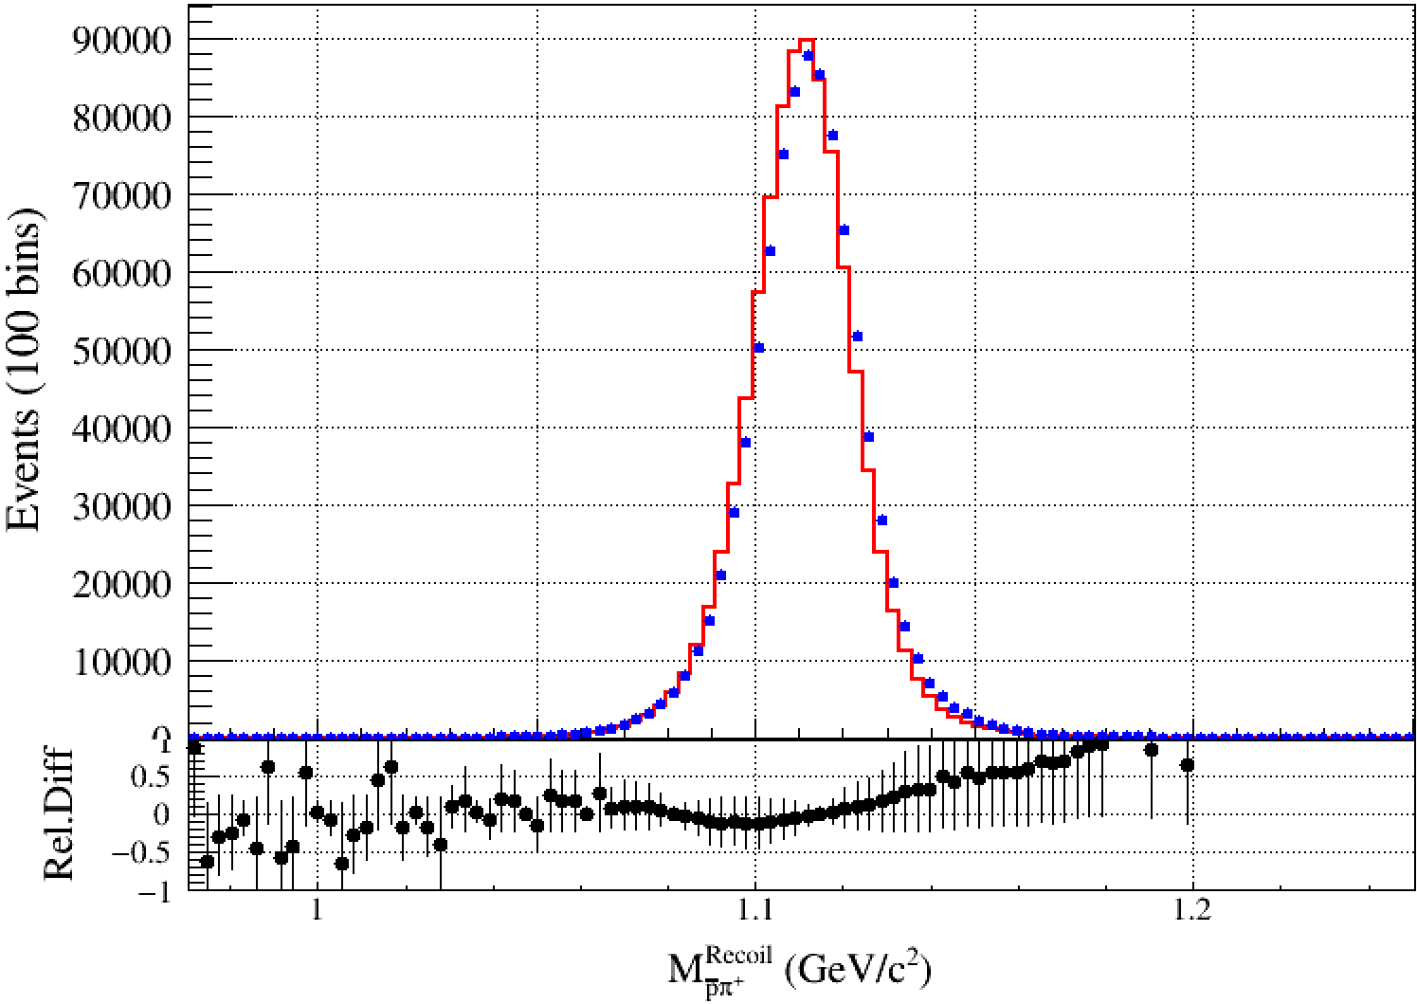
$M(pπ)$ Recoil Mass Window
Nominal value at $\left|M^{Recoil}\left(pπ\right)−M_{center}^{Recoil}\left(Λ\right)\right|<\text{42.5 }\text{MeV}/c^{2}, α±σ_{α}$
Vary this cut from 14 $\text{MeV}/c^{2}$ to 140 $\text{MeV}/c^{2}$ with step 14 $\text{MeV}/c^{2}$, repeat same angular fit. $α^{i}±σ_{α}^{i}$
Uncorrelated Error:
$$σ_{uncorr}=\sqrt{|σ_{α}^{2}−{σ_{α}^{i}}^{2}|}$$
Significance $ξ$:
$$ξ=\frac{α−α^{i}}{σ_{uncorr}}$$

Slide 10
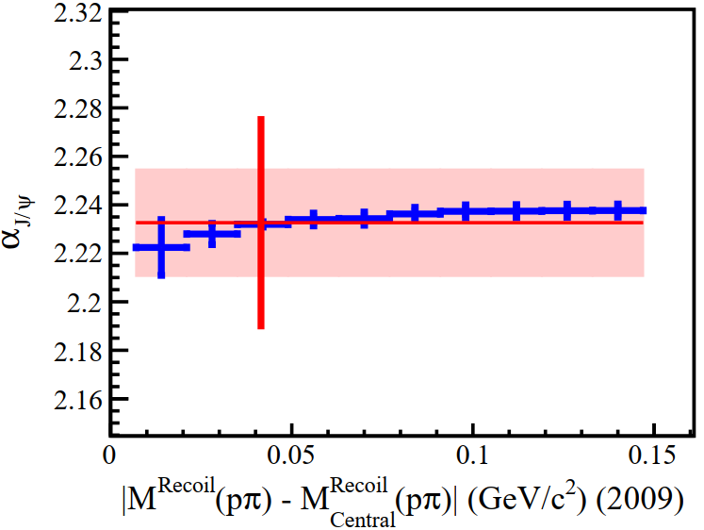
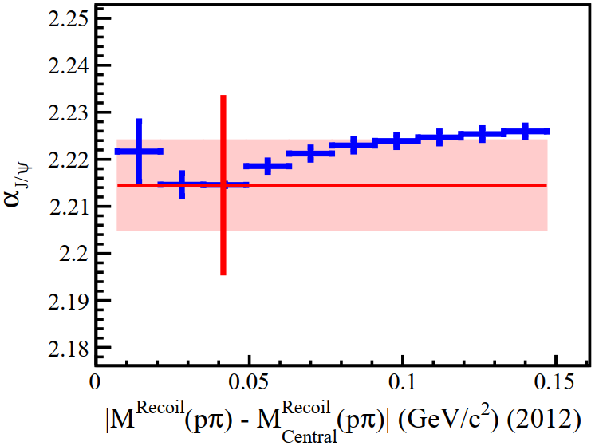
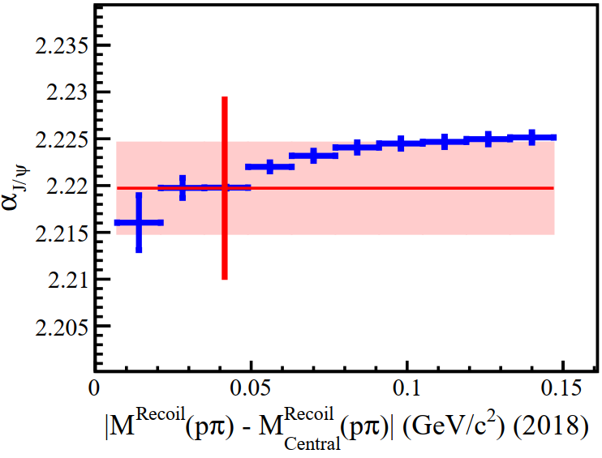
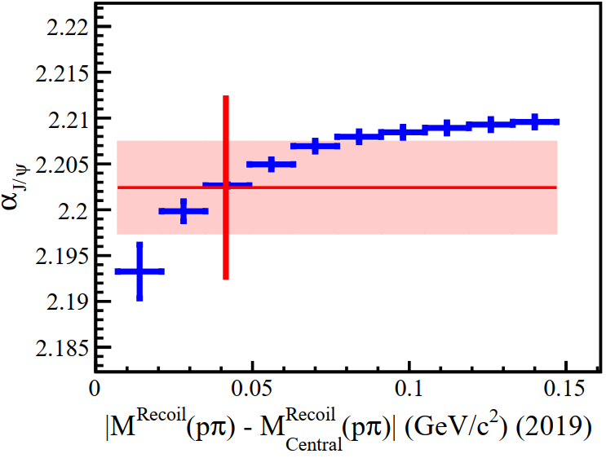
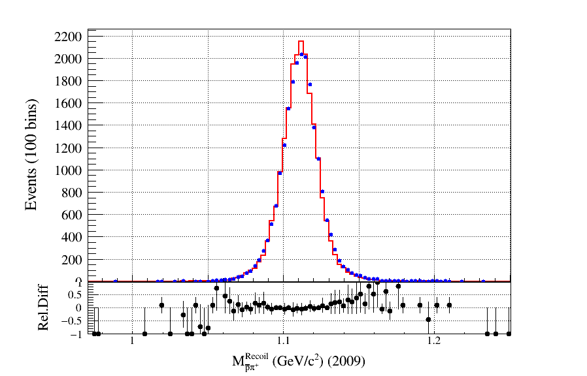
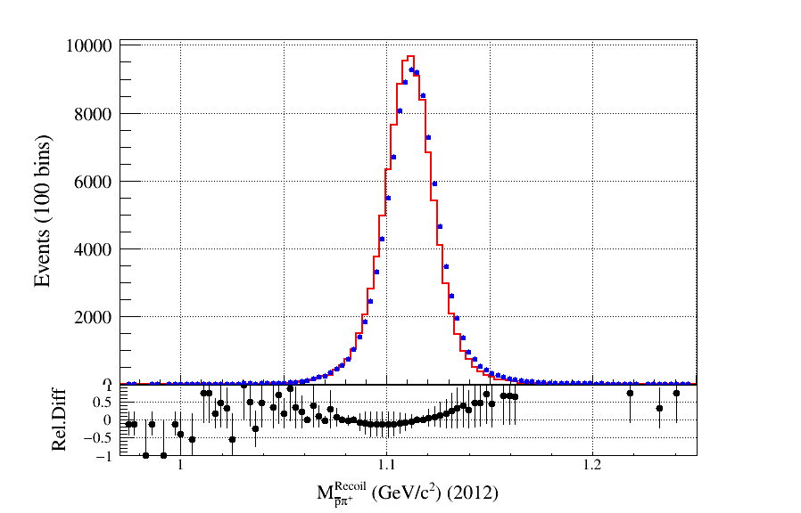
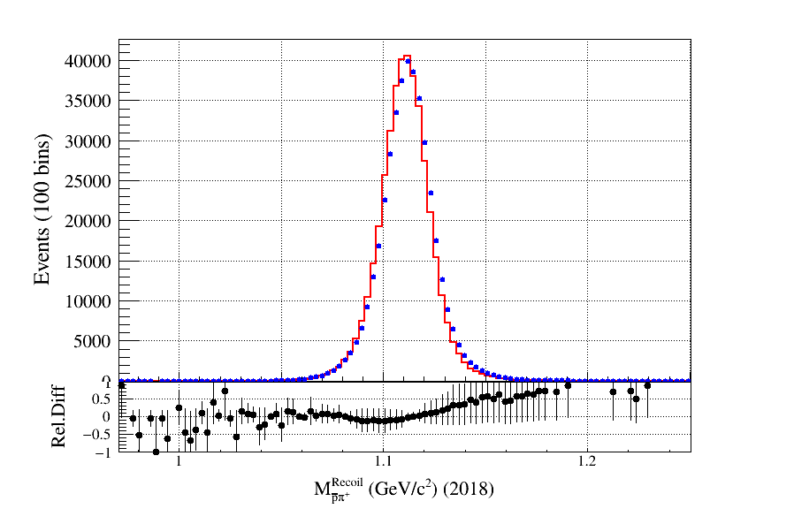
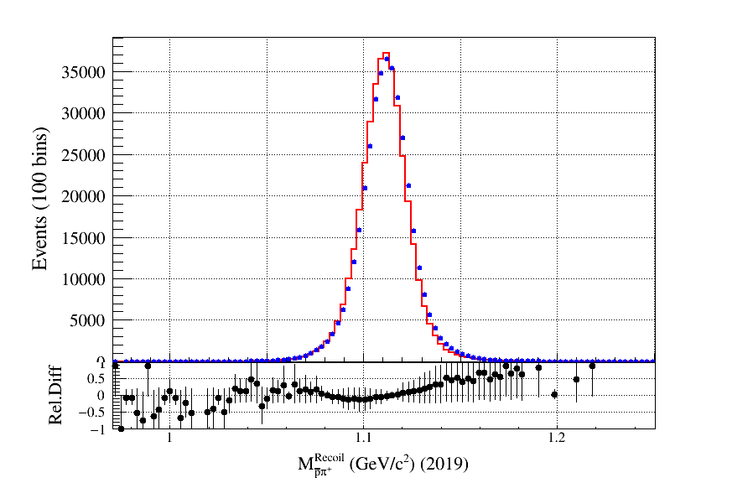

Slide 11
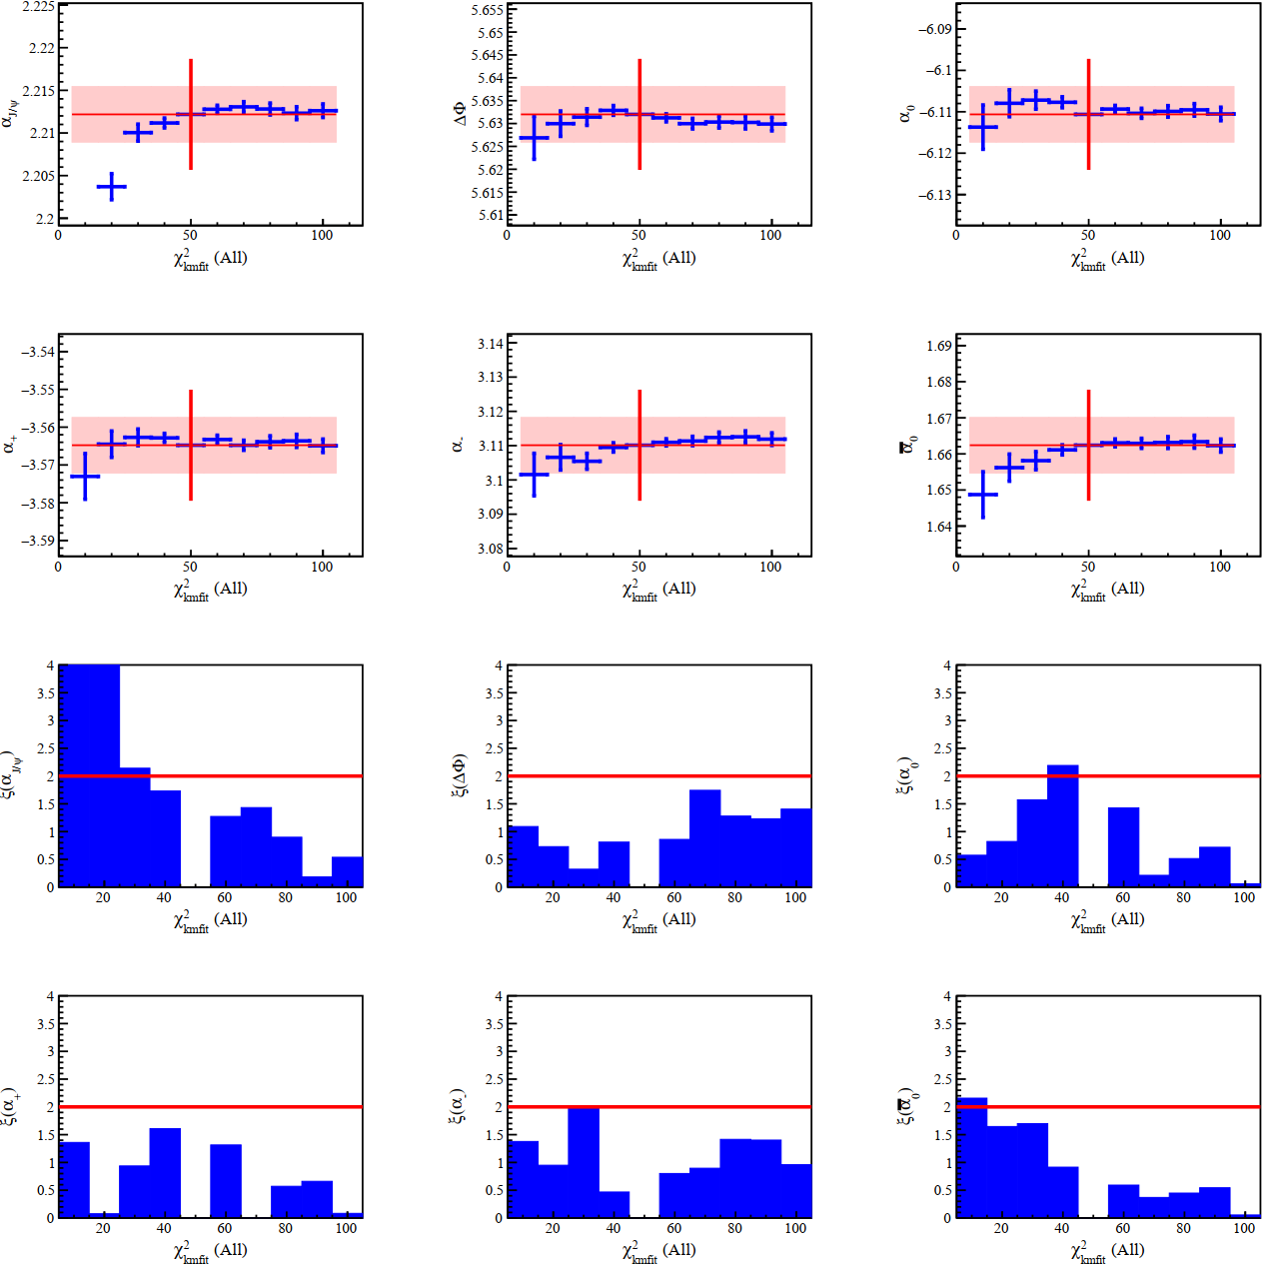
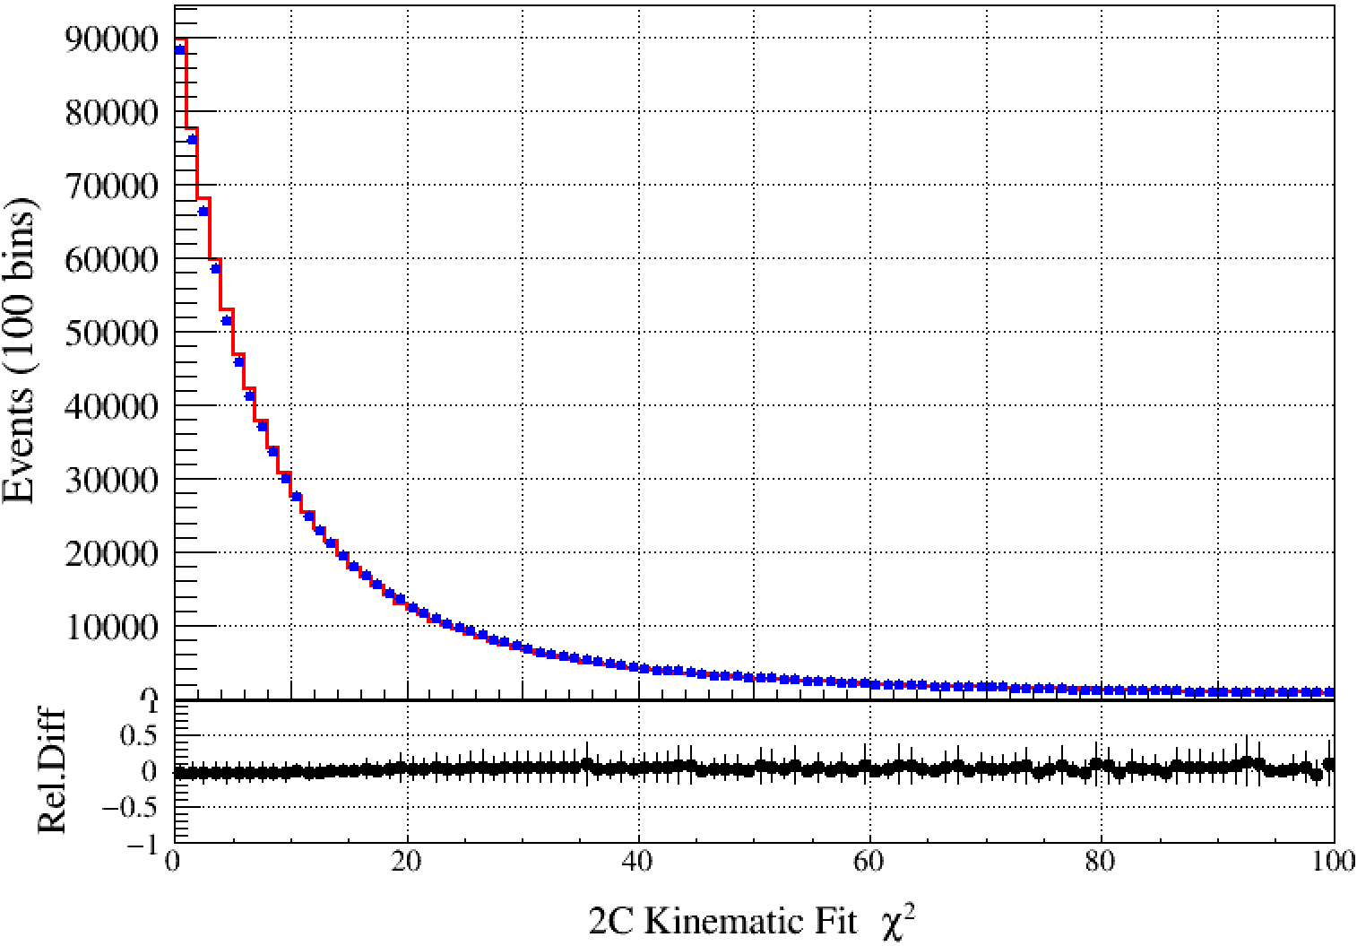
$$χ_{kmfit}^{2}$$
Nominal value at $χ_{kmfit}^{2}<50, α±σ_{α}$
Vary this cut from 10 to 100 with step 10, repeat same angular fit. $α^{i}±σ_{α}^{i}$
Uncorrelated Error:
$$σ_{uncorr}=\sqrt{|σ_{α}^{2}−{σ_{α}^{i}}^{2}|}$$
Significance $ξ$
$$ξ=\frac{α−α^{i}}{σ_{uncorr}}$$

Slide 12
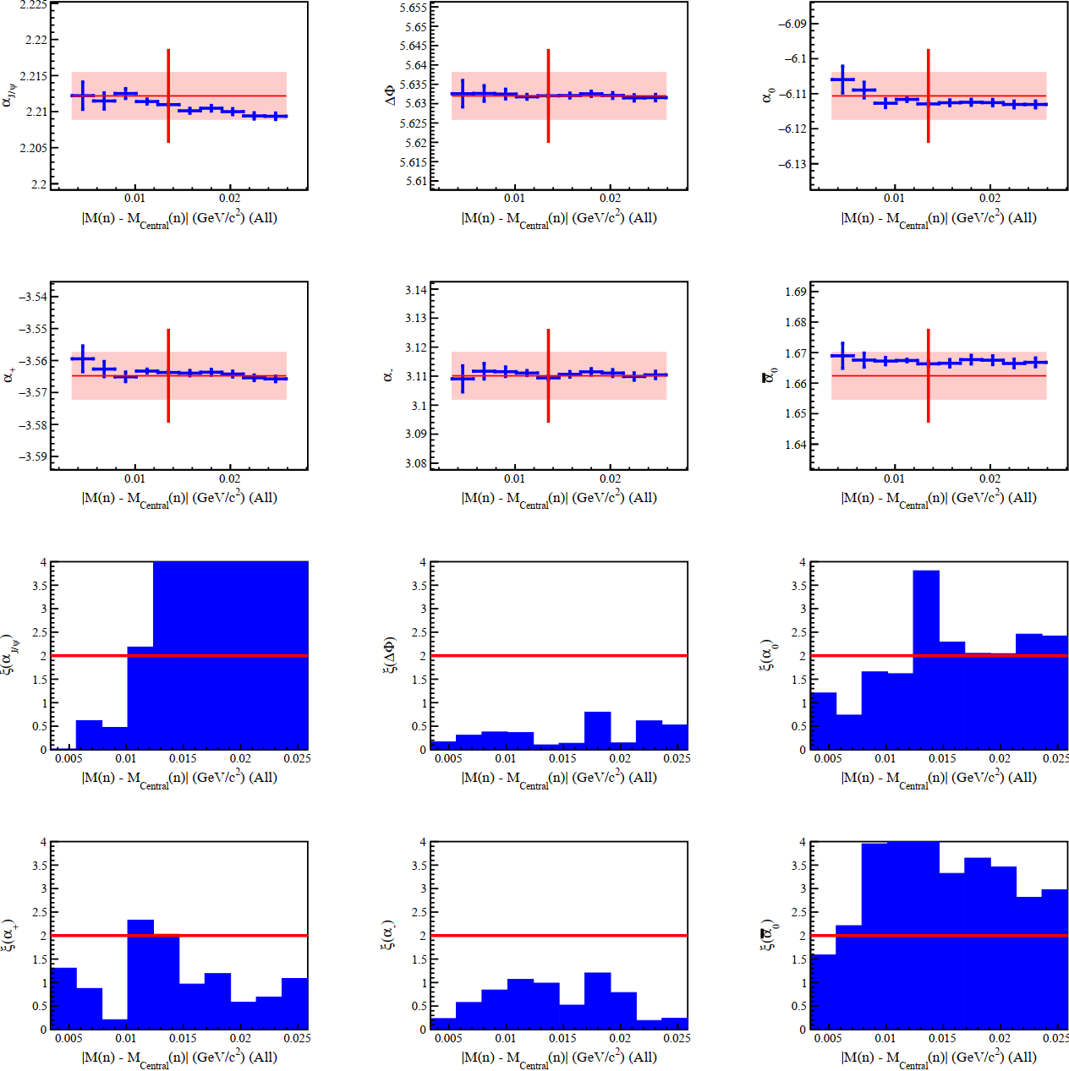
$M_{n}$ Signal Region
Nominal value at $\left|M_{n}−M_{n}^{center}\right|<\text{13.5 }\text{MeV}/c^{2}, α±σ_{α}$
Vary this cut from 4.5 $\text{MeV}/c^{2}$ to 24.75 $\text{MeV}/c^{2}$ with step 2.25 $\text{MeV}/c^{2}$, repeat same angular fit. $α^{i}±σ_{α}^{i}$
Uncorrelated Error:
$$σ_{uncorr}=\sqrt{|σ_{α}^{2}−{σ_{α}^{i}}^{2}|}$$
Significance $ξ$:
$$ξ=\frac{α−α^{i}}{σ_{uncorr}}$$

Slide 13
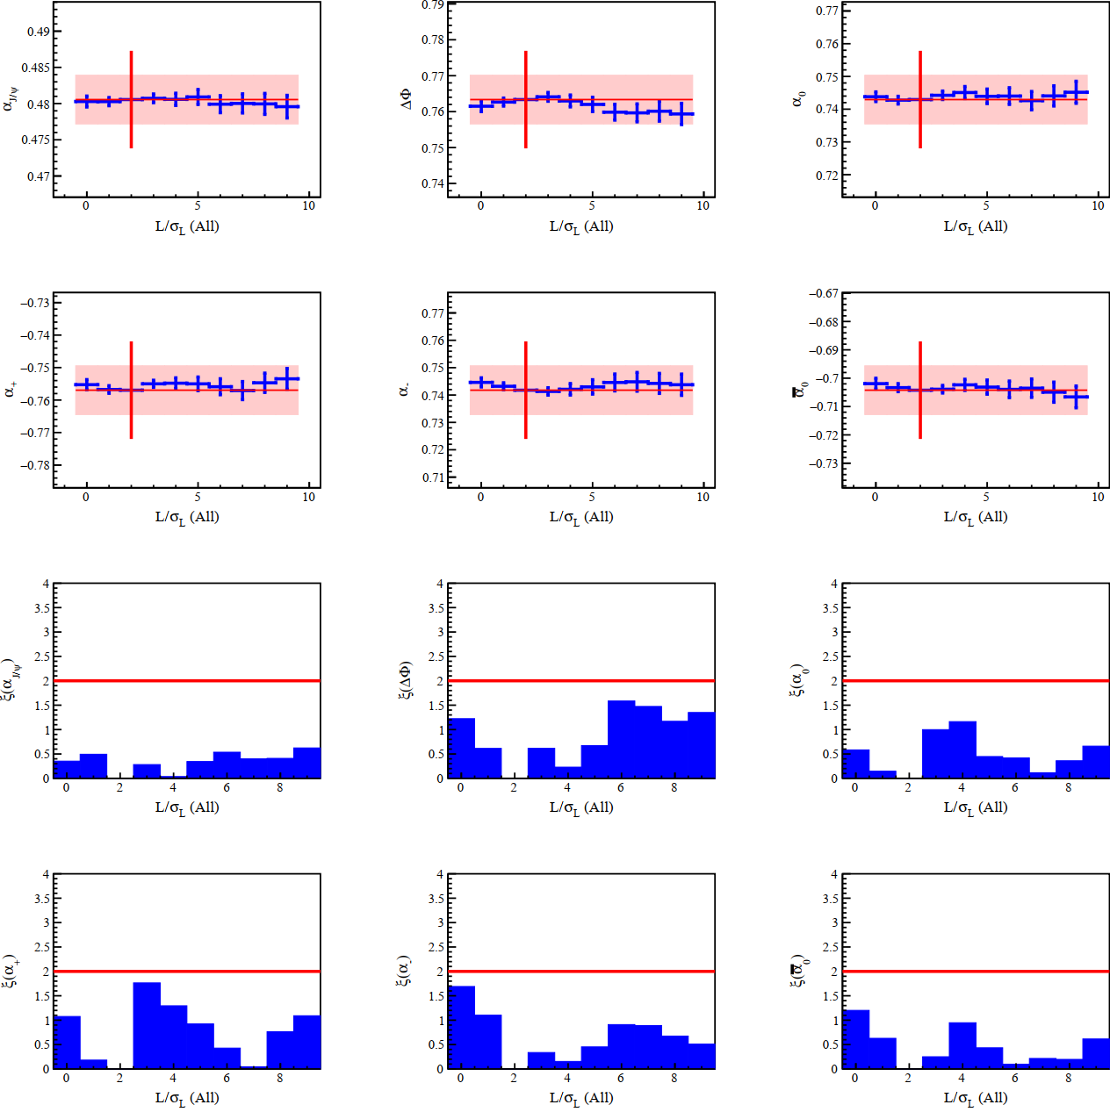
$$L/σ_{L}>2$$

Slide 14
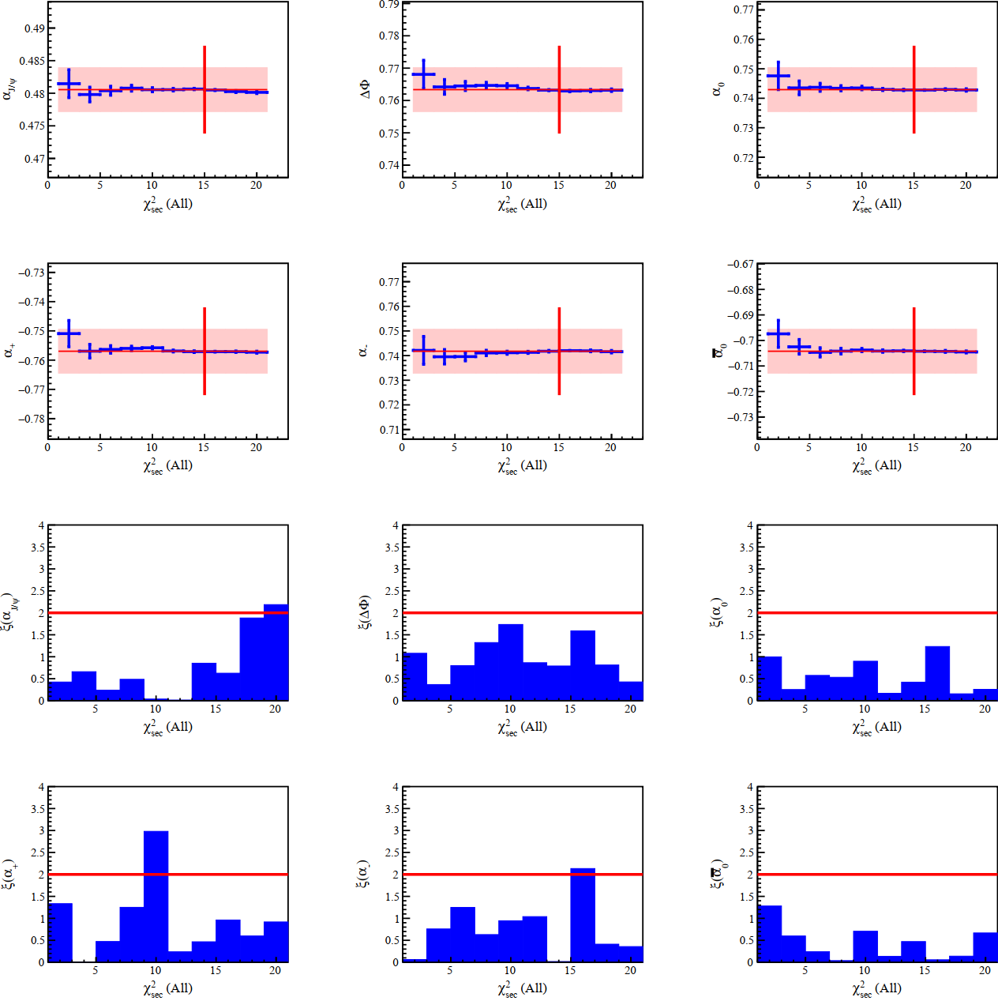
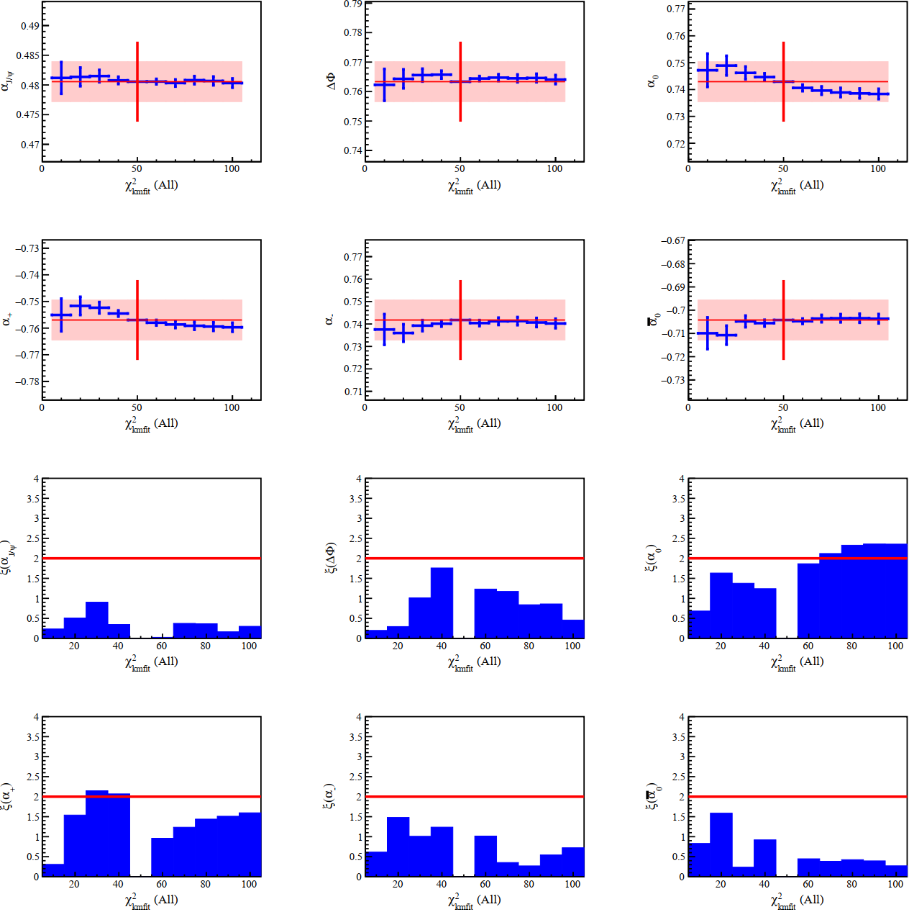
$$χ_{sec}^{2}<15$$
$$χ_{kmfit}^{2}<50$$

Slide 15
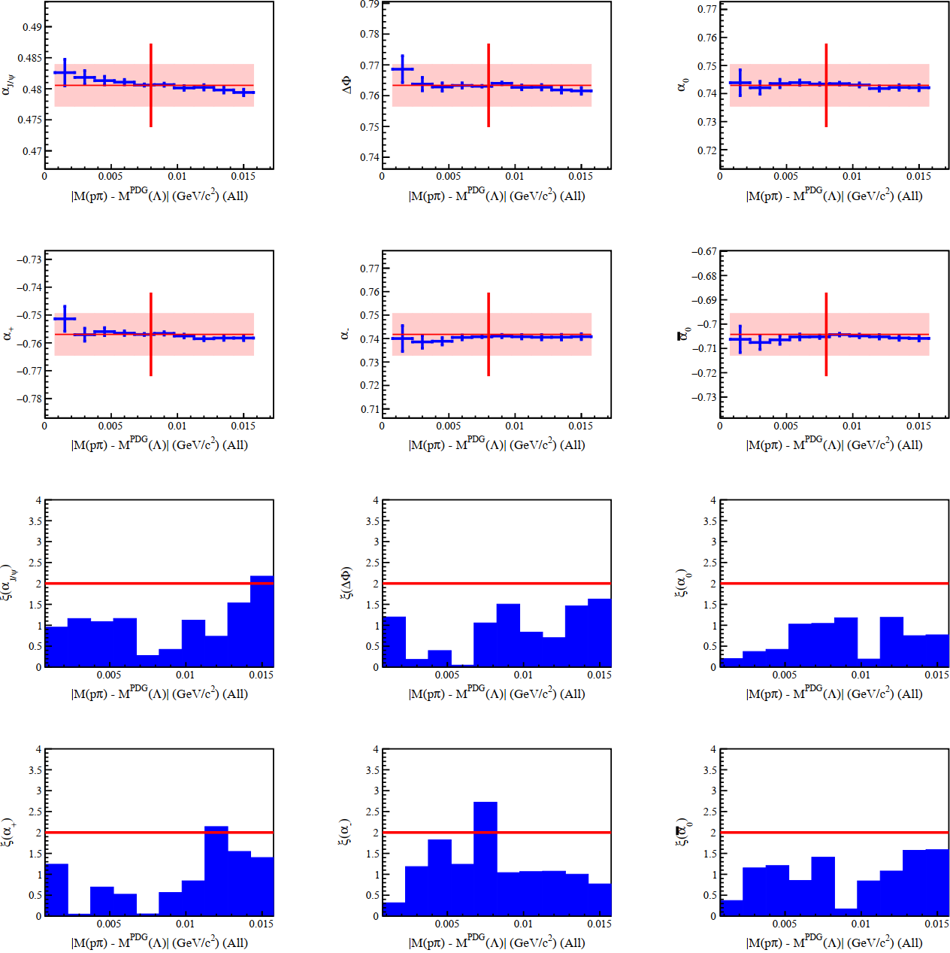
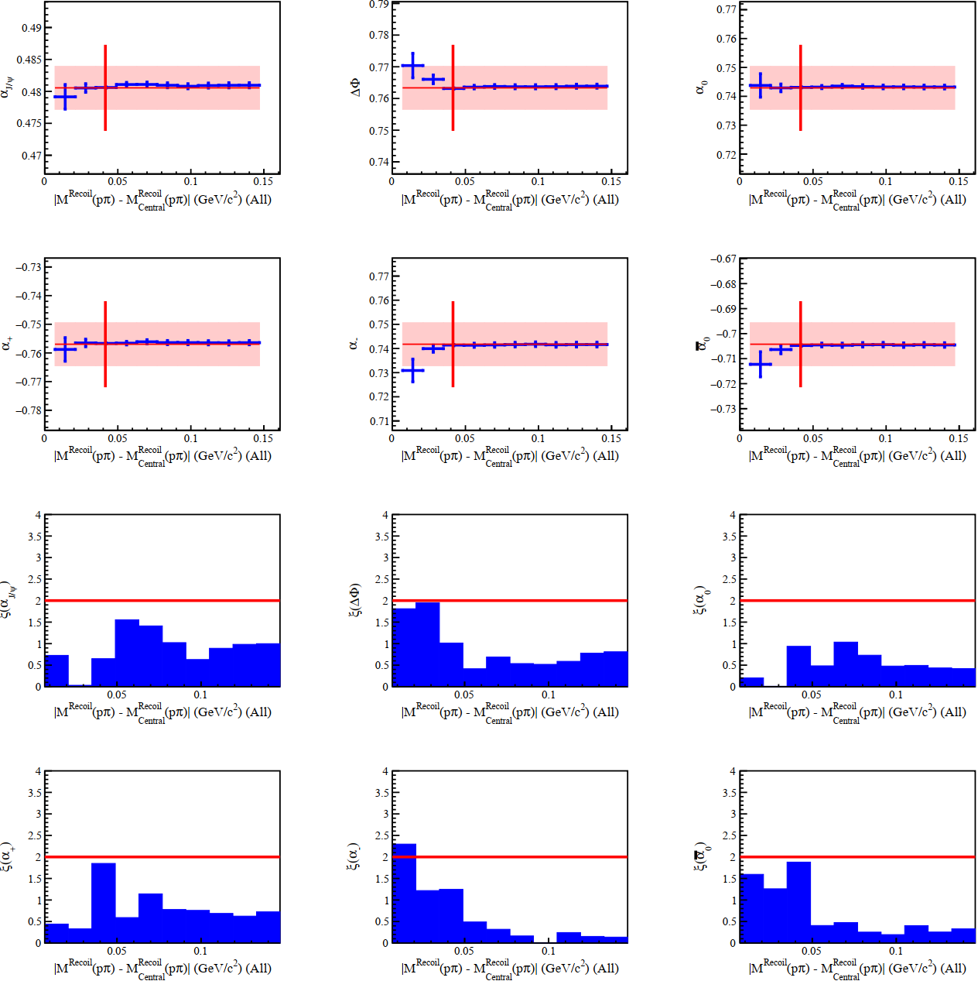
$$\left|M\left(pπ\right)−M^{PDG}\left(Λ\right)\right|<0.008$$
$$\left|M_{Recoil}\left(pπ\right)−M_{Recoil}^{central}\left(pπ\right)\right|<0.0415$$

Slide 16
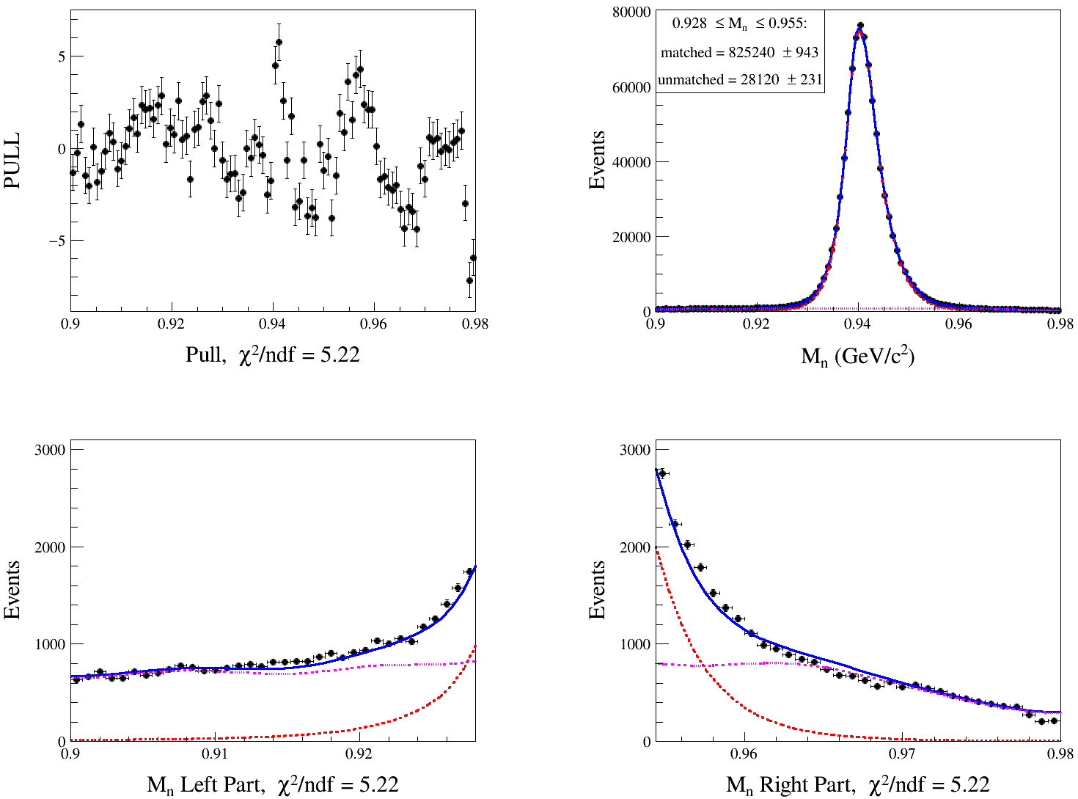
Extract the Nbkg ($PDF=sig shape ⨂{Gauss}+bkg shape$)
npi0

Slide 17
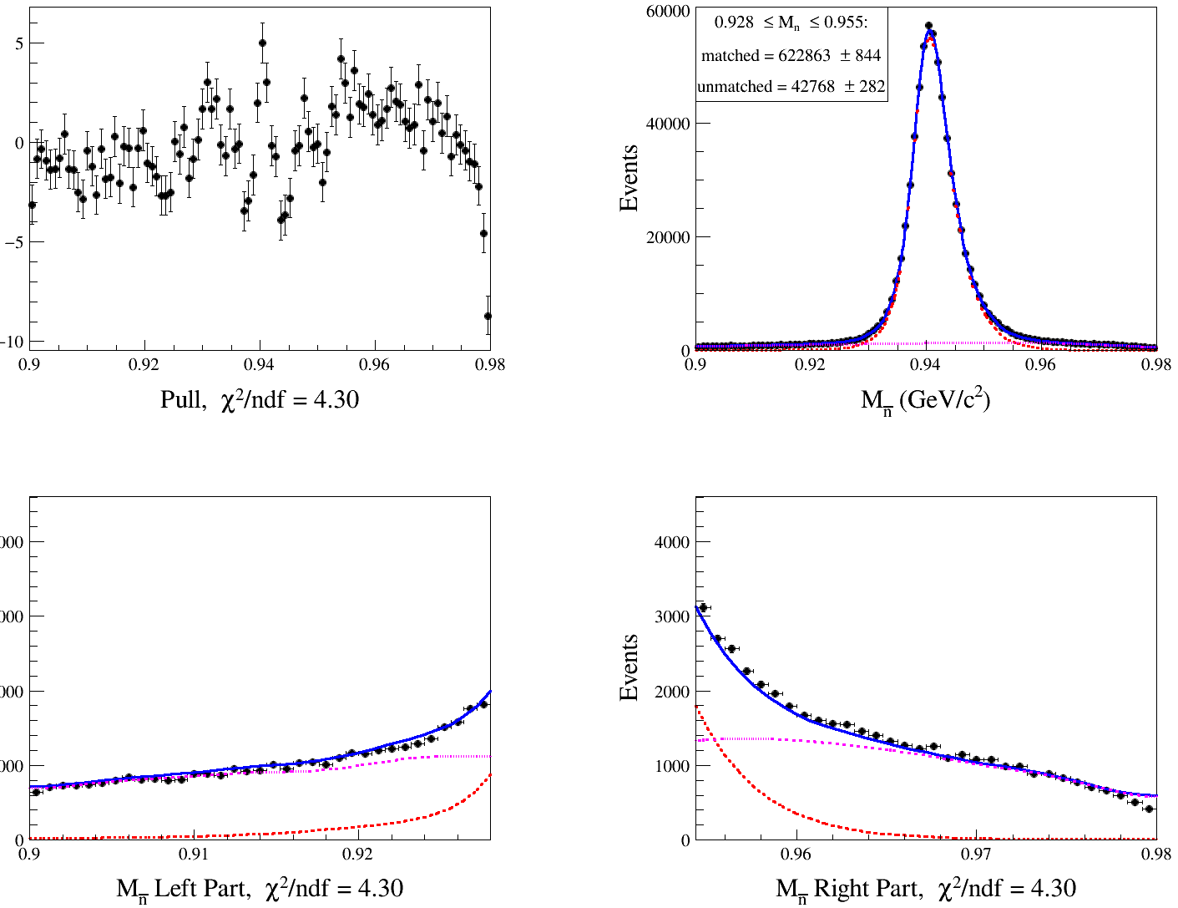
Extract the Nbkg ($PDF=sig shape ⨂{Gauss}+bkg shape$)
nbarpi0

