Slide 1
Luminosity Measurement using Bhabha process

Slide 2
Data Set
Below DD threshold:
Ecm | Taking time | runNo | Ecm | Taking time | runNo
2.2324 | 12.06.08-12.06.16 | [28624,28648] | 3.0990 | 12.06.07 | [28499,28503]
2.4000 | 12.06.08-12.06.16 | [28577,28611] | 3.1015 | 12.06.07 | [28504,28505]
2.8000 | 12.06.08-12.06.16 | [28553,28575] | 3.1055 | 12.06.07 | [28506,28509]
3.4000 | 12.06.08-12.06.16 | [28543,28548] | 3.1120 | 12.06.07 | [28510,28511]
3.0500 | 12.05.28 | [28312,28346] | 3.1200 | 12.06.07 | [28512,28513]
3.0600 | 12.05.28-12.05.30 | [28347,28381] | 3.0800 | 12.05.23-1205.24, 12.04.08 | [27147,27233] [28241,28266]
3.0830 | 12.05.30, 12.06.04 | [28382,28387],[28466,28469] | 3.5000 | 13.06.05-13.06.06 | [33725,33733]
3.0900 | 12.05.31-12.06.05 | [28388,28416],[28472,28475] | 3.5424 | 11.12.21-11.12.31, 13.06.05-13.06.06 | [24983,25015][33734,33743]
3.0930 | 12.06.01-12.06.05 | [28419,28453],[28476,28478] | 3.5538 | 11.12.21-11.12.31 | [25016,25094]
3.0943 | 12.06.05-12.06.06 | [28479,28482] | 3.5611 | 11.12.21-11.12.31 | [25100,25141]
3.0952 | 12.06.06 | [28487,28489] | 3.6002 | 11.12.21-11.12.31 | [25143,25243]
3.0958 | 12.06.06 | [28490,28492] | 3.6500 | 09.05.26-09.06.03, 13.06.05-13.06.06 | [9613,9779] [33747,33758]
3.0969 | 12.06.06 | [28493,28495] | 3.6710 | 13.06.05-13.06.06 | [33759,33764]
3.0982 | 12.06.07 | [28496,28498]

Slide 3
MC sample
e+e-→e+e- (babayaga3.5) : 500000
e+e-→γγ (babayaga3.5) : 500000
e+e-→μ+μ- (babayaga3.5) : 500000
e+e-→τ+τ- (KKMC) : 300000
e+e-→hadrons (LUNDARLW) : 300000
e+e-→e+ e- X (two photon process) : 300000

Slide 4
Event Selection
MDC Track
|Vr| < 1.0 cm
|Vz| < 10.0 cm
N₊= N₋= 1
|Δθ| < 10◦
|Δϕ| < 5◦
EMC Shower
N_{cluster}== 2
|cosθ| < 0.8
E_{shower}> 0.65*E_{beam}

Slide 5
Events and background estimation
Ecm | Events | Bkg from Digam | Bkg from Dimu | Ecm | Events | Bkg from Digam | Bkg from Dimu
2.2324 | 728522 | 0.7 | 0 | 3.0990 | 125436 | 0.1 | 0
2.4000 | 818942 | 0 | 0 | 3.1015 | 236847 | 1.2 | 0
2.8000 | 664078 | 0 | 0 | 3.1055 | 306048 | 0.1 | 0
3.4000 | 208091 | 0 | 0 | 3.1120 | 245929 | 0 | 0
3.0500 | 2221847 | 1.1 | 0 | 3.1200 | 181450 | 0 | 0
3.0600 | 2234301 | 4.5 | 0 | 3.0800 | 4538582 | 2.3 | 0
3.0830 | 693661 | 0.3 | 0 | 3.5000 | 411177 | 0.2 | 0
3.0900 | 2287810 | 1.1 | 0 | 3.5424 | 959870 | 0 | 0
3.0930 | 2086326 | 0 | 0 | 3.5538 | 612559 | 0 | 0
3.0943 | 338430 | 0 | 0 | 3.5611 | 422111 | 0.4 | 0
3.0952 | 330374 | 0 | 0 | 3.6002 | 1021449 | 0 | 0
3.0958 | 481291 | 0 | 0 | 3.6500 | 5045057 | 0 | 0
3.0969 | 572989 | 0 | 0 | 3.6710 | 474940 | 0 | 0
3.0982 | 436846 | 0 | 0

Slide 6
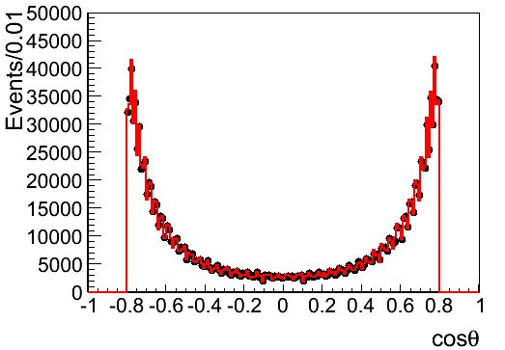
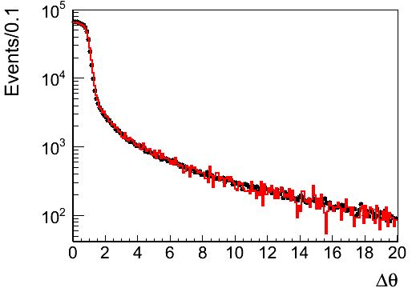
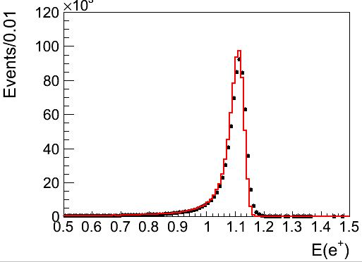
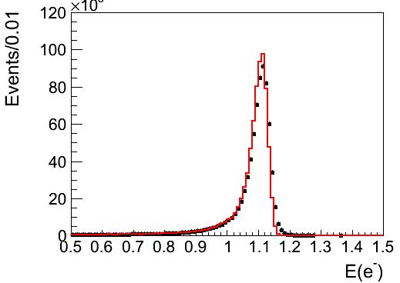
Comparison(2.23GeV)

Slide 7
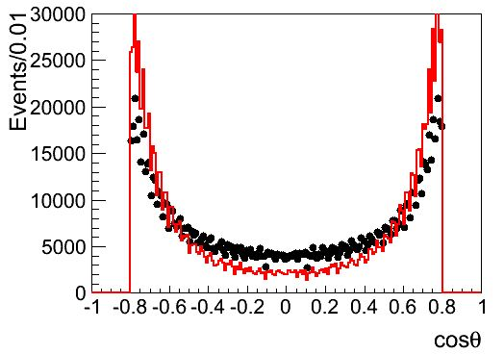
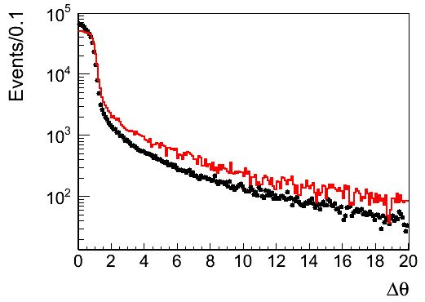
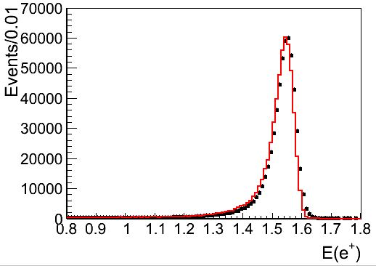
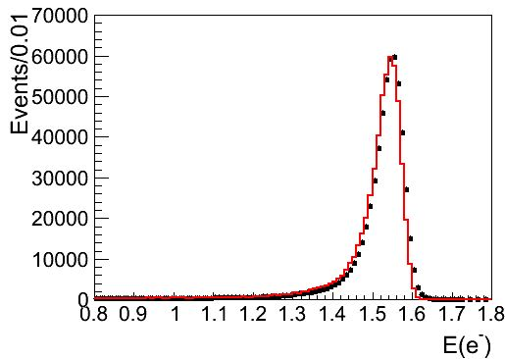
Comparison(3.0969GeV)

Slide 8
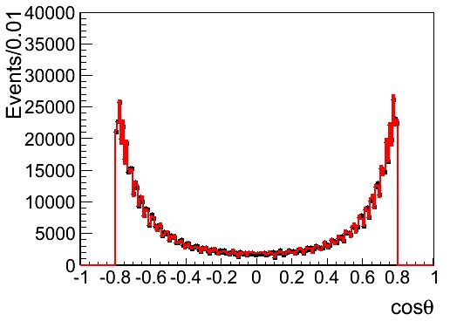
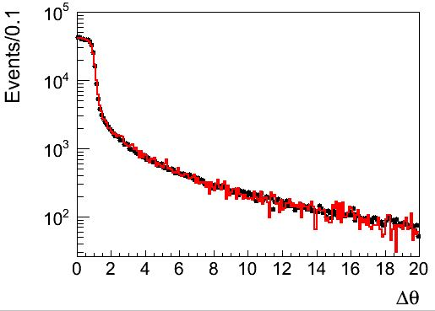
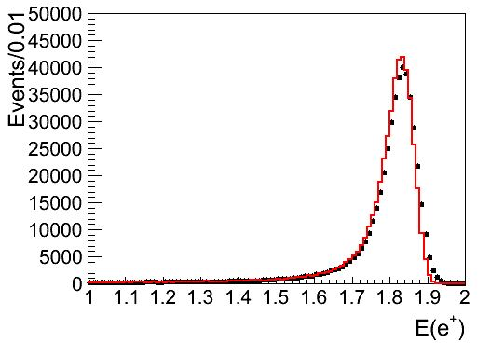
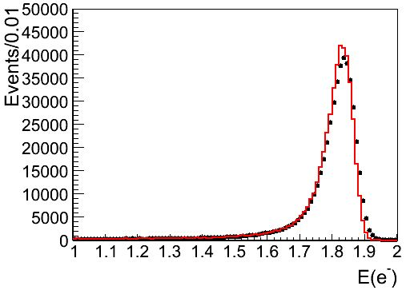
Comparison(3.671GeV)

Slide 9
Results
Ecm | Efficiency/% | Cross section/pb | Luminosity/pb-1 | Ecm | efficiency | Cross section | luminosity
2.2324 | 18.7952 | 1469.8 | 2.637 | 3.0990 | 18.9158 | 765.0 | 0.867
2.4000 | 18.7622 | 1278.1 | 3.415 | 3.1015 | 18.8702 | 770.1 | 1.630
2.8000 | 18.8384 | 938.1 | 3.757 | 3.1055 | 18.9328 | 765.3 | 2.112
3.4000 | 18.7904 | 639.2 | 1.681 | 3.1120 | 18.7846 | 760.3 | 1.722
3.0500 | 18.8102 | 785.7 | 15.033 | 3.1200 | 18.8256 | 757.9 | 1.272
3.0600 | 18.9068 | 787.4 | 15.007 | 3.0800 | 18.8414 | 776.5 | 31.019
3.0830 | 18.9066 | 775.9 | 4.728 | 3.5000 | 18.7864 | 603.9 | 3.624
3.0900 | 18.8116 | 773.2 | 15.729 | 3.5424 | 18.8222 | 586.8 | 8.690
3.0930 | 18.895 | 767.9 | 14.377 | 3.5538 | 18.821 | 585.7 | 5.556
3.0943 | 18.866 | 770.2 | 2.329 | 3.5611 | 18.6942 | 584.5 | 3.863
3.0952 | 18.8466 | 761.3 | 2.302 | 3.6002 | 18.9004 | 569.1 | 9.495
3.0958 | 18.8416 | 768.7 | 3.323 | 3.6500 | 18.7422 | 556.4 | 48.375
3.0969 | 18.9088 | 766.9 | 3.951 | 3.6710 | 18.7972 | 546.4 | 4.624
3.0982 | 18.987 | 770.3 | 2.987

Slide 10
Systematic Error(1)
Ecm | Event selections | Tracking efficiency | MC statistics | Bkg estimation | Trigger efficiency | Generator | Total/%
2.2324 | 0.57 | 0.31 | 0.06 | 0 | 0.1 | 0.5 | 0.83
2.4000 | 0.25 | 0.04 | 0.06 | 0 | 0.1 | 0.5 | 0.58
2.8000 | 0.15 | 0.21 | 0.06 | 0 | 0.1 | 0.5 | 0.58
3.4000 | 0.10 | 0.56 | 0.06 | 0 | 0.1 | 0.5 | 0.76
3.0500 | 0.27 | 0.22 | 0.06 | 0 | 0.1 | 0.5 | 0.62
3.0600 | 0.61 | 0.17 | 0.06 | 0 | 0.1 | 0.5 | 0.81
3.0830 | 0.13 | 0.06 | 0.06 | 0 | 0.1 | 0.5 | 0.53
3.0900 | 0.21 | 0.08 | 0.06 | 0 | 0.1 | 0.5 | 0.56
3.0930 | 0.28 | 0.26 | 0.06 | 0 | 0.1 | 0.5 | 0.64
3.0943 | 1.28 | 0.26 | 0.06 | 0 | 0.1 | 0.5 | 1.40
3.0952 | 4.11 | 0.77 | 0.06 | 0 | 0.1 | 0.5 | 4.21
3.0958 | 7.79 | 1.50 | 0.06 | 0 | 0.1 | 0.5 | 7.96
3.0969 | 12.1 | 1.78 | 0.06 | 0 | 0.1 | 0.5 | 12.27
3.0982 | 7.46 | 1.05 | 0.06 | 0 | 0.1 | 0.5 | 7.56

Slide 11
Systematic Error(1)
Ecm | Event selections | Tracking efficiency | MC statistics | Bkg estimation | Trigger efficiency | Generator | Total
3.0990 | 4.26 | 0.46 | 0.06 | 0 | 0.1 | 0.5 | 4.31
3.1015 | 1.51 | 0.20 | 0.06 | 0 | 0.1 | 0.5 | 1.61
3.1055 | 0.75 | 0.19 | 0.06 | 0 | 0.1 | 0.5 | 0.93
3.1120 | 0.51 | 0.06 | 0.06 | 0 | 0.1 | 0.5 | 0.73
3.1200 | 0.23 | 0.04 | 0.06 | 0 | 0.1 | 0.5 | 0.56
3.0800 | 0.10 | 0.03 | 0.06 | 0 | 0.1 | 0.5 | 0.52
3.5000 | 0.34 | 0.12 | 0.06 | 0 | 0.1 | 0.5 | 0.63
3.5424 | 0.34 | 0.10 | 0.06 | 0 | 0.1 | 0.5 | 0.62
3.5538 | 0.17 | 0.02 | 0.06 | 0 | 0.1 | 0.5 | 0.54
3.5611 | 0.42 | 0.09 | 0.06 | 0 | 0.1 | 0.5 | 0.67
3.6002 | 0.13 | 0.16 | 0.06 | 0 | 0.1 | 0.5 | 0.75
3.6500 | 0.11 | 0.15 | 0.06 | 0 | 0.1 | 0.5 | 0.55
3.6710 | 0.12 | 0.02 | 0.06 | 0 | 0.1 | 0.5 | 0.53

Slide 12
Final Result
Ecm | Luminosity | Ecm | Luminosity
2.2324 | 2.637±0.009±0.022 | 3.0990 | 0.867±0.004±0.037
2.4000 | 3.415±0.011±0.020 | 3.1015 | 1.630±0.006±0.026
2.8000 | 3.757±0.013±0.022 | 3.1055 | 2.112±0.008±0.020
3.4000 | 1.681±0.007±0.013 | 3.1120 | 1.722±0.007±0.013
3.0500 | 15.033±0.050±0.093 | 3.1200 | 1.272±0.005±0.007
3.0600 | 15.007±0.050±0.122 | 3.0800 | 31.019±0.102±0.163
3.0830 | 4.728±0.016±0.025 | 3.5000 | 3.624±0.013±0.023
3.0900 | 15.729±0.052±0.088 | 3.5424 | 8.690±0.030±0.054
3.0930 | 14.377±0.048±0.092 | 3.5538 | 5.556±0.019±0.030
3.0943 | 2.329±0.009±0.033 | 3.5611 | 3.863±0.014±0.026
3.0952 | 2.302±0.009±0.097 | 3.6002 | 9.495±0.032±0.071
3.0958 | 3.323±0.012±0.264 | 3.6500 | 48.375±0.160±0.264
3.0969 | 3.951±0.014±0.485 | 3.6710 | 4.624±0.017±0.025
3.0982 | 2.987±0.011±0.226

