Slide 1
Investigation of NTD Ge Sensors
Sicheng Wen
USTC
2018.6.26

Slide 2
OUTLINE
Background
Introduction of NTD Ge sensor
The procedure of fabrication of NTD Ge sensor
Conclusion

Slide 3
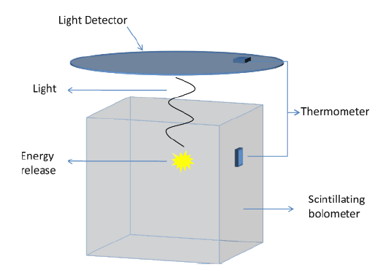
Background
Scintillating bolometer
low–temperature detectors (LTD) has been continuously growing and reaching many areas of research.
Features:
Excellent energy resolution
Sensitivity to all kind of particles
Low energy threshold
A wide choice of construction materials
dark matter, double and single beta decay, X–ray and Gamma–ray astronomy, and others. they find their best applications in rare events physics, particularly in double beta decay and dark matter searches.

Slide 4
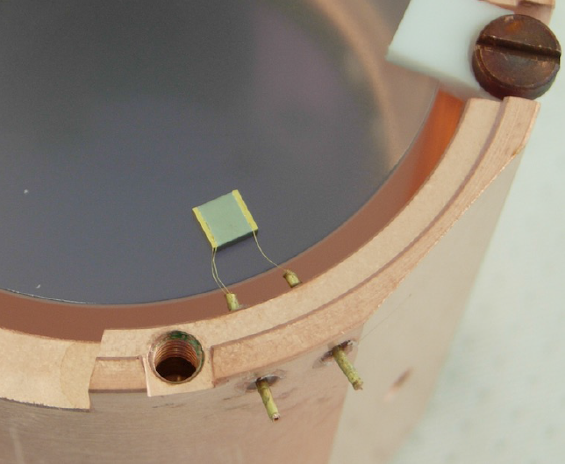
Introduction of NTD Ge sensor
Neutron Transmutation Doped(NTD) Ge sensor has been widely used as low temperature sensors in mK range for bolometric detectors in dark matter search and neutrino physics.
Properties:
1. high temperature sensitivity
2. mass producible
3. reproducibility
4. fast rise time
5. low specific heat
6. simple electric readout …

Slide 5
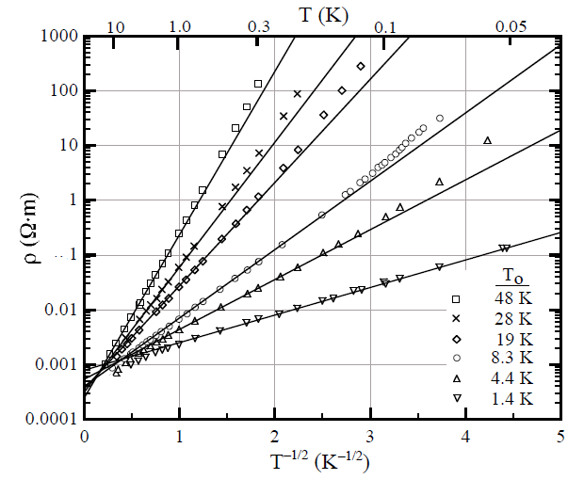
Mechanism
The conduction mechanism of the NTD Ge sensors at low temperature is believed to be in Variable range Hopping(VRH) mechanism.
the temperature dependence of the
resistivity of a NTD Ge sensor is:
$α$ is predicted to be 0.5, $ρ_{0}$ and $T_{0}$ are
parameters depending on the doping
compensation levels.

Slide 6
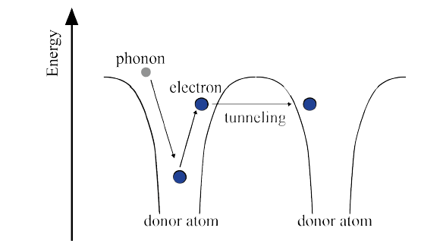
Variable Range Hopping(VRH)
Defined Metal-Insulator Transition(MIT)
A particular concentration of dopant does exist, just below the MIT, where the electrons wave functions can overlap between two dopant sites.
At very low temperatures (T<<10K), the conduction is due to a quantum mechanical tunneling effect through the potential barriers separating the dopant sites. This conduction regime is named Variable Range Hopping (VRH)

Slide 7
Procedure of the fabrication of NTD Ge sensor
Neutron irradiation of Ge wafers
Study of radiative impurities formed due to neutron irradiation
Study of fast neutron induced damages
Preparing resistance thermometers and characterizing it at mK temperature
S. Mathimalor. “NTD Ge sensor development for superconducting bolometers”. Doctoral thesis

Slide 8
Ge wafers
Estimated production rate of dopants(atoms/${cm}^{3}$) per neutron, obtained by multiplying measured isotopic abundance of Ge with n-capture cross section.
Net carrier concentration :

Slide 9
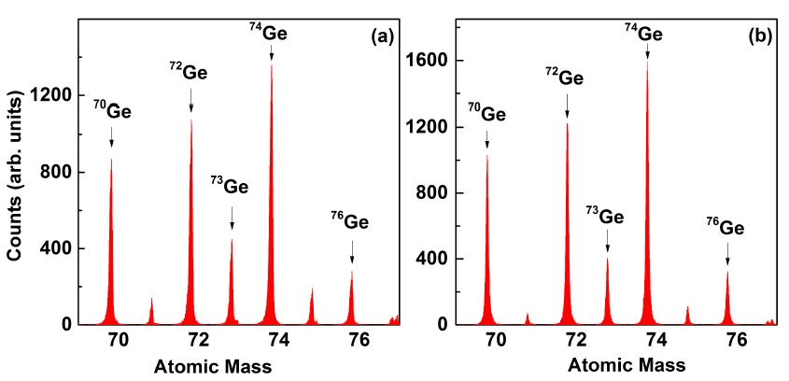
Isotopic abundance measurement
Measurement facilities：
Time of Flight Secondary Ion Mass Spectroscopy(TOF-SIMS)
Notes:
Mechanism:
using a 25keV${}_{}^{69}{Ga}$ mono-isotopic Liquid Metal ion gun as the primary ion source with a final current density of about 0.03mA/${cm}^{2}$ and spot size of about 250nm.
secondary ions produced through collision cascade mechanism were extracted with a wide acceptance angle which ensured that nearly every ion produced was extracted from the Ge sample surface.
The extracted ions with slightly varying kinetic energies were reflected by the reflectron and were eventually time focused onto a microchannel plate detector operated in the ion counting mode, the generated time spectrum later converted into a Mass Spectrum.

Slide 10
Neutron irradiation
The desired neutron fluence of $1−5×{10}^{18}/{cm}^{2}$.
Pre-etching($H_{2}O_{2}$ etching 50$μm$) of samples prior to n-irradiation will be highly desirable.
Ge samples packed in quartz tube and Al wrapper.
After irradiating, samples will cooldown period of ～45days.

Slide 11
Procedure of the fabrication of NTD Ge sensor
Neutron irradiation of Ge wafers
Study of radiative impurities formed due to neutron irradiation
Study of fast neutron induced damages
Preparing resistance thermometers and characterizing it at mK temperature
S. Mathimalor. “NTD Ge sensor development for superconducting bolometers”. Doctoral thesis

Slide 12
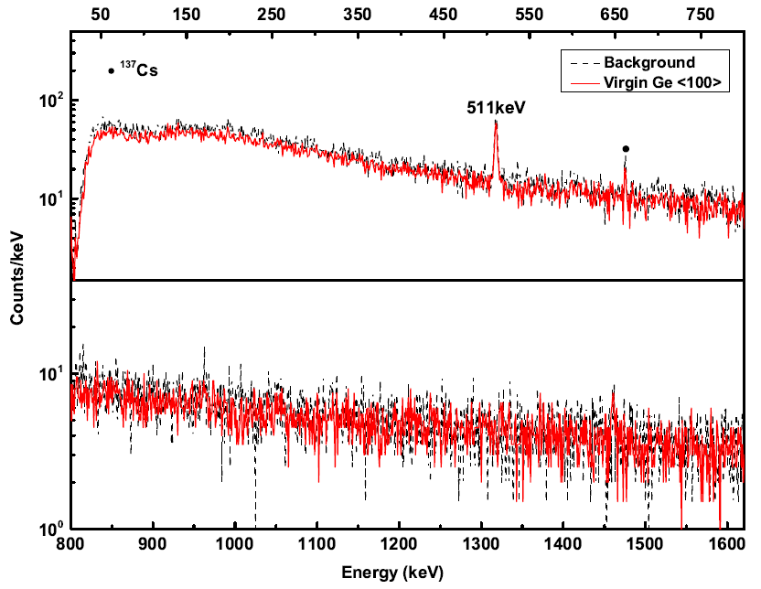
Radioactive impurity measurements
Experimetal Setup:
～70% HPGe detector surrounded by low activity Cu + Pb shield is used for detection of characteristic $γ$-rays of radioactive impurities.

Slide 13
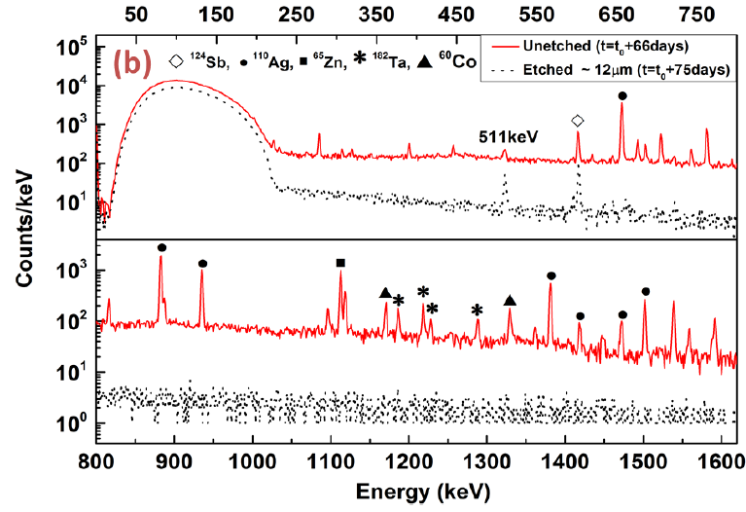
Radiative spectrum
REC
The${}_{}^{71}{Ge}$ has a half-life of 11.4 days and decays mainly by electron capture to the ground state of ${}_{}^{71}{Ga}$. However, a small fraction that undergoes Radioactive Electron Capture(REC) shows up as a continuous gamma spectrum of ${}_{}^{71}{Ge}$,which is observed with an endpoint energy of 225 keV

Slide 14
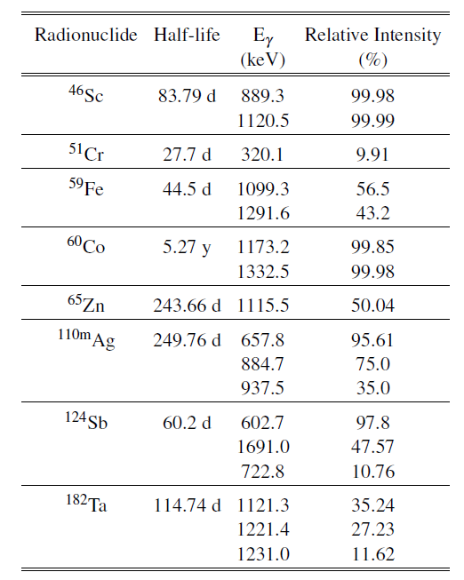
Impurities analysis
Neutron induced reaction products of impurities in bulk Germanium
Neutron induced reaction products of residual impurities in the Ge surface
Deposition and thermal diffusion of radioactive contaminants from the surrounding environment

Slide 15
Conclusion of irradiation
Etching 50$μm$ surface layer is found to be adequate.
A cooldown period of ～2 years would be necessary before sensors made from these samples can be used in rare decay studies requiring ultra low background(<=1 mBq/g).
Detector grade Ge wafers will be desirable.

Slide 16
Procedure of the fabrication of NTD Ge sensor
Neutron irradiation of Ge wafers
Study of radiative impurities formed due to neutron irradiation
Study of fast neutron induced damages
Preparing resistance thermometers and characterizing it at mK temperature
S. Mathimalor. “NTD Ge sensor development for superconducting bolometers”. Doctoral thesis

Slide 17
Defect studies in NTD Ge
Variable neutron energy
The average recoil energy(～182 eV) of Ge(n,$γ$) reaction is sufficiently high to drive the recoiling Ge atom into the interstitial position. The dopant atom in interstitial positions cannot contribute to the total number of carrier concentration
High temperature annealing is employed to cure the crystal defects

Slide 18
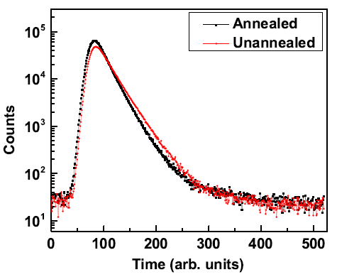
Positron Annihilation Lifetime Spectroscopy
When a positron interacts inside a crystal with defects, it is more likely to stay in the defect due to the repulsive force of ions and consequently its lifetime increase. Positron lifetime increases with the defect size.
Spectrum with a 1.27 MeV $γ$-ray as a start signal and the 511 keV$γ$-ray as a stop signal

Slide 19
Procedure of the fabrication of NTD Ge sensor
Neutron irradiation of Ge wafers
Study of radiative impurities formed due to neutron irradiation
Study of fast neutron induced damages
Preparing resistance thermometers and characterizing it at mK temperature
S. Mathimalor. “NTD Ge sensor development for superconducting bolometers”. Doctoral thesis

Slide 20
Fabrication of NTD Ge sensor
Au(88%)-Ge(12%) of about 50 nm thickness contact pads were sputtered on the HF cleaned oxygen free NTD Ge surface and rapid thermally annealed at 400 $℃$ for 2 min.
Wedge bonding Al/Au wires($∅$=25$μm$) to the Au-Ge contact pad.

Slide 21
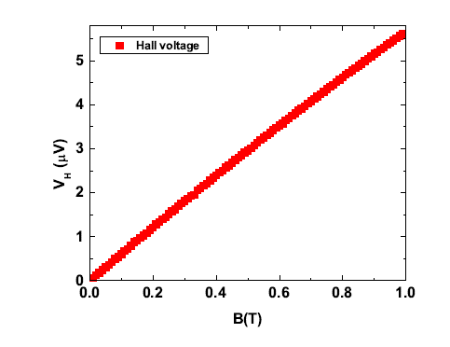
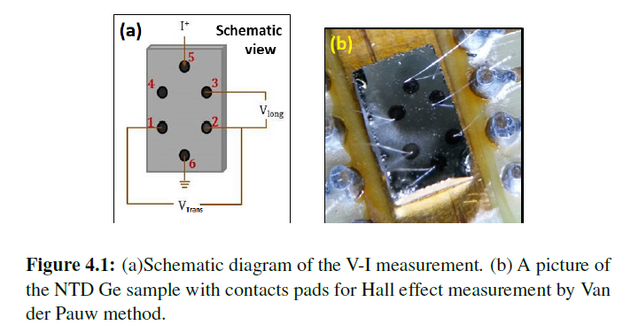
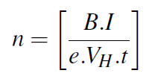
Carrier concentration measurement
Hall effect:

Slide 22
Resistance measurement of NTD Ge at mK
To avoid the self heating of the sensor during measurement, the net power dissipated in the sensor was maintained below 10 fW

Slide 23
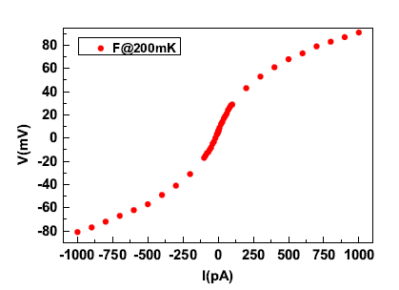
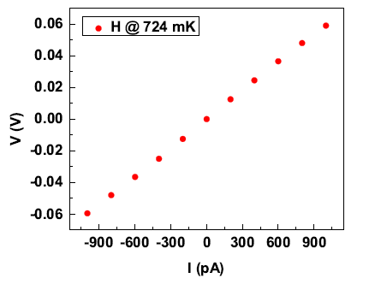
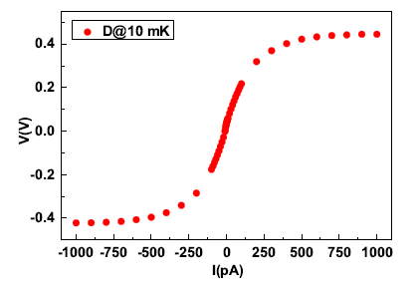
The NTD Ge to the Au-Ge pads is most crucial and is required to be fabricated with perfection to overcome the Schottky barrier and to provide a truly ohmic contact

Slide 24
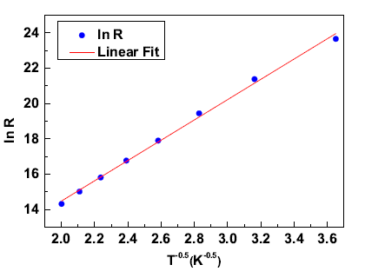
Results
Mott`s law
The NTD Ge samples with carrier concentration in the range $0.5−1×{10}^{17}/{cm}^{3}$ are found to be suitable for the sensor development.

Slide 25
Conclusion
NTD Ge sensors are produced by doping Ge wafers by neutron transmutation technique
Desired neutron fluence is $1−5×{10}^{18}$/${cm}^{2}$
Vacuum annealing at 600$℃$ for ~2 hours is sufficient to recover the damage in the irradiated samples
The NTD Ge samples with carrier concentration in the range $0.5−1 × {10}^{17}/{cm}^{3}$ are found to be suitable for the sensor development
THANK YOU

Slide 26
Backup

Slide 27
辐照前工作安排
切割Ge片：切割技术选择以及注意事项，咨询法国实验室，安排报告，然后选择与联系国内切割实验
Ge片保存与运输、Ge片切割大小：参考法国实验室经验
表面处理：参考法国实验室经验，双氧水蚀刻，以及异丙醇清洗，和氮气吹干处理。如果法国没有相关经验，则需要抽取样本进行测试，测试样本可以用边角料
同位素丰度测量：每一大块Ge片留下一小片样本，进行丰度测试
放射性本底测量：高纯锗探测器，样本同上
联系调研中子源

