Slide 1
Study of Determination of K_{s}⁰
Efficiency Systematics
Jiajun Liu¹,Xiaorong Zhou²,Bo Zheng¹
1(University of South China,Hengyang,China)
2(University of Science and Techology of China,Hefei,China)
1

Slide 2
Outline
1.Motivation
2.Data sets and Boss version
3. Event selection
4. Background analysis
5.Fit to M_{ks}² in different momentum region (sample)
6.Fit to M_{ks}² in different momentum region (signal)
7.Calculation of efficiency and uncertainiy
8.Summary
2

Slide 3
Motivation
1.The systematic error describes the difference between the data and the MC simulation. It reflects the consistency of monte carlo simulation to data.
2.When carrying out precise measurement with very small statistical error, the system error is required to be smaller than the statistical error or in the same size range.
3. If the system error is large, the measurement accuracy will be poor, affecting the experimental measurement accuracy.
3

Slide 4
Data sets and Boss version
Software:
Boss 703
Data sets:
June 12 to July 28, 2009 at the J/ψ resonance, 223.7 M;
April 18 to May 26, 2012 at the J/ψ resonance, 1086.9 M;
MC samples:
0.1 M exclusive Monte Carlo of J/ψ → K∗(892)∓K± in HELAMP, K∗(892)∓ → K⁰_{S}π∓ in VSS
225 M Inclusive MC generated by LH group
4

Slide 5
Channels analyzed
K⁻
π⁺
π⁺
π⁻
π⁺
π⁻
K⁺
π⁻
K*⁺
K*⁻
K⁻K⁺
e⁺e⁻
J/ψ
K_{S}⁰
π⁺π⁻
5

Slide 6
Event selection
Selection of control sample: J/ψ→K*⁻K⁺→KsKπ
1.Charged track Selection
Vertex cut:Vxy<1.0cm; Vz<10cm;
MDC :p < 2.0 GeV/c; | cos θ| < 0.93;
Ngood >=2
2.PID with de/dx and TOF
For kaons, prob(K) > prob(π);
For pions, prob(π) > prob(K);
Nk⁺=1 && Npi⁻>=1
3. Select the π- with minimum Delta = |M^{rec}_{πK}-M_{ks}|
4. Further selection:
|p^{CMS}_{K} −1.373| < 0.06 GeV/c;
veto: j/ψ ->π+ π- π0: M^{recoil}_{ππ} > 0.4 GeV/c²;
veto bhabha: E_{deposit} < 2.5 GeV;
Selection of Ks signal:
1. Selection of additional charged track:
Vz<20 cm
assigned to be π
2.Ks selection
Loop the π⁺ and π⁻, do second vertex fit, select the combination with minimum chisq
3. Further selection
|Mπ⁺π⁻ − MK⁰_{S}| < 12 MeV/c;
L/σ_{L} >2;
Observable: Mks²
6
Notes:
Ks 反冲pi k

Slide 7
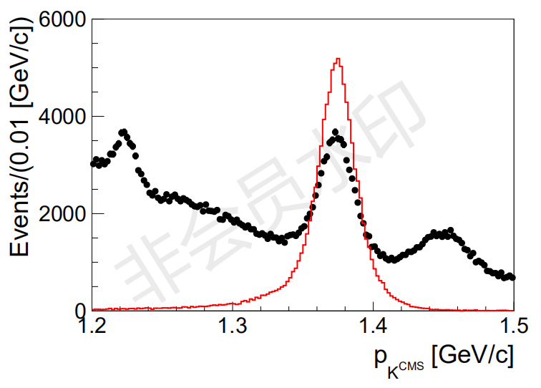
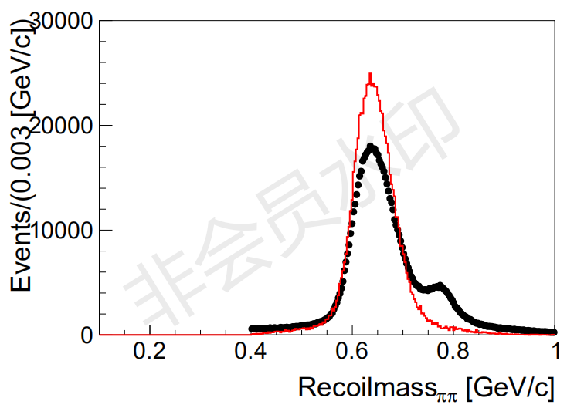
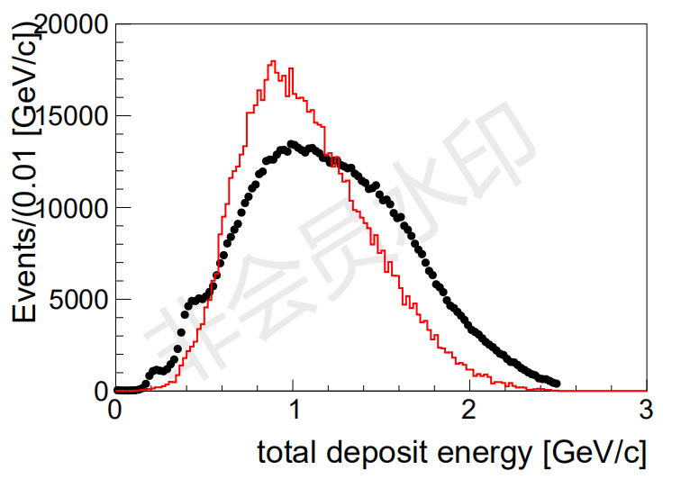
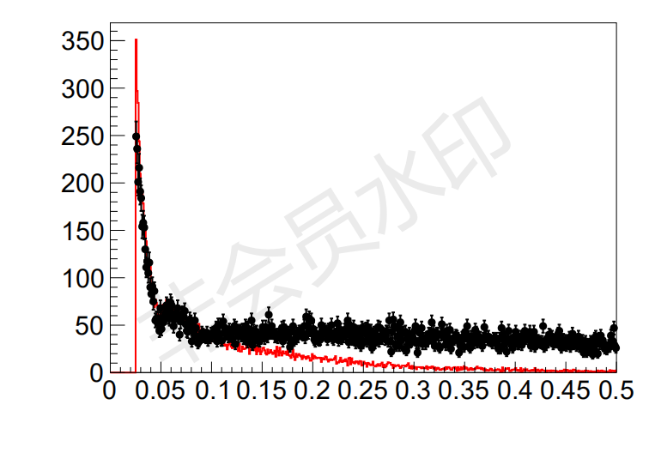
Distribution in selecting of sample
P^{CMS}_{K}
Recoil mass of ππ
7
Total deposit energy
The energy of the neutral track

Slide 8
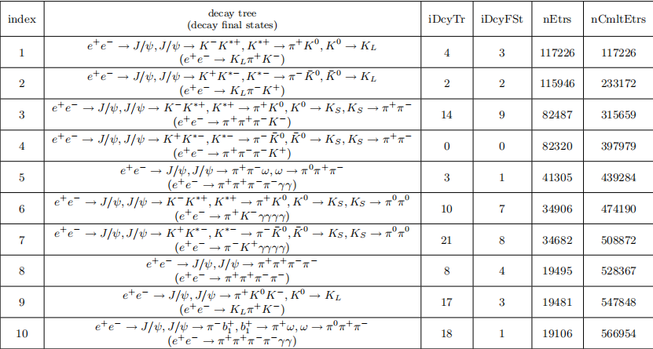
Background analysis of selecting sample
The main background
J/ψ->ω ππ
8

Slide 9
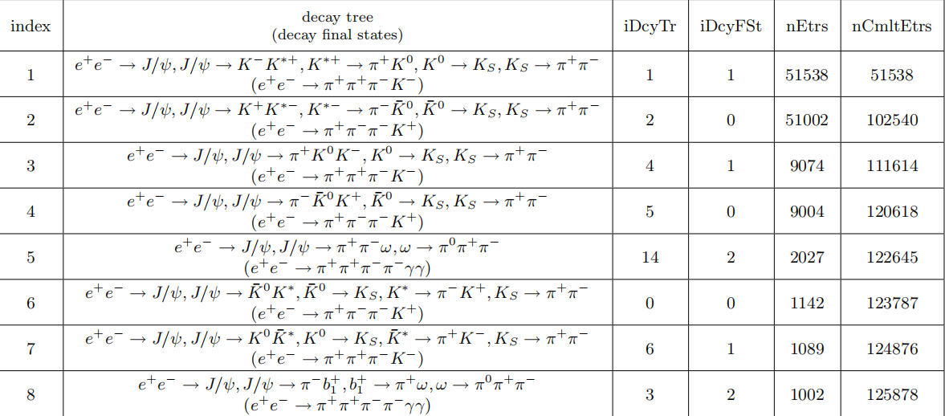
Background analysis of selecting signal
The main background
J/ψ->ω ππ
9

Slide 10
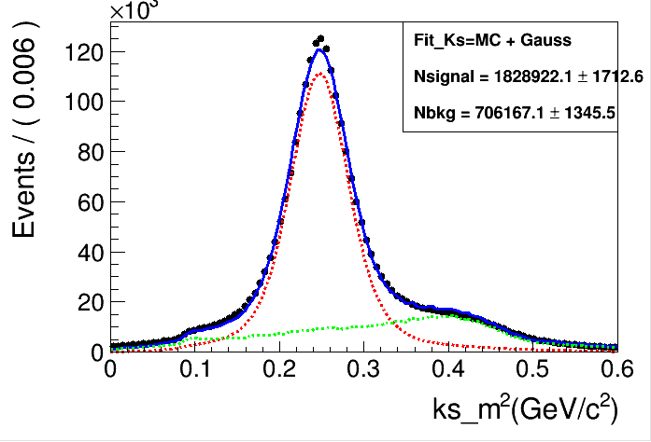
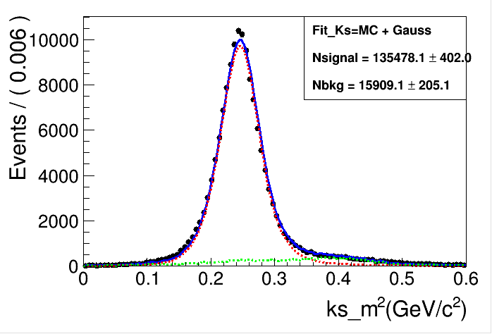
Distribution of M_{ks}²
After selection of control sample
After Selection of ks signal
No peaking background from inclusive study (as green line)
Data is fitted with signal MC shape $⨂Ga$ussian + background fixed from inclusive
In the selection of control sample, there is contribution from Jpsi->k*k, K*->KL pi
10

Slide 11
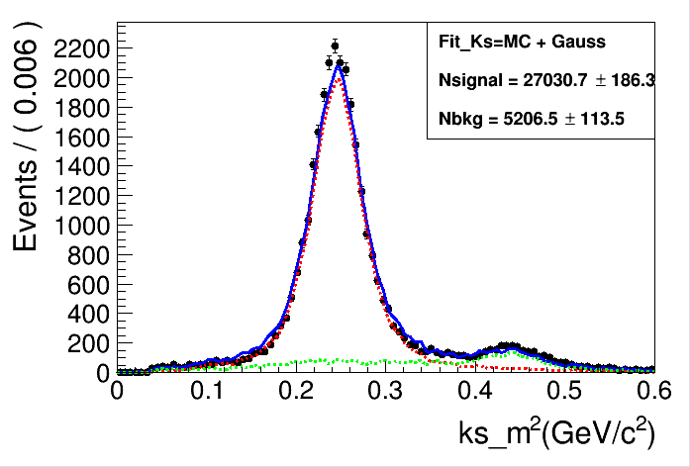
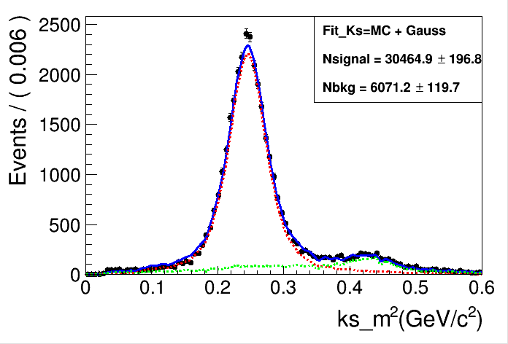
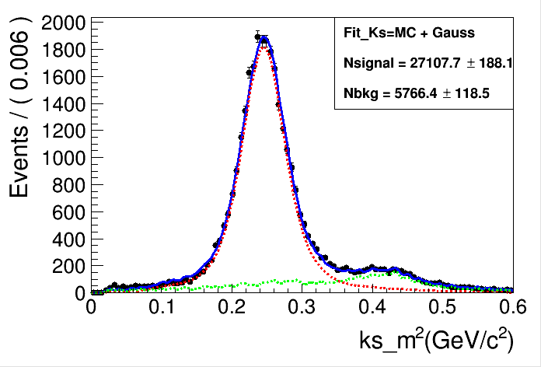
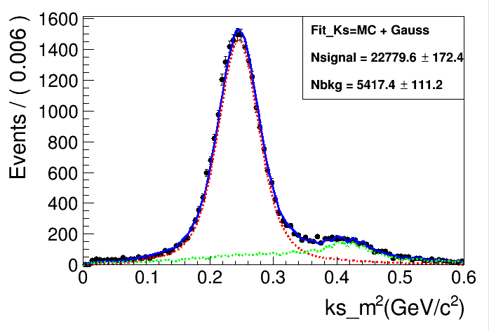
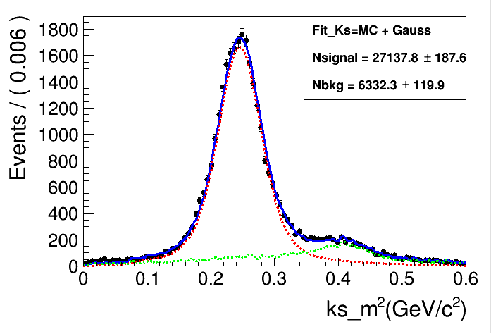
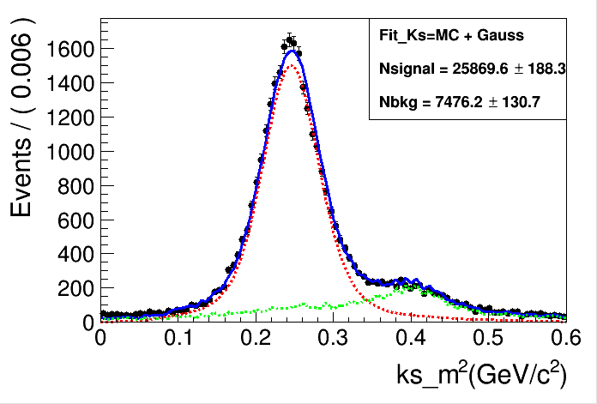
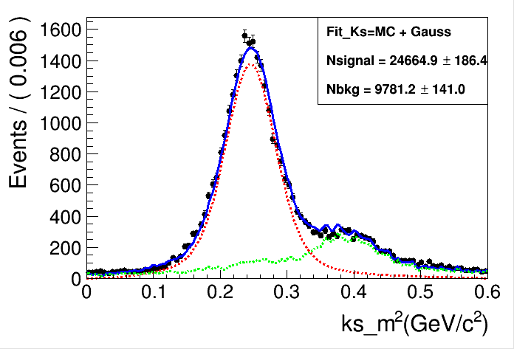
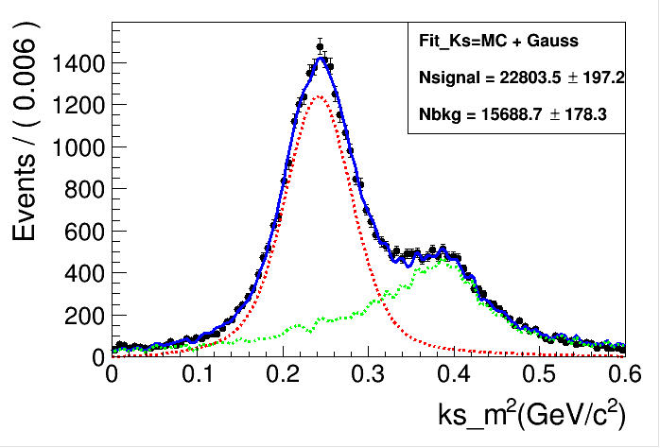
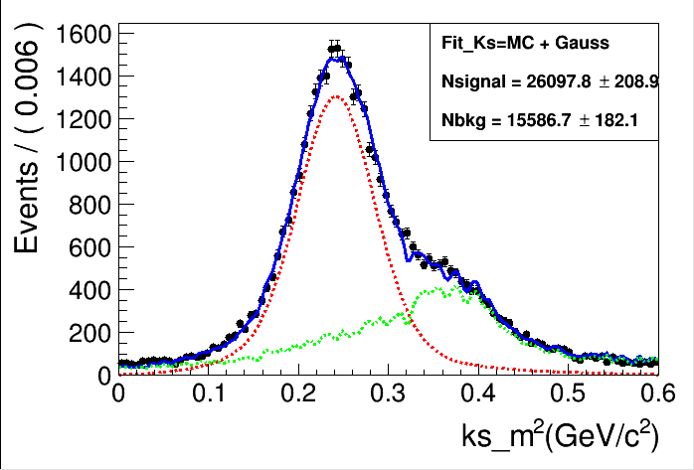
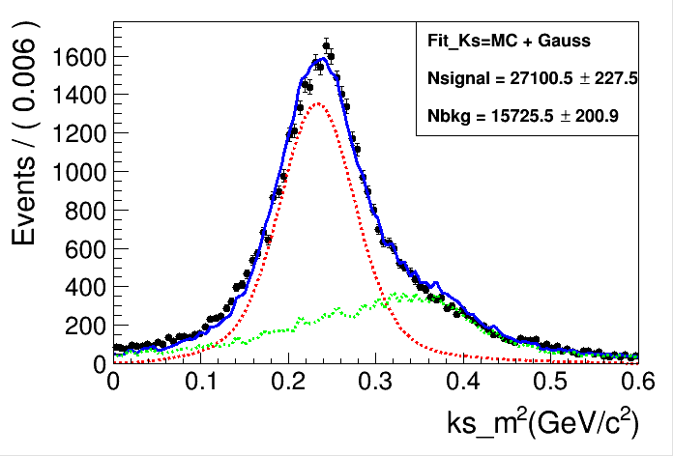
Fit to M_{ks}² in different momentum region (sample)
（0.67,0.74）
（0.74,0.81）
（0.81,0.87）
（0.87,0.92）
（0.92,0.98）
（0.98,1.04）
（1.04,1.10）
（1.1,1.17）
11
（1.17,1.26）
（1.26,1.40）

Slide 12
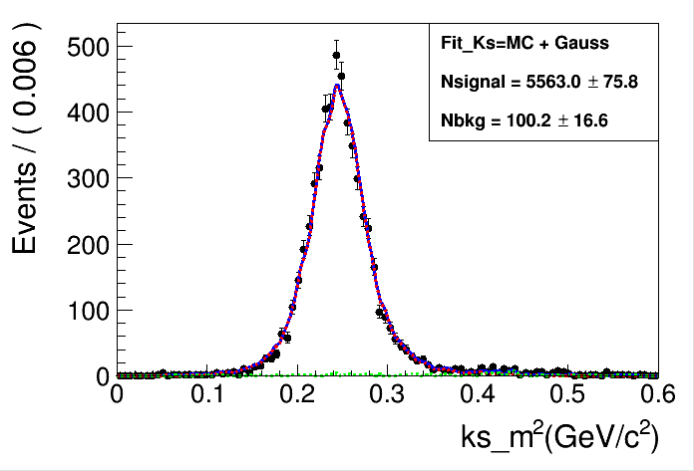
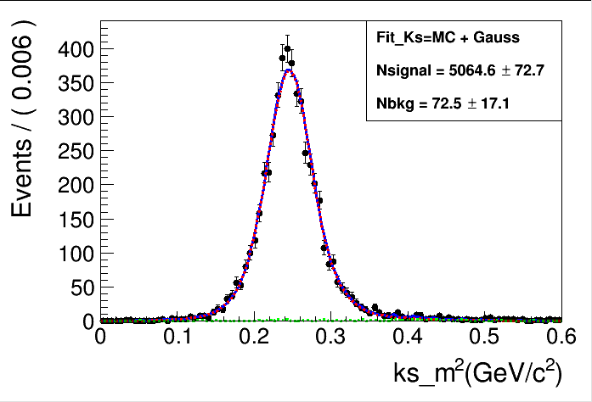
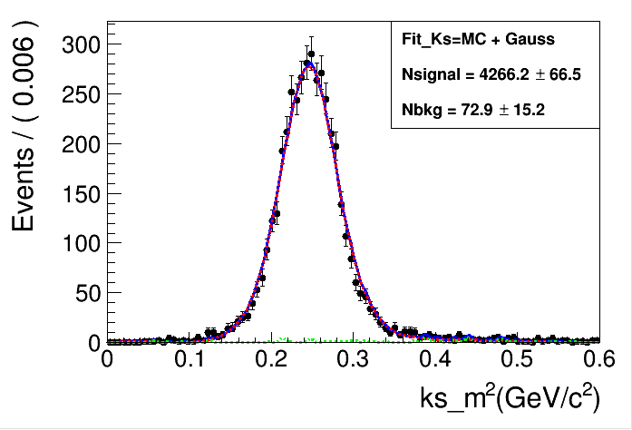
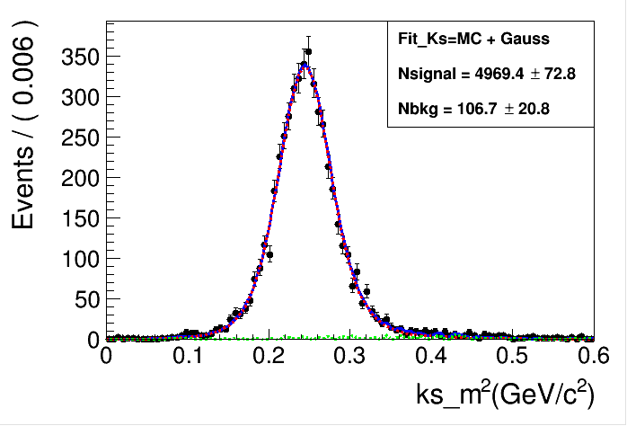
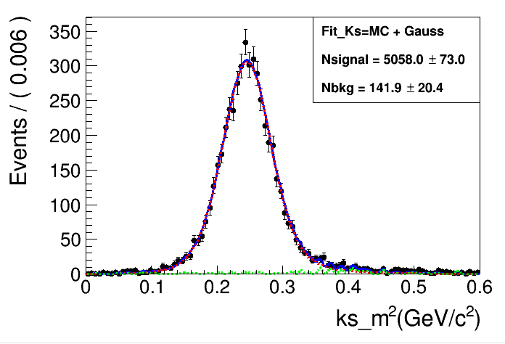
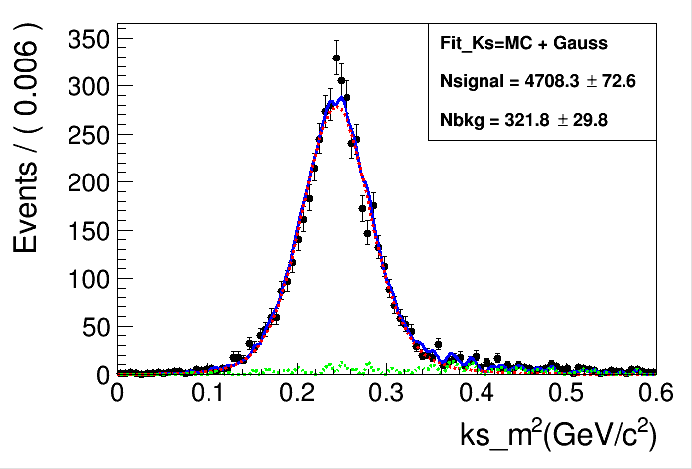
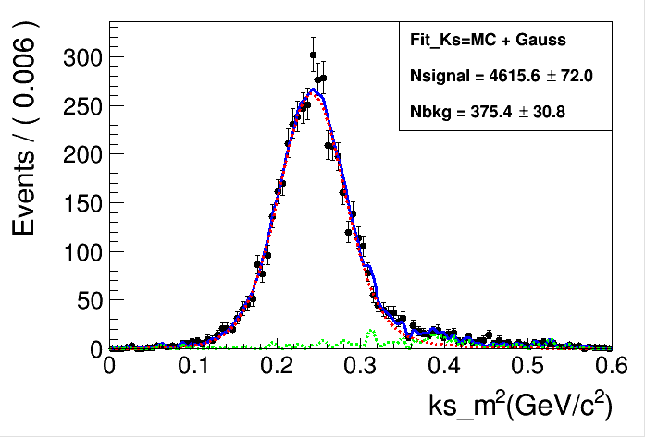
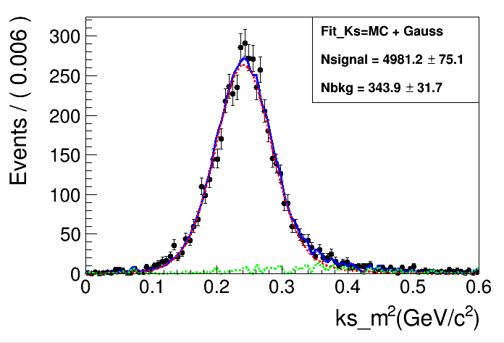
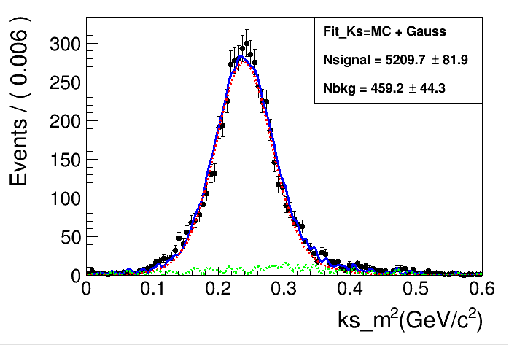
Fit to Mks2 in different momentum region (signal)
（0.67,0.74）
（0.74,0.81）
（0.81,0.87）
（0.87,0.92）
（0.92,0.98）
（0.98,1.04）
（1.04,1.10）
（1.1,1.17）
12
（1.17,1.26）
（1.26,1.40）

Slide 13
Calculation of efficiency and uncertainiy
运用的公式：
（0.67,0.74） | （0.74,0.81） | （0.81,0.87） | （0.87,0.92） | （0.92,0.98） | （0.98,1.04） | （1.04,1.10） | （1.10,1.17） | （1.17,1.26） | （1.26,1.40）
26786.5±186.9 | 30290.4±197.5 | 22591.1±173.6 | 25786.6±181.8 | 25786.6±173.6 | 25656.4±189.8 | 24525.6±186.8 | 22803.2±197.2 | 26231.0±227.6 | 27701.9±256.4
4648.0 ±68.0 | 5563.0 ±75.8 | 5064.6 ±72.7 | 4266.2 ±66.5 | 4969.4 ±72.8 | 5058.0 ±73.0 | 4708.3 ±72.6 | 4615.6 ±72.0 | 4981.2 ±75.0 | 5209.7 ±81.9
34.7% | 36.7% | 37.6% | 37.8% | 38.5% | 39.4% | 38.4% | 40.5% | 38.0% | 37.6%
1.97 | 2.01 | 2.26 | 2.51 | 2.35 | 2.60 | 2.55 | 3.22 | 2.98 | 3.15
N_{sample}
N_{signal}
（0.67,0.74） | （0.74,0.81） | （0.81,0.87） | （0.87,0.92） | （0.92,0.98） | （0.98,1.04） | （1.04,1.10） | （1.10,1.17） | （1.17,1.26） | （1.26,1.40）
2534 | 2905 | 2741 | 2270 | 2781 | 2692 | 2294 | 2502 | 2333 | 1537
1183 | 1431 | 1442 | 1225 | 1485 | 1481 | 1298 | 1399 | 1268 | 838
29.8% | 31.5% | 33.6% | 34.5% | 34.1% | 35.1% | 36.1% | 35.7% | 34.7% | 34.8%
N_{MC_sam}
N_{MC_sig}
13

Slide 14
Summary
1.` Learned the reconstruction of KS, fitting, error and efficiency calculation.
2.The image of signal and background is obtained, and the systematic error is obtained by calculations.
3.The next step:
generate more MC。
analyze the errors further.
12

Slide 15
Thank you

Slide 17
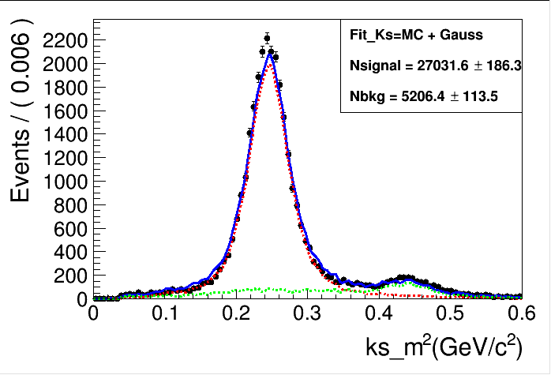
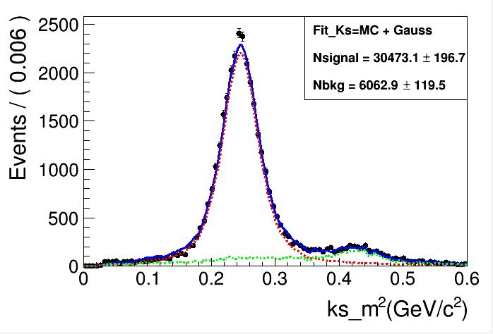
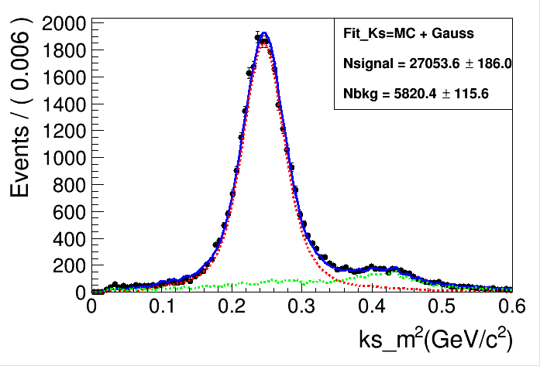
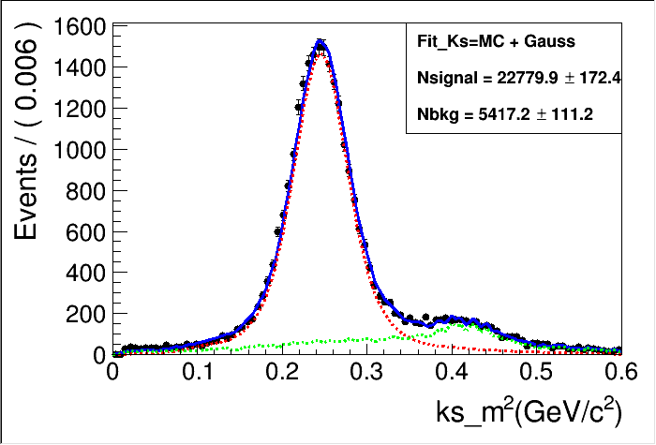
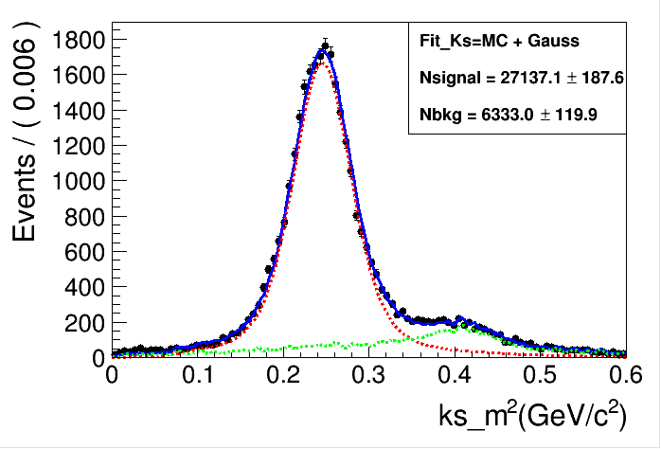
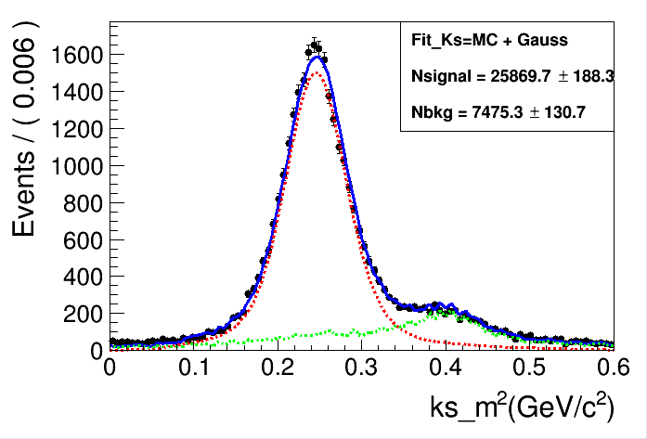
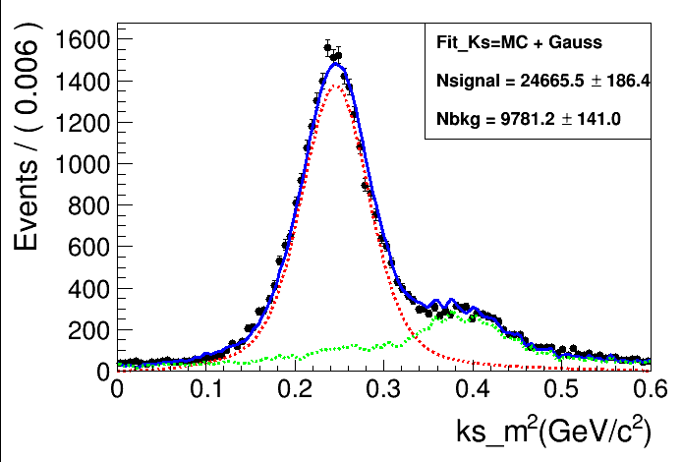
（0.67,0.74）
（0.74,0.81）
（0.81,0.87）
（0.87,0.92）
（0.92,0.98）
（0.98,1.04）
（1.04,1.10）
（1.1,1.17）
（1.17,1.26）
（1.26,1.40）

Slide 18
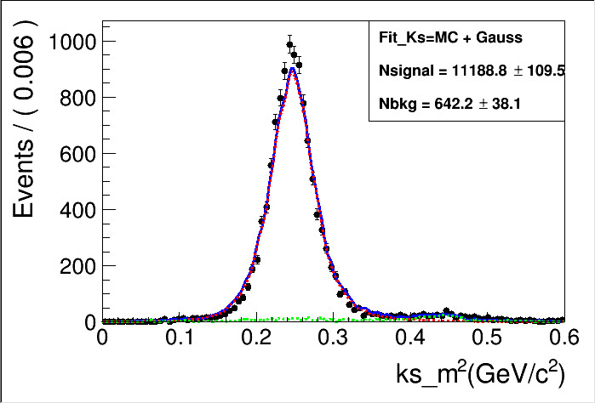
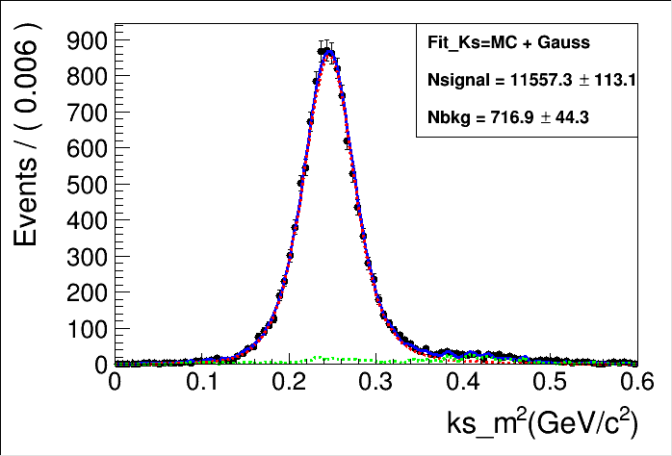
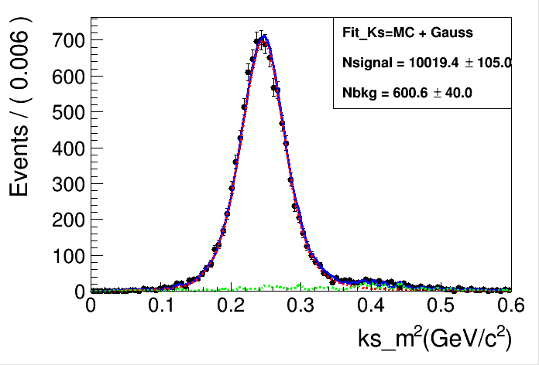
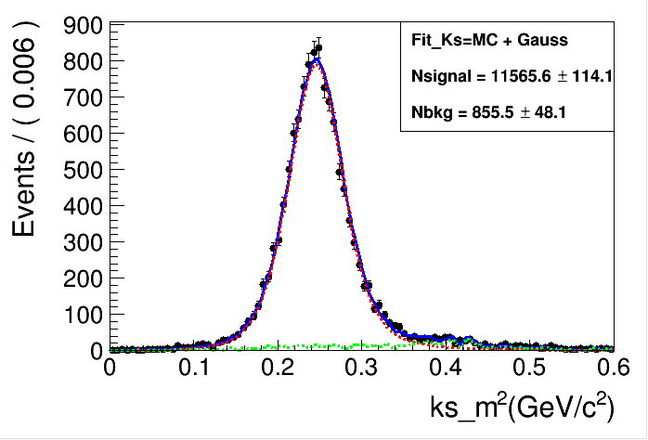
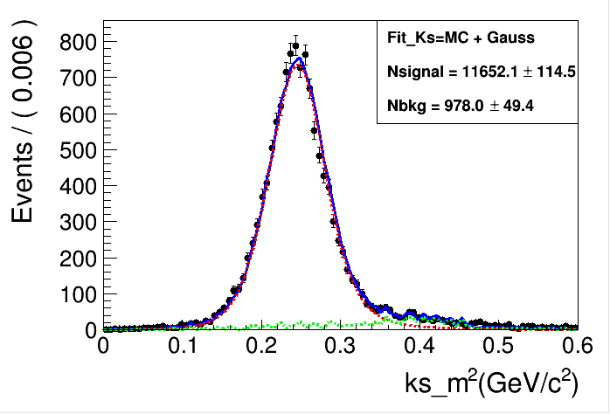
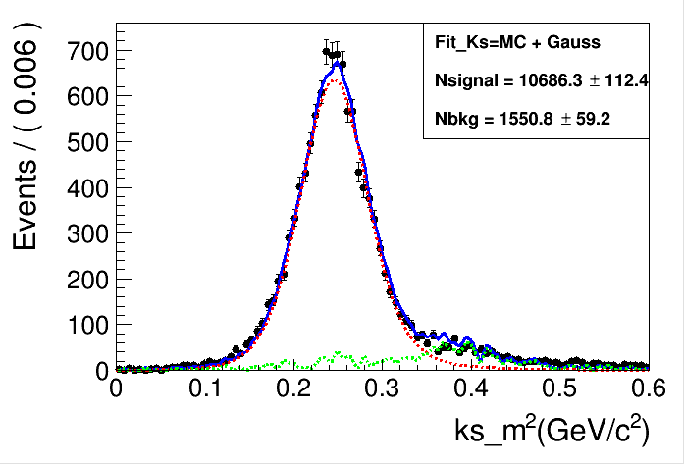
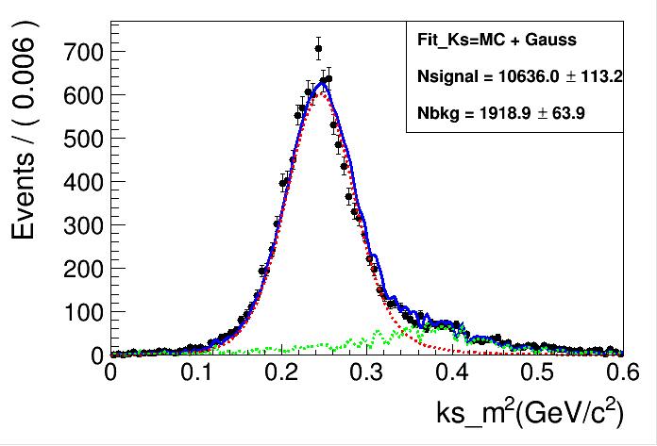
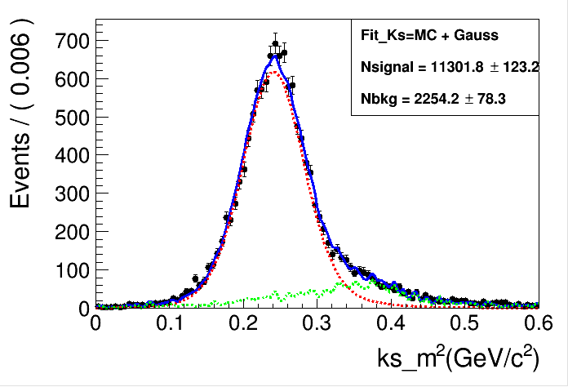
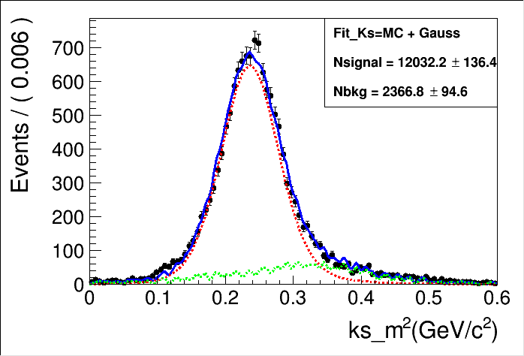
（0.67,0.74）
（0.74,0.81）
（0.81,0.87）
（0.87,0.92）
（0.92,0.98）
（0.98,1.04）
（1.04,1.10）
（1.10,1.17）
（1.17,1.26）
（1.26,1.40）

