Slide 1
Measurements of the branching fraction for $$Ξ^{−}→ Λ e^{−}ν$$

Slide 2
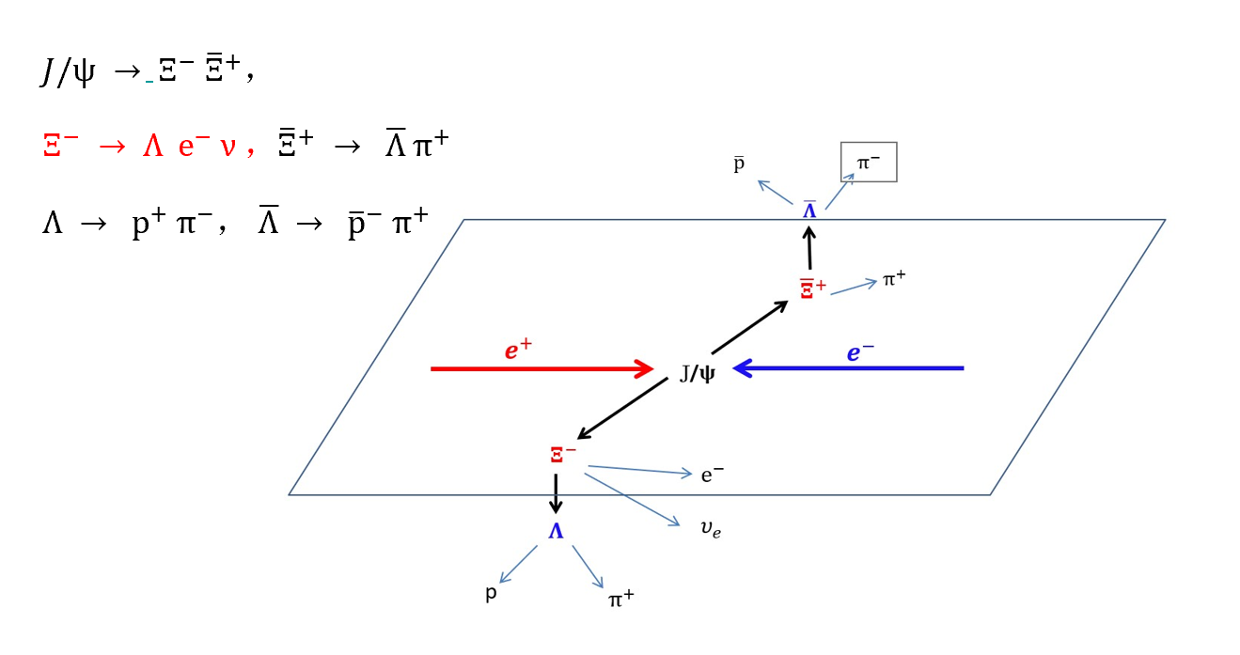
Data set
Here I chose $Ξ^{−} → Λ e^{−} ν$，${\overline{Ξ}}^{+} → \overline{Λ} π^{+}$ as my data set.

Slide 3
Event selection
Charged Tracks
No Vertex requirement; $\left|\cos{θ}\right|<0.93;Ngood≥6;$
PID
Proton: p>0.32 GeV/c;
Pion: p<0.32 GeV/c;
Electron: prob_e>prob_K && prob_e>prob_π; ie.size()==1;
Vertex fit for $\overline{Λ}, {\overline{Ξ}}^{+}$
For $\overline{Λ}, {\overline{Ξ}}^{+},$ primary and secondary vertex fit used for the ${\overline{p}}^{−}π^{+}$for $\overline{Λ}, \overline{Λ}π^{+}$for ${\overline{Ξ}}^{+}$.
Loop all the pairs, select combination by minimizing $χ^{2}={\left(M\left({\overline{p}}^{−}π^{+}\right)−M\left(Λ_{PDG}\right)\right)}^{2}+{\left(M\left({\overline{Λ}}_{\overline{p}π^{+}}π^{+}\right)−M(Ξ_{PDG})\right)}^{2}$
Notes:
I did

Slide 4
Event selection
Vertex fit for $Λ, Ξ^{−}$
For $Λ$, primary and secondary vertex fit used for the $p^{+}π^{−}$for $Λ$, $Λ$ for $Ξ^{−}$.
For $Ξ^{−},$ primary vertex fit used for the $Λe^{−}$ for $Ξ^{−}$.
Loop all the pairs, select combination by minimizing $χ^{2}= {chisq}_{pπ^{−}}+{chisq}_{Λ}+{chisq}_{Λe^{−}}$
Notes:
I did

Slide 5
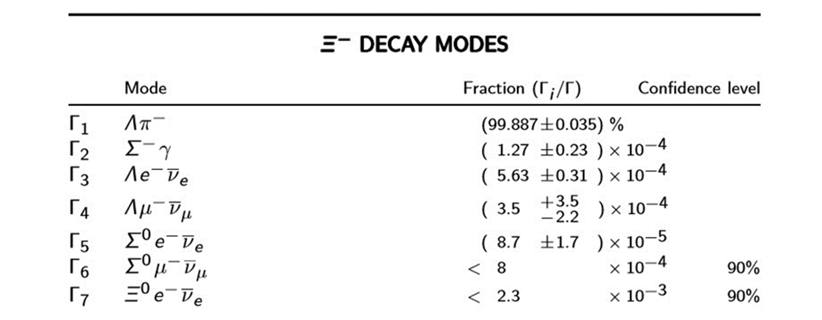
Background analysis
The main background should be $Ξ^{−} →Λ π^{−}$

Slide 6
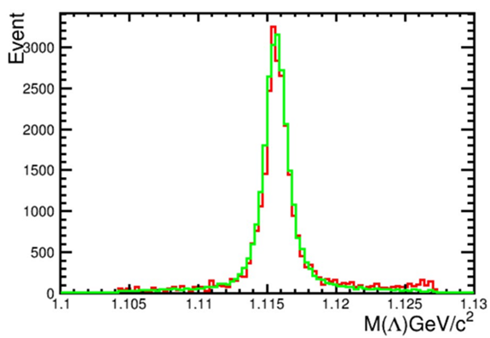
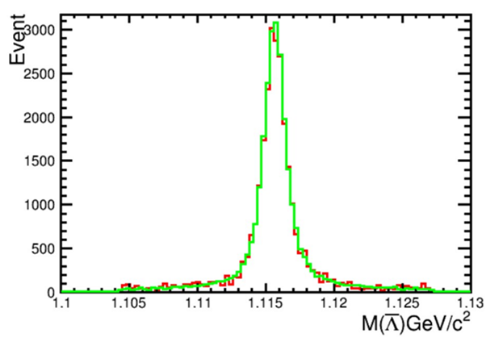
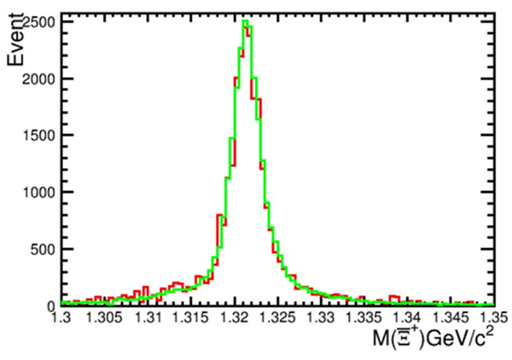
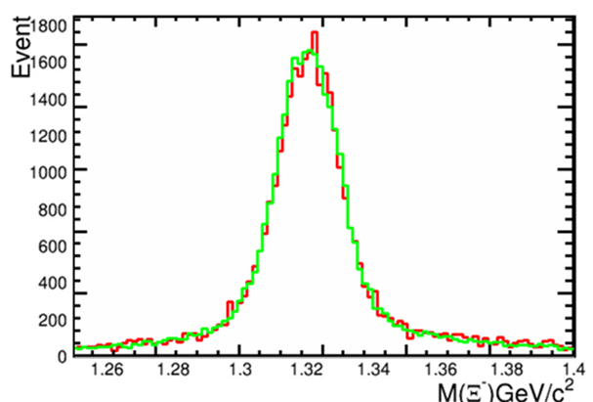
Background analysis
The green line is Signal which is $Ξ^{−} → Λ e^{−} ν$
The red line is background which is $Ξ^{−} →Λ π^{−}$
Here are the mass spectrum of $Λ$ ,$Ξ$.

Slide 7
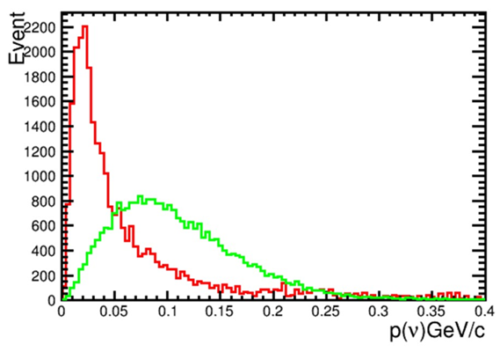
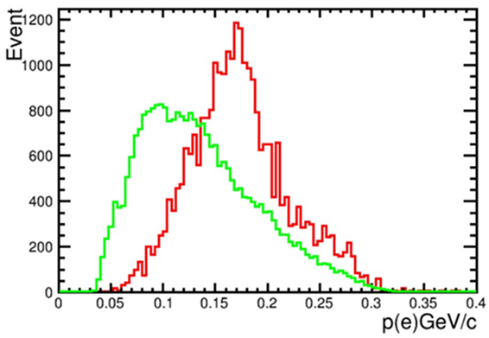
Background analysis
$$Ξ^{−} → Λ e^{−} ν$$
$$Ξ^{−} →Λ π^{−}$$
The momentum cut of neutrino should be higher than 0.05

Slide 8
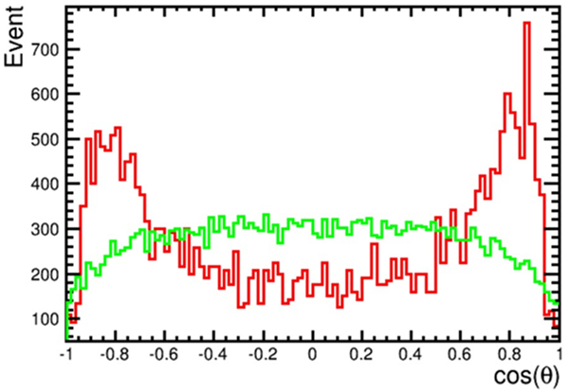
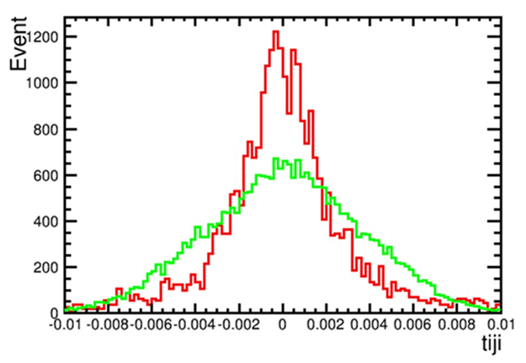
Background analysis
$${\vec{P}}_{π}={\vec{P}}_{beam}−{\vec{P}}_{Λ}$$
Here is the costheta of recoiling pion. We prefer the modulus of costheta is smaller than 0.7
Because $Ξ→Λ e υ$ has 4 particles in this process and $Ξ→Λ π$ only has 3. If we mistake $π$ for electron, this result should be zero as for the background.

Slide 9
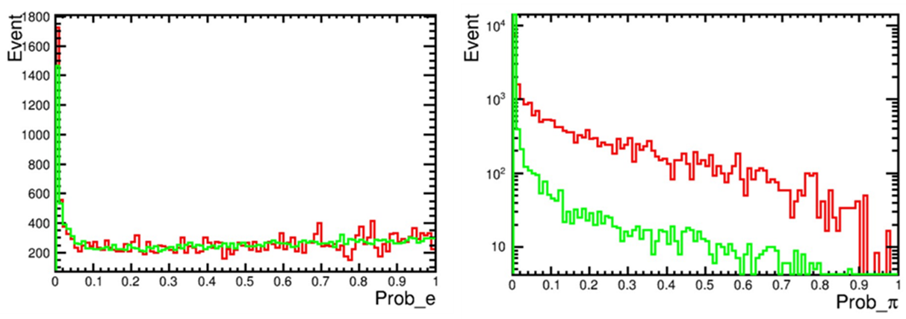
Background analysis
Probability of pion should be smaller than 0.05

Slide 10
Data sample
4.1 billion jpsi data ,
4.1 billion jpsi inclusive mc data
2 million signal mc data.

Slide 11
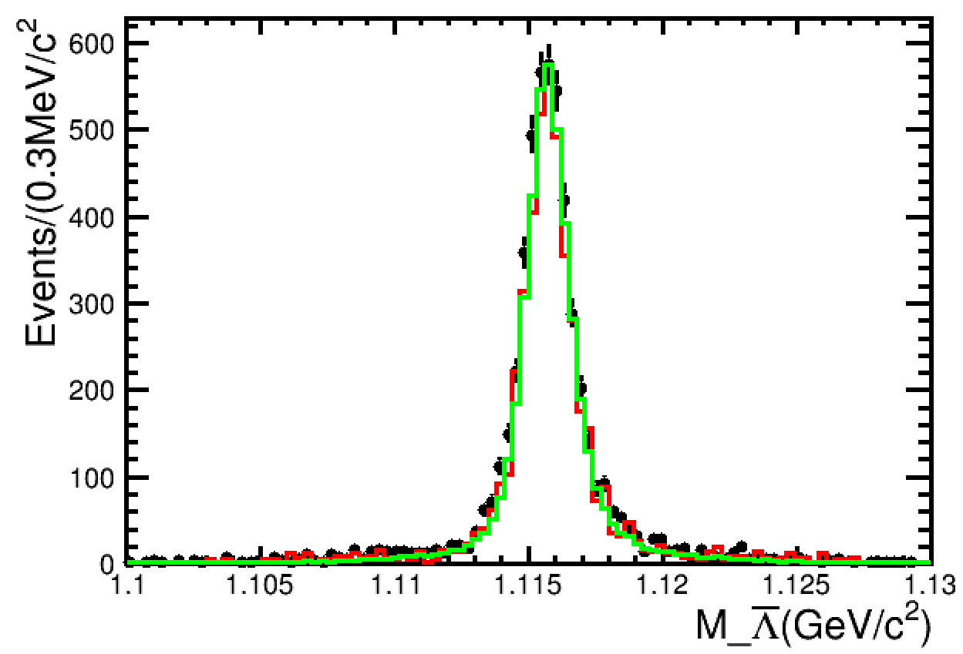
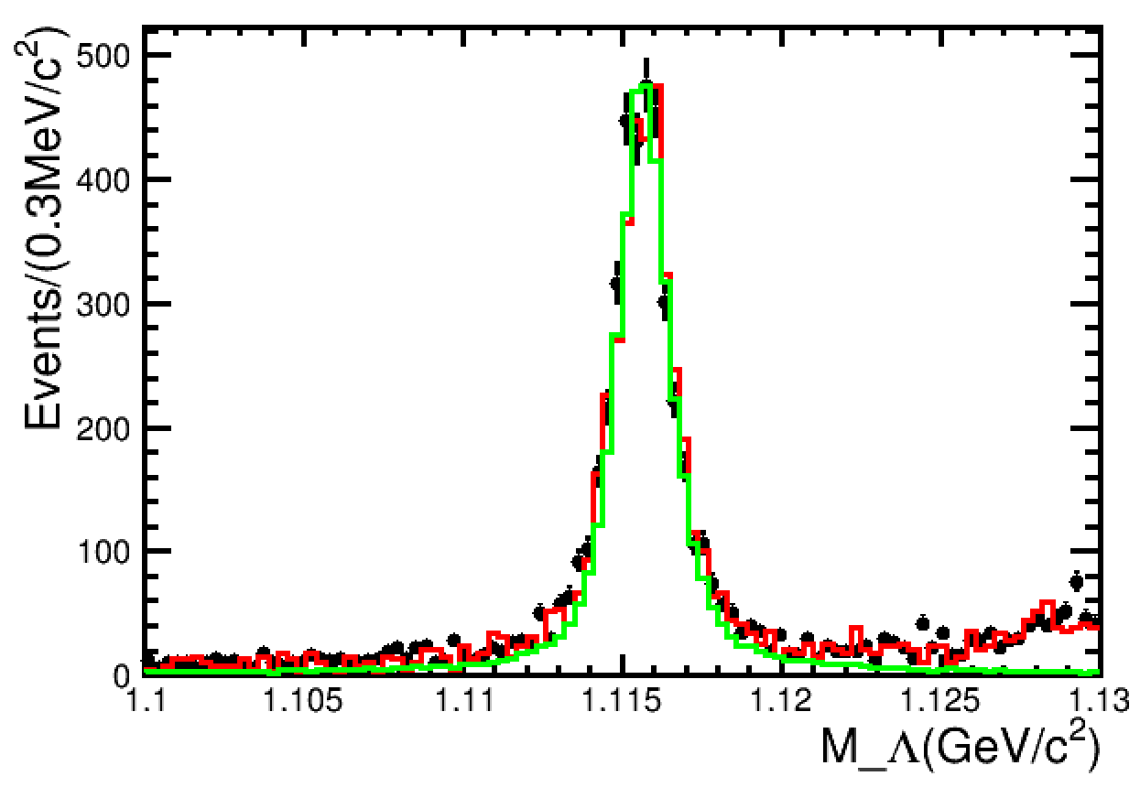
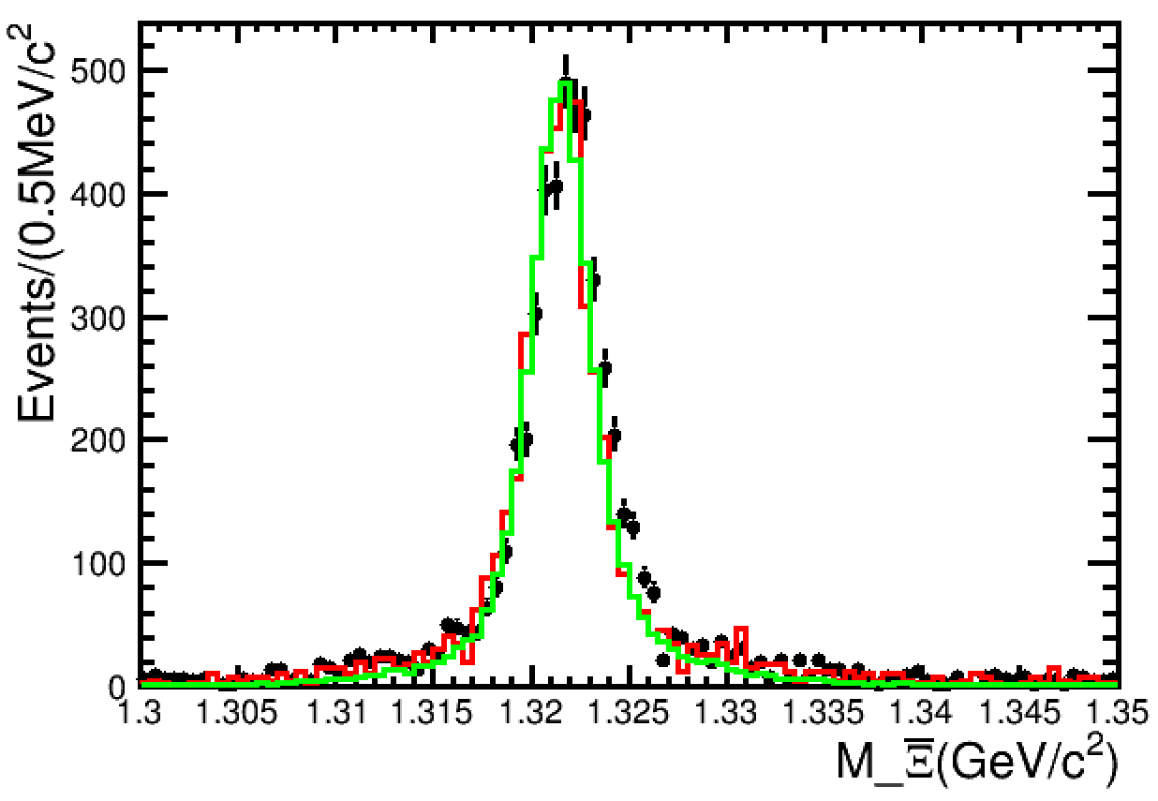
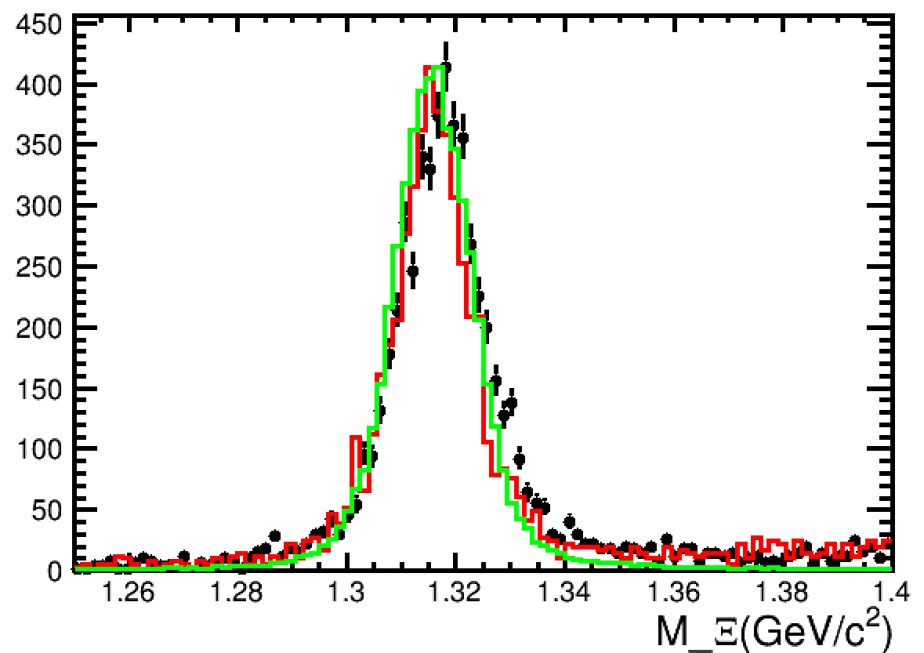
Apply selection to data
Inclusive MC
Jpsi data

Slide 12
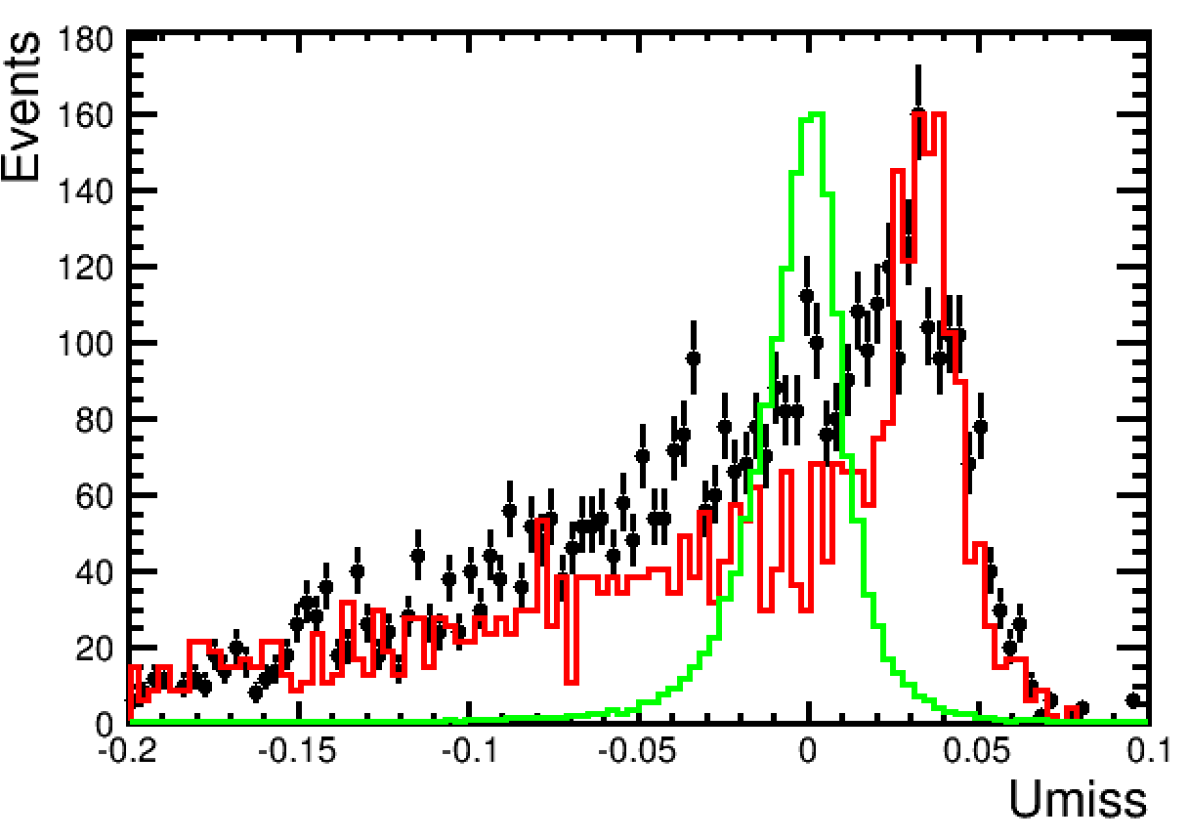
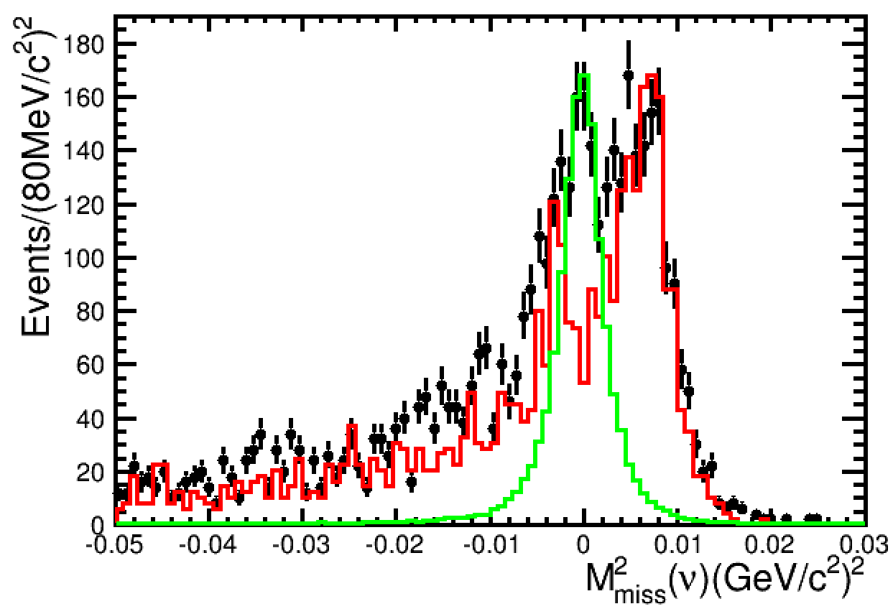
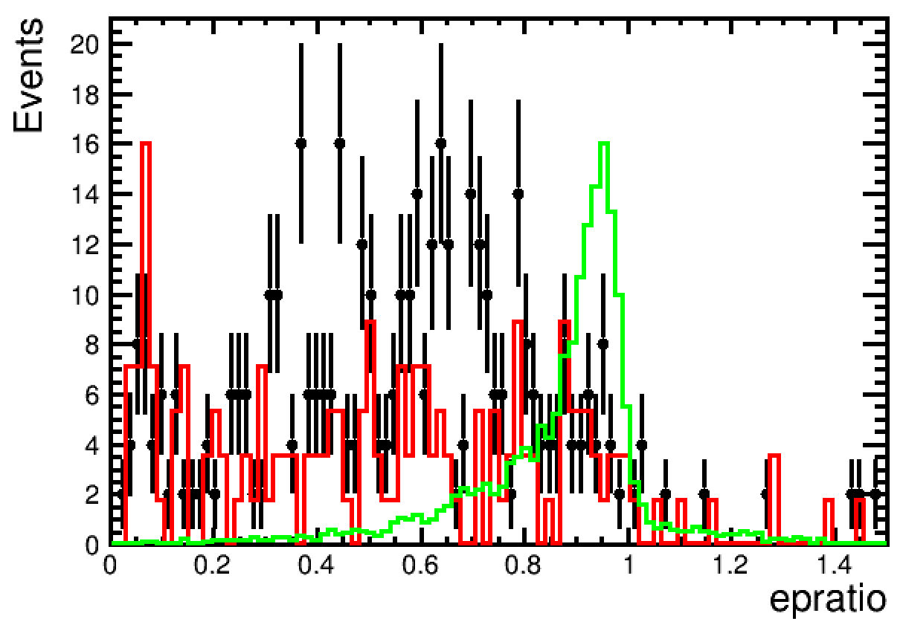
Apply selection to data
$$Umiss=E_{ν}−\left|{\vec{p}}_{ν}\right|$$
$$E_{ν}=E_{beam}−E_{Λ}−E_{e}$$
$${\vec{p}}_{ν}={\vec{p}}_{all}−{\vec{p}}_{\overline{Ξ}}−{\vec{p}}_{Λ}−{\vec{p}}_{e}$$
$${\vec{p}}_{\overline{Ξ}}={\hat{p}}_{tag}\sqrt{E_{beam}^{2}−m_{\overline{Ξ}}^{2}}$$
$$M_{miss}^{2}=E_{ν}^{2}−{\left|{\vec{p}}_{ν}\right|}^{2}$$
$$\frac{E_{electron}}{p_{electron}}$$

Slide 13
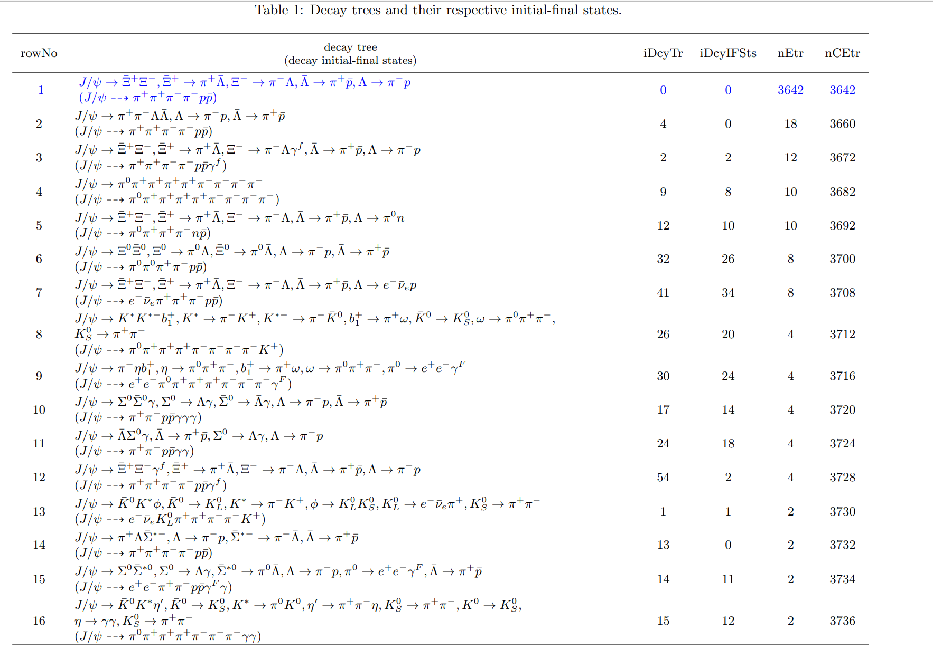
Topology information of inclusive mc data

