Slide 1
Research of Very-Near-Site(VNS) NUCLEUS Experiment
Luxin Zhang
2019.9.26

Slide 2
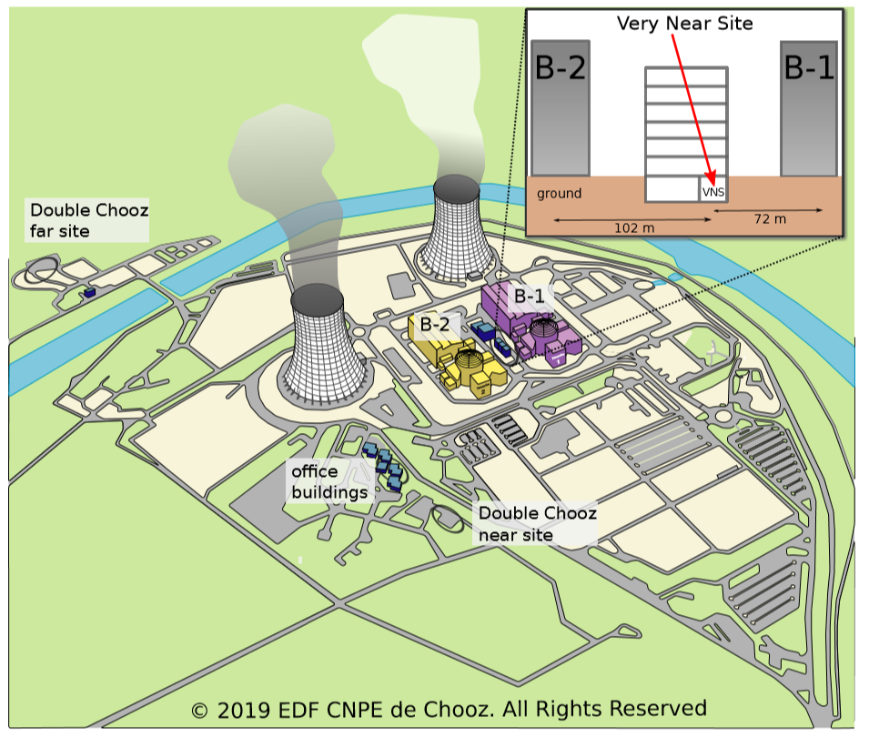
Introduction
Coherent elastic neutrino nucleus scattering (CE$ν$NS);
VNS: located between the two 4.25GWth reactor cores ;
Neutrino flux: total $8×{10}^{20}/s$
at VNS $1×{10}^{12}/(s·cm^{2})$
Neutrino mean energy 1.5MeV(for IBD,
at least 1.8MeV)

Slide 3
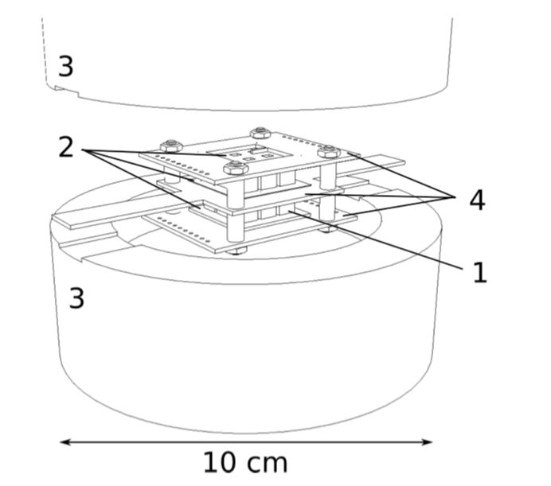
The NUCLEUS Experiment
1. NUCLEUS-10g: a 3*3 array of $CaWO_{4}$ (6g) and a 3*3 array of $Al_{2}O_{3}$ (4g);
2. Si-wafers read out by TESs which enable a 4π low-threshold inner veto;
3. outer veto to reject neutron and -ray backgrounds;
BASKET detector: gram-size Li2WO4 crystals as target detectors to yield supplementary information on the background at a few tens of eV.
MC simulation show that with the vetos a background suppression of O(${10}^{3}$) can be achieved

Slide 4
The NUCLEUS Experiment
1. the cryostat base temperature of O(10mK);
2. the experimental volume;
3. passive shielding consisting of alternating layers of borated PE(B for neutron capture) and lead.
4. active muon-veto consisting of 5cm thick plastic scintillator plates;
5. the weight support platform.

Slide 5
Source of Background
Classification: external, internal, cosmic-ray induced and reactor-correlated backgrounds;
The external background is dominated by gamma-rays from $α$- and $β$-decaying nuclides present in material surrounding the experiment, and the internal background form the nuclides in the detector target itself;
The remaining muons and neutrons are the main components of cosmic-ray-induced background at shallow overburden;
The reactor-correlated neutron background is negligible.

Slide 6
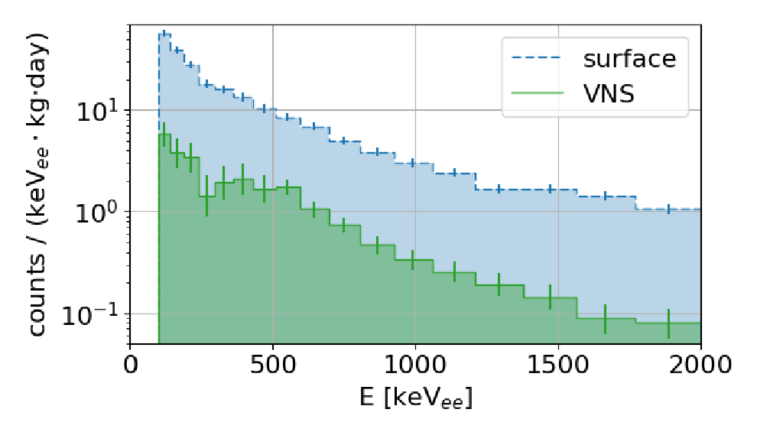
Fast Neutron Flux Reduction
Detector: hexagonal cell ﬁlled with approximately 300g of liquid scintillator read out by PMT
Site: the surface measurements were performed in a hut close to the Double Chooz near site and another part at VNS;
The neutron ﬂux is reduced by a
factor of 8.1±0.4 .

Slide 7
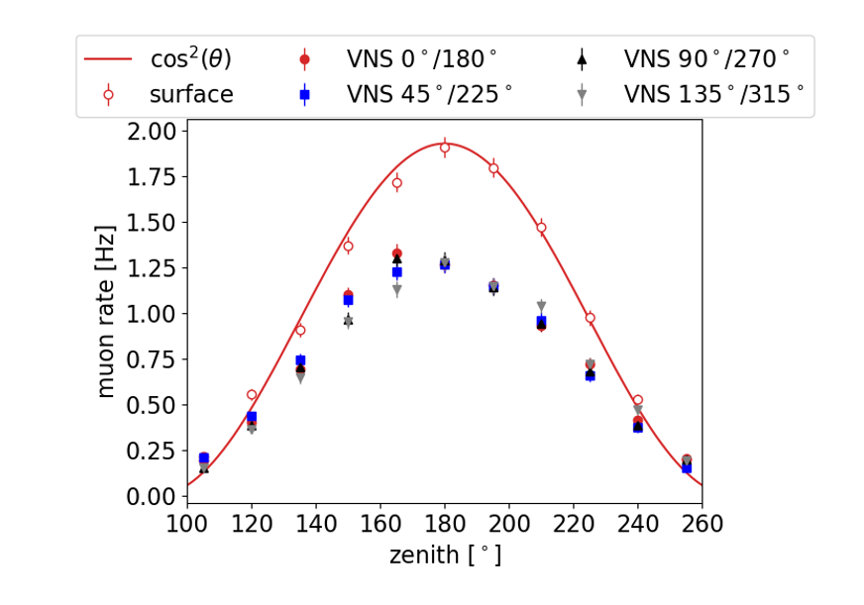
Muon Flux Attenuation
Cosmic wheel: three (26*14) $cm^{2}$ plastic scintillator plates separated by 10cm, read out by PMT;
Give overburden $m_{0}$ in m.w.e(meters of water equivalent) with the following relation:
where d=1+ $m_{0}$/10;

Slide 8
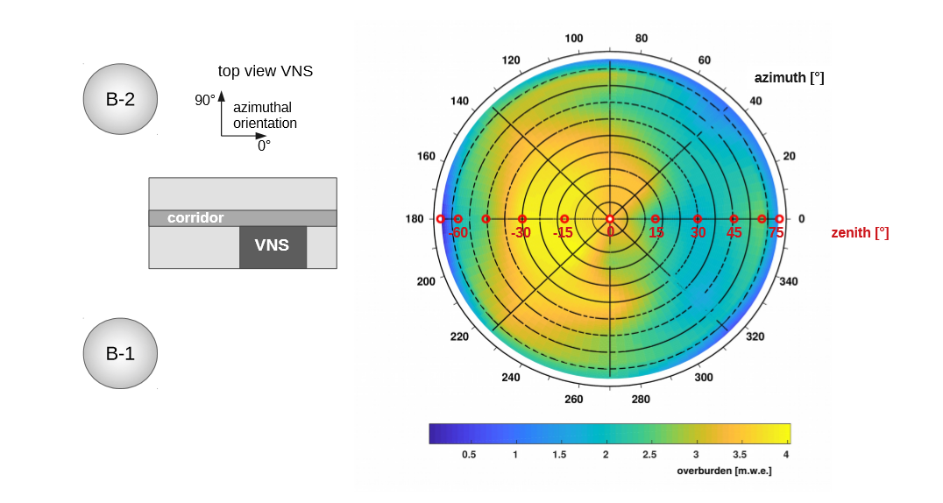
Muon Flux Attenuation
The measured muon rates are integrated over the zenith angle to give the averaged attenuation factor
corresponding to $m_{0}$=$\left(2.9±0.1\right) m.w.e.$

Slide 9
Muon Induced Dead Time
Muons between 4.5MeV and 450GeV in logarithmic binning were simulated. The results were weighted according to the ﬂux within the given energy range with respect to the total ﬂux;
The trigger rate of the muon-veto is calculated by
An upper limit on the muon trigger rate of (487±38)Hz (for muon veto edge length 1m);
Dead time: a cubic-shaped muon-veto of 1m side length, is about 2%(rise time 100$μs$) .

Slide 10
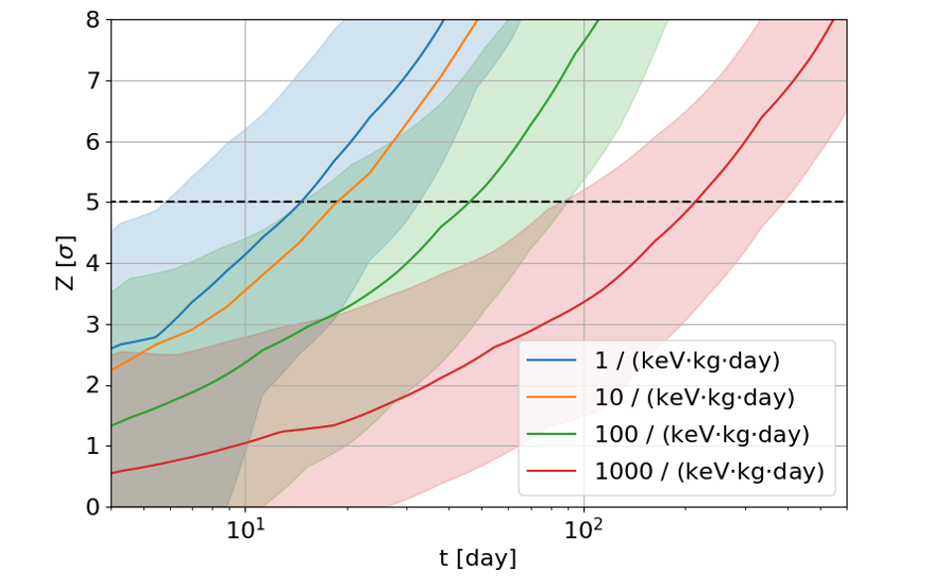
Sensitivity to CE$ν$NS
Signal rate: NUCLEUS-10g, 0.33(0.03);
A ﬂat-background plus CE$ν$NS signal strength model (“free model”) and a ﬂat-background-only model (“null model”);
For a benchmark background rate of
100 counts/(keV·kg·day), anobservation
can be achieved in less than 40 days of
measurement time.

Slide 11
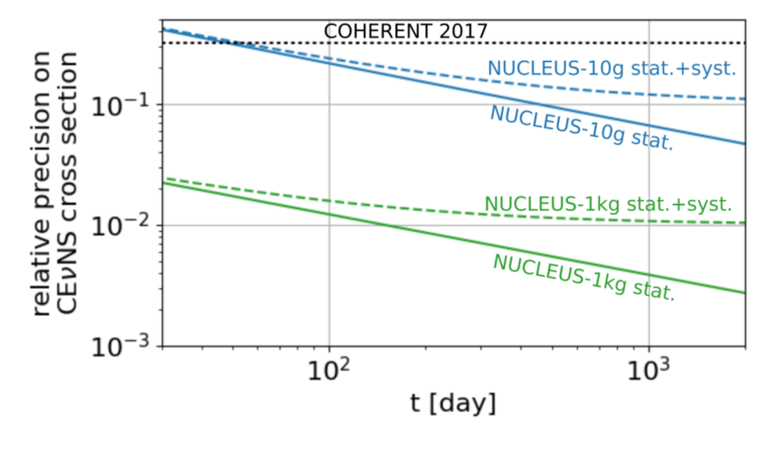
Sensitivity to CE$ν$NS
At energies above the IBD threshold(38 eV in nuclear recoil energy), the reactor antineutrino spectrum is modeled with an uncertainty of 2-3%;
NUCLEUS-10g with a ﬂat background of 100 counts/(keV·kg·day) and an energy threshold of 10 eV, the statistical precision after one year is 11%;
NUCLEUS-1kg with an assumed improved background index of 1 counts/(keV·kg·day) and an energy threshold of 4 eV the achievable statistical precision with one year of data is 0.64%;

Slide 12
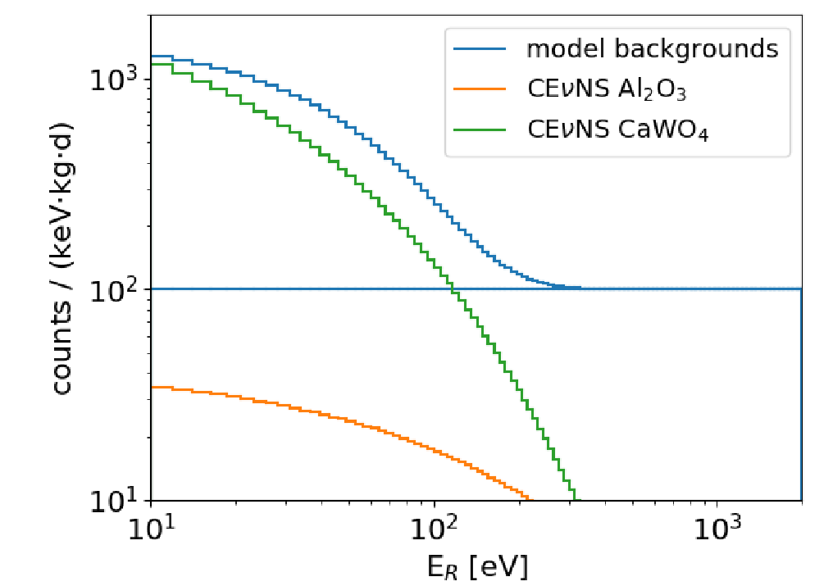
Non-ﬂat Background
R(E)=C +$Ae^{E/B}$
No sensitivity to the CE$ν$NS cross-section can be derived from CaWO4 alone;
The sensitivity is signiﬁcantly improved even without any prior knowledge of the background shape;

