Slide 1
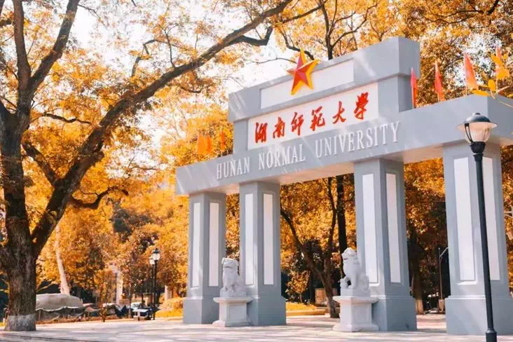
BESIII粲强子物理研讨会
Flavor sum rules
for charmed hadron weak decays
报告人： 王 迪
单 位：湖南师范大学

Slide 2
BESIII粲强子物理研讨会
Contents
1
Motivation
2
SU(3) sum rules
3
Isospin sum rules
4
Conclusion

Slide 3
BESIII粲强子物理研讨会
Contents
1
Motivation
2
SU(3) sum rules
3
Isospin sum rules
4
Conclusion

Slide 4
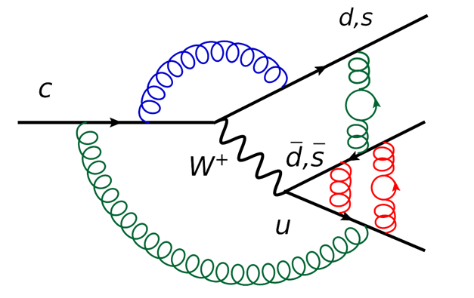
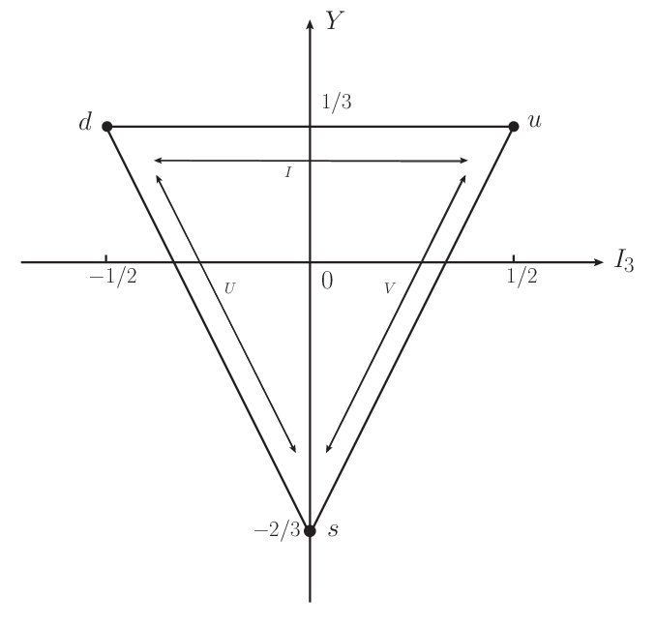
BESIII粲强子物理研讨会
Nonleptonic weak decay of charm hadron
Charm hadron decay
Non-perturbative
Lu:2016ogy, Wang:2017azm, Shi:2017dto, Geng:2017esc, Geng:2017mxn, Wang:2017gxe, He:2018php, Wang:2018utj, He:2018joe, Geng:2018plk, Geng:2018bow, Jia:2019zxi, Geng:2019bfz, Wang:2020gmn, Li:2021rfj, He:2021qnc,…
SU(3) symmetry
4

Slide 5
BESIII粲强子物理研讨会
Decay amplitude
CKM matrix elements
Operators
…
Wigner-Eckart theorem
CG Coefficients
Reduced Matrix Elements
5

Slide 6
BESIII粲强子物理研讨会
SU(3) sum rule
Example
Amplitude decomposition
Other Way ? Isospin, U-spin, V-spin sum rules ?
C. P. Jia, D. Wang and F. S. Yu, Nucl. Phys. B 956, 115048 (2020)
6

Slide 7
BESIII粲强子物理研讨会
Contents
1
Motivation
2
SU(3) sum rules
3
Isospin sum rules
4
Conclusion

Slide 8
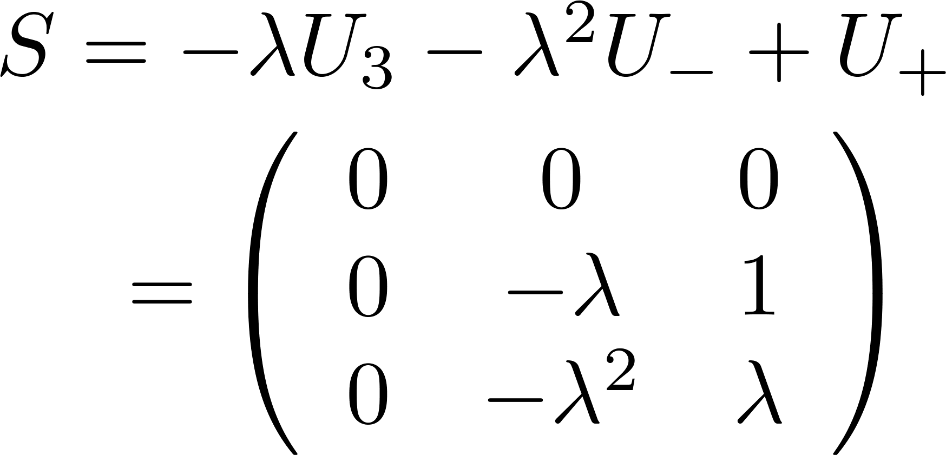
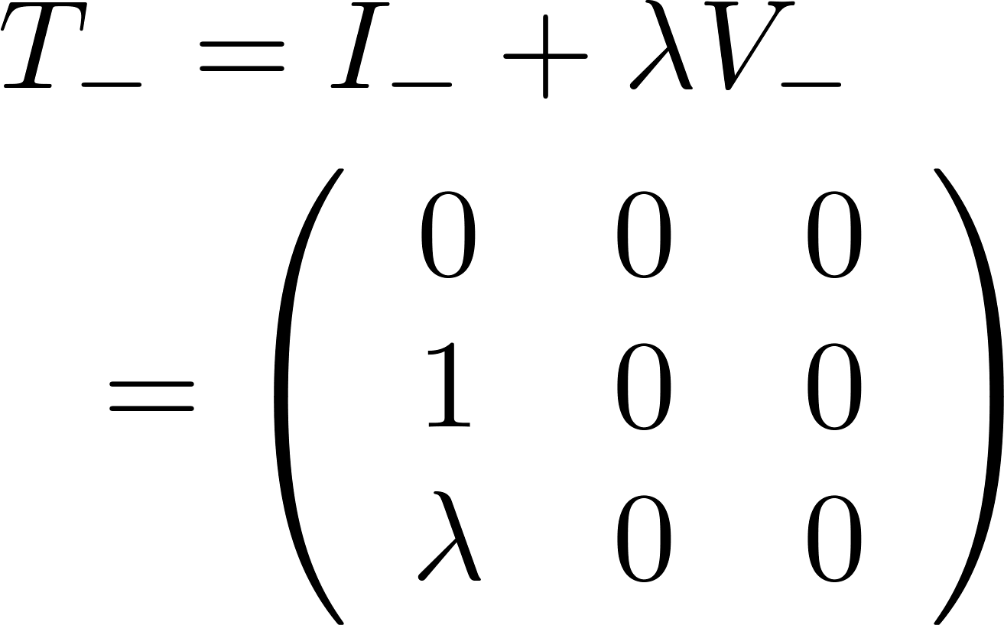
BESIII粲强子物理研讨会
Abstract SU(3) sum rule
If there exists an operator T, under which the Hamiltonian is invariant, TH = 0 . The invariance of Hamiltonian under T is related to the generation of sum rules.
Y. Grossman and D. J. Robinson, JHEP 04, 067 (2013)
8

Slide 9
BESIII粲强子物理研讨会
SU(3) sum rules
To obtain SU(3) sum rules, we apply operator T to the initial/final states and compute coefficients expanded by the initial/final states
Basis:
arXiv:2204.05915 [hep-ph]
9

Slide 10
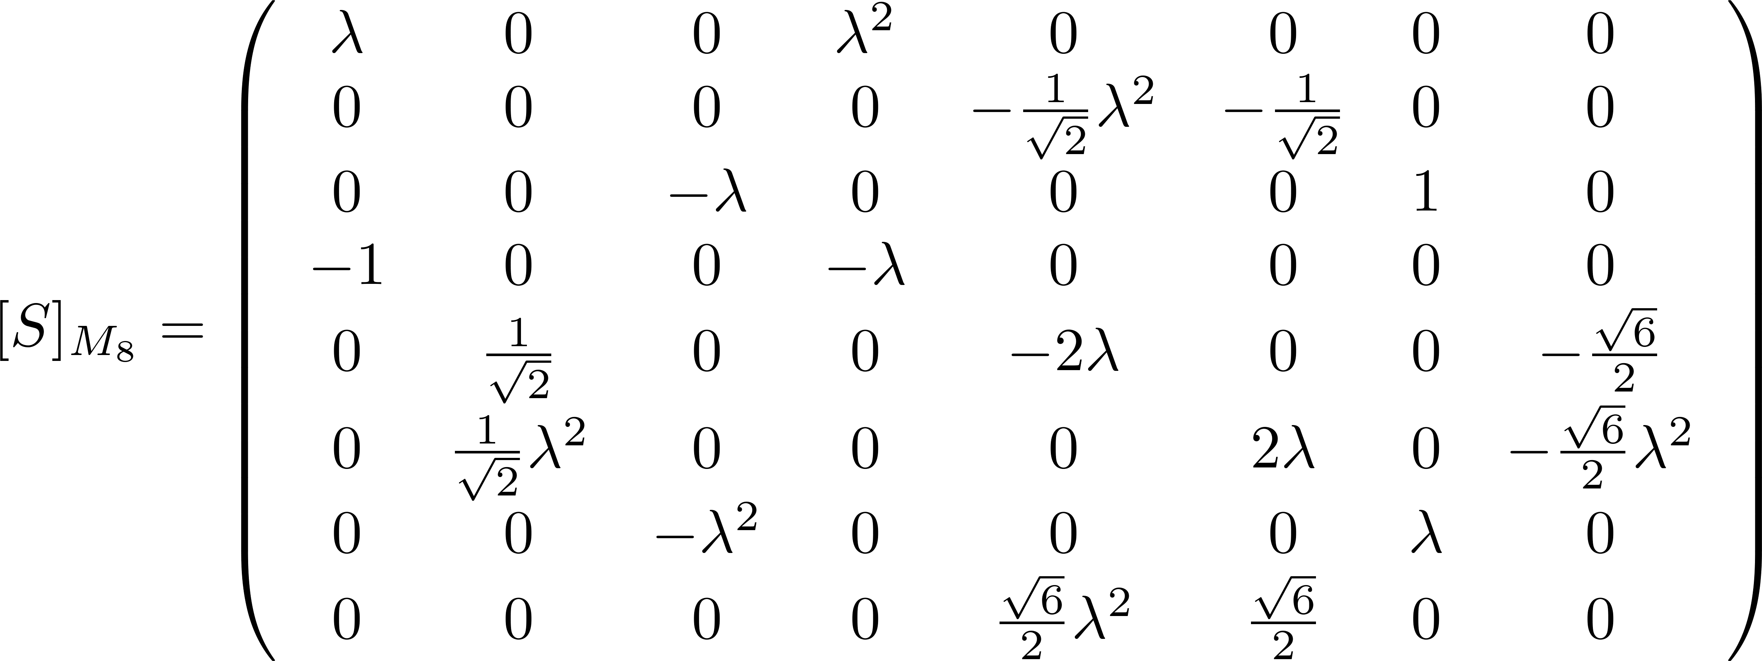
BESIII粲强子物理研讨会
SU(3) sum rules
Basis:
10

Slide 11
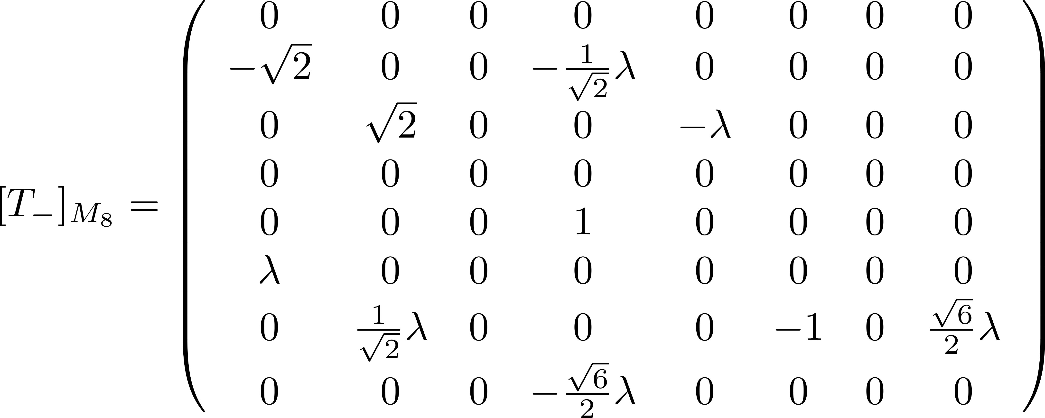
BESIII粲强子物理研讨会
SU(3) sum rules
Master formula:
arXiv:2204.05915 [hep-ph]
11

Slide 12
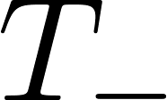
BESIII粲强子物理研讨会
SU(3) sum rules
A SU(3) sum rule is generated if appropriate are selected.
 | Charge |  | Subgroup
arXiv:2204.05915 [hep-ph]
12

Slide 13
BESIII粲强子物理研讨会
Decay into baryon decuplet
Basis:
Master formula:
arXiv:2204.05915 [hep-ph]
13

Slide 14
BESIII粲强子物理研讨会
Doubly charmed baryon decays
arXiv:2204.05915 [hep-ph]
14

Slide 15
BESIII粲强子物理研讨会
Contents
1
Motivation
2
SU(3) sum rules
3
Isospin sum rules
4
Conclusion

Slide 16
BESIII粲强子物理研讨会
Abstract isospin sum rule
Isospin
sum rule ?
No operator T constructed by I₃, I₋, I₊ which T H_{c}=0.
16

Slide 17
BESIII粲强子物理研讨会
Isospin sum rule
Apply I₋ to the initial/final states
The isospin sum rules are generated by I- acting on initial/final states once and twice.
17

Slide 18
BESIII粲强子物理研讨会
Isospin sum rules
CF mode
SCS/DCS mode
Other decay modes:
18

Slide 19
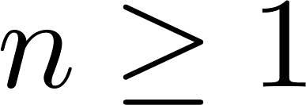
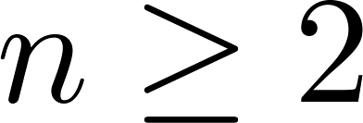
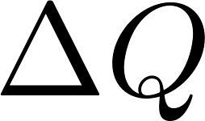
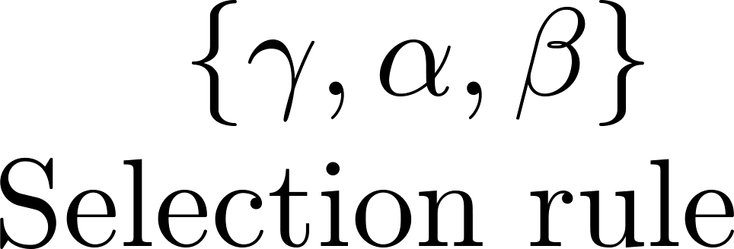
BESIII粲强子物理研讨会
Isospin sum rule
Mode | CF | SCS | DCS
arXiv:2301.06104 [hep-ph]
19

Slide 20
BESIII粲强子物理研讨会
V-spin and U-spin sum rules
Mode | CF | SCS | DCS
arXiv:2301.06104 [hep-ph]
20

Slide 21
BESIII粲强子物理研讨会
b-hadron decays
Mode
Other decay modes
Multi-body decays
Semi-leptonic decays
SU(3) breaking
…
21

Slide 22
BESIII粲强子物理研讨会
Contents
1
Motivation
2
SU(3) sum rules
3
Isospin sum rules
4
Conclusion

Slide 23
BESIII粲强子物理研讨会
Conclusion
We propose a systematic method to compute SU(3), isospin, V-spin and U-spin sum rules for the charmed hadron weak decays without the Wigner-Eckart invariants.
It could be extended to other decay modes.
Thanks for your attention !
23

