Slide 1
$$D^{0}→K_{S}^{0} ω$$
Haoran Zhang

Slide 2
Boss version :
6.6.4p01
MC sample :
$e^{+}e^{−}→ψ\left(3770\right)→D^{0} \overline{D^{0}} ,74 million+158.36 million,round03+round 04$
Tag mode:
$D^{0}→Kπ$; $D^{0}→Kππ^{0}$ ; $D^{0}→Kπππ$
Signal :
$D^{0}→K_{S}^{0} ω$

Slide 3
ST Event selection
Good neutral track selection
Definition of Barrel: | $cosθ$|<0.8
Definition of EndCap: 0.86<|$cosθ$|<0.92
Barrel: E>25MeV
Endcap: E>50MeV
ToF:0<T<14 (50ns)
The opening angle between a candidate shower and the closest charged track should be no less than ${10}^{∘}$
Good charged track selection
|Vr| < 1 cm
|Vz| < 10 cm
$\cos{θ<0.93}$
PID
Use SimplePID
$$for π :prob\left(π\right)>0.00 ;prob\left(π\right)>prob\left(K\right)$$
$$for K :prob\left(K\right)>0.00 ;prob\left(K\right)>prob(π)$$
$π^{0} selection$
$χ_{}^{2}$<200
The mass of $π^{0}$: $0.115<M_{γγ}<0.150 MeV$

Slide 4
Event selection
(tag :$D^{0}→Kπ$)
$D^{0}reconstruction$
$D^{0}$ reconstructed by the $Kπ$tracks after pid
no vertex fit.
$$D^{0}\text{selection}$$
$$ΔE=E_{D} −\frac{\sqrt{s}}{2};\left|ΔE\right|<0.2$$
$$M_{BC}=\sqrt{\left({\left(\frac{\sqrt{s}}{2}\right)}^{2}/c^{4} −p_{D}^{2}/c^{2}\right)} ;{1.83<M}_{BC}$$
(tag :$D^{0}→Kππ^{0}$)
$D^{0}reconstruction$
$D^{0}$ reconstructed by the $Kπ$tracks after pid and two $γ$ track from $π^{0}$
no vertex fit.
(tag :$D^{0}→K3π$)
veto $K_{S}^{0}→π^{+}π^{−}$
$$\left|m_{π^{+}π^{−}}−m_{K_{S}^{0}}\right|≥0.03$$
$D^{0}reconstruction$
$D^{0}$ reconstructed by the $Kπππ$tracks after pid
no vertex fit.

Slide 5
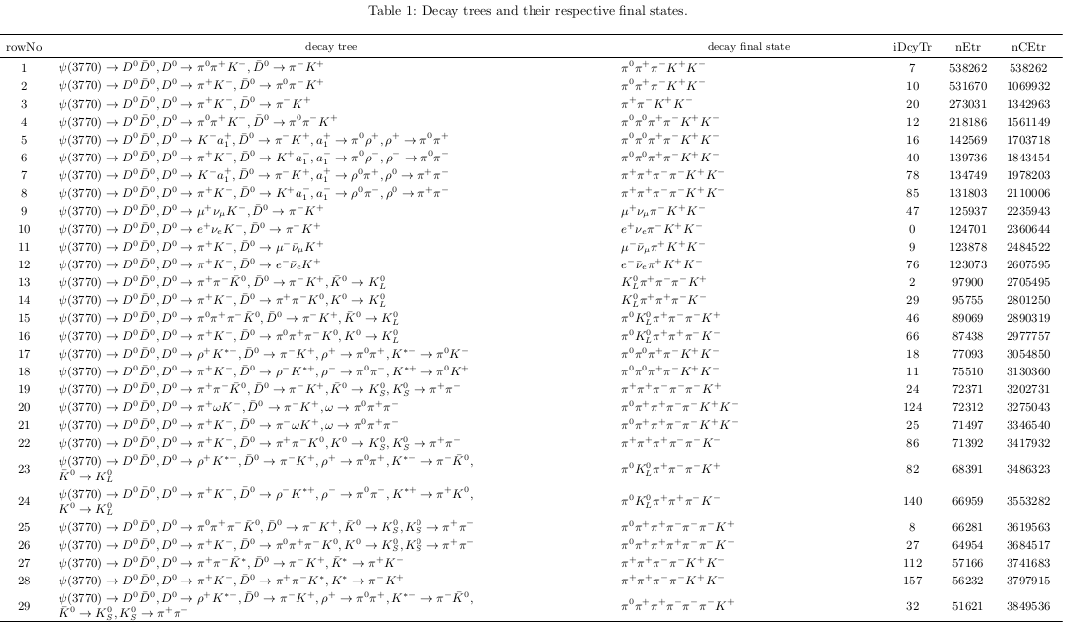
tag : $D^{0}→Kπ$

Slide 6
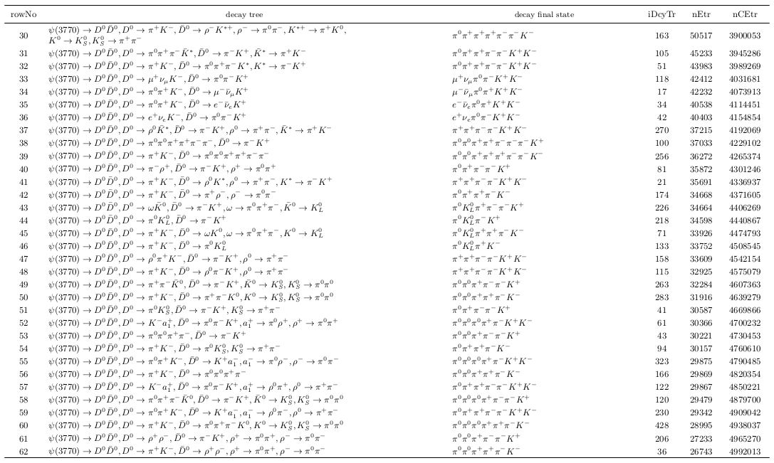
tag : $D^{0}→Kπ$

Slide 7
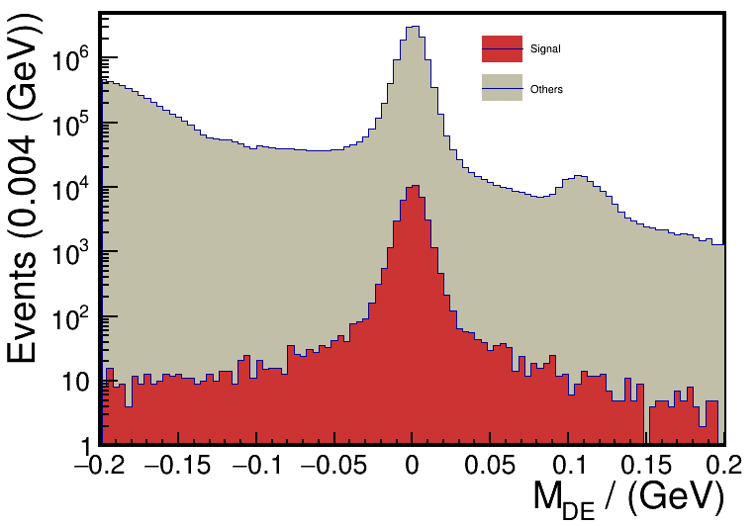
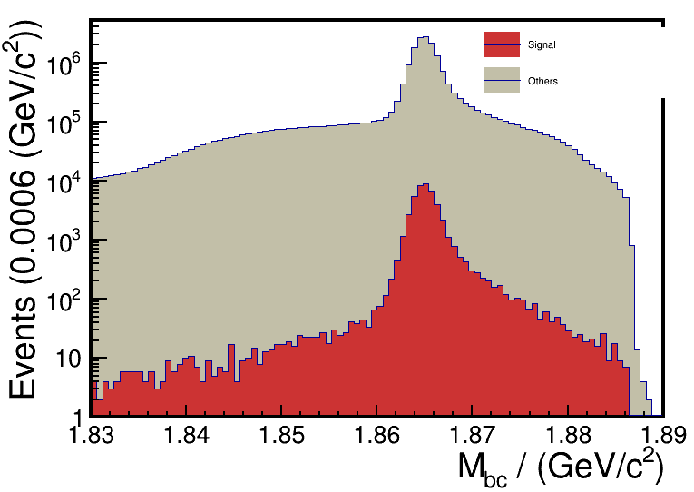
tag : $D^{0}→Kπ$

Slide 8
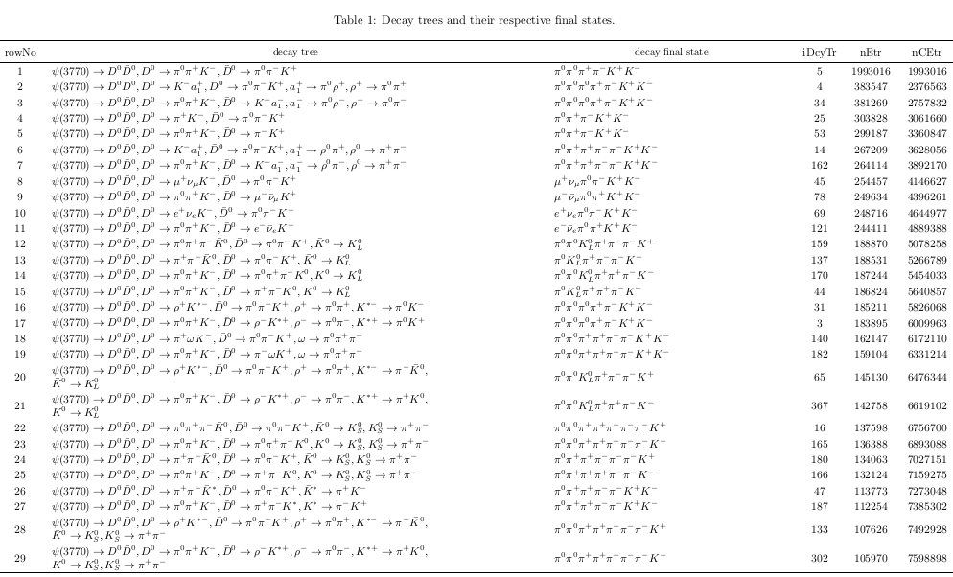
tag : $D^{0}→Kππ^{0}$

Slide 9
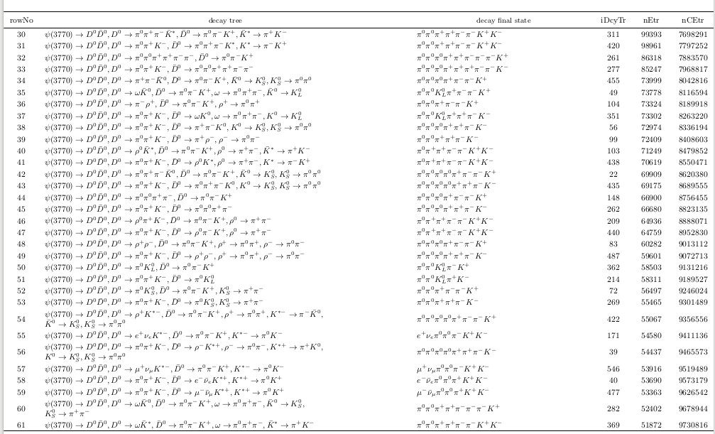

Slide 10
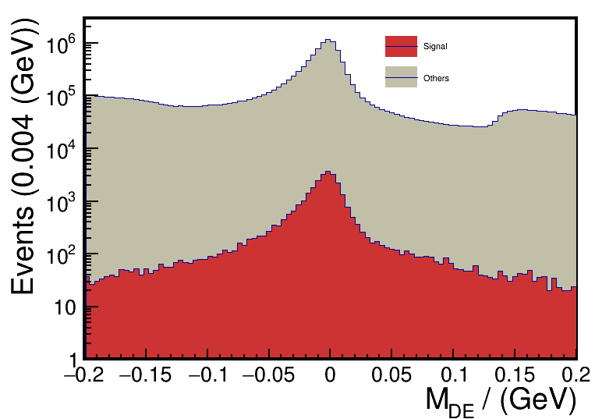
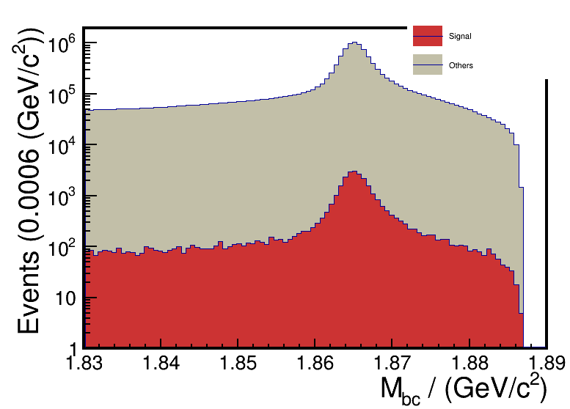

Slide 11
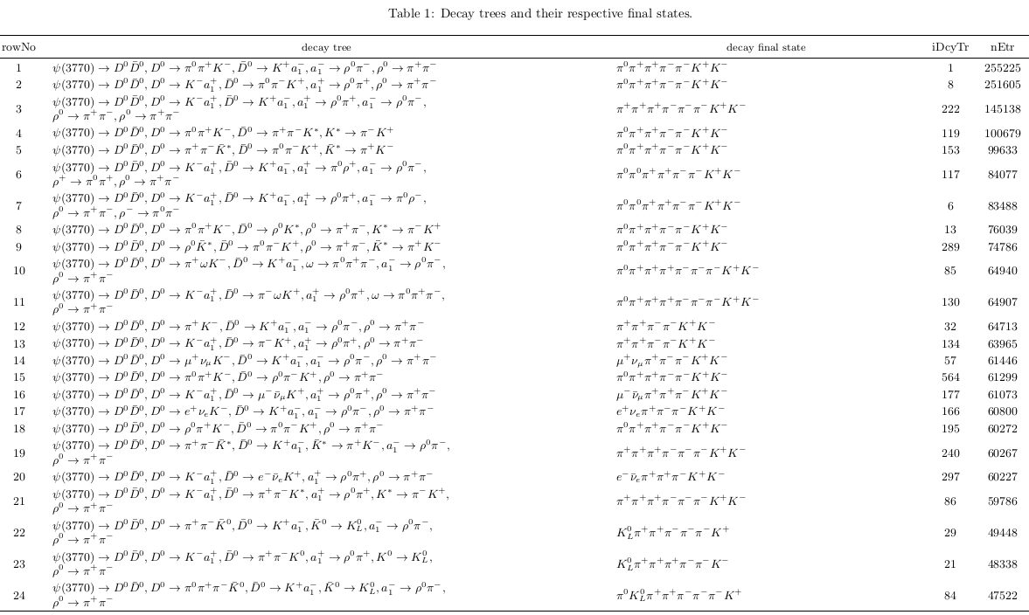
tag : $D^{0}→K3π$

Slide 12
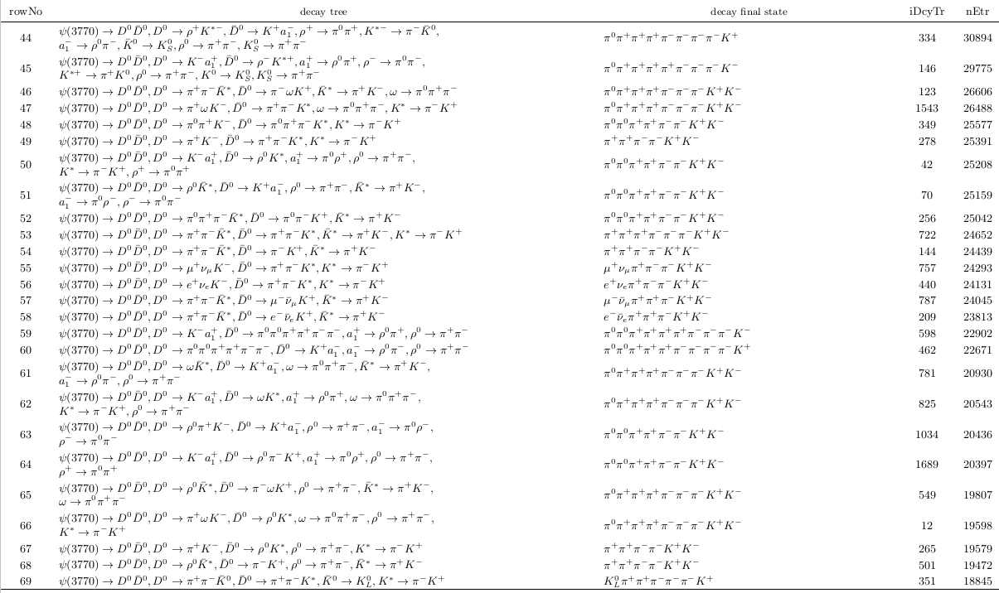
tag :
$D^{0}→K3π$

Slide 13
