Slide 1
Composite NOL-CsI scintillator

Slide 2
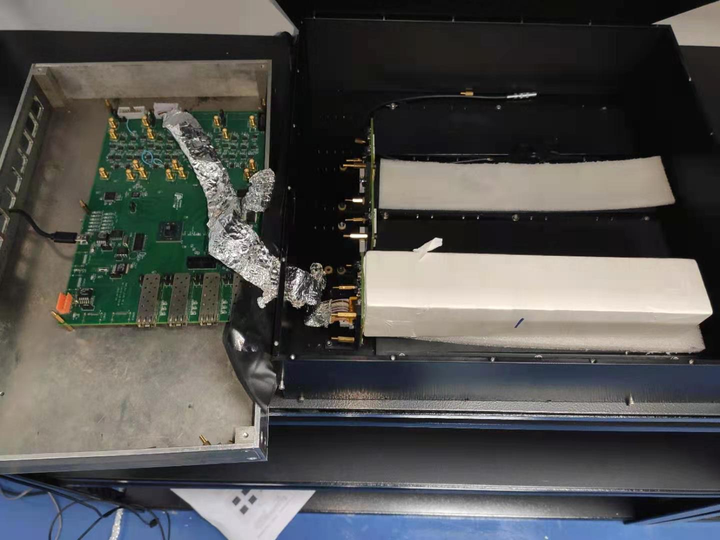
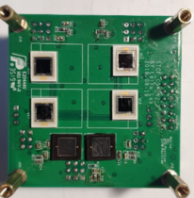
Recent upgrades on electronics
CSA + Optional (RC)2 shaping
Modified bandwidth to reduce the decay time of the trailing edge
后前端板
前端板+APD
晶体

Slide 3
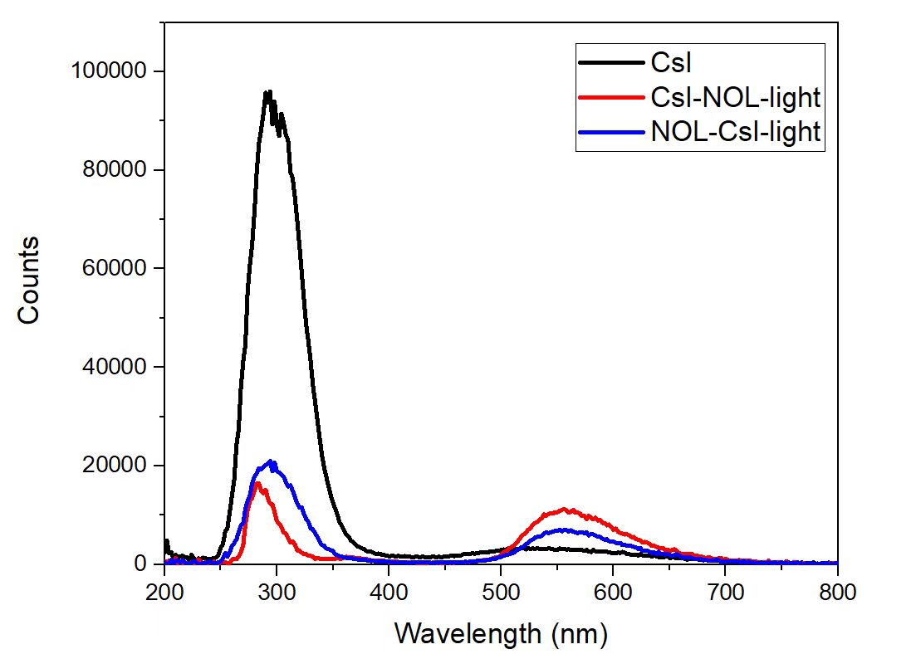
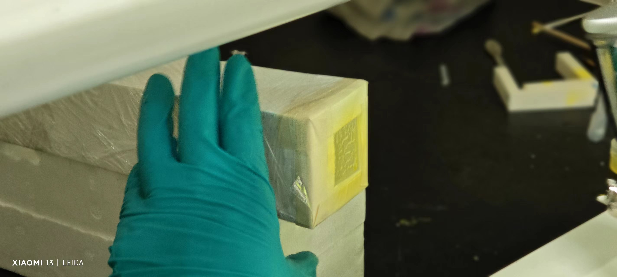
Small crystal tests – XEL test
Apply NOL on the crystal with spray gun
Significant transformation effect of the NOL

Slide 4
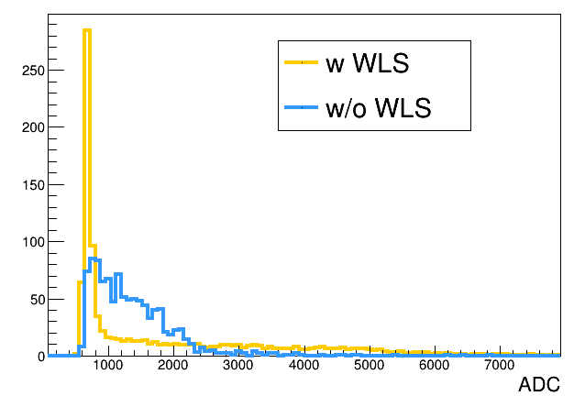
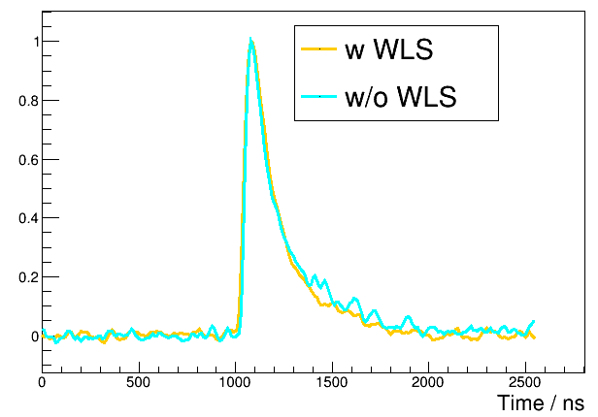
Small crystal tests – Cosmic ray test
Very limited energy deposition due to the small size
L. Y. enhancement effect needs further investigation (with VIS sensitive PMT)
Reasonable trailing edge (No obvious slow component)

Slide 5
Large crystal tests
Firstly demonstrated at USTC for system feasibility validation
Apply NOL on the crystal at SIC (5g per crystal)
Experiment schemes:
1. Bare CsI + Teflon
2. CsI + NOL (face 1) + Teflon
3. CsI + NOL (face 1,2,3) + Teflon
4. CsI + NOL (face 2,3) + Teflon
2
1
3

Slide 6
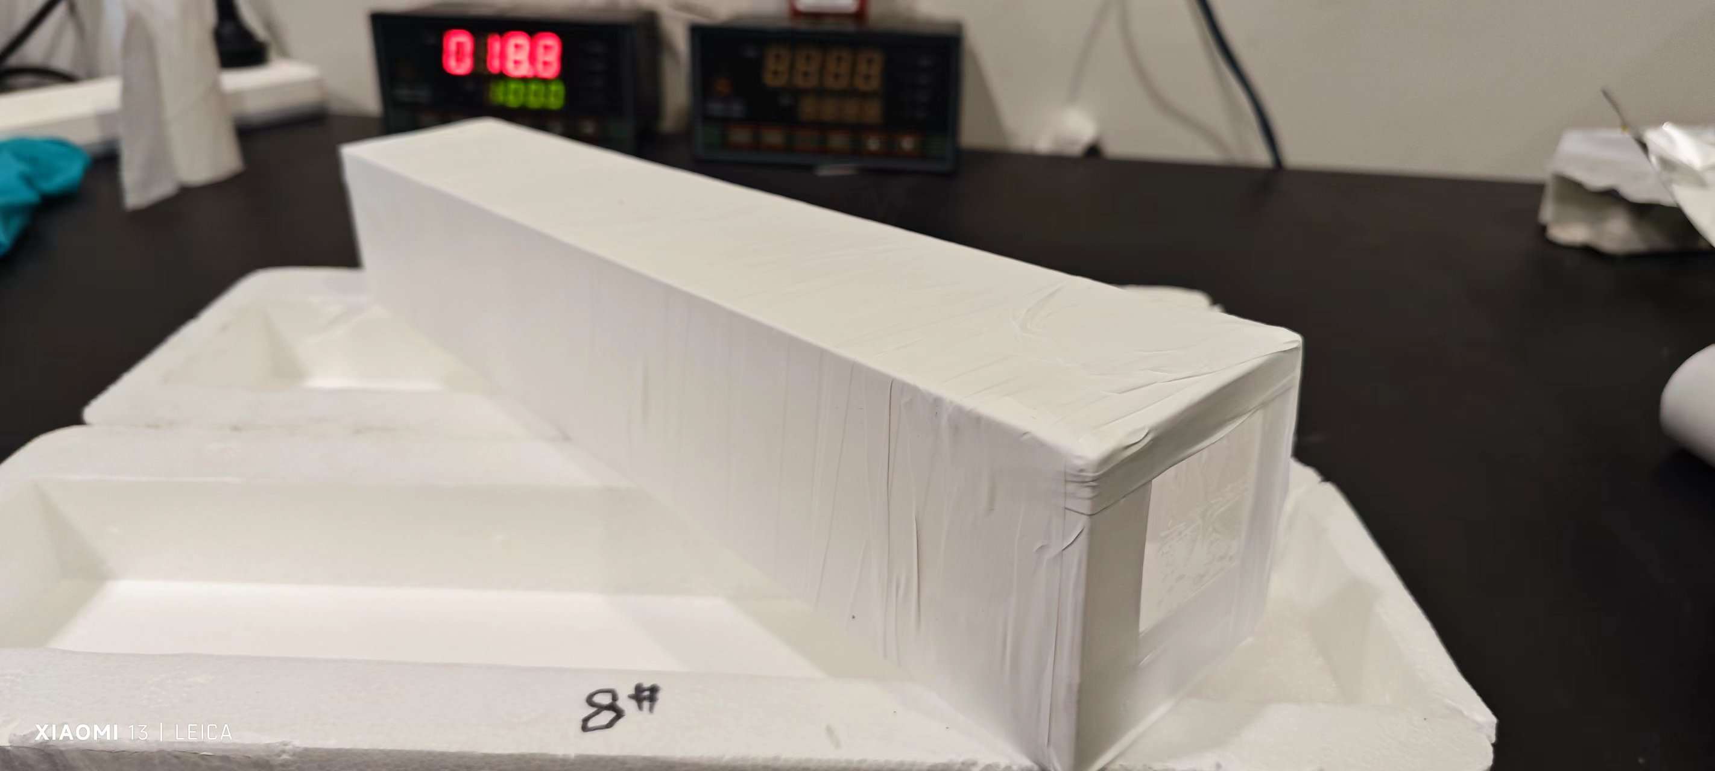
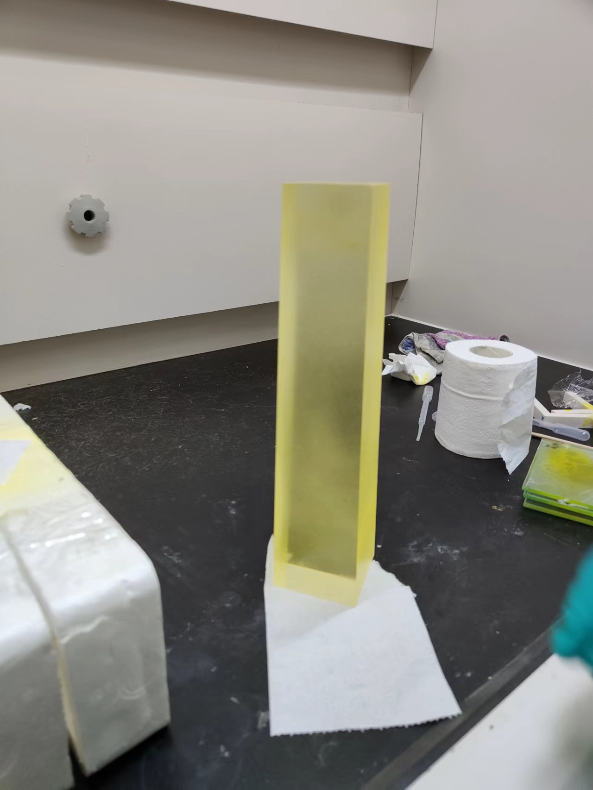
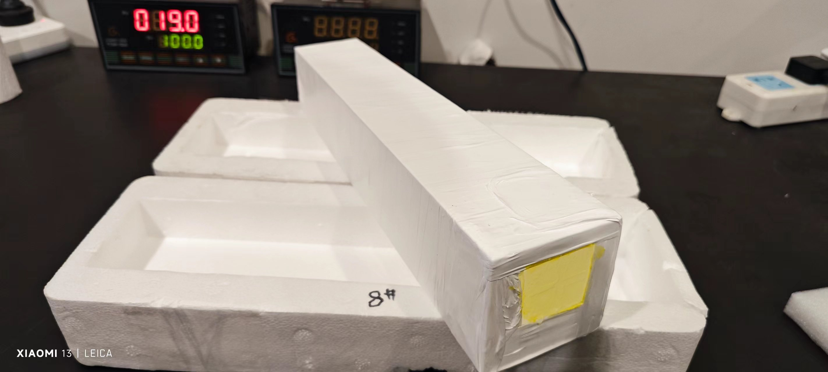
Large crystal tests
Hard to control and monitor the film thickness (Need automation device)
The current film thickness on the crystal seems thinner than 50 um (the thickness achieved by the mayer bar)
Comparison with last years’ experiment at USTC:
Much larger crystal size
Much thinner film thickness

Slide 7
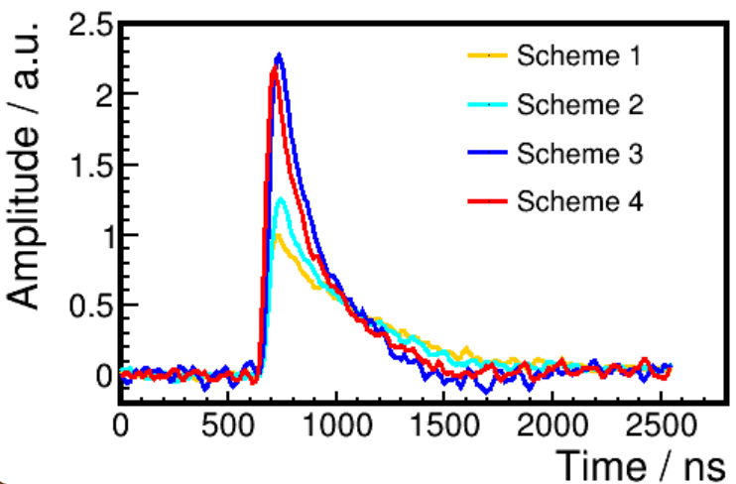
Large crystal tests
Significant slow component in large crystal – contributes large to the CR-(RC)2 L.Y.
Consistent results with 10.1016/j.nima.2023.168173 (CSA L.Y.)
Reduced Delta L.Y. after applying NOL. No significant slow component in the waveform of Scheme 3,4
Contribution from slow component reduced?
Scheme | CSA L.Y. | Ratio | CR-(RC)2 L.Y. | Ratio | Delta L.Y.
1 | 117 |  | 174.1 |  | 57.1
2 | 146.69 | 1.25 | 220.13 | 1.26 | 54.5
3 | 266.36 | 2.28 | 294.0 | 1.69 | 28.3
4 | 255.7 | 2.18 | 287.1 | 1.65 | 31.4

Slide 8
Large crystal tests
Laser test on 20.12.30
Excite the pure CsI under its intrinsic excitation wavelength and around its emission wavelength
297 nm laser induces strong slow component at vis wavelength
Setup | τ1 (ns) | A1 (ns*V) | τ2 (ns) | A2 (ns*V) | τ3 (ns) | A3 (ns*V)
ug | 8.2 | 12.2 | 25.7 | 2.2 | --- | ---
gg420 | 5.1 | 6.5 | 26.9 | 60.7 | 496.5 | 8.9
uggg | 8.1 | 0.2 | 19.2 | 0.03 | --- | ---
241 nm
Combined ratio of each component
Decay time (ns) | 6 | 30 | 500
Ratio (%) | 19.6 | 70.4 | 10.0
Setup | τ1 (ns) | A1 (ns*V) | τ2 (ns) | A2 (ns*V) | τ3 (ns) | A3 (ns*V)
ug | 6.0 | 227.5 | --- | --- | 404.9 | 3.8
gg420 | 5.1 | 10.8 | 153.6 | 56.3 | 531.1 | 438.8
uggg | 5.7 | 0.23 | 45.0 | 0.03 | --- | ---
297 nm

Slide 9
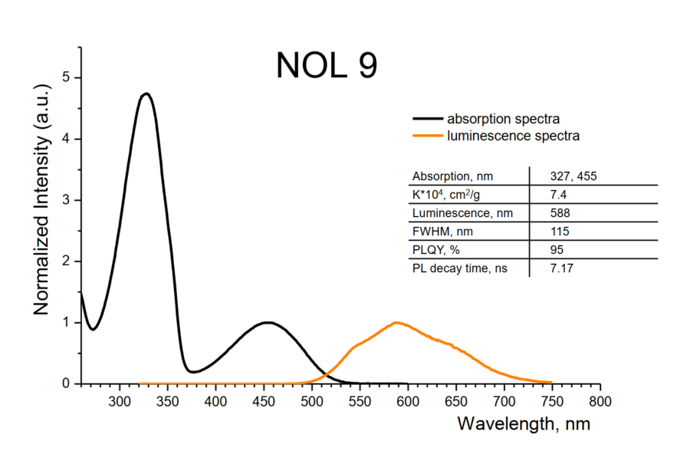
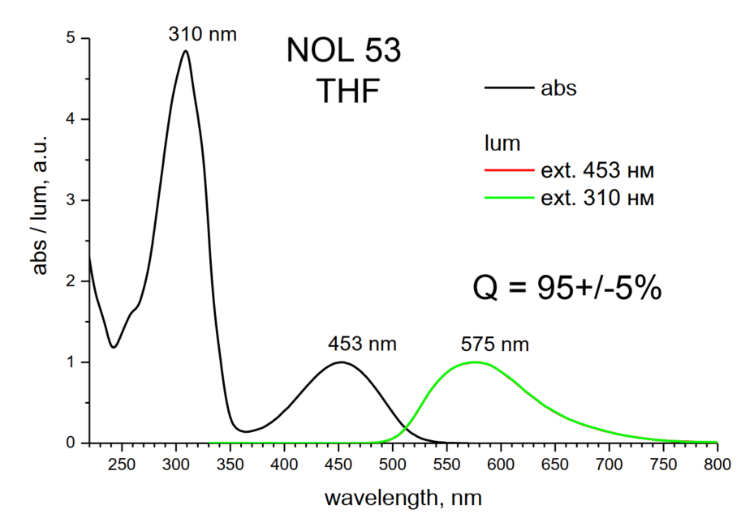
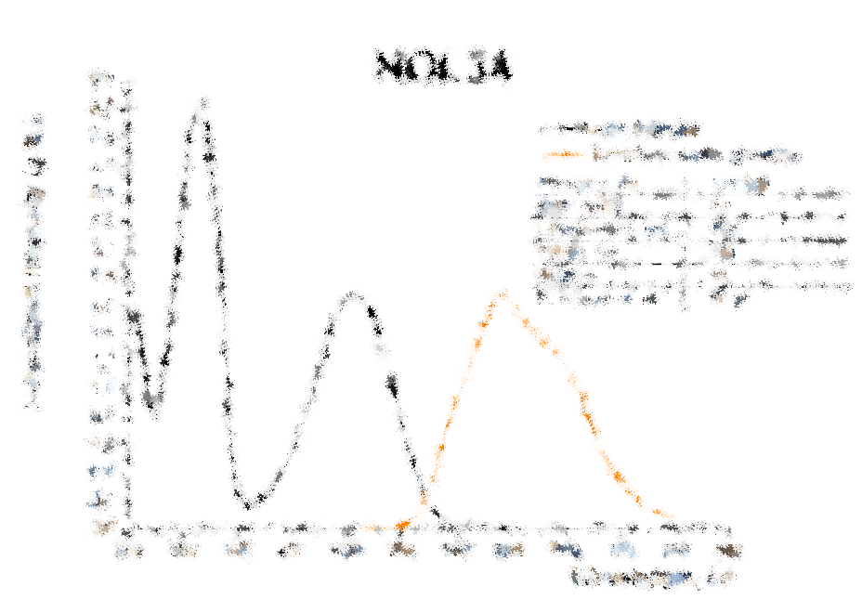
NOL 9
NOL 34
NOL 53

Slide 10
Large crystal tests
Only face 3 painted
1. CsI + NOL9 + Teflon
2. CsI + NOL34 + Teflon
3. CsI + NOL53 + Teflon
4. CsI + NOL53 + NOL53 + Teflon
Plan:
New paining scheme
Light collection uniformity & timing resolution
Scheme | CSA L.Y.
1 | 232.2
2 | 244.87
3 | 273.64
4 | 302.90
2
1
3

