Slide 1
Question Raised in $τ$QCD Meeting Weekly Report
Date: 2019-05-22

Slide 2
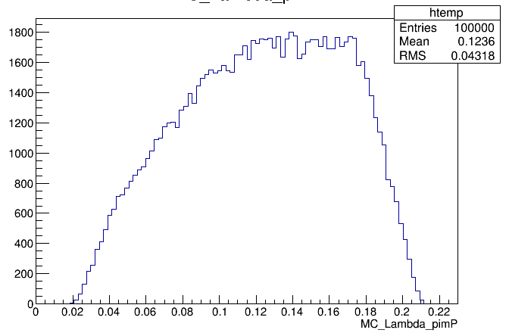
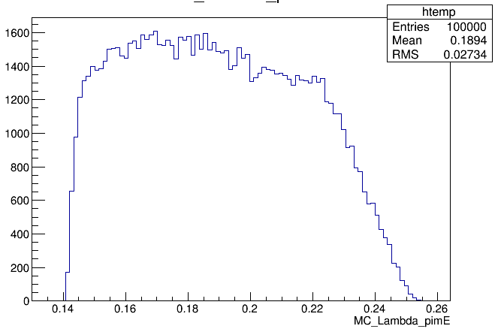
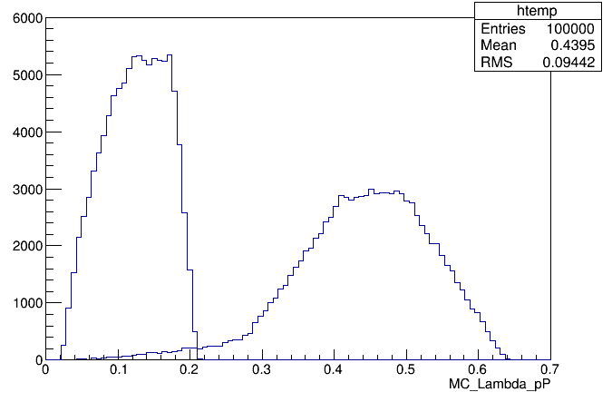
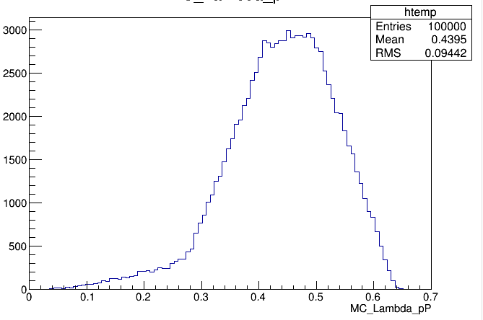
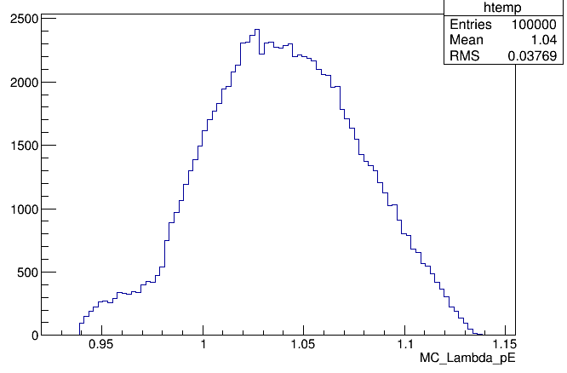
MC_Truth Distribution for Pim
Momentum Distribution
Proton/Pion MC truth momentum distribution
Due to ISR effect
MC_Truth Distribution for Proton
Momentum of Protons>250MeV
Momentum of Pions <200MeV
Suggestion: Select the Pion and Proton without PID due to low momentum.

Slide 3
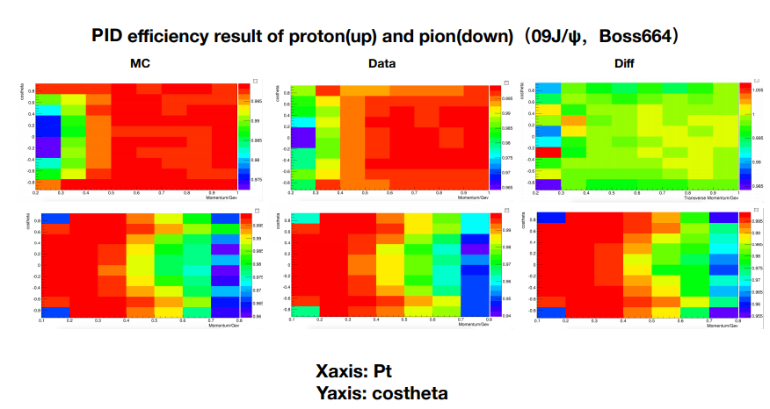
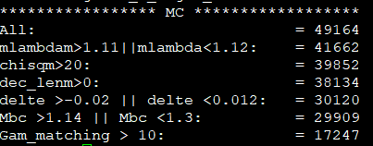
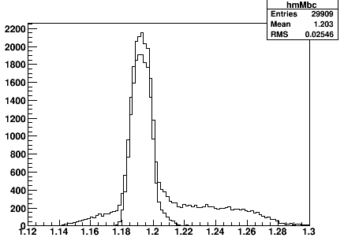
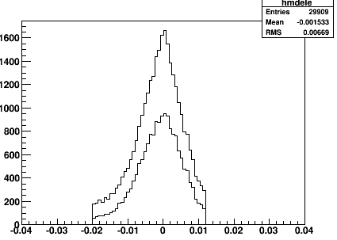
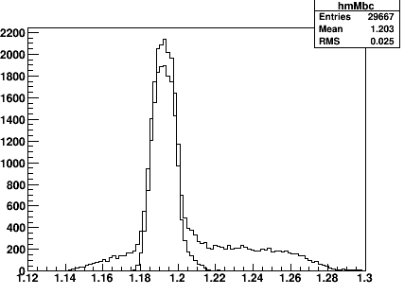
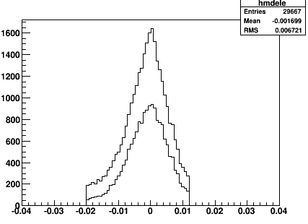
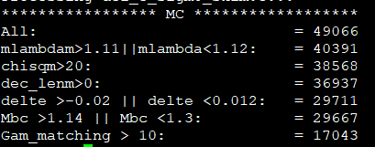
Without Pid
Comparison b/w PID to without PID
With Pid
https://indico.ihep.ac.cn/event/8271/contribution/0/material/slides/0.pdf
Remarks1: From the above picture, you can see that at lower momentum proton have almost 99% percent PID efficiency, while pion to be 96%.
Remarks2: you can also see that efficiency with PID slightly larger than selection based on without PID. Without PID some of the efficiency lose due to ISR effect.
P_(proton)>250MeV
P_(pion) <200MeV

Slide 4
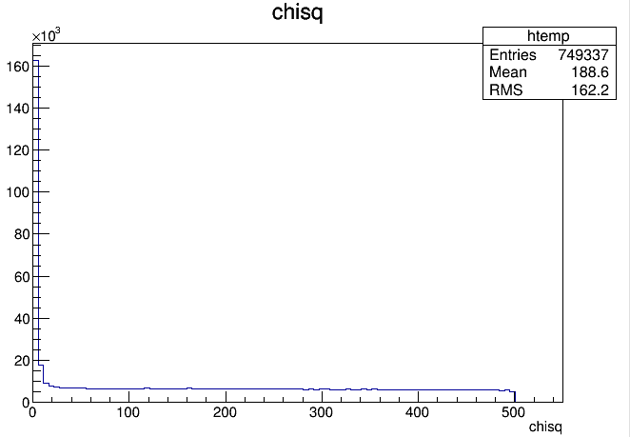
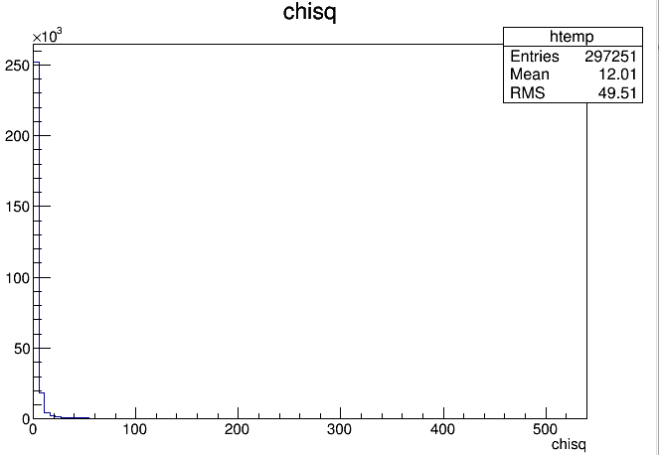
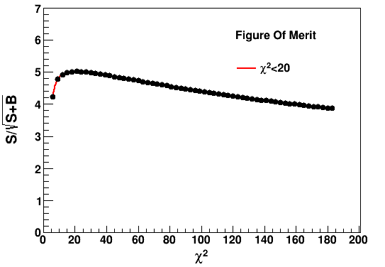
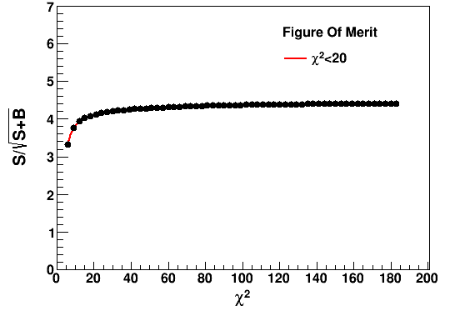
Chisq FOM
Sigma0
Anti-Sigma0
REMARKS: For the chisq optimization, there is no maximum value have seen in anti-sigam0. This indicate that there is no background in the Data. You can see from chisq distribution of anti-sigma0. No tail has been seen which mean MC chisq is well described by our data. We can choose freely chisq cut to anywhere. We can conclude that chisq <20 for both sigma0 anti-sigma0 .
Sigma0
Anti-Sigma0

Slide 5
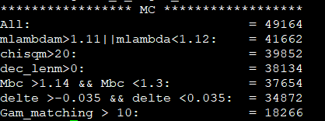
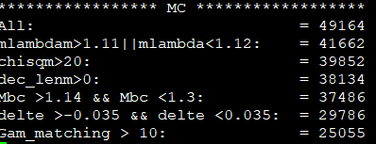
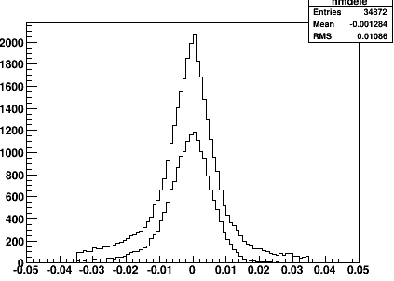
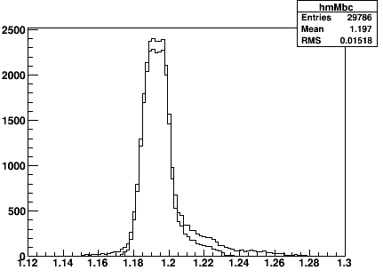
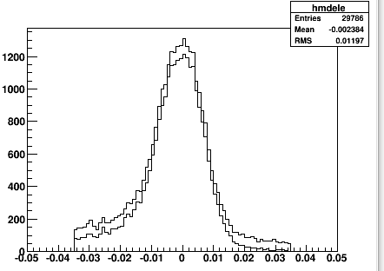
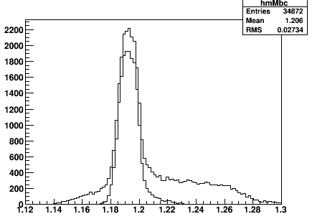
Selection Efficiency Comparison
Photon selection is based on Delta E and after gam_matching efficiency will be 18% for nominal result.
Why this is happened?
Now, we have selected photons on the basis of gam_matching. In this way although some mis-combine photon, but after matching the gam_match, efficiency 25%. It means that photon is selected by delta E is not reliable.
Now our plan to test our strategy. In one neutral shower, we have multiple entries of photons. By applying the restrict cut on Delta E, check the Mbc distribution. Also compare the efficiency result with nominal result. In this way may be we can maximize the efficiency up to 10%.
Alpha = 0.104 if GE = GM
Photon selected by gam_matching

Slide 6
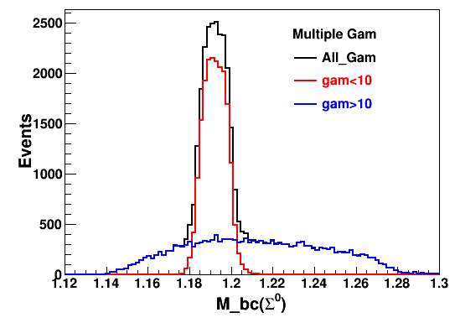
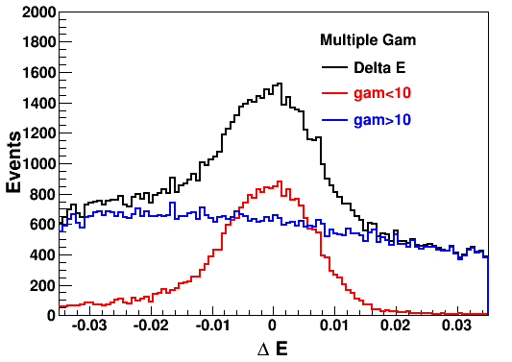
Mbc and Delta E Distribution for Multiple gamma
Problem:
Firstly, background picture even in MC is too bad, so as data the bkg also too much high.
Secondly, by applying a Delta E cut, the efficiency is not increasing too much, due to poorly reconstructed gamma and leakage energy in EMC which almost reduce 22% our efficiency after matching. This applies our method of delta E is solid. We can ignore this test but add in appendix of the memo.

Slide 7
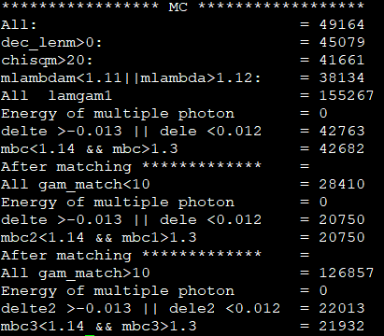
Rate of Cut flow for Multiple Entries

Slide 8
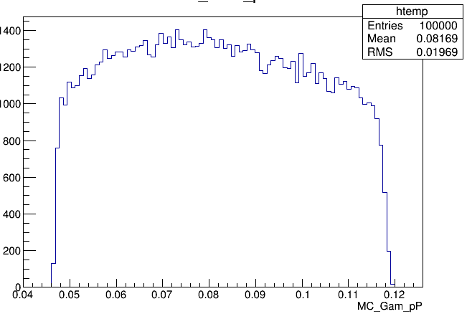
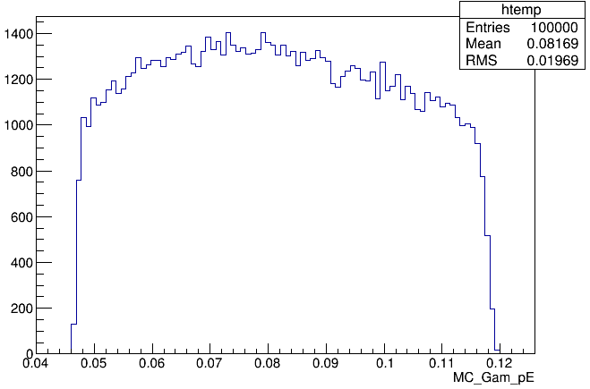
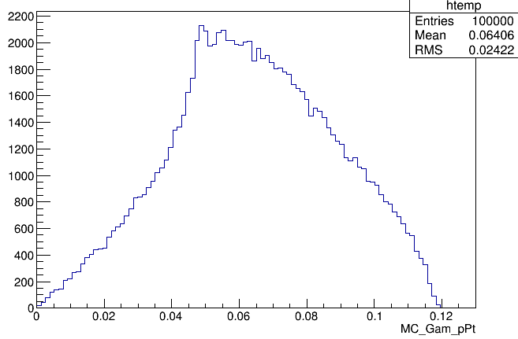
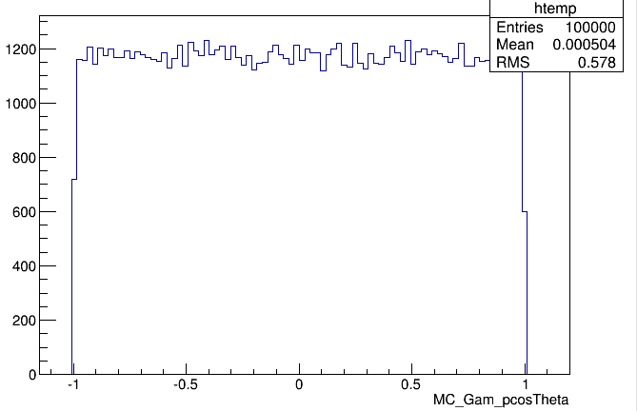
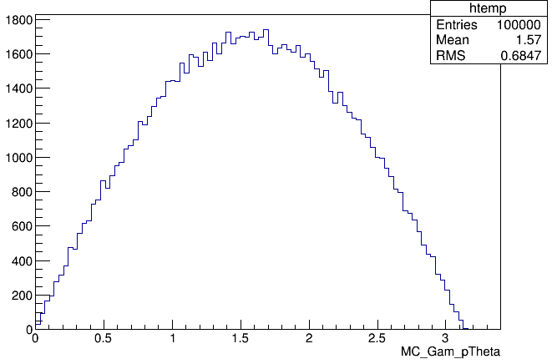
MC_Truth Distribution for Photon
For avoid the mis-combination, in the for loop, we required that Energy of the photon to be E_photon > 40MeV. Since we have already applied E_barrel to be >25 MeV. There is some Energy leakage between to 25 to 40 MeV. Now we decided that we have to remove this cut to avoid this loss.

