Slide 1
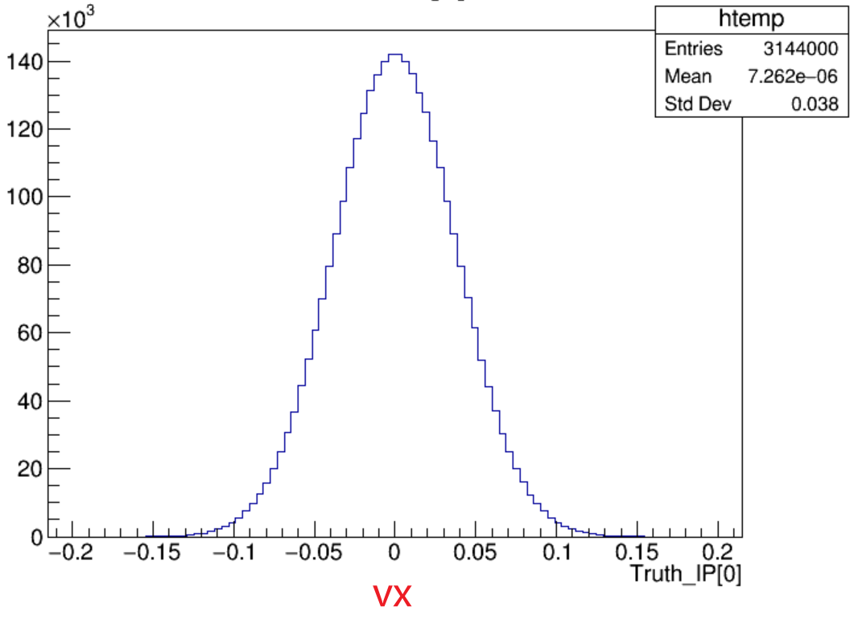
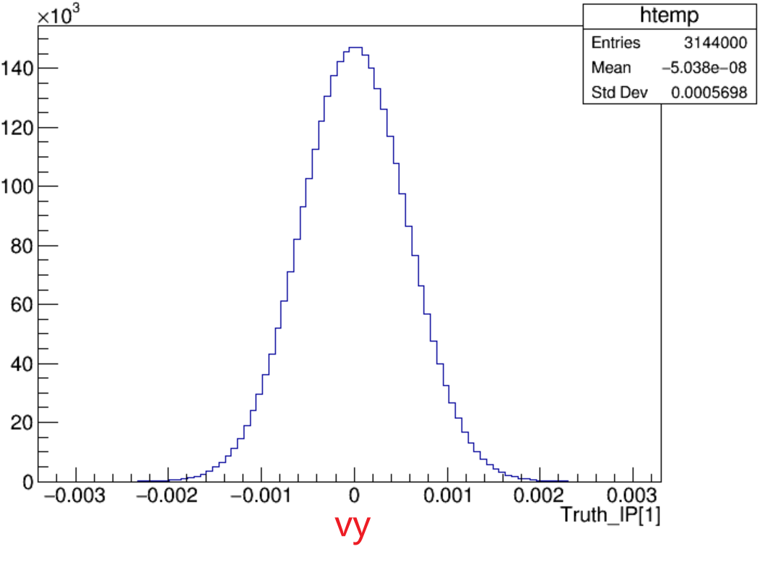
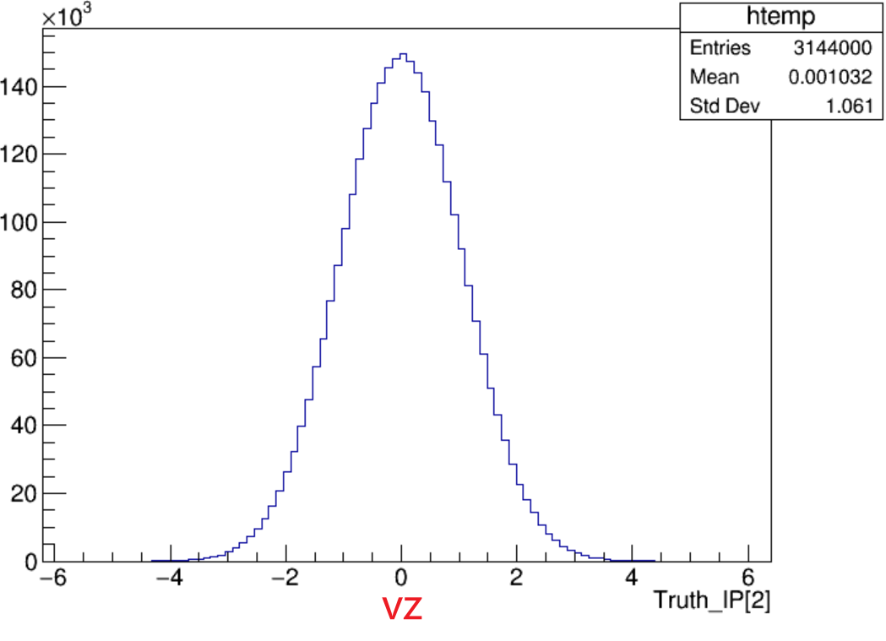
A MC sample with IP = (0,0,0)
产生MC时，将对撞点设置在(0,0,0)
次级顶点拟合中的初级顶点设置的与Truth的初级顶点一致
Truth_IP
Notes:
/ustcfs/BES3User/2021/ypei/BESIII/Lambda/WriteMemo/Check/STLamcos/JianyuCode/IniVtx

Slide 2
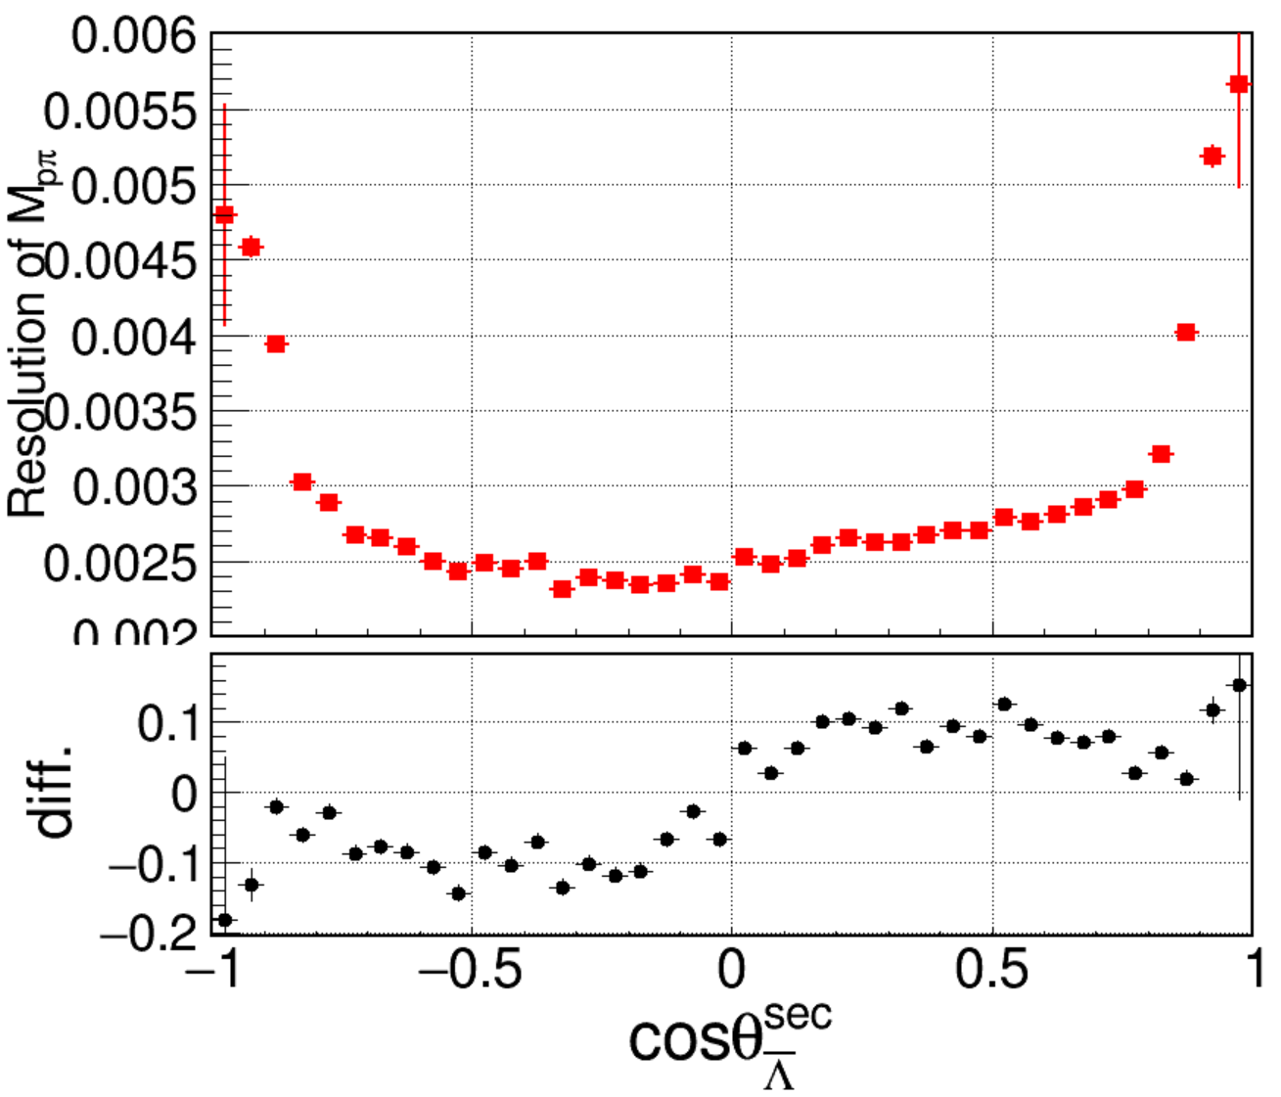
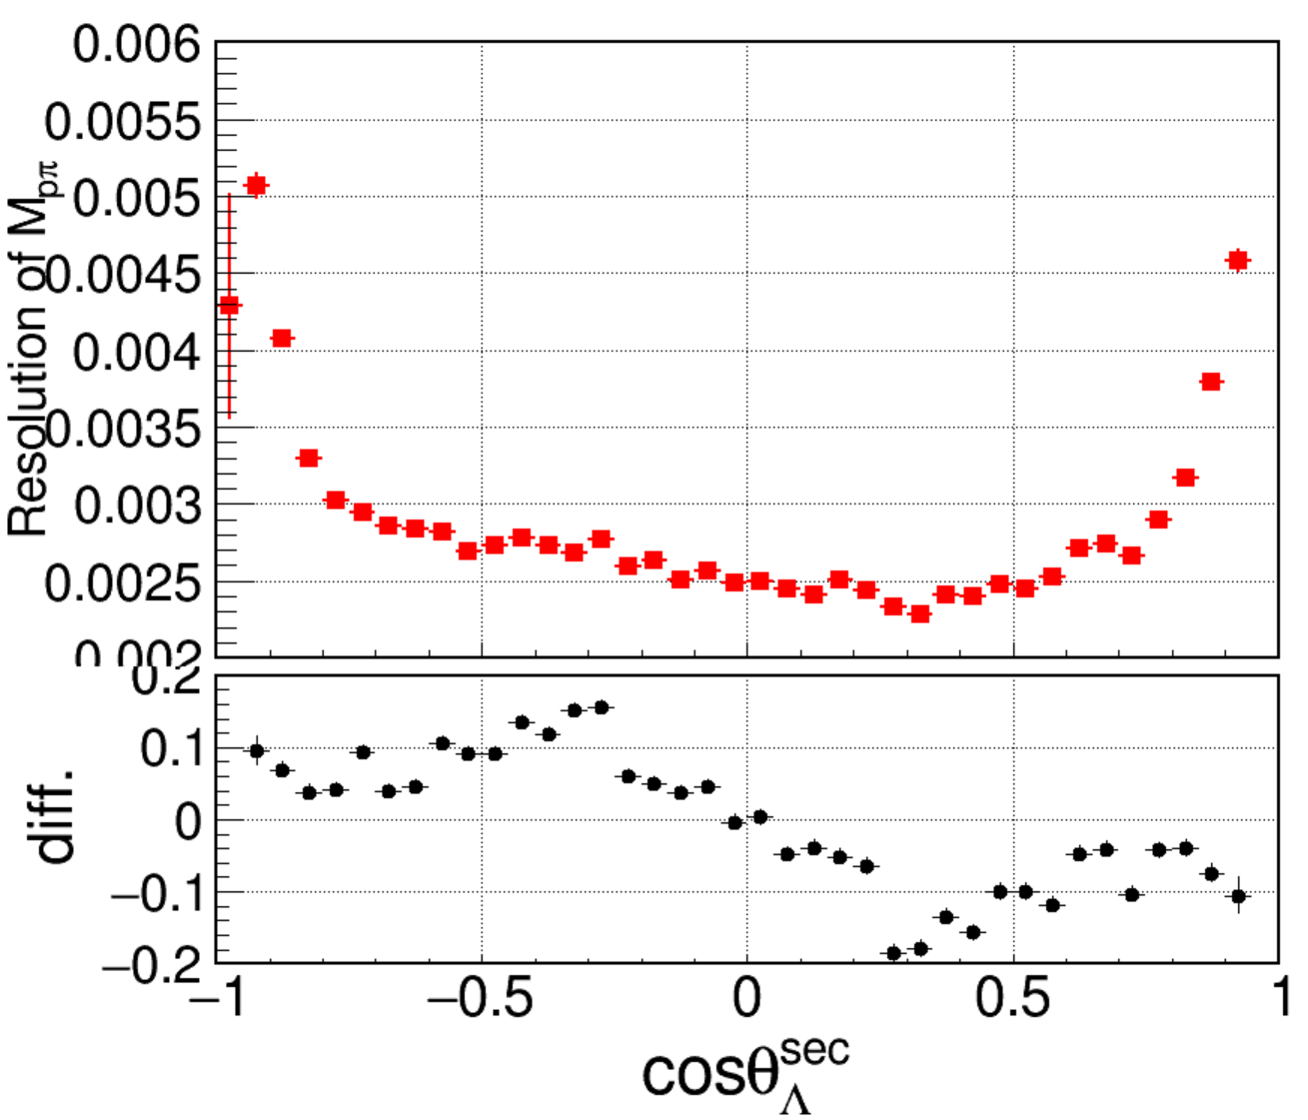
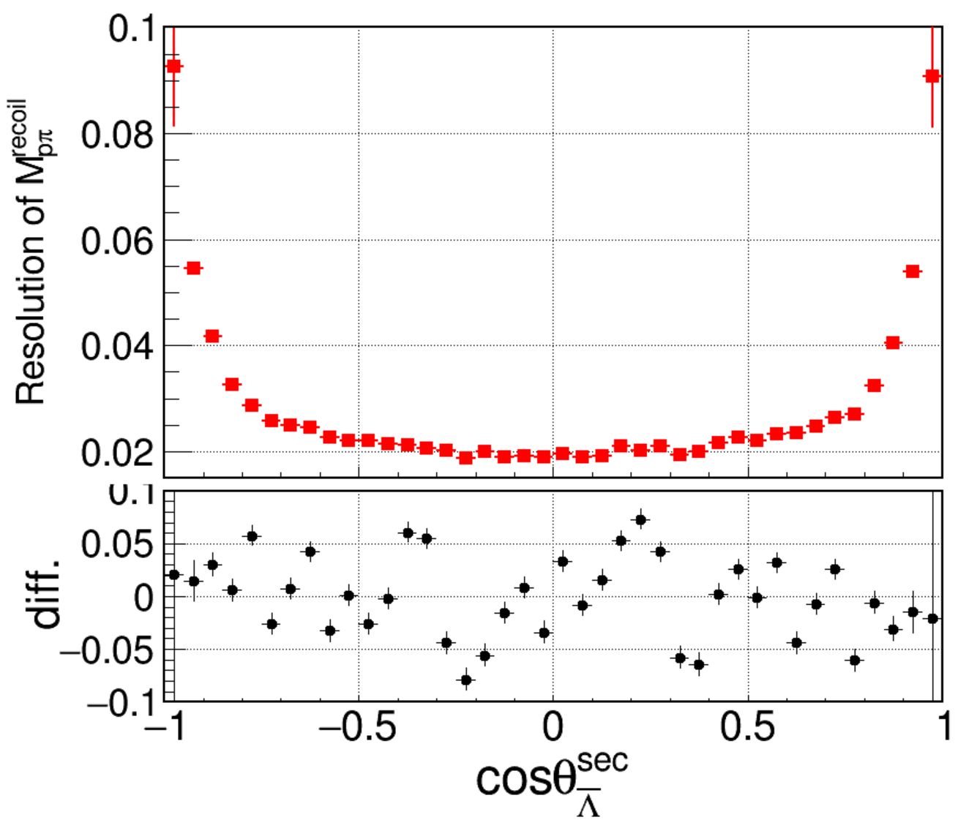
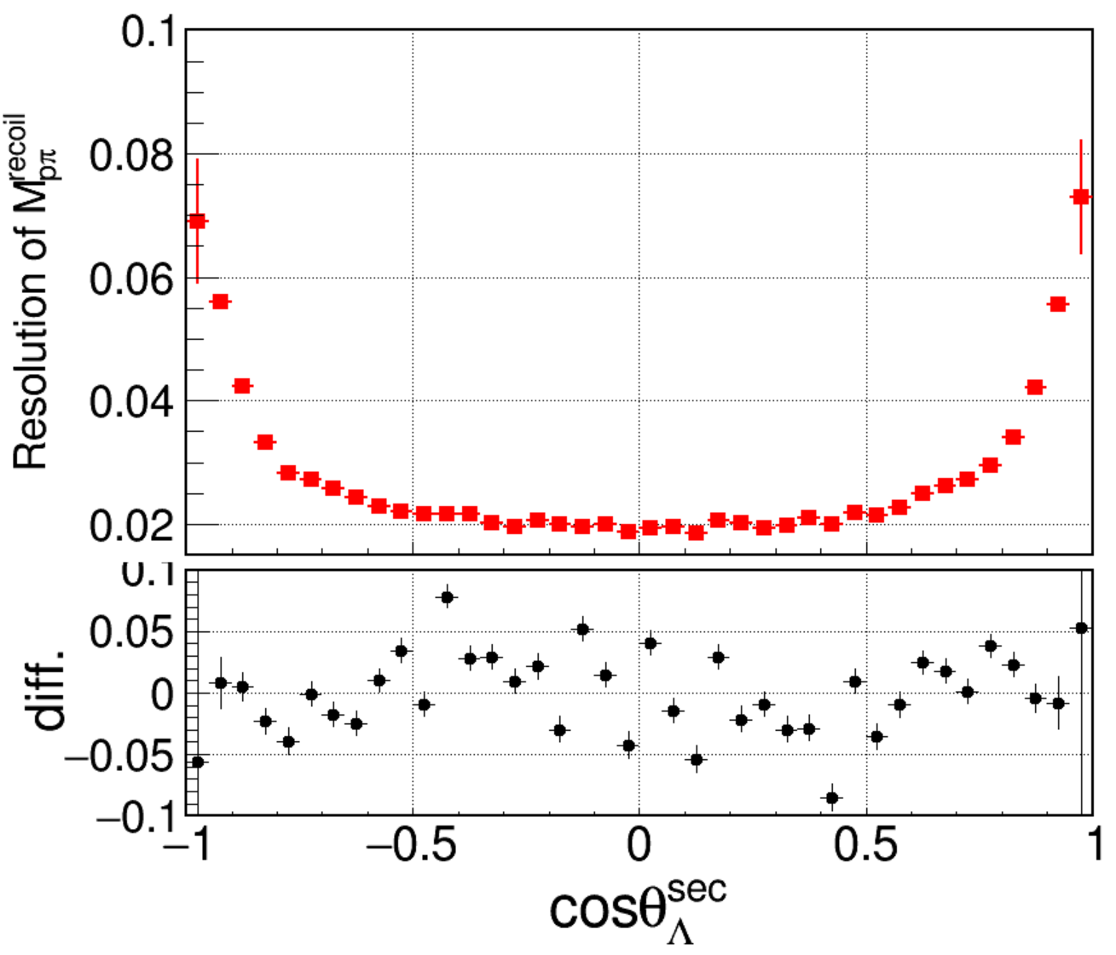
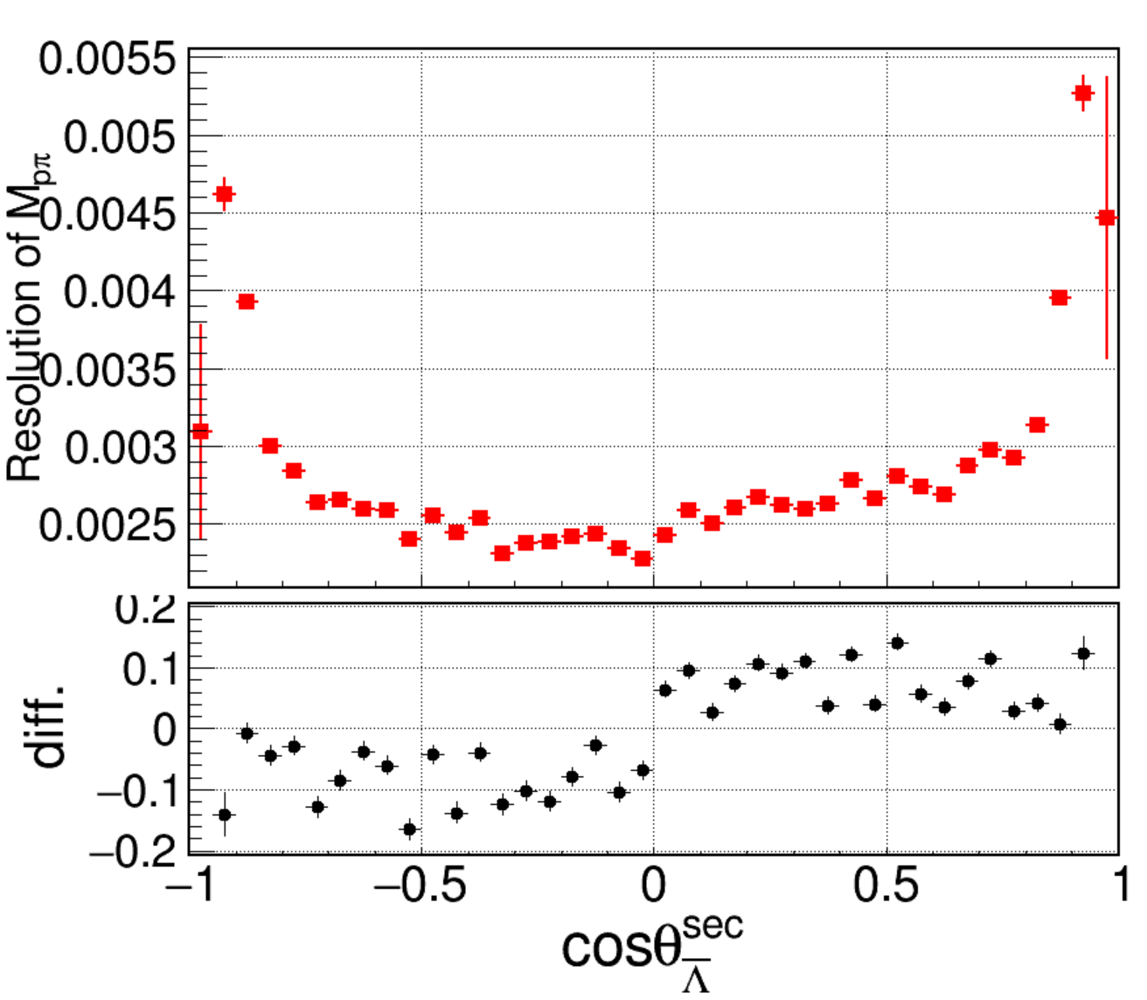
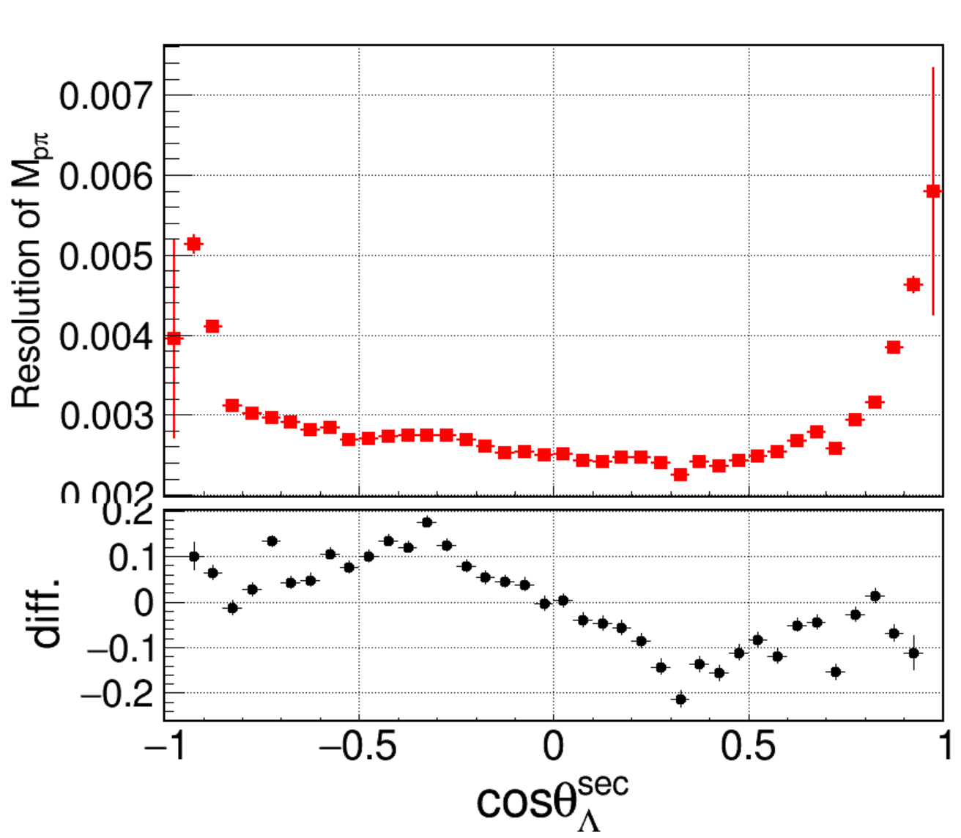
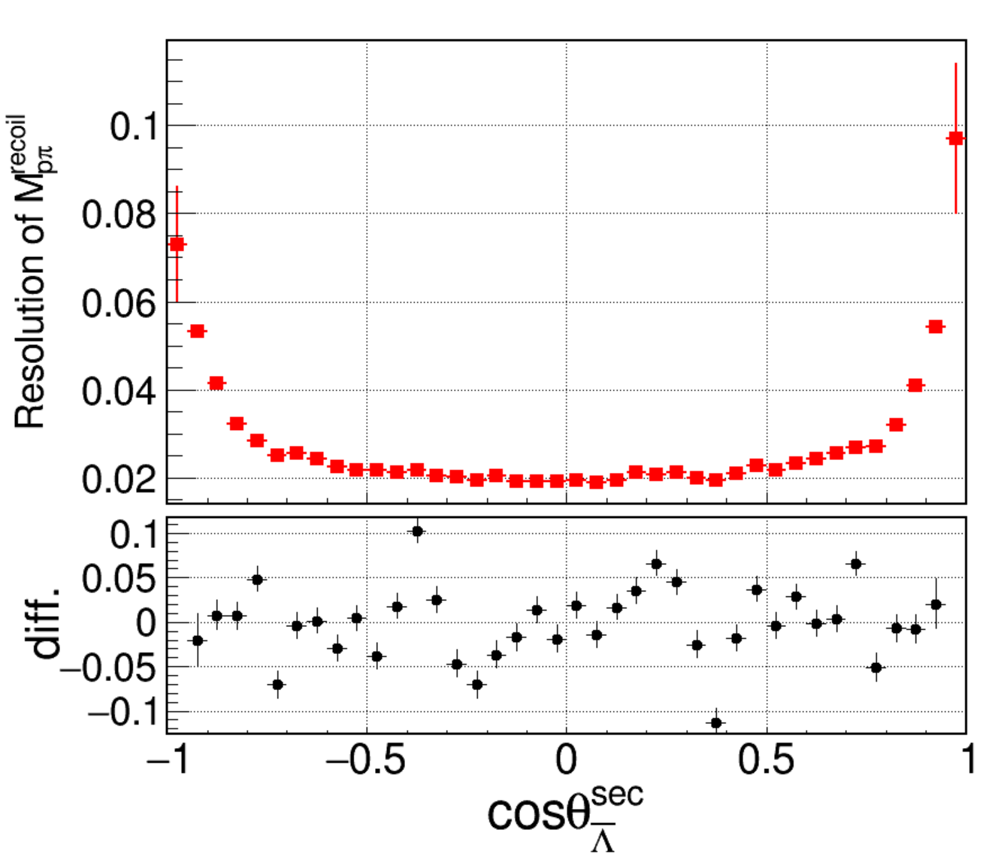
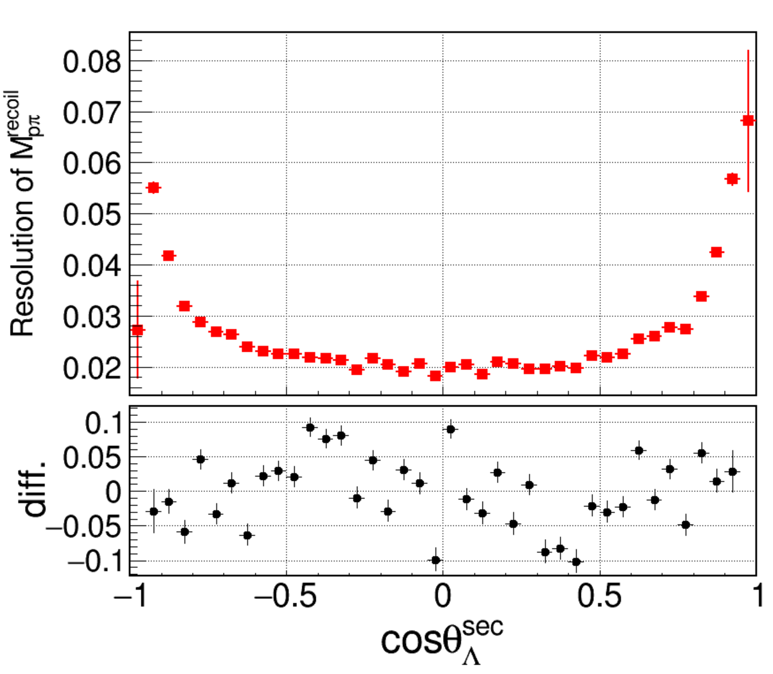
Resolution of MLam
secvtx
Set Vxyz near 0, (1 sigma)
Notes:
/ustcfs/BES3User/2021/ypei/BESIII/Lambda/WriteMemo/inclusiveMC_data/npi0nbarpi0/OtherMC/IPSet000/result_SetIP000/skim

Slide 3
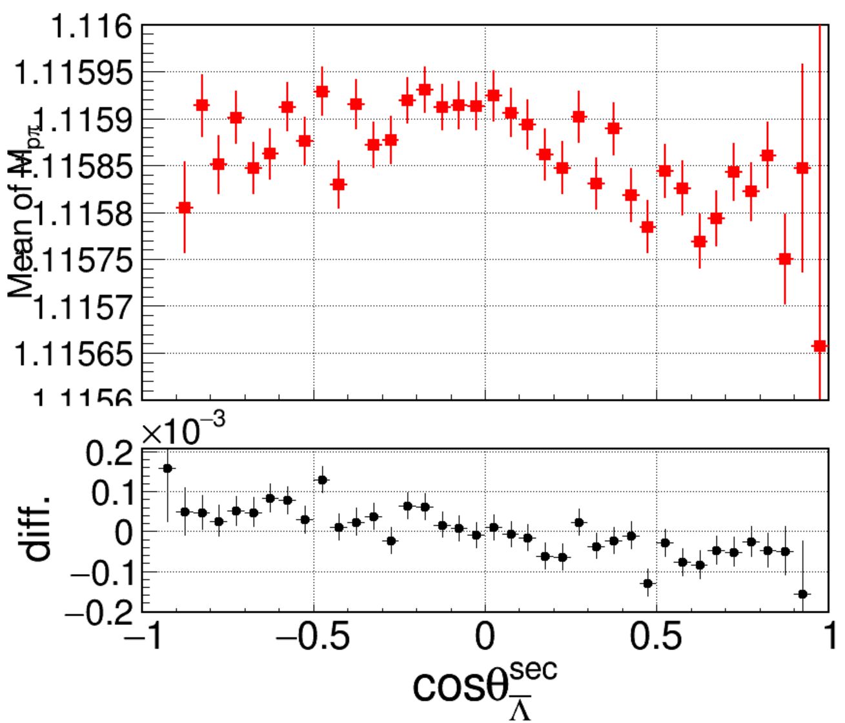
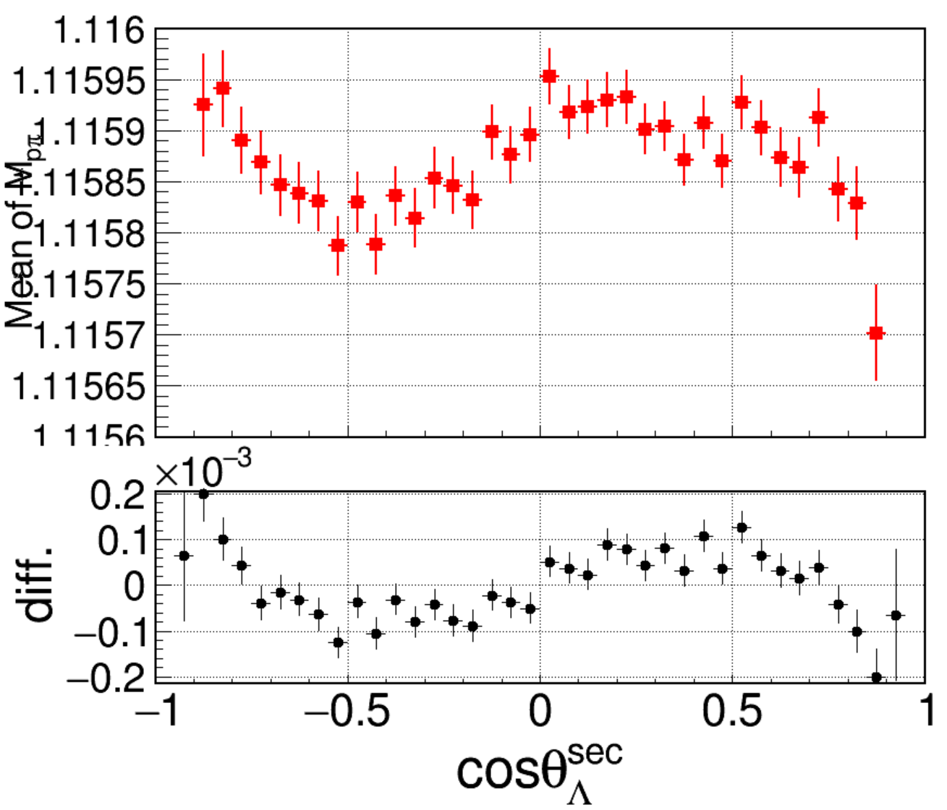
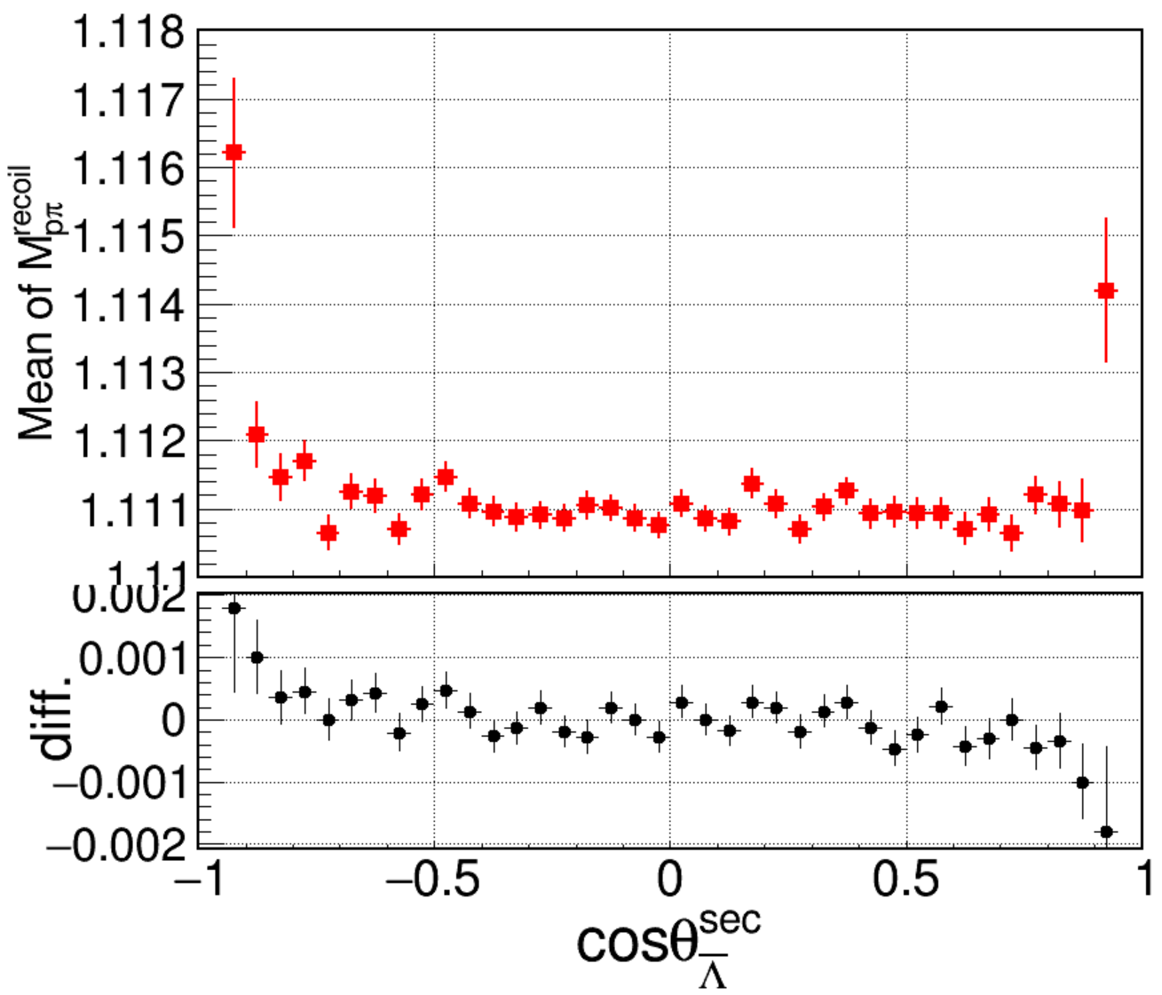
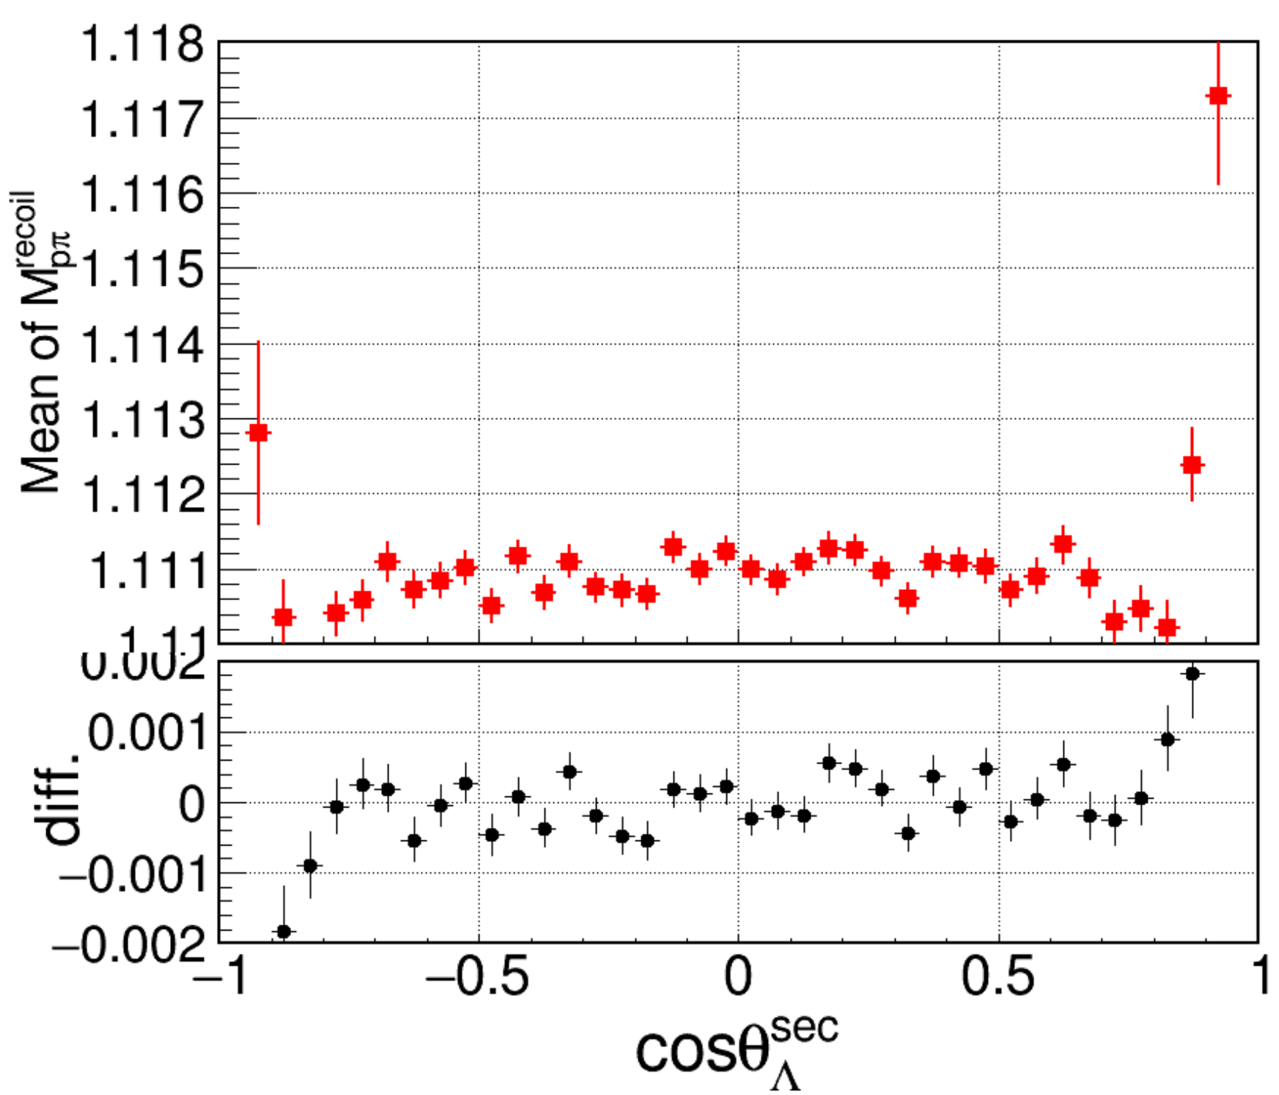
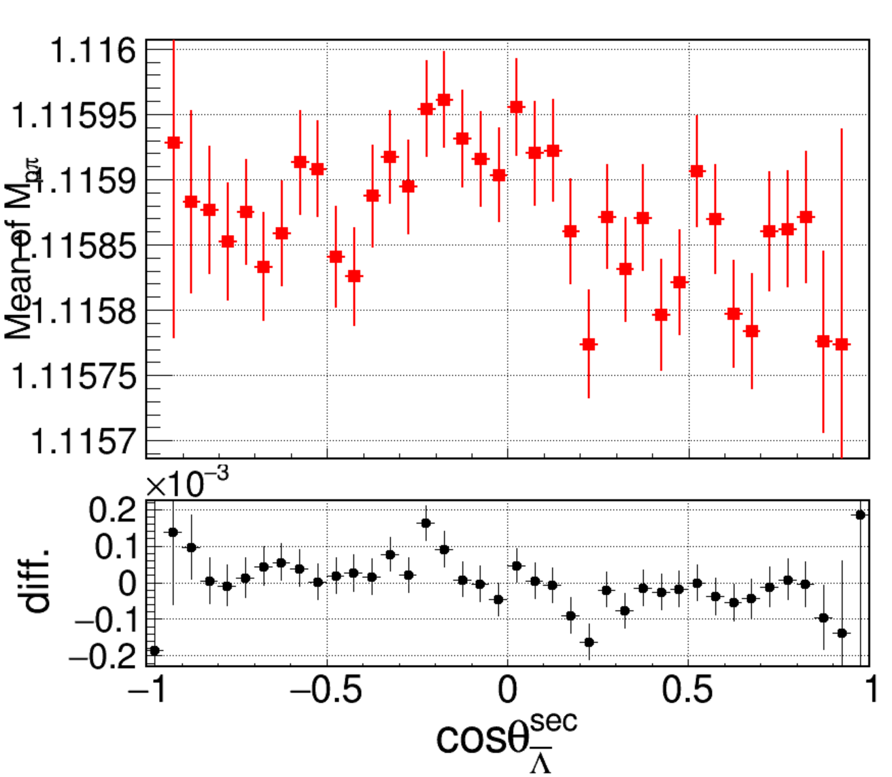
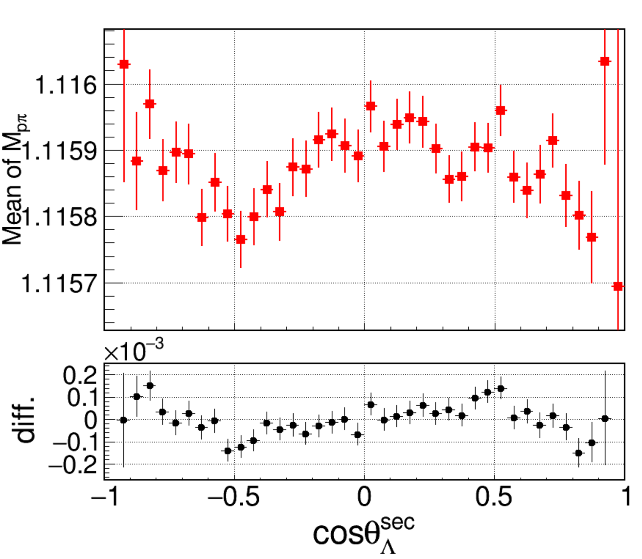
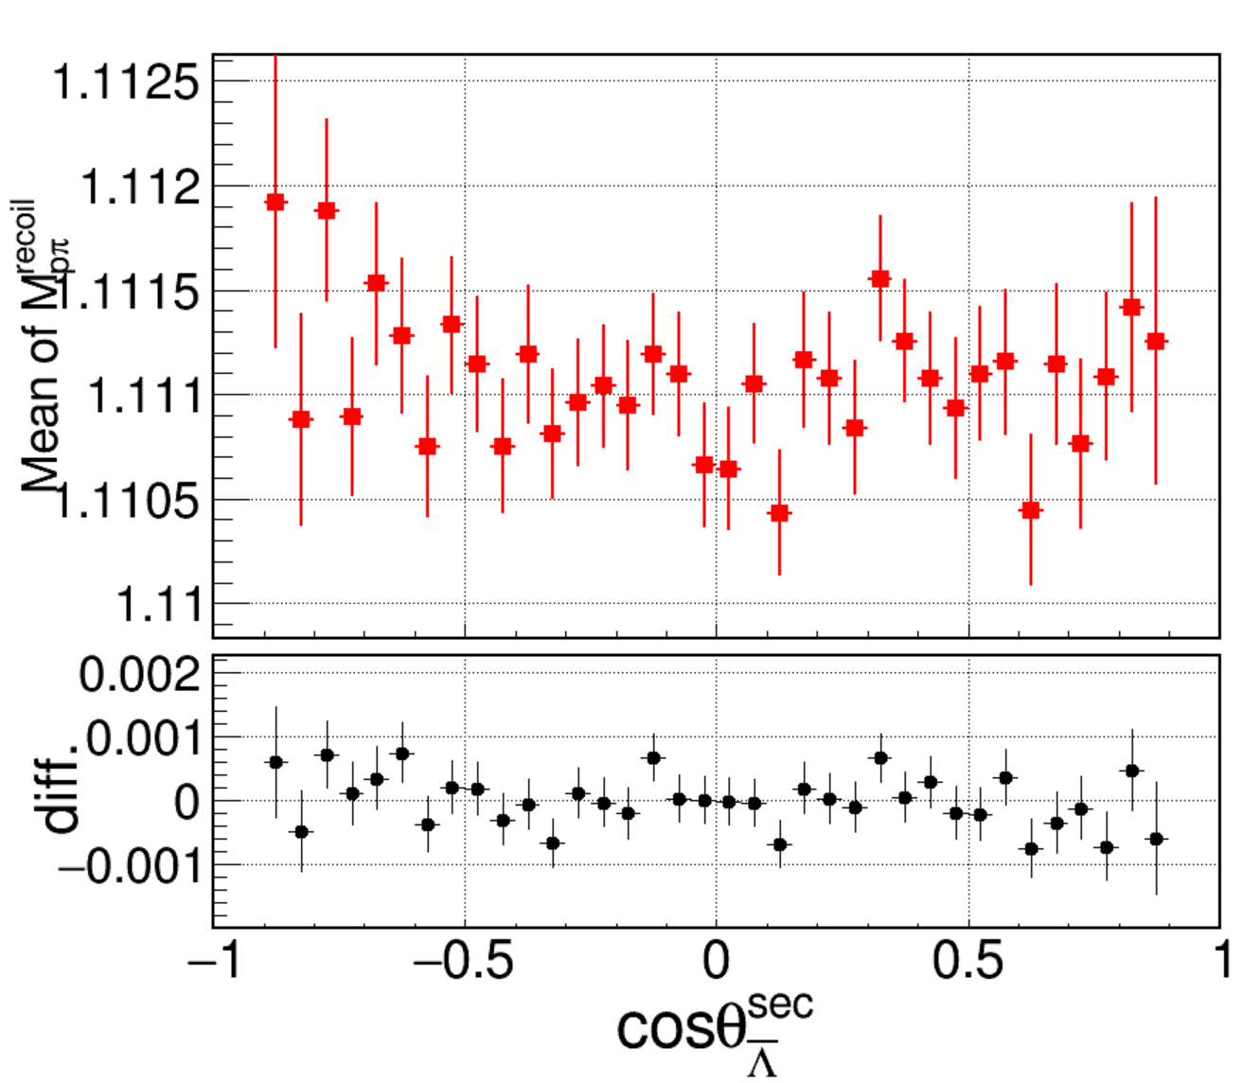
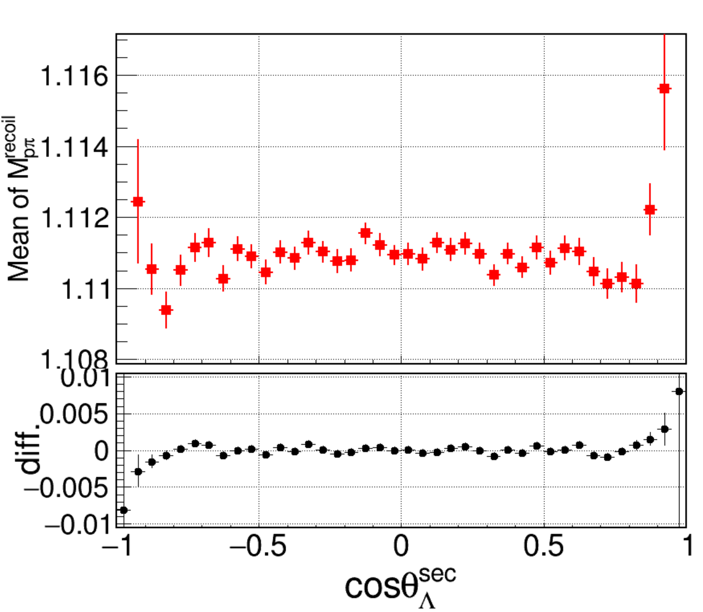
Mean of MLam
secvtx
Set Vxyz near 0, (1 sigma)
Notes:
/ustcfs/BES3User/2021/ypei/BESIII/Lambda/WriteMemo/inclusiveMC_data/npi0nbarpi0/OtherMC/IPSet000/result_SetIP000/skim

Slide 4
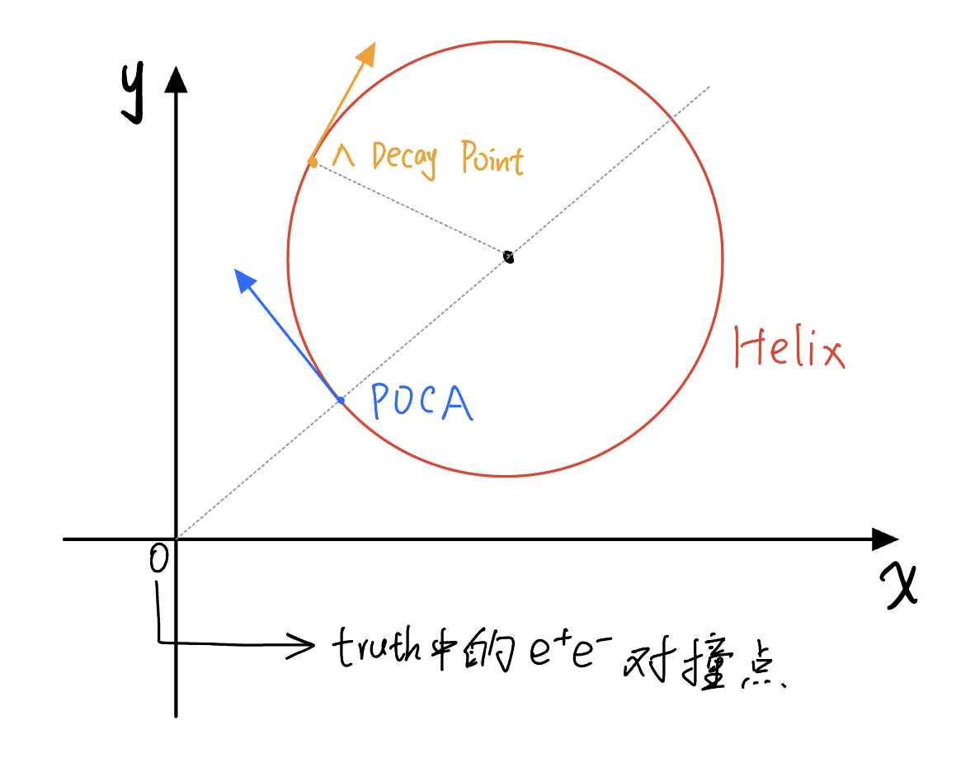
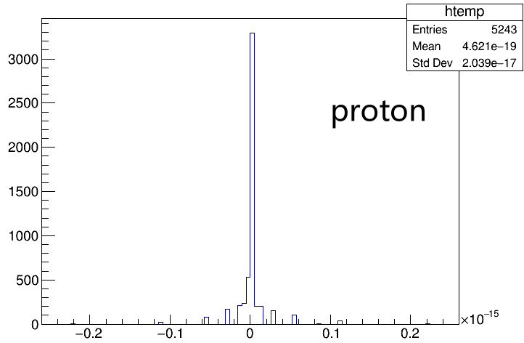
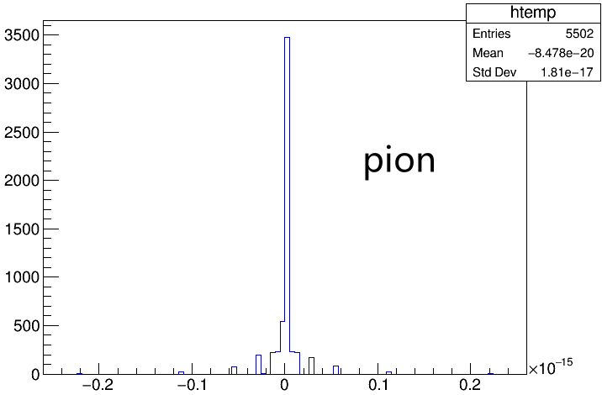
Set Truth WTrackParameter
带电径迹：Truth的动量 $→$ Lambda decay点的动量
放入初级顶点拟合是POCA点的Helix信息
对于proton/pion：
Truth的信息更新为POCA点
HelixErr使用重建的
CheckVar = $xp_{x}+yp_{y}$
Notes:
/ustcfs/BES3User/2021/ypei/BESIII/Lambda/WriteMemo/Check/STLamcos/JianyuCode/IniVtx

Slide 5
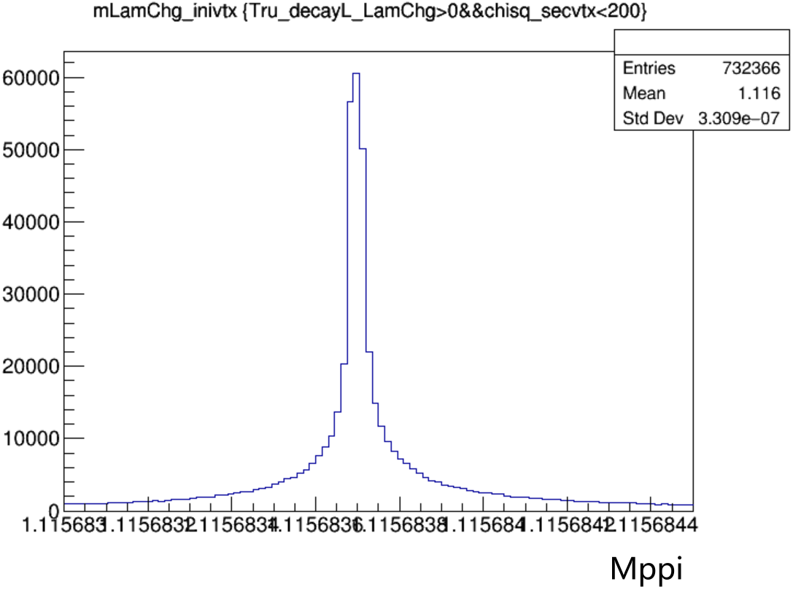
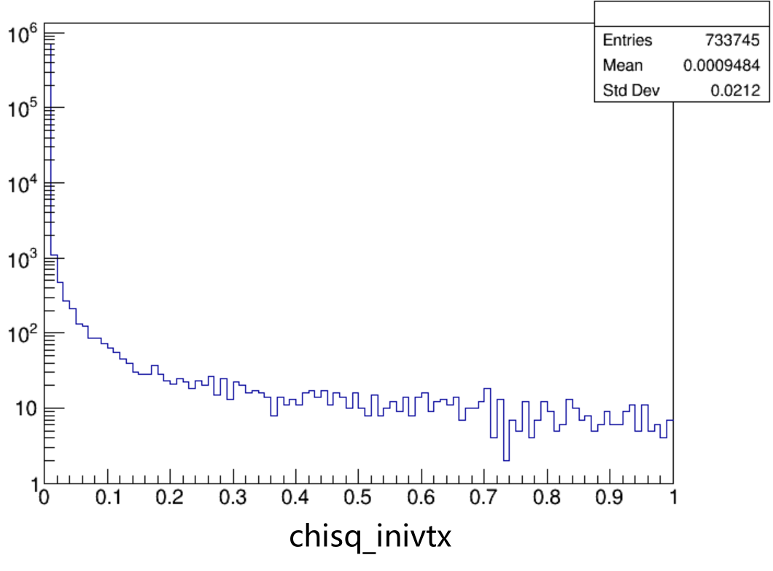
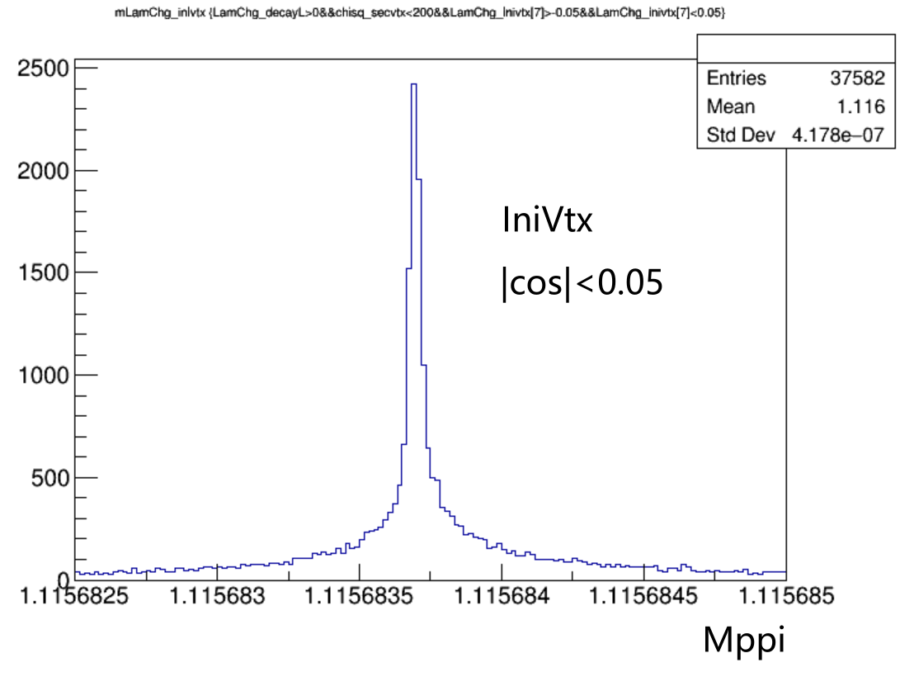
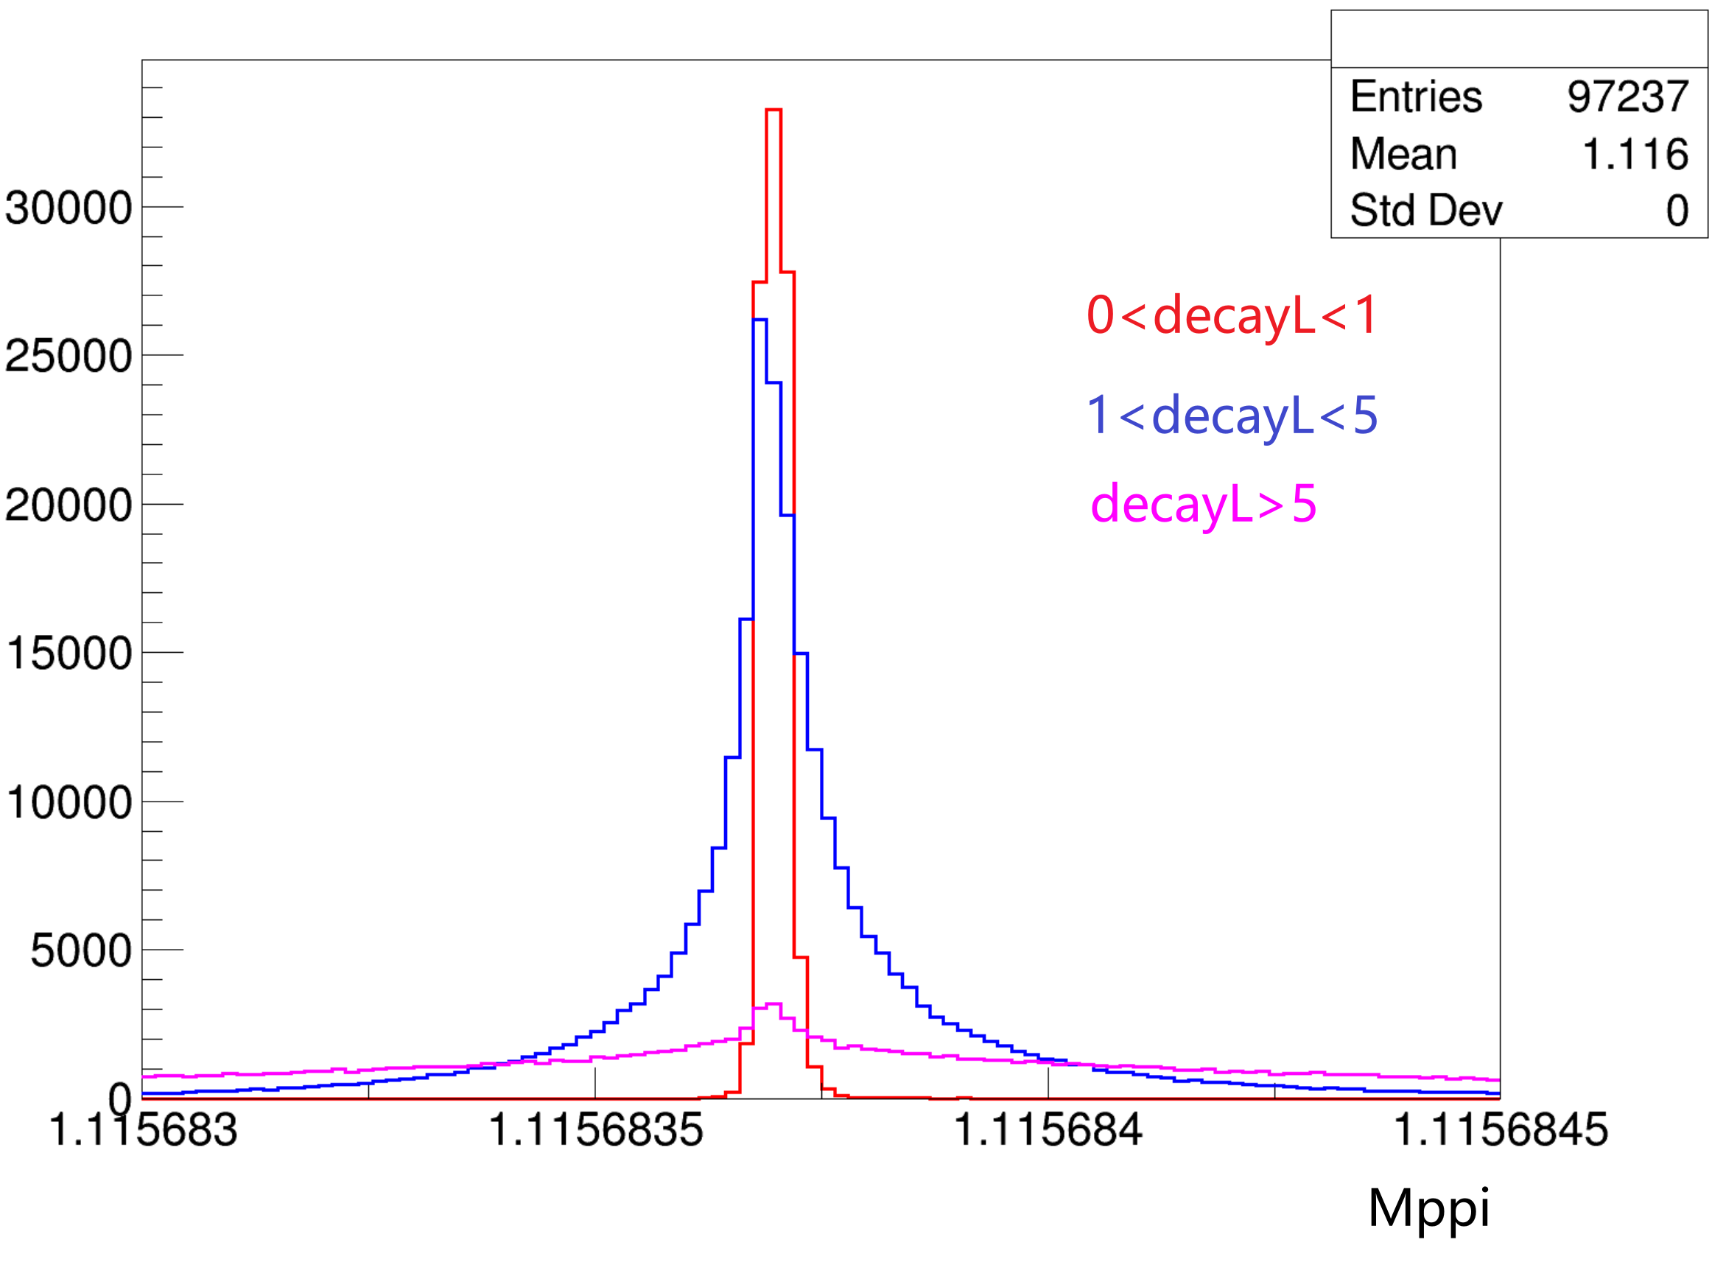
Use truth to do VtxFit
Eff(vtxfit) = 99.5%
误差？
Notes:
/ustcfs/BES3User/2021/ypei/BESIII/Lambda/WriteMemo/Check/STLamcos/JianyuCode/IniVtx

Slide 6
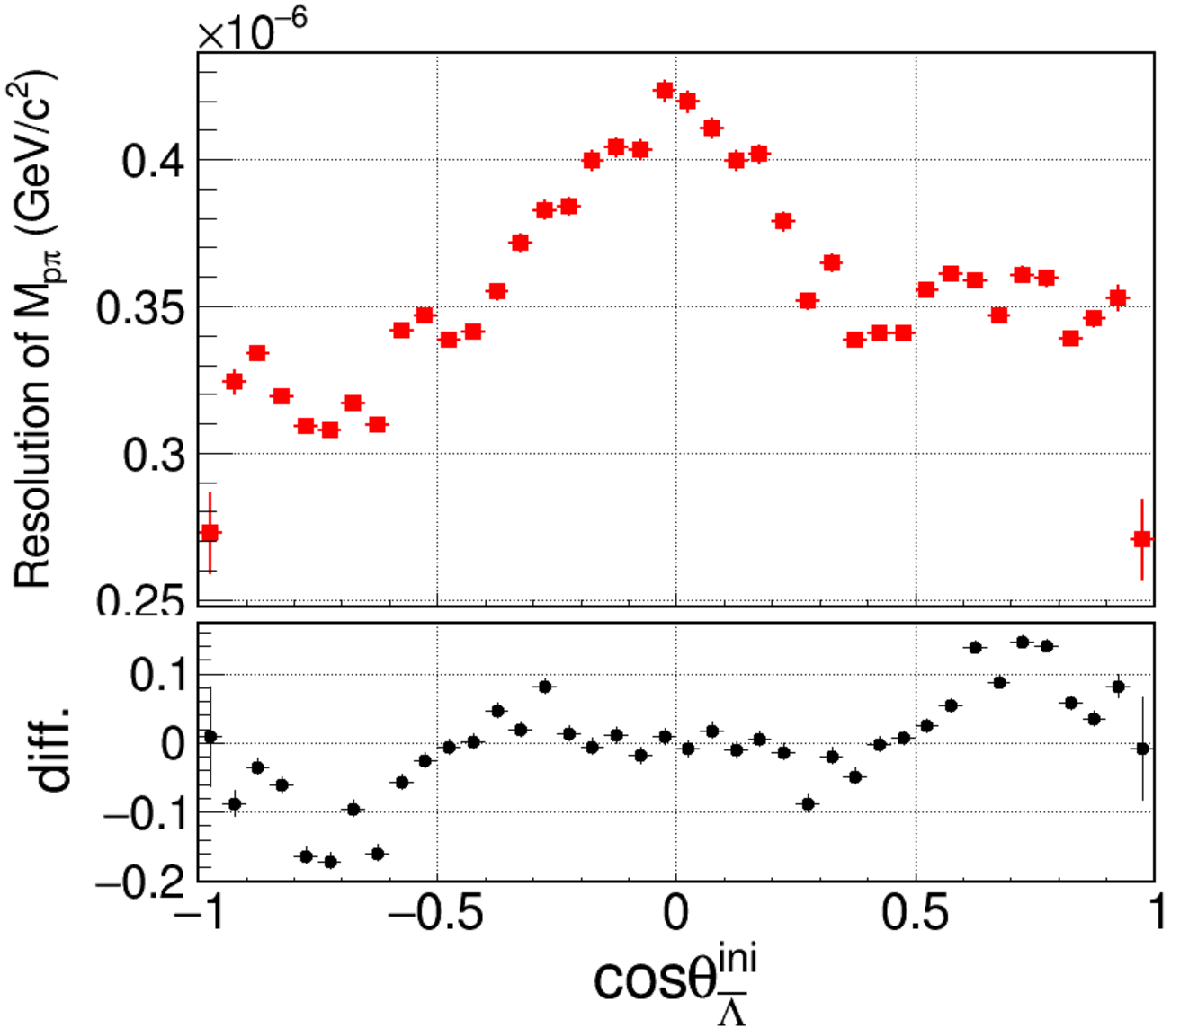
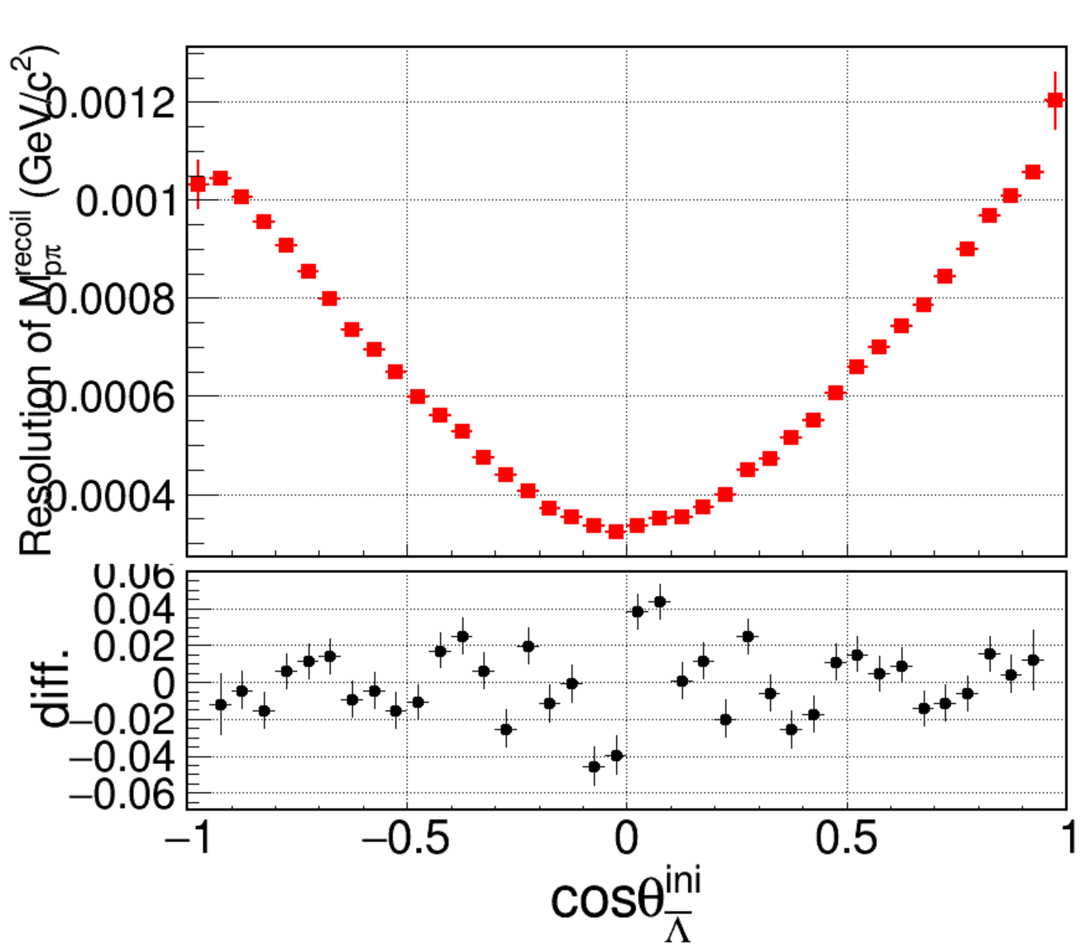
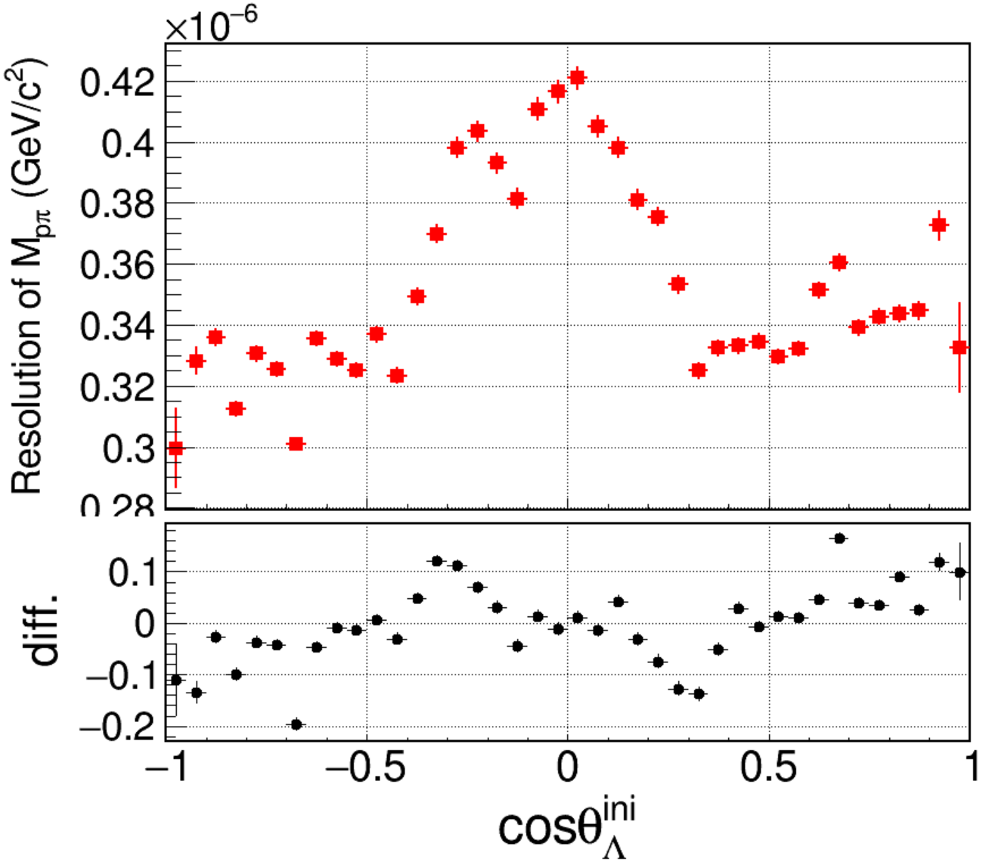
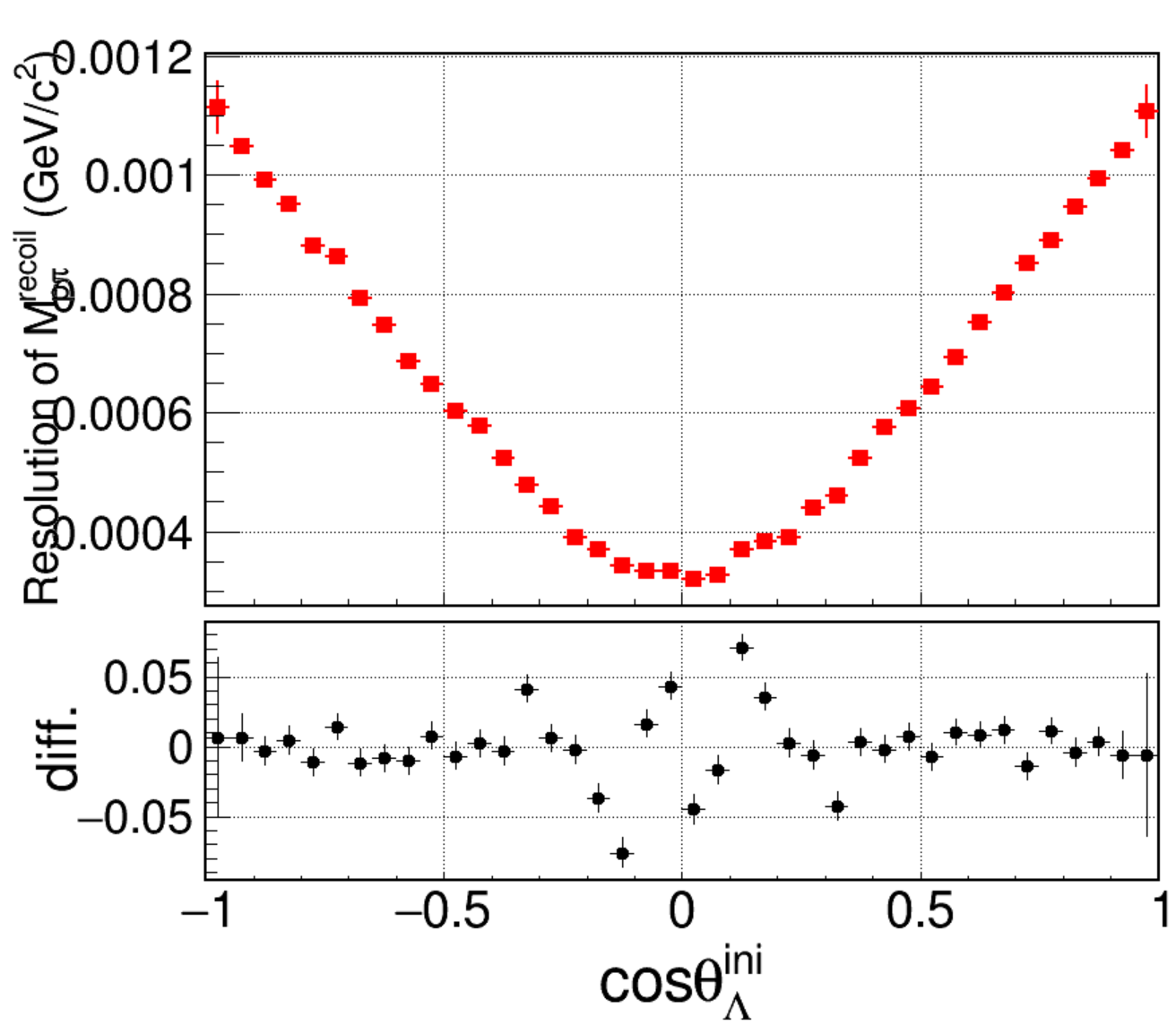
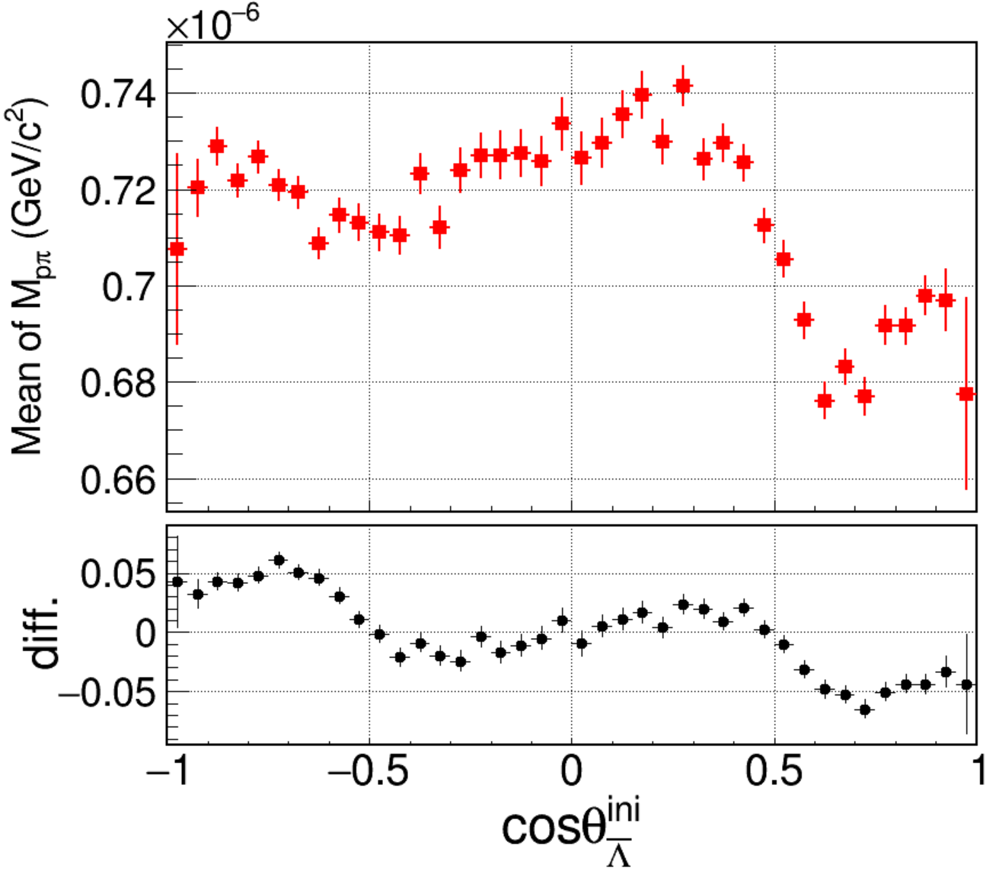
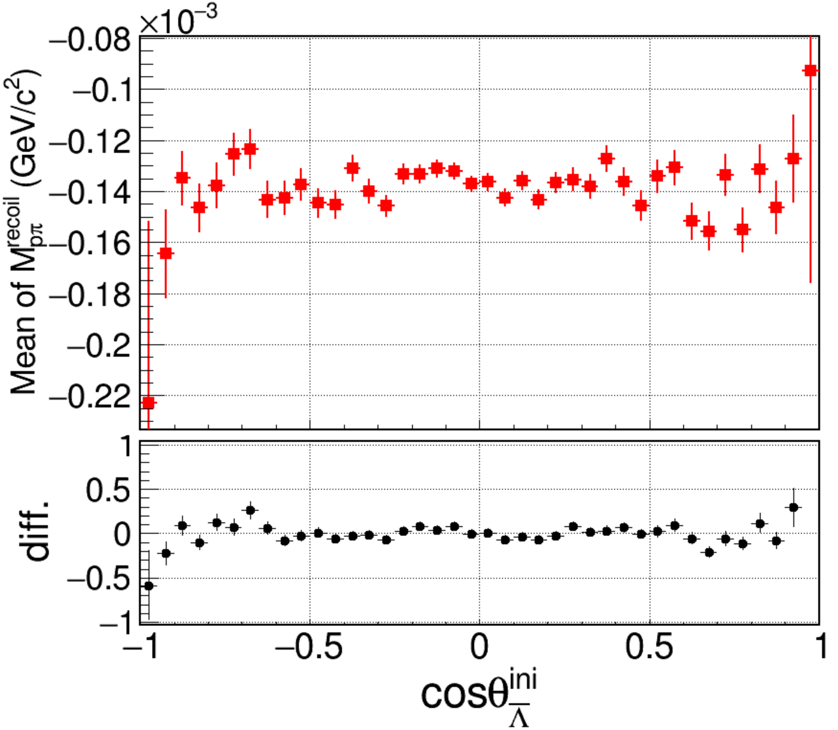
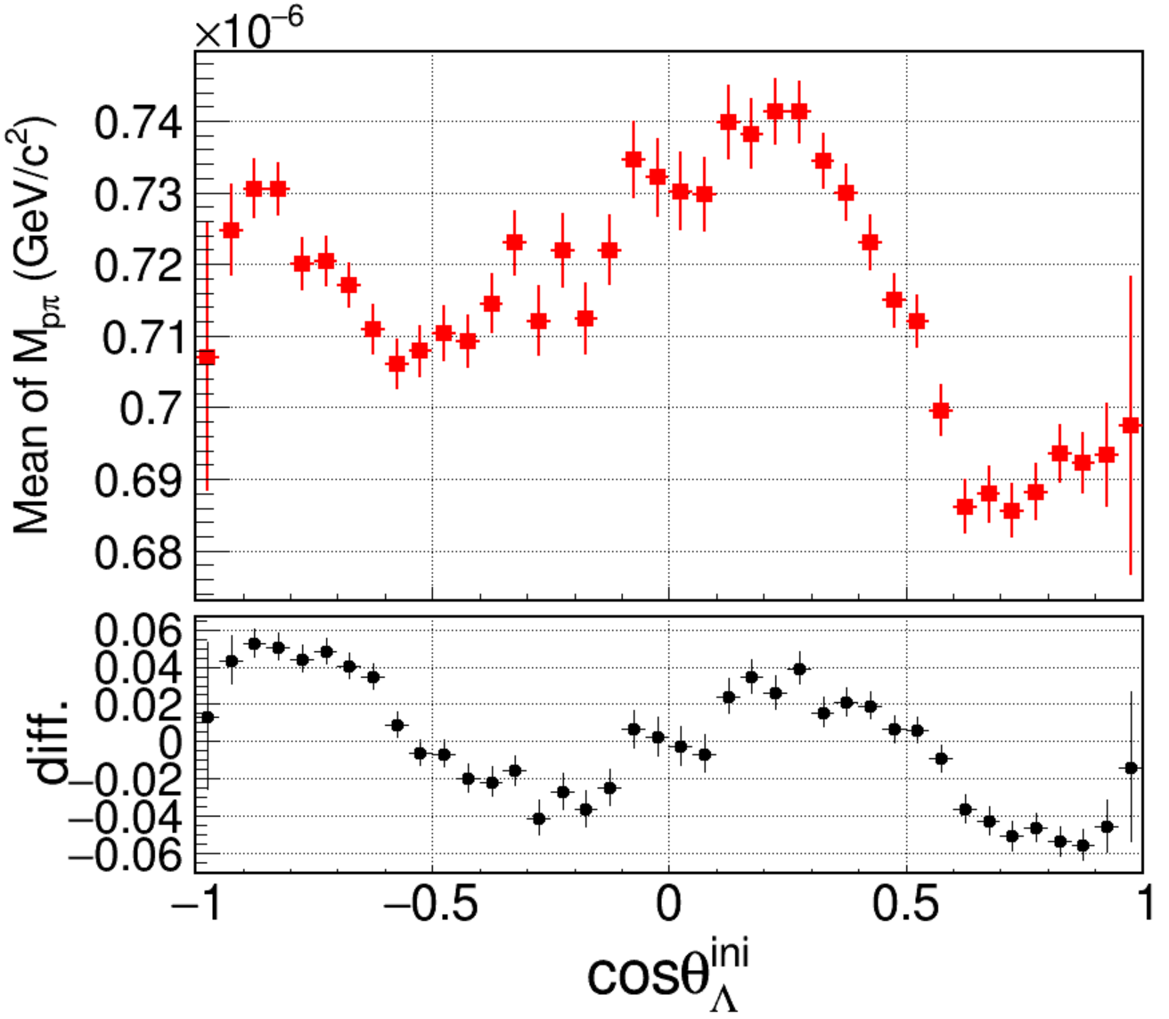
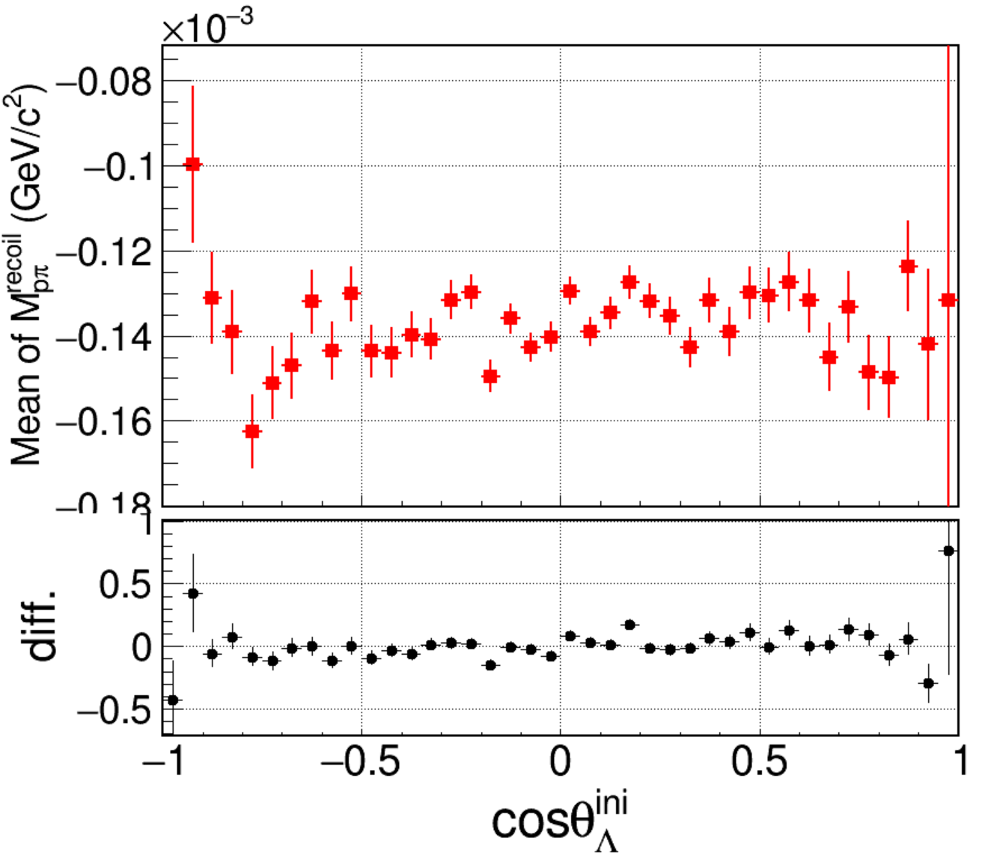
IniVtx of MLam
Resolution
Mean
Notes:
/ustcfs/BES3User/2021/ypei/BESIII/Lambda/WriteMemo/inclusiveMC_data/npi0nbarpi0/OtherMC/IPSet000/result_SetIP000/skim

Slide 7
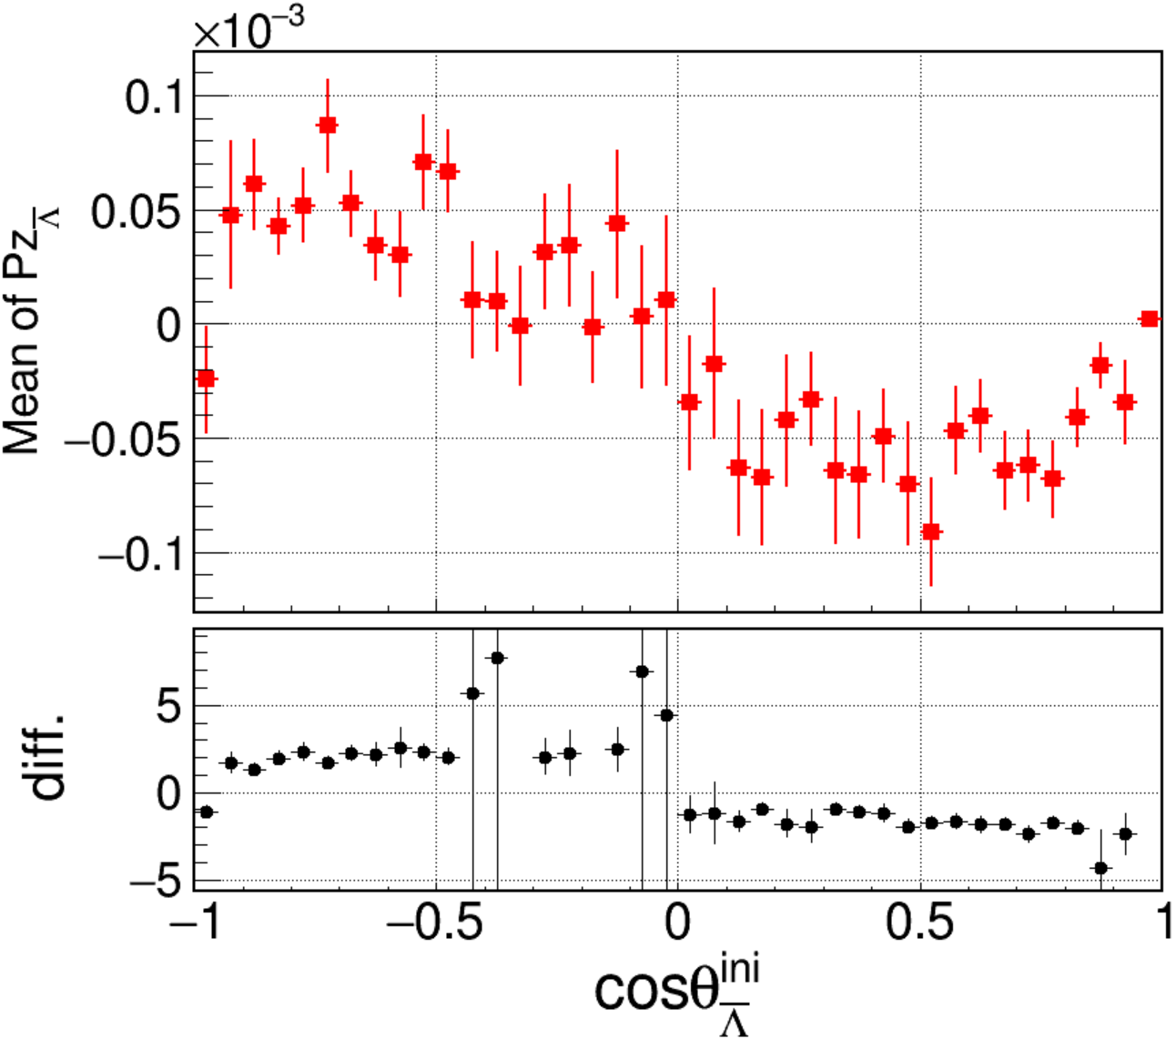
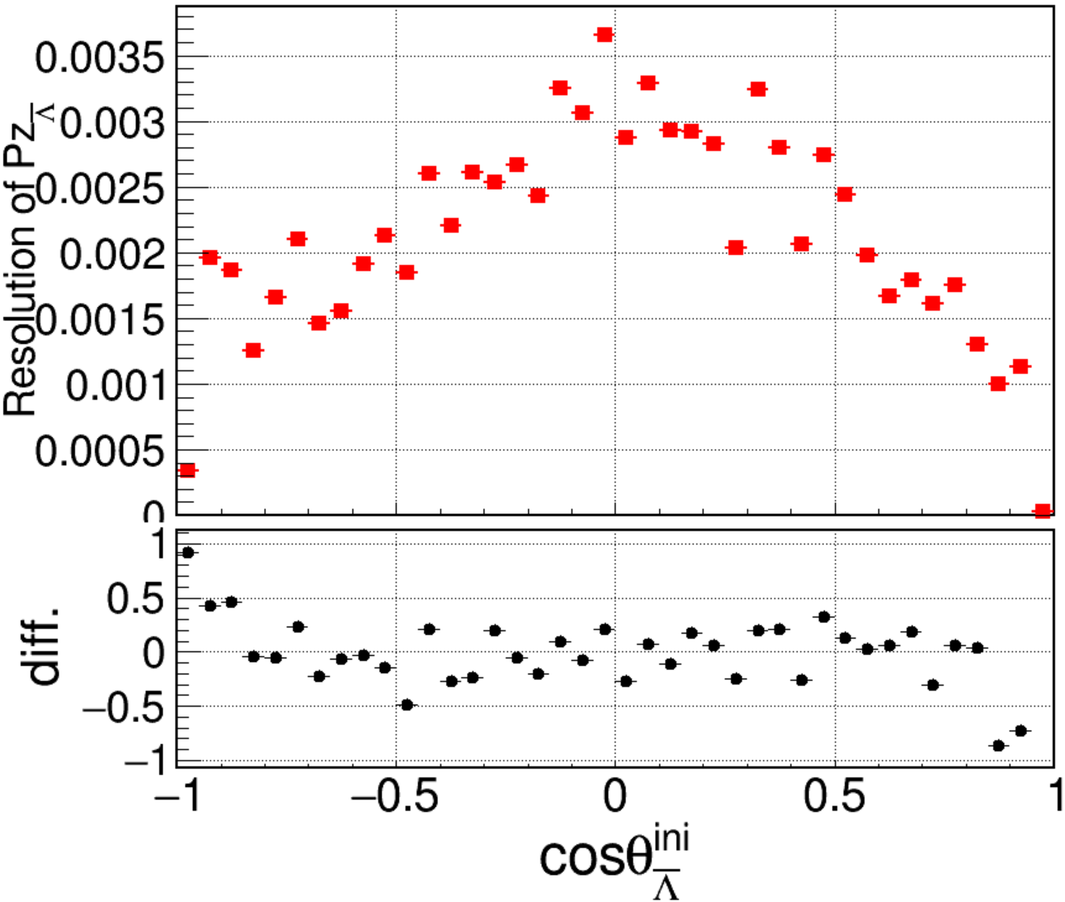
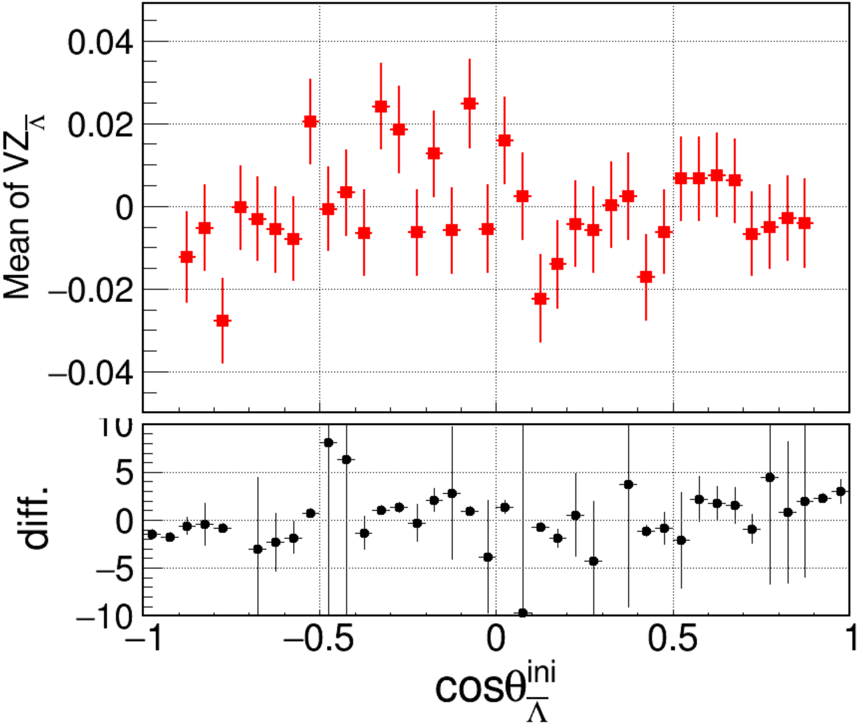
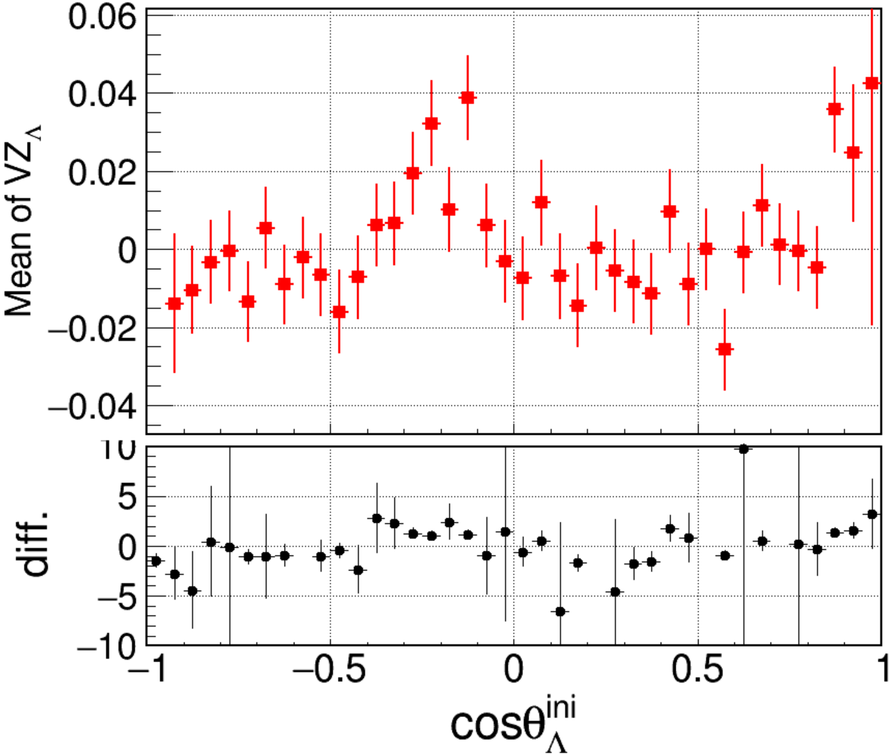
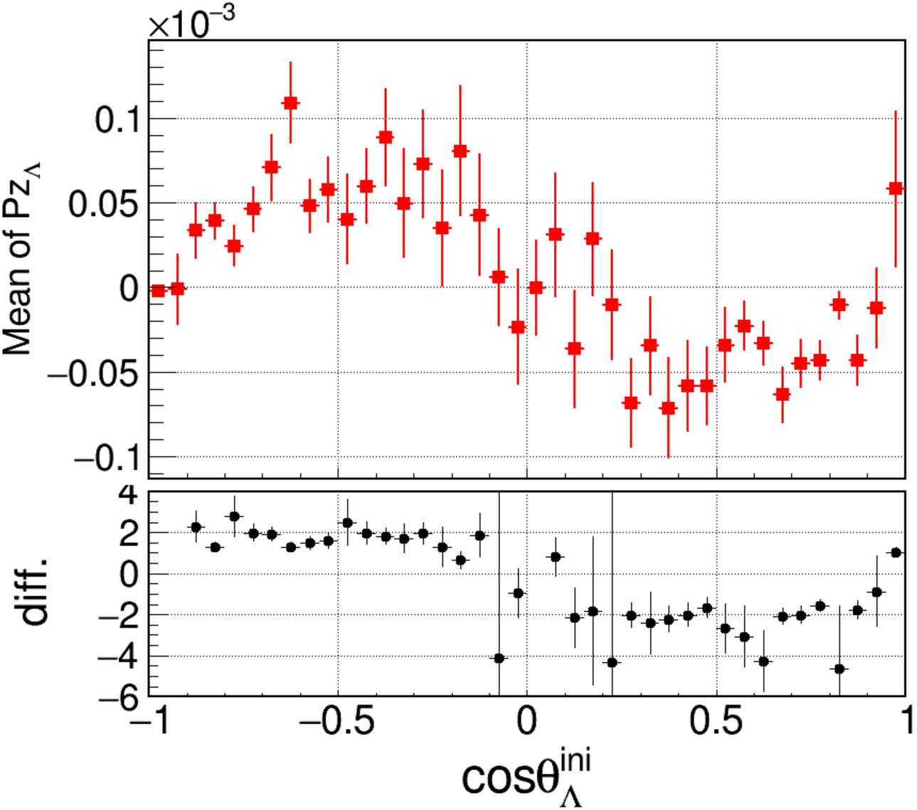
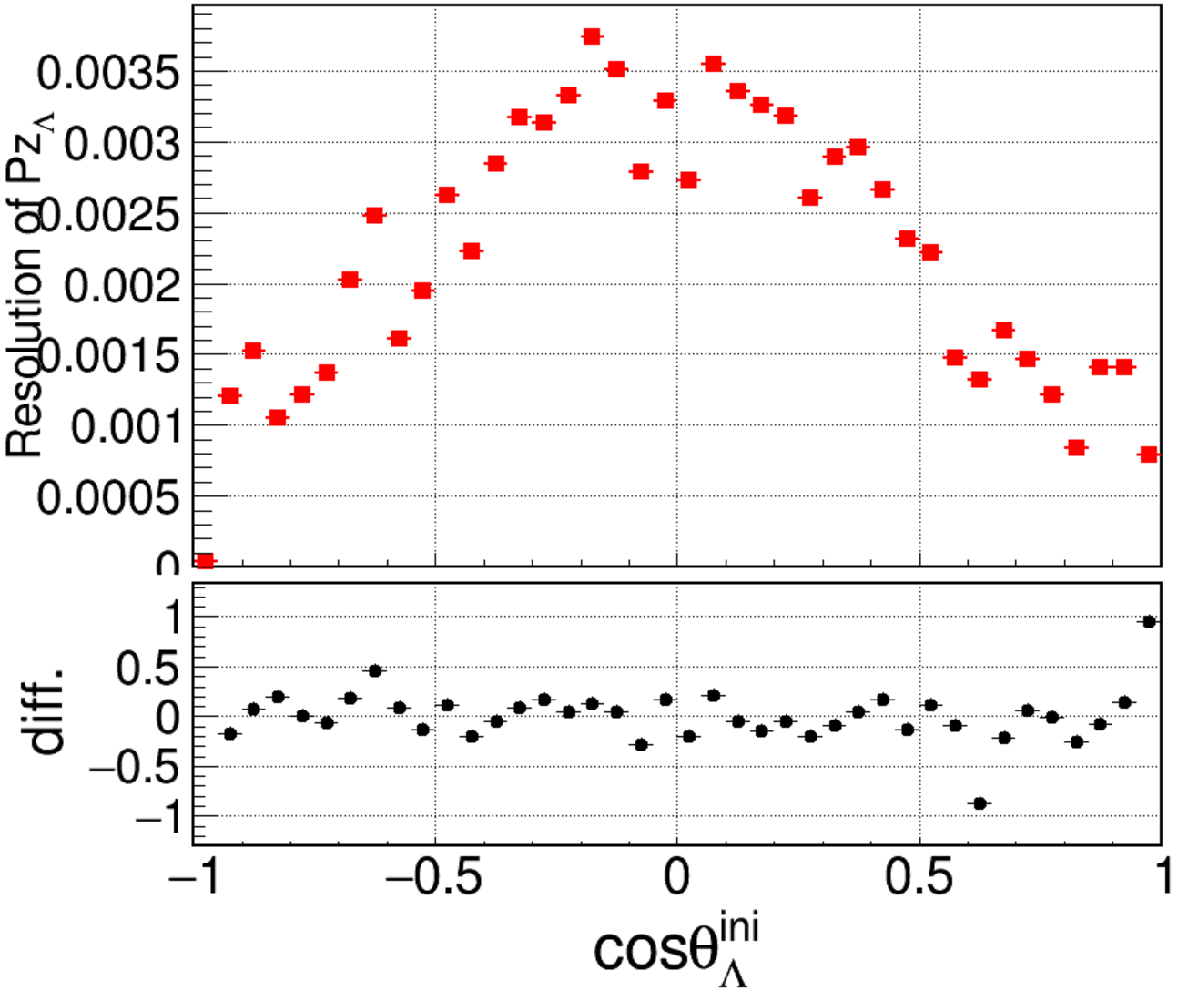
IniVtx
Mean of Vz
Mean of Pz
Res of Pz
Notes:
/ustcfs/BES3User/2021/ypei/BESIII/Lambda/WriteMemo/Check/STLamcos/JianyuCode/IniVtx/VertexStudy/Draw/picture

