Slide 1
Preliminary Considerations on Tracking for HIEPA
Yifei Zhang and Jianbei Liu
University of Science and Technology of China
Workshop on Physics at Future High Intensity Colliders @ 2-7GeV in China
USTC, China
January 16, 2015

Slide 2
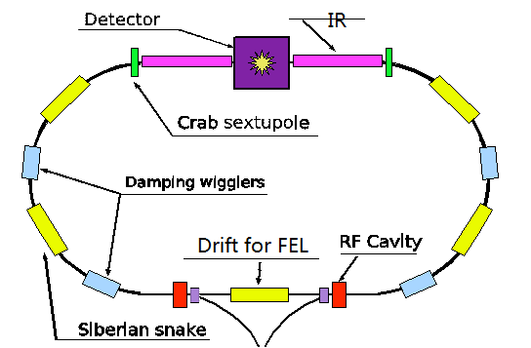
HIEPA
A High Intensity Electron Positron Accelerator
E_{cm} = 2-7 GeV; L = (0.5-1)x10³⁵ cm⁻²s⁻¹ at 4 GeV, single polarized beam.
A 3rd/4th generation SRF (synchrotron radiation facility).
Potential for FEL( free electron laser) with the long LINAC.
Circumference ~ 1000m
( From Prof. Zhengguo Zhao )
Primary physics requirement on detectors for HIEPA: highly efficient and precise reconstruction of exclusive final states in electron-positron collisions.
Tracking detectors at HIEPA play a central role in the final state reconstruction.

Slide 3
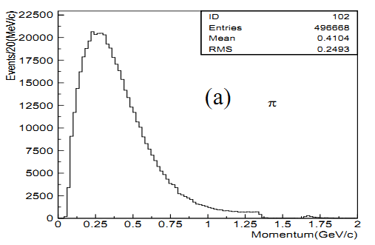
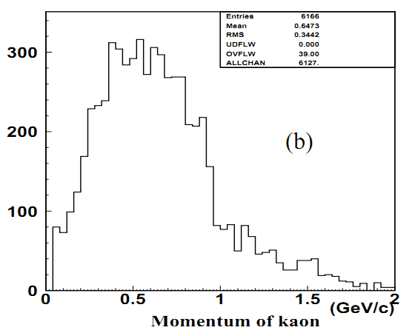
A glimpse of final states in τ-c regime
π’s from inclusive J/psi decays
Kaon’s from inclusive D⁰ decays
The momenta of charged final-state particles are mostly below 1GeV/c.
Designs of tracking detectors for HIEPA have to match this important feature of final states.

Slide 4
Requirements for Tracking System
Large acceptance (close to 4*pi)
High efficiency at momentum down to <~100MeV
Good momentum resolution at momentum <~1GeV
High rate capability
Fast response
Radiation hard
Fast and efficient triggering on charged particles
Good transparency to downstream measurements (PID and Ecal)
PID for low-momentum (<600-700MeV) particles
Vertexing (less critical, more on background rejection)
`

Slide 5
Detector Design Considerations
Dominant factor in tracking performance in tau-charm regime
multiple scattering
So the driving force in tracking design
low mass (to be also transparent to downstream measurements)
Special design required for inner tracking
to cope with the very hostile radiation environment expected at HIEPA
So an inner-outer separate design would be the optimal choice
An outer-tracker option: a drift chamber
High momentum resolution from low mass plus good spatial resolution
PID via dE/dx
Inner-tracker options
Silicon detectors: Pixel/Strip
MPGD: Cylindrical GEM, Cylindrical MicroMegas, (pixel/strip readout)
…

Slide 6
Outer Tracker: Drift Chamber Option
Low mass
Helium-based working gas
Aluminum wires
Carbon-fiber support structure
Small cells
Fast response
Small electron diffusion → good spatial resolution
Super-layer arrangement
Facilitates triggering and reconstruction
Stereo layers
Z measurement

Slide 7
Continued
Chamber dimensions
R_{in}: beam background
R_{out} : cost of EM calorimeter
Length: acceptance and cost of EM calorimeter
Number of wire layers
Sufficient enough for both momentum and dE/dx measurements
Must also balance with material budget
B field
Balance between momentum resolution and low-pT tracking efficiency

Slide 8
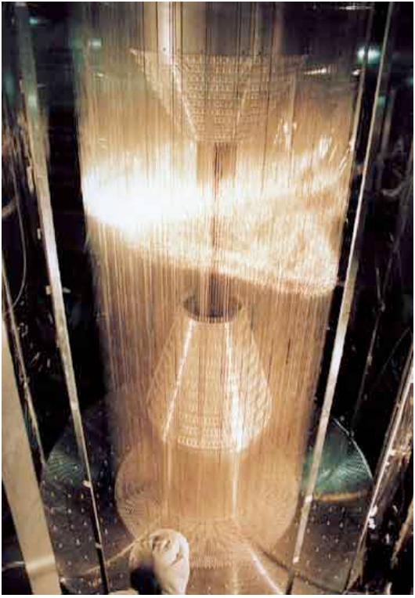
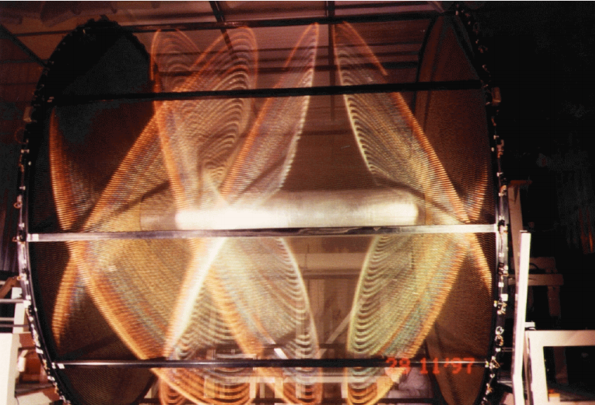
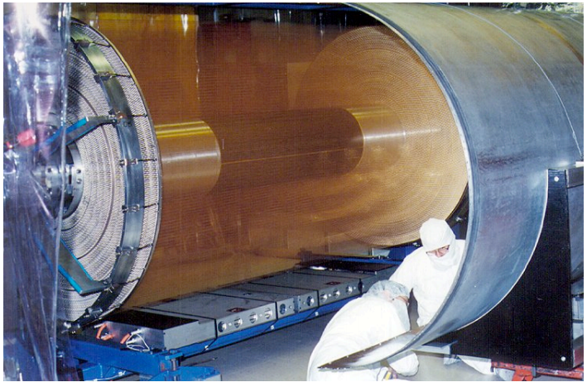
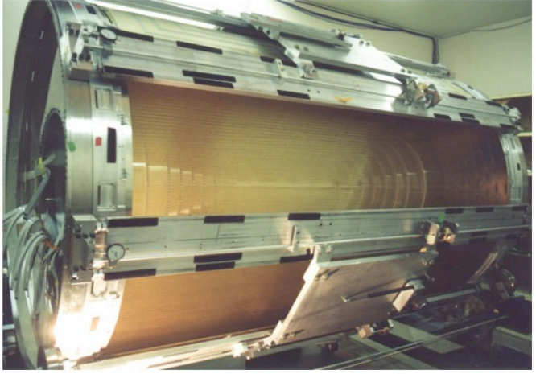
Low-Mass Drift Chambers
KLOE
Belle
• Low mass design
• helium-based working gas
• Al ﬁeld wires (less tension needed -> lighter chamber structure)
• Carbon ﬁber structure (for cylinders or even endplates)
• Typical performance
• spatial resolution: 100-130 um
• momentum resolution: 0.5%@1GeV (1T)
• dE/dx resolution: 5-6% (MIP)
Babar
CLEO-C

Slide 9
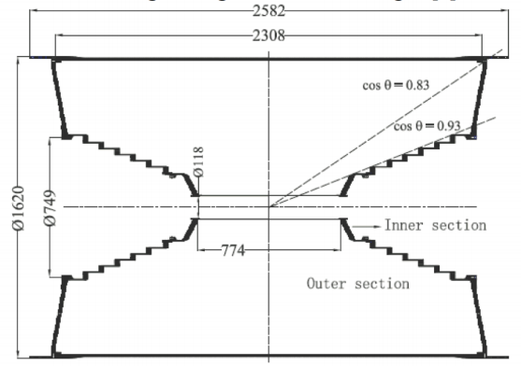
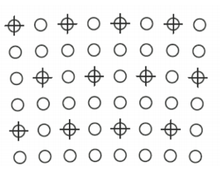
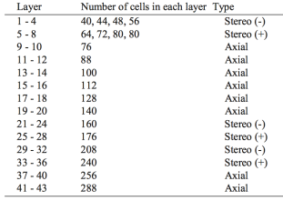
BESIII Drift Chamber
Could serve as a starting point
Square drift cells
Cell size
1.2cm (inner), 1.6 cm (outer)
# of layers = 43
L~70cm
B = 1 T
He/C₃H₈ (60/40)
Performance
Momentum resolution: ~ 0.5% @1GeV
dE/dx resolution: ~ 6% (MIP)

Slide 10
Adapting to HIEPA ?
Enlarge R_{in} to avoid the very high beam background near IR expected at HIEPA.
Reduce cell size for inner layers to accommodate generally high counting rates in the region at HIEPA.
To further reduce material ?
No Au coating on Al wires
Thinner W wires
A lighter working gas
Sharing field wires at axial-stereo boundaries

Slide 11
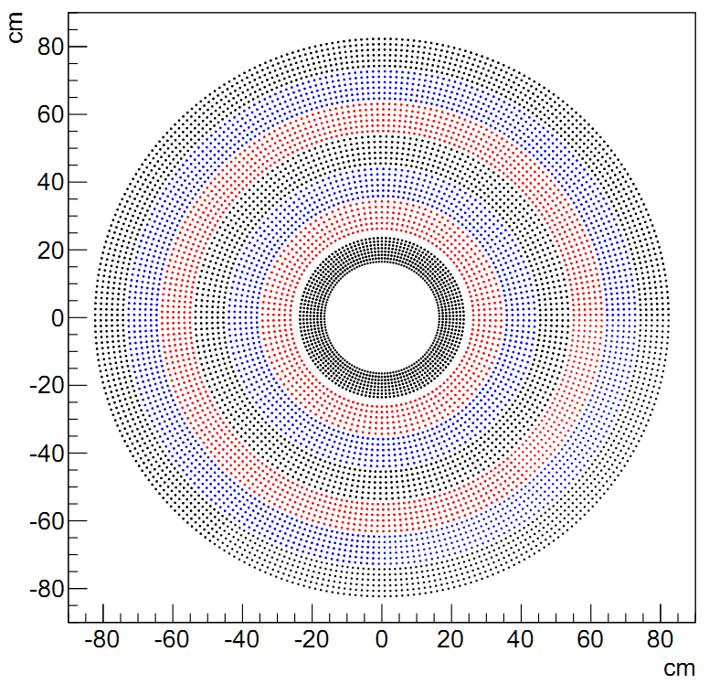
A Drift Chamber for HIEPA ?
Rin = 15 cm
Rout = 85 cm
L = 2.4 m
B = 1 T
He/C2H6 (60/40)
Cell size =1.0cm(inner),1.6cm(outer)
Sense wire: 20 um W
Field wire: 110 um Al
# of layers = 44
Layer configuration: 8A-6U-6V-6A-6U-6V-6A
Carbon fiber for both inner and outer walls
Expected spatial resolution: ~130 um
Expected dE/dx resolution: 6%

Slide 12
Standalone Tracking Performance
Outer tracker (the drift chamber) alone
Momentum resolution estimated using empirical formula
σ_{x} | 130um
L | 70cm
B | 1T
N | 44
X₀ | cm
Inner region | 19209.0
Outer region | 36522.0
Overall | 34942.8
momentum resolution | position measurement | multiple scattering | total
(%) | 0.335 | 0.364 | 0.495

Slide 13
Inner Tracker Options
Silicon detectors
Prerequisite for use at HIEPA: low material
Examples
STAR heavy flavor tracker
BELLE2 pixel detector
Cylindrical GEM
a gaseous detector, low mass intrinsically
An example
KLOE2 inner tracker
…

Slide 14
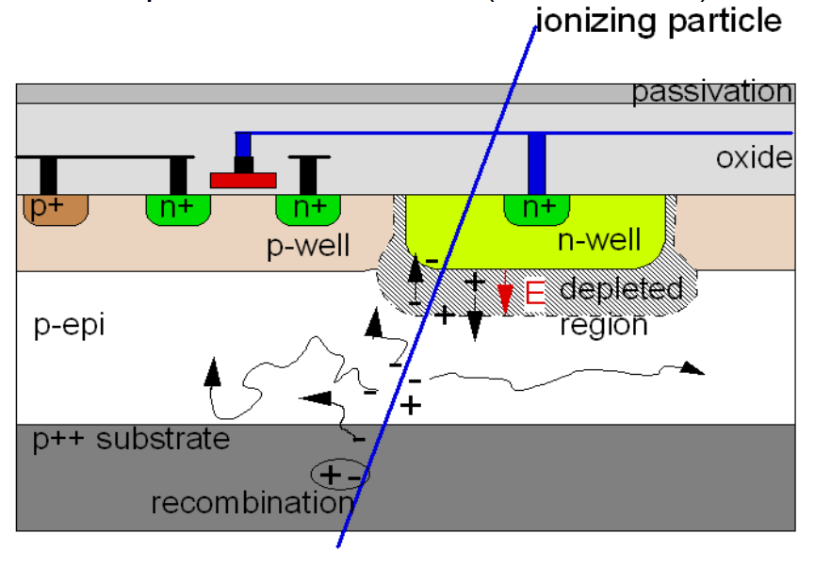
STAR Heavy Flavor Tracker
SSD: single-layer double-side strips
IST: one layer of strips
PIXEL
MAPS technique : sensor and signal processing integrated → low material, low power consumption
pixel pitch: 20 μm *20μm
2cm*20cm ladder, 10 ladder in total
double layers
MAPS technology
A prototype pixel ladder

Slide 15
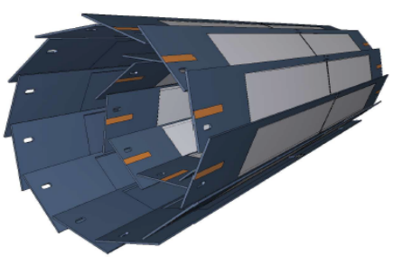
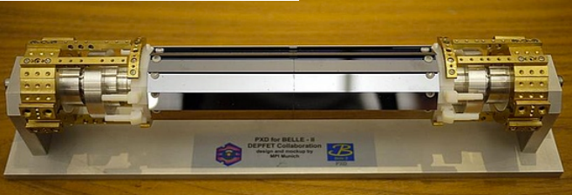
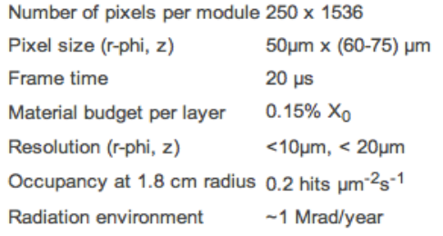
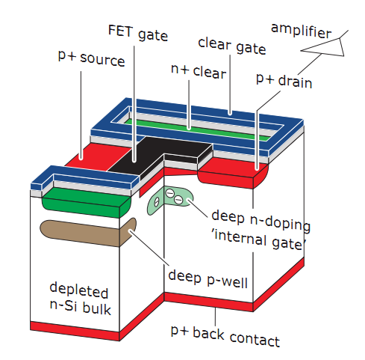
BELLE2 Pixel Detector
Two layers of PXD: 1.8 cm and 2.2 cm in radius, consisting of 8 and 12 modules for innermost layer and the second, respectively.
DEPFET Technology

Slide 16
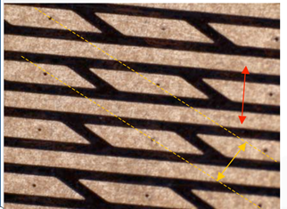
KLOE2 Inner Tracker
2-d strip readout
Material Budget
Total 1 layer | 0.49%
Total 4 layers | 1.95%
Pixel readout would be required for the innermost layers at HIEPA
X pitch 650μm → X res 190 μm
V pitch 650μm → Y res 350 μm

Slide 17
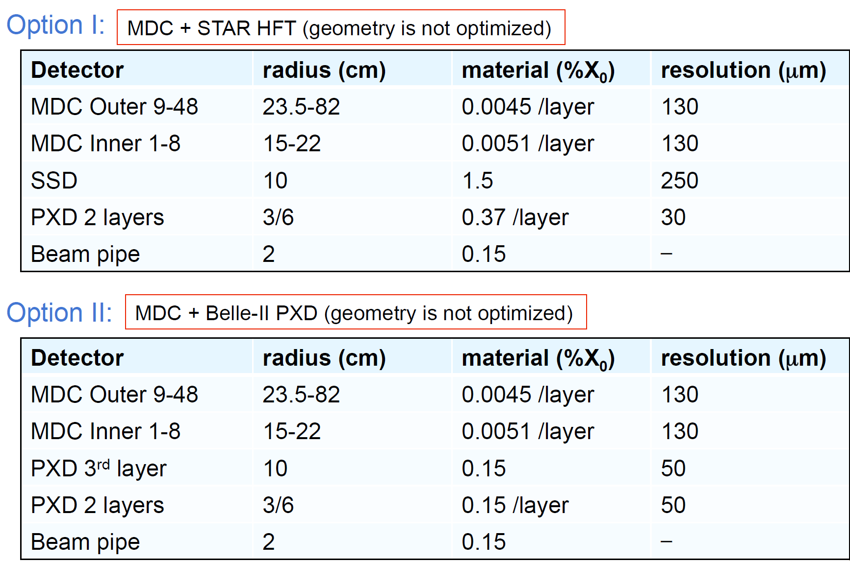
Combining inner and outer trackers

Slide 18
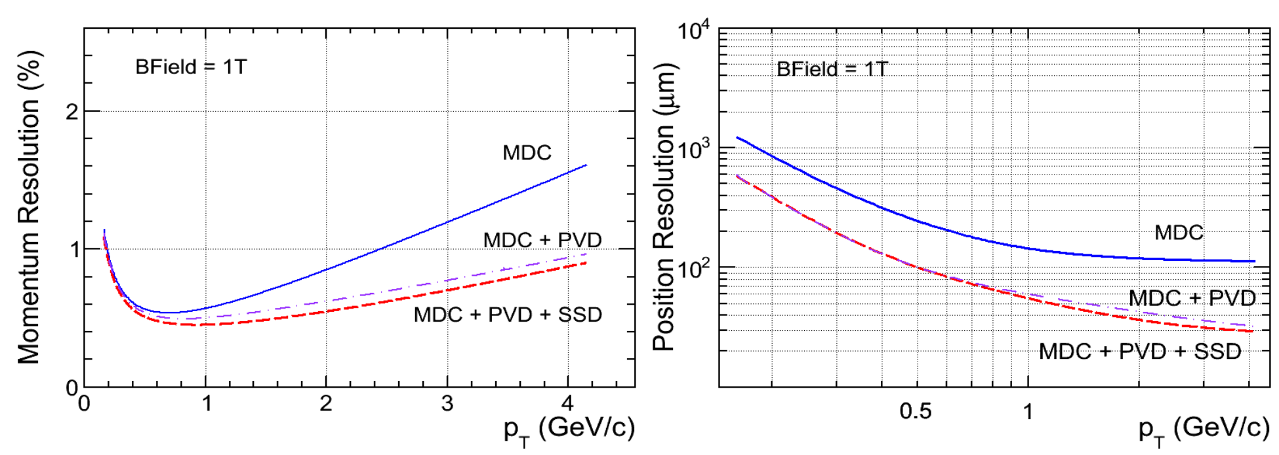
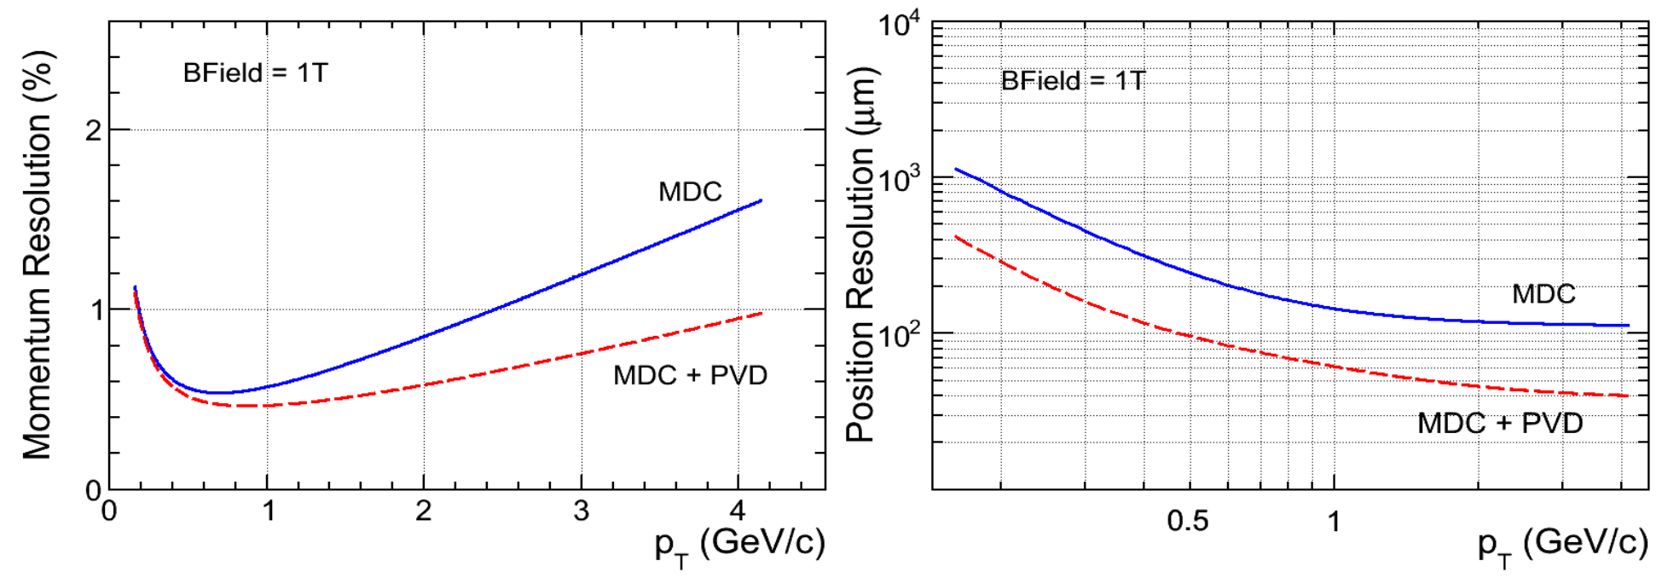
Combined Tracking Performance
Option1
Option2
Caveat: very rough modeling used on material effect

Slide 19
Summary
Tracking system for HIEPA
Outer tracker (main tracker)
a small-cell drift chamber with helium-based gas and Al wires.
Inner tracker
Silicon or GEM? Material still a concern? cost for pixels? …
Others?
More concrete and serious work needs to be done.

Slide 20
Backup

Slide 24
KLOE CGEM

