Slide 1
Update of signal reconstruction(${}_{Λ}^{3}H$) in Run2020 FXT Au-Au 5.2GeV
yulou

Slide 2
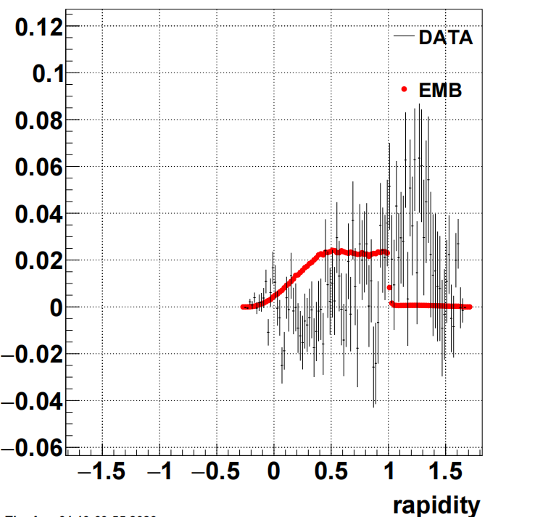
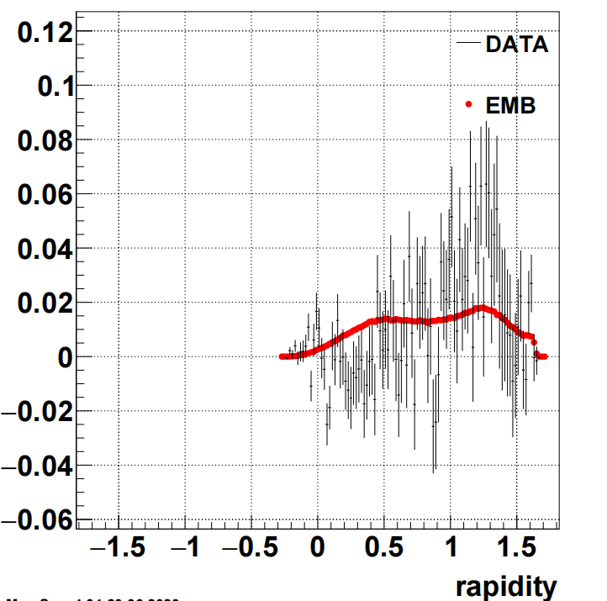
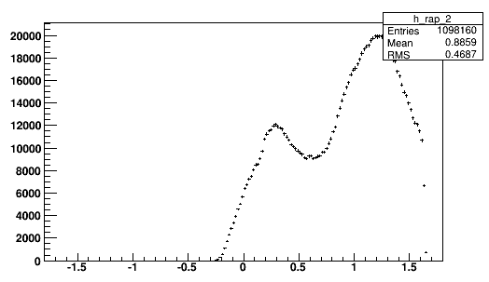
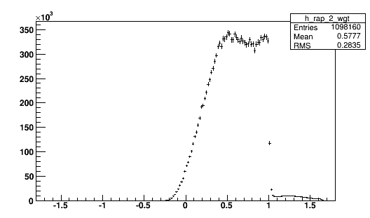
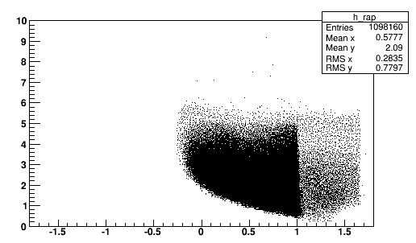
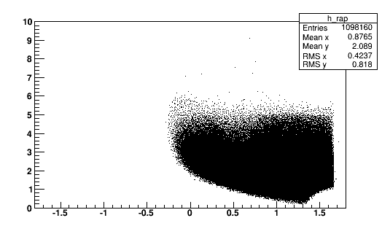
Reconstruct H3L and compare with MC using the same topological cuts
pT&y weighted MC, parameters of functions is the default in codes.(later I’ll change them)
The raw pT and rapidity distributions,daughter track comparison are also shown.
from embedding data

Slide 3
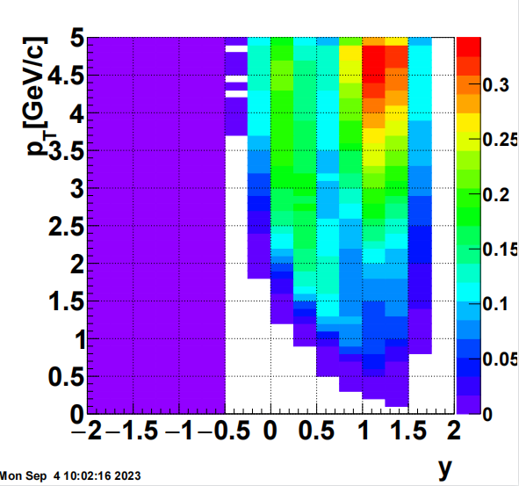
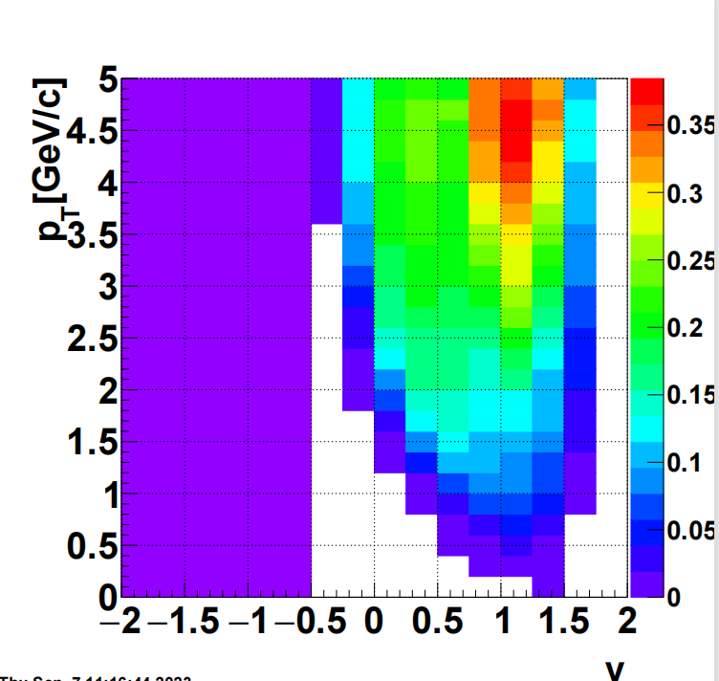
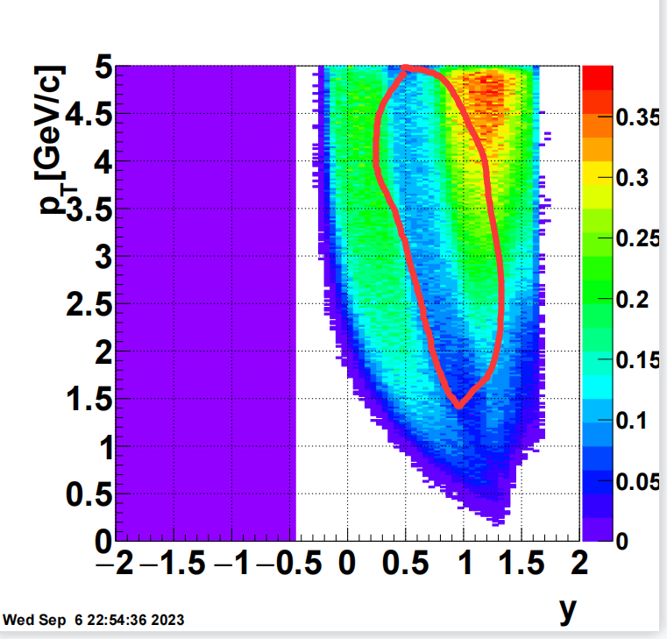
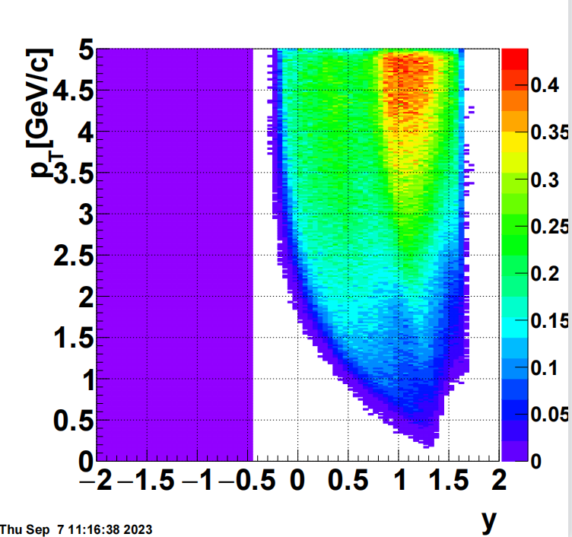
Reconstruct H3L and compare with MC using the same topological cuts
pT&y weighted MC, parameters of functions is the default in codes.(later I’ll change them)

