Slide 1
Weekly Report

Slide 2
A: amplitude A(x)，coupling coefficient a
B：amplitude B(x)，coupling coefficient b
Here x means 4-momentum of one event
$$A\left(x\right)=a(x)∗e^{iα(x)}$$
$$a=A∗e^{iθ}$$
$$B\left(x\right)=b(x)∗e^{iβ(x)}$$
$$b=B∗e^{iγ}$$
$$\left[a∗A\left(x\right)+b∗B\left(x\right)\right]∗{[a∗A\left(x\right)+b∗B(x)]}^{∗}$$
A：$A^{2}∗a^{2}(x)$ B：$B^{2}∗b^{2}(x)$
A&B interference：$2∗A∗B∗a\left(x\right)∗b\left(x\right)∗cos⁡[(α\left(x\right)+θ)−(β\left(x\right)+γ)]$
Total：$A^{2}∗a^{2}\left(x\right)+B^{2}∗b^{2}\left(x\right)+2∗A∗B∗a\left(x\right)∗b\left(x\right)∗cos⁡[(α\left(x\right)+θ)−(β\left(x\right)+γ)]$

Slide 3

Situation I:
$$A\left(x\right)=B(x)$$
Total：${(A}^{2}+B^{2}+2∗A∗B∗cos⁡(θ−γ))∗a^{2}\left(x\right)$
A：$A^{2}∗a^{2}(x)$
A&B interference：$2∗A∗B∗a^{2}(x)∗cos⁡[(α\left(x\right)+θ)−(β\left(x\right)+γ)]$
Situation II:
$$A\left(x\right)≠B\left(x\right)$$
Total：$A^{2}∗a^{2}\left(x\right)+B^{2}∗b^{2}\left(x\right)+2∗A∗B∗a\left(x\right)∗b\left(x\right)∗cos⁡[(α\left(x\right)+θ)−(β\left(x\right)+γ)]$
A：$A^{2}∗a^{2}(x)$ B：$B^{2}∗b^{2}(x)$

Slide 4
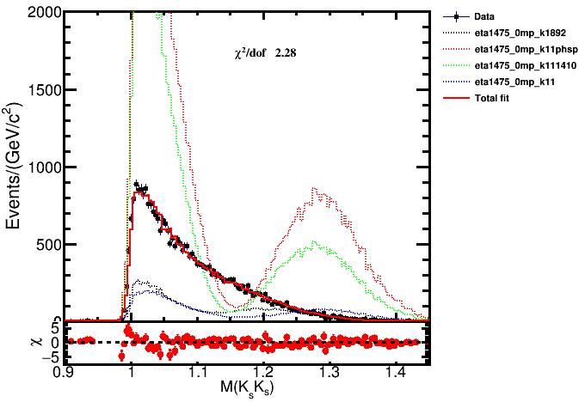

Slide 5
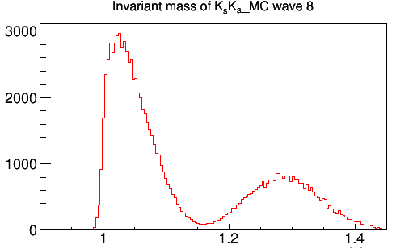
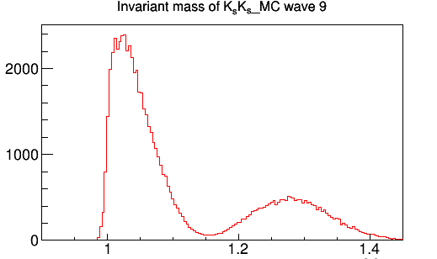
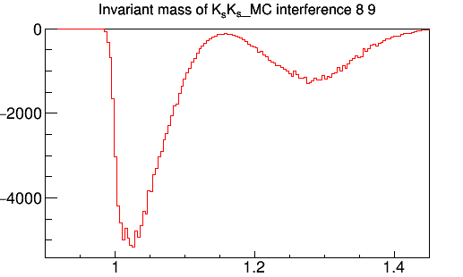

Slide 6
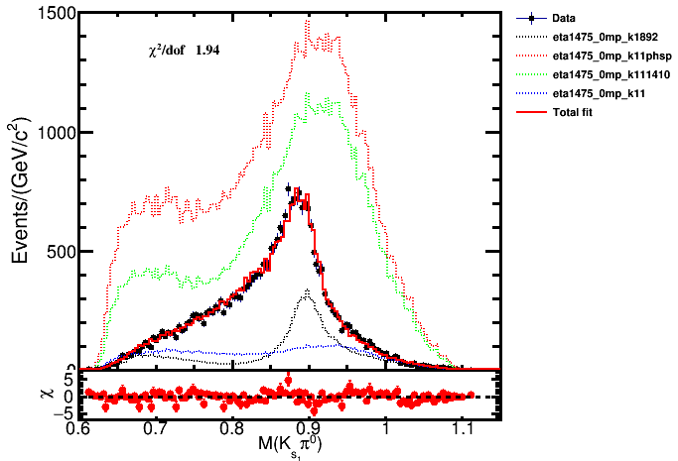

Slide 7
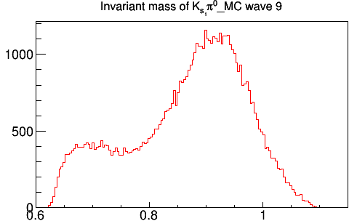
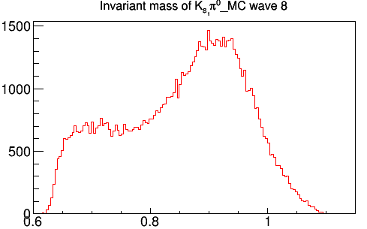
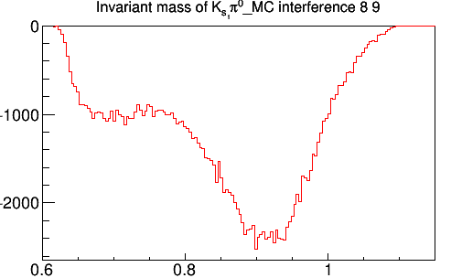

Slide 8
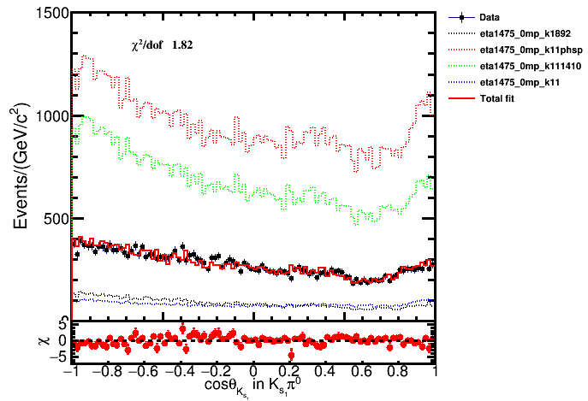

Slide 9
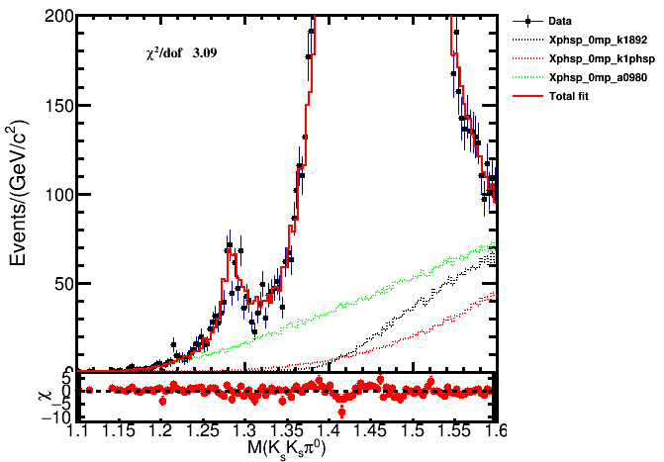
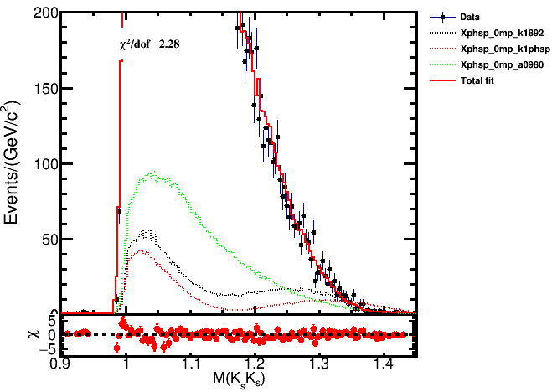
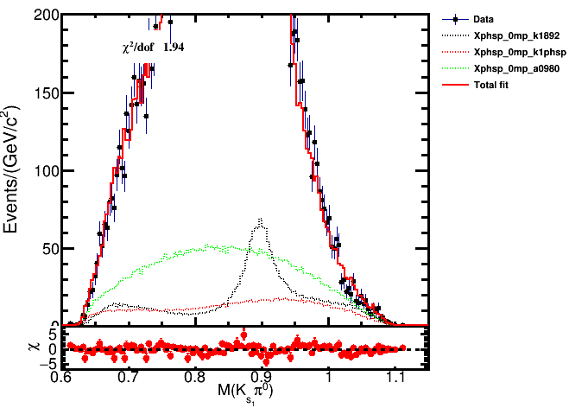
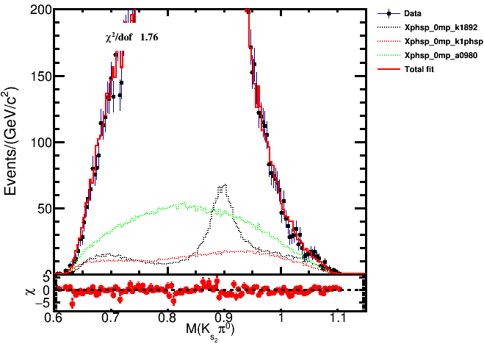
PHSP 0-+

