Slide 1
Luminosity Measurement using Bhabha process

Slide 2
Data Set
Below DD threshold:
Ecm | Taking time | runNo | Ecm | Taking time | runNo
2.2324 | 12.06.08-12.06.16 | [28624,28648] | 3.0990 | 12.06.07 | [28499,28503]
2.4000 | 12.06.08-12.06.16 | [28577,28621] | 3.1015 | 12.06.07 | [28504,28505]
2.8000 | 12.06.08-12.06.16 | [28553,28575] | 3.1055 | 12.06.07 | [28506,28509]
3.4000 | 12.06.08-12.06.16 | [28543,28548] | 3.1120 | 12.06.07 | [28510,28511]
3.0500 | 12.05.28 | [28312,28346] | 3.1200 | 12.06.07 | [28512,28513]
3.0600 | 12.05.28-12.05.30 | [28347,28381] | 3.0800 | 12.05.23-1205.24, 12.04.08 | [27147,27233] [28241,28266]
3.0830 | 12.05.30, 12.06.04 | [28382,28387],[28466,28469] | 3.5000 | 13.06.05-13.06.06 | [33725,33733]
3.0900 | 12.05.31-12.06.05 | [28388,28416],[28472,28475] | 3.5424 | 11.12.21-11.12.31, 13.06.05-13.06.06 | [24983,25015][33734,33743]
3.0930 | 12.06.01-12.06.05 | [28419,28453],[28476,28478] | 3.5538 | 11.12.21-11.12.31 | [25016,25094]
3.0943 | 12.06.05-12.06.06 | [28479,28482] | 3.5611 | 11.12.21-11.12.31 | [25100,25141]
3.0952 | 12.06.06 | [28487,28489] | 3.6002 | 11.12.21-11.12.31 | [25143,25243]
3.0958 | 12.06.06 | [28490,28492] | 3.6500 | 09.05.26-09.06.03, 13.06.05-13.06.06 | [9613,9779] [33747,33758]
3.0969 | 12.06.06 | [28493,28495] | 3.6710 | 13.06.05-13.06.06 | [33759,33764]
3.0982 | 12.06.07 | [28496,28498]

Slide 3
Data Set
Above DD threshold:
Ecm | Taking time | runNo
3.850—4.590 | 2013.12.09—2014.01.24 | 34011--35116

Slide 4
MC sample
e+e-→e+e- (babayaga3.5) : 500000
e+e-→γγ (babayaga3.5) : 500000
e+e-→μ+μ- (babayaga3.5) : 500000
e+e-→τ+τ- (KKMC) : 300000
e+e-→hadrons (LUNDARLW) : 300000
e+e-→e+ e- X (two photon process) : 300000

Slide 5
Event Selection
MDC Track
|Vr| < 1.0 cm
|Vz| < 10.0 cm
N₊= N₋= 1
|Δθ| < 10◦
|Δϕ| < 5◦
EMC Shower
N_{cluster}== 2
|cosθ| < 0.8
E_{shower}> 0.65*E_{beam}

Slide 6
Part 1 :
2.2324GeV ~ 3.671GeV

Slide 7
Events and background estimation
Ecm | Events | Bkg from Digam | Bkg from Dimu | Ecm | Events | Bkg from Digam | Bkg from Dimu
2.2324 | 728522 | 0.7 | 0 | 3.0990 | 125436 | 0.1 | 0
2.4000 | 818942 | 0 | 0 | 3.1015 | 236847 | 1.2 | 0
2.8000 | 664078 | 0 | 0 | 3.1055 | 306048 | 0.1 | 0
3.4000 | 208091 | 0 | 0 | 3.1120 | 245929 | 0 | 0
3.0500 | 2221847 | 1.1 | 0 | 3.1200 | 181450 | 0 | 0
3.0600 | 2234301 | 4.5 | 0 | 3.0800 | 4538582 | 2.3 | 0
3.0830 | 693661 | 0.3 | 0 | 3.5000 | 411177 | 0.2 | 0
3.0900 | 2287810 | 1.1 | 0 | 3.5424 | 959870 | 0 | 0
3.0930 | 2086326 | 0 | 0 | 3.5538 | 612559 | 0 | 0
3.0943 | 338430 | 0 | 0 | 3.5611 | 422111 | 0.4 | 0
3.0952 | 330374 | 0 | 0 | 3.6002 | 1021449 | 0 | 0
3.0958 | 481291 | 0 | 0 | 3.6500 | 5045057 | 0 | 0
3.0969 | 572989 | 0 | 0 | 3.6710 | 474940 | 0 | 0
3.0982 | 436846 | 0 | 0

Slide 8
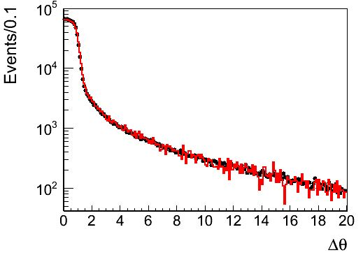
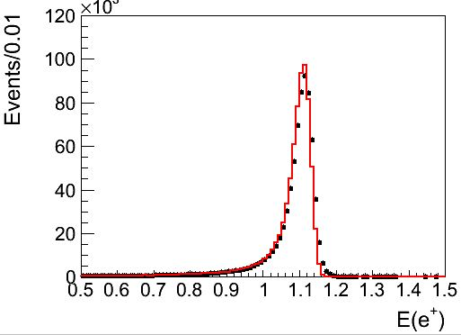
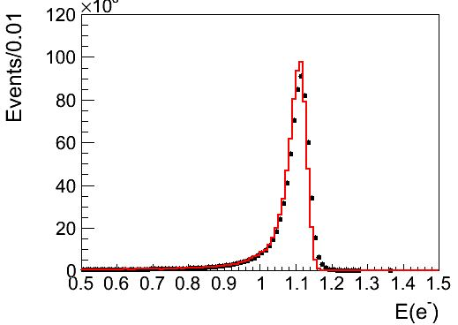
Comparison(2.23GeV)

Slide 9
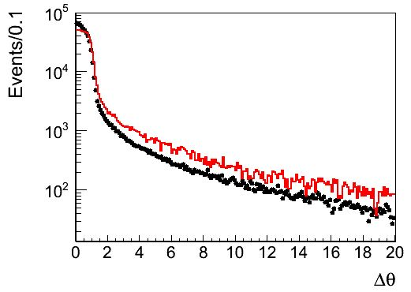
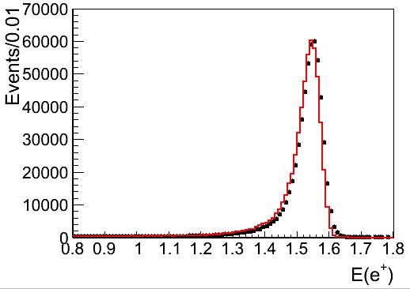
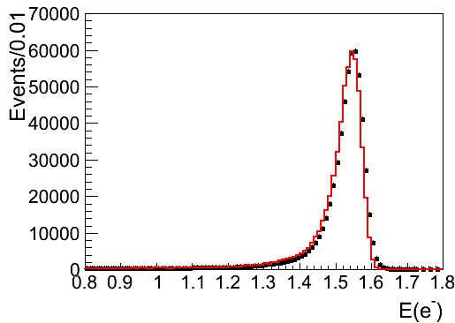
Comparison(3.0969GeV)

Slide 10
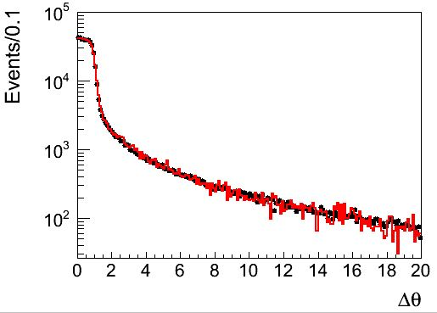
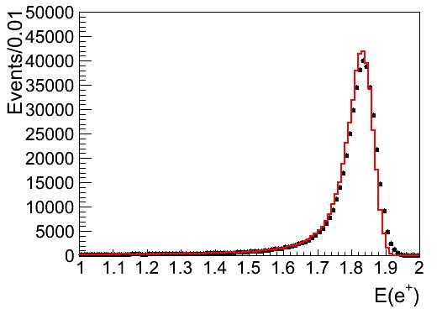
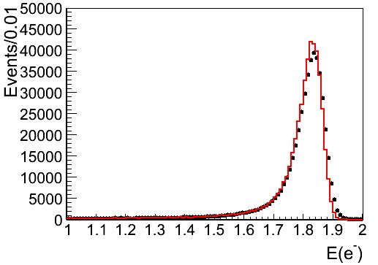
Comparison(3.671GeV)

Slide 11
Results
Ecm | Efficiency/% | Cross section/pb | Luminosity/pb-1 | Ecm | efficiency | Cross section | luminosity
2.2324 | 18.7952 | 1469.8 | 2.637 | 3.0990 | 18.9158 | 765.0 | 0.867
2.4000 | 18.7622 | 1278.1 | 3.415 | 3.1015 | 18.8702 | 770.1 | 1.630
2.8000 | 18.8384 | 938.1 | 3.757 | 3.1055 | 18.9328 | 765.3 | 2.112
3.4000 | 18.7904 | 639.2 | 1.681 | 3.1120 | 18.7846 | 760.3 | 1.722
3.0500 | 18.8102 | 785.7 | 15.033 | 3.1200 | 18.8256 | 757.9 | 1.272
3.0600 | 18.9068 | 787.4 | 15.007 | 3.0800 | 18.8414 | 776.5 | 31.019
3.0830 | 18.9066 | 775.9 | 4.728 | 3.5000 | 18.7864 | 603.9 | 3.624
3.0900 | 18.8116 | 773.2 | 15.729 | 3.5424 | 18.8222 | 586.8 | 8.690
3.0930 | 18.895 | 767.9 | 14.377 | 3.5538 | 18.821 | 585.7 | 5.556
3.0943 | 18.866 | 770.2 | 2.329 | 3.5611 | 18.6942 | 584.5 | 3.863
3.0952 | 18.8466 | 761.3 | 2.302 | 3.6002 | 18.9004 | 569.1 | 9.495
3.0958 | 18.8416 | 768.7 | 3.323 | 3.6500 | 18.7422 | 556.4 | 48.375
3.0969 | 18.9088 | 766.9 | 3.951 | 3.6710 | 18.7972 | 546.4 | 4.624
3.0982 | 18.987 | 770.3 | 2.987

Slide 12
Systematic Error(1)
Ecm | Event selections | Tracking efficiency | MC statistics | Bkg estimation | Trigger efficiency | Generator | Total/%
2.2324 | 0.57 | 0.31 | 0.06 | 0 | 0.1 | 0.5 | 0.83
2.4000 | 0.25 | 0.04 | 0.06 | 0 | 0.1 | 0.5 | 0.58
2.8000 | 0.15 | 0.21 | 0.06 | 0 | 0.1 | 0.5 | 0.58
3.4000 | 0.10 | 0.56 | 0.06 | 0 | 0.1 | 0.5 | 0.76
3.0500 | 0.27 | 0.22 | 0.06 | 0 | 0.1 | 0.5 | 0.62
3.0600 | 0.61 | 0.17 | 0.06 | 0 | 0.1 | 0.5 | 0.81
3.0830 | 0.13 | 0.06 | 0.06 | 0 | 0.1 | 0.5 | 0.53
3.0900 | 0.21 | 0.08 | 0.06 | 0 | 0.1 | 0.5 | 0.56
3.0930 | 0.28 | 0.26 | 0.06 | 0 | 0.1 | 0.5 | 0.64
3.0943 | 1.28 | 0.26 | 0.06 | 0 | 0.1 | 0.5 | 1.40
3.0952 | 4.11 | 0.77 | 0.06 | 0 | 0.1 | 0.5 | 4.21
3.0958 | 7.79 | 1.50 | 0.06 | 0 | 0.1 | 0.5 | 7.96
3.0969 | 12.1 | 1.78 | 0.06 | 0 | 0.1 | 0.5 | 12.27
3.0982 | 7.46 | 1.05 | 0.06 | 0 | 0.1 | 0.5 | 7.56

Slide 13
Systematic Error(1)
Ecm | Event selections | Tracking efficiency | MC statistics | Bkg estimation | Trigger efficiency | Generator | Total
3.0990 | 4.26 | 0.46 | 0.06 | 0 | 0.1 | 0.5 | 4.31
3.1015 | 1.51 | 0.20 | 0.06 | 0 | 0.1 | 0.5 | 1.61
3.1055 | 0.75 | 0.19 | 0.06 | 0 | 0.1 | 0.5 | 0.93
3.1120 | 0.51 | 0.06 | 0.06 | 0 | 0.1 | 0.5 | 0.73
3.1200 | 0.23 | 0.04 | 0.06 | 0 | 0.1 | 0.5 | 0.56
3.0800 | 0.10 | 0.03 | 0.06 | 0 | 0.1 | 0.5 | 0.52
3.5000 | 0.34 | 0.12 | 0.06 | 0 | 0.1 | 0.5 | 0.63
3.5424 | 0.34 | 0.10 | 0.06 | 0 | 0.1 | 0.5 | 0.62
3.5538 | 0.17 | 0.02 | 0.06 | 0 | 0.1 | 0.5 | 0.54
3.5611 | 0.42 | 0.09 | 0.06 | 0 | 0.1 | 0.5 | 0.67
3.6002 | 0.13 | 0.16 | 0.06 | 0 | 0.1 | 0.5 | 0.75
3.6500 | 0.11 | 0.15 | 0.06 | 0 | 0.1 | 0.5 | 0.55
3.6710 | 0.12 | 0.02 | 0.06 | 0 | 0.1 | 0.5 | 0.53

Slide 14
Final Result
Ecm | Luminosity | Ecm | Luminosity
2.2324 | 2.637±0.009±0.022 | 3.0990 | 0.867±0.004±0.037
2.4000 | 3.415±0.011±0.020 | 3.1015 | 1.630±0.006±0.026
2.8000 | 3.757±0.013±0.022 | 3.1055 | 2.112±0.008±0.020
3.4000 | 1.681±0.007±0.013 | 3.1120 | 1.722±0.007±0.013
3.0500 | 15.033±0.050±0.093 | 3.1200 | 1.272±0.005±0.007
3.0600 | 15.007±0.050±0.122 | 3.0800 | 31.019±0.102±0.163
3.0830 | 4.728±0.016±0.025 | 3.5000 | 3.624±0.013±0.023
3.0900 | 15.729±0.052±0.088 | 3.5424 | 8.690±0.030±0.054
3.0930 | 14.377±0.048±0.092 | 3.5538 | 5.556±0.019±0.030
3.0943 | 2.329±0.009±0.033 | 3.5611 | 3.863±0.014±0.026
3.0952 | 2.302±0.009±0.097 | 3.6002 | 9.495±0.032±0.071
3.0958 | 3.323±0.012±0.264 | 3.6500 | 48.375±0.160±0.264
3.0969 | 3.951±0.014±0.485 | 3.6710 | 4.624±0.017±0.025
3.0982 | 2.987±0.011±0.226

Slide 15
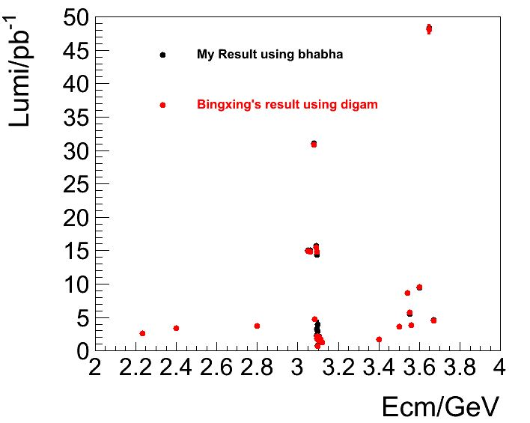
Comparison
Result with two methods:
Systematic Error comparison:

Slide 16
Part 2 :
3.850GeV ~ 4.590GeV

Slide 17
Events and background estimation
Ecm | Events | Bkg from Digam | Bkg from Dimu | Bkg from Hadrons
3.850 | 745606 | 0.4 | 0 | 101.0
4.000 | 671866 | 0 | 0 | 38.8
4.050 | 557522 | 0 | 0 | 39.6
4.100 | 602474 | 0.3 | 0 | 5.7
4.150 | 620786 | 0 | 0 | 0.5
4.200 | 599857 | 0 | 0 | 0
4.250 | 663143 | 0 | 0 | 0.5
4.300 | 635965 | 0 | 0 | 2.4
4.350 | 628814 | 0 | 0 | 1.9
4.400 | 516865 | 0 | 0 | 0
4.450 | 541200 | 0 | 0 | 0
4.500 | 549911 | 0.5 | 0 | 0
4.550 | 587193 | 0 | 0 | 0
4.590 | 538420 | 0.3 | 0 | 0

Slide 18
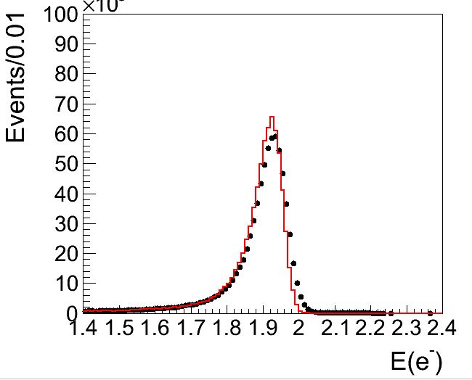
@3.850GeV

Slide 19
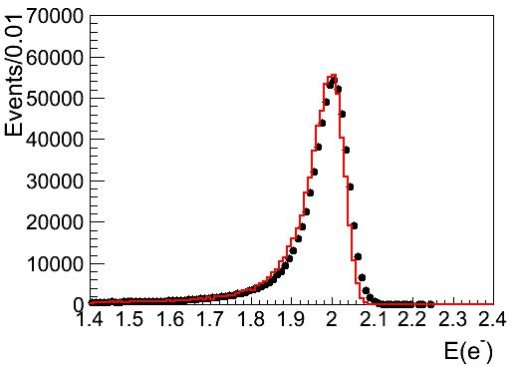
@4.000GeV

Slide 20
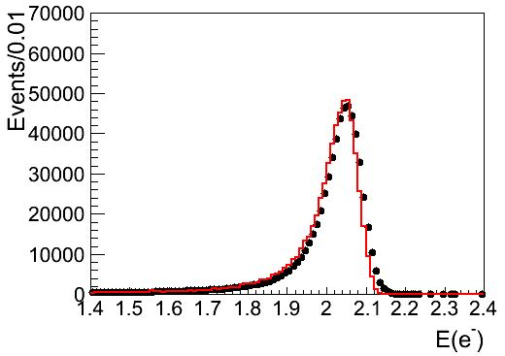
@4.100GeV

Slide 21
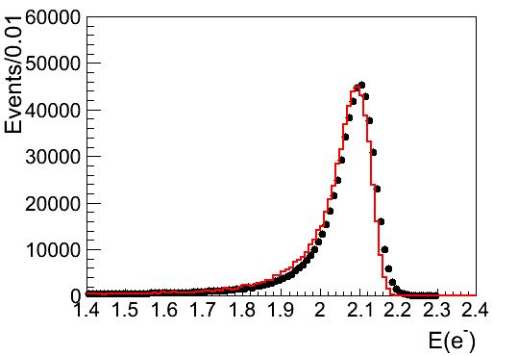
@4.200GeV

Slide 22
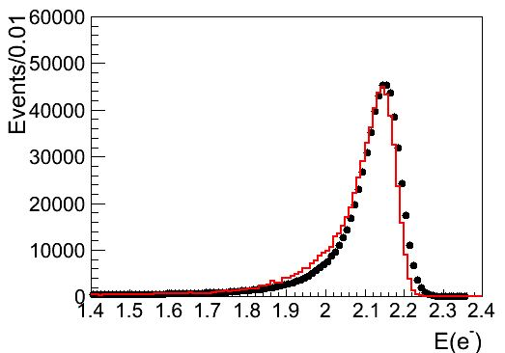
@4.300GeV

Slide 23
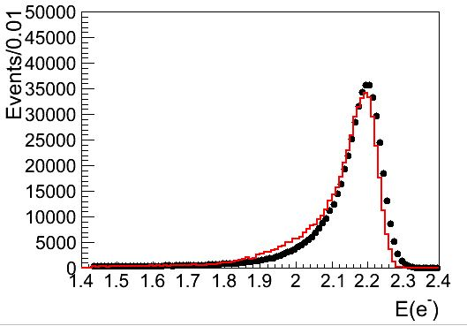
@4.400GeV

Slide 24
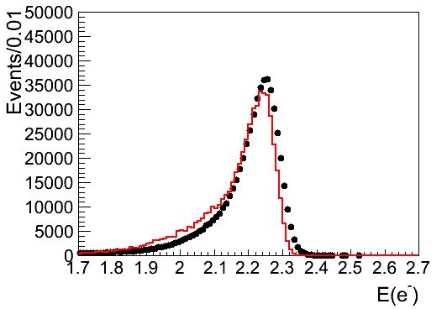
@4.500GeV

Slide 25
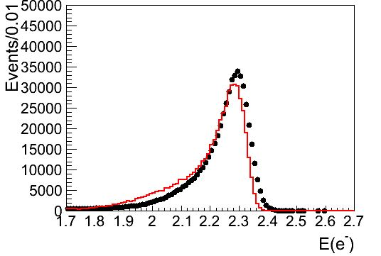
@4.590GeV

Slide 26
Results
Ecm | Efficiency/% | Cross section/pb | Luminosity/pb-1 | Statistic Error
3.850 | 18.764 | 499.593 | 7.954 | 0.034
4.000 | 18.680 | 462.963 | 7.769 | 0.034
4.050 | 18.710 | 452.299 | 6.588 | 0.029
4.100 | 18.781 | 441.102 | 7.272 | 0.032
4.150 | 18.824 | 430.660 | 7.657 | 0.034
4.200 | 18.790 | 420.579 | 7.591 | 0.033
4.250 | 18.862 | 410.202 | 8.571 | 0.038
4.300 | 18.803 | 400.777 | 8.439 | 0.037
4.350 | 18.796 | 391.872 | 8.537 | 0.038
4.400 | 18.741 | 383.576 | 7.190 | 0.032
4.450 | 18.903 | 374.678 | 7.641 | 0.034
4.500 | 18.754 | 366.521 | 8.000 | 0.035
4.550 | 18.742 | 357.910 | 8.753 | 0.039
4.590 | 18.830 | 352.580 | 8.110 | 0.036

Slide 27
Systematic Error
Ecm | Event selections | Tracking efficiency | MC statistics | Bkg estimation | Trigger efficiency | Generator | Total/%
3.850 | 0.43 | 0.26 | 0.07 | 0.01 | 0.1 | 0.5 | 0.72
4.000 | 0.46 | 0.34 | 0.07 | 0.01 | 0.1 | 0.5 | 0.77
4.050 | 0.17 | 0.56 | 0.07 | 0.01 | 0.1 | 0.5 | 0.78
4.100 | 0.57 | 0.73 | 0.07 | 0.01 | 0.1 | 0.5 | 1.06
4.150 | 0.11 | 0.55 | 0.07 | 0.01 | 0.1 | 0.5 | 0.76
4.200 | 0.46 | 0.54 | 0.07 | 0.01 | 0.1 | 0.5 | 0.88
4.250 | 0.30 | 0.08 | 0.07 | 0.01 | 0.1 | 0.5 | 0.60
4.300 | 0.28 | 0.40 | 0.07 | 0.01 | 0.1 | 0.5 | 0.71
4.350 | 0.29 | 0.32 | 0.07 | 0.01 | 0.1 | 0.5 | 0.67
4.400 | 0.08 | 0.20 | 0.07 | 0.01 | 0.1 | 0.5 | 0.56
4.450 | 0.34 | 0.40 | 0.07 | 0.01 | 0.1 | 0.5 | 0.74
4.500 | 0.17 | 0.12 | 0.07 | 0.01 | 0.1 | 0.5 | 0.56
4.550 | 0.16 | 0.23 | 0.07 | 0.01 | 0.1 | 0.5 | 0.59
4.590 | 0.67 | 0.12 | 0.07 | 0.01 | 0.1 | 0.5 | 0.86

Slide 28
Final Result(1)
Ecm | Luminosity/pb-1 | Ecm | Luminosity/pb-1
3.850 | 7.954±0.035±0.057 | 3.955 | 8.117±0.036±0.050
3.890 | 7.732±0.034±0.044 | 3.960 | 8.466±0.037±0.051
3.895 | 7.563±0.033±0.066 | 3.965 | 7.799±0.034±0.066
3.900 | 7.613±0.033±0.091 | 3.970 | 7.299±0.032±0.048
3.905 | 7.576±0.033±0.069 | 3.975 | 8.099±0.036±0.072
3.910 | 7.207±0.032±0.049 | 3.980 | 7.892±0.035±0.053
3.915 | 7.448±0.033±0.048 | 3.985 | 7.963±0.035±0.081
3.920 | 6.824±0.030±0.040 | 3.990 | 8.028±0.035±0.069
3.925 | 6.698±0.030±0.043 | 3.995 | 7.980±0.035±0.051
3.930 | 6.756±0.030±0.059 | 4.000 | 7.769±0.034±0.060
3.935 | 7.185±0.032±0.048 | 4.005 | 7.517±0.033±0.058
3.940 | 7.249±0.032±0.053 | 4.010 | 7.199±0.032±0.048
3.945 | 7.614±0.033±0.056 | 4.012 | 6.898±0.030±0.047
3.950 | 7.679±0.034±0.056 | 4.014 | 6.681±0.029±0.042

Slide 29
Final Result(2)
Ecm | Luminosity/pb-1 | Ecm | Luminosity/pb-1
4.016 | 6.549±0.029±0.045 | 4.100 | 7.272±0.032±0.077
4.018 | 6.976±0.031±0.047 | 4.110 | 7.174±0.032±0.054
4.020 | 6.739±0.030±0.042 | 4.120 | 7.667±0.034±0.046
4.025 | 6.537±0.029±0.043 | 4.130 | 7.209±0.032±0.062
4.030 | 16.466±0.071±0.115 | 4.140 | 7.285±0.032±0.046
4.035 | 6.701±0.029±0.050 | 4.145 | 7.779±0.034±0.053
4.040 | 6.583±0.029±0.055 | 4.150 | 7.658±0.034±0.058
4.050 | 6.588±0.029±0.051 | 4.160 | 8.014±0.035±0.058
4.055 | 6.942±0.031±0.048 | 4.170 | 18.015±0.077±0.117
4.060 | 6.359±0.028±0.042 | 4.180 | 7.301±0.032±0.045
4.065 | 7.024±0.031±0.051 | 4.190 | 7.587±0.033±0.055
4.070 | 7.279±0.032±0.048 | 4.195 | 7.532±0.033±0.072
4.080 | 7.731±0.034±0.053 | 4.200 | 7.591±0.033±0.067
4.090 | 7.647±0.034±0.055 | 4.203 | 6.825±0.030±0.052

Slide 30
Final Result(3)
Ecm | Luminosity/pb-1 | Ecm | Luminosity/pb-1
4.206 | 7.632±0.034±0.056 | 4.265 | 8.635±0.038±0.056
4.210 | 7.646±0.034±0.048 | 4.270 | 8.540±0.037±0.057
4.215 | 7.759±0.034±0.050 | 4.275 | 8.581±0.038±0.050
4.220 | 7.962±0.035±0.057 | 4.280 | 8.772±0.039±0.065
4.225 | 8.266±0.036±0.079 | 4.285 | 8.554±0.037±0.056
4.230 | 8.242±0.036±0.065 | 4.290 | 9.020±0.039±0.053
4.235 | 8.316±0.037±0.057 | 4.300 | 8.439±0.038±0.060
4.240 | 7.839±0.035±0.054 | 4.310 | 8.599±0.038±0.052
4.243 | 8.587±0.038±0.053 | 4.320 | 9.316±0.041±0.059
4.245 | 8.495±0.037±0.067 | 4.330 | 8.654±0.038±0.060
4.248 | 8.560±0.038±0.061 | 4.340 | 8.691±0.038±0.058
4.250 | 8.571±0.038±0.052 | 4.350 | 8.537±0.038±0.057
4.255 | 8.672±0.038±0.070 | 4.360 | 8.087±0.036±0.051
4.260 | 8.944±0.039±0.070 | 4.370 | 8.461±0.037±0.054

Slide 31
Final Result(4)
Ecm | Luminosity/pb-1 | Ecm | Luminosity/pb-1
4.380 | 8.118±0.036±0.050 | 4.540 | 9.339±0.041±0.064
4.390 | 7.424±0.033±0.043 | 4.550 | 8.753±0.039±0.051
4.395 | 7.461±0.033±0.047 | 4.560 | 8.231±0.036±0.048
4.400 | 7.190±0.032±0.040 | 4.570 | 8.356±0.037±0.046
4.410 | 6.359±0.028±0.047 | 4.580 | 8.516±0.038±0.047
4.420 | 7.513±0.033±0.054 | 4.590 | 8.110±0.036±0.069
4.425 | 7.437±0.033±0.061
4.430 | 6.774±0.030±0.046
4.440 | 7.638±0.034±0.048
4.450 | 7.641±0.034±0.056
4.460 | 8.732±0.038±0.053
4.480 | 8.157±0.036±0.047
4.500 | 8.000±0.035±0.044
4.520 | 8.641±0.038±0.059

Slide 32
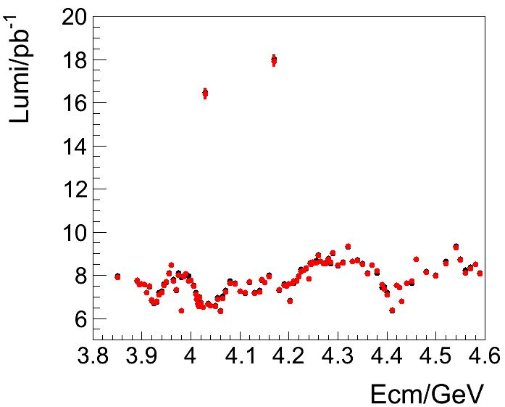
Comparison
Result with two methods:
Systematic Error comparison:

