Slide 1
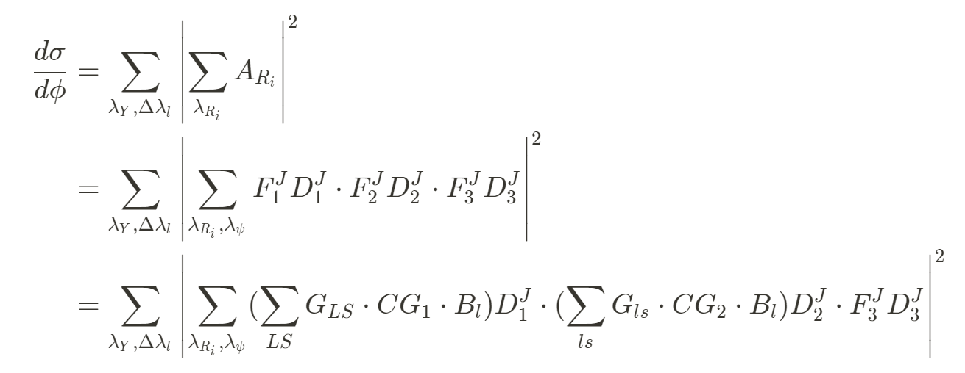
$F_{λ_{b}, λ_{a}}^{J}$ is helicity decay amplitude
Two body decay
Sequential decays: $Y→π^{+}π^{−}J/ψ, J/ψ→l^{+}l^{−}$
$G_{LS}$ is LS coupling partial wave amplitude
With a definite set of helicity of (b,c), $G_{LS}$ should be same
In fit, $G_{LS}$ is float parameter
To obtain the contribution of a LS wave component

Slide 2
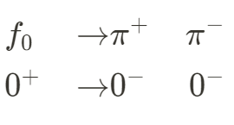
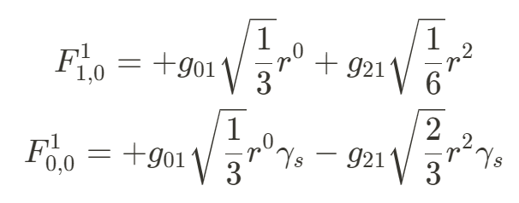
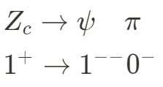
Two components: $SS$ and $DS$
four components:
$SS$, $SD$, $DS$ and $DD$

Slide 3
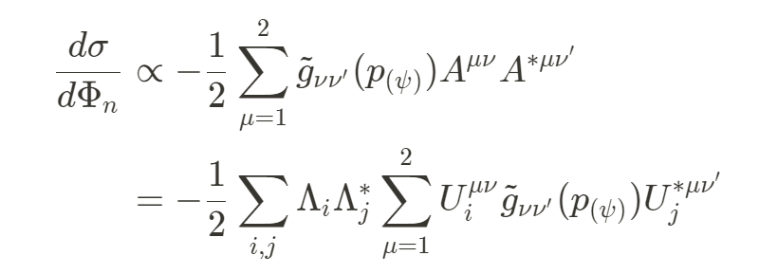
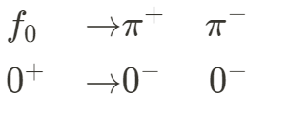
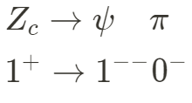
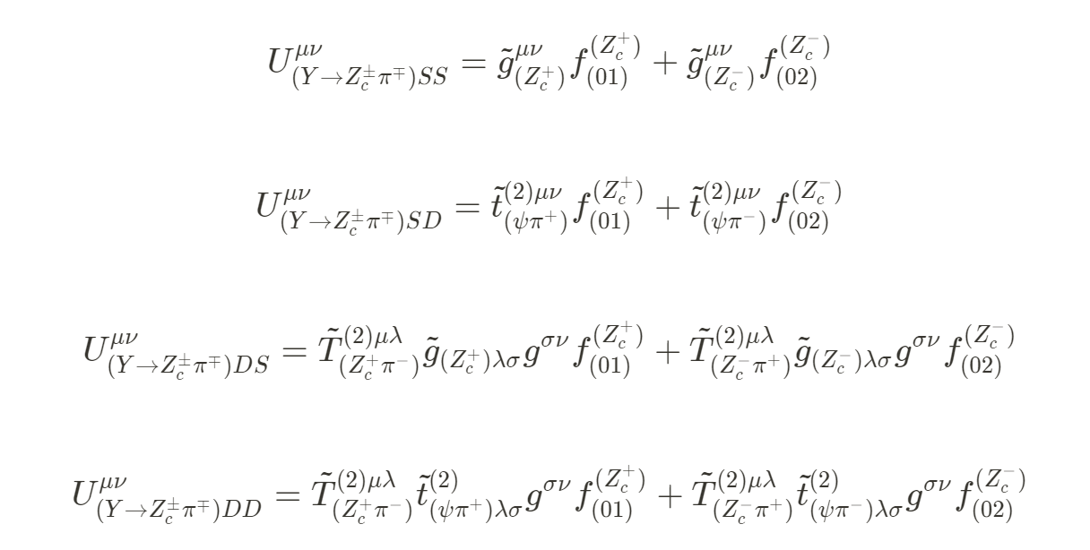
$U^{μν}$ is the partial wave amplitude constructed according to LS coupling

Slide 4
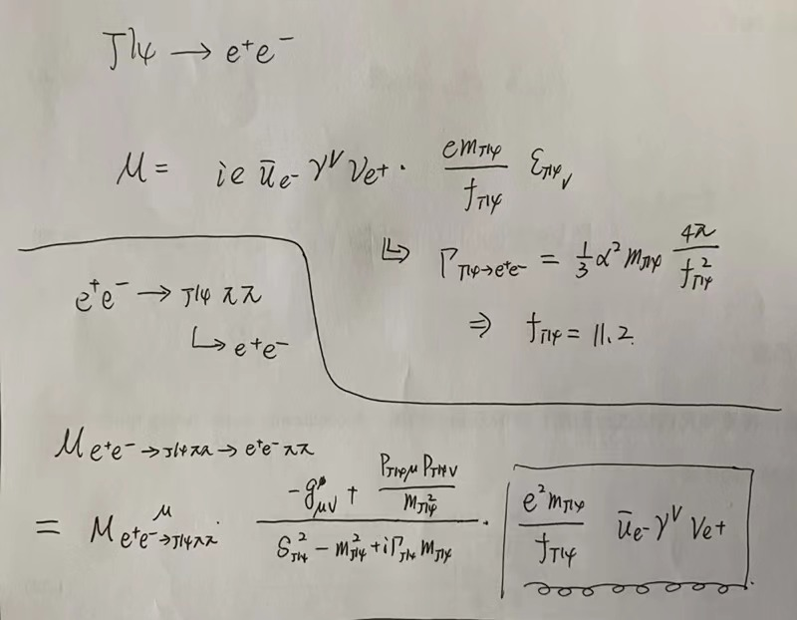
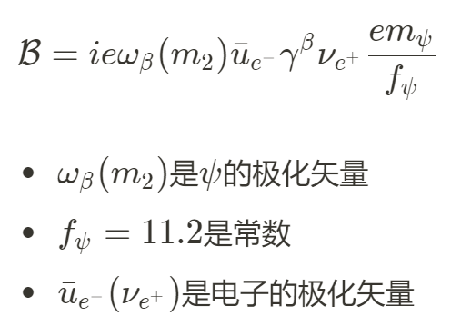
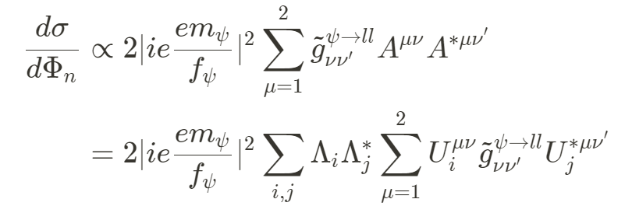

Slide 5
Sequential decays: $Y→π^{+}π^{−}J/ψ, J/ψ→l^{+}l^{−}$
Assume leptons have 0 spin
Come from the boost of frame
$Δλ_{l}=0$

Slide 6
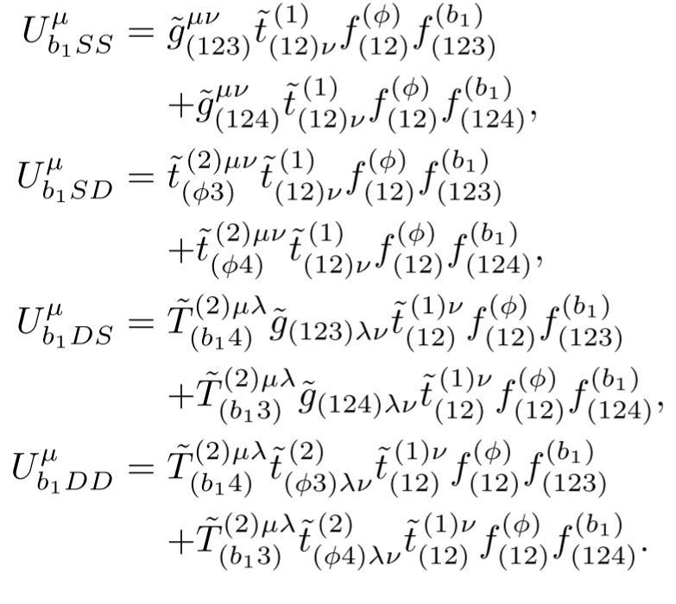
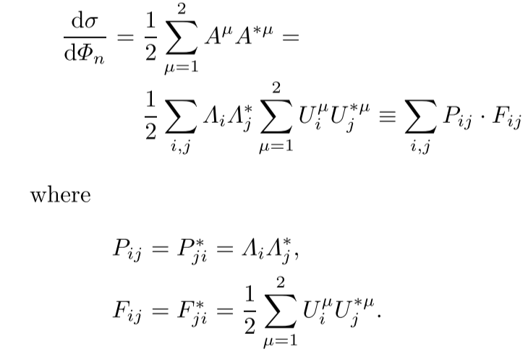
In covariant tensor formalism:

Slide 7
For leptons with 0 spin, Two methods give almost same results:
Zc SS MC sample
Zc DS MC sample

Slide 8
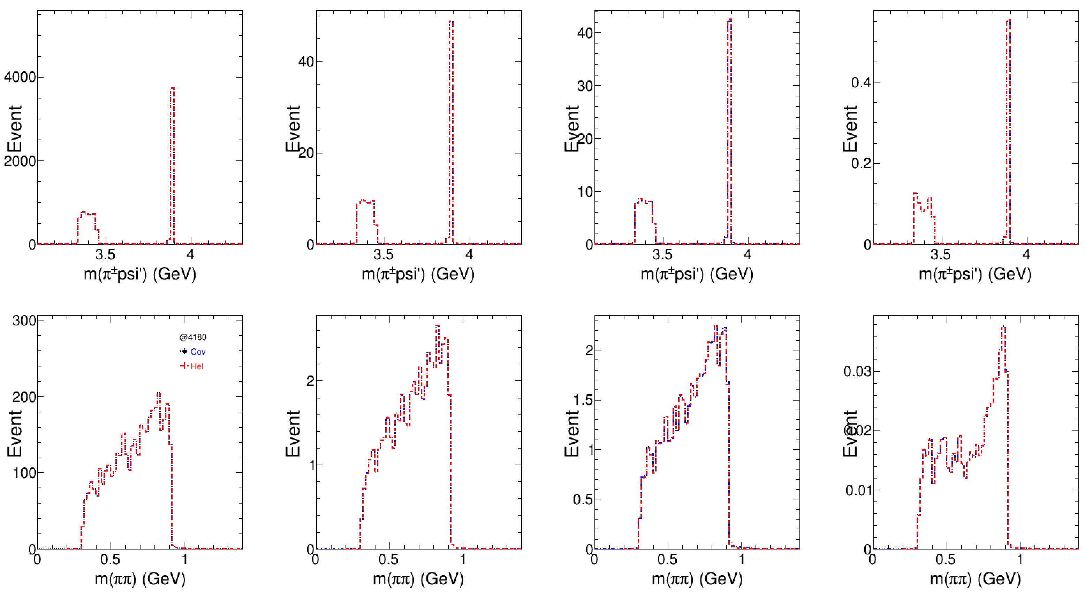

Slide 9
Zc mass=3880 MeV
Width = 1 MeV
Zc mass=3885 MeV
Width = 1 MeV
Zc mass=3890 MeV
Width = 1 MeV
MC sample with different Zc mass and 1 MeV width
Four components: SS+SD+DS+DD
Fit results give similar parameters
The fractions are consistent between covariant tensor formalism and helicity formalism

Slide 10
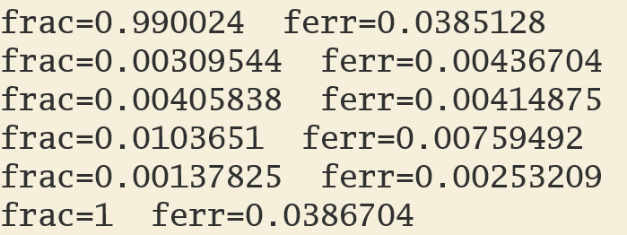
Zc MC sample: four components involved
Jpsi to ll is considered
Jpsi to ll is not considered

