Slide 1
Study of $D^{0}→K_{S}^{0} ω$
Haoran Zhang

Slide 2
Boss version :
6.6.4p02 $→$ 7.1.0
Data set :
inclusive MC :
$ψ\left(3770\right)→D^{0} \overline{D^{0}} 40X\left(round03+round 04+round15\right)$
$signal MC:$ tag+ $D^{0}→K_{S}^{0}ω$
$D^{0}→Kπ$ round03+round04 30w ,rounde15 30w
$D^{0}→Kππ^{0}$ round03+round04 30w ,rounde15 30w,
$D^{0}→K3π$round03+round04 30w ,rounde15 30w
Data: round03+round04+ rounde15

Slide 3
ST Event selection
Based on DTagAlg-02-04 Package in BOSS 710
Good neutral track selection
Definition of Barrel: | $cosθ$|<0.8
Definition of EndCap: 0.86<|$cosθ$|<0.92
Barrel: E>25MeV
Endcap: E>50MeV
ToF:0<T<14 (50ns)
The opening angle between a candidate shower and the closest charged track should be no less than ${10}^{∘}$ ($\left|dang\right|>$ ${10}^{∘}$ )
Good charged track selection
|Vr| < 1 cm
|Vz| < 10 cm
$\cos{θ<0.93}$
PID
Use SimplePID
$$for π :prob\left(π\right)>0.00 ;prob\left(π\right)>prob\left(K\right)$$
$$for K :prob\left(K\right)>0.00 ;prob\left(K\right)>prob(π)$$
$π^{0} selection$
$χ_{1c}^{2}$<200
The mass of $π^{0}$: $0.115<M_{γγ}<0.150 MeV$
reject candidate if both photons are in endcaps

Slide 4
ST Event selection
$$ΔE=E_{D} −E_{Beam};\left|ΔE\right|<0.1$$
$$M_{BC}=\sqrt{\left({E_{Beam}}^{2} −p_{D}^{2}\right)} ;{1.83<M}_{BC}$$
the $E_{Beam}$is the calibrated beam energy under BOSS7.1.0
(tag :$D^{0}→Kπ$)
$D^{0}reconstruction$
$D^{0}$ reconstructed by the $Kπ$tracks after pid
no vertex fit.
(tag :$D^{0}→Kππ^{0}$)
$D^{0}reconstruction$
$D^{0}$ reconstructed by the $Kπ$tracks after pid and two $γ$ track from $π^{0}$
no vertex fit.
(tag :$D^{0}→K3π$)
veto $K_{S}^{0}→π^{+}π^{−}$
$$\left|m_{π^{+}π^{−}}−m_{K_{S}^{0}}\right|≥0.03$$
$D^{0}reconstruction$
$D^{0}$ reconstructed by the $Kπππ$tracks after pid
no vertex fit.

Slide 5
DT Event selection
$$D^{0}→K_{S}^{0}ω$$
$$vertex fit of K_{S}^{0}$$
$$χ<100 ,\frac{l}{σ_{l}}>2$$
$$find the charged track pair with minimum χ$$
$$vertex fit of ω$$
do vertex fit to the charged tracks
$$kinematic fit$$
$$2C \left(M_{D^{0}}^{PDG} M_{π^{0}}^{PDG}\right)kinematic fit to$$
$$charged tracks after vertex fit and \text{neutral} \text{track}$$

Slide 6
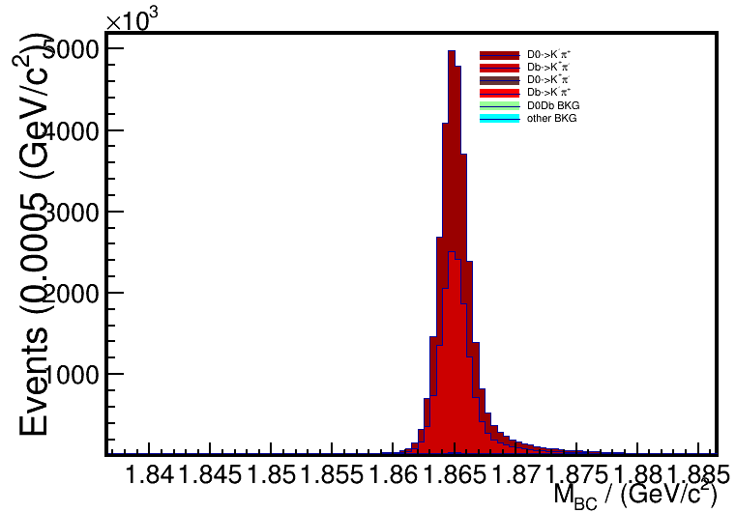
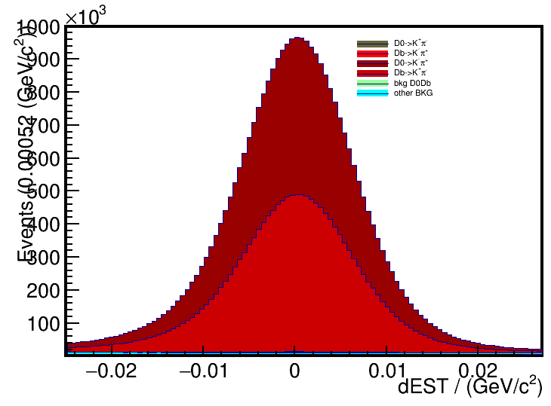
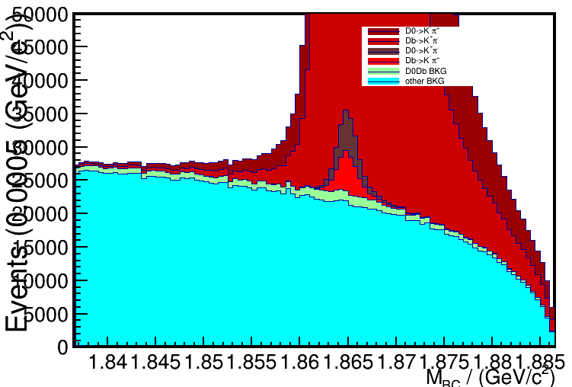
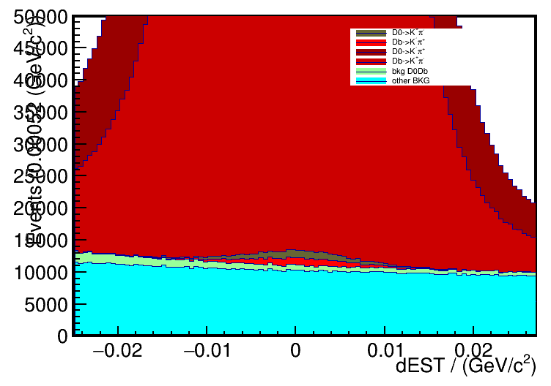
$ΔE cut for single Tag:$
$D^{0}→Kπ:$
$−0.025<ΔE<0.025$(GeV)
$D^{0}→Kππ^{0}:$
$−0.04<ΔE<0.053$ (GeV)
$D^{0}→K3π:$
$−0.02<ΔE<0.024$ (GeV)

Slide 7
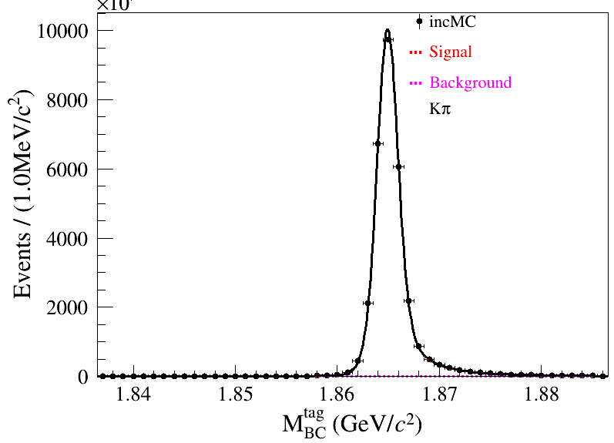
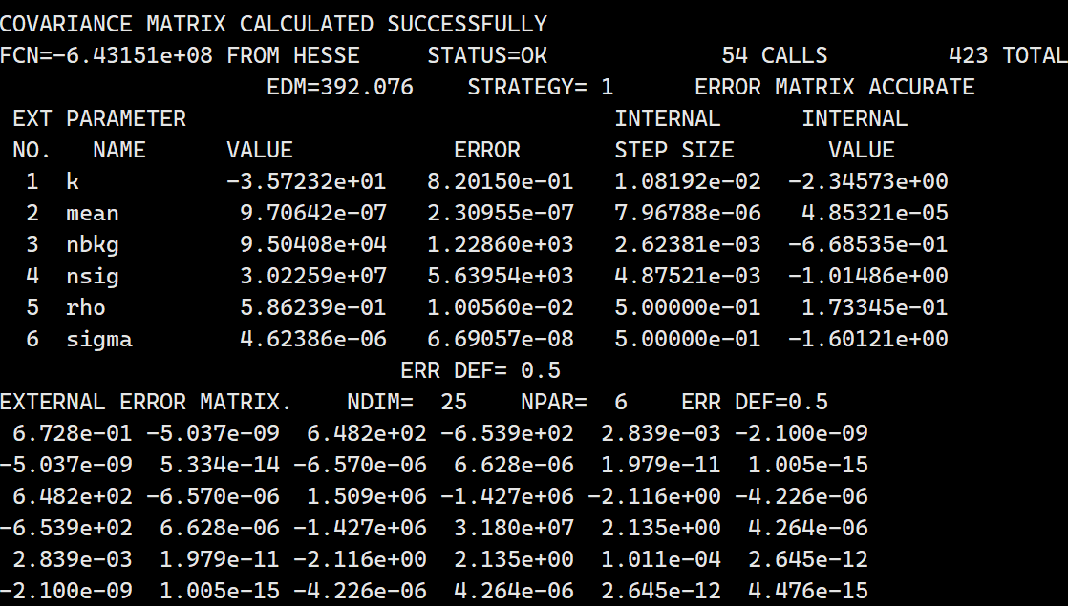

Slide 8
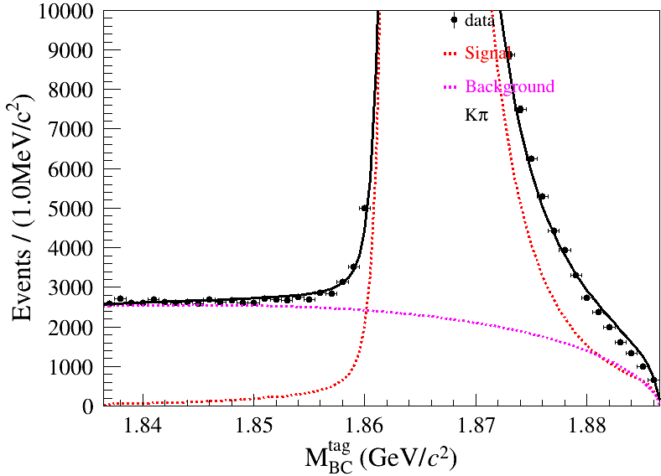
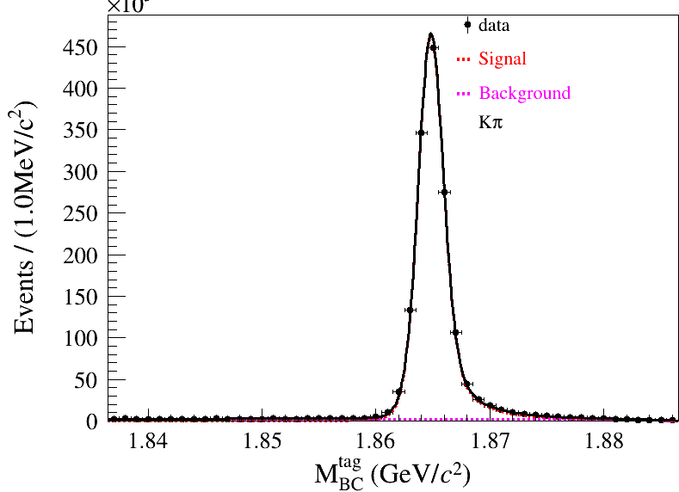
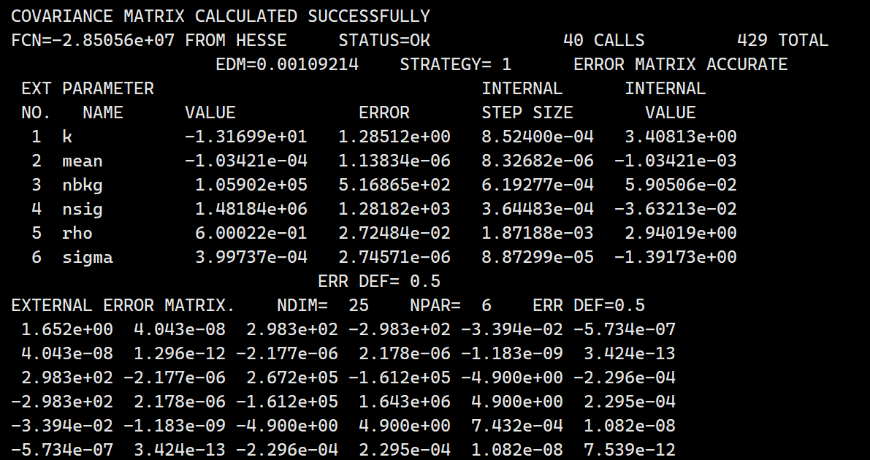
$$N_{Fit}^{ST}=1481840±1281.82$$
$$ε_{ST}^{signalMC}=65.92\%$$
$$N_{}^{ST}=1878171.81±1624.65$$
$$ε_{ST}^{inc}=78.898\%$$

Slide 9
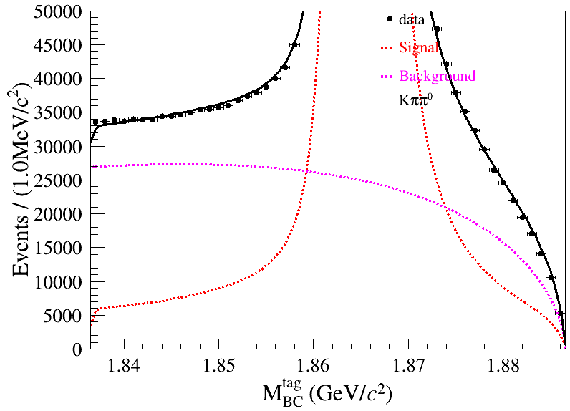
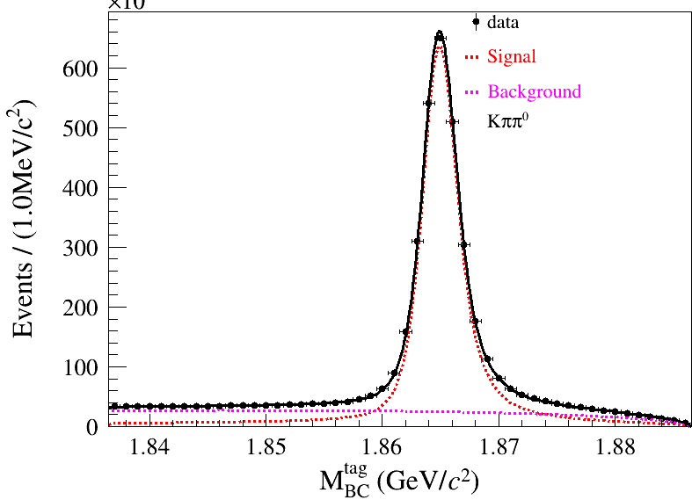
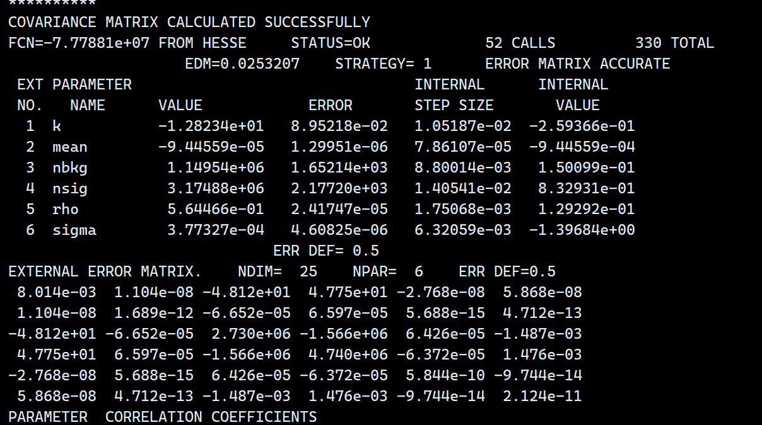
$$N_{Fit}^{ST}=3174880±2177.2$$

Slide 10
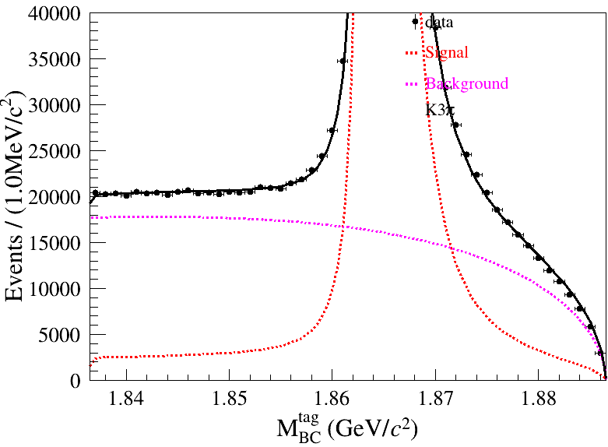
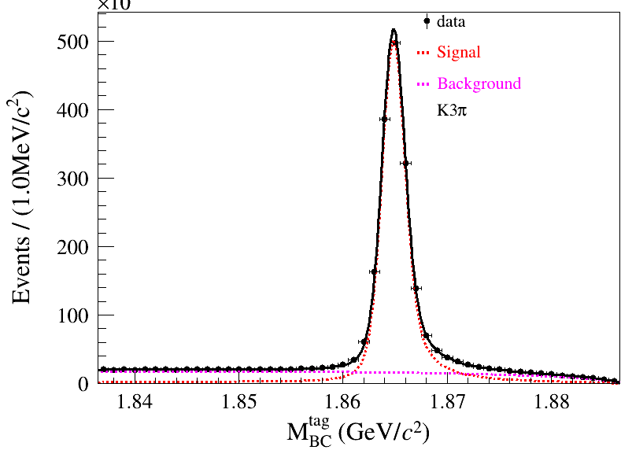
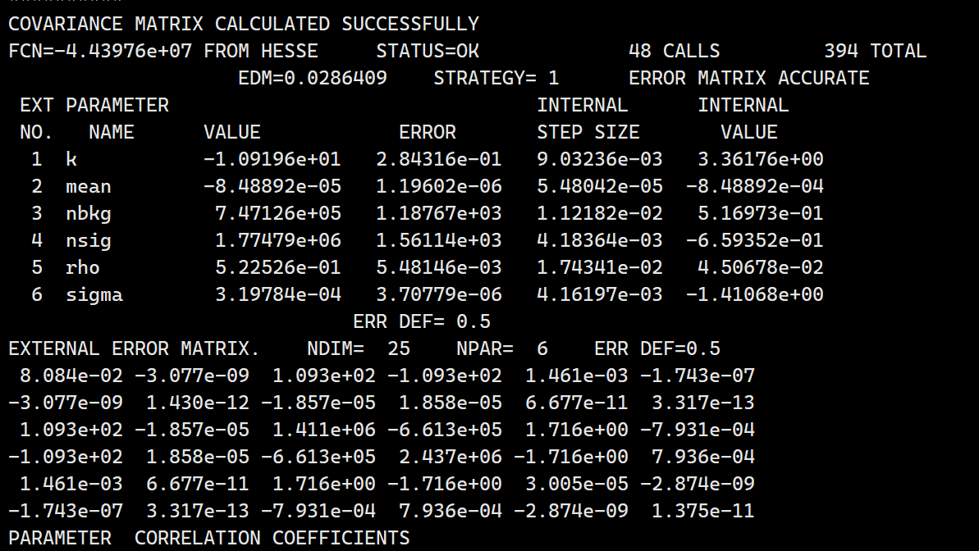
$$N_{Fit}^{ST}=1774790±1561.14$$

Slide 11
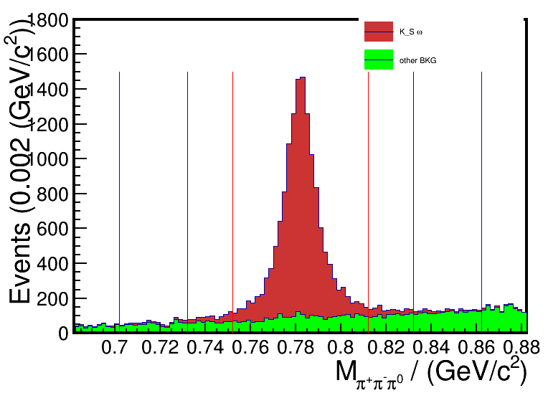
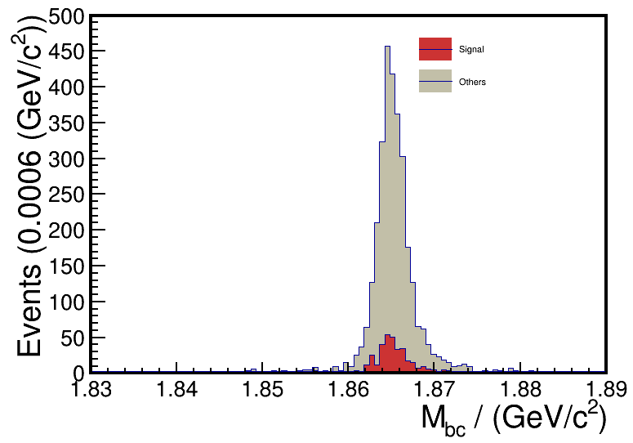
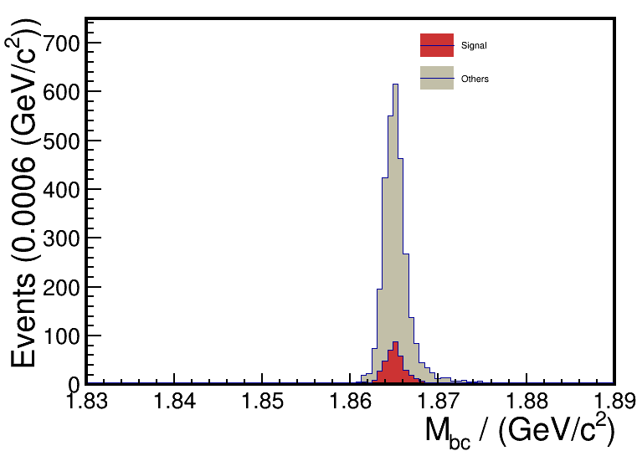
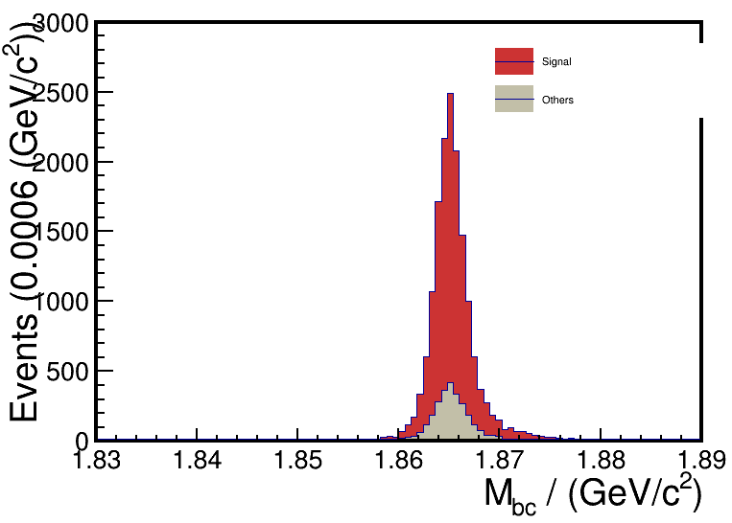
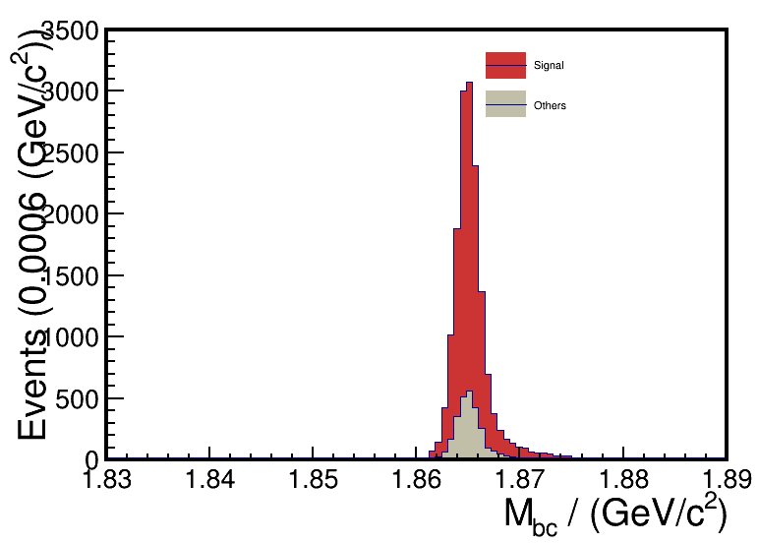
DT
ST
DT
ST

Slide 12
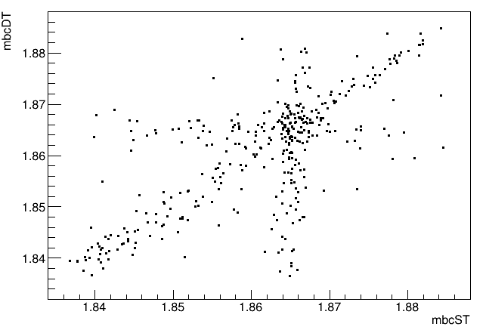
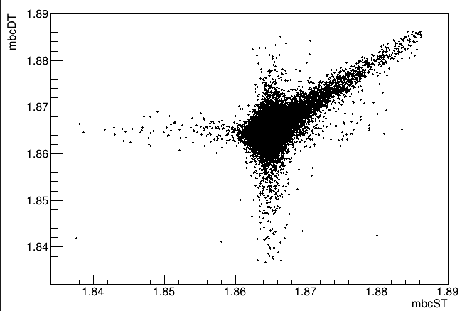
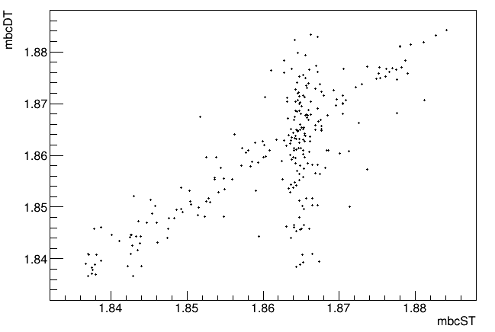

Slide 13
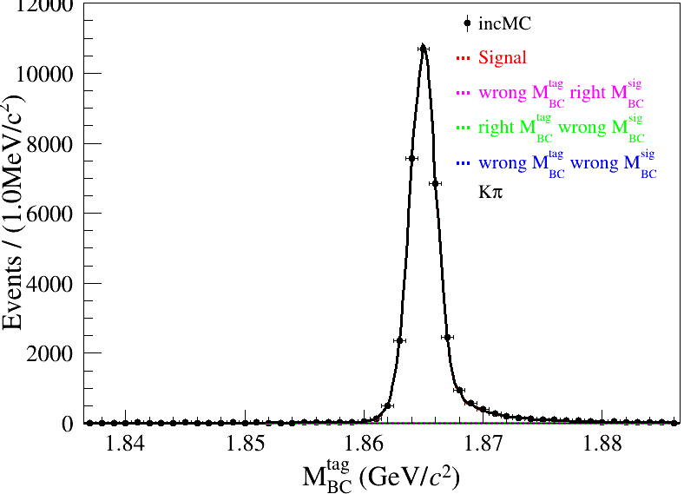
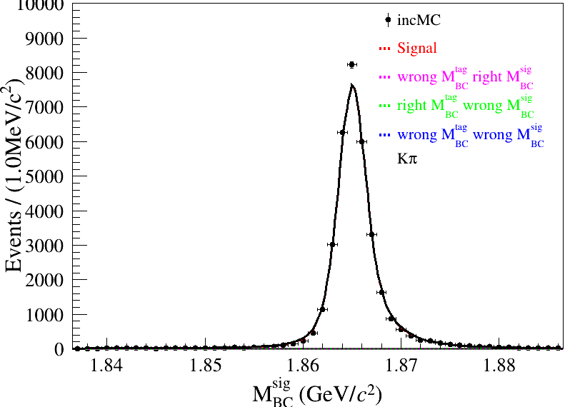
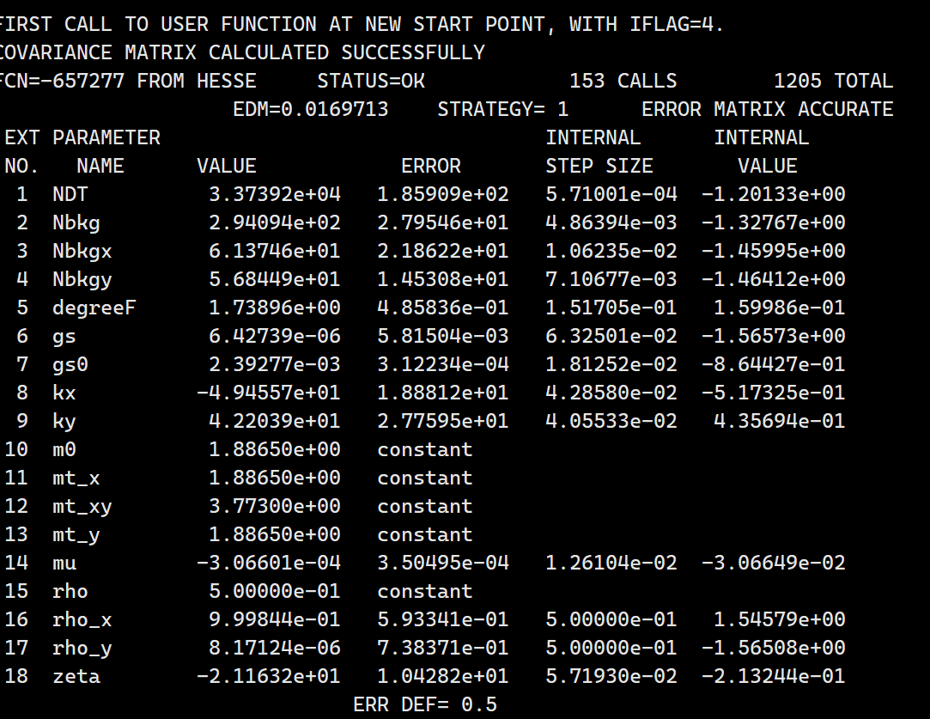
2D Fit of inclusive MC samples in signal region of pi+pi-pi0 mass
$$N_{DT}^{sigregion}=33739.2±185.9$$

Slide 14
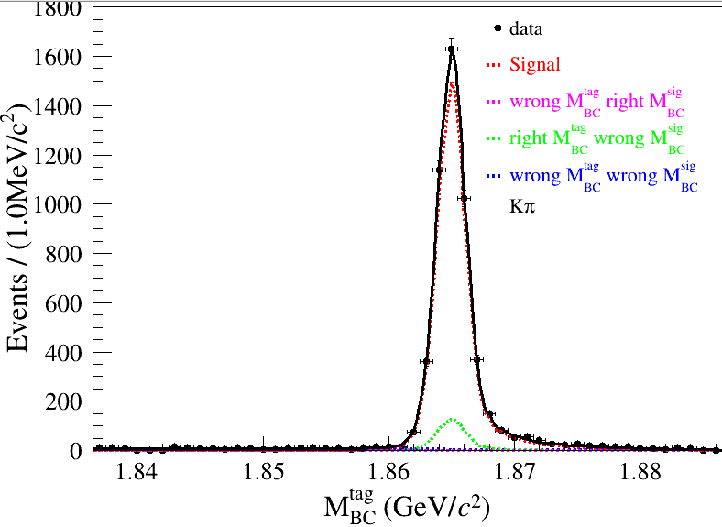
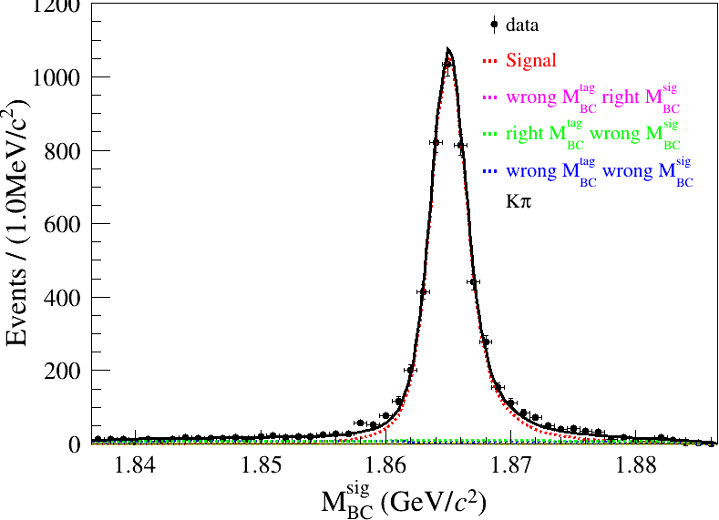
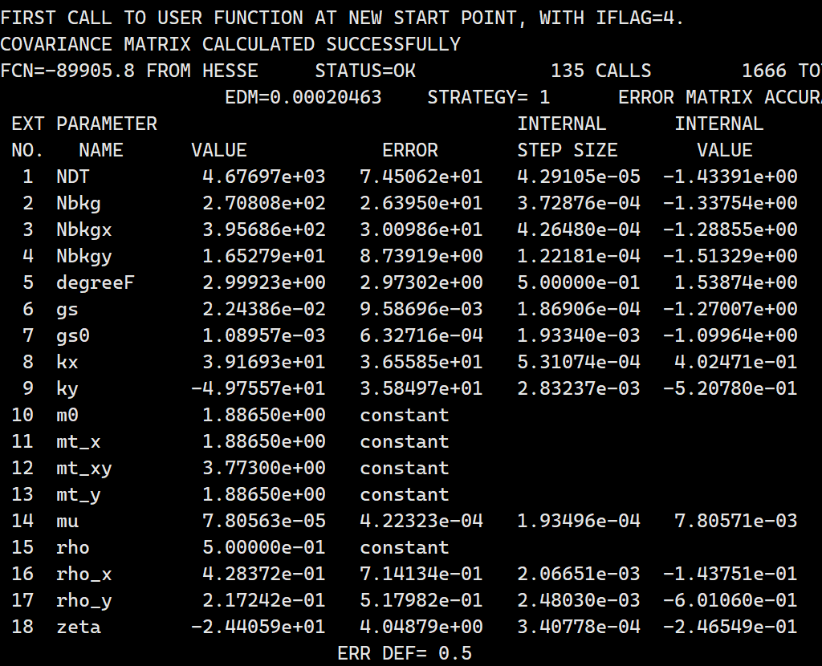
2D Fit of inclusive MC samples in sideband region of pi+pi-pi0 mass
$$N_{DT}^{sideband}=4676.97±74.5$$
$$N_{DT}^{sigregion}=33739.2±185.9$$
$$N_{Fit}^{sigregion}−{1.193N}_{Fit}^{sideband}=27937.12±200.27$$
$$N_{inc}^{sigregion}−{1.193N}_{inc}^{sideband}=27749.1$$
$$ε_{tagsig}=\frac{66481−1.193∗3067}{600000}=10.47\%$$

Slide 15
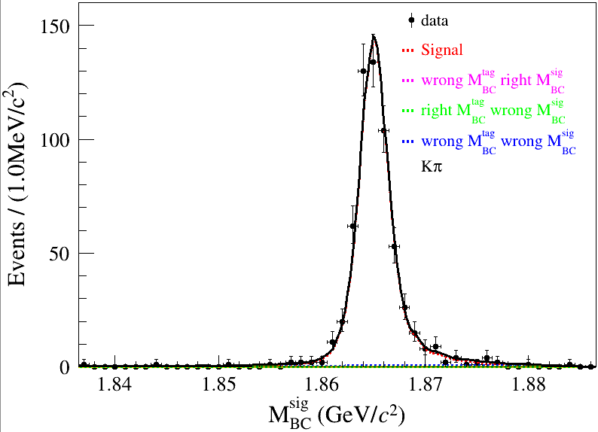
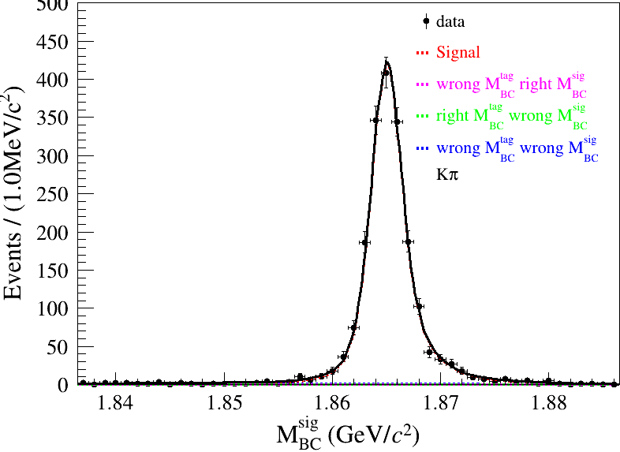
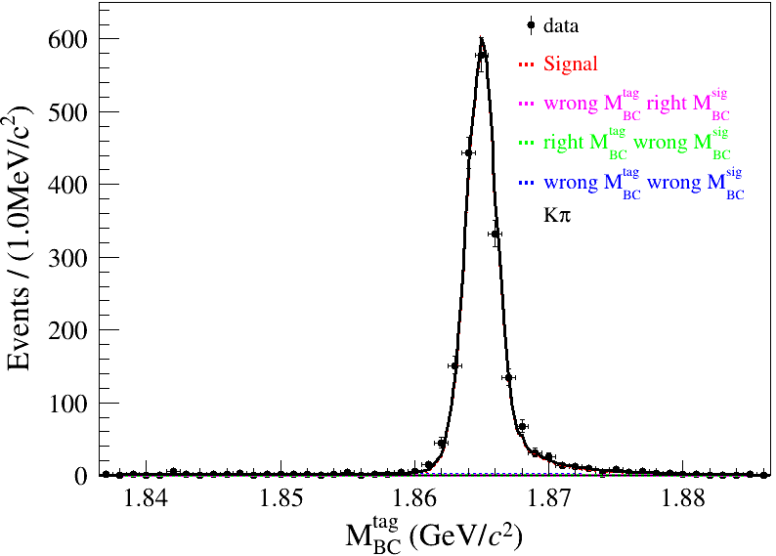
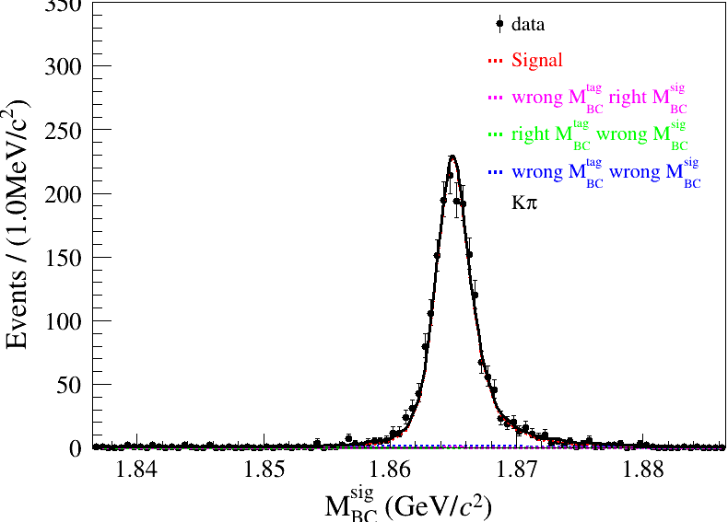
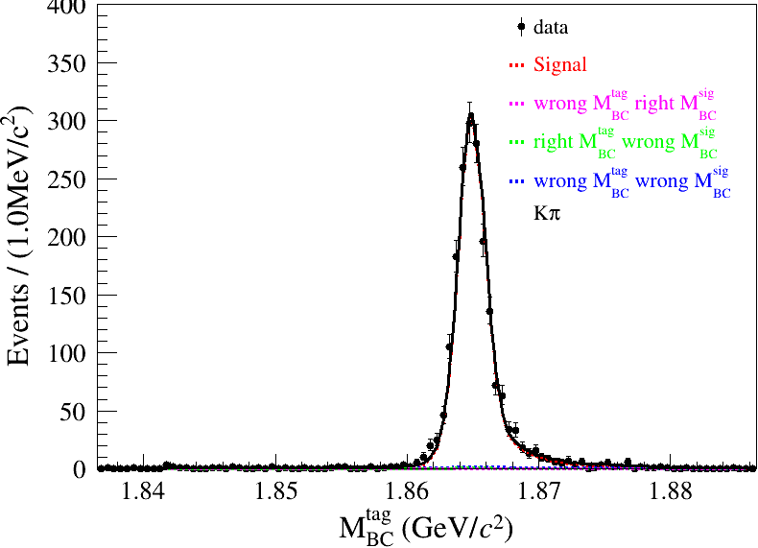
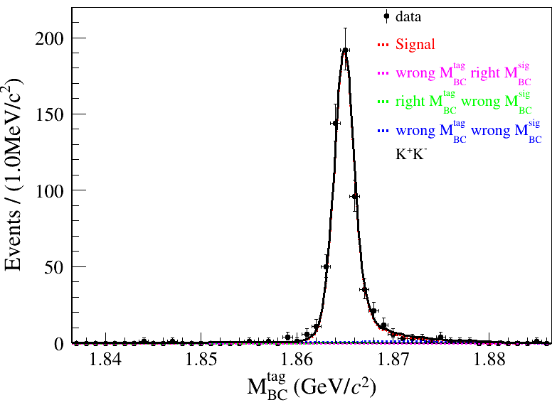
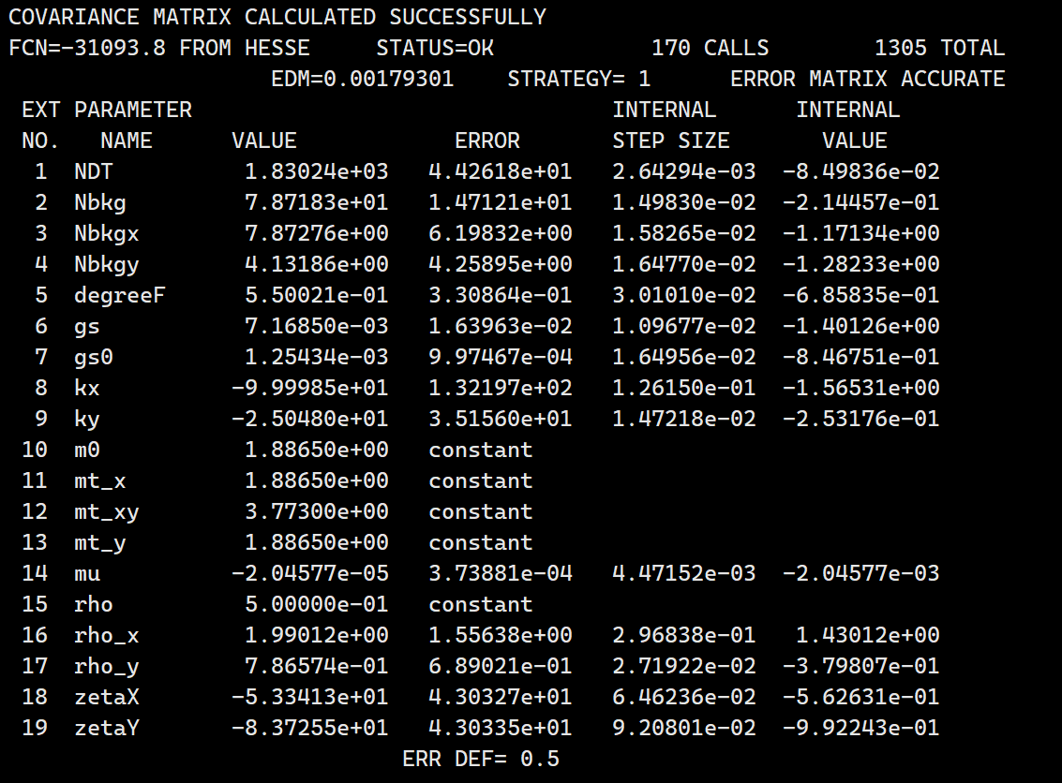
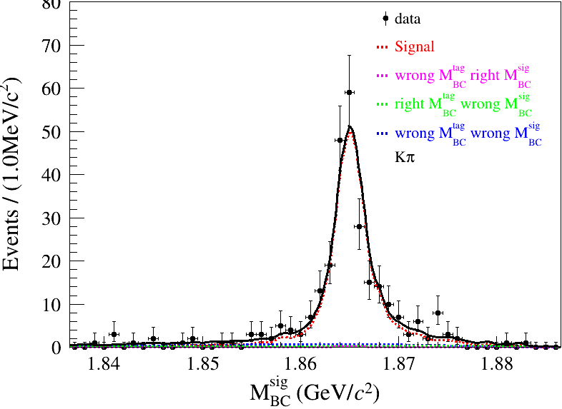
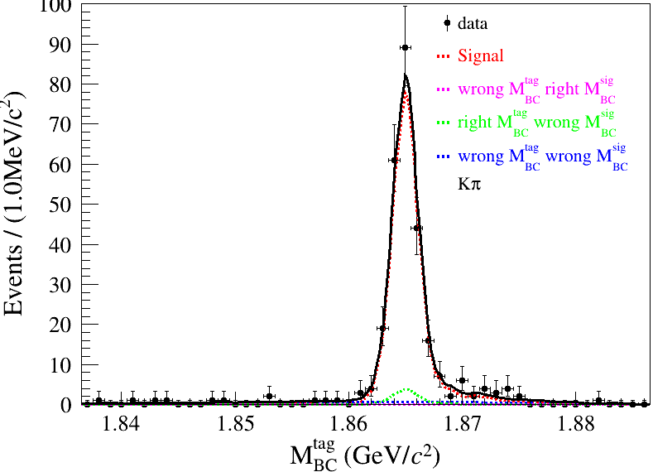
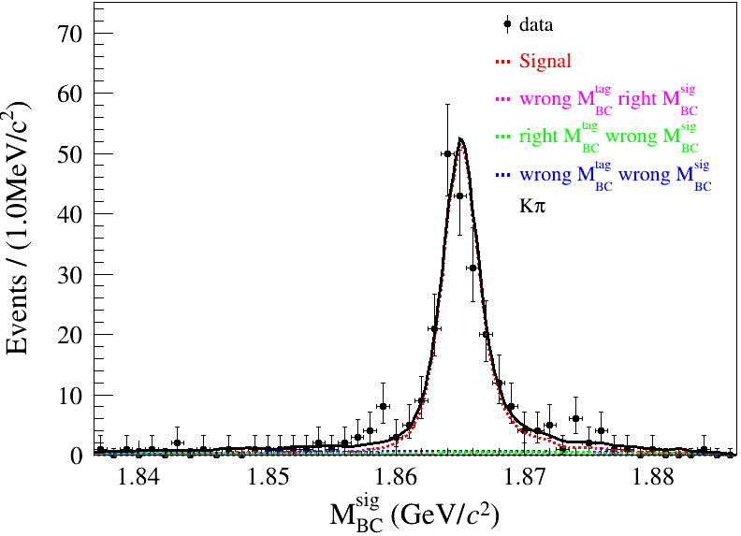
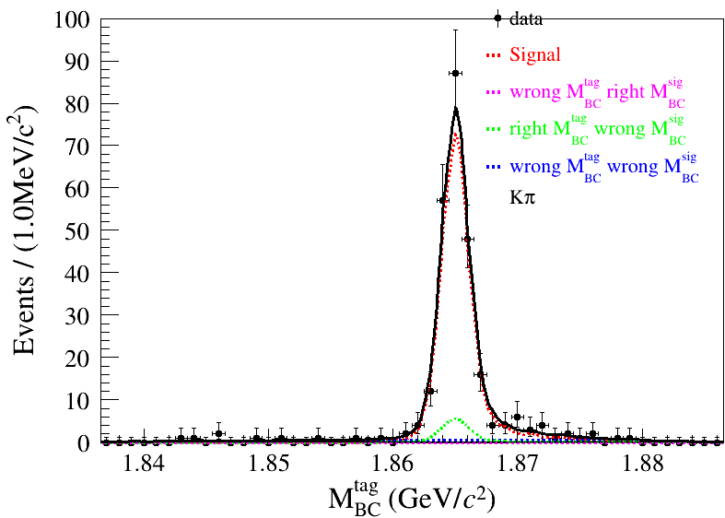
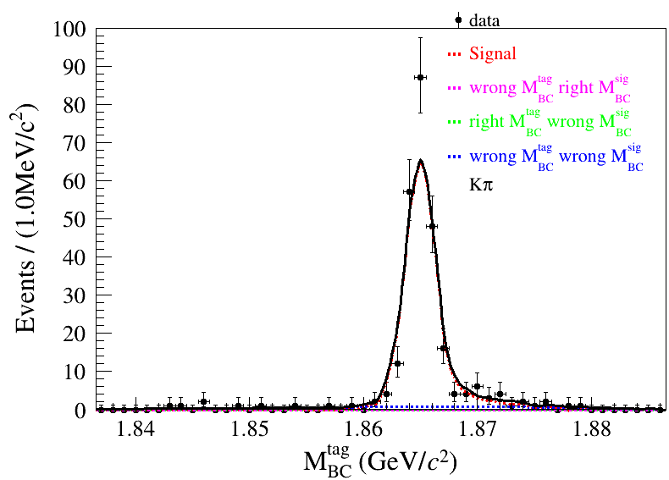
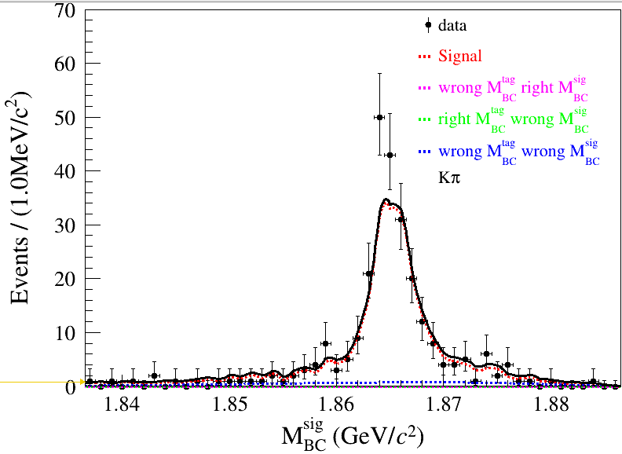
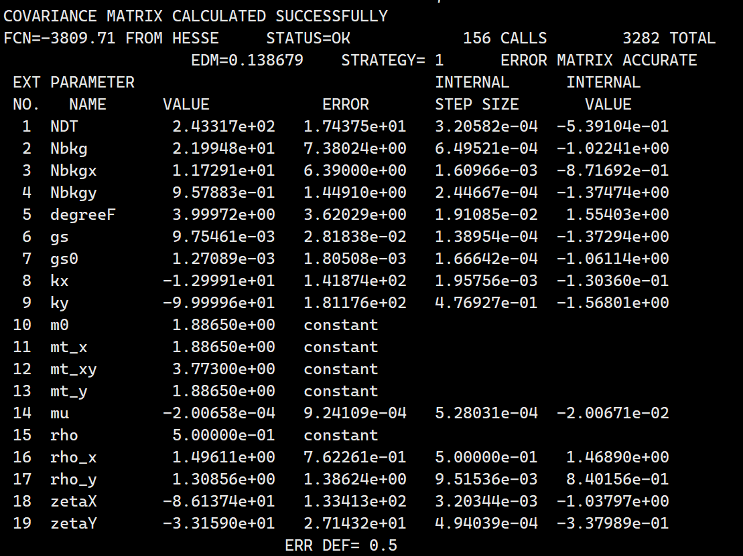
$$N_{DT}^{sigregion}=1830.24±44.26$$
$$N_{DT}^{sideband}=243.31±17.43$$
$$N_{Fit}^{sigregion}−{1.193N}_{Fit}^{sideband}$$
$$=1539.97±48.9$$
$$N_{Fit}^{ST}=1481840±1281.82$$
$${Br}_{{D^{0}→K}_{s}ω,ω→π^{+}π^{−}π^{0}}^{Tag0}=\left(10.06±0.319\right)×{10}^{−3}$$

Slide 16
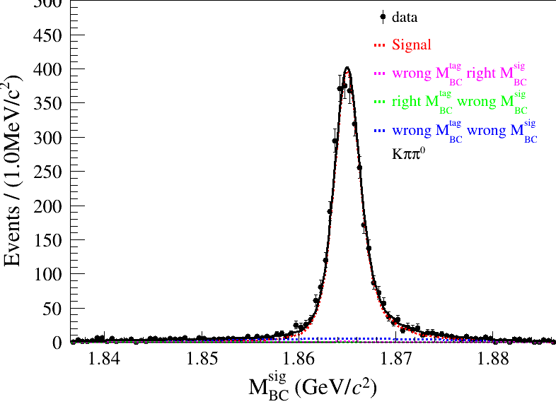
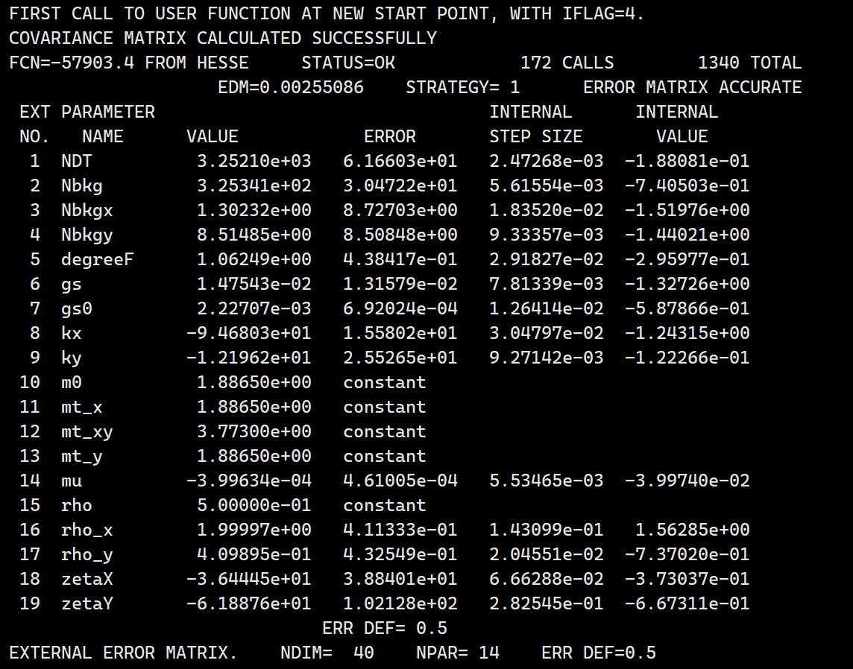
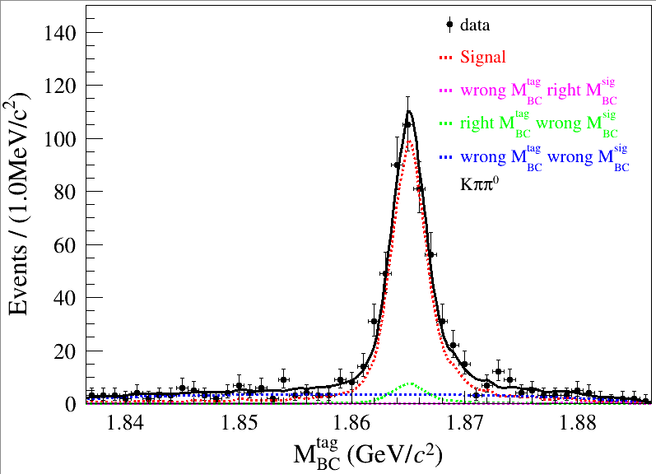
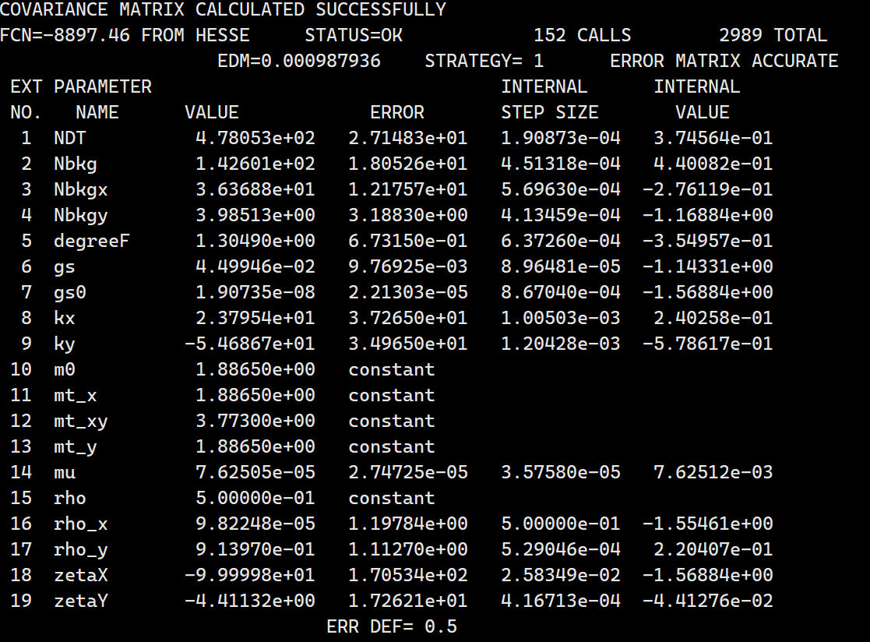
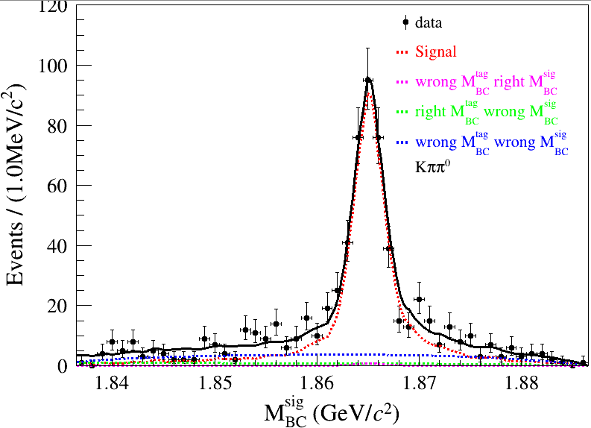
$$N_{DT}^{sigregion}=3252.1±61.66$$
$$N_{DT}^{sideband}=478.05±17.43$$
$$N_{Fit}^{sigregion}−{0.984N}_{Fit}^{sideband}$$
$$=2781.69±48.9$$
$$N_{Fit}^{ST}=3174880±2177.2$$
$${Br}_{{D^{0}→K}_{s}ω,ω→π^{+}π^{−}π^{0}}^{Tag1}=\left(10.27±0.\right)×{10}^{−3}$$

Slide 17
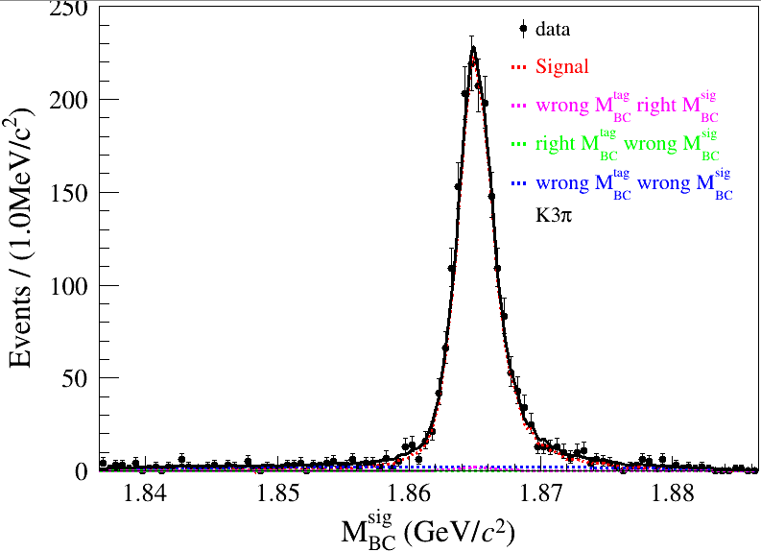
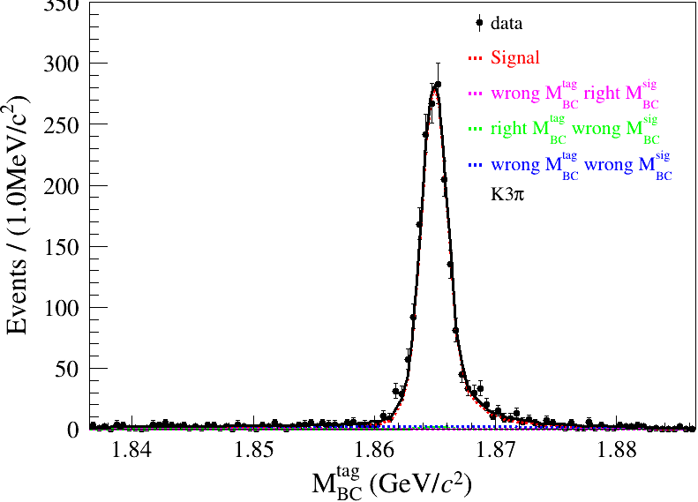
$$N_{DT}^{sigregion}=1823.06±45.11$$
$$N_{DT}^{sideband}=271.14±14.86$$
$$N_{Fit}^{sigregion}−{1.2474N}_{Fit}^{sideband}$$
$$=1484.84±48.77$$
$${Br}_{{D^{0}→K}_{s}ω,ω→π^{+}π^{−}π^{0}}^{Tag3}=\left(10.87±0.\right)×{10}^{−3}$$

Slide 19
$$N_{DT}^{sigregion}−N_{DT}^{sideband}=29062.23±200.27$$
$$28881$$

Slide 20
DT
ST
DT
ST

Slide 21
29,30,1,17,

Slide 22
$$inclusive MC$$
$$N_{event}=12210800±3552.8$$

Slide 23
$$inclusive MC$$
$$N_{event}=13357200±4000.6$$

Slide 24
The peaking bkg comes from $K^{+}K^{−}l v_{l}$processes
Eg:

Slide 26
$$ε_{signal} after ST selection , ΔE and M_{bc} cut$$
$$ε_{signal}=\frac{190917}{600000}=31.8195\%$$
$$N_{event}=981701±1175.73$$

Slide 27
$$ε_{signal} after ST selection , ΔE and M_{bc} cut$$
$$ε_{signal}=\frac{199907}{600000}=33.3178\%$$
$$N_{event}=657790±966.67$$

Slide 28
$$ε_{signal} after ST selection , ΔE and M_{bc} cut$$
$$ε_{signal}=\frac{399570}{600000}=66.595\%$$
$N_{event}=539935±766.05$(left,round3+4)
$$N_{event}=1484430±1275.43$$
（right,round15+3+4)

Slide 29
$$N_{DT}^{sigregion}=572.07±24.34$$
$$N_{DT}^{sideband}=66.65±8.34$$

Slide 30
$$N_{DT}^{sigregion}=907.79±28.53$$
$$N_{DT}^{sideband}=109.33±10.49$$

Slide 31
$$N_{DT}^{sigregion}=619.72±25.79$$
$$N_{DT}^{sideband}=76.21±9.65$$

