Slide 1
Weekly report

Slide 2
Roofit
ROOT::Math::MinimizerOptions::SetDefaultMaxFunctionCalls(10000);
Introduction to Fitting:
–what is fitting,
–how to fit a histogram in ROOT,
–how to retrieve the fit result.
Building complex fit functions in ROOT.
Interface to Minimization.
~~

Slide 3
Roofit
Estimate way
– Least square fit ( 𝛘2)
–Maximum Likelihood (ML) Fit
How to fit in ROOT
– Create a parametric function object, TF1(available in ROOT library)
–Set the initial values of the function parameters
– Fit the data object

Slide 4
Minimization
Methods like Minuit based on gradient can get stuck easily in local minima
Stochastic methods like simulated annealing or genetic algorithms can
help to find the global minimum
– (but it can be quite inefficient, e.g. many function calls)
Parameter Errors
A approximation to estimate the confidence level:
-use directly the log-likelihood function and look at the difference from the minimum

Slide 5
purpose
Efficiency
fit successful
1.Make sure functions all right;
2.Fit in Liufang’s criteria;
3.Maybe improve criteria.
To do
1.Code and Roofit checked;
2.debug in Liufang’s criteria→Change resonance state the same with liu;
$$MΓ∗\frac{B_{2}}{{{(Q}_{abc}^{2})}^{2.5}}∗\frac{{{(Q}_{abc}^{2})}^{2.5}}{B_{2}}$$
3.Fit and find a good result;
4..

Slide 6
resonance
<$φf_{J}$|LS>
<$φf_{0}$|01> : phasespace, $f_{0}(980)$, $f_{0}\left(1370\right)$, $σ$, $f_{0}\left(1750\right)$, $f_{0}\left(1500\right)$, $f_{0}\left(1710\right)$,
<$φf_{0}$|21> : $f_{0}(980)$, $f_{0}(1370)$, $σ$, $f_{0}\left(1750\right)$, $f_{0}\left(1500\right)$, $f_{0}\left(1710\right)$,
<$φf_{2}$|01> : $f_{2}(1270)$, $f_{2}(1525)$, $f_{2}(1950)$,
<$φf_{2}$|21> : $f_{2}(1270)$, $f_{2}(1525)$, $f_{2}(1950)$,
<$φf_{2}$|22> : $f_{2}(1270)$, $f_{2}(1525)$, $f_{2}(1950)$,
<$φf_{2}$|23> : $f_{2}(1270)$, $f_{2}(1525)$, $f_{2}(1950)$,
<$φf_{2}$|43> : $f_{2}(1270)$, $f_{2}(1525)$, $f_{2}(1950)$,

Slide 7
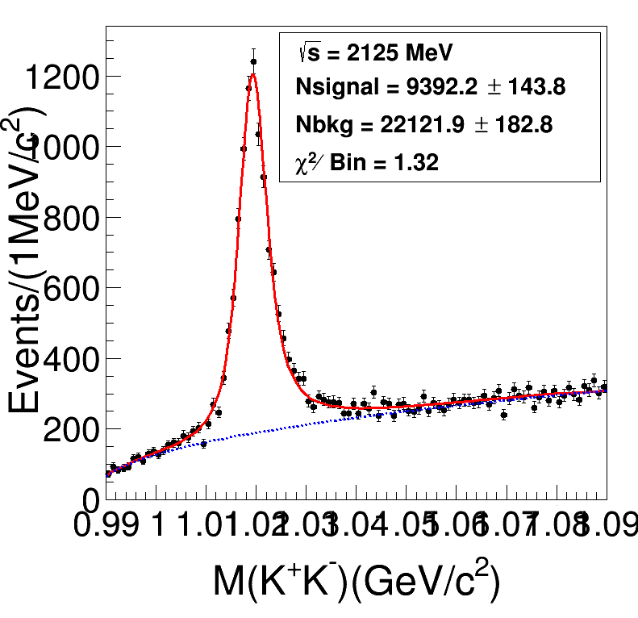
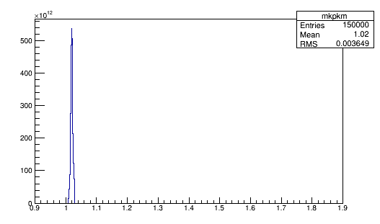
Preliminary Fitting

Slide 8
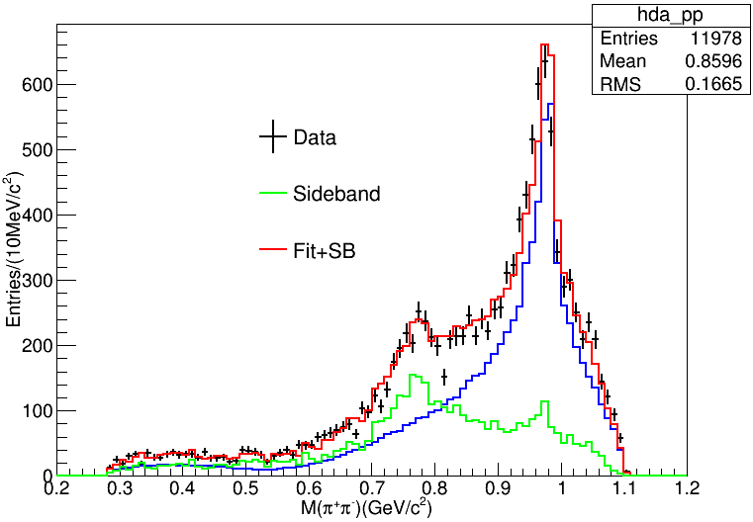
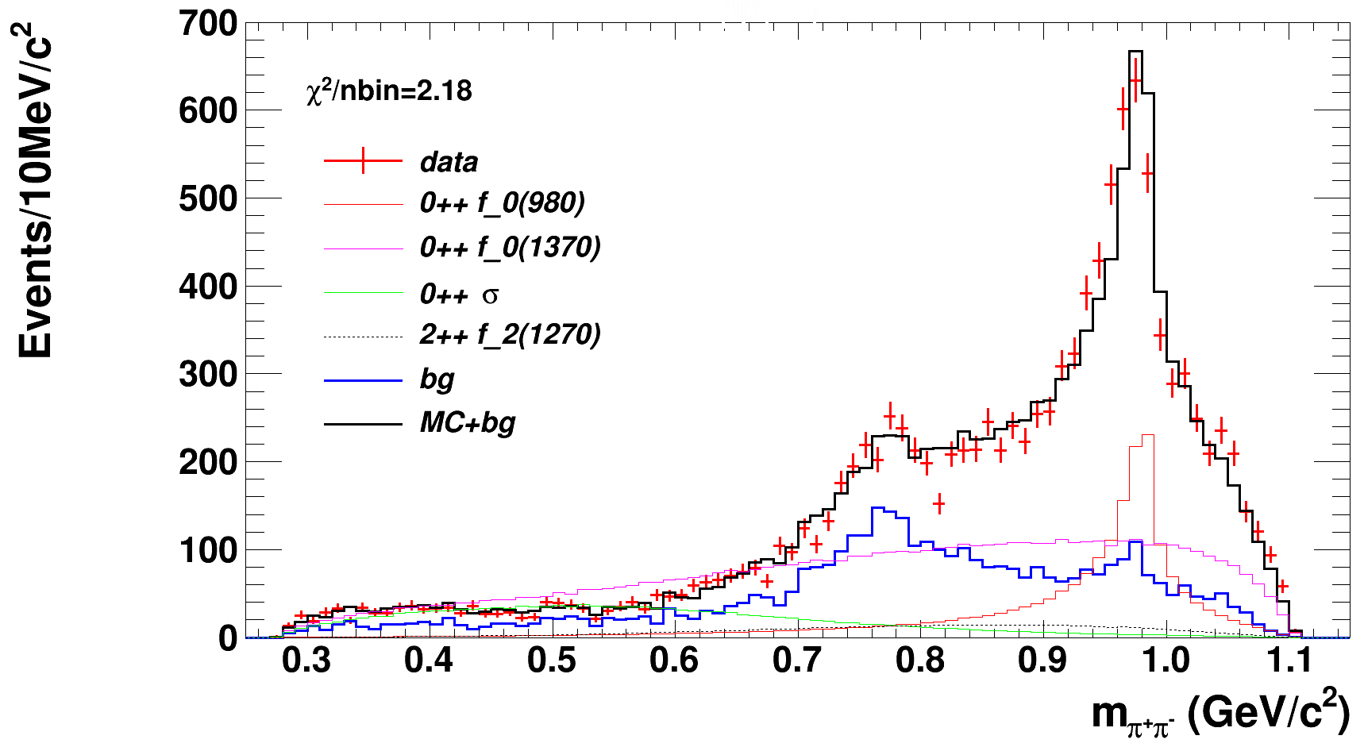
Preliminary Fitting

Slide 9
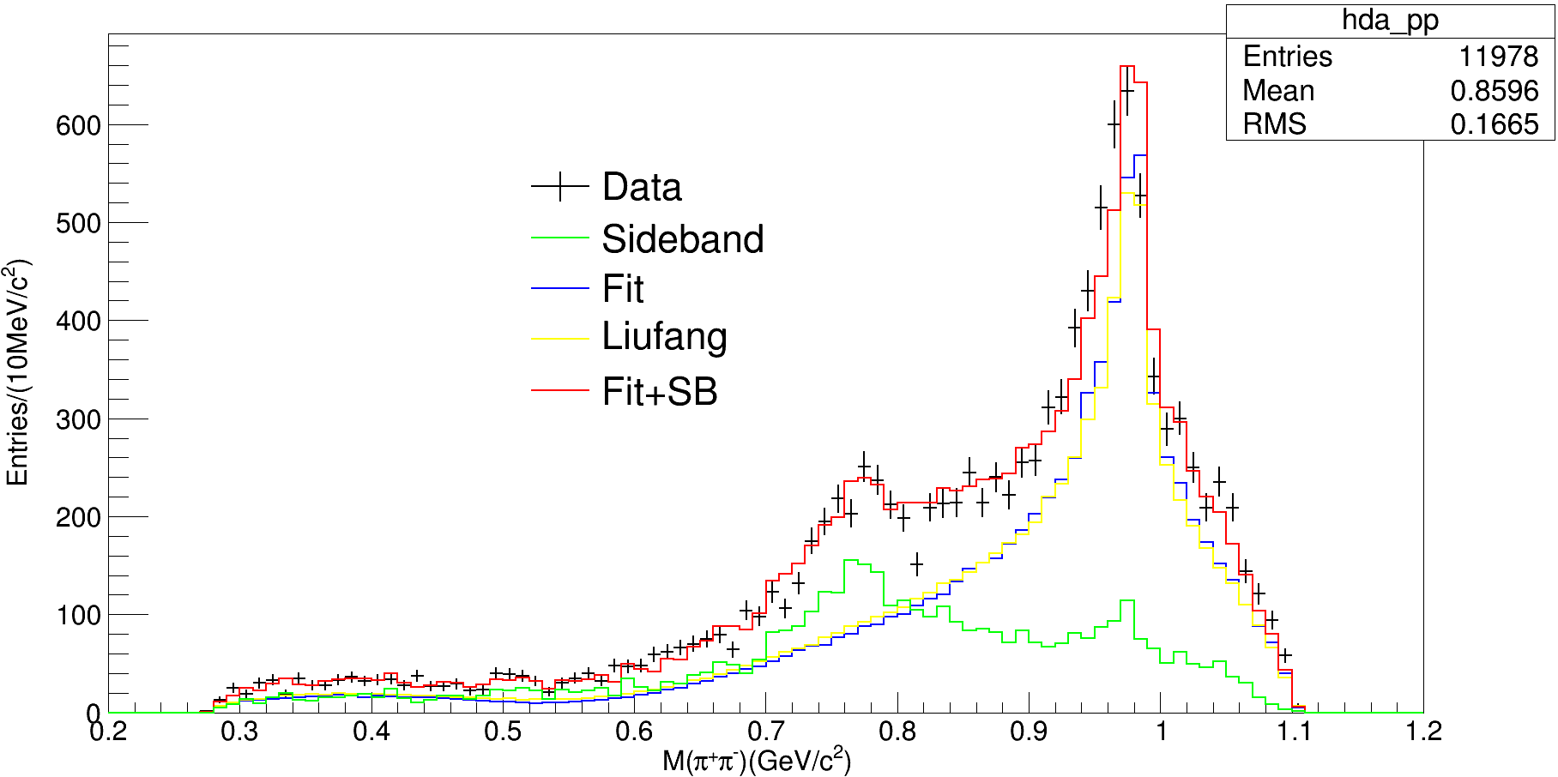
Preliminary Fitting
2scan/OK/scripe115

Slide 10
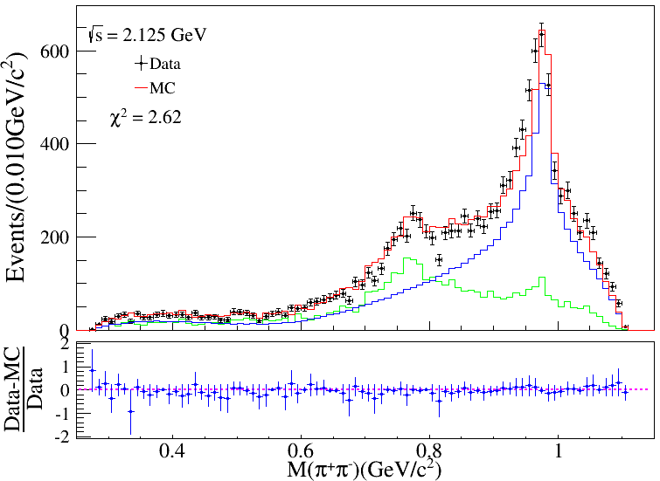
Preliminary Fitting
Liu Fang

Slide 11
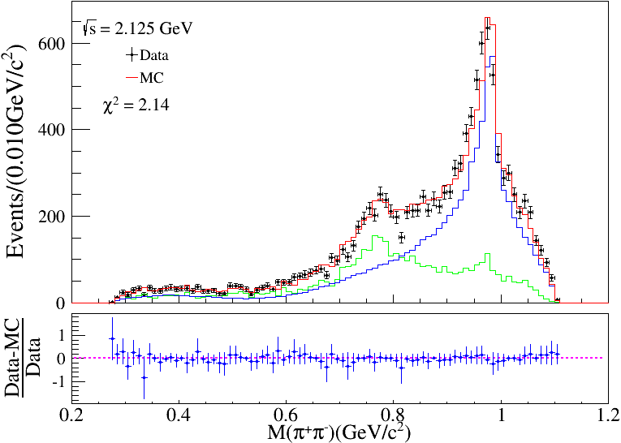
Preliminary Fitting
2scan/OK/scripe115
Tan Yx

Slide 12
Preliminary Fitting
comparation

Slide 13
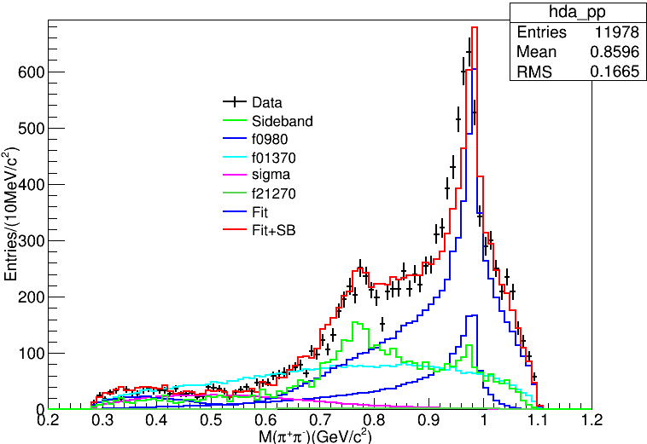
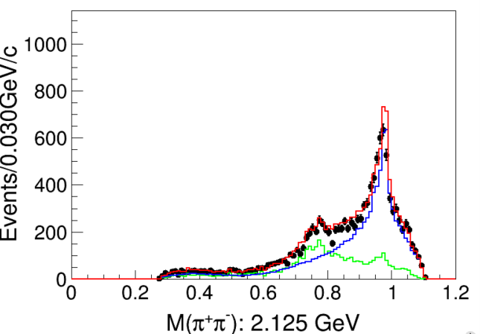
Preliminary Fitting

Slide 14
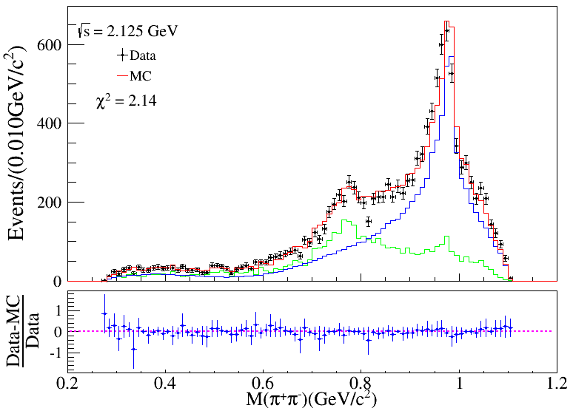
Model
6337M1: 1442; 1628($χ$²2.16); 127($χ$²2.10)
6325M1: 441
6342M2: 2013

Slide 15
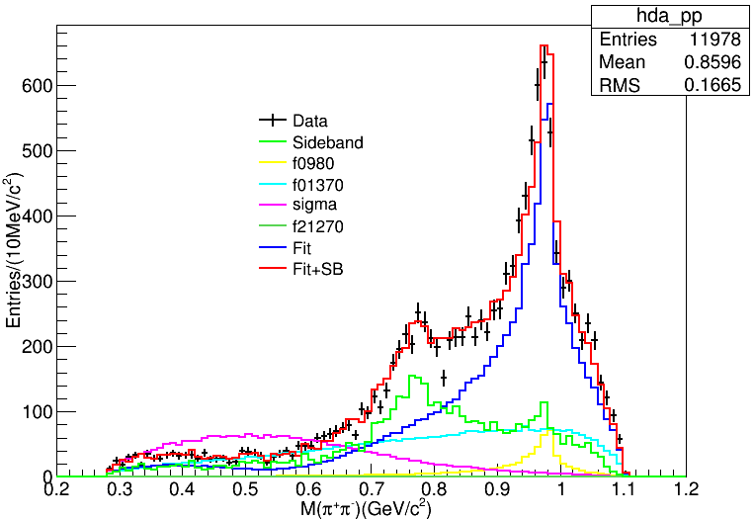
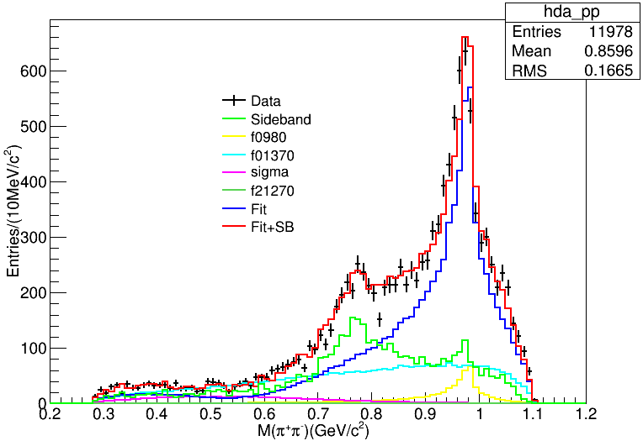
Model
6342M4: 2013
6325M1: 441

Slide 16
Model
6342M2: 2013
6325M1: 441

