Slide 1
Measurements of Dielectron Production in Au+Au Collisions at √sNN= 27, 39, and62.4 GeV from the STAR Experiment
Yulou Yan
March 10,2023

Slide 2
Introduction
Motivation
✭
leptons don’t participate in the strong interaction good probes of Quark-Gluon Plasma (QGP)
●
providing means to experimentally test models that predict chiral symmetry restoration;
enable a better understanding of the microscopic properties of QCD matter(QGP)；
●
✭
a significant excess yield of dielectrons is observed in the low-mass region (0.40< $M_{ee}$ < 0.75 MeV/$C^{2}$) compared to hadronic cocktail simulations at freeze-out
●
Models that include an in-medium broadening of the ρ-meson spectral function consistently describe the observed excess;chiral symmetry restoration result in the modification of chiral partners
The generation of hadronic masses is in part caused by the spontaneous breaking of chiral symmetry
●
Mass range
✭
HMR
$$M_{ll}<M_{∅}$$
Drell-Yan (DY) decays $q\overline{q} l^{+}l^{−}$
✭
IMR
$${M_{∅}<M}_{ll}<M_{J/ψ}$$
QGP thermal dilepton production
✭
LMR
$${M_{J/ψ}<M}_{ll}$$
vector mesons decays(ρ, ω, φ,etc.)

Slide 3
Background
✭
CERES Collaboration at the Super Proton Synchrotron(Pb+Au collisionsat;√sNN = 8 and 17.3 GeV)
●
observed an excess yield in the dielectron LMR(excess yield,difference between the measured yield and an expected yield based on simulations )
excess yield relative to known hadronic sources, including the ρ−decay in vacuum
●
NA60 Collaboration ( In+In collisions;√sNN = 17.3 GeV)
✭
●
observed LMR excess( dimuon)
the observed LMR excess is consistent with the in-medium broadening of the ρ spectral function
●
✭
Relativistic Heavy Ion Collider ( Au+Au collisions;√sNN = 200 GeV)
●
show a significant excess compared to the known hadronic sources
both calculations(many-body approach,a transport model predict an in-medium broadened ρ spectral function) are consistent with the previously published STAR and ALICE results(Au+Au √sNN = 200GeV，Pb+Pb √sNN = 5.02TeV )
●

Slide 4
In this article
first measurements of dielectron production in Au+Au collisions with colliding nucleon + nucleon pair energy(√sNN= 27, 39, and 62.4 GeV）

Slide 5
About the data
✭
2010 and 2011 RHIC runs using a minimum-bias trigger(VPD&ZDC)
✭
The analyses included 68M,132M, and 62M collision events for √sNN = 27 GeV,39 GeV, and 62.4 GeV respectively
✭
0−80% most-central Au+Au collisions

Slide 6
Analysis—Electron identification（real data）
✭
Electrons (including positrons if not specified) were identified based on a combination of the TPC and TOF detectors.
●
TPC(energy-loss measurements,dE/dX）
●
TOF(β）
TOF velocity selection |1/β − 1| < 0.025
The purity of the electron samples is 95% for 62.4 GeV and 94% for the other two energies

Slide 7
Analysis—The invariant mass spectrum for dielectrons（real data）
✭
using all accepted, oppositely-charged electron candidate pairs from the same event and summing over all events
●
|$η_{e}$| <1
●
$P_{T}^{e}$ > 0.2 GeV/c
The dielectrons from photon conversionin the detector materials were greatly suppressed by requiring a minimum pair opening angle
✭
background subtraction
●
The like-sign combination method was adopted to reproduce the background because it simultaneously reproduces correlated and uncorrelated sources
✭
The raw data were corrected
tracking efficiency
embedding technique
●
single-electron reconstruction efficiency
electron identification efficiency
data- driven techniques
●
loss of dielectrons in the very low-mass region $M_{ee}$< 0.2 GeV/$C^{2}$
(caused by the minimum opening angle requirement)

Slide 8
Analysis—The systematic uncertainties（real data）
✭
the acceptances for like-sign and unlike-sign dielectrons
✭
the hadron contamination
✭
the efficiency corrections
dominant systematic uncertainty contribution in LMR is efficiency correction uncertainty
√sNN = 27GeV
√sNN = 39GeV
√sNN = 62.4GeV
8%
7.7%
10.8%

Slide 9
Analysis—hadronic cocktail（simulative data）
✭
The hadronic sources
✭
The semi-leptonic decays

Slide 10
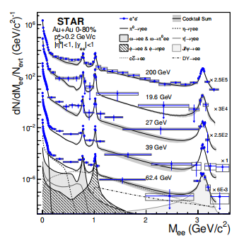
Result—pT-integrated invariant mass spectra（ efficiency-corrected spectra）
|$η_{e}$| < 1, $P_{T}^{e}$ > 0.2 GeV/c, and |$y_{ee}$| < 1
√sNN = 27GeV (2.5× ${10}^{2}$)
√sNN = 39GeV (1) this article
√sNN = 62.4GeV(6× ${10}^{−3}$)
√sNN = 19.6GeV(3 × ${10}^{4}$)
another article
√sNN = 200GeV (2.5 × ${10}^{5}$)
Blue point——real data
black curves——hadronic cocktail

Slide 11
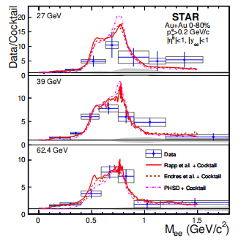
Result— ratio of the present data to the hadronic cocktail（ yields from ω and ϕ subtracted form both ）
A clear enhancement is observed in the LMR relative to the hadronic cocktail for each of the three collision energies.
Blue point——real data
Red curves——Rapp model+hadronic cocktail
Brown dotted line——Endres model+hadronic cocktail
Pink pecked line——PHSD model+hadronic cocktail
Rapp model :many-body calculation( primarily due to interactions with baryons and mesons)
Endres model:a coarse-grainedtransport approach
PHSD model: a microscopic transport model（includes the collisional broadening of the ρ）（contributions from the ρ, the QGP,
and Dalitz decays of the a1 and ∆ resonances）

Slide 12
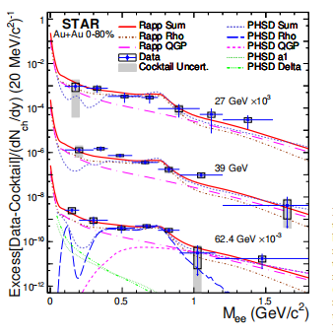
Result—the acceptance-corrected(using a virtual photon method) excess spectra（ ρ-meson were subtracted）
Rapp model: broadening of the ρ spectral function in a hadron gas (Rapp Rho) and from QGP radiation (Rapp QGP)
PHSD model:ρ meson (PHSD Rho), QGP(PHSD QGP), Dalitz decays of the a1 (PHSD a1), and ∆ resonances (PHSD Delta)
The sums (Rapp Sum, PHSD
Sum) are compared with the excess yield at each energy.
Blue point——real data
Rapp model: uncertainty on the order of 15%
PHSD model:uncertainty on the order of 30%

Slide 13
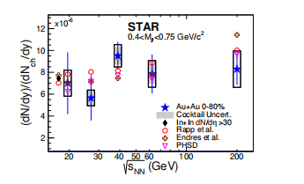
Result—the integrated excess yields（normalized by dNch/dy; integrated mass region from 0.40 to 0.75 GeV/$C^{2}$）
√sNN = 27GeV (2.5× ${10}^{2}$)
√sNN = 39GeV (1) this article
√sNN = 62.4GeV(6× ${10}^{−3}$)
√sNN = 19.6GeV(3 × ${10}^{4}$)
another article
√sNN = 200GeV (2.5 × ${10}^{5}$)
no statistically significant collision-energy dependence for the 0-80% most-central Au+Au collisions
dilepton production is expected to be mainly determined by the strong coupling of the ρ-meson to baryons, rather than to mesons
(total baryon density remains approximately unchanged for minimum-bias Au+Au collisions with collision energies above √sNN = 200GeV)

Slide 14
Summary
✭
reported dielectron yields for the 0−80% most-central Au+Au collisions at √sNN =27, 39, and 62.4 GeV
(complementing the previously published results √sNN =19.6 and 200GeV, combined data sets cover an order-of-magnitude range in collision energies over which the total baryon density and freeze-out temperatures are remarkably constant)
✭
observed statistically significant excesses in the LMR when comparing the data to hadronic cocktails that do not include vacuum ρ decay contributions.
✭
integrated from 0.40 to 0.75 GeV/$C^{2}$, and reported as a function of √sNN
( no significant energy dependence and are statistically consistent with model calculations)
✭
Further experimental tests of the models discussed in this paper are warranted
findings are consistent with models that include ρ broadening in the approach to chiral symmetry restoration
Beam Energy Scan Phase II project collected over an order of magnitude more data than previously acquired in the energy range from 7.7 to 19.6 GeV, where the total baryon density changes substantially
better understanding(factors in the LMR dielectron excess;connection between ρ-meson broadening and chiral symmetry restoration)
Future studies

