Slide 1
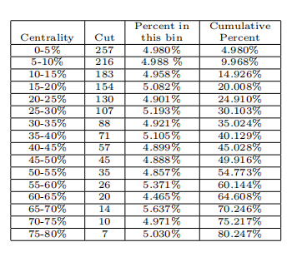
centrality
one runid :
using default cuts
centrality&weight:
https://drupal.star.bnl.gov/STAR/system/files/Centrality_Determination_for_4_5_GeV_2020_Production.pdf
$$Λ$$
htriton

Slide 2
reweight
reweight
reweight
cen:https://drupal.star.bnl.gov/STAR/system/files/Centrality_Determination_for_4_5_GeV_2020_Production.pdf

Slide 3
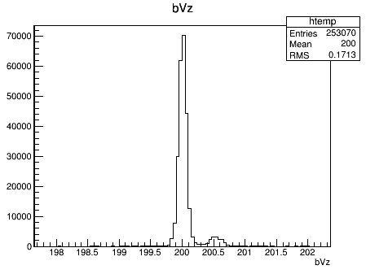
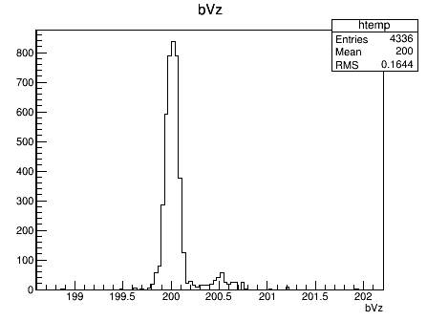
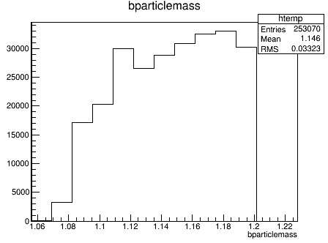
$$Λ$$
htriton
$$Λ$$
htriton

Slide 4
