Slide 1
Energy | Event number | Bkg(2X) | Purity
4180 | 416 | 20 | 0.98
4190 | 72 | 4 | 0.97
4200 | 96 | 0 | 1.00
4210 | 96 | 4 | 0.98
4220 | 136 | 4 | 0.99
4230 | 296 | 16 | 0.97
4237 | 132 | 4 | 0.98
4246 | 136 | 8 | 0.97
4260 | 216 | 0 | 1.00
4270 | 148 | 8 | 0.97
4280 | 64 | 0 | 1.00
4290 | 180 | 4 | 0.99
4315 | 232 | 4 | 0.99
4340 | 320 | 8 | 0.99
4360 | 420 | 16 | 0.98
4380 | 408 | 12 | 0.99
4400 | 396 | 12 | 0.98
4420 | 676 | 24 | 0.98
4440 | 280 | 12 | 0.98

Slide 2
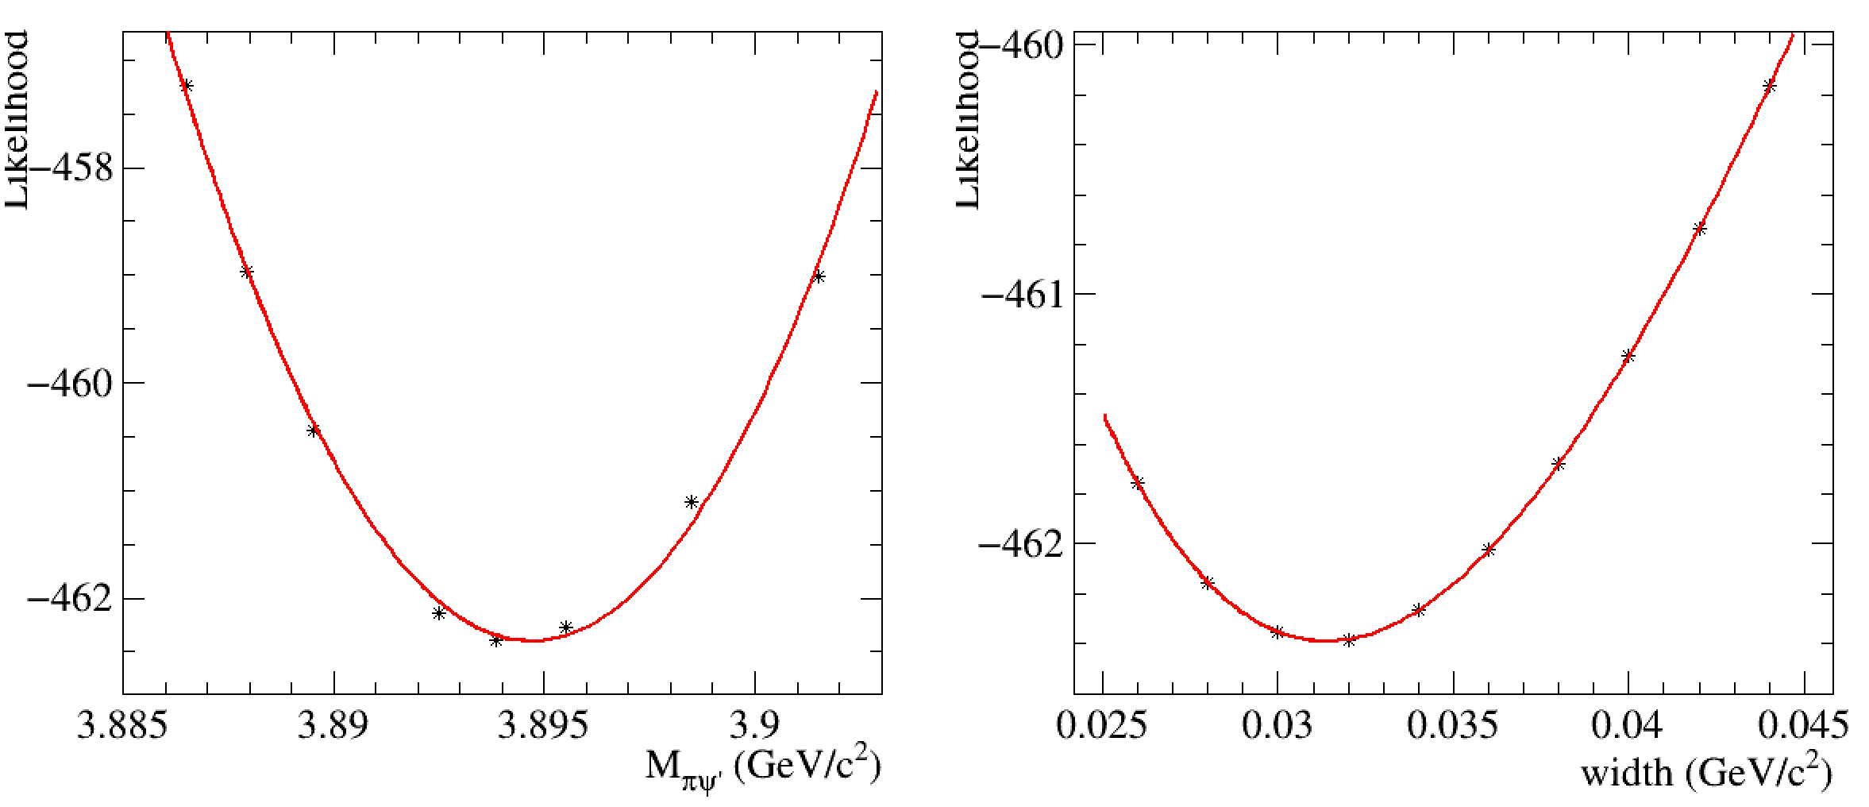
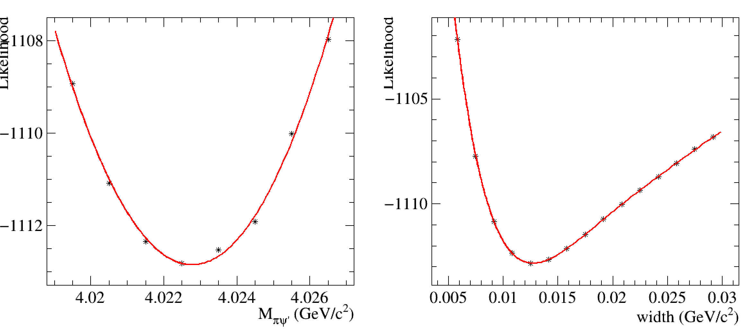
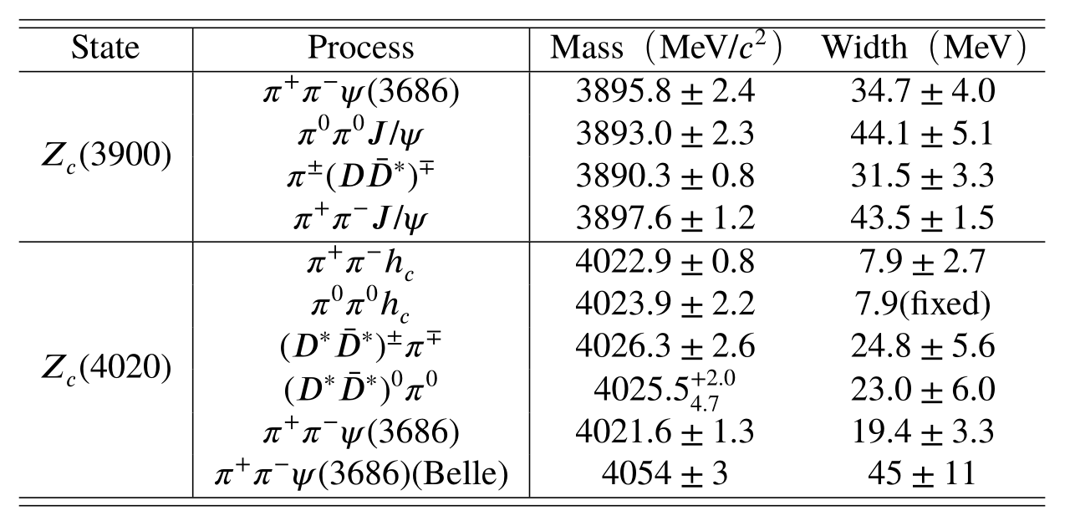
M=3894.7 +- 2.6
W=31.4 +- 5.1
4246-4290 scan for Zc3900
4400-4440 scan for Zc4020
M=4022.8 +- 1.2
W=12.7 +- 2.2

Slide 3
Energy | Significance of F0980 | Significance of Zc3900 | Significance of Zc4020
4180 | 5.6 | 6.8 | 3.6
4190 | 3.8 | 3.1 | 0.3
4200 | 3.9 | 1.5 | 0.6
4210 | 0.9 | 3.0 | 0.6
4220 | 2.0 | 2.2 | 0.9
4230 | 3.5 | 5.3 | 2.4
4237 | 1.1 | 2.7 | 1.9
4246 | 1.5 | 3.8 | 1.3
4260 | 6.8 | 6.0 | 0.2
4270 | 8.1 | 3.6 | 2.1
4280 | 4.3 | 3.5 | 0.5
4290 | 8.3 | 5.0 | 1.0
4315 | 13.8 | 1.7 | 3.1
4340 | 17.8 | 1.3 | 1.0
4360 | 25.2 | 0.4 | 5.2
4380 | 22.7 | 1.1 | 3.4
4400 | 21.3 | 1.8 | 3.6
4420 | 28.7 | 2.7 | 7.5
4440 | 18.3 | 1.7 | 6.6
Significance of F0980 is calculated with base model Zc3900+F0500
Significance of Zc3900 is calculated with base model F0500+F0980
Significance of Zc4020 is calculated with base model Zc3900+F0500+F0980

Slide 4
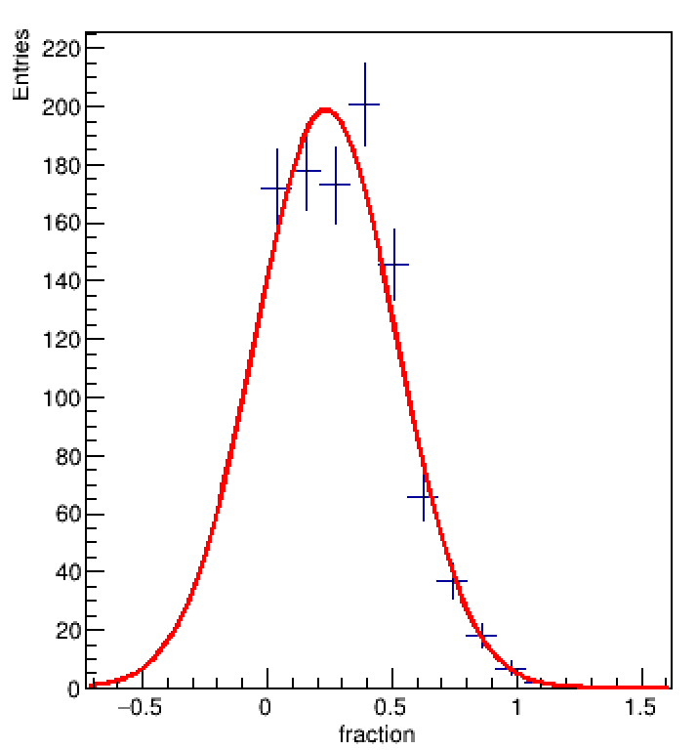
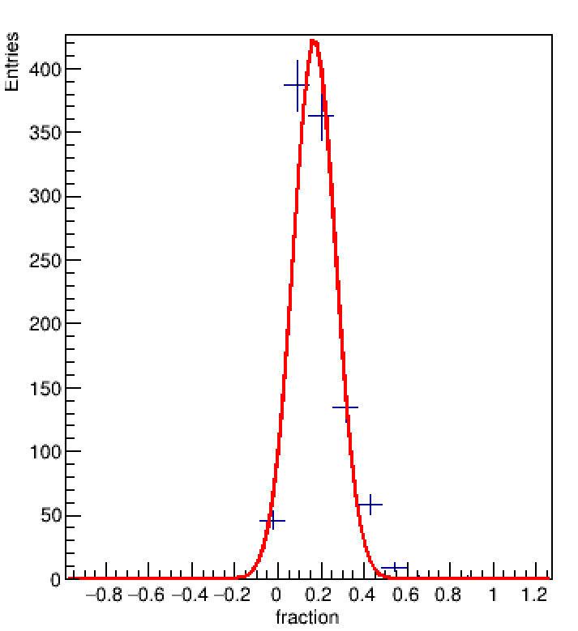
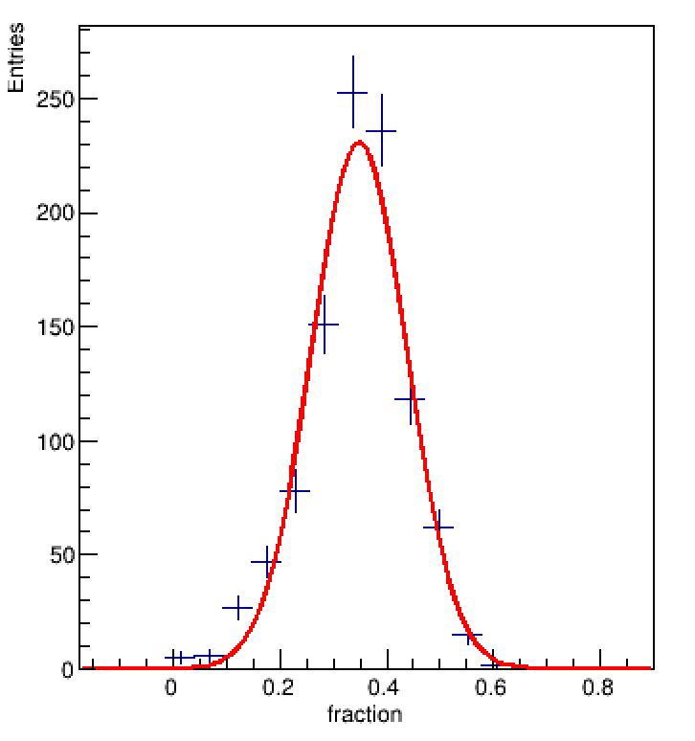
Zc3900+F0500+F0980
Energy | Event number | Initial | fit
4180 | 416 | 19.27+/-5.14 | 19.93+/-5.14
4190 | 72 | 101.87+/-14.09 | 92.99+/-14.09
4200 | 96 | 16.19+/-9.41 | 16.57+/-9.41
4210 | 96 | 44.8+/-28.38 | 23.37+/-28.38
4220 | 136 | 14.48+/-9.95 | 16.83+/-9.95
4230 | 296 | 36.29+/-8.96 | 34.77+/-8.96
4237 | 132 | 26.92+/-14.08 | 23.13+/-14.08
4246 | 136 | 40.95+/-16.04 | 32.7+/-16.04
4260 | 216 | 28.35+/-7.4 | 28.53+/-7.4
4270 | 148 | 26.07+/-8.07 | 25.26+/-8.07
4280 | 64 | 42.35+/-12.68 | 36.63+/-12.68
4290 | 180 | 25.52+/-8.3 | 25.01+/-8.3
4315 | 232 | 5.81+/-3.65 | 6.64+/-3.65
4340 | 320 | 4.99+/-3.65 | 5.68+/-3.65
4360 | 420 | 0.98+/-1.64 | 0.82+/-1.64
4380 | 408 | 3+/-2.81 | 2.87+/-2.81
4400 | 396 | 2.45+/-1.69 | 2.85+/-1.69
4420 | 676 | 2.32+/-1.28 | 2.89+/-1.28
4440 | 280 | 4.91+/-3.26 | 5.47+/-3.26
4210
4220
4230

Slide 5
Energy | Event number | Zc3900+F0500 |  | Zc3900+F0500+F0980 |  | Zc3900+Zc4020+F0500+F0980
Energy | Event number | Initial | fit | Initial | fit | Initial | fit
4180 | 416 | 138.25+/-8.41 | 137.03+/-8.41 | 19.27+/-5.14 | 19.93+/-5.14 | 135.2+/-5.96 | 134.21+/-5.96
4190 | 72 | 134.41+/-39.02 | 80.62+/-39.02 | 101.87+/-14.09 | 92.99+/-14.09 | 108.01+/-14.91 | 91.39+/-14.91
4200 | 96 | 20.2+/-9.41 | 21.22+/-9.41 | 16.19+/-9.41 | 16.57+/-9.41 | 16.32+/-7.52 | 16.94+/-7.52
4210 | 96 | 33.27+/-33.9 | 26.8+/-33.9 | 44.8+/-28.38 | 23.37+/-28.38 | 44.21+/-16.17 | 34.38+/-16.17
4220 | 136 | 16.39+/-7.38 | 17.65+/-7.38 | 14.48+/-9.95 | 16.83+/-9.95 | 88.33+/-20.53 | 74.59+/-20.53
4230 | 296 | 36.71+/-27.07 | 44.57+/-27.07 | 36.29+/-8.96 | 34.77+/-8.96 | 38.57+/-8.67 | 35.57+/-8.67
4237 | 132 | 131.76+/-7.64 | 126.24+/-7.64 | 26.92+/-14.08 | 23.13+/-14.08 | 50.85+/-19.93 | 42.19+/-19.93
4246 | 136 | 111.57+/-11.57 | 104.97+/-11.57 | 40.95+/-16.04 | 32.7+/-16.04 | 31.89+/-14.92 | 24.94+/-14.92
4260 | 216 | 87.4+/-7.52 | 86.68+/-7.52 | 28.35+/-7.4 | 28.53+/-7.4 | 30.01+/-8.39 | 29.29+/-8.39
4270 | 148 | 51.53+/-10.51 | 52.39+/-10.51 | 26.07+/-8.07 | 25.26+/-8.07 | 21.92+/-2.66 | 21.81+/-2.66
4280 | 64 | 84.03+/-18.69 | 73.28+/-18.69 | 42.35+/-12.68 | 36.63+/-12.68 | 34.91+/-13.16 | 33.12+/-13.16
4290 | 180 | 74.09+/-8.19 | 72.46+/-8.19 | 25.52+/-8.3 | 25.01+/-8.3 | 25.16+/-9.82 | 20.02+/-9.82
4315 | 232 | 69.25+/-9.61 | 67.86+/-9.61 | 5.81+/-3.65 | 6.64+/-3.65 | 2.38+/-2.02 | 3.06+/-2.02
4340 | 320 | 50.01+/-4.12 | 49.85+/-4.12 | 4.99+/-3.65 | 5.68+/-3.65 | 4.75+/-3.12 | 5.78+/-3.12
4360 | 420 | 50.17+/-20.94 | 47.09+/-20.94 | 0.98+/-1.64 | 0.82+/-1.64 | 1.7+/-0.91 | 1.9+/-0.91
4380 | 408 | 37.17+/-6.58 | 37.3+/-6.58 | 3+/-2.81 | 2.87+/-2.81 | 3.33+/-1.88 | 3.39+/-1.88
4400 | 396 | 115.53+/-5.12 | 113.43+/-5.12 | 2.45+/-1.69 | 2.85+/-1.69 | 7.26+/-2.63 | 7.46+/-2.63
4420 | 676 | 120.51+/-3.83 | 119.21+/-3.83 | 2.32+/-1.28 | 2.89+/-1.28 | 3.99+/-1.48 | 4.39+/-1.48
4440 | 280 | 102.47+/-6.6 | 101.19+/-6.6 | 4.91+/-3.26 | 5.47+/-3.26 | 5.91+/-2.91 | 6.47+/-2.91

Slide 6
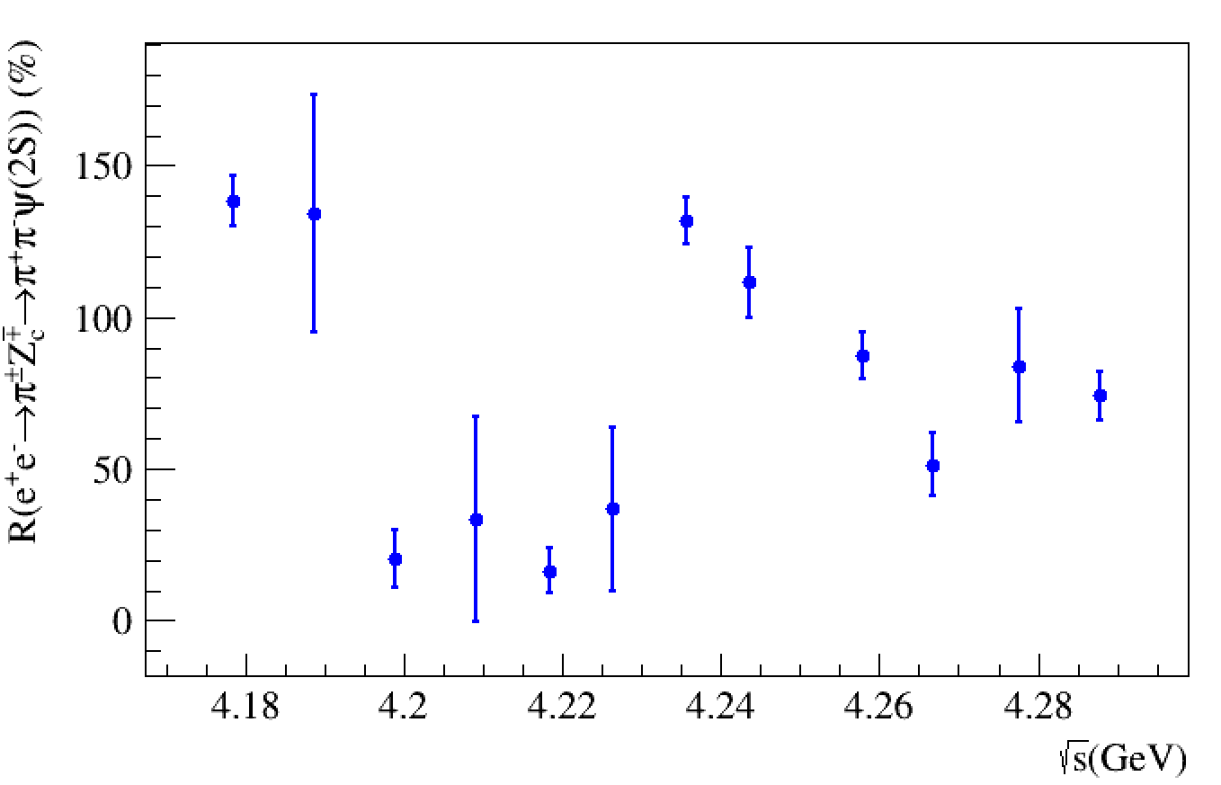
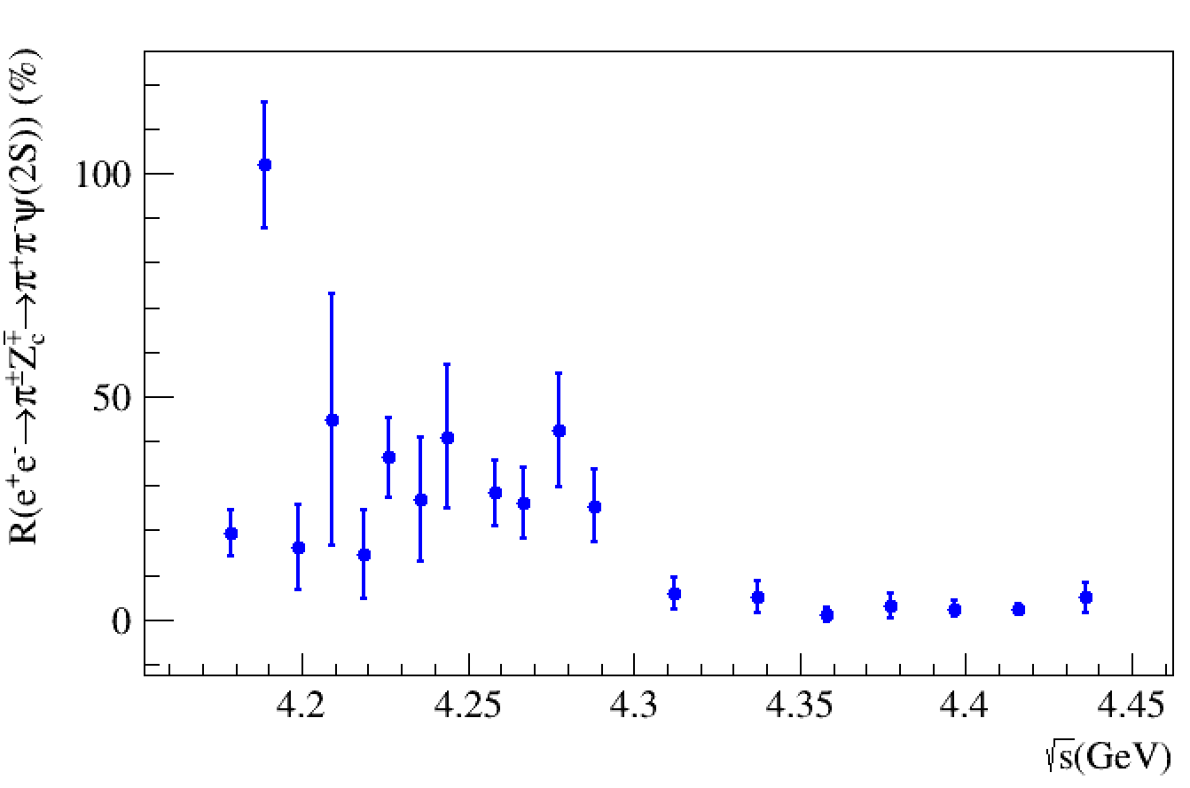
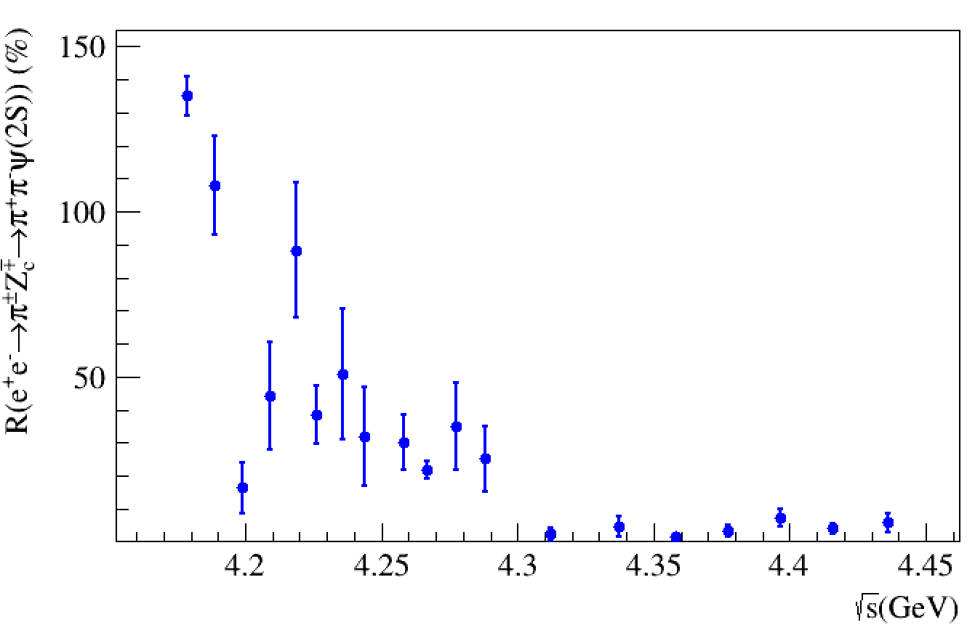
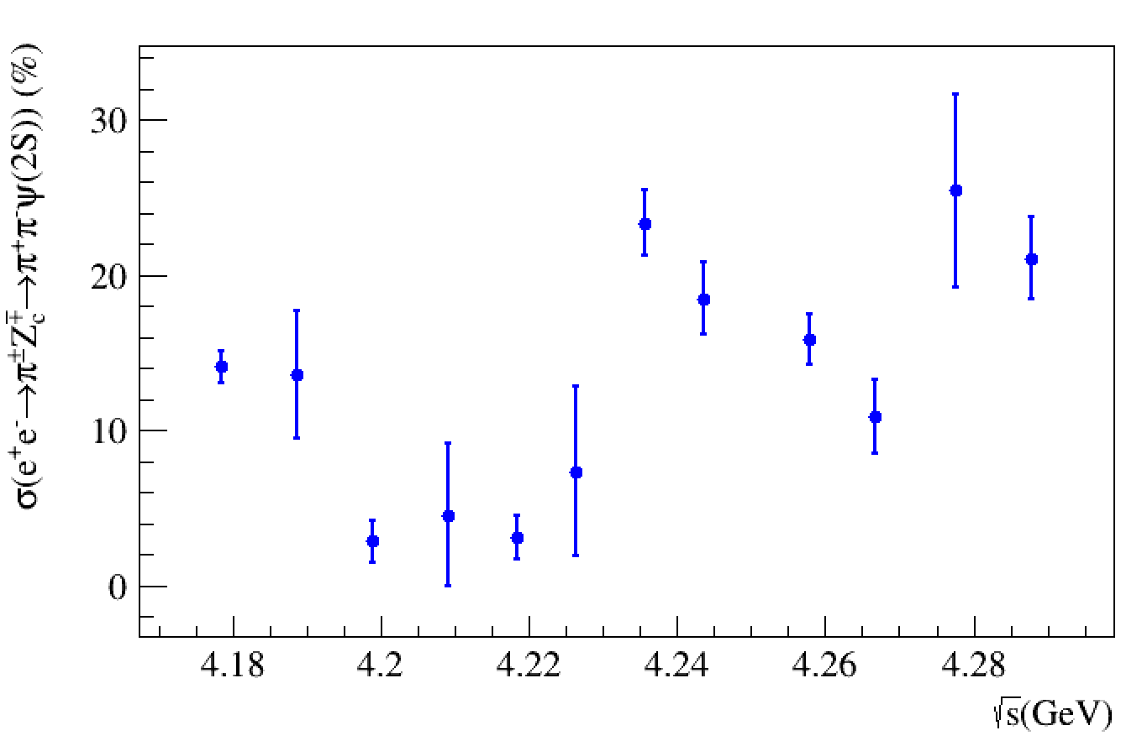
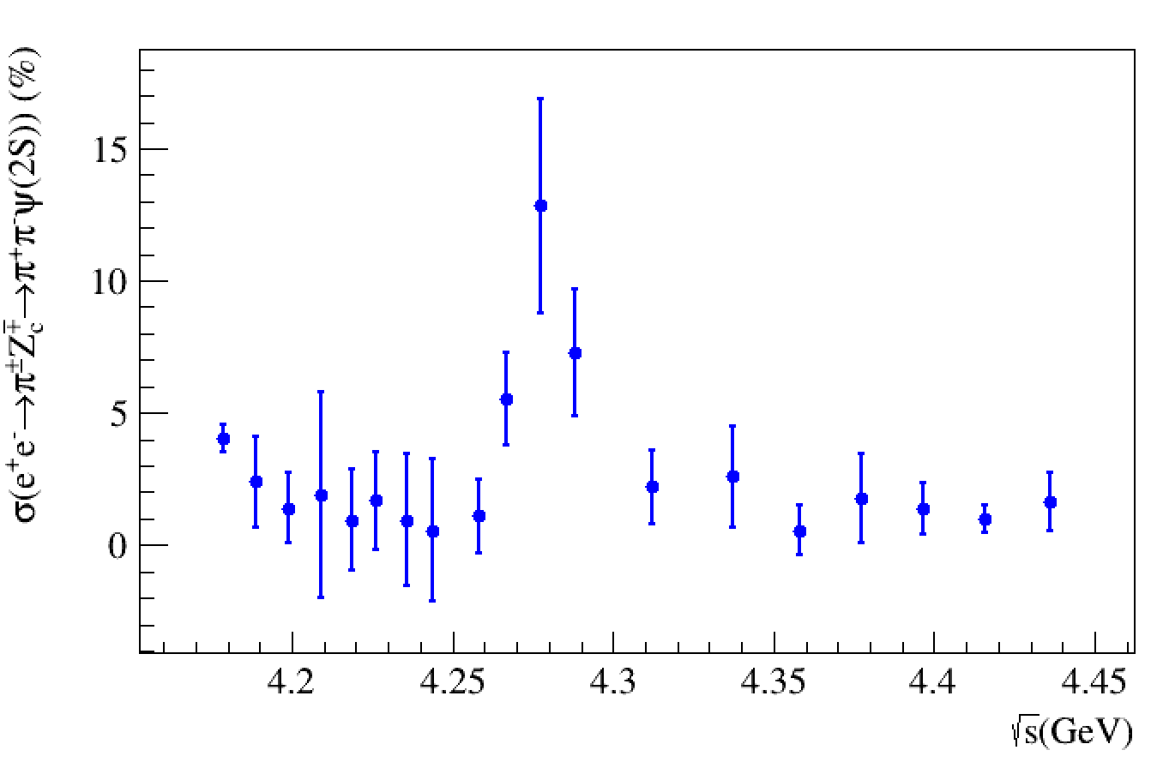
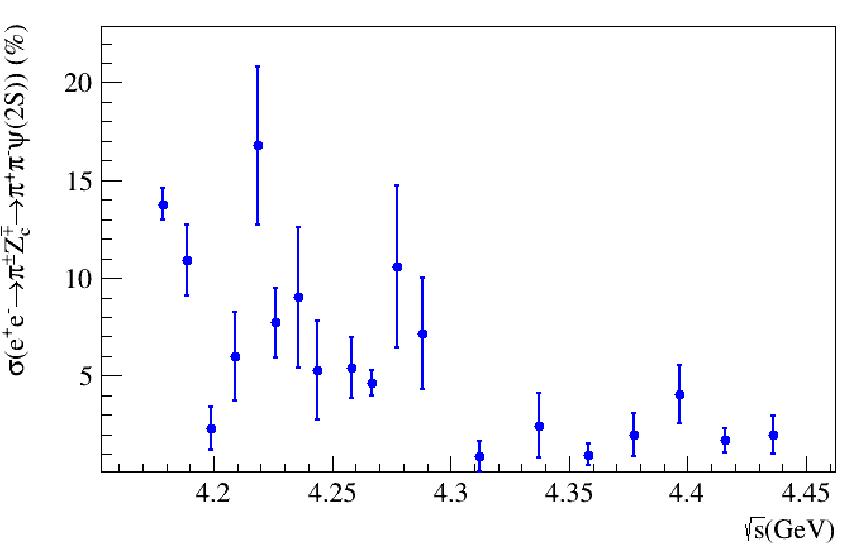
Zc3900+F0500
Zc3900+F0500+F0980
Zc3900+Zc4020+F0500+F0980

Slide 7
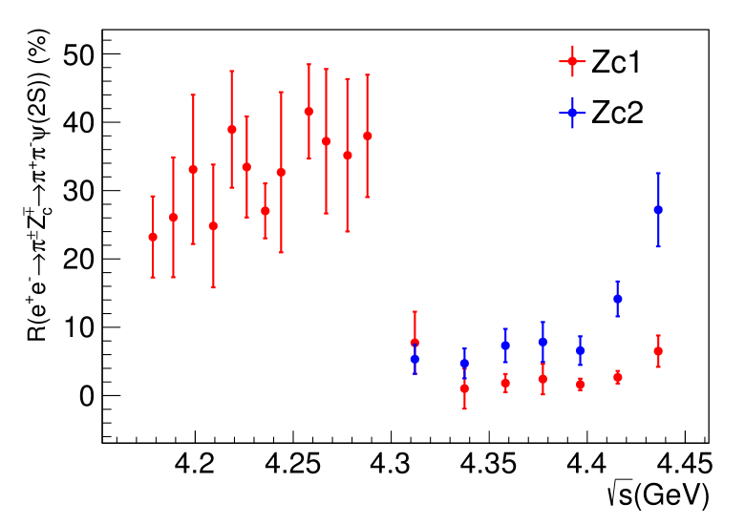
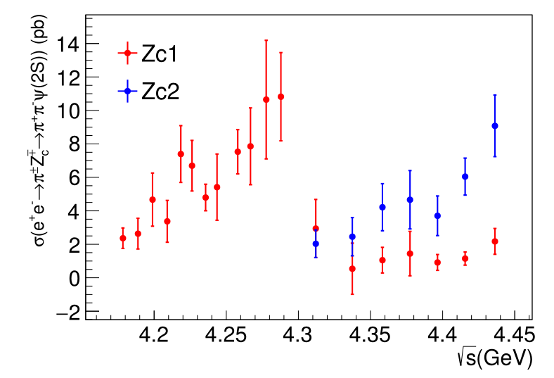

Slide 8
4180
4210
4260

Slide 9
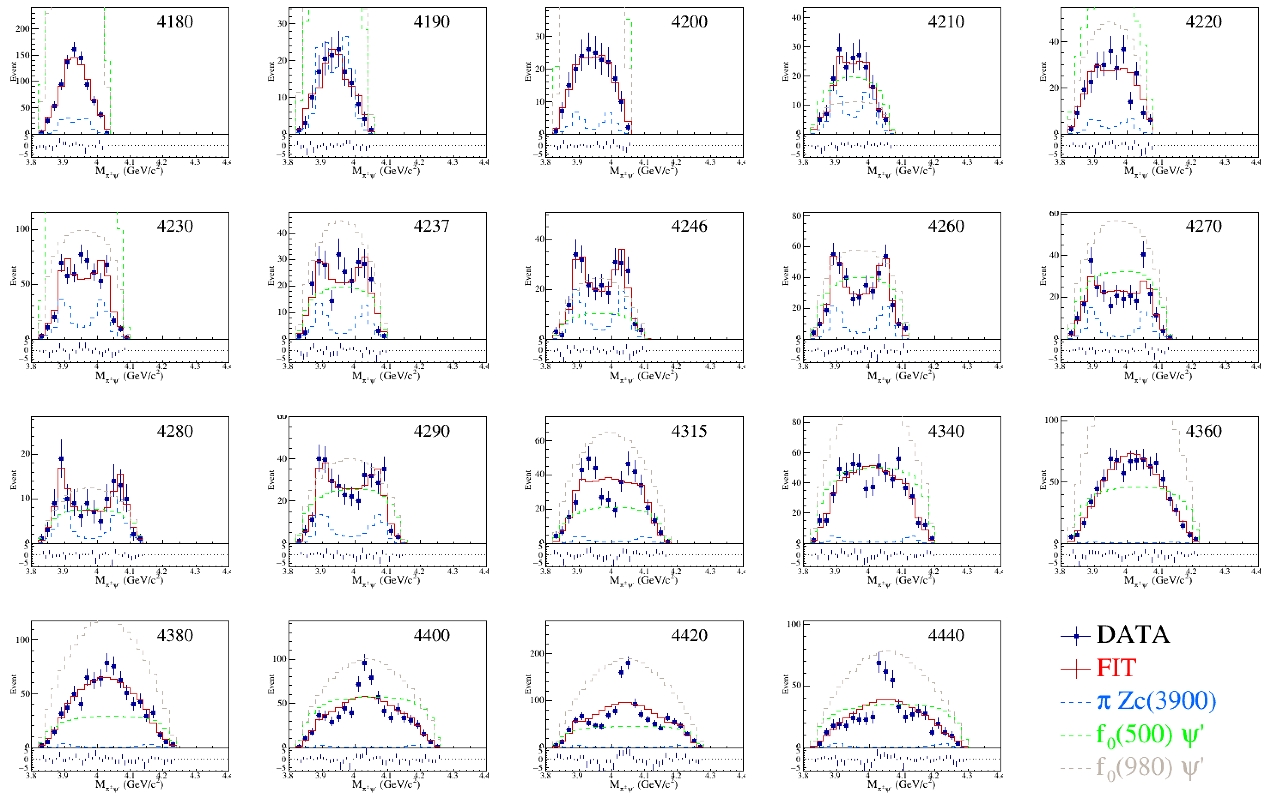

Slide 10
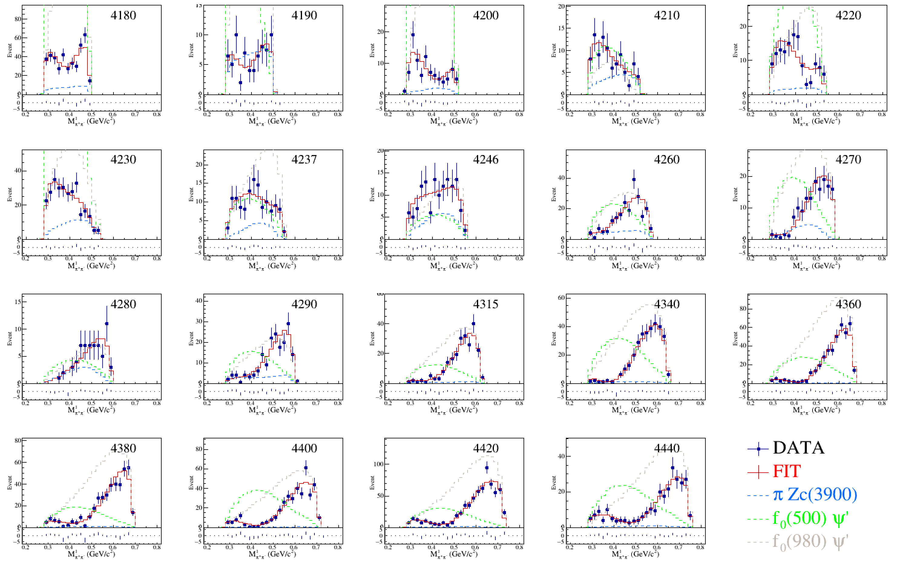

Slide 11
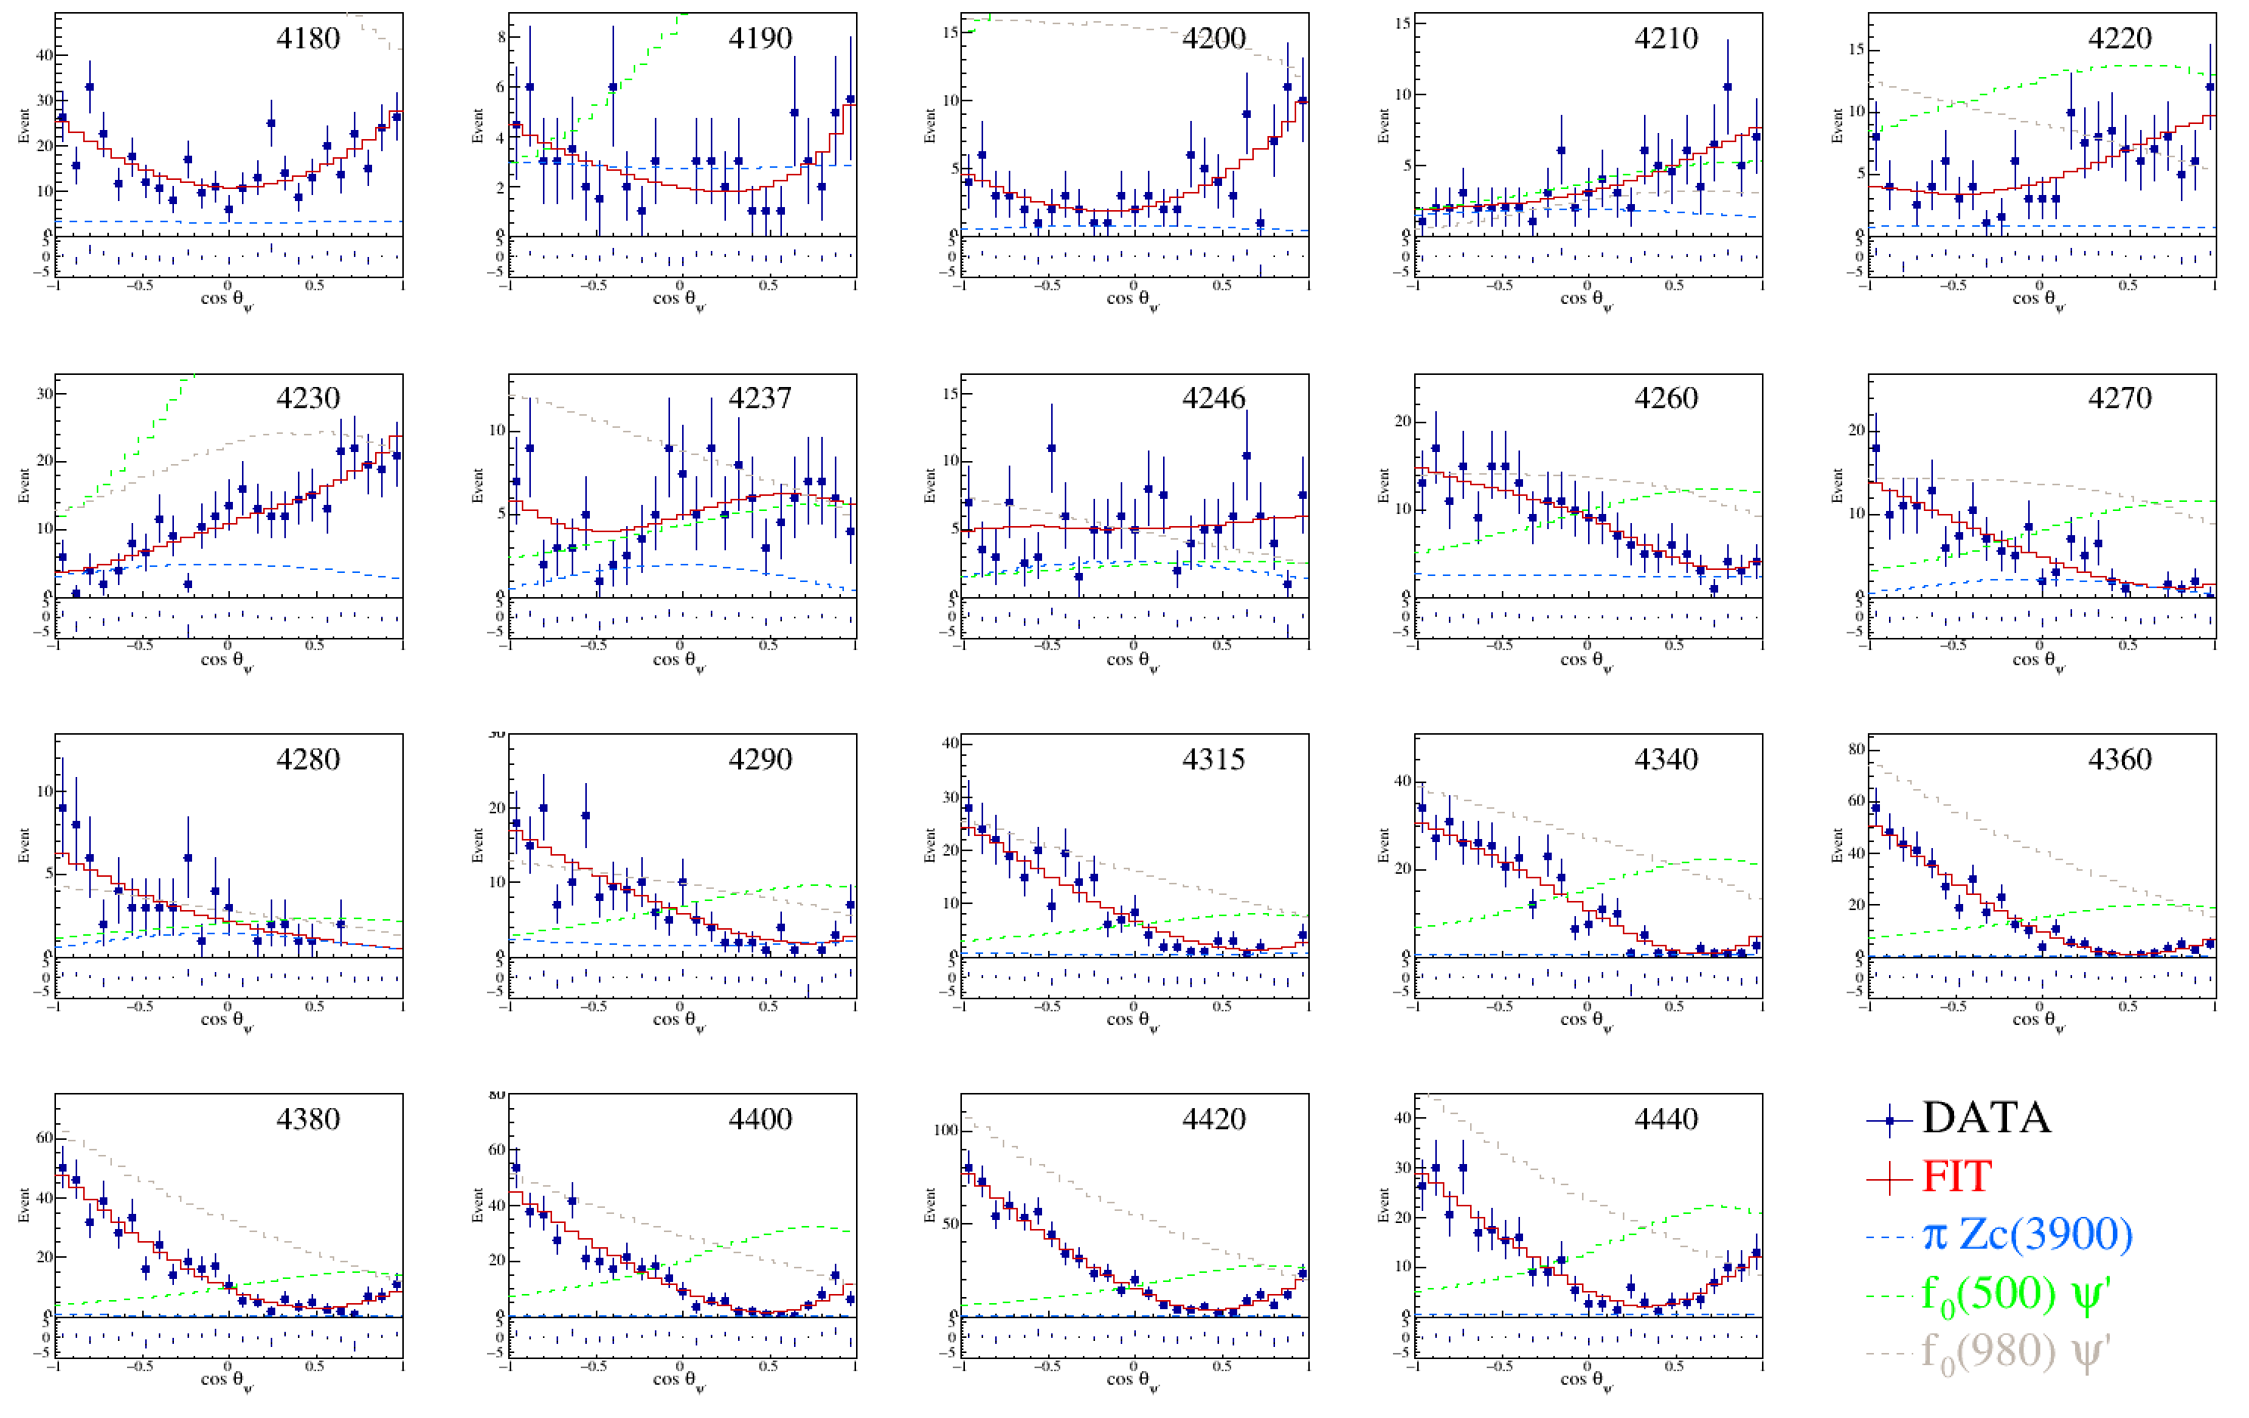

Slide 12
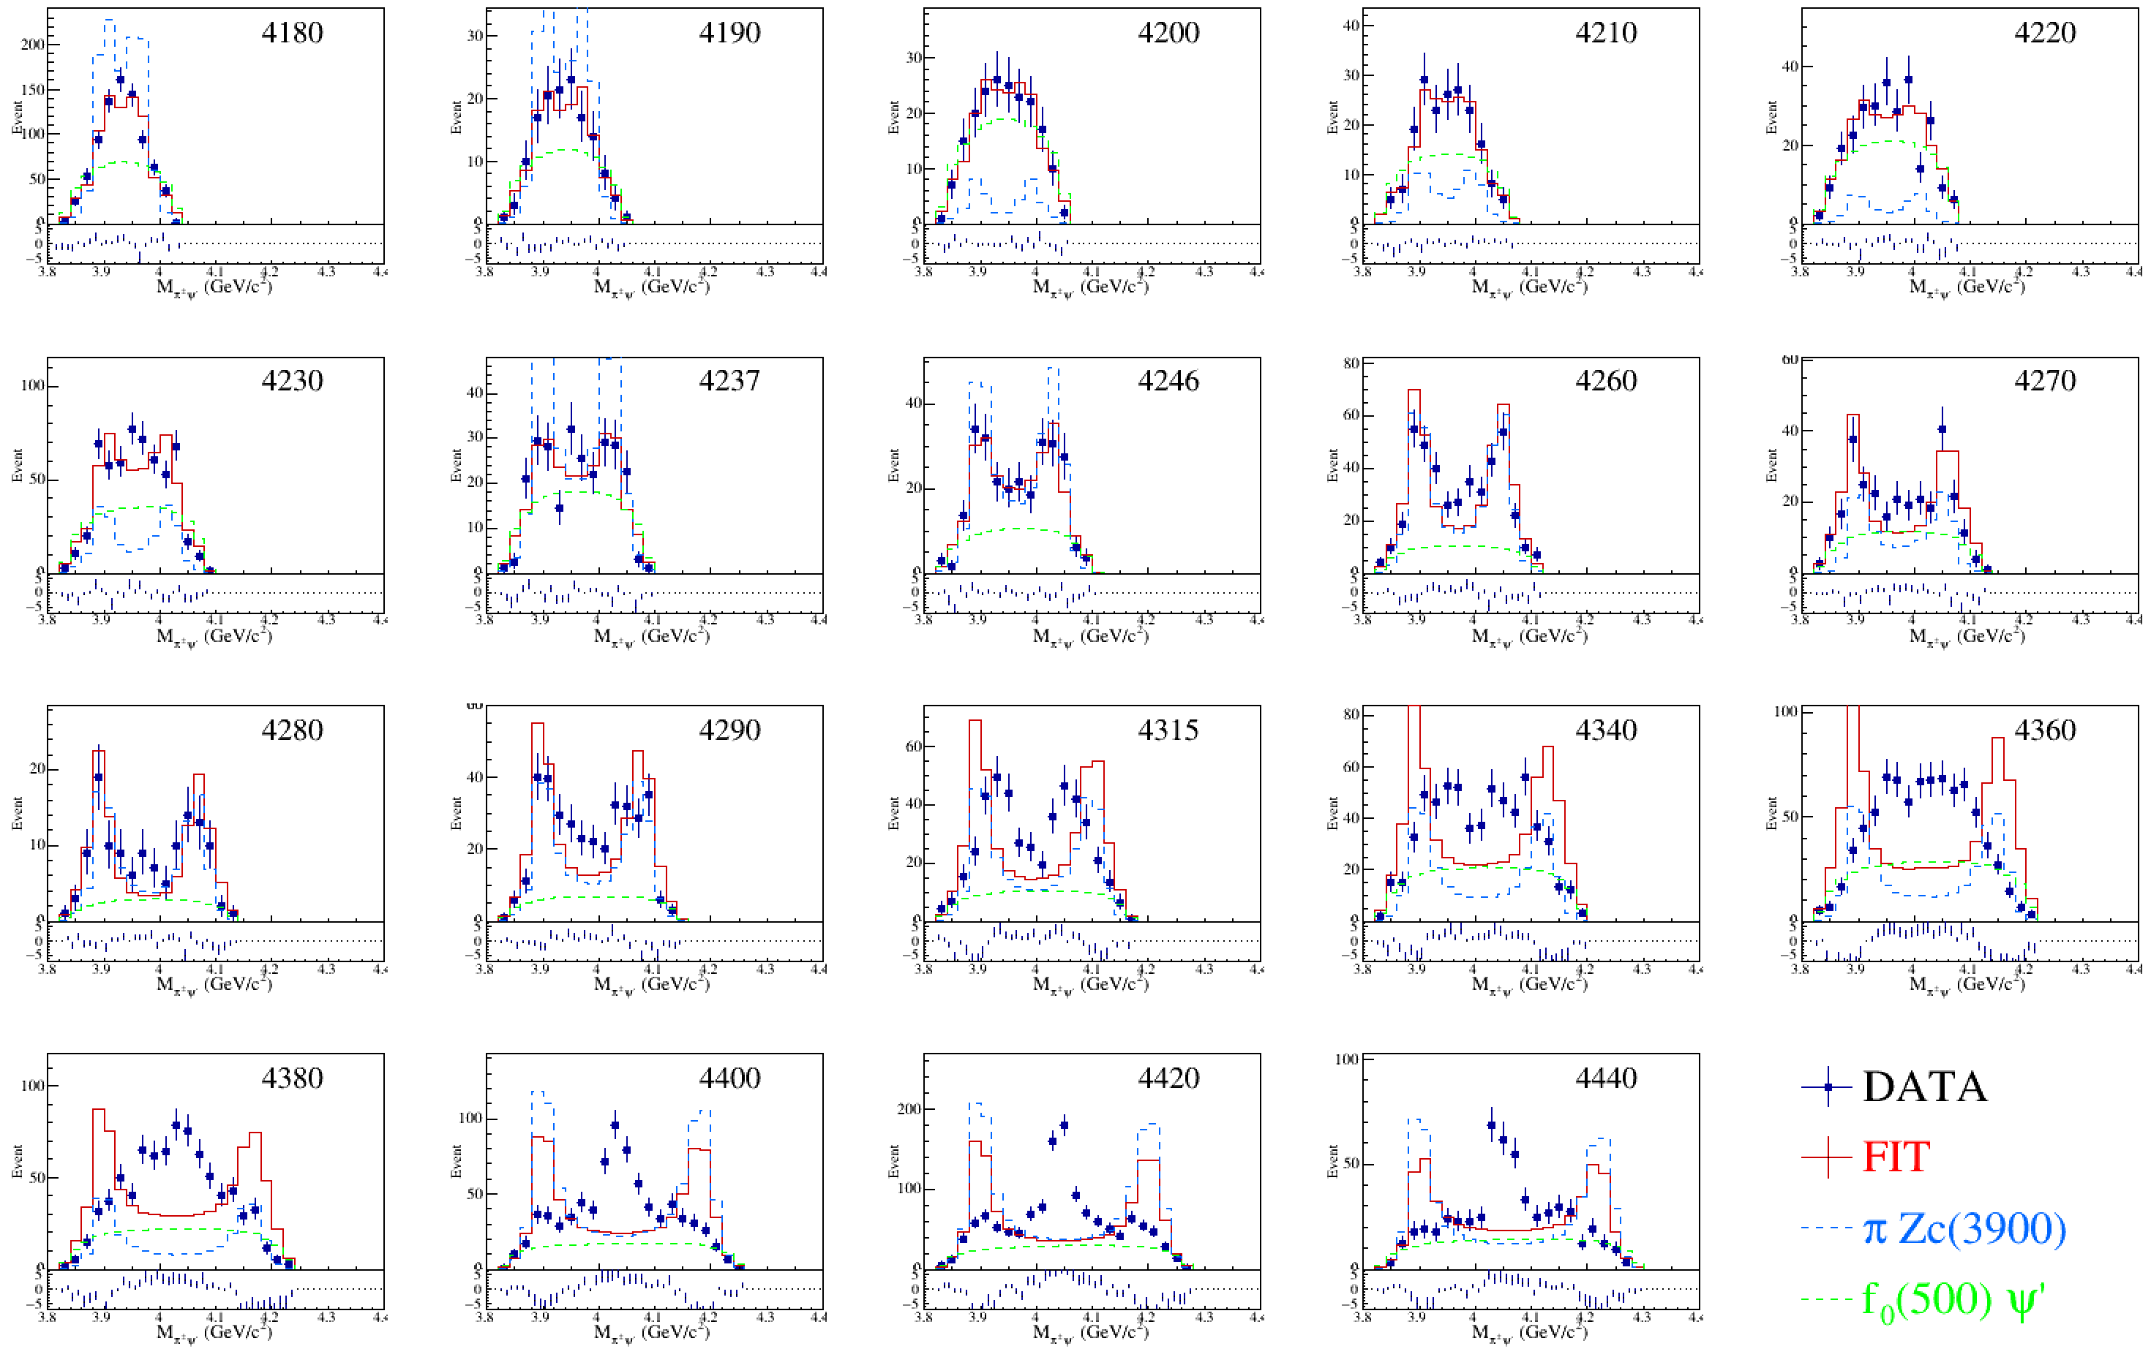

Slide 13
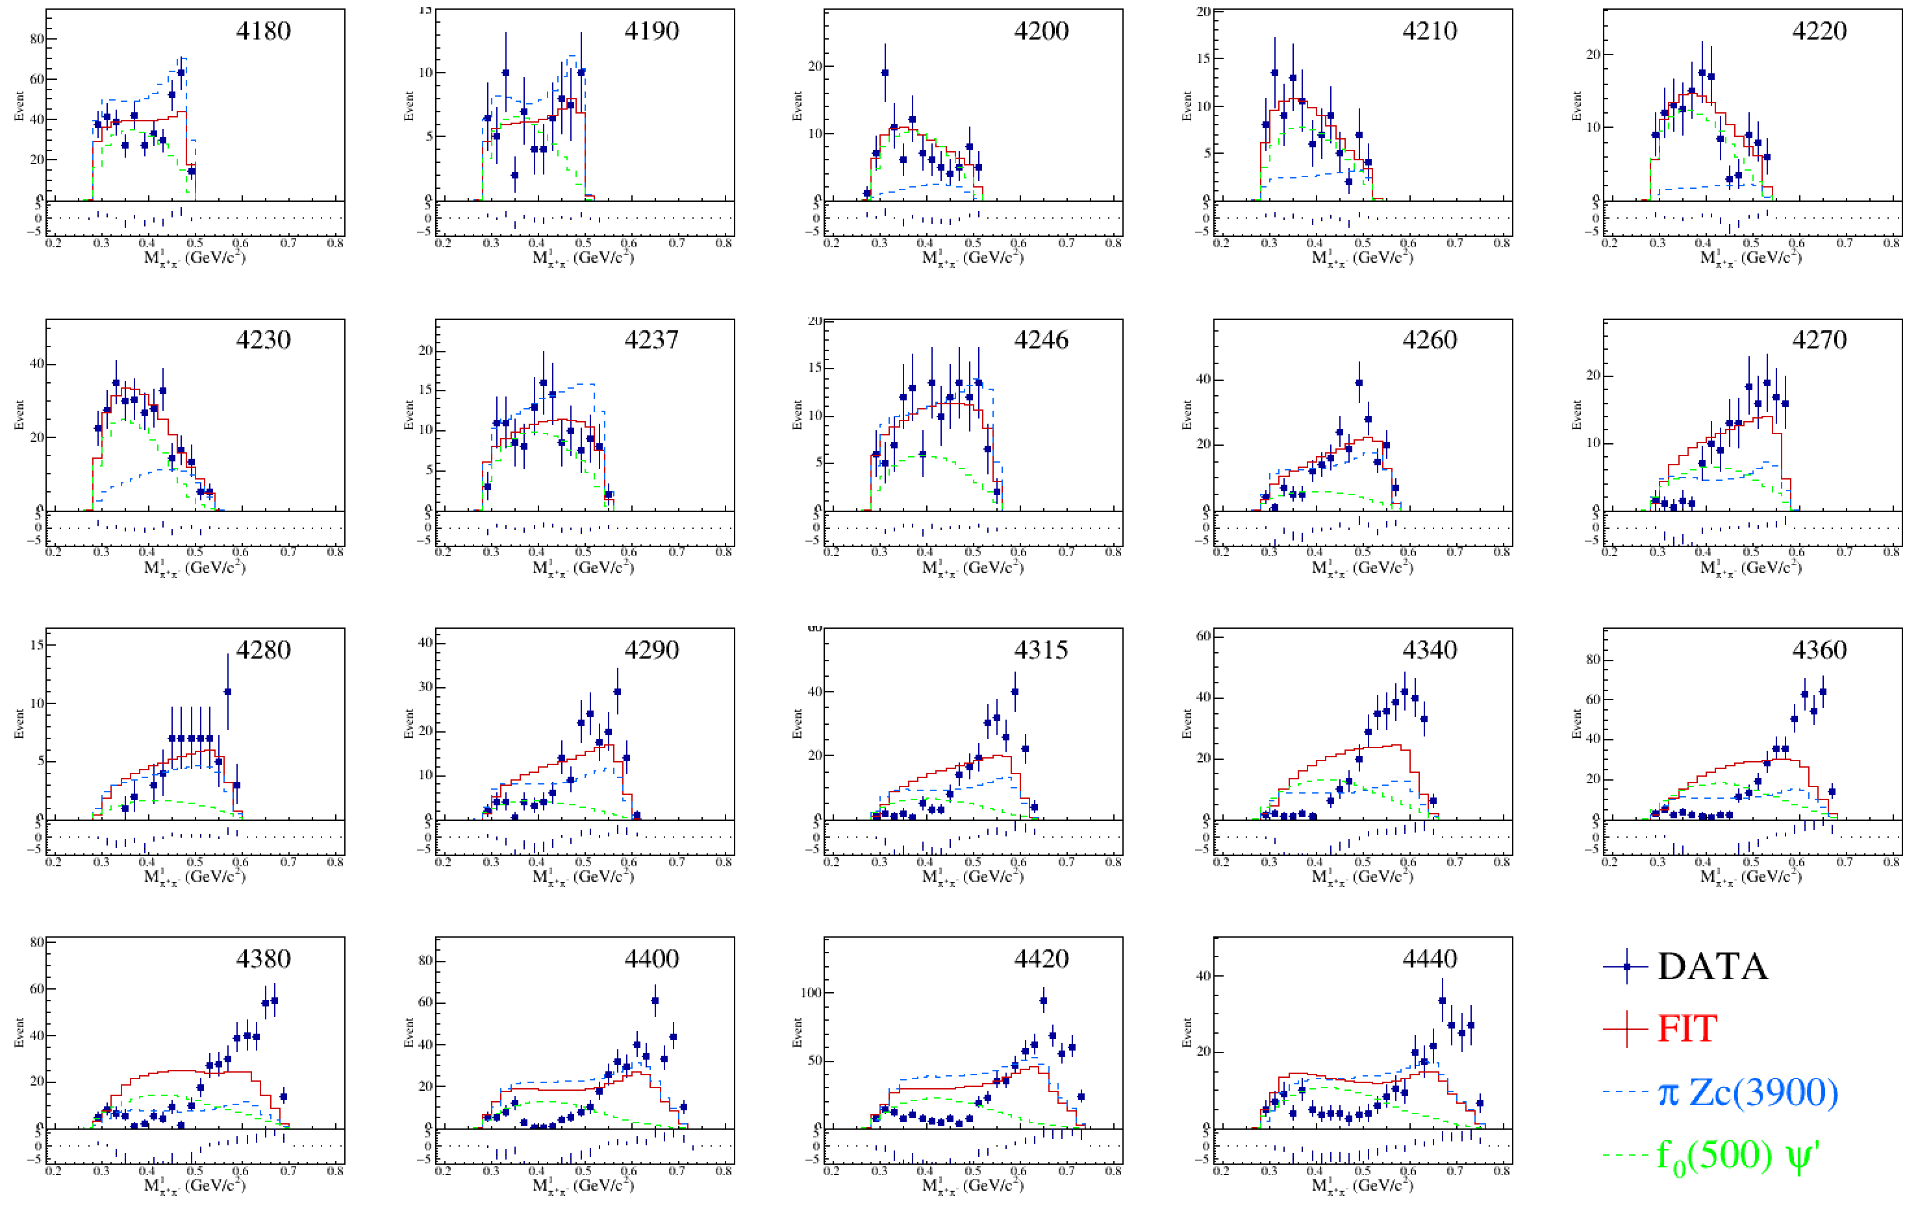

Slide 14
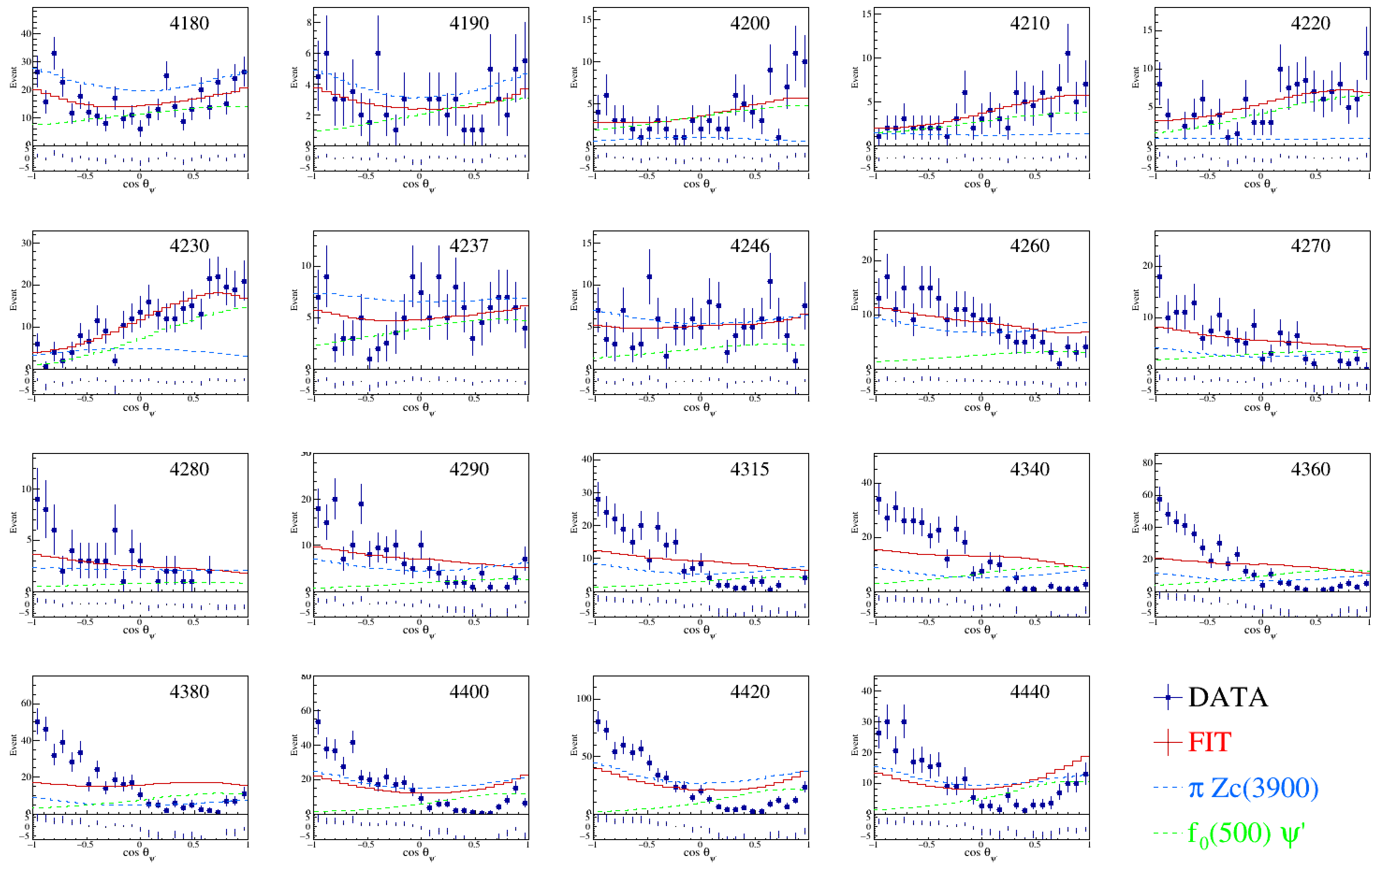

Slide 15
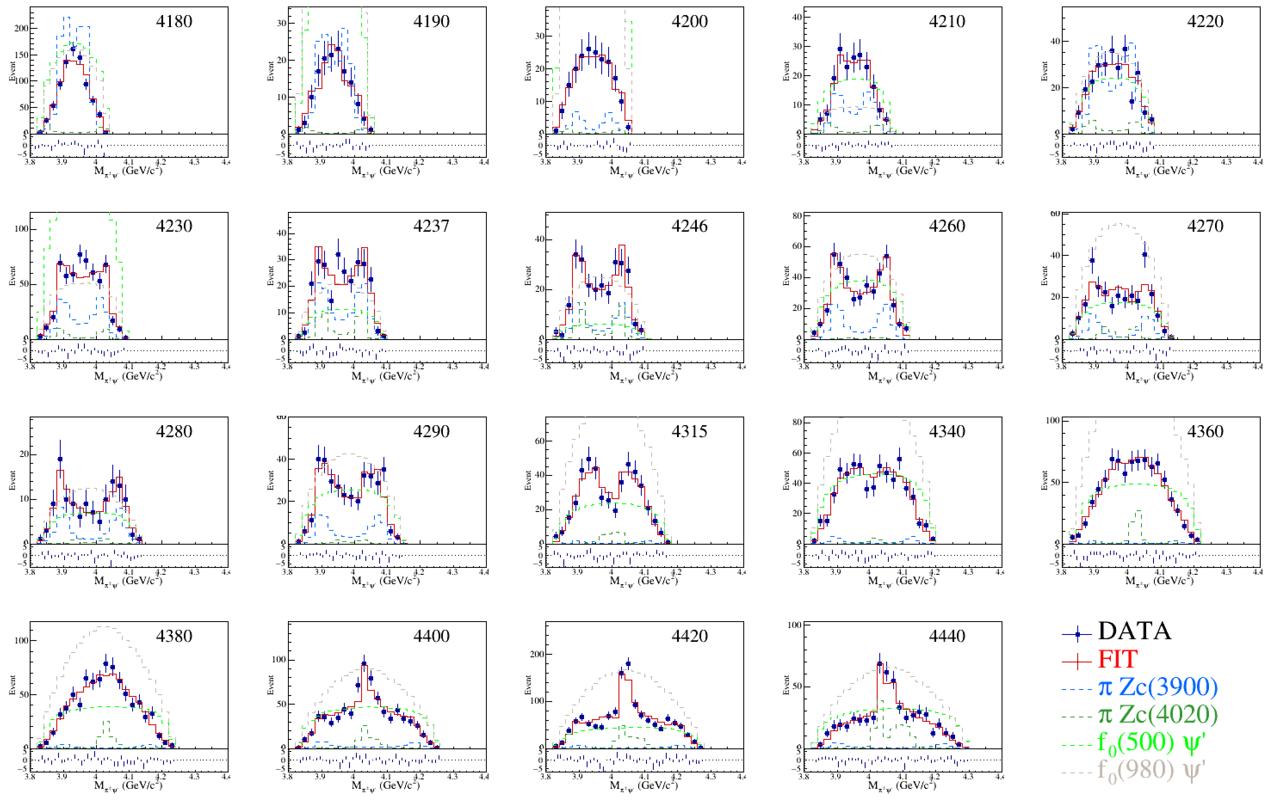

Slide 16
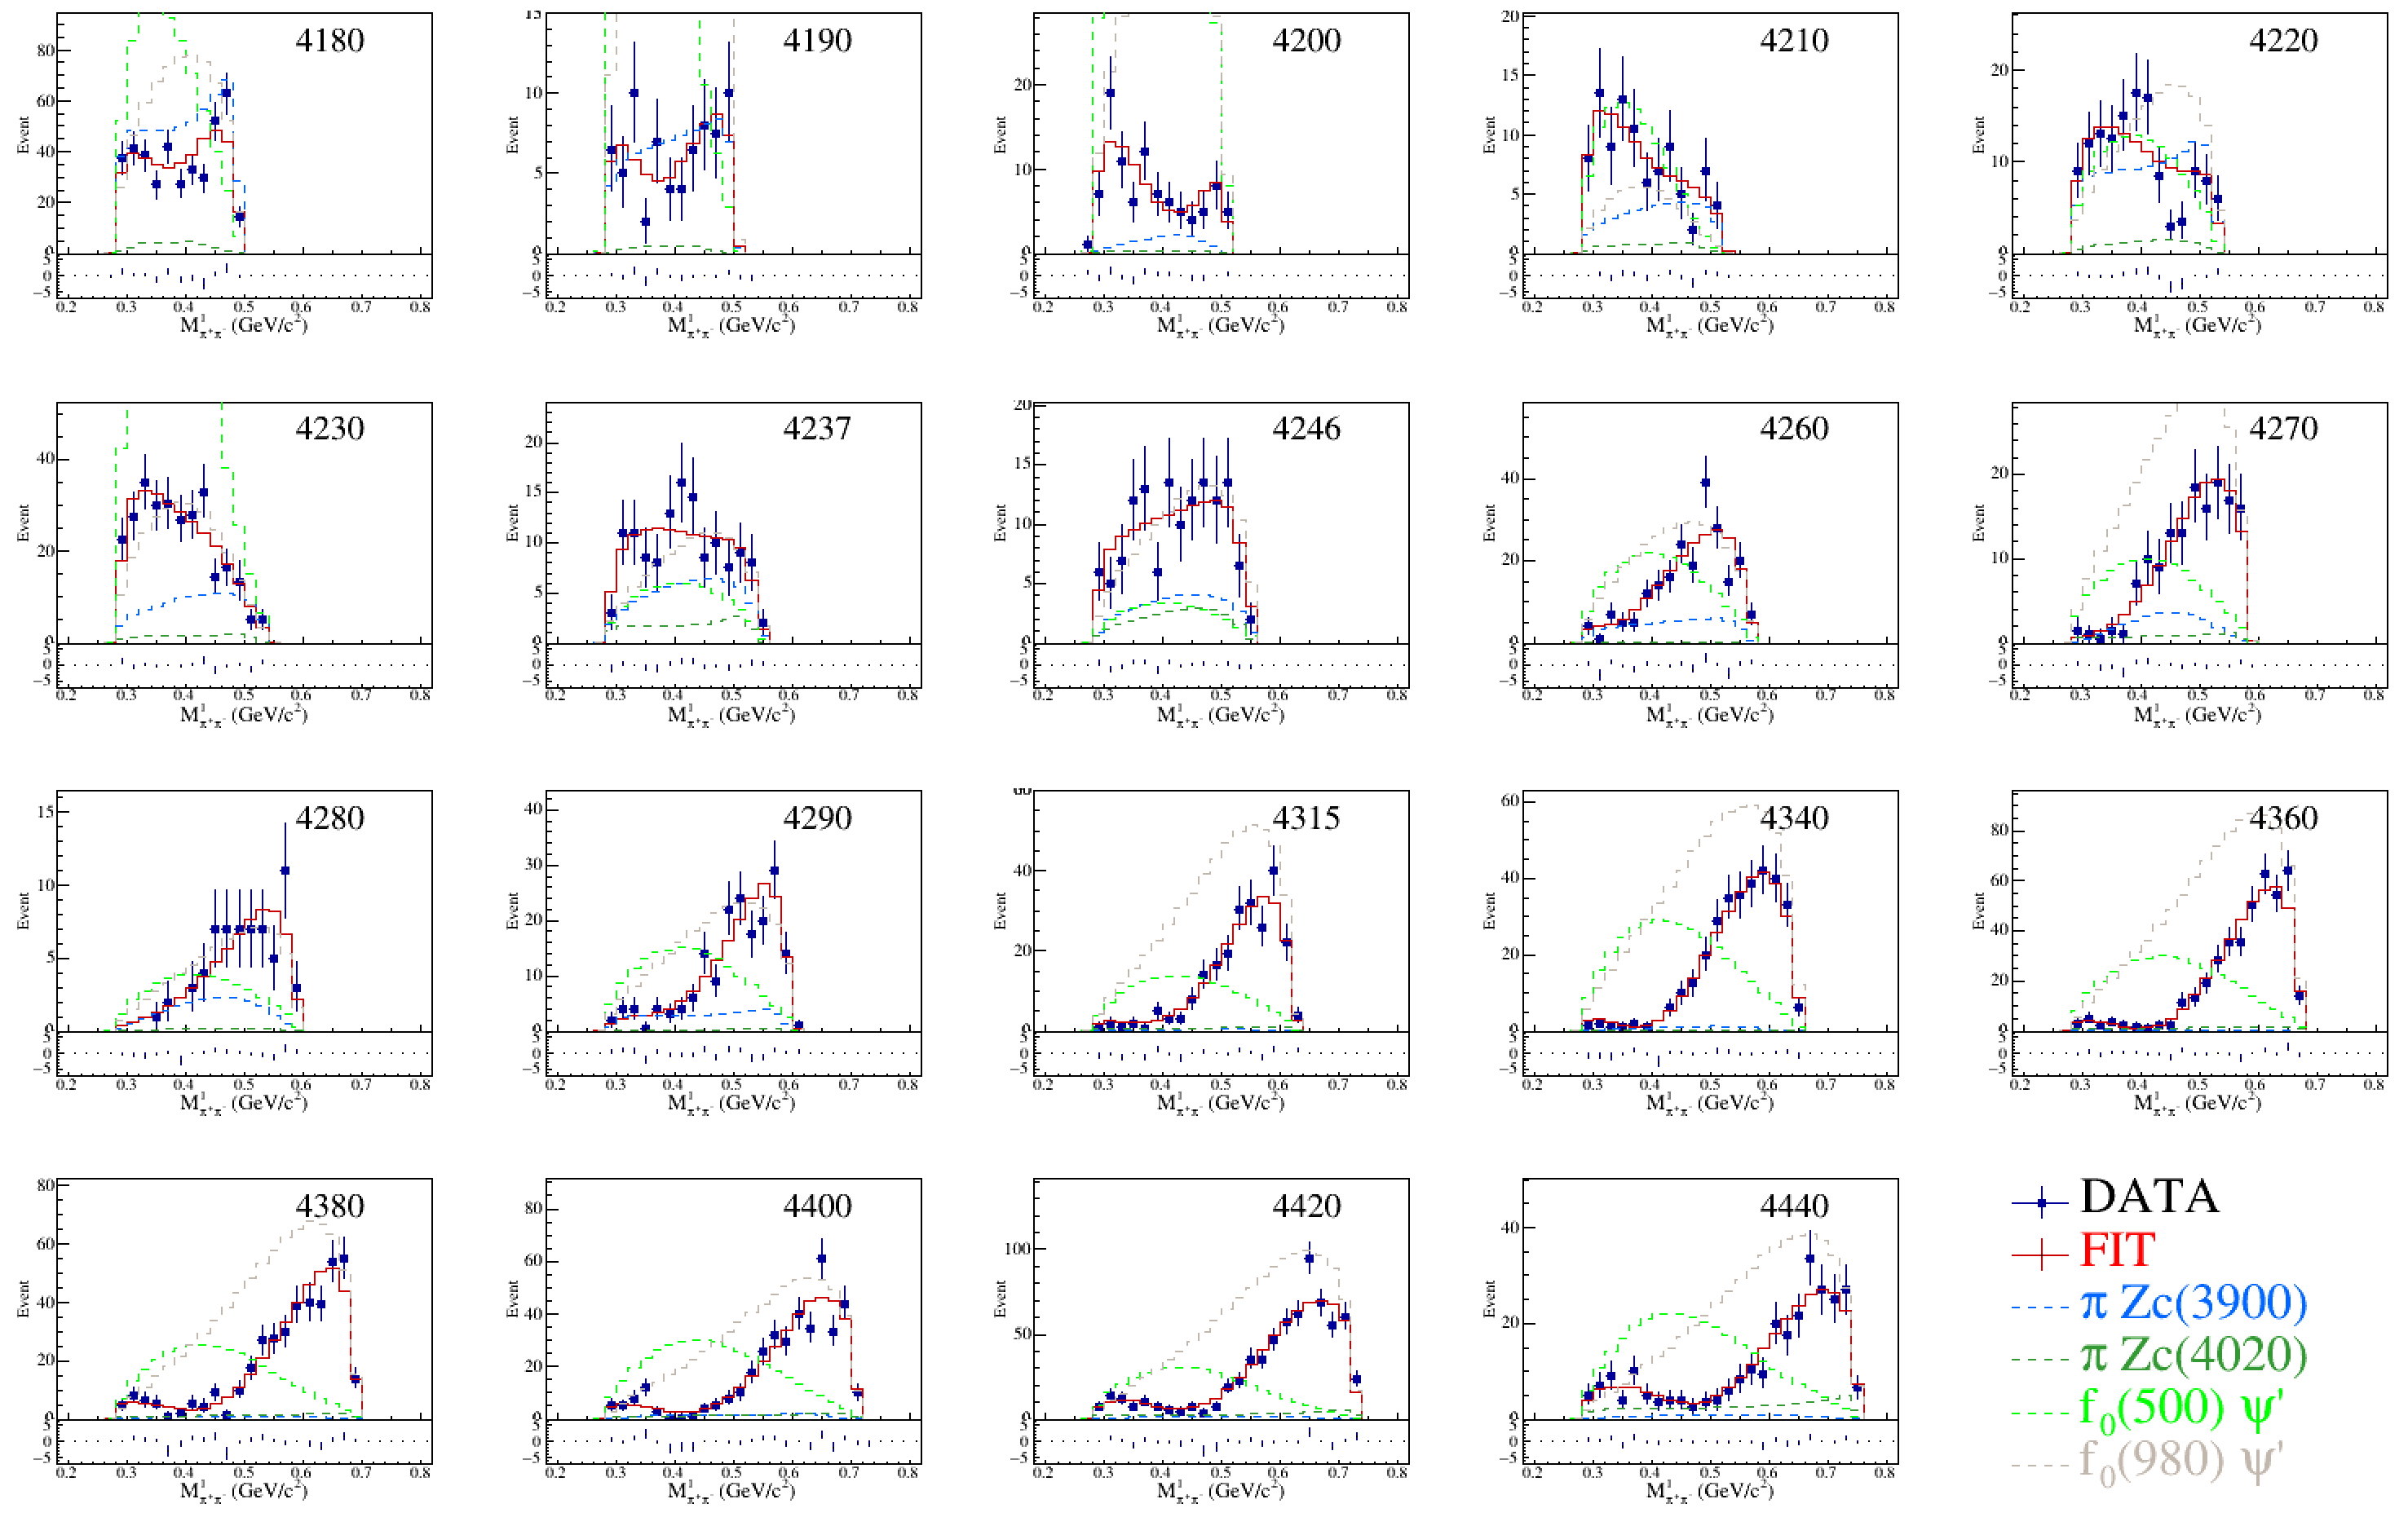

Slide 17
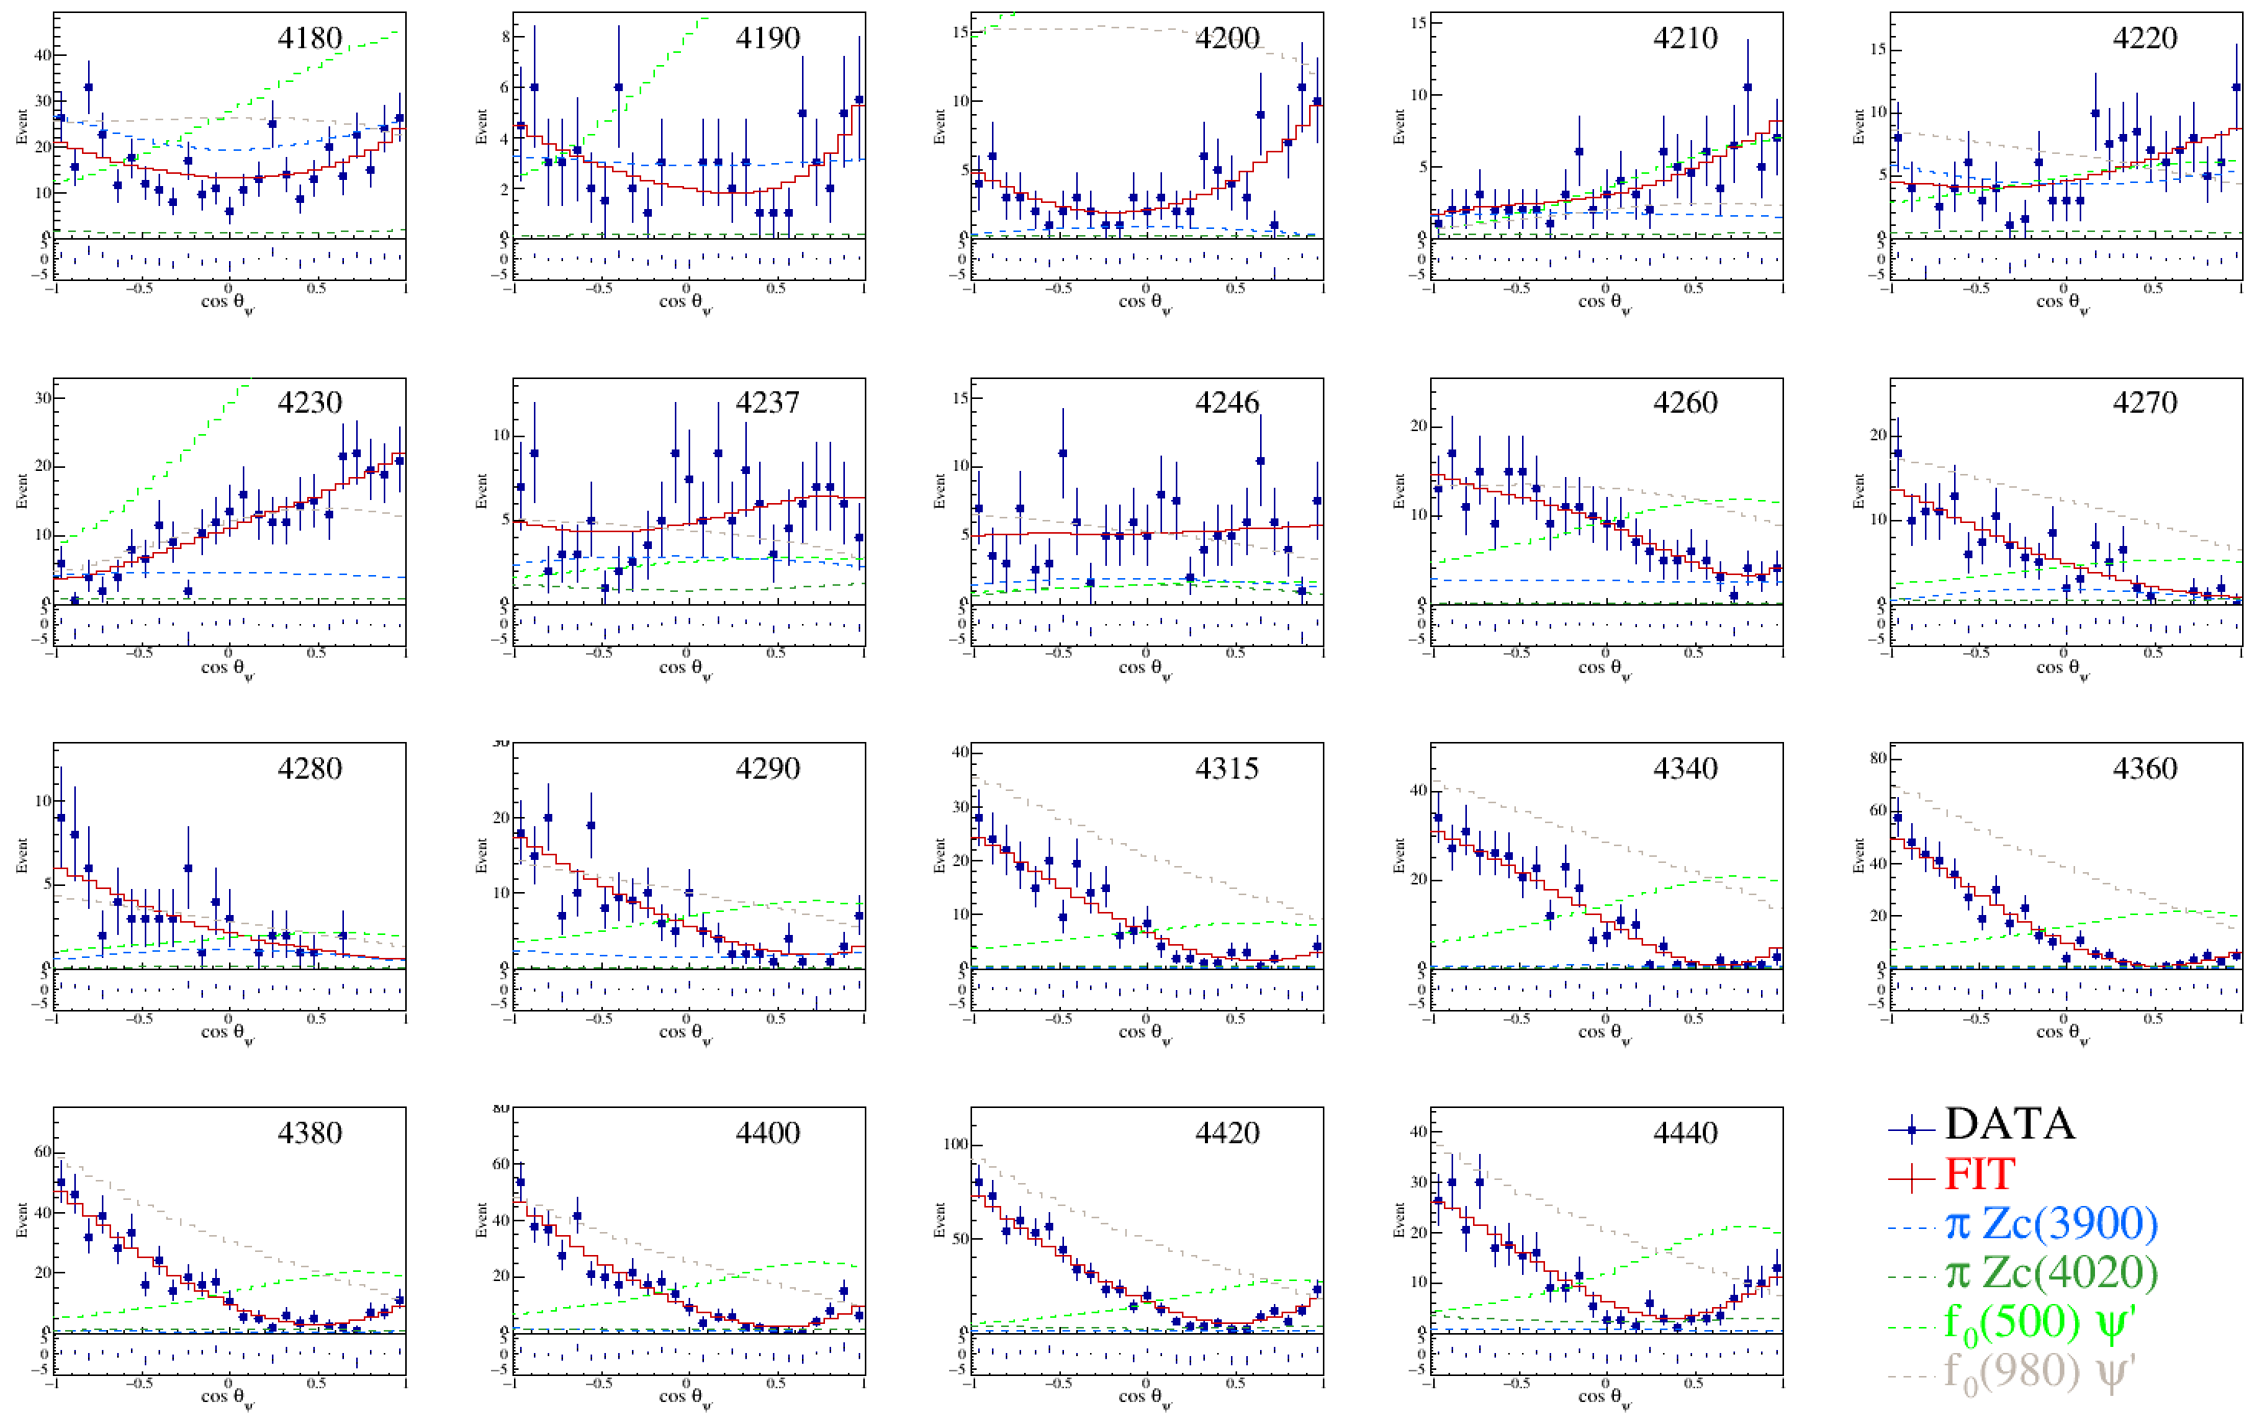

Slide 18
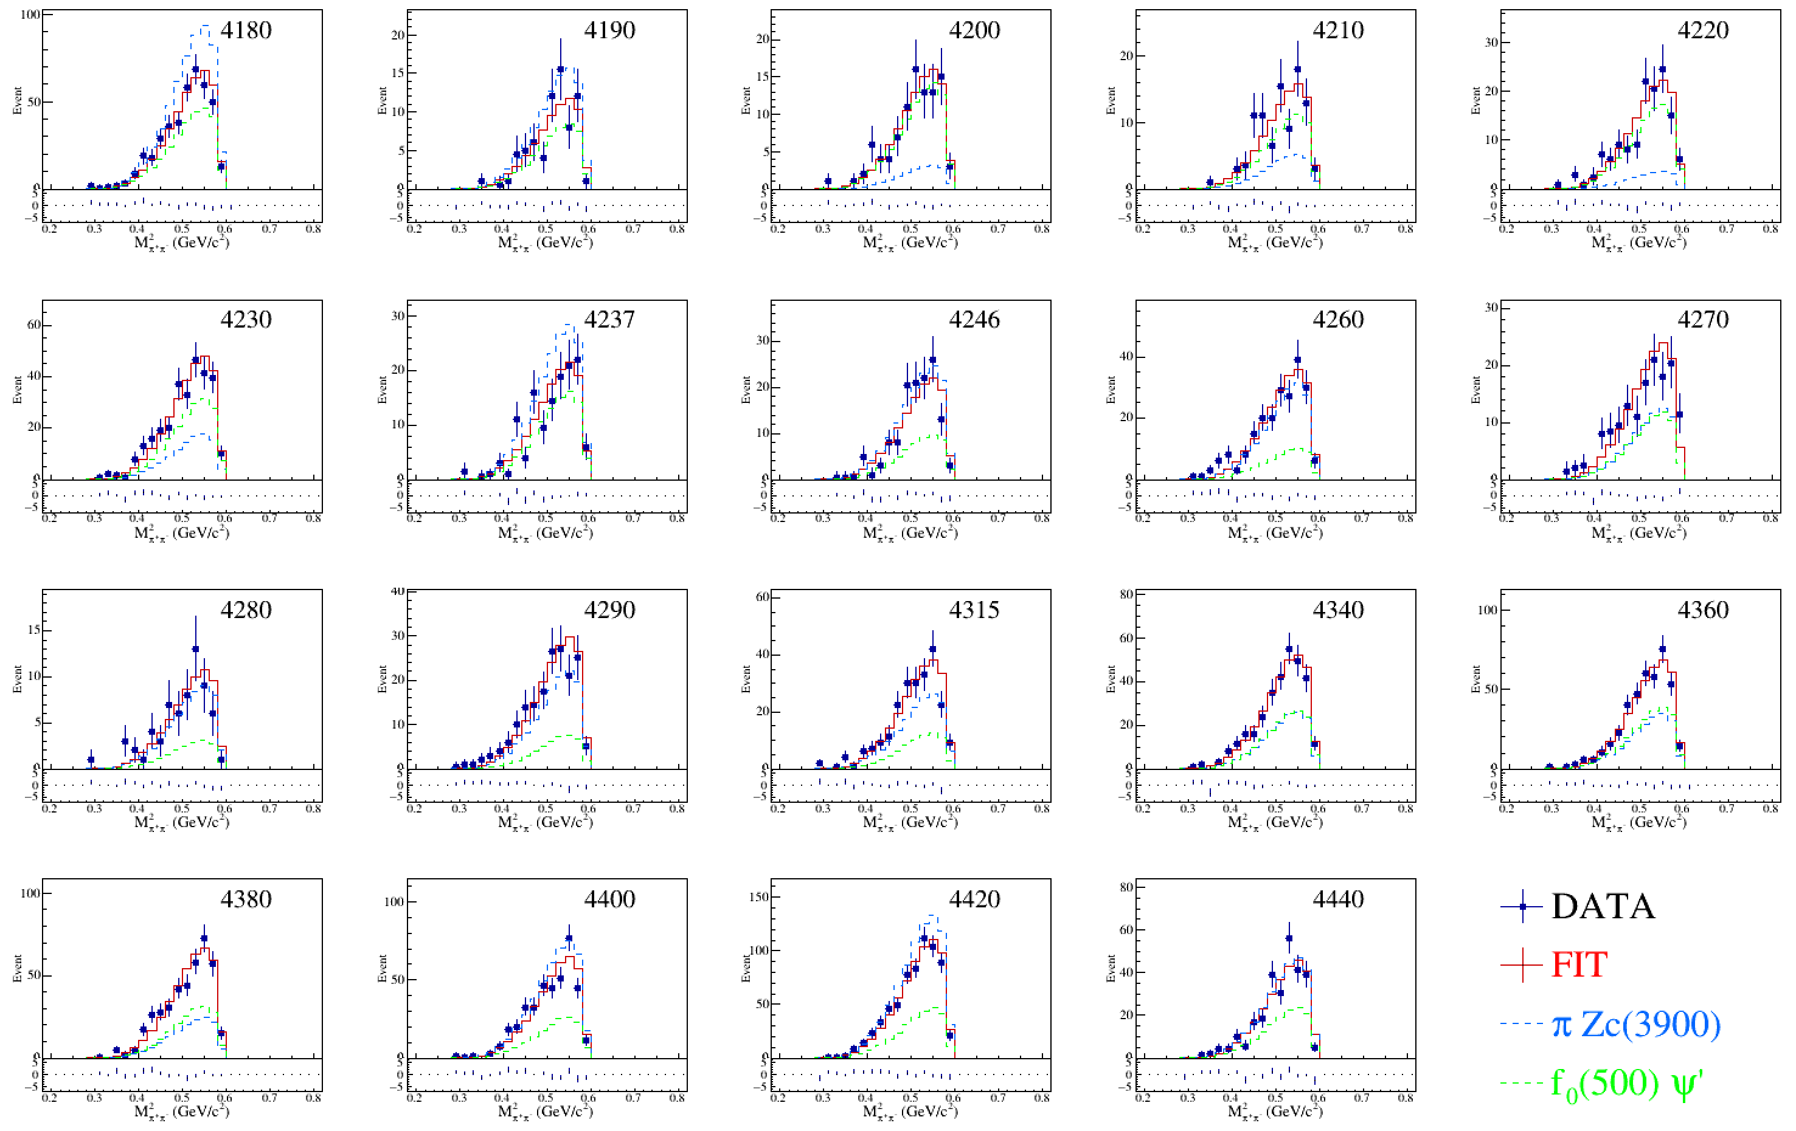

Slide 19
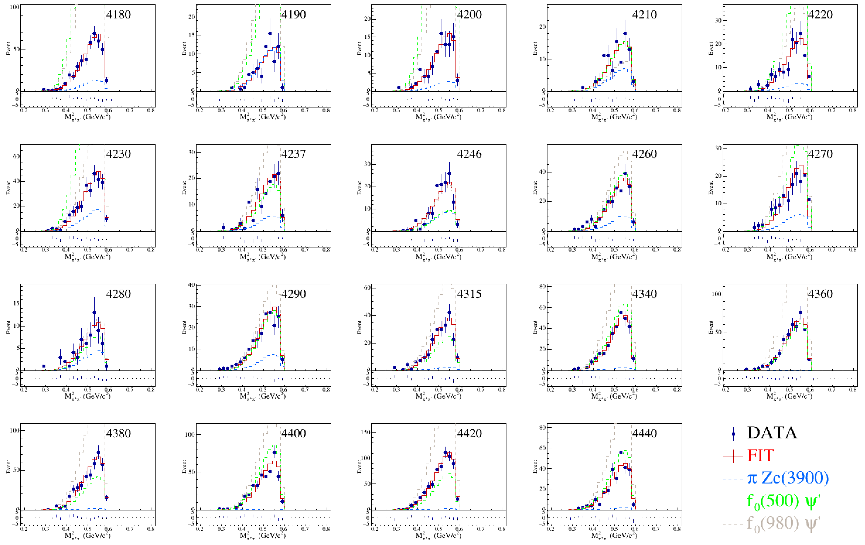

Slide 20
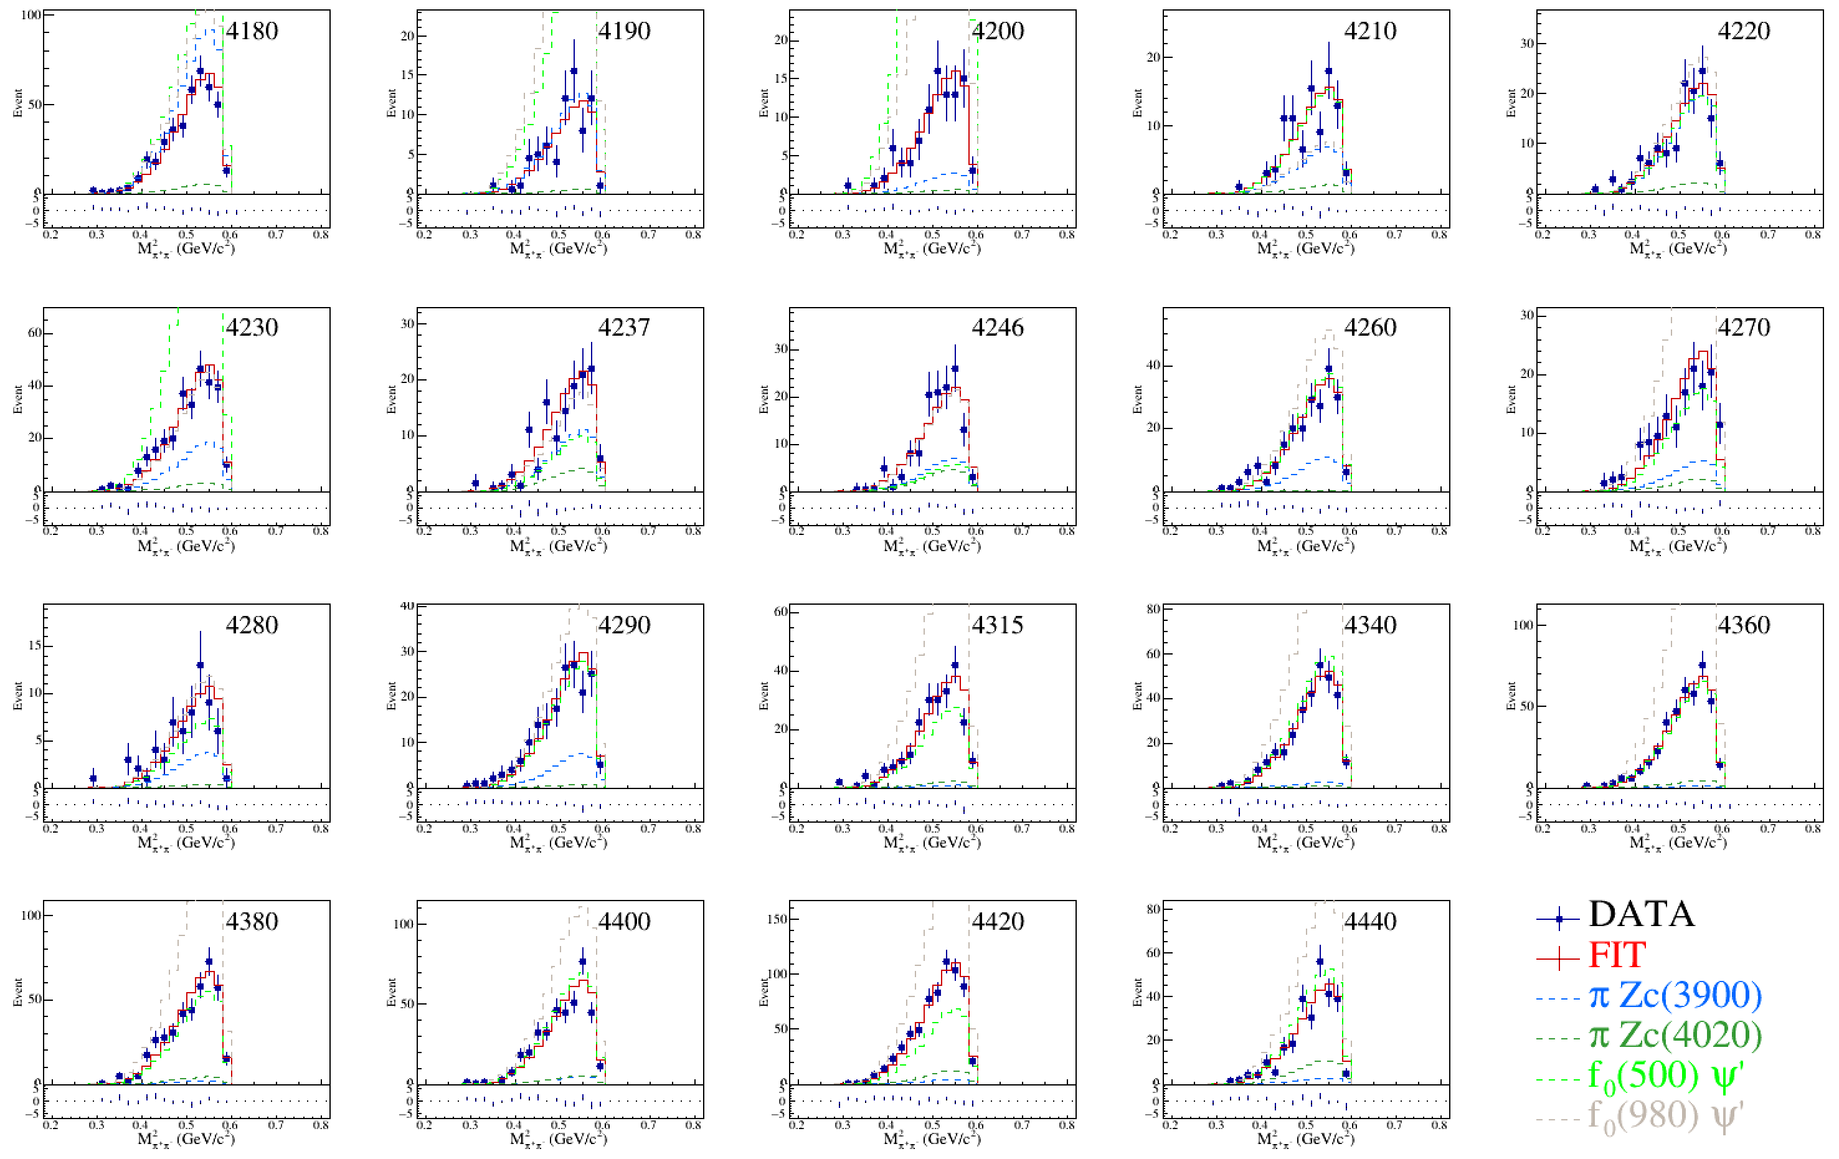

Slide 21
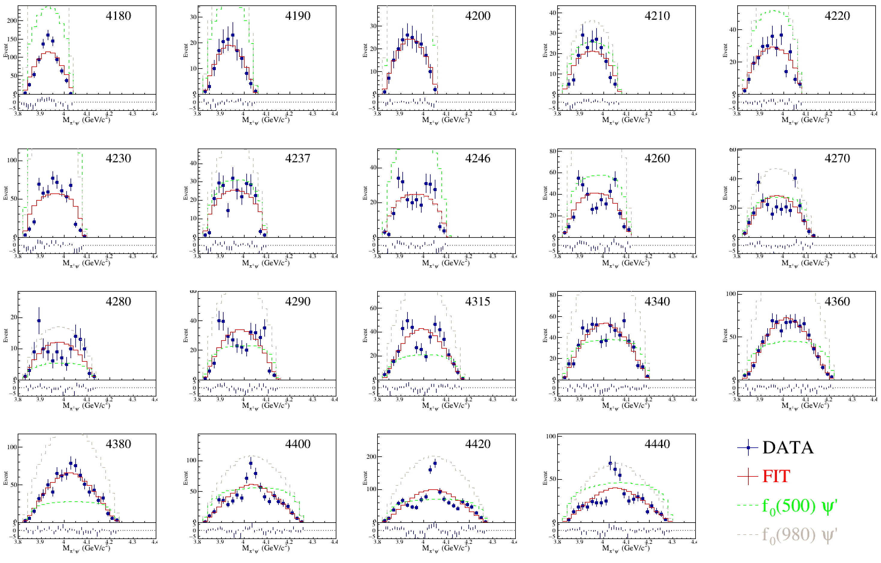

Slide 22
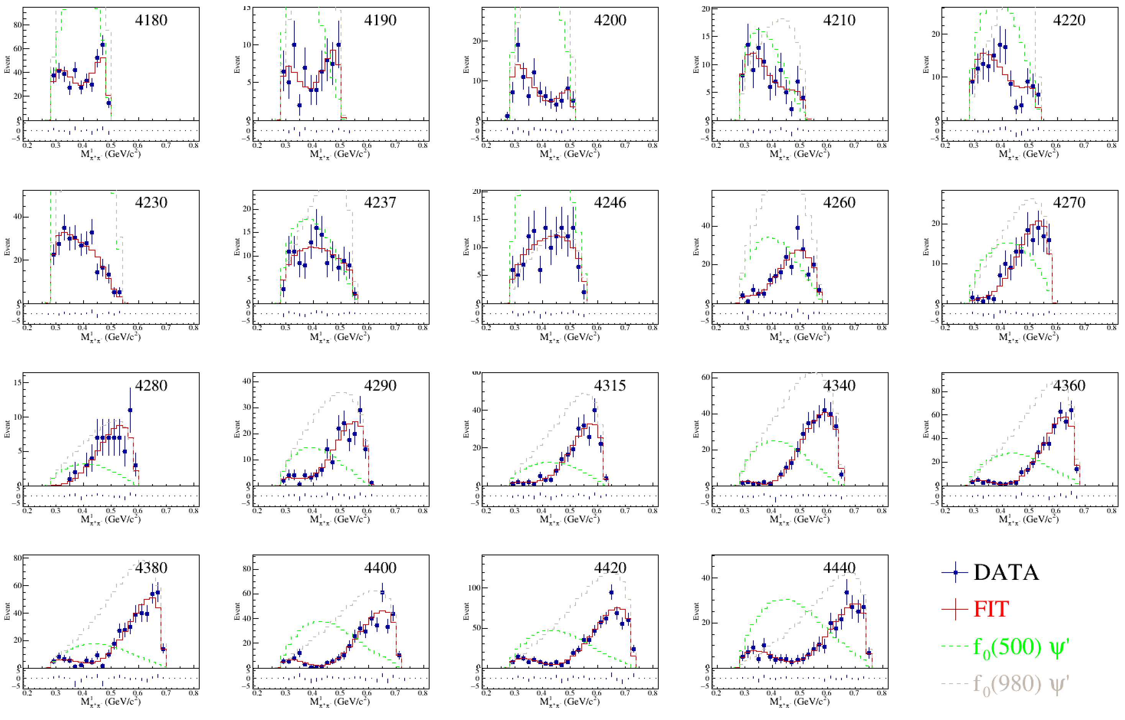

Slide 23
