Slide 1
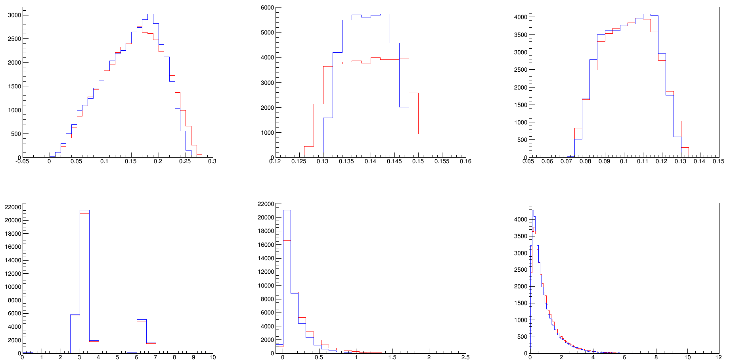
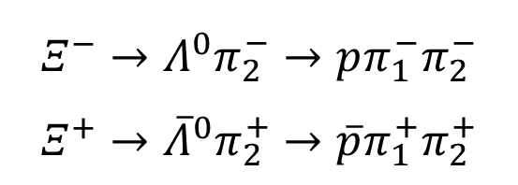
Signal MC@2644 and 2646 ( MCTruth )
$$Ξ^{−}→Λ^{0}π_{2}^{−}→pπ_{1}^{−}π_{2}^{−}$$
$$Ξ^{+}→{\overline{Λ}}^{0}π_{2}^{+}→\overline{p}π_{1}^{+}π_{2}^{+}$$
$2646:− 2644:−$
$$InitialMomentum of P$$
$$InitialMomentum of π_{2}$$
$$InitialMomentum of π_{1}$$
$$FinalPosition of P$$
$$InitialPosition of π_{2}$$
$$InitialPosition of π_{1}(P)$$

Slide 2
Event Selection(07)
⨀ Final State: $Ξ^{+}→{\overline{Λ}}^{0}π_{2}^{+}→\overline{p}π_{1}^{+}π_{2}^{+}$
Good Charged Track:
$\left|cosθ\right|<0.93$ , $\left|dz\right|≤10$ , $\left|dr\right|≤1$ , $N_{+}=2 or 3$
PID with dE/dx and TOF:
$N_{π1}=1 , N_{π2}=1$
Largest Vertex Point:
Looping all the charged tracks, find the largest Vr of other charged tracks,
assume the farthest charged track as antiproton, if the antiproton interacts
with the beam pipe, there should produce an enhancement around 3 cm.

Slide 3
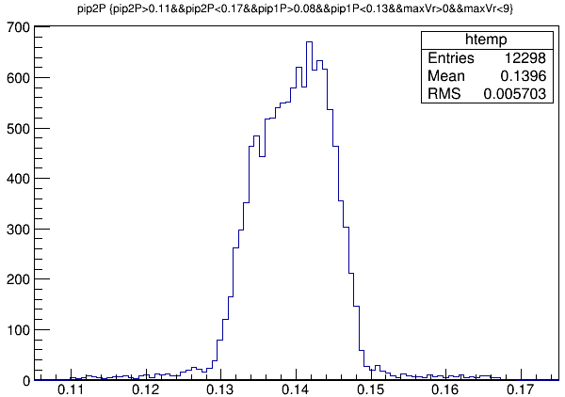
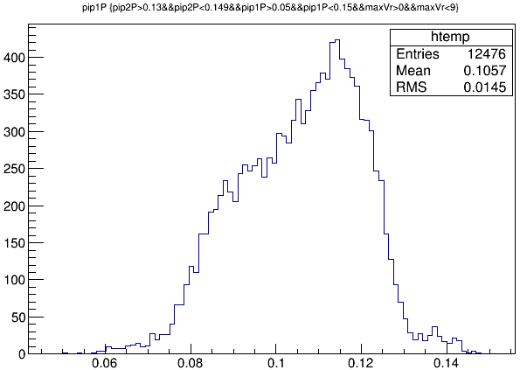
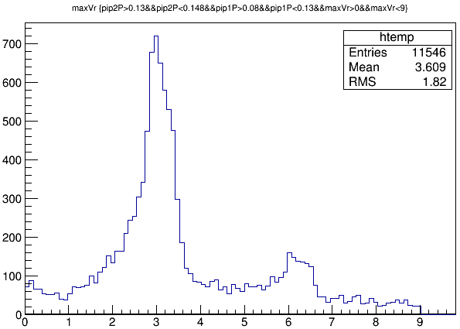
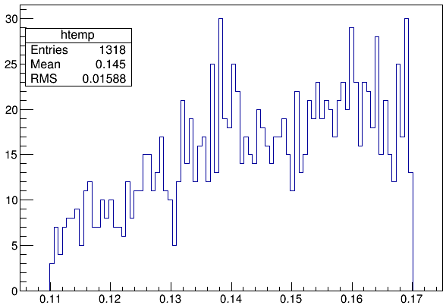
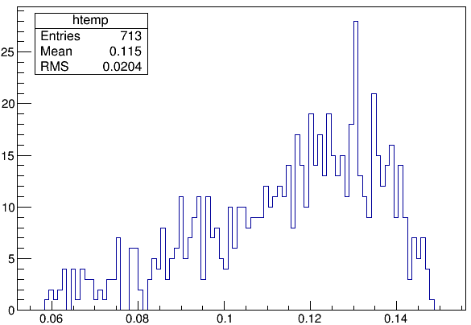
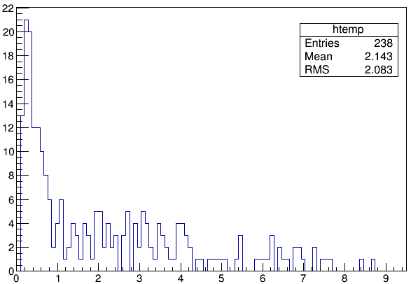
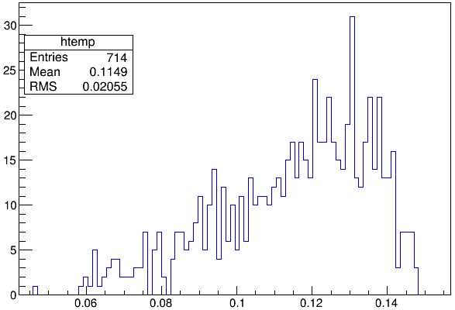
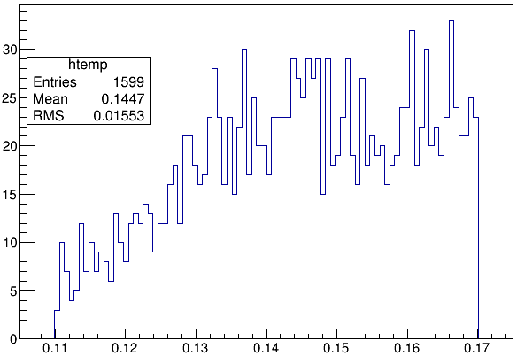
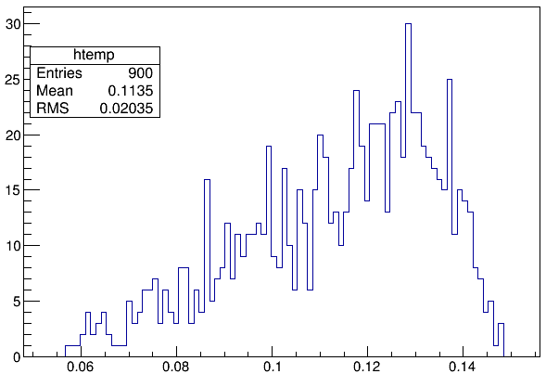
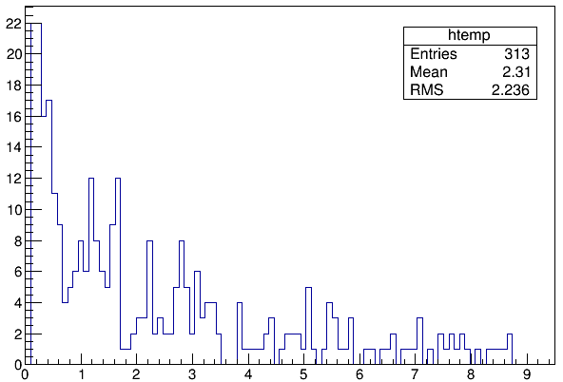
$$2644:$$
$$π_{2}$$
$$π_{1}$$
$$\text{Vr}\text{_}\text{max}$$

Slide 4
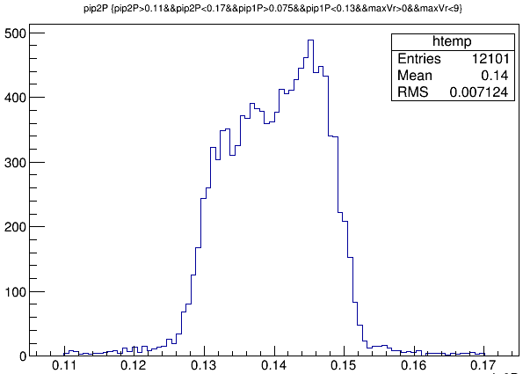
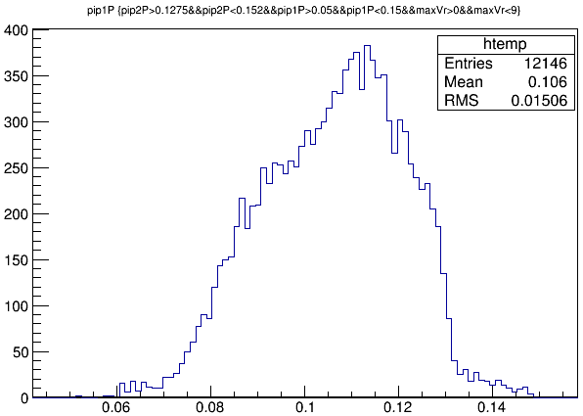
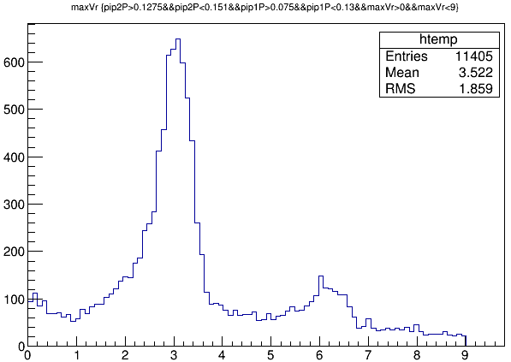
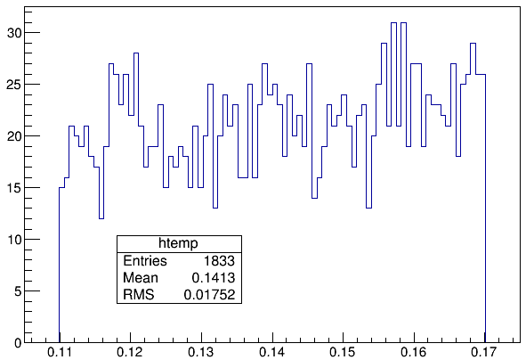
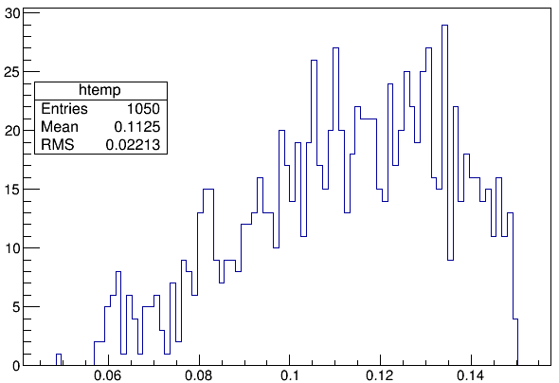
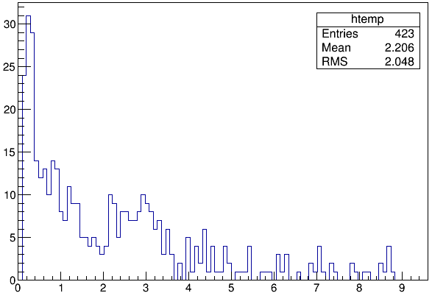
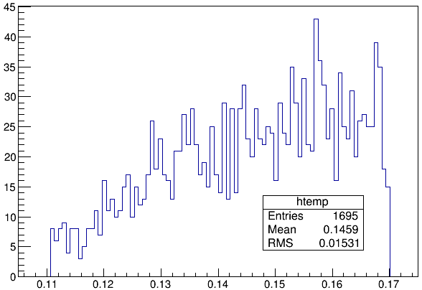
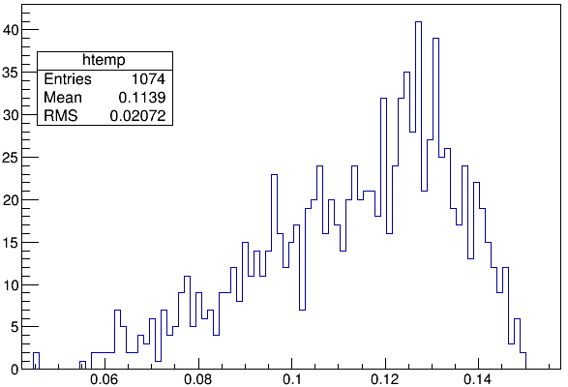
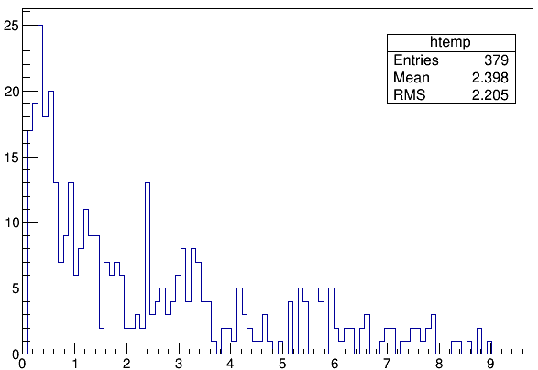
$$2646:$$
$$π_{2}$$
$$π_{1}$$
$$\text{Vr}\text{_}\text{max}$$

Slide 5
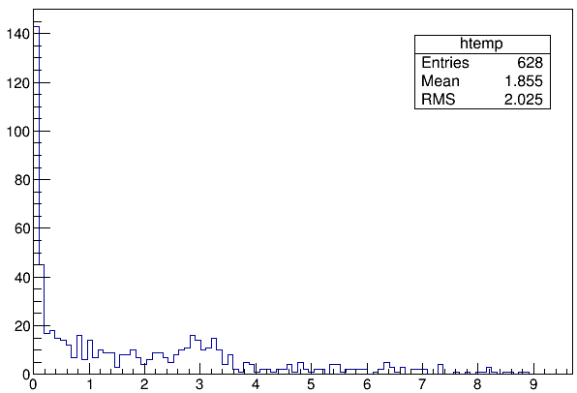
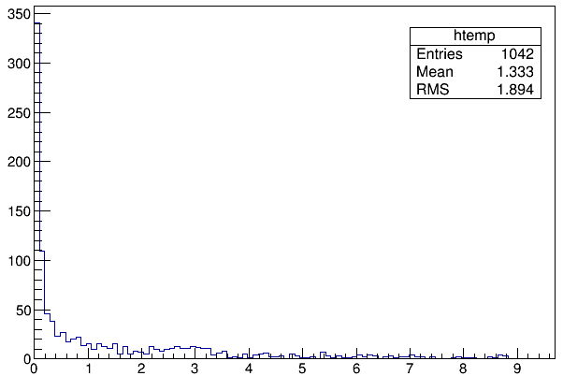
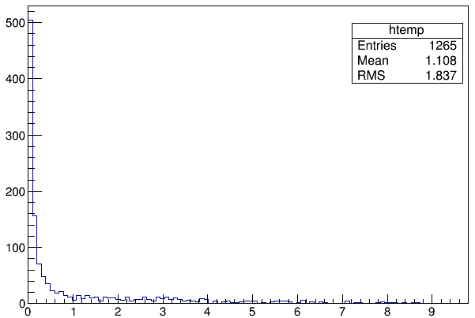
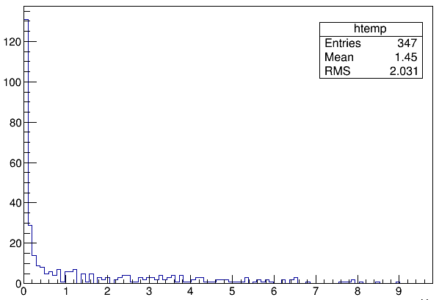
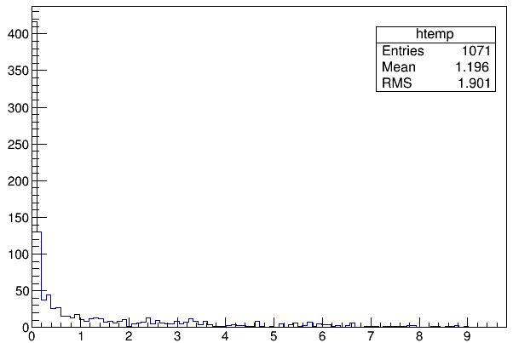
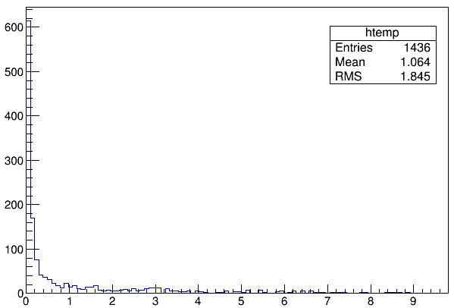

Slide 6
Event Selection(08)
⨀ Final State: $Ξ^{−}→Λ^{0}π_{2}^{−}→pπ_{1}^{−}π_{2}^{−}$
Good Charged Track:
$\left|cosθ\right|<0.93$ , $\left|dz\right|≤10$ , $N_{+}≥1, N_{−}≥2$ , no cut on $\left|dr\right|$
PID with dE/dx and TOF:
$N_{π1}=1 , N_{π2}=1 , N_{p}=1$
Mbc method:
$$m_{Ξ}=\sqrt{E_{beam}^{2}−{\overset{⃑}{P}}_{pππ}^{2}}$$

Slide 7
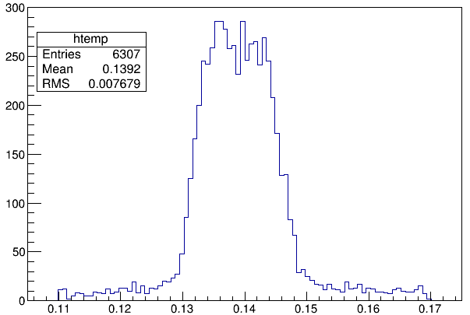
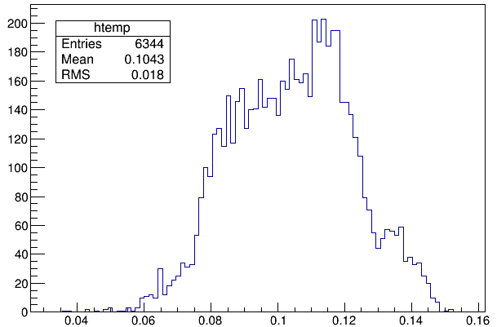
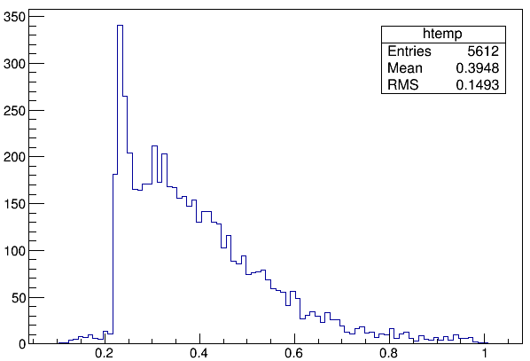
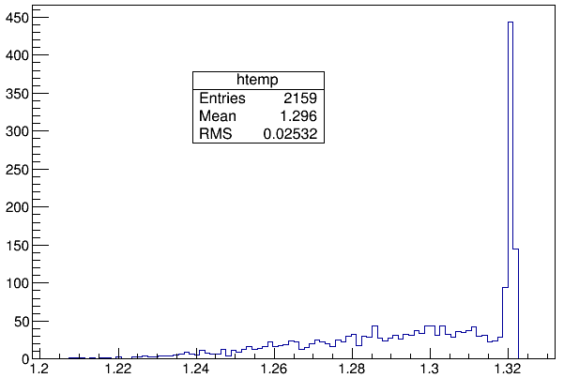
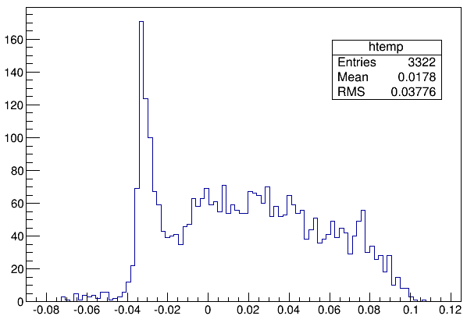
$$2644:$$
$$π_{2}$$
$$π_{1}$$
$$proton$$
$$E_{pππ}−E_{beam}$$
$$m_{Ξ}$$

Slide 8
Event Selection(09)
⨀ Tag Final State: $Ξ^{−}→Λ^{0}π_{2}^{−}→pπ_{1}^{−}π_{2}^{−}$
Good Charged Track:
$\left|cosθ\right|<0.93$ , $\left|dz\right|≤10$ , $N_{+}≥1, N_{−}≥2$ , no cut on $\left|dr\right|$
PID with dE/dx and TOF:
$N_{π}≥2 , N_{p}≥1$
Looping all < $pππ$> combination, select the one with minimum $E_{pππ}−E_{beam}$
Mbc method:
$$m_{Ξ}=\sqrt{E_{beam}^{2}−{\overset{⃑}{P}}_{pππ}^{2}}$$

Slide 9
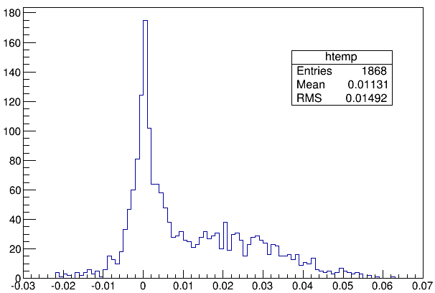
$$2644:$$
$$π_{2}$$
$$π_{1}$$
$$proton$$
$$E_{pππ}−E_{beam}$$
$$m_{Ξ}$$

Slide 10
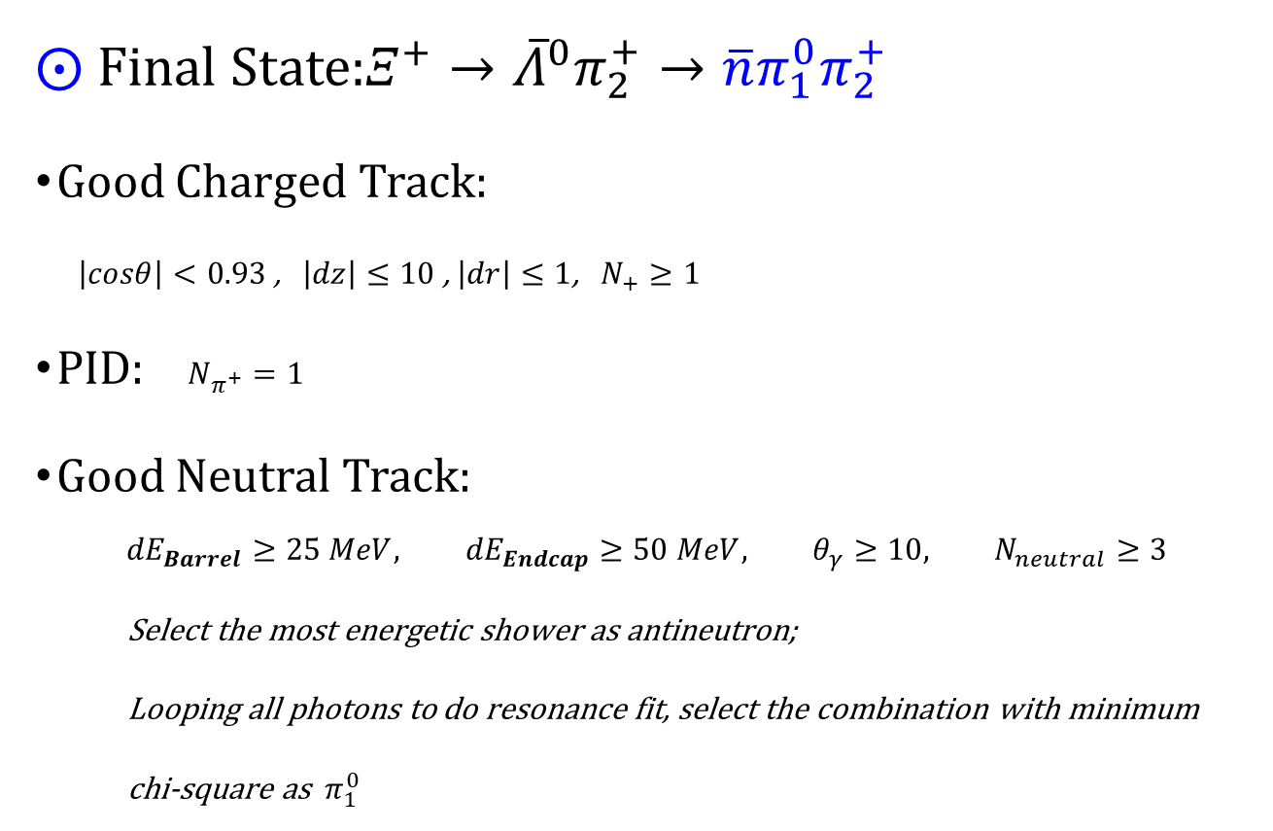
Event Selection(10)
⨀ Final State:$Ξ^{+}→{\overline{Λ}}^{0}π_{2}^{+}→\overline{n}π_{1}^{0}π_{2}^{+}$
Good Charged Track:
$\left|cosθ\right|<0.93$ , $\left|dz\right|≤10$ , $\left|dr\right|≤1$, $N_{+}≥1$
PID: $N_{π^{+}}=1$
Good Neutral Track:
$${dE}_{Barrel}≥25 MeV, {dE}_{Endcap}≥50 MeV, θ_{γ}≥10, N_{neutral}≥3$$
Select the most energetic shower as antineutron;
Looping all photons to do resonance fit, select the combination with minimum
chi-square as $π_{1}^{0}$

Slide 11
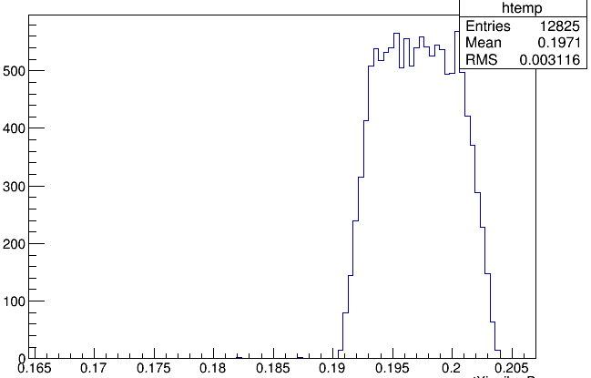
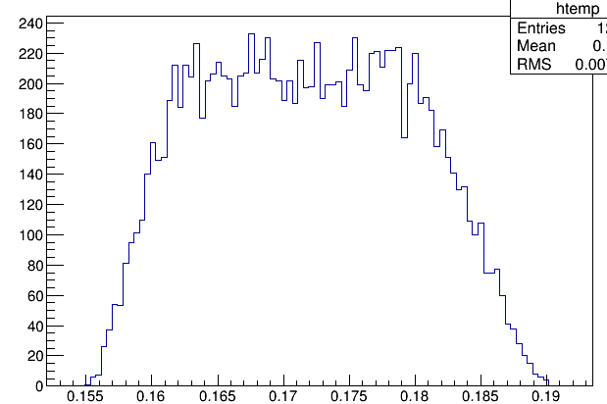
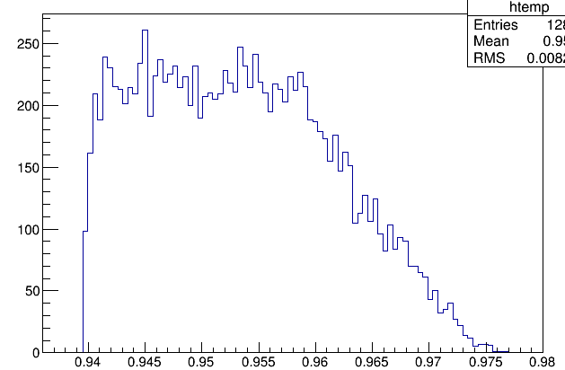
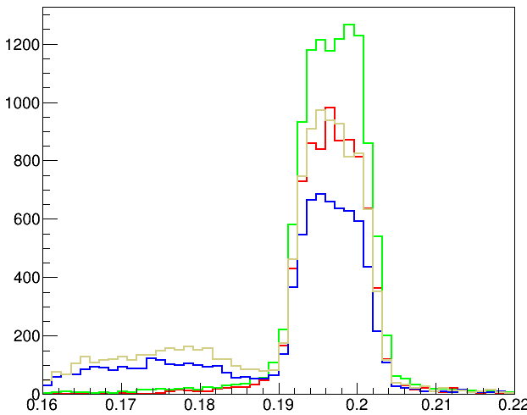
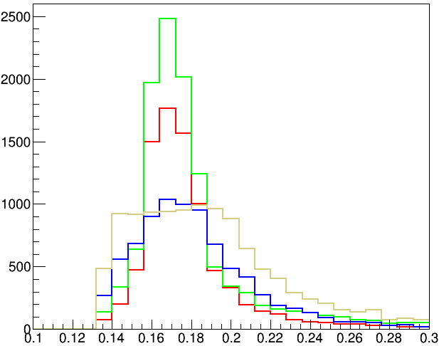
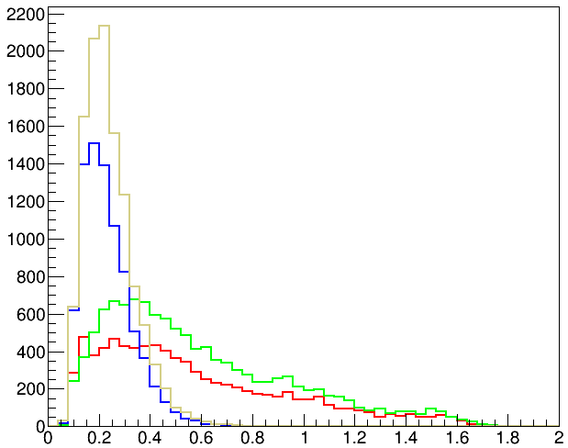
$$2644:$$
$π_{2}$ Energy
$π_{1}$ Energy
$$N\text{bar} \text{Energy}$$
$${dE}_{\overline{n}}$$

Slide 12
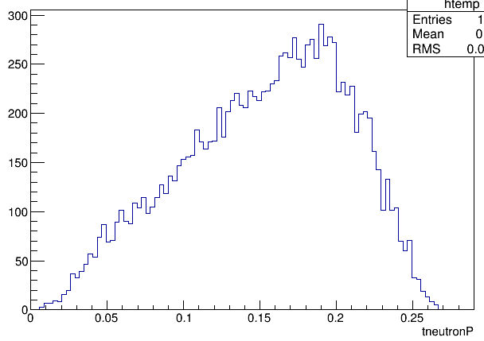
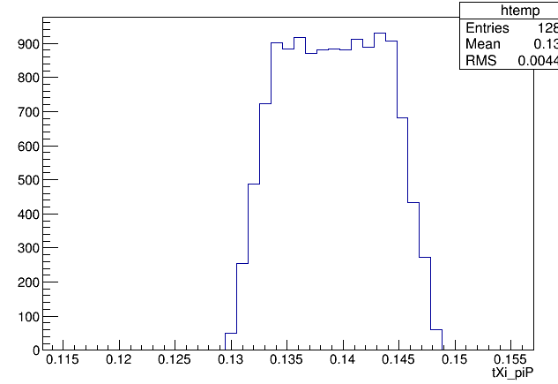
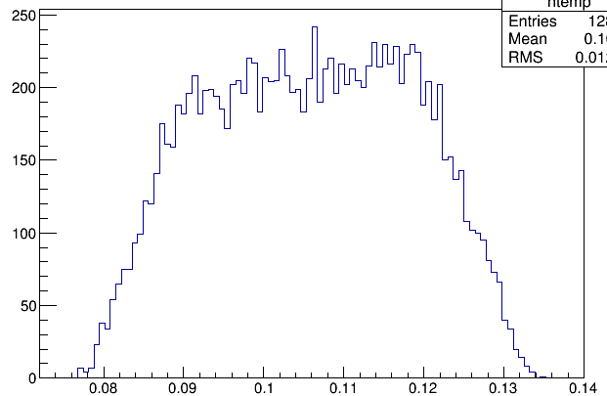
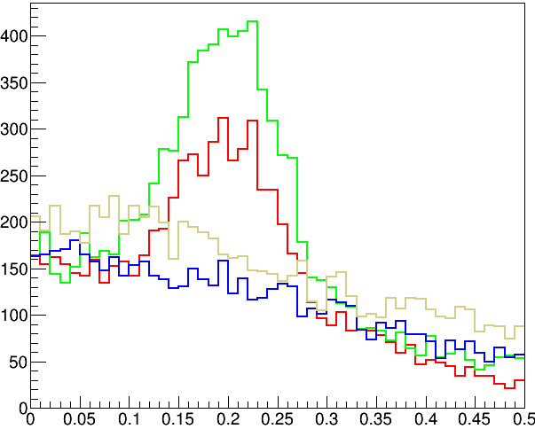
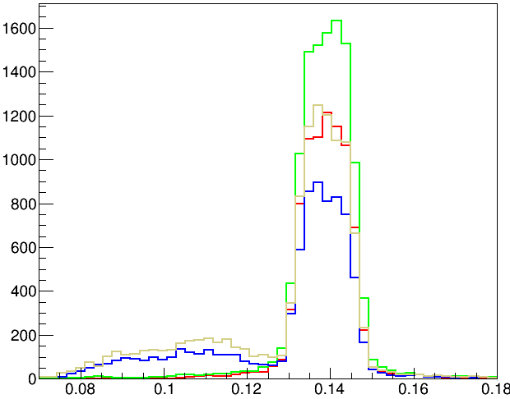
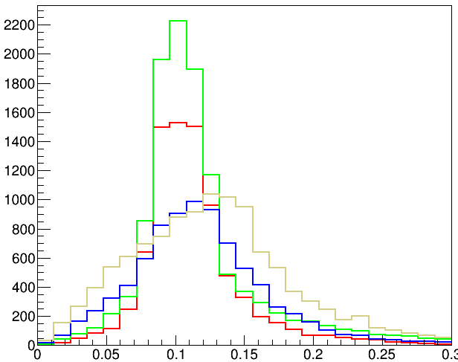
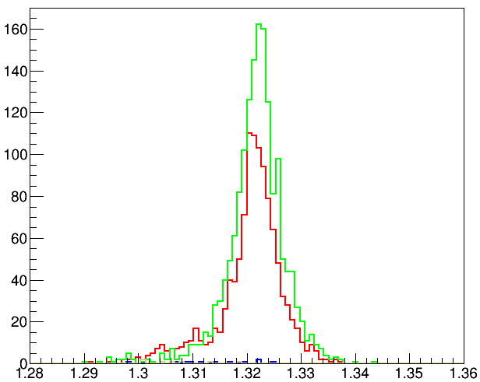
$$2644:$$

