Slide 1
Resolution Correction on LamLambar

Slide 2
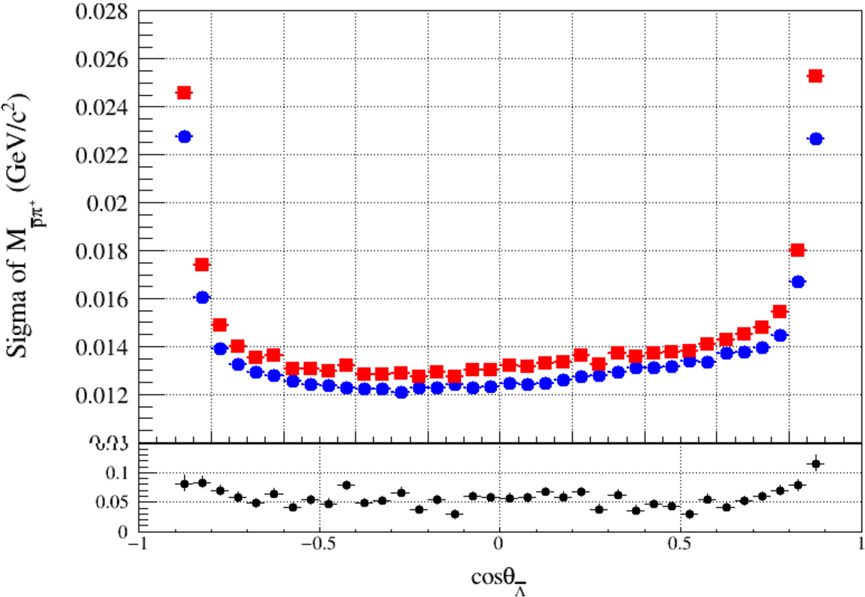
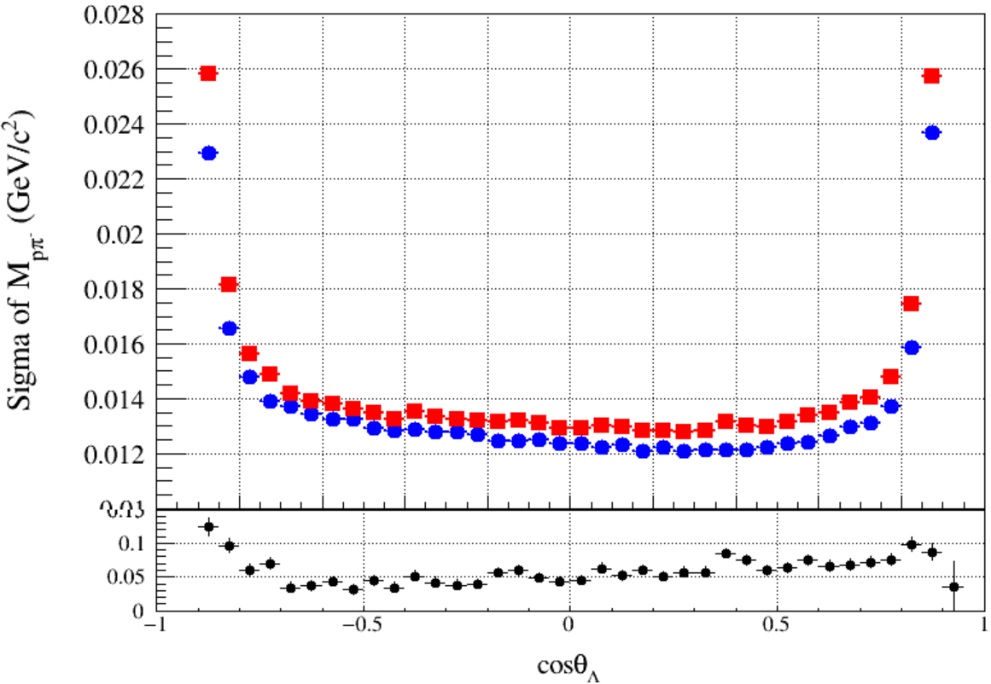
Introduction
Using $J/ψ→Λ\left(→pπ^{−}\right)\overline{Λ}(→\overline{p}π^{+})$
Bad resolution of $M_{pπ}$ and $M_{pπ}^{recoil}$ at endcap part !
The Difference of $Λ$ mass resolution between data and MC exists discrepancy at barrel and endcap

Slide 3
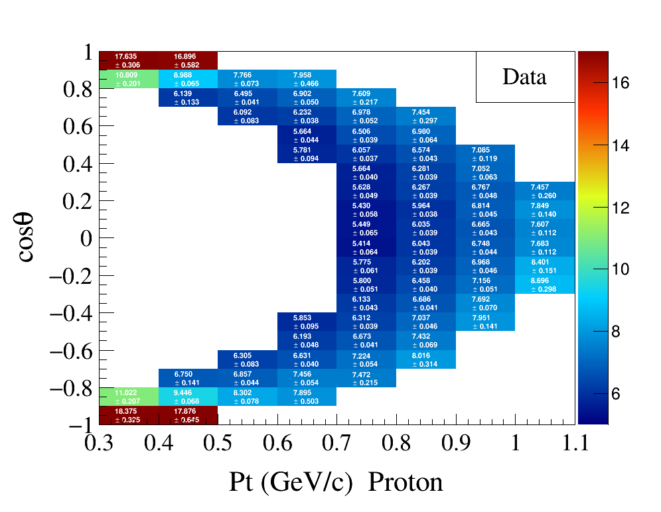
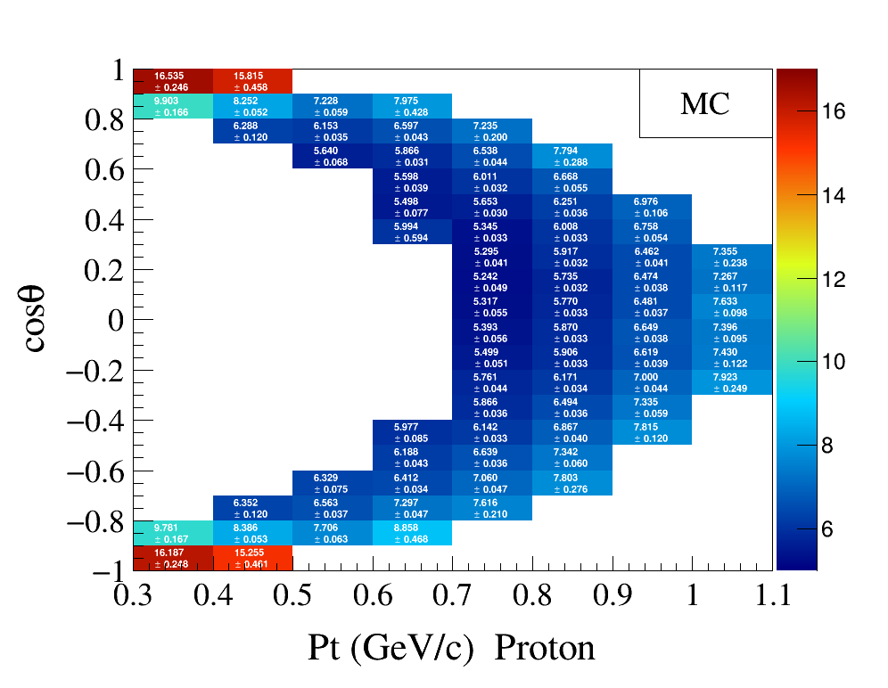
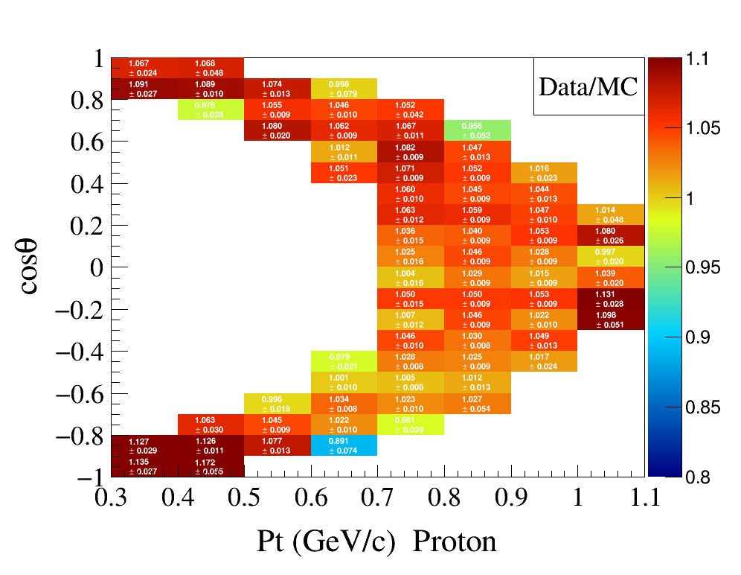
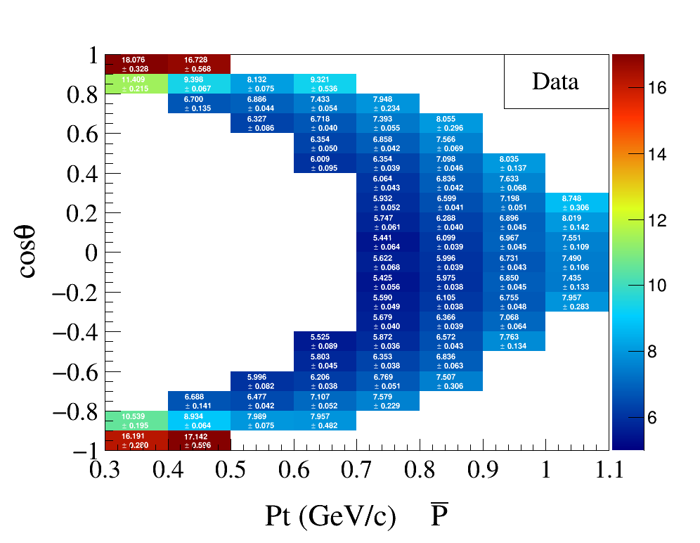
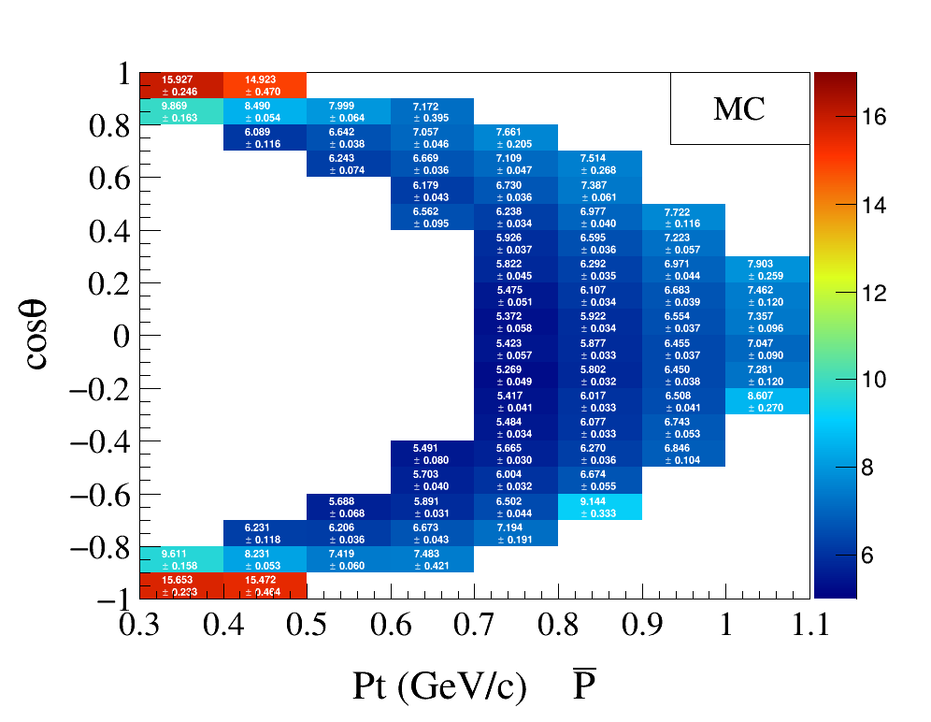
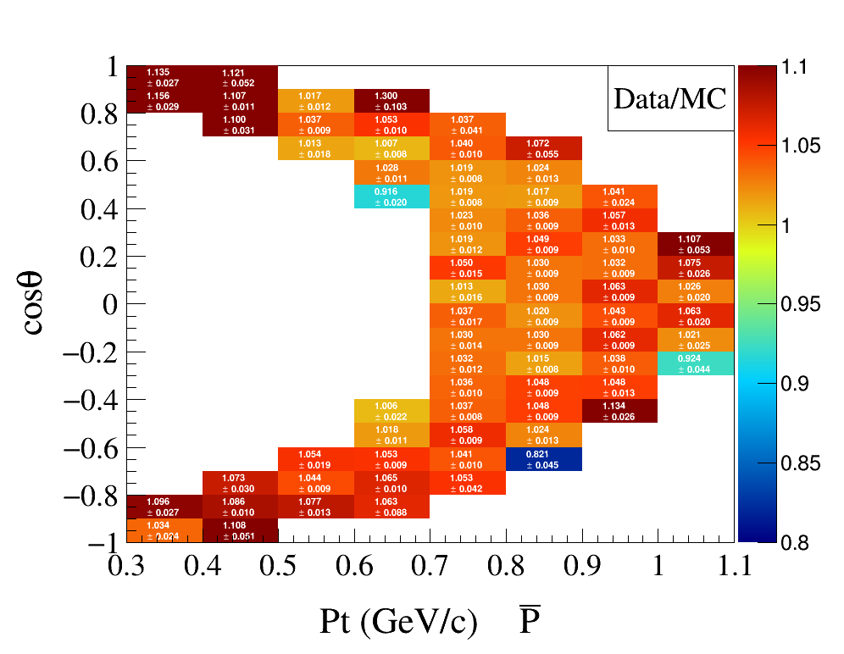
Pseudo-Resolution of $p/\overline{p}$
$res=p^{KalTrk}−p^{kmfit}, (MeV/c)$
Notes:
/ustcfs/BES3User/2021/ypei/BESIII/Lambda/WriteMemo/Check/STLamcos/JianyuCode/resolution

Slide 4
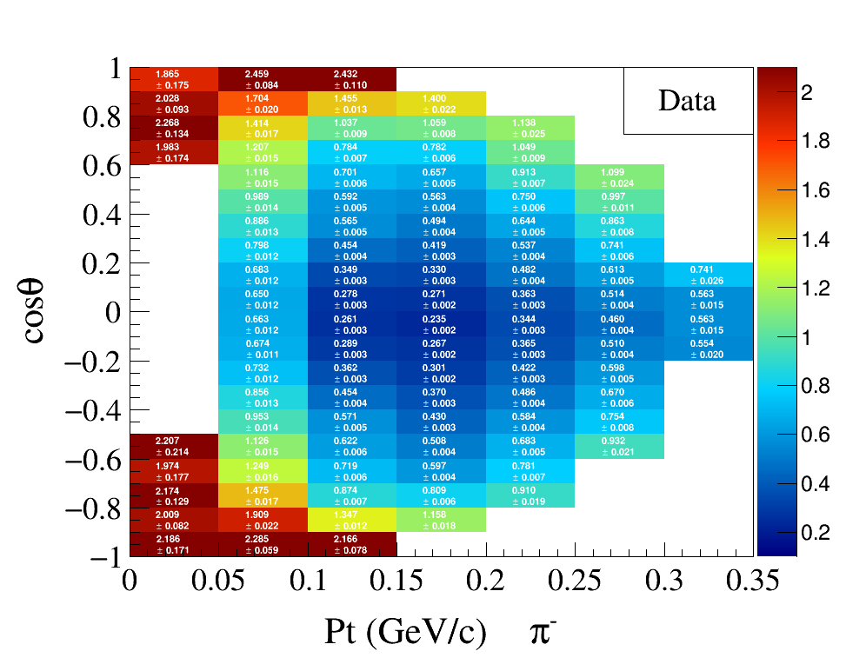
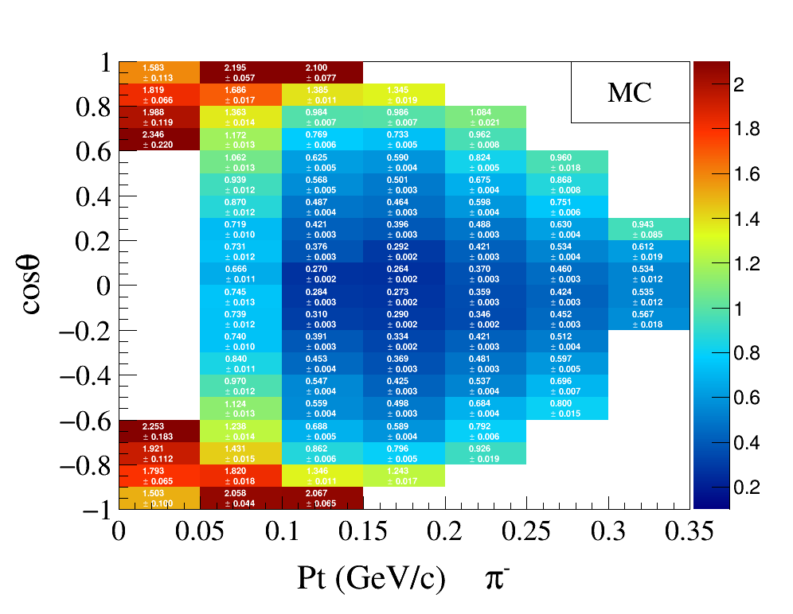
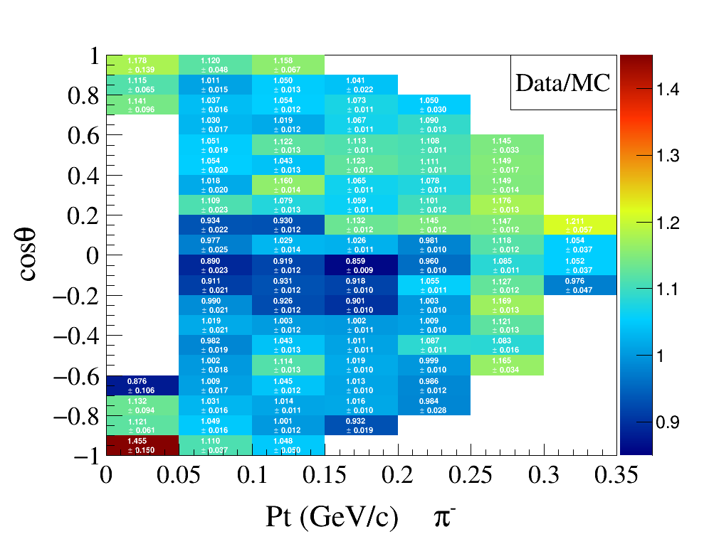
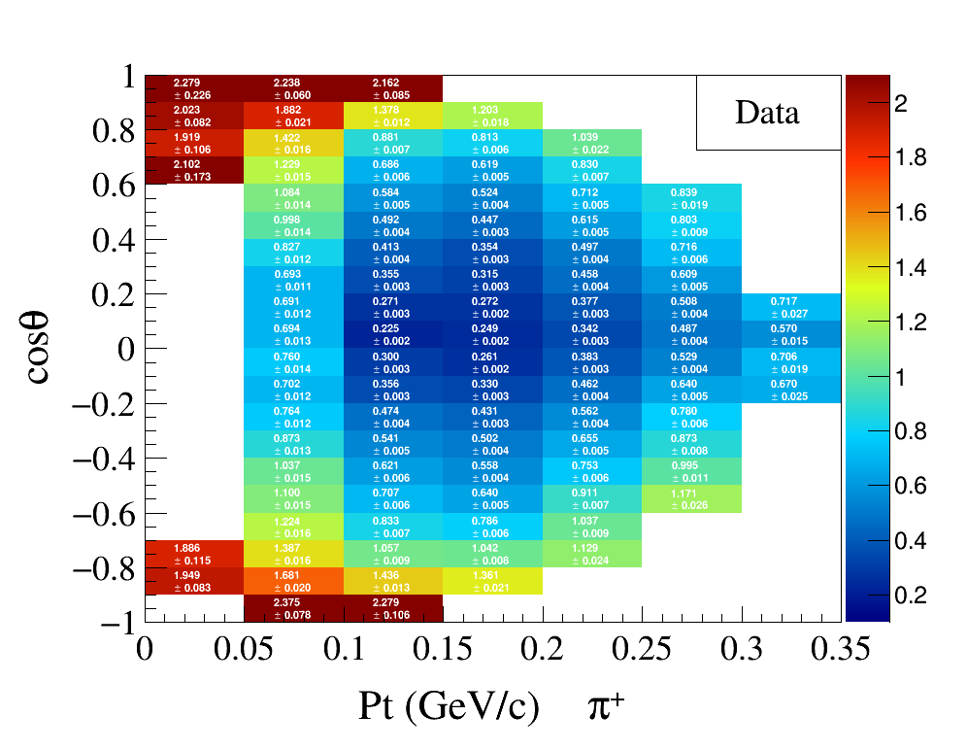
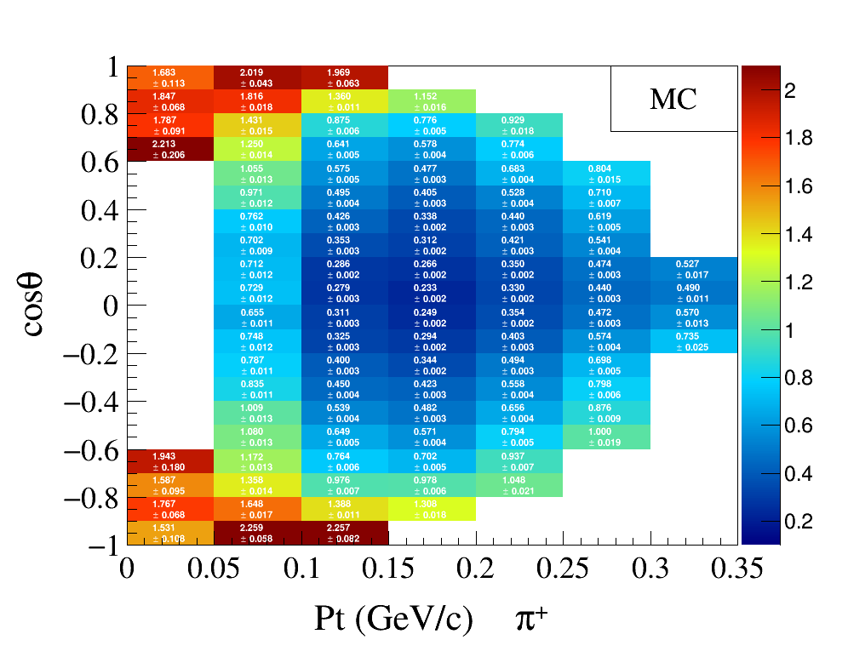
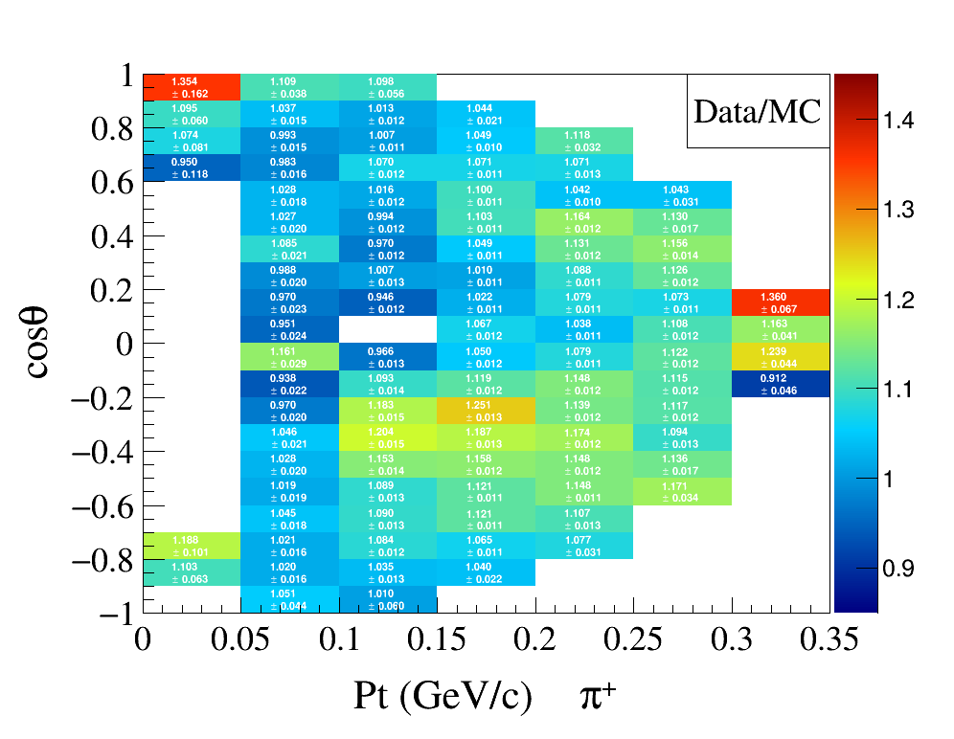
Pseudo-Resolution of $π^{±}$
$res=p^{KalTrk}−p^{kmfit}, (MeV/c)$
Notes:
/ustcfs/BES3User/2021/ypei/BESIII/Lambda/WriteMemo/Check/STLamcos/JianyuCode/resolution

Slide 5
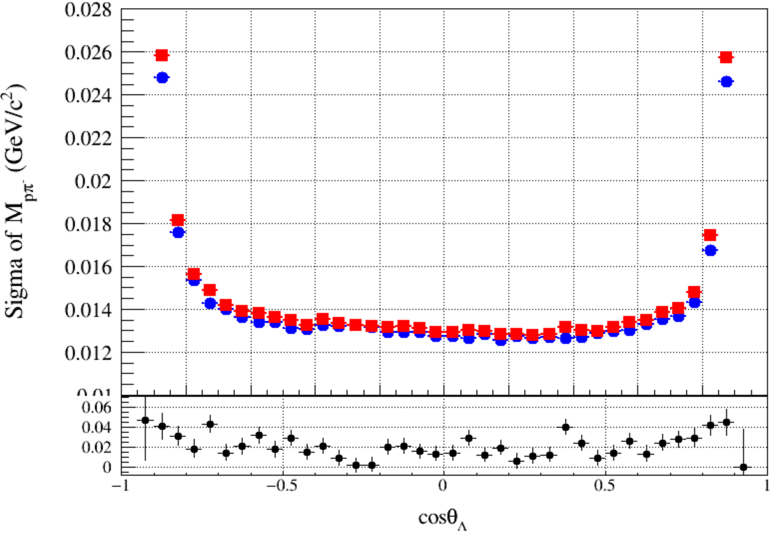
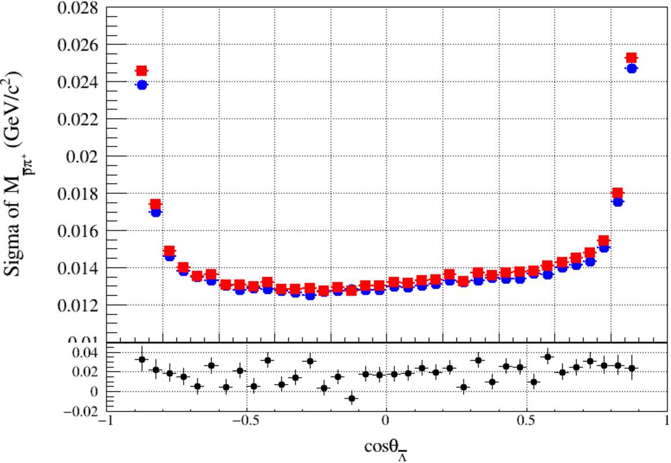
Correct the Pseudo-Resolution on MC
Correction factor:
$$χ=\frac{{\left(p^{Kal}−p^{4c}\right)}_{data}}{{\left(p^{Kal}−p^{4c}\right)}_{MC}}$$
For each Charged Tracks:
$p^{corr}=p^{truth}+\left(p^{Kal}−p^{truth}\right)∗Gaus(μ_{χ}, σ_{χ})$
To do vertex fit, kinematic fit ……
Notes:
/ustcfs/BES3User/2021/ypei/BESIII/Lambda/WriteMemo/Check/STLamcos/JianyuCode/resolution/AfterCorr

Slide 6
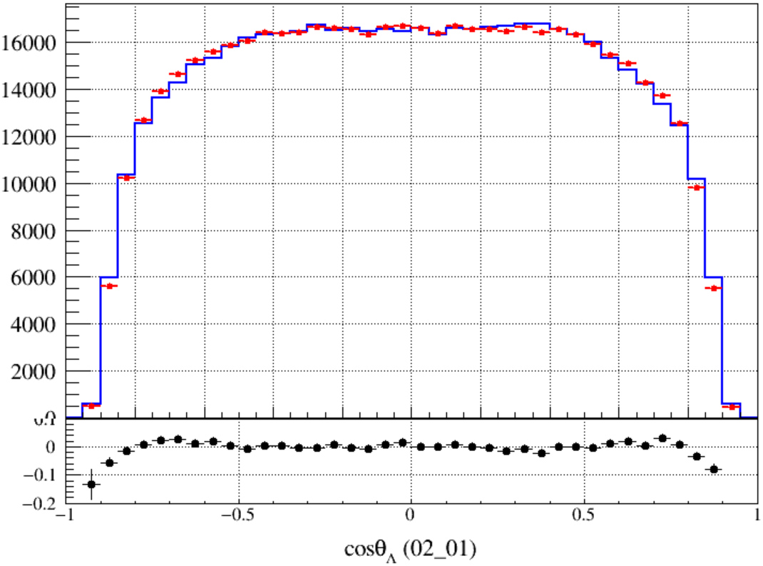
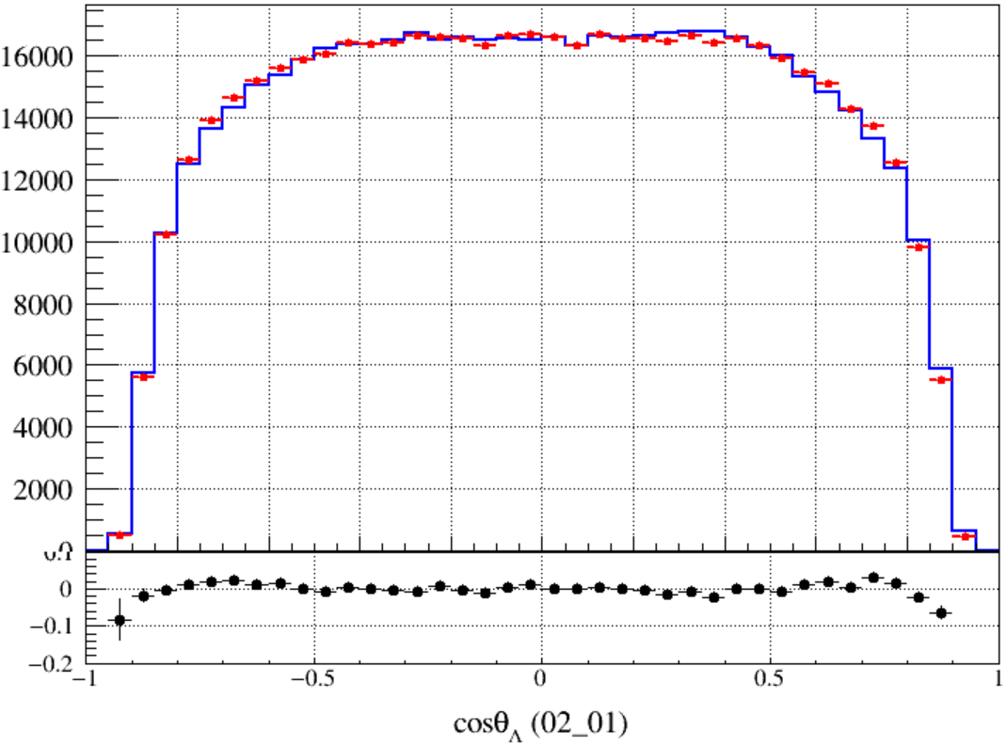
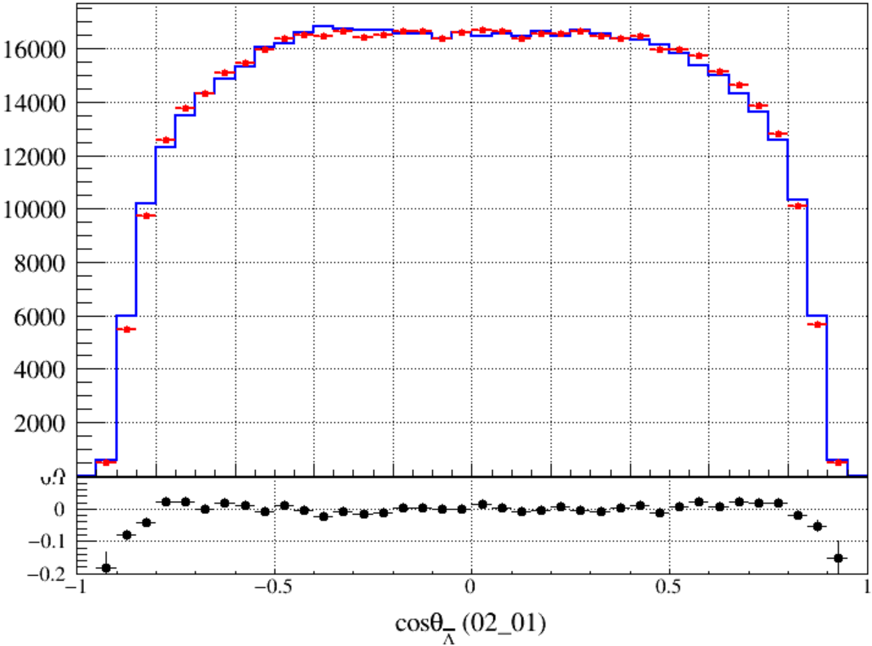
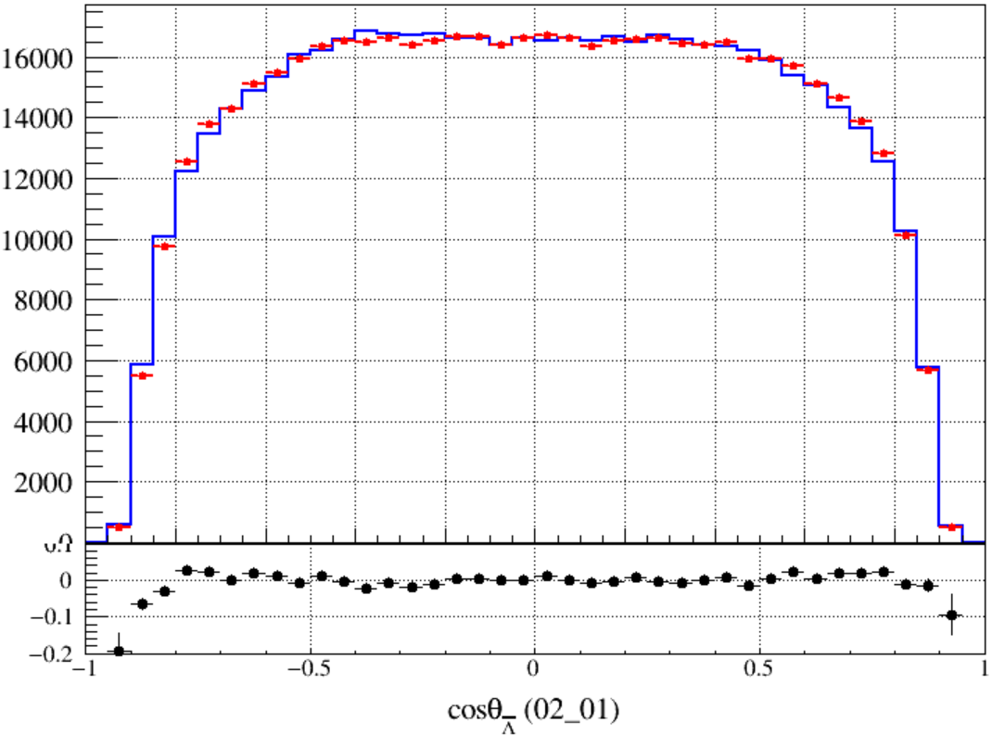
Original
recoiling Mass cut
First-Corr
recoiling Mass cut
Notes:
/ustcfs/BES3User/2021/ypei/BESIII/Lambda/WriteMemo/Check/STLamcos/JianyuCode/resolution/AfterCorr/distribution

Slide 7
Secondary Correction
Correction factor:
$$χ_{sec}=\frac{{\left(p^{corr}−p^{4c}\right)}_{data}}{{\left(p^{corr}−p^{4c}\right)}_{MC}}$$
For each Charged Tracks:
$p_{sec}^{corr}=p^{truth}+\left(p^{corr}−p^{truth}\right)∗Gaus(μ_{χ_{sec}}, σ_{χ_{sec}})$
$p^{corr}=p^{truth}+\left(p^{Kal}−p^{truth}\right)∗Gaus(μ_{χ}, σ_{χ})$
To do vertex fit, kinematic fit ……
Notes:
/ustcfs/BES3User/2021/ypei/BESIII/Lambda/WriteMemo/Check/STLamcos/JianyuCode/resolution/AfterCorr

Slide 8
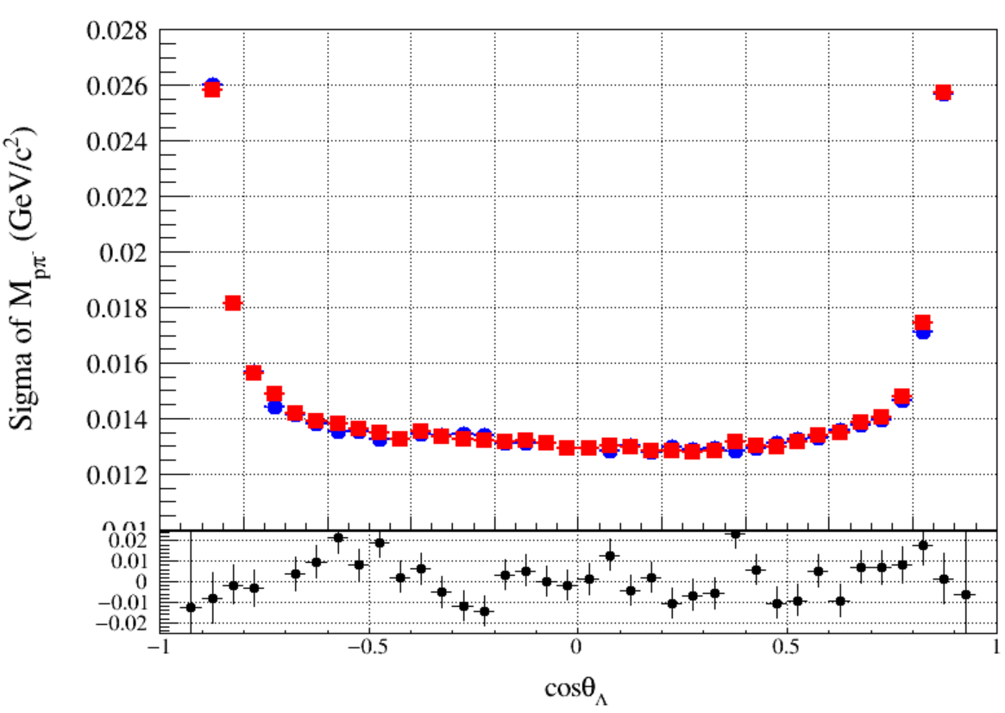
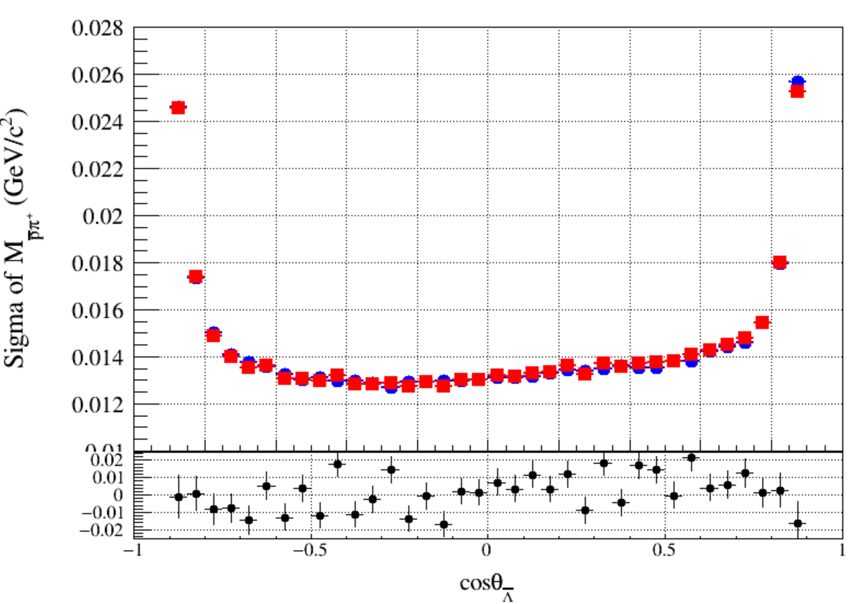
Compare
Original
First-Correction
Second-Correction
Notes:
/ustcfs/BES3User/2021/ypei/BESIII/Lambda/WriteMemo/Check/STLamcos/JianyuCode/resolution/AfterCorr

Slide 9
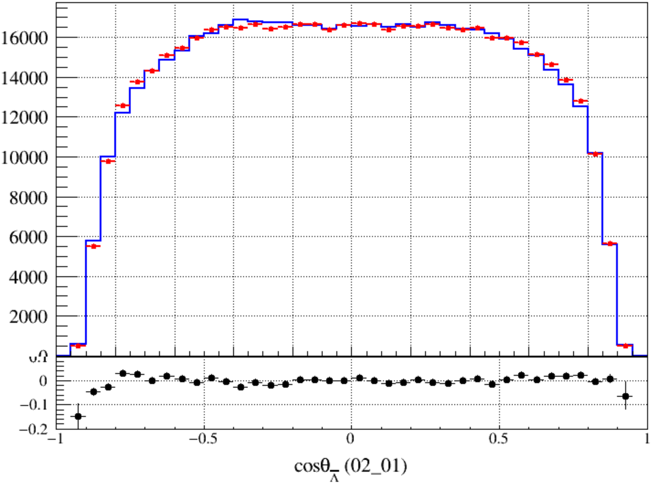
Original
First-Corr
Sec-Corr

Slide 10
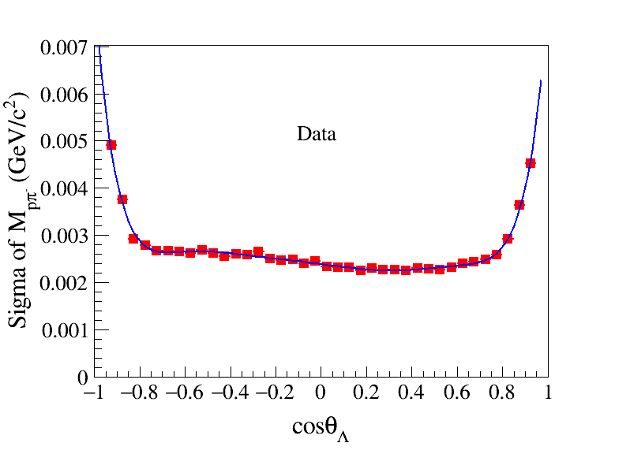
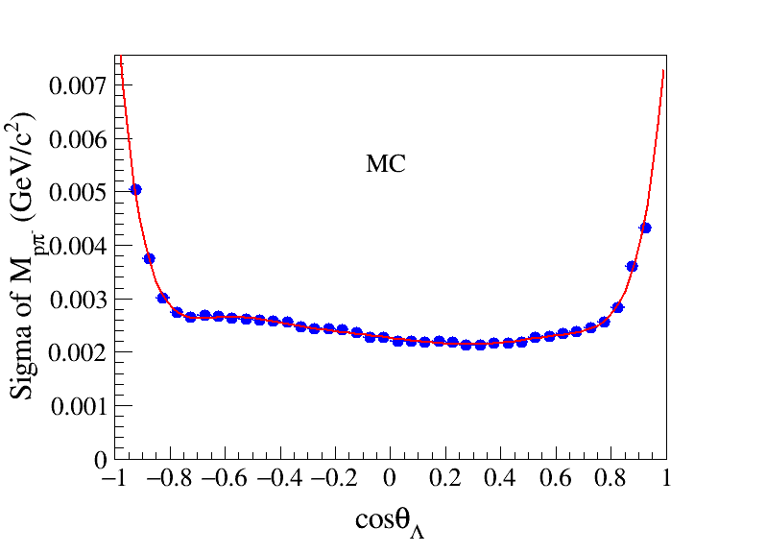
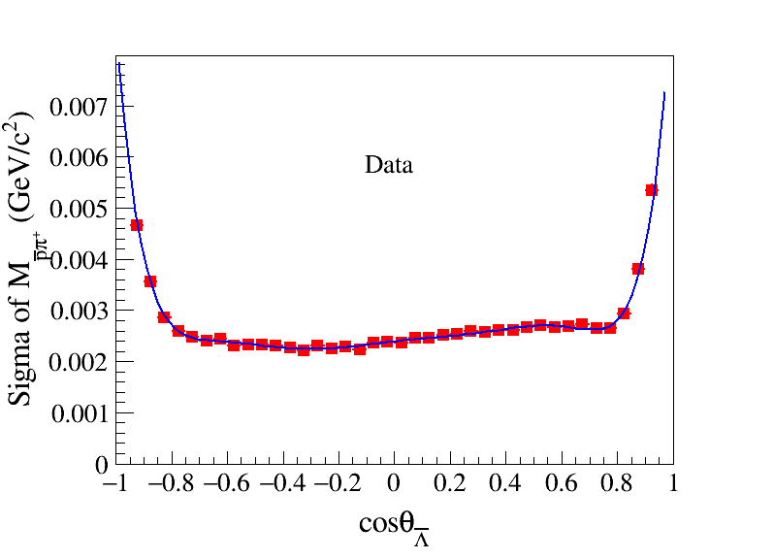
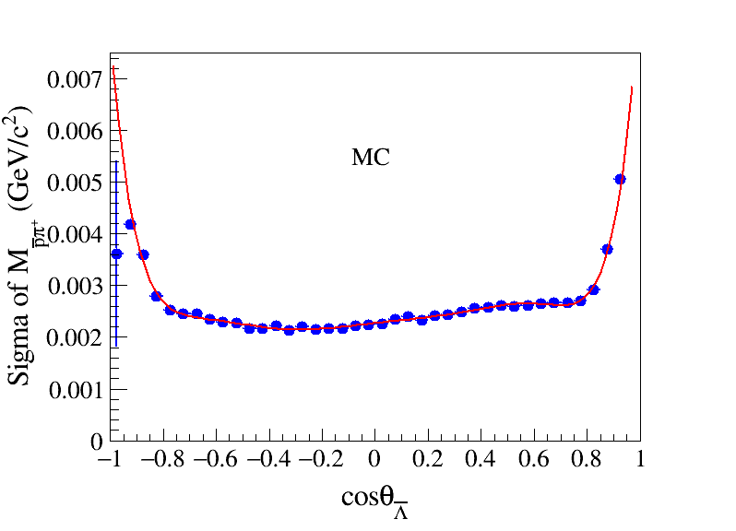
Cos-dependent Mass Window ($M_{pπ}$)
Notes:
/ustcfs/BES3User/2021/ypei/BESIII/Lambda/WriteMemo/Check/STLamcos/JianyuCode/resolution/AfterCorr/distribution/mLam_RM_res.cxx
/ustcfs/BES3User/2021/ypei/BESIII/Lambda/WriteMemo/Check/STLamcos/JianyuCode/resolution/AfterCorr/distribution/LamRes.root

Slide 11
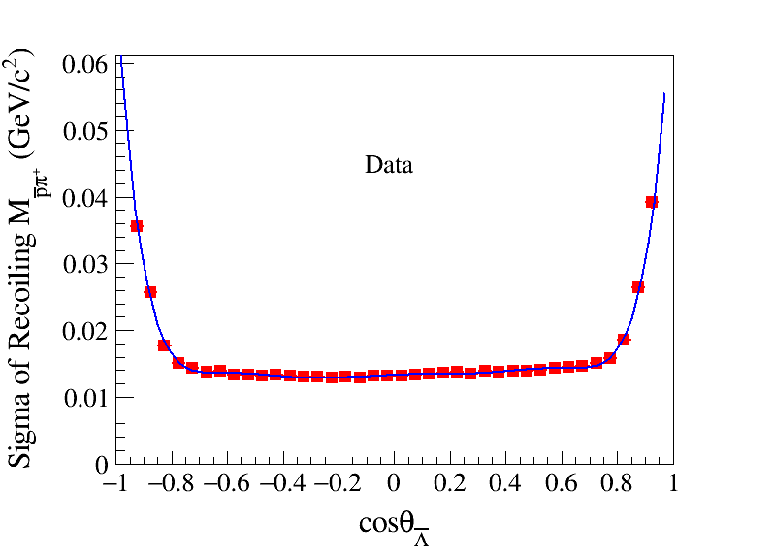
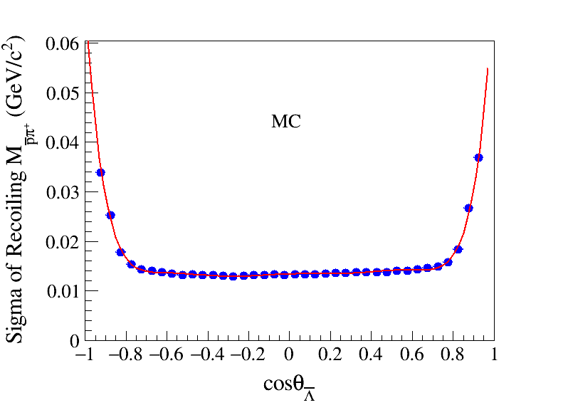
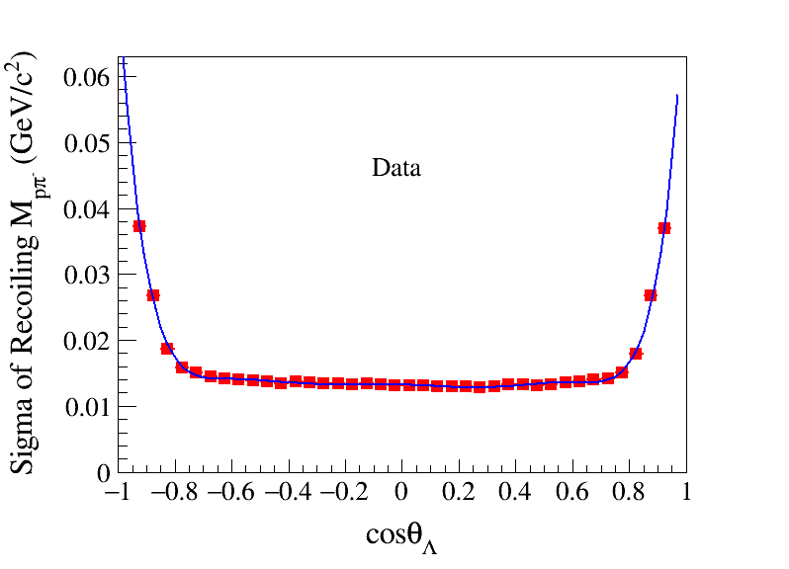
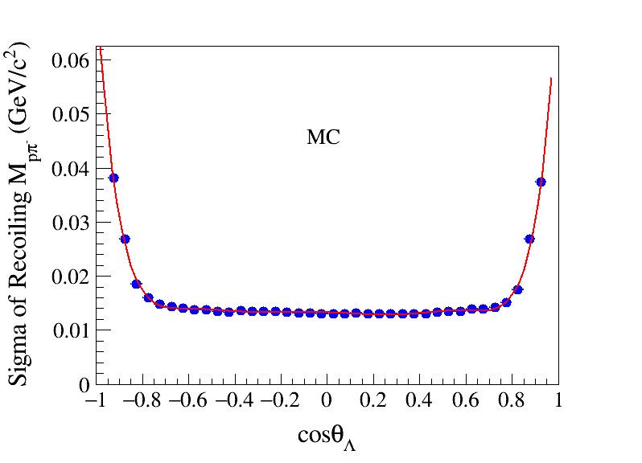
Cos-dependent Mass Window ($M_{pπ}^{recoiling}$)
Notes:
/ustcfs/BES3User/2021/ypei/BESIII/Lambda/WriteMemo/Check/STLamcos/JianyuCode/resolution/AfterCorr/distribution

Slide 12
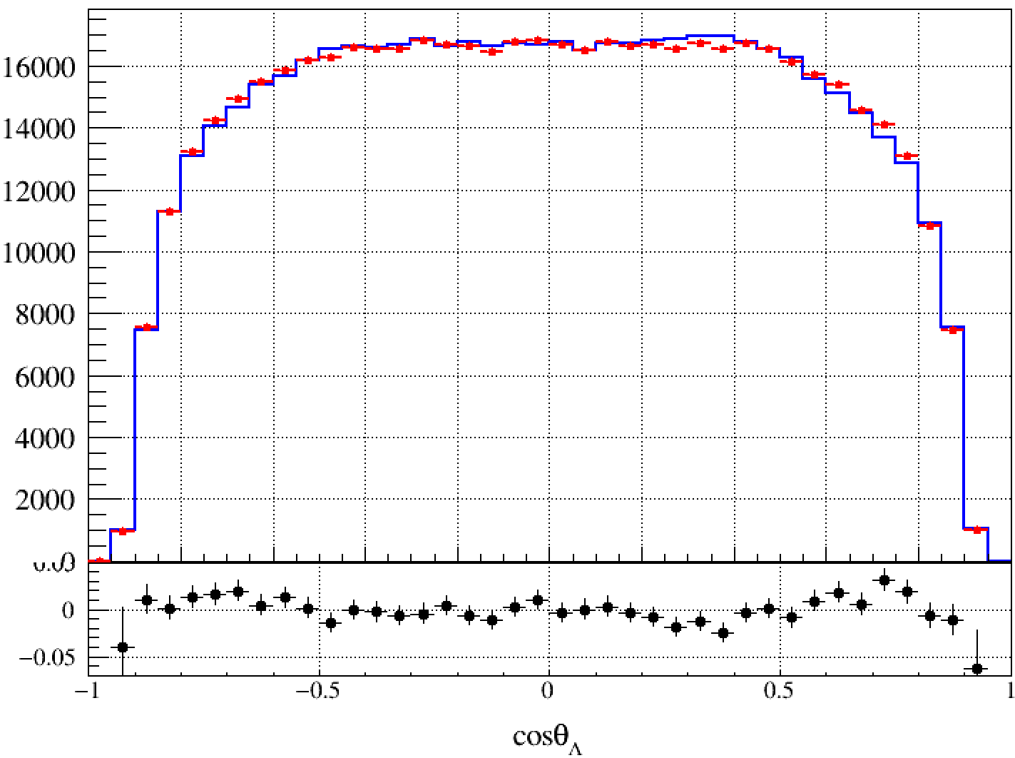
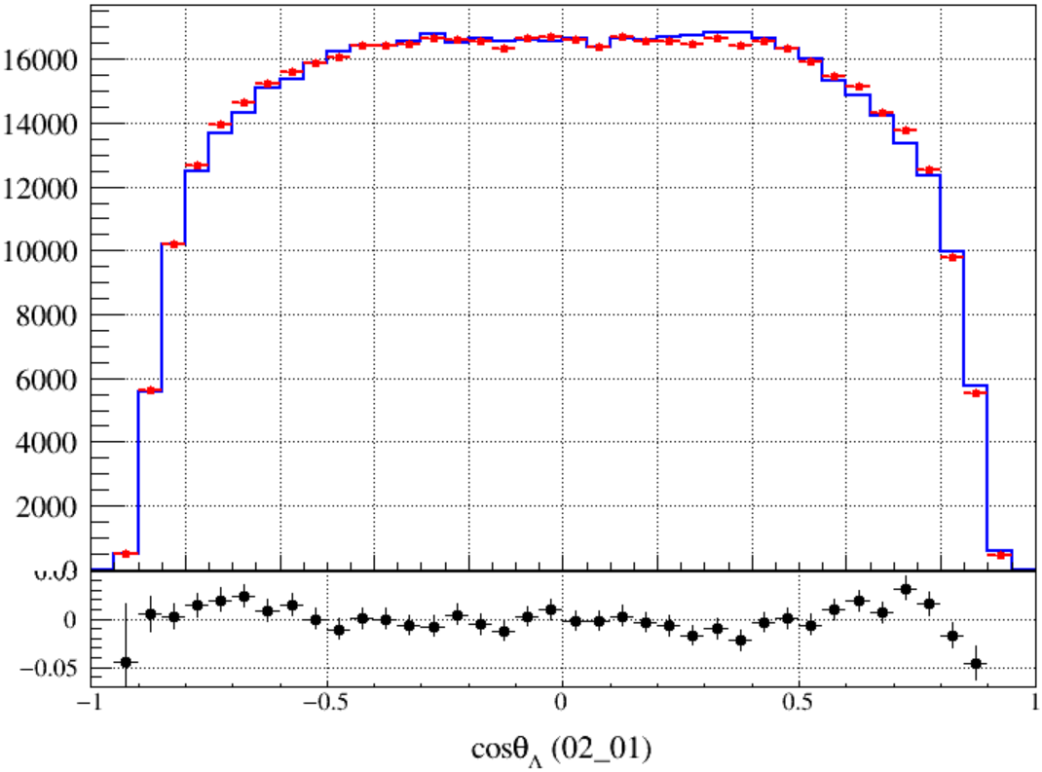
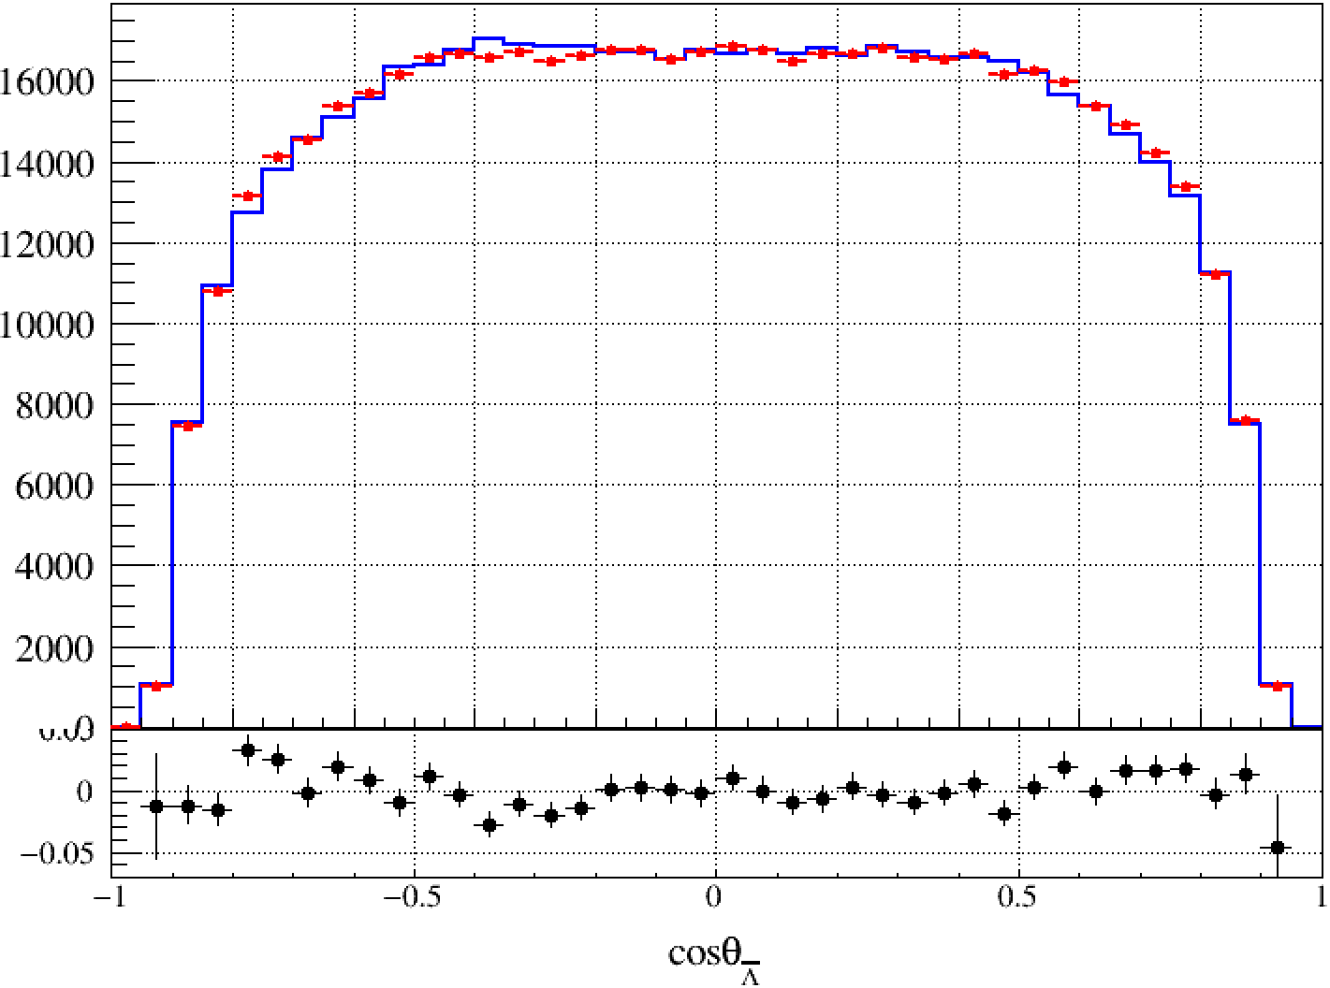
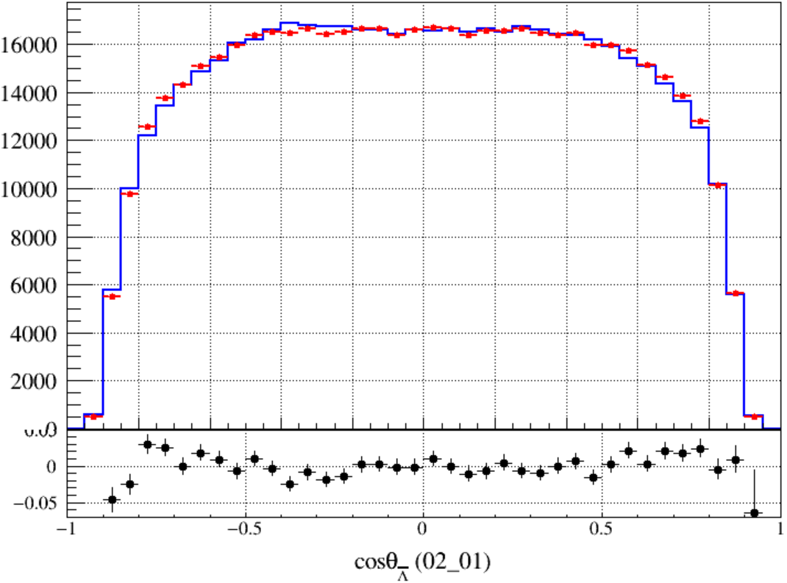
Cos-dependent Mass Window Cut
Sec-Corr
With Recoiling Mass Cut
Sec-Corr
After Sec-Corr … …
Notes:
/ustcfs/BES3User/2021/ypei/BESIII/Lambda/WriteMemo/Check/STLamcos/JianyuCode/resolution/SecondCorr/distribution

Slide 13
 | BKG-Level
No Recoiling Mass Cut | 1.03%
Fixed Mass Window | 0.45%
Cos-dependent Mass Window | 0.62%
Notes:
/ustcfs/BES3User/2021/ypei/BESIII/Lambda/WriteMemo/inclusiveMC_data/npi0/inclusive/result_Ver_02_01/topo

Slide 14
Next to do
Using $J/ψ→Σ^{+}\left(→pπ^{0}\right){\overline{Σ}}^{−} (→\overline{p}π^{0})$ to study the reconstruct of $π^{0}$ in my channel ($J/ψ→Λ\overline{Λ}→\overline{p}π^{+}nπ^{0}$)

Slide 15
Event Selection of $\overline{p}π^{0}pπ^{0}$
Good Charged Tracks
$V_{r}≤2cm, |V_{z}|≤10cm$
$\left|cosθ\right|<0.93$
PID (Use dedx+TOF)
Proton: $p>0.5$ GeV/c && PID: Prob(p) > Prob(K/$π$)
nProton == 1 && nPbar == 1
Shower Selection
$\left|cosθ\right|≤0.8 , E>25MeV$
$0.86≤ \left|cosθ\right|≤0.92 , E>50MeV$
$0≤TDC≤14$
$Ang_{shower, ChgTrk}≥10°$ (for $\overline{p}≥20°$)
Nshower $≥2$
${\overline{Σ}}^{−}$ Selection
Select the combination of $\overline{p},π^{0}$ with minimum $|M_{pπ^{0}}−M_{Σ^{+}}|$
$M_{pπ^{0}}^{recoil}$ is in $Σ^{+}$ region
Good Shower Selection
No contain the $γ$ from above $π^{0}$ (from ${\overline{Σ}}^{−}→\overline{p}π^{0}$)
Common Selection
$Ang_{shower, ChgTrk}≥10°$ (for $\overline{p}≥20°$)
Nshower $≥2$
2C Kinematic fit
On the hypothesis of $\overline{p}π^{0}pγγ$
Loop all $γ$ pairs, perform:
$\frac{\left|E_{1}−E_{2}\right|}{p_{π^{0}}}<0.9$
$θ_{γ, Λ}>10°, Λ$ direction is recoiled from $\overline{Λ}$
BDT Response > 0.15
Proton is treated as a missing particle
Constrain $M_{pγγ}=M_{Λ}^{PDG}$ and $M_{γγ}=M_{π^{0}}^{PDG}$
$π^{0}$(from ${\overline{Σ}}^{−}$) Selection
$116<M_{γγ}<148 MeV/c^{2}$
1C is performed
$χ_{1C}^{2}<25$
Notes:
We require total good charged tracks equal to 2
Recoil mass of neutron is in a large range
To study these two cuts, our preliminary selection is without these two cuts

Slide 16
Backup

Slide 17
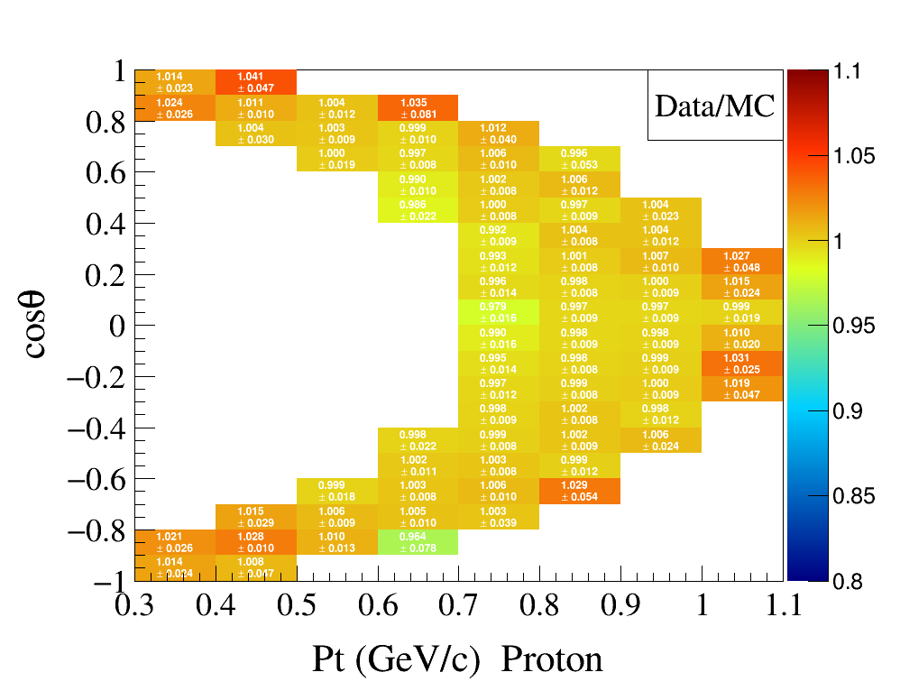
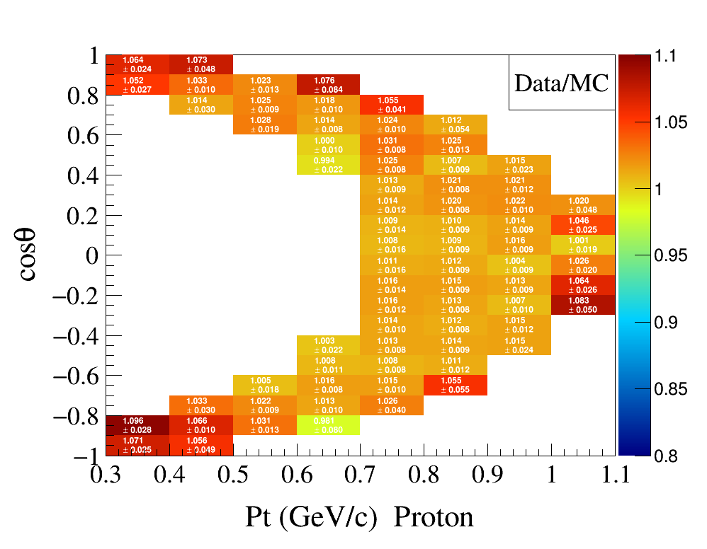
Original
Sec-Corred
Corred

Slide 18
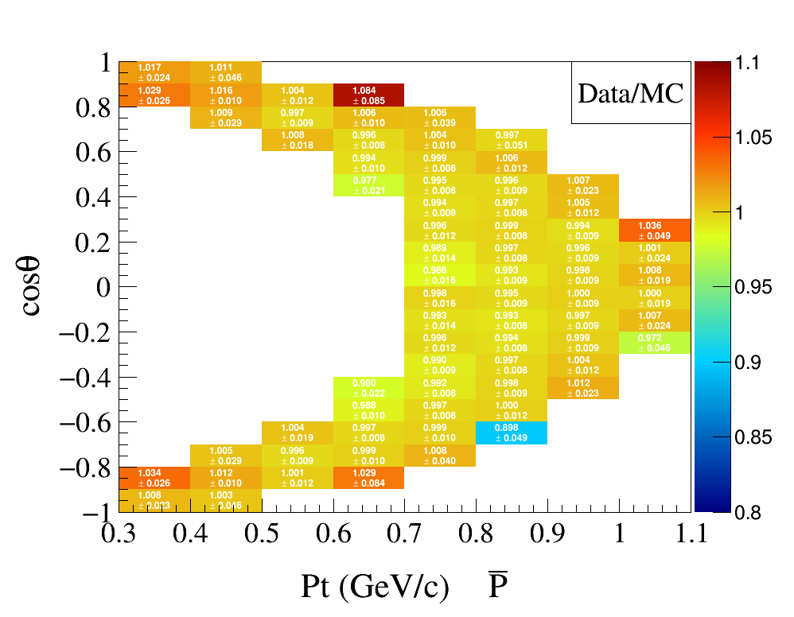
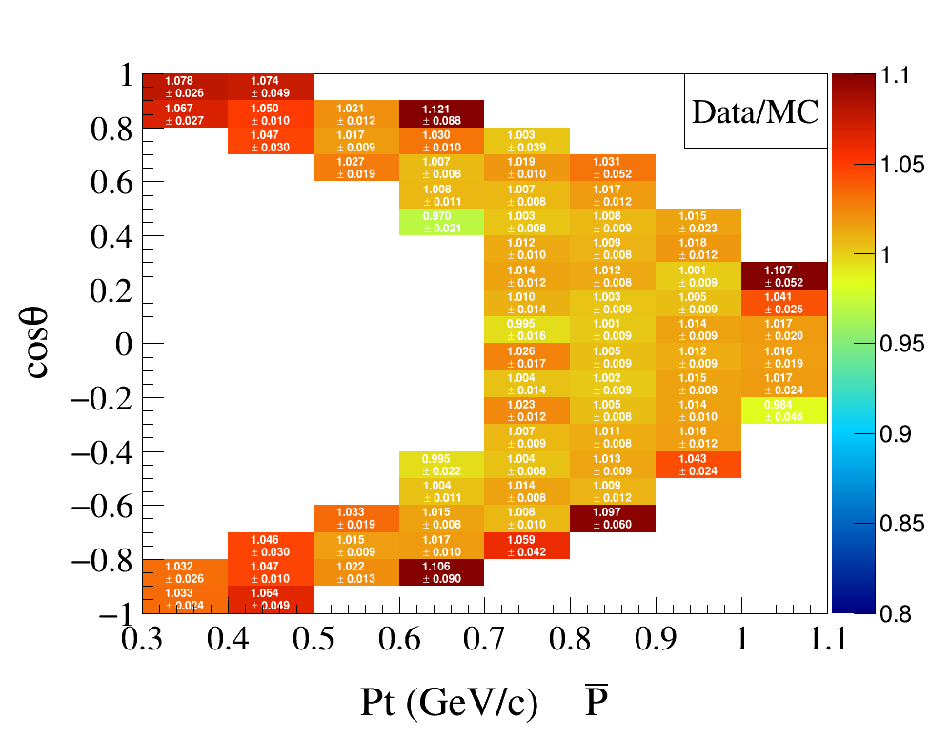
Original
Sec-Corred
Corred

Slide 19
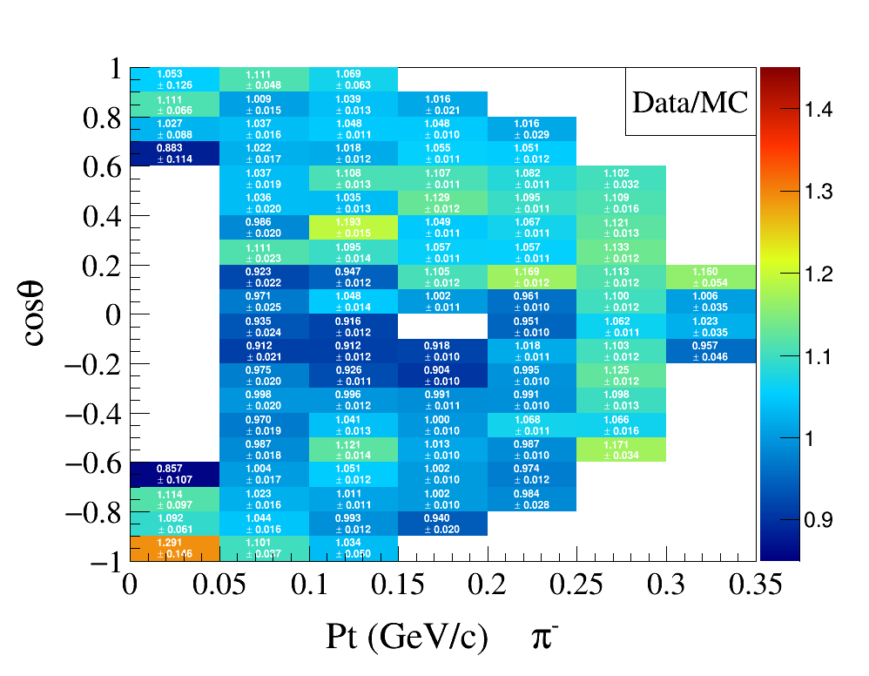
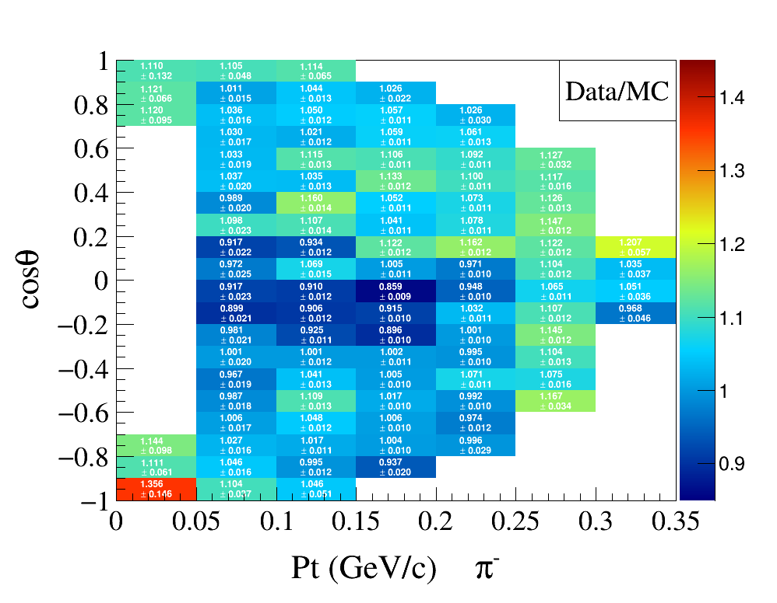
Original
Sec-Corred
Corred

Slide 20
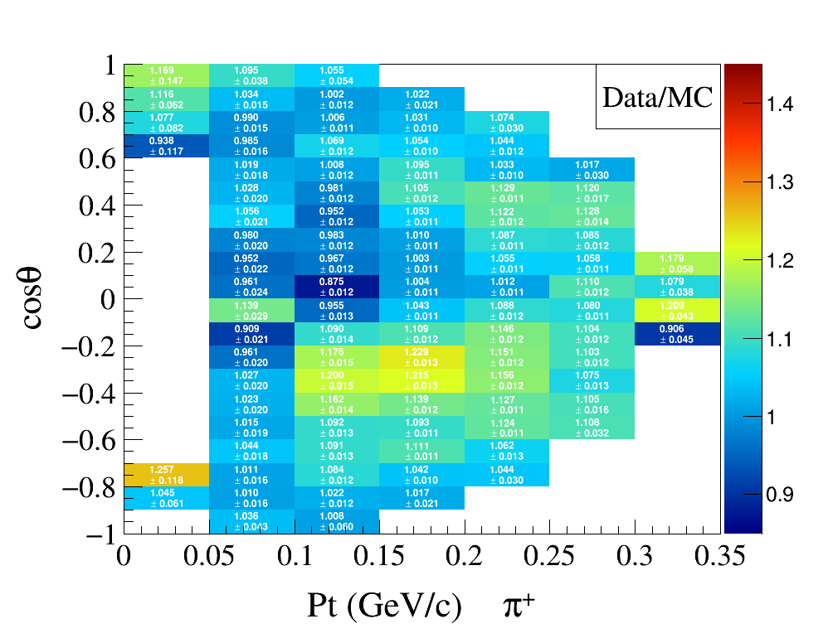
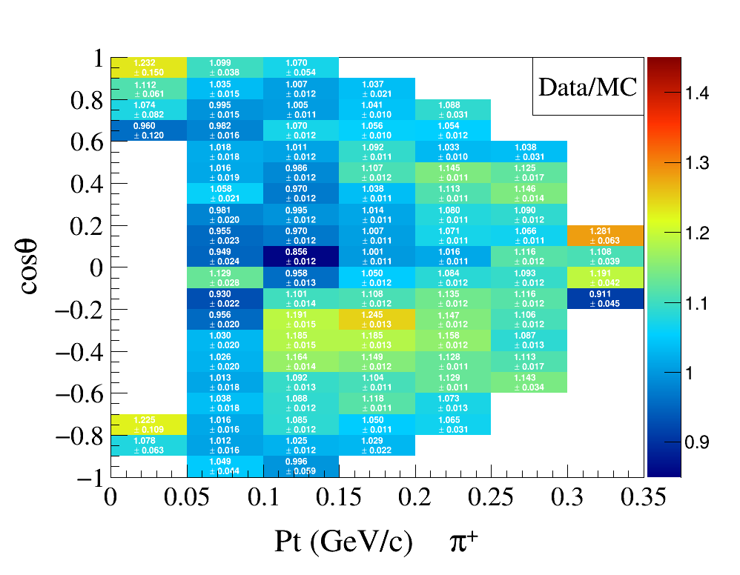
Original
Sec-Corred
Corred

