Slide 1
The Study of Peaking and Non- Peaking Background in ${ γχ}_{cJ }→ {γΣ}^{+}{\overline{Σ}}^{−}→γn \overline{n}π^{+}π^{−}$ to measure the BF.

Slide 2
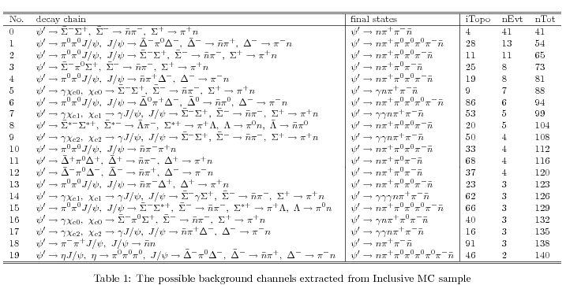
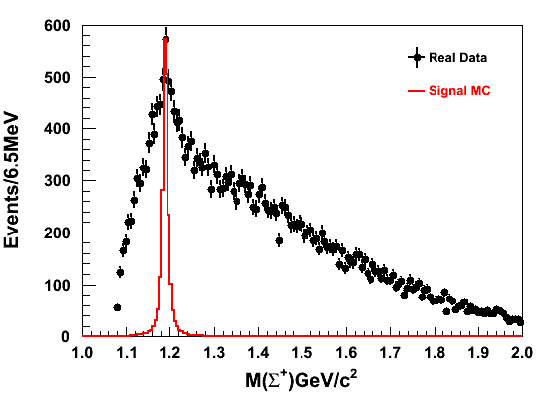
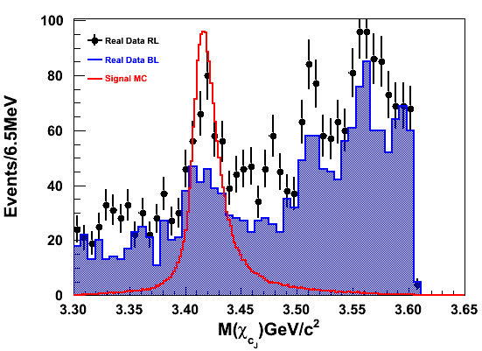
Sideband of sigma+ applied to improve the signal (Black dot)
Note:
Main Peaking Bkg in Mass of Chicj:
Gama chicJ -> gam Delta+ anti-Delta- (no idea ??)
Gama chicJ-> gam gam J/psi -> gg Delta+ anti-Delta-
gamChicj-> gamgama Jpsi-> gg Sigma+ anti-Sigma- ( BF is known to calculate no. of chicJ event by using normalization)

Slide 3
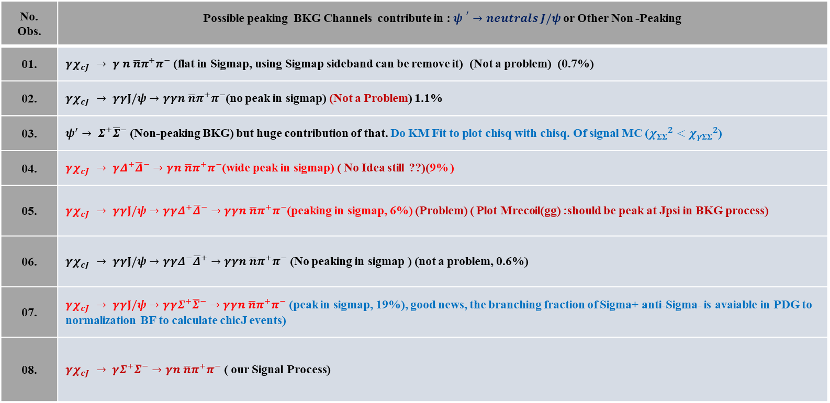
Event Selection for Minimized BKG
Event Selection : ${ψ }^{′}→neutrals J/ψ$ :
|$M_{π^{o}}−0.135$ |$>0.015 GeV$
Add later
No. Obs. | Possible peaking BKG Channels contribute in : ${ψ }^{′}→neutrals J/ψ$ or Other Non -Peaking
01. | ${γχ}_{cJ }→ γ n \overline{n}π^{+}π^{−}$ (flat in Sigmap, using Sigmap sideband can be remove it) (Not a problem) (0.7%)
02. | ${γχ}_{cJ }→ γγJ/ψ→γγn \overline{n}π^{+}π^{−}$(no peak in sigmap) (Not a Problem) 1.1%
03. | $ψ^{′}→ Σ^{+}{\overline{Σ}}^{−}$ (Non-peaking BKG) but huge contribution of that. Do KM Fit to plot chisq with chisq. Of signal MC (${χ_{ΣΣ}}^{2}<{χ_{γΣΣ}}^{2}$)
04. | ${γχ}_{cJ }→ γΔ^{+}{\overline{Δ}}^{−}→γn \overline{n}π^{+}π^{−}$(wide peak in sigmap) ( No Idea still ??)(9% )
05. | ${γχ}_{cJ }→ γγJ/ψ→γγΔ^{+}{\overline{Δ}}^{−}→γγn \overline{n}π^{+}π^{−}$(peaking in sigmap, 6%) (Problem) ( Plot Mrecoil(gg) :should be peak at Jpsi in BKG process)
06. | ${γχ}_{cJ }→ γγJ/ψ→γγΔ^{−}{\overline{Δ}}^{+}→γγn \overline{n}π^{+}π^{−}$ (No peaking in sigmap ) (not a problem, 0.6%)
07. | ${γχ}_{cJ }→ γγJ/ψ→γ{γΣ}^{+}{\overline{Σ}}^{−}→γγn \overline{n}π^{+}π^{−}$ (peak in sigmap, 19%), good news, the branching fraction of Sigma+ anti-Sigma- is avaiable in PDG to normalization BF to calculate chicJ events)
08. | ${γχ}_{cJ }→ {γΣ}^{+}{\overline{Σ}}^{−}→γn \overline{n}π^{+}π^{−}$ ( our Signal Process)

Slide 4
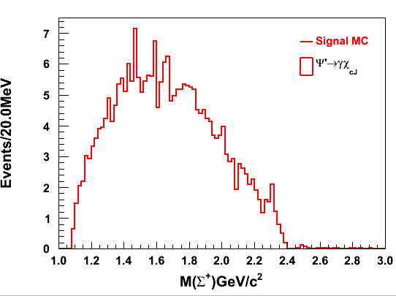
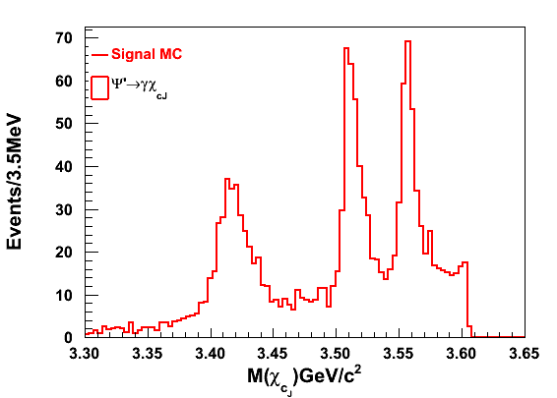
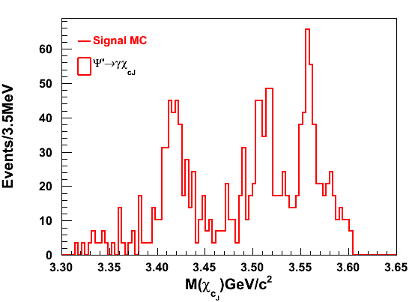
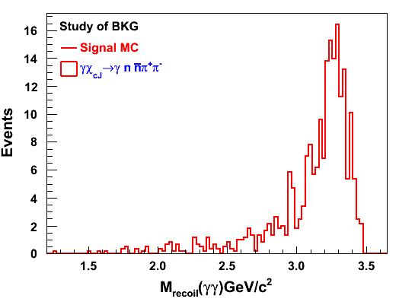
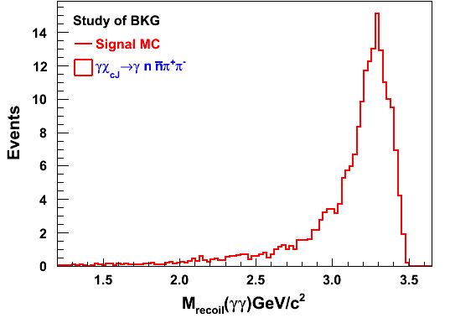
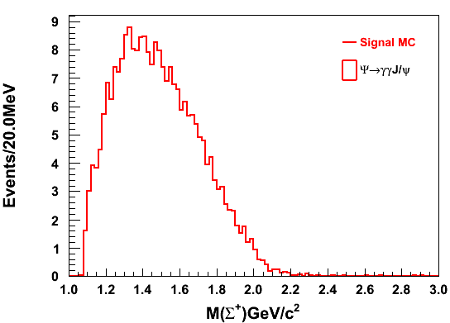
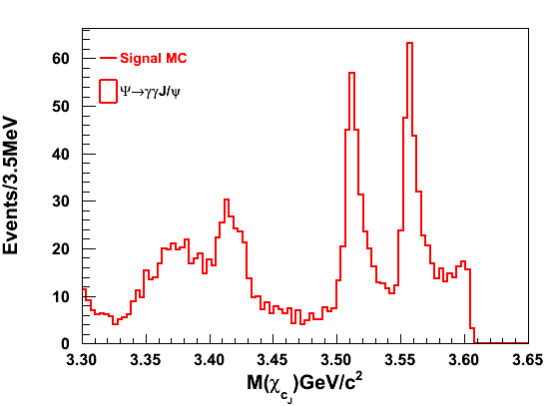
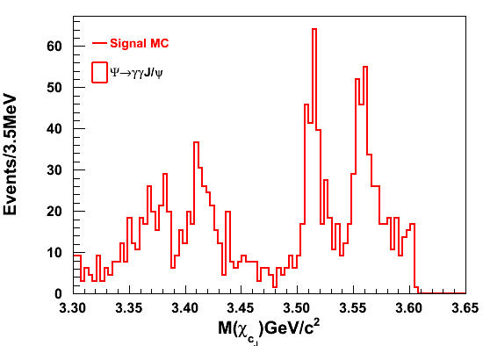
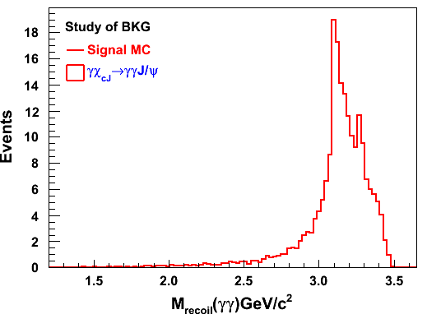
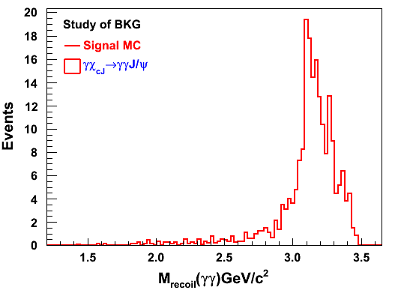
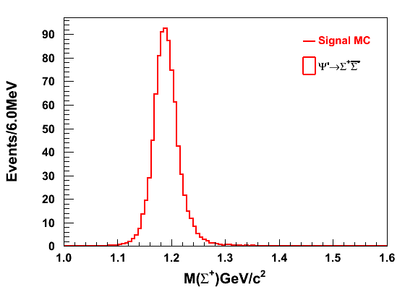
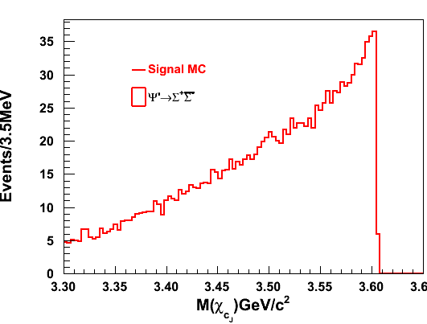
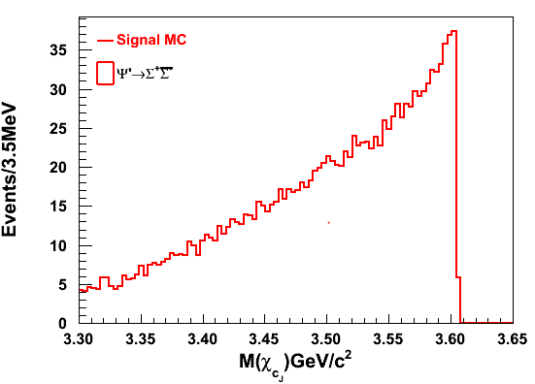
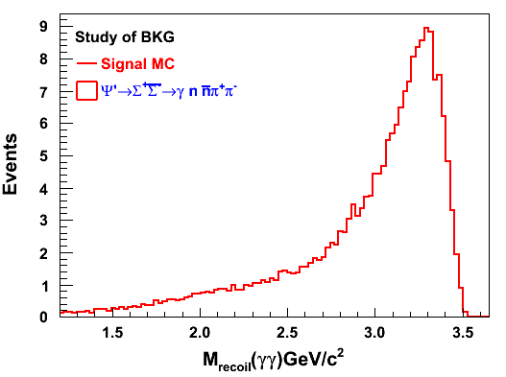
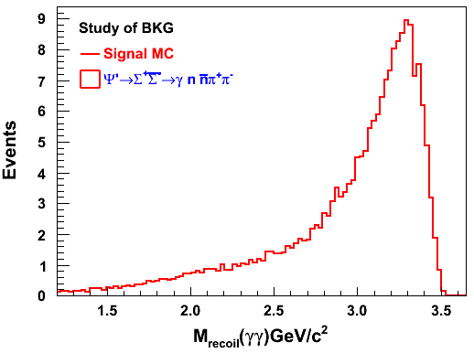
0.7%
11%
9%
1.1%
27%
29%
Invariant Mass of Sigmap no mass cut
Without Sigmap mass window Cut
Sigmap mass window Cut [1.15,1.25]
Without Sigmap mass window Cut
Sigmap mass window Cut [1.15,1.25]

Slide 5
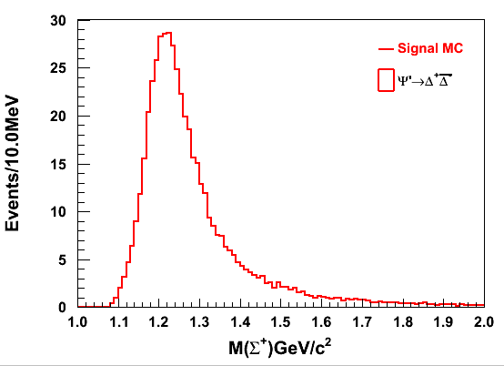
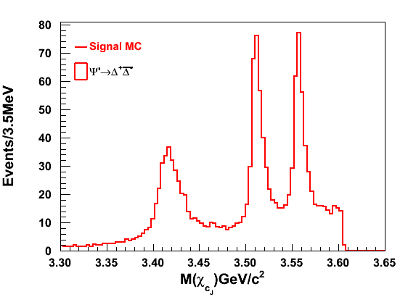
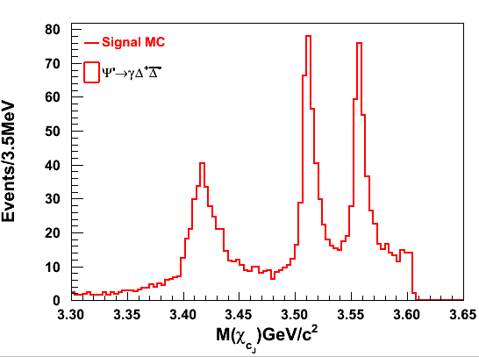
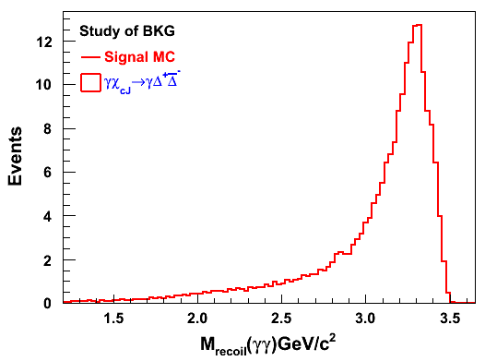
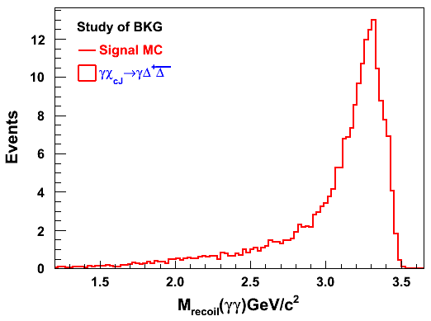
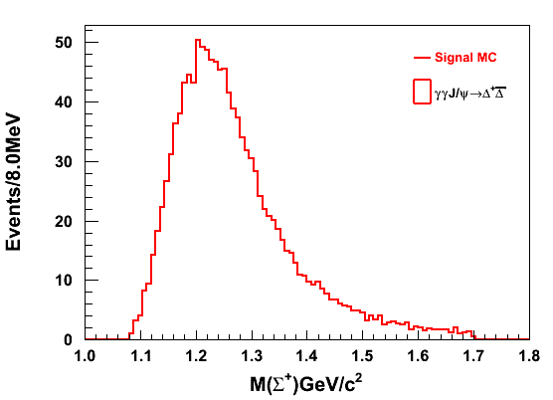
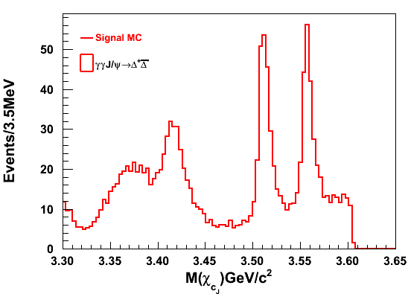
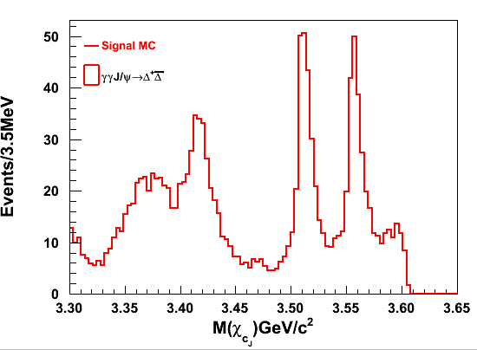
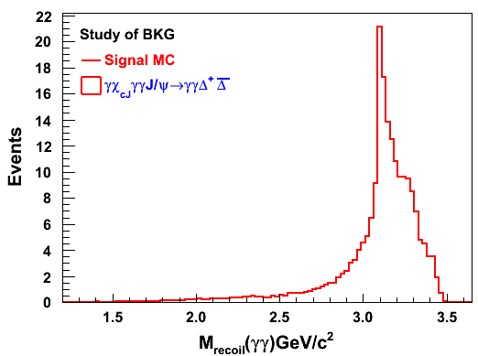
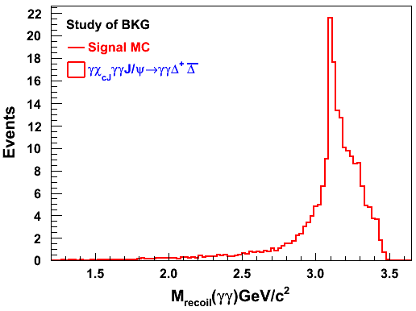
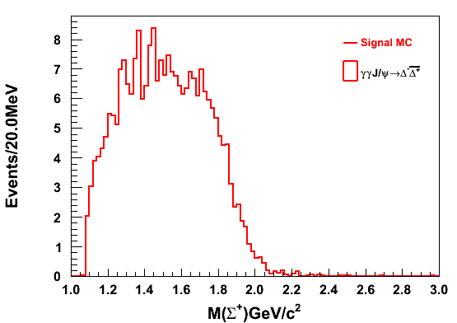
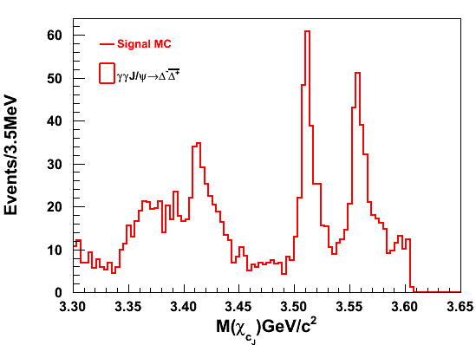
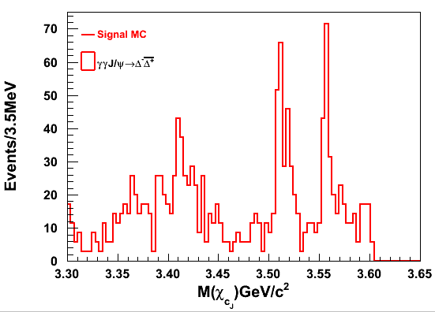
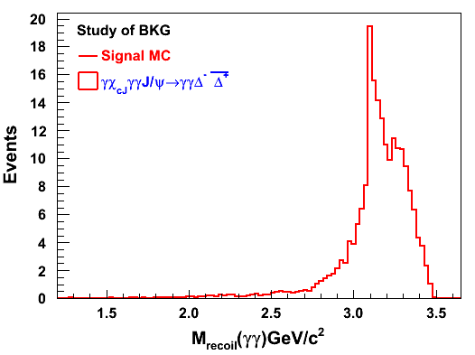
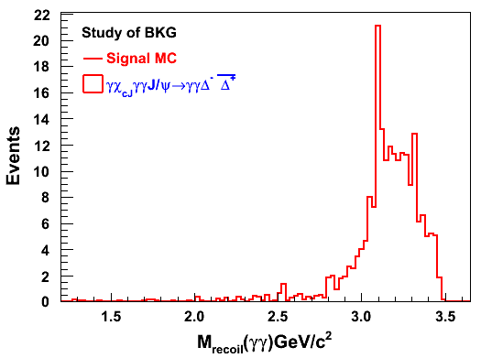
9%
19%
6%
14%
0.6%
7%
Invariant Mass of Sigmap no mass cut
Without Sigmap mass window Cut
Sigmap mass window Cut [1.15,1.25]
Without Sigmap mass window Cut
Sigmap mass window Cut [1.15,1.25]

Slide 6
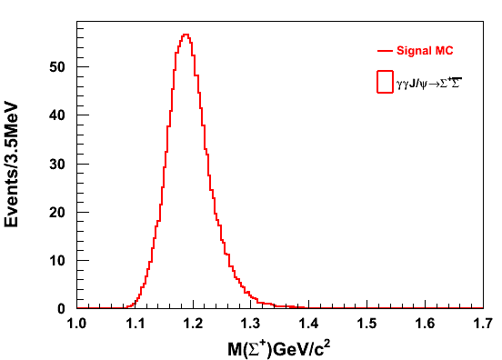
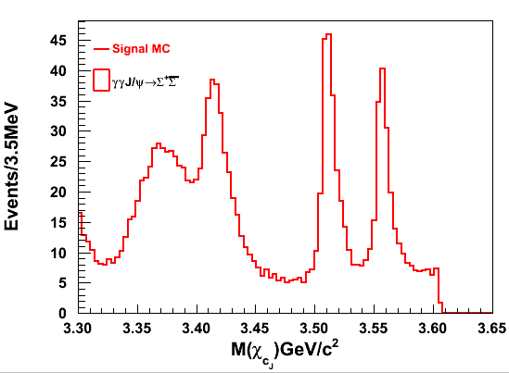
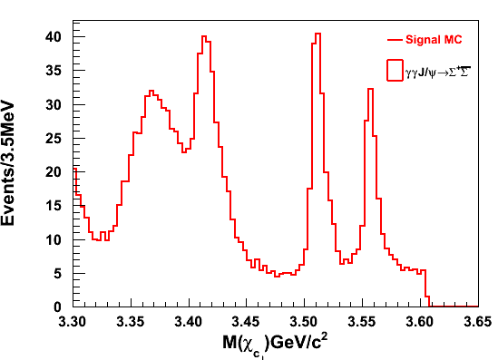
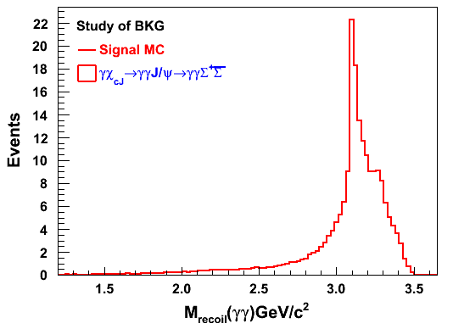
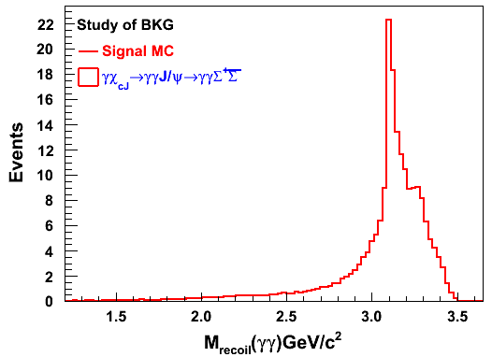
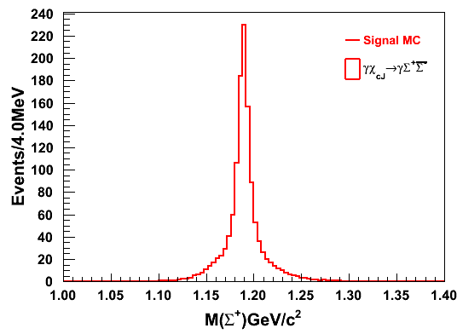
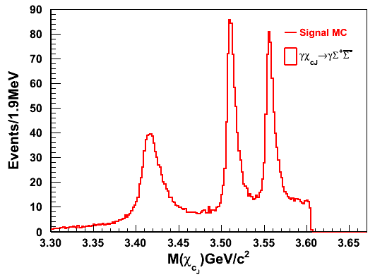
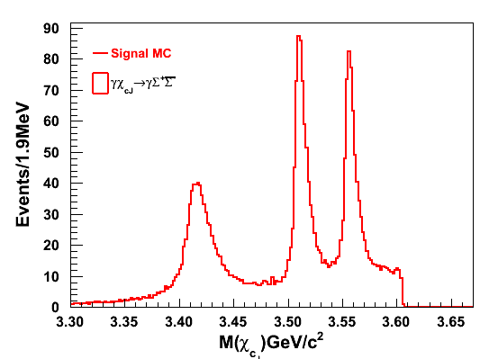
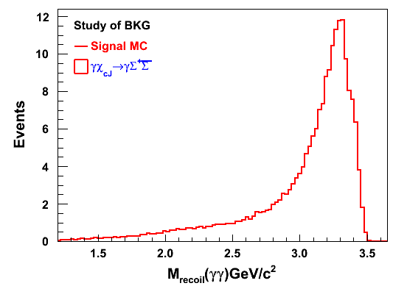
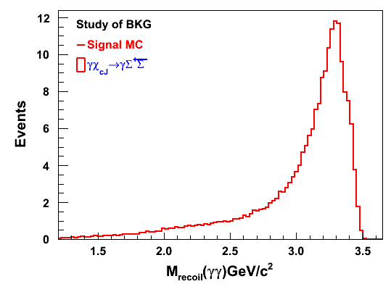
19%
24%
If Gam_macth<10
19%
27%
29%
Invariant Mass of Sigmap no mass cut
Without Sigmap mass window Cut
Sigmap mass window Cut [1.15,1.25]
Without Sigmap mass window Cut
Sigmap mass window Cut [1.15,1.25]

Slide 7
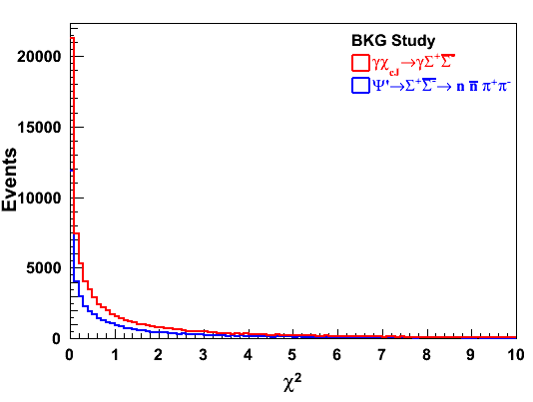
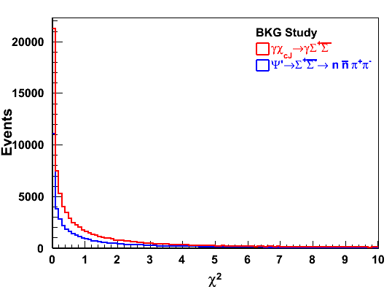
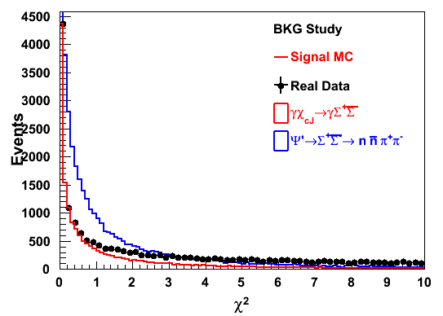
Other Non-Peaking Background in Mass of ChicJ
Without Sigmap mass window Cut
Sigmap mass window Cut [1.15,1.25]
Sigmap mass window Cut [1.15,1.25]

Slide 8
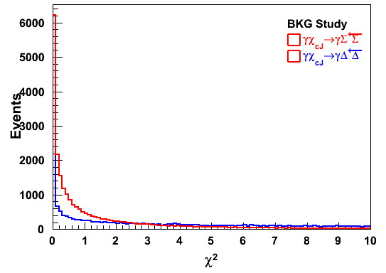
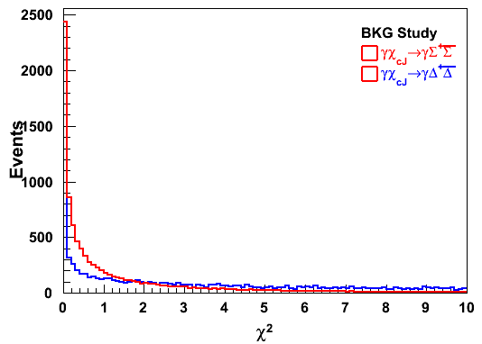
Without Sigmap mass window Cut
Sigmap mass window Cut [1.15,1.25]
Sigmap mass window Cut [1.15,1.25]

Slide 9
Summary
Peaking background in Mass of chicJ: where psip->gam chicJ:
chicj -> n nbar pi+ pi- (flat in Sigmap, using Sigmap sideband can be remove it) (not a problem) (0.7%)
chicj -> Delta Delta (baryons) (wide peak in sigmap, ...9% ) ( Not really found) ???? How??
chicj -> gam jpsi -> gam n nbar pi+ pi- (no peak in sigmap) (not a problem) 1.1%
chicj -> gam jpsi -> gam Sigma+ anti-Sigma- (peak in sigmap, 19%), good news, the branching fraction of Sigma+ anti-Sigma- is avaiable in PDG to normalization to calculate chicj events in .
chicj -> gam jpsi -> gam Delta- Delta (no peaking in sigma ) (not a problem, 0.6%)
chicJ->gam jpsi -> gam Delta+ Delta- (peaking in sigma, 6%) (below solve this problem)
Other non-peaking background in Mass of chicJ:
psip->Sigma+ anti-Sigma- ( plot together; new KM fit to calculate without gamma loop to calculate chi2 -> Sigma+ anti-Sigma- with signal MC of chisq -> gamma Sigma+ anti-Sigma- and also data as well ) (Done)
psip->n nbar pi+ pi- psip->Delta Delta solution: use poly to fit such a flat background (chisq2 optimization may be reduced this type of background ) Tips: Efficiency of psip->Sigma+ anti-Sigma-, check Again but same result found nothing changed in it.
what's the selection efficiency of chicj->Sigma+ anti-Sigma- (don't match gamma )( 29 % without mass window cut look graph more explantion)
How to remove gam jpsi peak in our Signal process;
1. double loop gam, do the ecms – (p4gam + p4gam) (array) Including anti-neutron also. (recoil 2 gamm’s to construct jpsi for all bkg process )
Prediction: For the background process with gam jpsi, should be a jpsi peak appears
2. chicj -> Delta+ anti- Delta- (baryons) (wide peak in sigmap, ...9%) (show the chisq for this process)
(Discussion Conc: 02-01-2018)

