Slide 1
Amplitude Analysis Framework TF-PWA and Its Application in $Λ_{c}^{+}$ $→Λπ^{+}π^{0}$
Yi Jiang
University of Chinese Academy of Sciences
2023.4.8

Slide 2
Outline
Introduction
Partial wave analysis with TF-PWA
TF-PWA framework
Special properties for $Λ_{c}^{+}$ decay
Results and performances
Analysis of $Λ_{c}^{+}→Λπ^{+}π^{0}$
Ongoing work in TF-PWA
Summary

Slide 3
Introduction
Partial wave analysis
Fit to the full kinematic
Angular analysis and mass projection fit together (more information)
Include interference effect
Extract the interested information
Fit fractions or branching ratio
Coupling or decay asymmetry
TF-PWA for easy and fast partial wave analysis
Open source: https://github.com/jiangyi15/tf-pwa
Powered by TensorFlow2 with GPU and Automatic Differentiation
$Λ_{c}^{+}$ charmed baryon
Large statistics in $e^{+}e^{−}→c\overline{c}$ for near threshold charmed baryon pair
$Λ_{c}^{+}→Λρ,Λ_{c}^{+}→Σ^{∗}(1385)π$: theoretical prediction exists, no measurement

Slide 4
The TF-PWA Framework
Automatic generations of different kinds of fitting outputs
General Decay Description.
Decay, Particle
General Helicity Angle Process
Results
data
MC sample
4-momenta
DecayChain
structure
plots
config.yml
angle
pre-
prepared
user
scripts
Configuration file
DecayGroup
fit fractions
alignment
Helicity Amplitude Rule
error matrices
users only need to take care of the input files
fit parameters
partial wave
distributions
amplitude model
fit
toy MC
Likelihood model,
Expression transformation
Fast Evaluation
…
Can be a black box for beginners

Slide 5
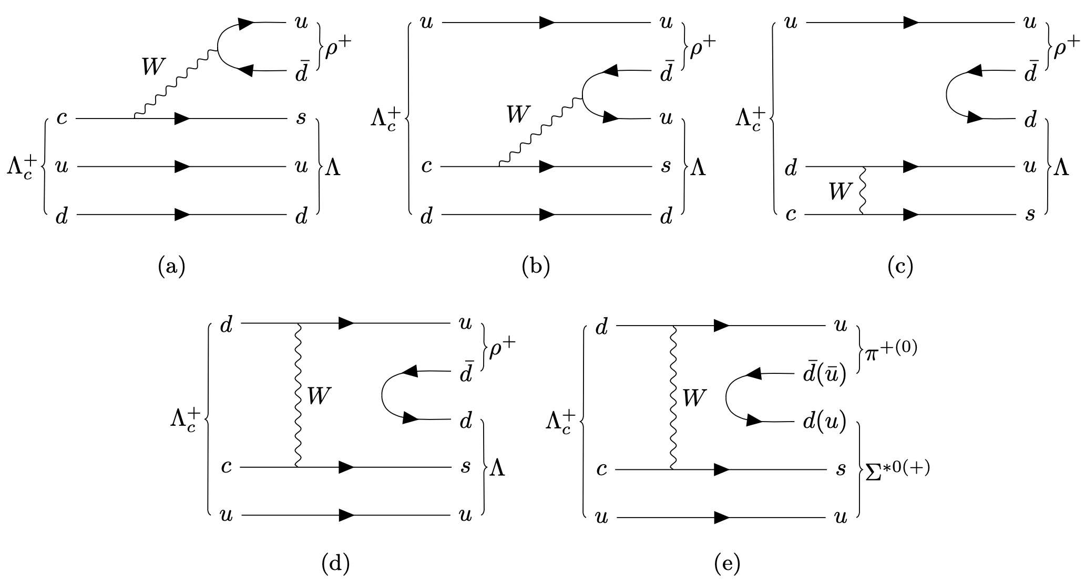
$Λ_{c}^{+}→Λπ^{+}π^{0}$
JHEP12(2022)033
Possible process in this $Λ_{c}$ decay
2-body decay
$$ρ^{+}$$
$$Λ_{c}^{+}$$
$$Λ$$
Serialize as
Lambda_c: [
[Lambda, rho],
[Sigma_starp, pi0 ],
[Sigma_star0, pip ],
]
rho:
J: 1
P: -1
mass: 0.77511
width: 0.1491
model: GS_rho
…
Config.yml In TF-PWA

Slide 6
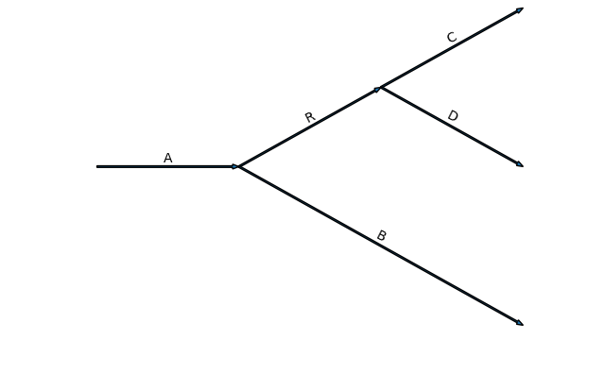
Helicity formalism
Feynman rules
User defined
$$C$$
Decay
$$A^{0→1+2}=H_{λ_{1},λ_{2}}D_{λ_{0},λ_{1}−λ_{2}}^{j_{0}⋆}(φ,θ,0)$$
$$R$$
$$D$$
$$A$$
Wigner-D matrix
$$B$$
$$R\left(M\right)=\frac{1}{m_{0}^{2}−M^{2}−im_{0}Γ},⋯$$
Particle
$$1 or ρ=1+\vec{p}⋅\vec{σ}$$
$$A_{λ_{A},λ_{B}^{′},λ_{C}^{′},λ_{D}^{′}}^{R}$$
=
$$D_{λ_{1},λ_{1}′}^{j_{1}⋆}(α,β,γ)$$
$$\sum_{λ}{{H_{λ_{R}λ_{B}}D}_{λ_{A},λ_{R}−λ_{B}}^{j_{A}⋆}\left(φ_{1},θ_{1},0\right)R\left(M\right)H_{λ_{C},λ_{D}}D_{λ_{R},λ_{C}−λ_{D}}^{j_{R}⋆}\left(φ_{2},θ_{2},0\right)}$$
$$D_{λ_{B},λ_{B}′}^{j_{B}⋆}\left(α_{B},β_{B},γ_{B}\right)D_{λ_{C},λ_{C}′}^{j_{C }⋆}\left(α_{C},β_{C},γ_{C}\right)D_{λ_{D},λ_{D}′}^{j_{D}⋆}(α_{D},β_{D},γ_{D})$$
alignment
probability: $|𝒜|^2$
Decay Group: $𝒜={\tilde{A}}_{1}+{\tilde{A}}_{2}+⋯$
Decay Chain: $\tilde{A}=A_{1}RA_{2}⋯$
Decay: Wigner D-matrix, $A=HD^{∗J} (φ,θ,0)$
Particle: Breit-Wigner: $R(m)$, user defined
$$\frac{dσ}{dΦ}∝\sum_{λ_{A}}{\sum_{λ_{B},λ_{C},λ_{D}}{{\left|\sum_{R}{A_{λ_{A},λ_{B},λ_{C},λ_{D}}^{R}}\right|}^{2}}}$$
Automatically calculated from decay structure

Slide 7
Automatic Angle Plot
${\vec{p}}_{B}^{A}$ means momentum of B in the rest frame of A
$+φ$ means the rotation is anticlockwise, $−φ$ means the rotation is clockwise
$$θ_{Λ}^{Λπ^{+}}$$
$${\vec{p}}_{p}^{Λ(Λπ^{+})}$$
$$Λ→pπ^{−}$$
$$θ_{p}^{Λ(Λπ^{0})}$$
$$Λ→pπ$$
$${\vec{p}}_{π^{−}}^{Λ(Λπ^{+})}$$
$$θ_{p}^{Λ}$$
$$θ_{Λ}^{Λπ^{+}}$$
$${\vec{p}}_{Λ}^{Λπ^{+}}$$
$$Λ→pπ^{−}$$
$${\vec{p}}_{p}^{Λ(Λπ^{0})}$$
$$φ_{p}^{Λ(Λπ^{+})}$$
$${\vec{p}}_{π}^{Λ(Λπ^{0})}$$
$${\vec{p}}_{p}^{Λ}$$
$${\vec{p}}_{π^{−}}^{Λ}$$
$$−φ_{p}^{Λ(Λπ^{0})}$$
$$θ_{Λ}^{Λπ^{0}}$$
$$\left(Λπ^{+}\right)→Λπ^{+}$$
$$−φ_{Λ}^{Λπ^{+}}$$
$$θ_{(Λπ^{0})}^{Λ_{c}^{+}}$$
$${\vec{p}}_{p}^{Λπ^{0}}$$
$$θ_{\left(Λπ^{+}\right)}^{Λ_{c}^{+}}$$
$${\vec{p}}_{π^{+}}^{Λπ^{+}}$$
$$θ_{\left(π^{+}π^{0}\right)}^{Λ_{c}^{+}}$$
$$φ_{p}^{Λ}$$
$$(Λπ^{0})→Λπ^{0}$$
$${\vec{p}}_{Λπ^{+}}^{Λ_{c}^{+}}$$
$$Λ_{c}^{+} →\left(π^{+}π^{0}\right)Λ$$
$$−φ_{π^{+}}^{π^{+}π^{0}}$$
$${\vec{p}}_{Λπ^{0}}^{Λ_{c}^{+}}$$
$${\vec{p}}_{π^{0}}^{Λπ^{0}}$$
$$φ_{\left(Λπ^{+}\right)}^{Λ_{c}^{+}}$$
$$φ_{Λ}^{Λπ^{0}}$$
$${\vec{p}}_{π^{0}}^{Λ_{c}^{+}}$$
$${\vec{p}}_{π^{+}}^{π^{+}π^{0}}$$
$${\vec{p}}_{π^{0}}^{Λ_{c}^{+}}$$
$$Λ_{c}^{+}→\left(Λπ^{+}\right)π^{0}$$
$${\vec{p}}_{π^{+}π^{0}}^{Λ_{c}^{+}}$$
$$θ_{π^{0}}^{π^{+}π^{0}}$$
$$Λ_{c}^{+}→\left(Λπ^{0}\right)π^{+}$$
$$−φ_{(Λπ^{0})}^{Λ_{c}^{+}}$$
Auto calculated by TF-PWA,
Only required the 4-monmenta
$${\vec{p}}_{π^{0}}^{π^{+}π^{0}}$$
$$\left(π^{+}π^{0}\right)→π^{+}π^{0}$$
3D model generated by a script using TF-PWA.

Slide 8
Special properties in $Λ_{c}^{+}→Λπ^{+}π^{0},Λ→pπ^{−}$
$$\vec{p}$$
$${\vec{p}}^{′}$$
Alignment
Helicity is dependent on the reference frame
Helicity change in boost and rotation
$\left|λ_{p}\right\rangle =R\left|λ_{p}^{′}\right\rangle ⇒A_{λ_{p}}=\sum_{λ_{p}^{′}}{A_{λ_{p}^{′} }D_{λ_{p}^{′},λ_{p}}^{J_{p} }(α,β,γ)}$
Sum of amplitude required the same helicity for the same particle
$A_{λ_{p}}=A_{λ_{p}}^{ρ}+A_{λ_{p}}^{Σ^{∗}}≠A_{λ_{p}}^{ρ}+A_{λ_{p}^{′}}^{Σ^{∗}}$
Solution in TF-PWA
Automatic calculate alignment angle, use SU(2) group to represent boost and rotation
Add D matrix to correct it.
Checks: 4-body(w/ $Λ→pπ^{−}$) results can apply to 3-body (w/o $Λ→pπ^{−}$).
Using the same parameters values of $Λ_{c}^{+}→Λπ^{+}π^{0}$ in 3-body as 4-body,
the fractions and distribution have to be the same.
$$λ_{p}$$
boost
$$λ_{p}^{′}$$
$$\vec{S}$$
$$\vec{S}$$
Especially, for $J=\frac{1}{2}$, rotating $2π$ not equal to origin
https://github.com/jiangyi15/tf-pwa/tree/dev/checks/chain_frac

Slide 9
Special properties in $Λ_{c}^{+}→Λπ^{+}π^{0},Λ→pπ^{−}$
Ambiguity
Total probability $\frac{dσ}{dΦ}∝{\left|H_{+}+H_{−}\right|}^{2}+{\left|H_{+}−H_{−}\right|}^{2}=2({\left|H_{+}\right|}^{2}+{\left|H_{−}\right|}^{2})$
$H_{±}=\left(A_{λ_{Λ_{c}^{+}},λ_{Λ}=±\frac{1}{2}}^{Λ_{c}^{+}→Λπ^{+}π^{0}}\right)A_{λ_{Λ}=±\frac{1}{2},λ_{p}}^{Λ→pπ^{−}}, A_{λ_{Λ},λ_{p}}^{Λ→pπ^{−}}=H_{λ_{p}}^{Λ→pπ^{−}}D_{λ_{Λ},λ_{p}−0 }^{\frac{1}{2}∗}\left(φ,θ,0\right)$
$±$ for $Λ$ helicity, sum over $Λ_{c}^{+}$ or $p$ helicity.
The P parity symmetry cause the sign flip.
The same part $A_{λ_{Λ},λ_{p}}^{Λ→pπ^{−}}$have arbitrary phase
can only determine $r=\left|H_{λ_{p}=\frac{1}{2}}^{Λ→pπ^{−}}\right|/\left|H_{λ_{p}=−\frac{1}{2}}^{Λ→pπ^{−}}\right|$
It is a circle for $re^{iφ}$, in LS scheme it is an ellipse
The phase $φ$ is fixed to 0
In this analysis, $r$ is also fixed with $α_{Λ}=\text{0.732}\text{±}\text{0.014}$
$$α_{Λ}=\frac{{\left|H_{λ_{p}=\frac{1}{2} }^{Λ→pπ^{−}}\right|}^{2}−{\left|H_{λ_{p}=−\frac{1}{2} }^{Λ→pπ^{−}}\right|}^{2}}{{\left|H_{λ_{p}=+\frac{1}{2} }^{Λ→pπ^{−}}\right|}^{2}+{\left|H_{λ_{p}=−\frac{1}{2} }^{Λ→pπ^{−}}\right|}^{2} }=\frac{1−r^{2}}{1+r^{2}}$$
From PDG

Slide 10
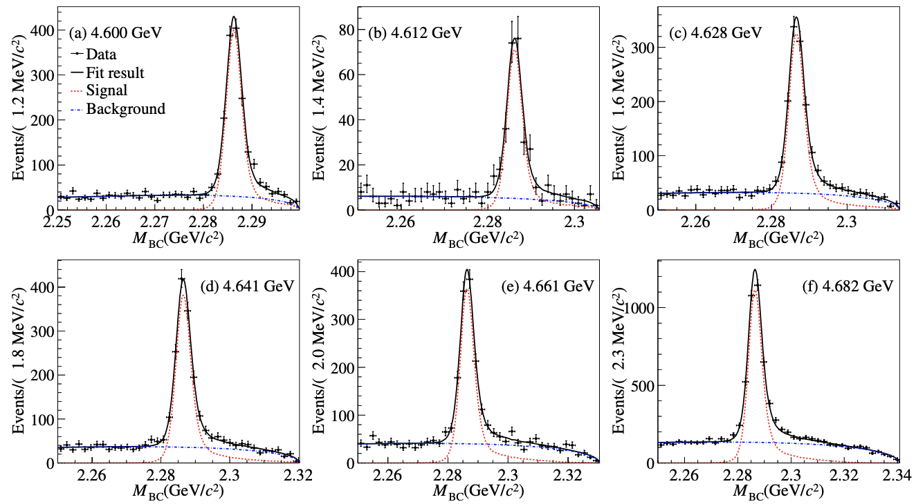
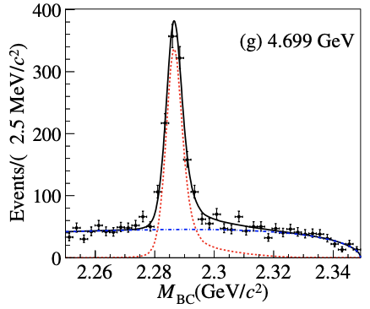
Data and selection for $Λ_{c}^{+}→Λπ^{+}π^{0}$
Single Tag Method
4.4 fb⁻¹ data from 4.6 GeV to 4.7 GeV
Threshold production of $Λ_{c}^{+} {\overline{Λ}}_{c}^{−}$ samples, only one side reconstructed
Variables energy difference $ΔE≡E_{rec}−E_{beam}$and beam-constraint mass $M_{BC}^{2}≡E_{beam}^{2}/c^{4}−p^{2}/c^{2}$used to extract signal candidates:
Signal purity > 80%
Only 4-momenta required,
more information can be added
such as weights and charge.
data:
dat_order: [p, pim, pip, pi0]
data: [data.dat]
bg: [sideband.dat]
bg_weight: [0.13858078]
phsp: [pshp.dat]
Result of $M_{BC}$ fits on data for each energy point

Slide 11
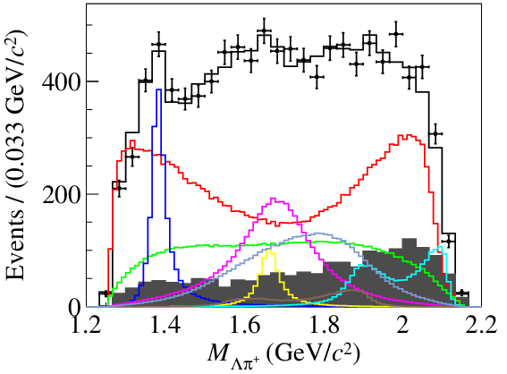
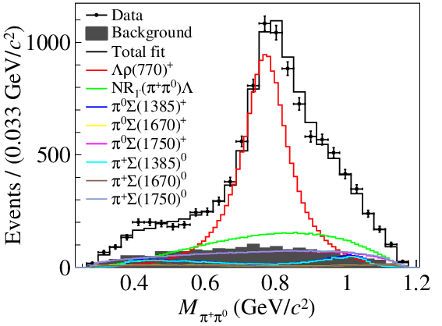
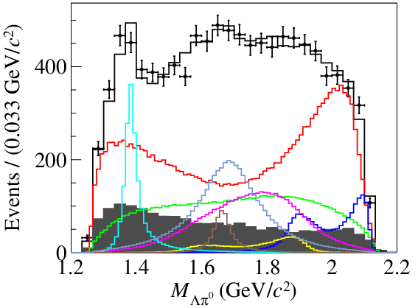
Base fit results
Plot thought TF-PWA with simple config.yml
All decay chain will add automatic
$Λ_{c}^{+}→Λ\left(→pπ^{−}\right)π^{+}π^{0}$
Simultaneous fit
7 energy points
Total around 10k events, 854k MC
38 free parameters
Dominated by $Λ_{c}^{+}→Λρ$: 57.2 ± 4.2%
Clear peak for $Λ_{c}^{+}→πΣ(1385)$
plot:
mass:
Sigma_star0: # name in page 5
display: "$M_{\\Lambda\\pi^{0}}$"
bins: 30
range: [1.2, 2.2]
legend: False

Slide 12
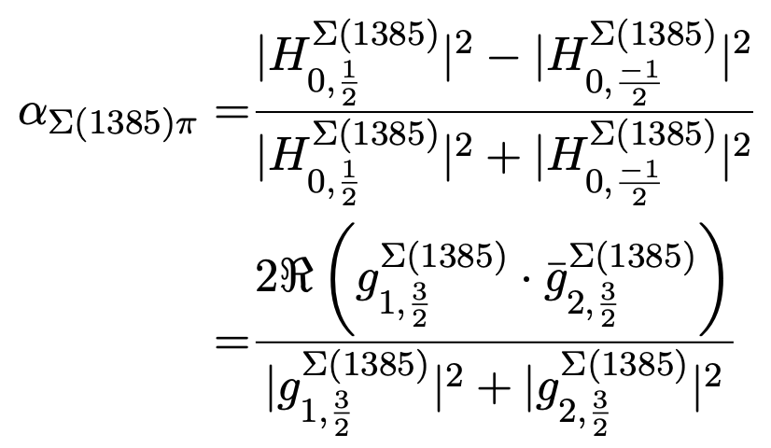
Extract the interested observations
Easy to get the uncertainties though the error propagation
Decay asymmetry and branching ratio
First measurement
Automatic error propagation
Consistent with some theoretical predictions.
with config.params_trans() as pt:
# g1 is fixed to 1
g2_r = pt["Lmdc->piz.Sigma(1385)p_g_ls_1r"]
g2_phi = pt["Lmdc->piz.Sigma(1385)p_g_ls_1i"]
alpha = 2*g2_r*tf.cos(g2_phi) / (1 + g2_r * g2_r)
print(alpha, pt.get_error(alpha))
Fixed to 1
[13] C. Q. Geng, C. W. Liu and T. H. Tsai, Phys. Rev. D 101 (2020) 053002.
[14] H. Y. Cheng and B. Tseng, Phys. Rev. D 46(1992) 1042.
[15] H. Y. Cheng and B. Tseng, Phys. Rev. D 55 (1997) 1697.
[16] Y. K. Hsiao, Q. Yi, S. T. Cai and H. J. Zhao, Eur. Phys. J. C 80 (2020) 1067.
[17] C. Q. Geng, C. W. Liu, T. H. Tsai and Y. Yu, Phys. Rev. D 99 (2019) 114022.
error propagation
$$σ_{f}^{2}=\frac{∂f}{∂θ_{i}}V_{ij}\frac{∂f}{∂θ_{j}}$$

Slide 13
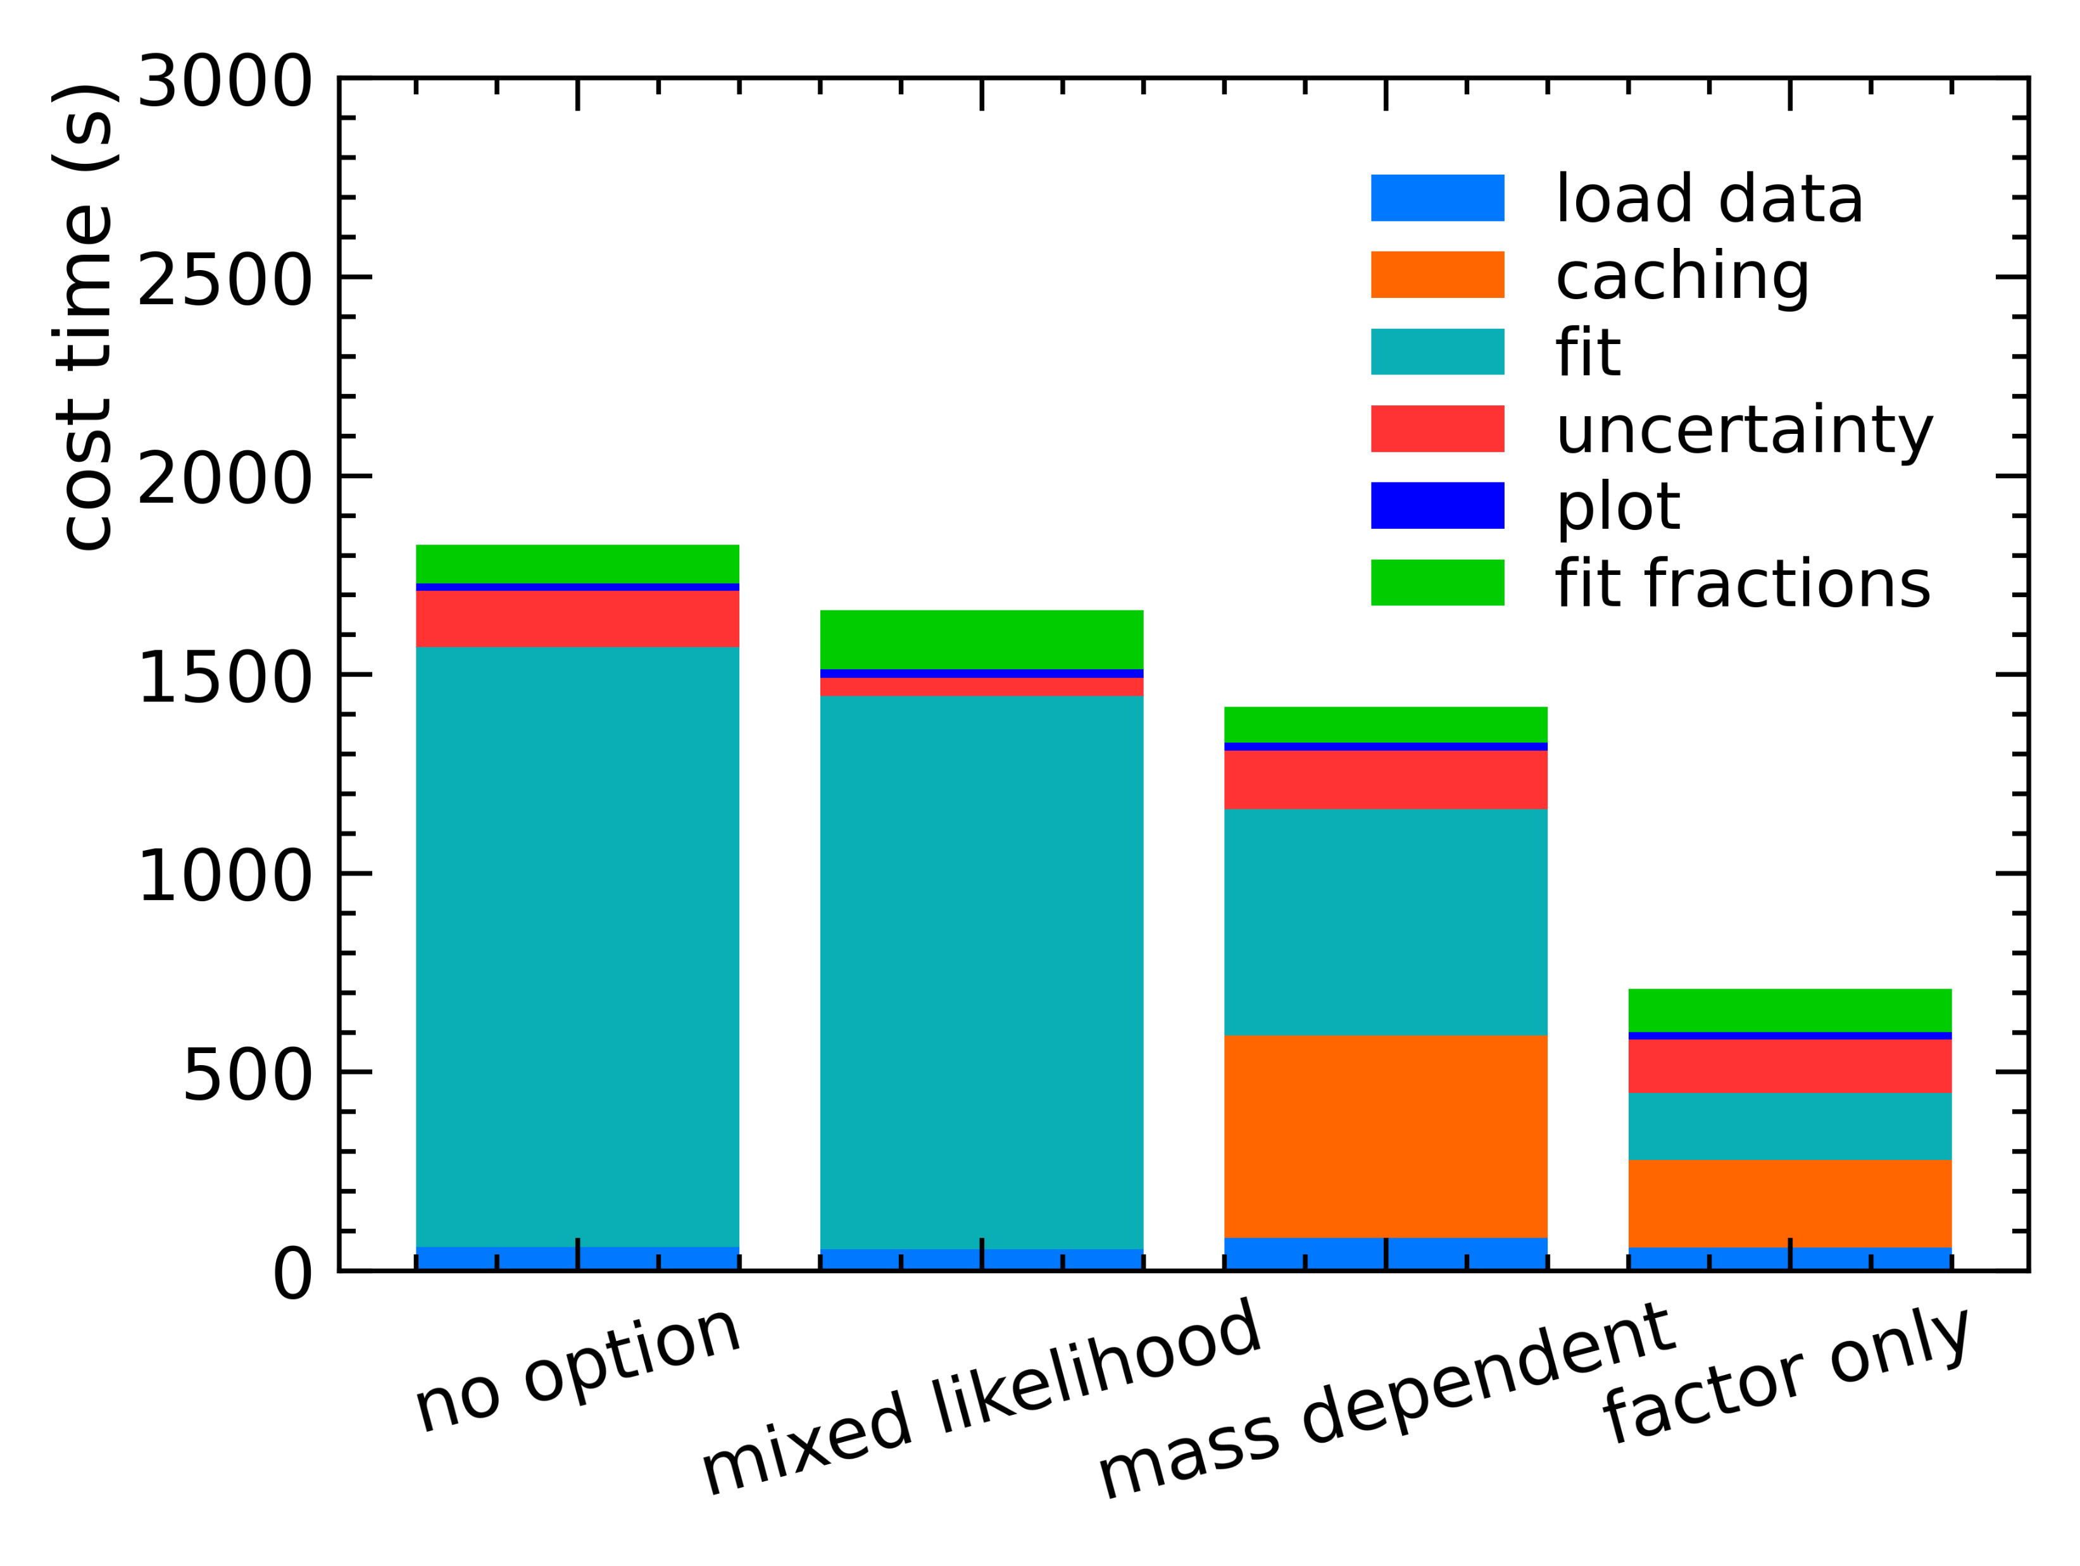
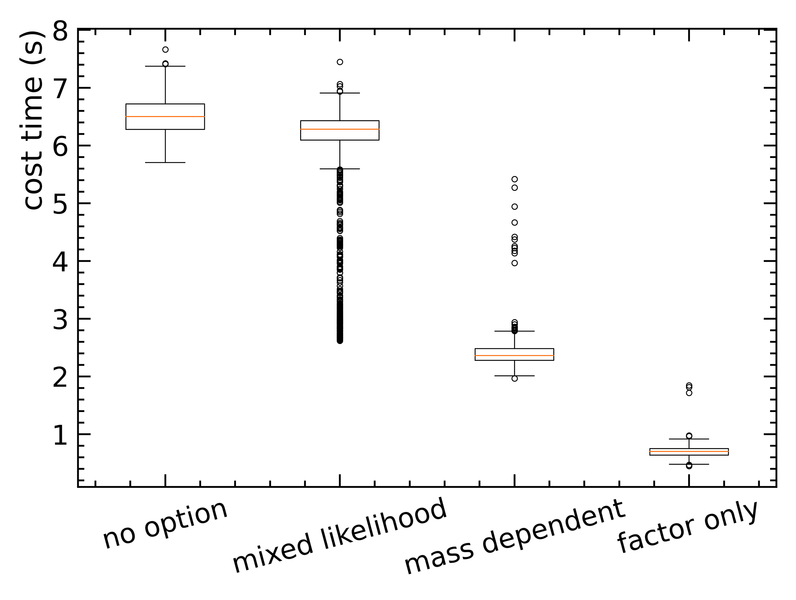
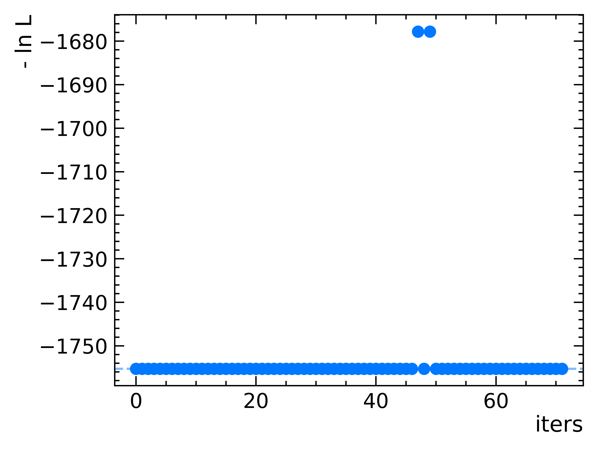
Performance
Environment:
NVIDIA RTX 3080
TensorFlow 2.2
CUDA 10.1
TF-PWA provide different options
Normal mode: for simple evaluation
Caching method: for long time fits
required time for caching
required more memory
limited in special cases
Stability show good results in random initial parameters
Total fit time
~20 mins
Time in each iterations
Fit stability test
Fit time scale to
N iterations = 230

Slide 14
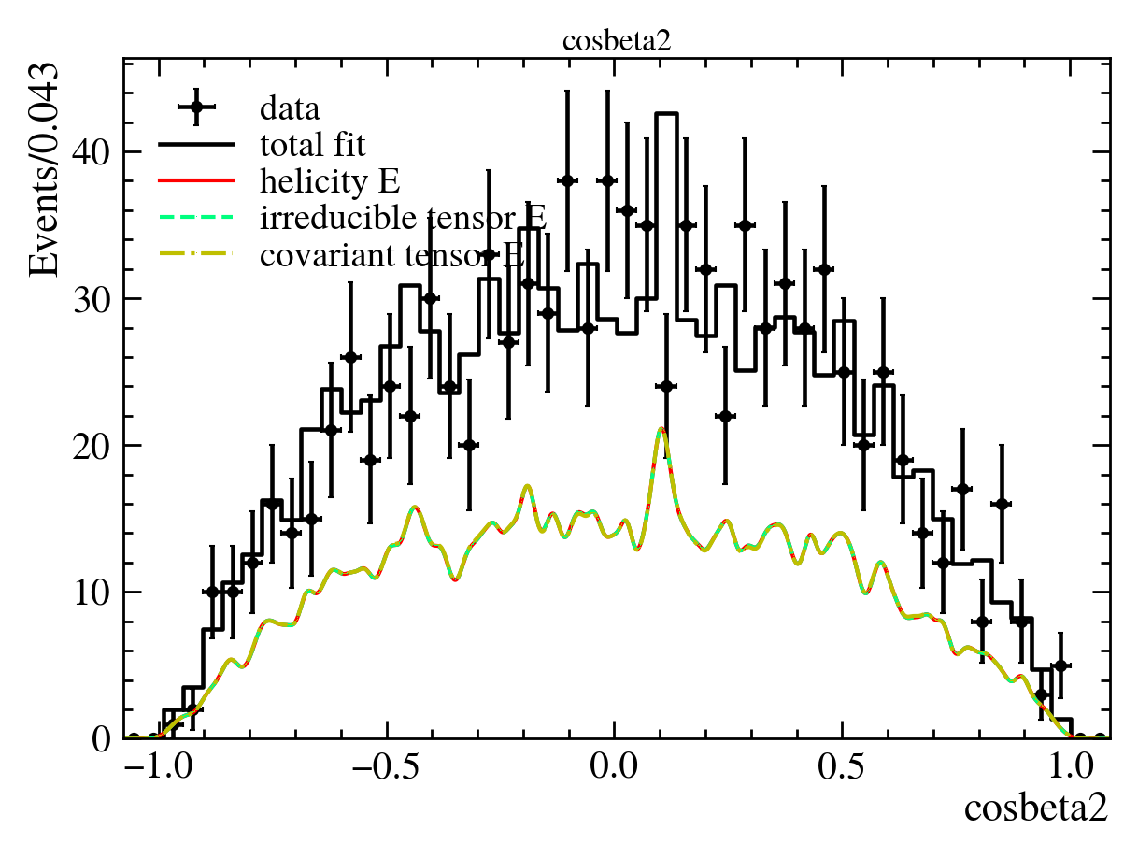
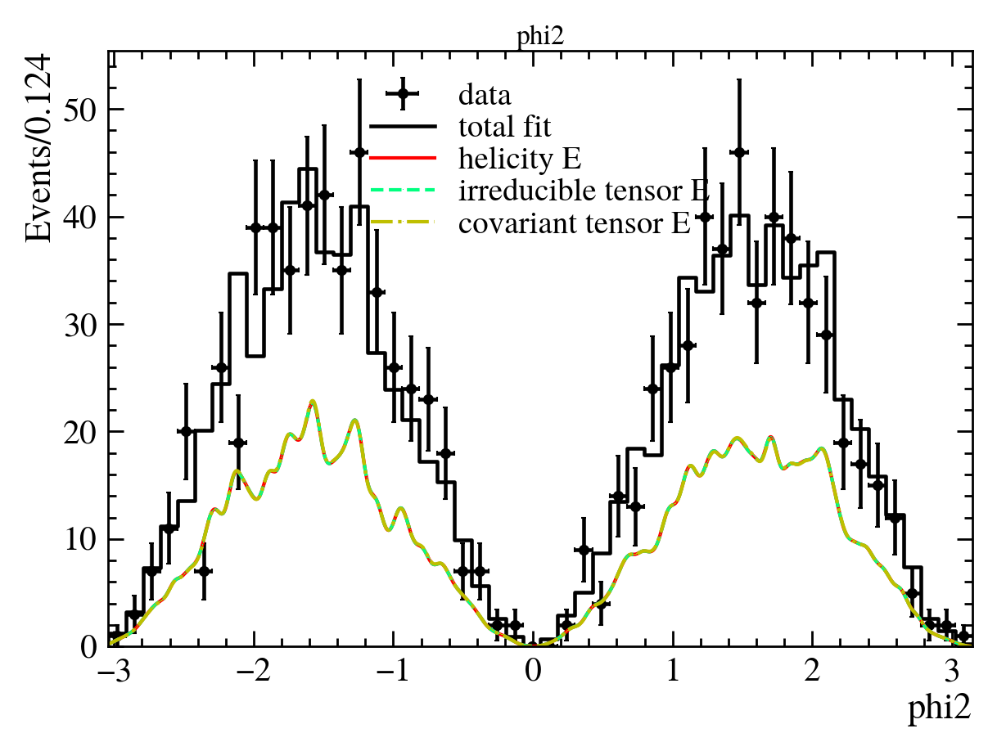
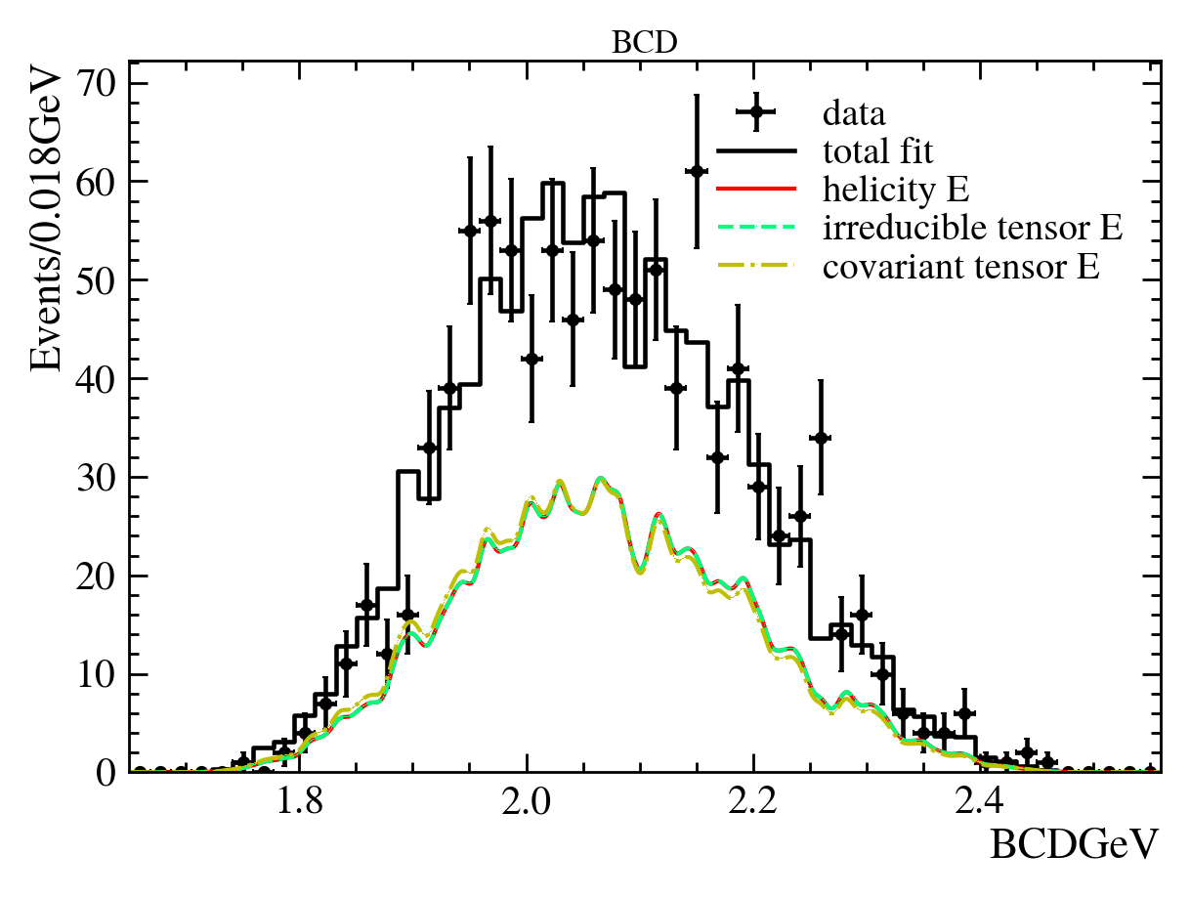
Implement of covariant tensor formula
Covariant tensor formula
Covariant orbital-spin scheme for any spin based on irreducible tensor
Traditional covariant tensor formula
Angular distribution consist in simple cases.
$0^{−}→R_{1}(2^{+})0^{−},R_{1}(2^{+})→R_{2}(1^{−})0^{−},R_{2}(1^{−})→0^{−}0^{−}$
Preliminary implement, more checks are doing
arxiv:2301.01575
Eur. Phys. J. A 16 537-547(2003) Zou, Hugg
Fluctuations due to MC sample size
$$\cos{θ_{2}}$$
$$φ_{2}$$
$$M(R_{1})$$
$$\cos{θ_{2}}$$
$$φ_{2}$$
$$M(R_{1})$$

Slide 15
Summary
PWA for $Λ_{c}^{+}→Λπ^{+}π^{0}$
4.4 fb⁻¹ data from 4.6 GeV to 4.7 GeV
first measurement of $α_{ρ^{+}},α_{Σ(1385)}$ and branching ratio
TF-PWA
designed for automatic and fast partial wave analysis
Activate developing: covariant tensor support are ongoing
Thanks for your attentions!

Slide 16
Alignment angle
$$Boost: B_{z}\left(ω\right),Rotation: R_{z}\left(φ\right),R_{y}(θ)$$
For final state $\left|out\right\rangle =\left|p_{1}\right\rangle ⨂\left|p_{2}\right\rangle ⨂\left|p_{3}\right\rangle$ ,choose a single particle state $|p_{1}⟩$.
The final state define in $0→R,2;R→1, 3$:
$${\left|p_{1}\right\rangle }_{R}=B_{z}\left(ω_{1}\right)R_{z}\left(0\right)R_{y}\left(θ_{1}\right)R_{z}\left(φ_{1}\right)\left|p_{1}\right\rangle =L_{1}\left|p_{1}\right\rangle$$
$${\left|p_{1}\right\rangle }_{1}=B_{z}\left(ω_{2}\right)R_{z}\left(0\right)R_{y}\left(θ_{2}\right)R_{z}\left(φ_{2}\right)\left|p_{1}\right\rangle =L_{2}{\left|p_{1}\right\rangle }_{R}$$
On the other decay chain $0→R^{′},3;R^{′}→1, 2$:
$${\left|p_{1}\right\rangle }_{R^{′}}=B_{z}\left(ω_{1}^{′}\right)R_{z}\left(0\right)R_{y}\left(θ_{1}^{′}\right)R_{z}\left(φ_{1}^{′}\right)\left|p_{1}\right\rangle =L_{1}^{′}\left|p_{1}\right\rangle$$
$${\left|p_{1}\right\rangle }_{2}=B_{z}\left(ω_{2}^{′}\right)R_{z}\left(0\right)R_{y}\left(θ_{2}^{′}\right)R_{z}\left(φ_{2}^{′}\right)\left|p_{1}\right\rangle =L_{2}^{′}{\left|p_{1}\right\rangle }_{R^{′}}$$
The alignment angle is the rotation
$${\left|p_{1}\right\rangle }_{2}=L_{r}{\left|p_{1}\right\rangle }_{1}=B_{z}\left(ω\right)R_{z}\left(γ\right)R_{y}\left(β\right)R_{z}\left(α\right){\left|p_{1}\right\rangle }_{1}$$
So
$$L_{r}=B_{z}\left(ω\right)R_{z}\left(γ\right)R_{y}\left(β\right)R_{z}\left(α\right)=L_{2}^{′}L_{1}^{′}L_{1}^{−1}L_{2}^{−1}$$
In general
$$L_{r}=L_{a}L_{b}^{−1}=\left(\prod_{i}{L_{n−i}^{′}}\right)\left(\prod_{j}{L_{j}^{−1}}\right)$$
$$\vec{p_{2}}$$
$$\vec{p_{0}}$$
$$y_{1}$$
$$x_{2}$$
$$x_{1}$$
$$z_{2}$$
$$θ$$
$$φ$$
$$z_{1}$$
$$\vec{p_{1}}$$
$$y_{2}$$
$$\vec{p_{3}}$$
$$\vec{p_{4}}$$

Slide 17
$SU\left(2\right)$ represetion
$$B_{z}\left(ω\right)=\left(\begin{matrix}e^{−\frac{ω}{2}} & 0 \\ 0 & e^{\frac{ω}{2}}\end{matrix}\right),R_{z}\left(φ\right)=\left(\begin{matrix}e^{−\frac{iφ}{2}} & 0 \\ 0 & e^{\frac{iφ}{2}}\end{matrix}\right),R_{y}\left(θ\right)=\left(\begin{matrix}\cos{\frac{β}{2}} & −sin{\frac{β}{2}} \\ \sin{\frac{β}{2}} & \cos{\frac{β}{2}}\end{matrix}\right)$$
$$ω=\operatorname{arccosh}{\frac{1}{\sqrt{1−\frac{v^{2}}{c^{2}}}}}$$
$${L_{ab}=B}_{z}\left(ω\right)R_{z}\left(γ\right)R_{y}\left(β\right)R_{z}\left(α\right)=\left(\begin{matrix}e^{−\frac{ω}{2}}\cos{\frac{β}{2}}e^{−\frac{i\left(α+γ\right)}{2}} & −e^{−\frac{ω}{2}}\sin{\frac{β}{2}}e^{\frac{i\left(α−γ\right)}{2}} \\ e^{\frac{ω}{2}}\sin{\frac{β}{2}}e^{−\frac{i\left(α−γ\right)}{2}} & e^{\frac{ω}{2}}\cos{\frac{β}{2}}e^{\frac{i\left(α+γ\right)}{2}}\end{matrix}\right)$$
$$\cos{β}=\cos^{2}{\frac{β}{2}}−\sin^{2}{\frac{β}{2}}=L_{11}L_{22}+L_{12}L_{21},β∈[0,π]$$
$$ω=\ln{|\frac{L_{22}}{L_{11}}|}$$
$α+γ=−2\operatorname{ang}{L_{11}}=2\operatorname{ang}{L_{22}}$, $α−γ=−2\operatorname{ang}{L_{12}}=−2\operatorname{ang}{L_{21}}$
$$L_{ab}^{−1}=\left(\begin{matrix}L_{22} & −L_{12} \\ −L_{21} & L_{11}\end{matrix}\right)$$
$$\left|L_{ab}\right|=1$$

Slide 18
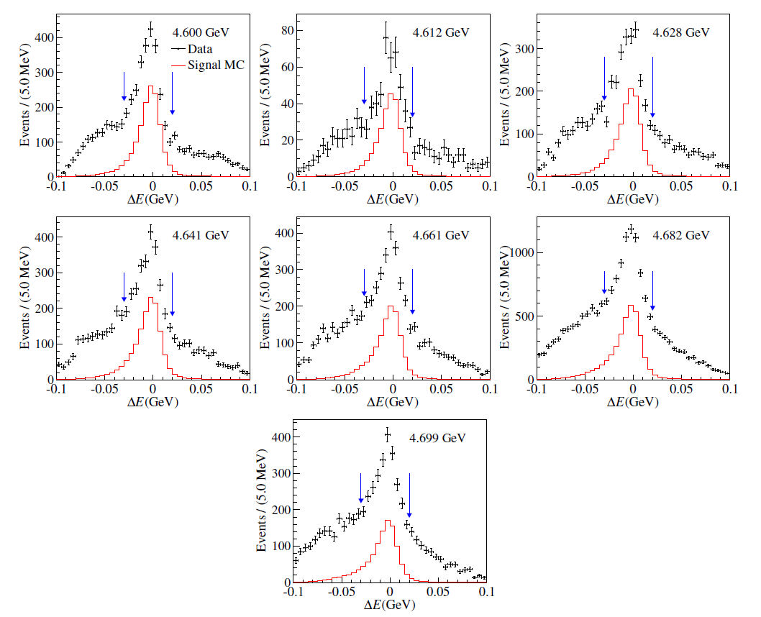
$ΔE$
cut range in $ΔE$

Slide 19
Likelihood
Signal probability density for fit:
$$P_{sig}\left(x\right)=\frac{{\left|A\right|}^{2}ε}{∫{\left|A\right|}^{2}εdΩ }=\frac{{\left|A\right|}^{2}ε}{\sum_{i∈MC}{{\left|A\right|}^{2}}}$$
Negative log-Likelihood
$$−\int{P_{real}\left(x\right)\ln{P_{sig}\left(x\right)}}dx⇒−\ln{L}=−α\sum_{i}{w_{i}P_{sig}(x_{i})}$$
$α=\frac{\sum_{i}{w_{i}}}{\sum_{i}{w_{i}^{2}}}$: Simple factor to correct uncertainties
For data $w_{i}=1$, for sideband $w_{i}=−f_{bg},$ $f_{bg}$ deteminated by $M_{BC}$ fit

Slide 20
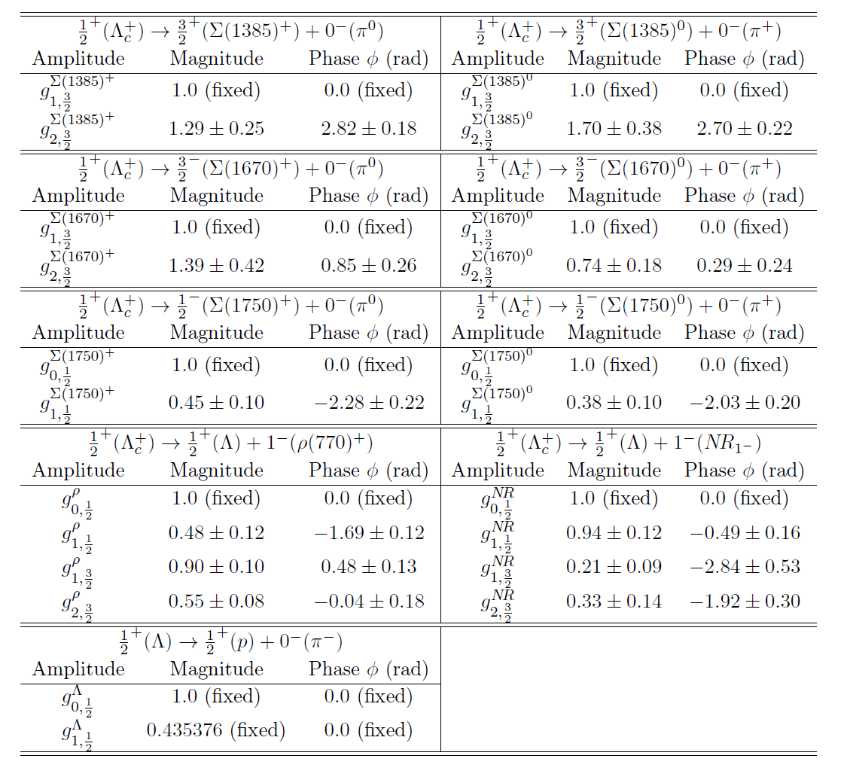
Fit parameters
Summary of all parameters in a table

Slide 21
Formula of $α_{ρ}$ and interference

Slide 22
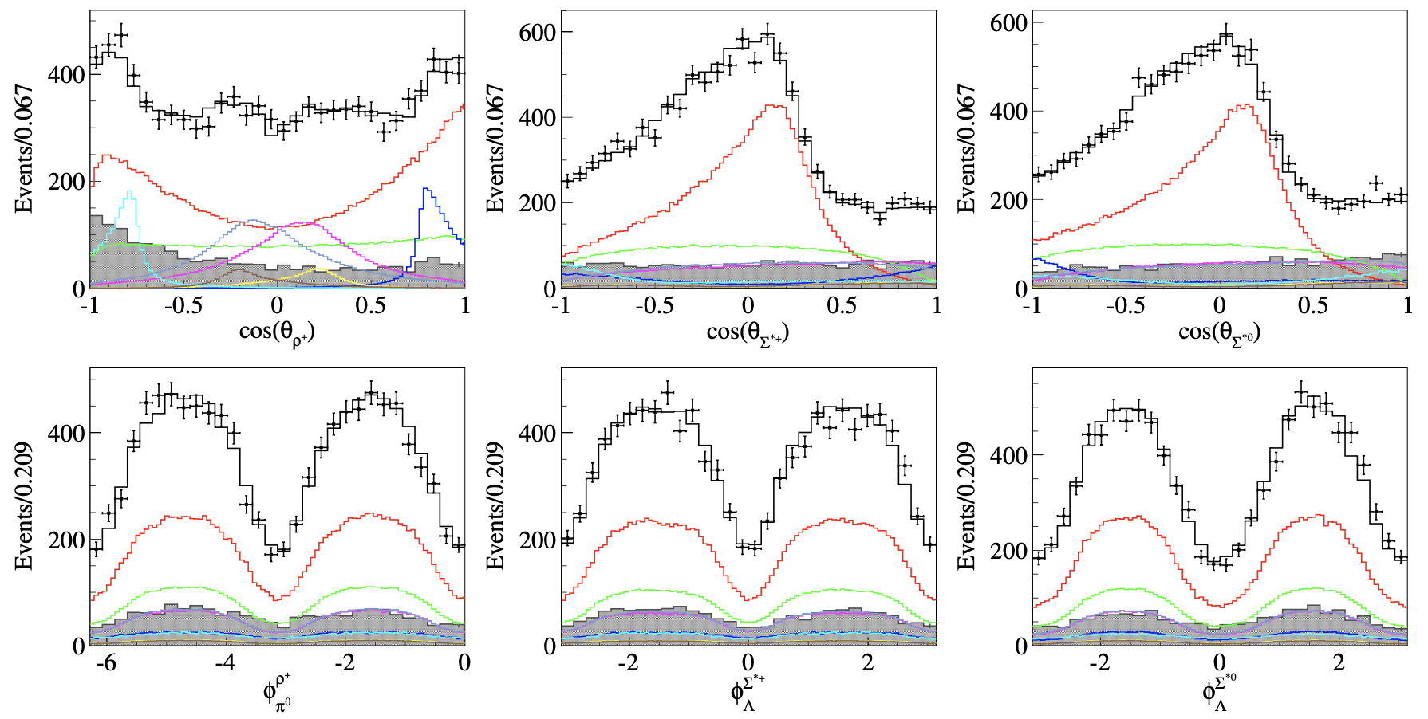
Projection in angle

