Slide 1
A study on $γ_{ISR}n\overline{n}$ events
Based on EMC-time information proposed on STCF

Slide 2
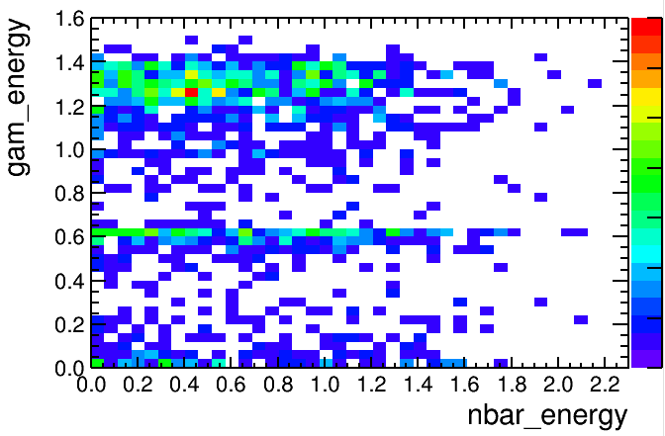
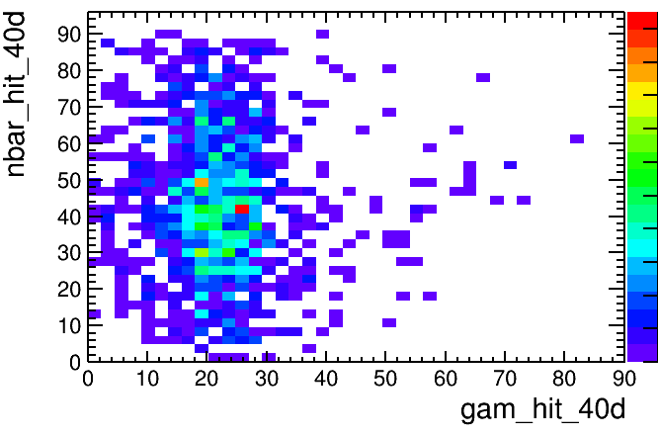
Basic idea
Select nbar and gamma only, then recoil neutron mass
The two most energetic showers are nbar / gamma separately
Using hit numbers within 40 degrees to distinguish nbar/gamma: 70% up precision.

Slide 3
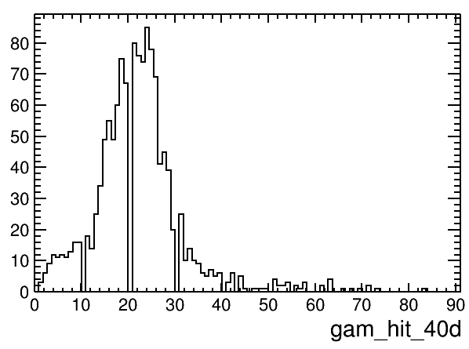
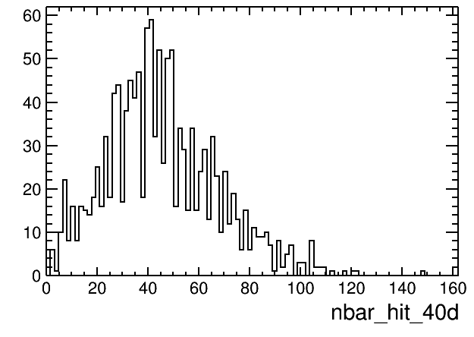
Shower Hit Numbers
Choice of BDT ?

Slide 4
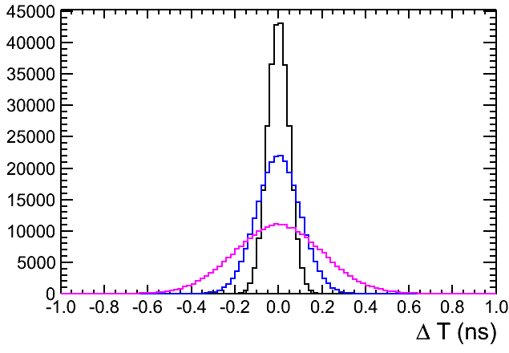
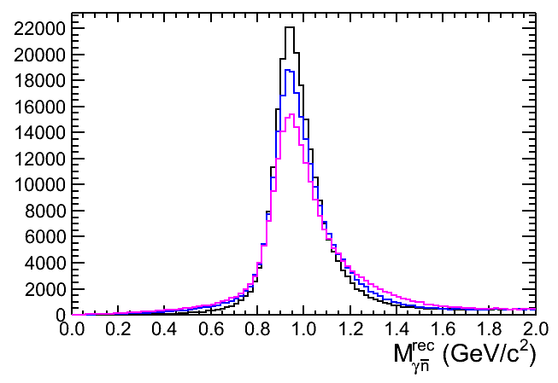
EMC time information
Give nbar candidate a time information, smeared with 50/100/200 ps resolution (different STCF design index)
Matching nbar and gam with truth.

Slide 5
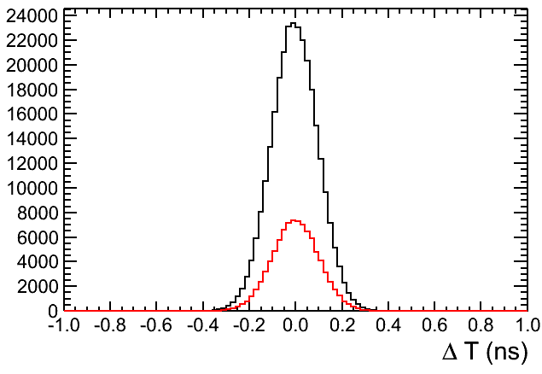
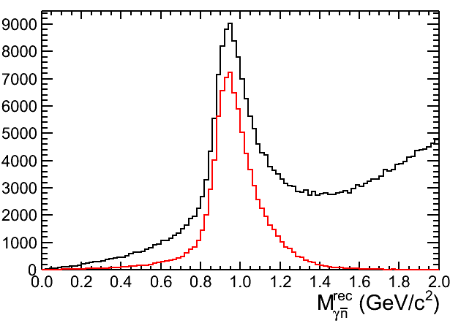
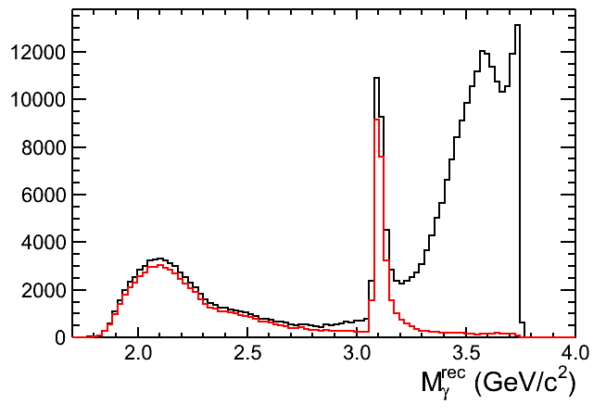
EMC time information
Select nbar and gam with number of hits ($σ=$100 ps)
black: reconstructed MC
red: after matching truth

Slide 6
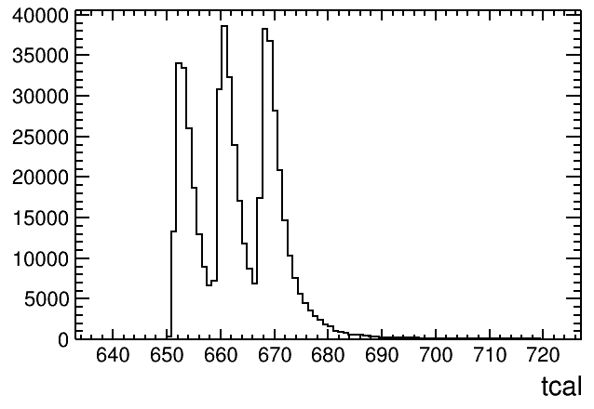
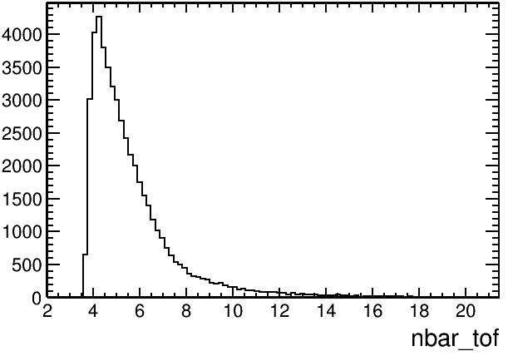
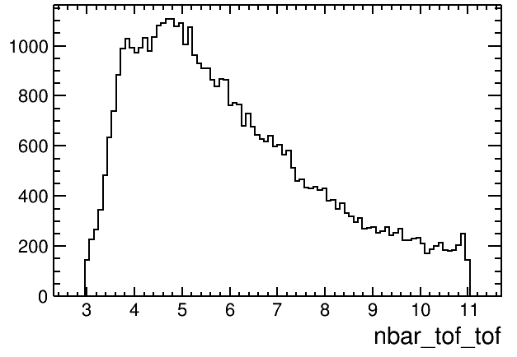
TOF time information
Determine time of flight
From tof record
EMC time
In MC: T0 time clock:
8*N+offset (N=integer)
offset negligible
nbar_tof_tof=tcal-int(tcal/8)*8
If nbar_tof_tof<3, nbar_tof_tof+=8

Slide 7
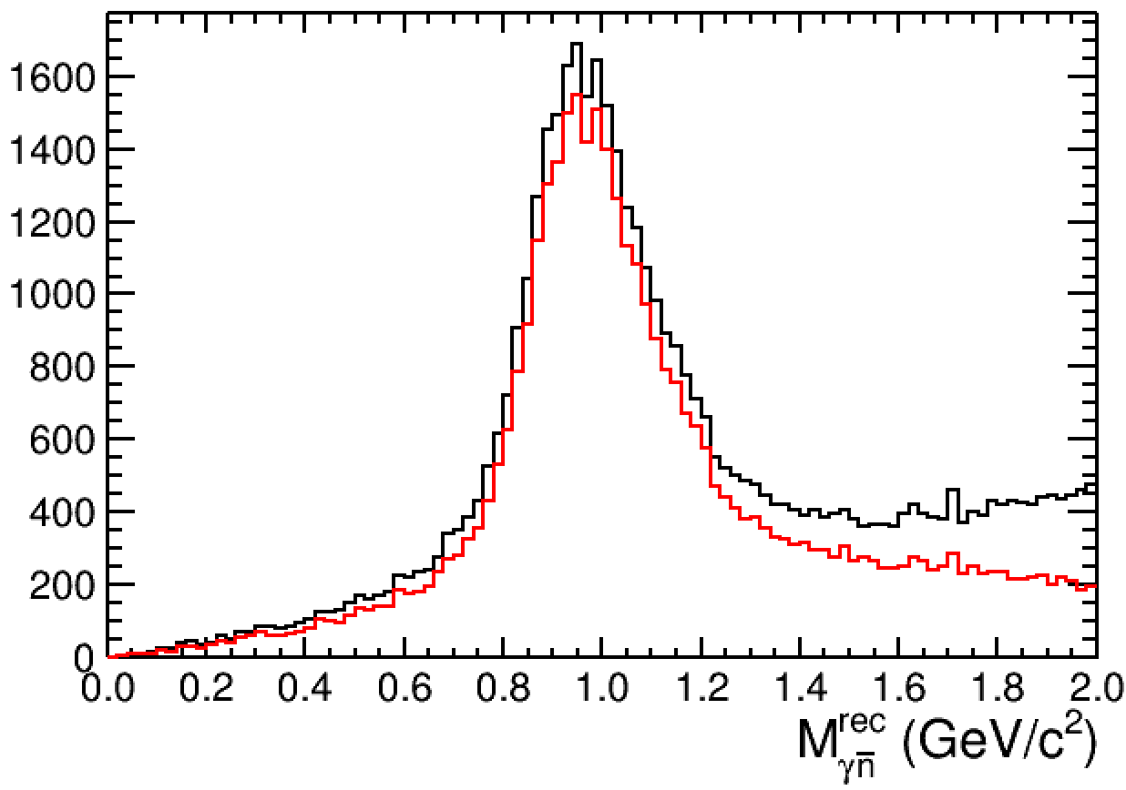
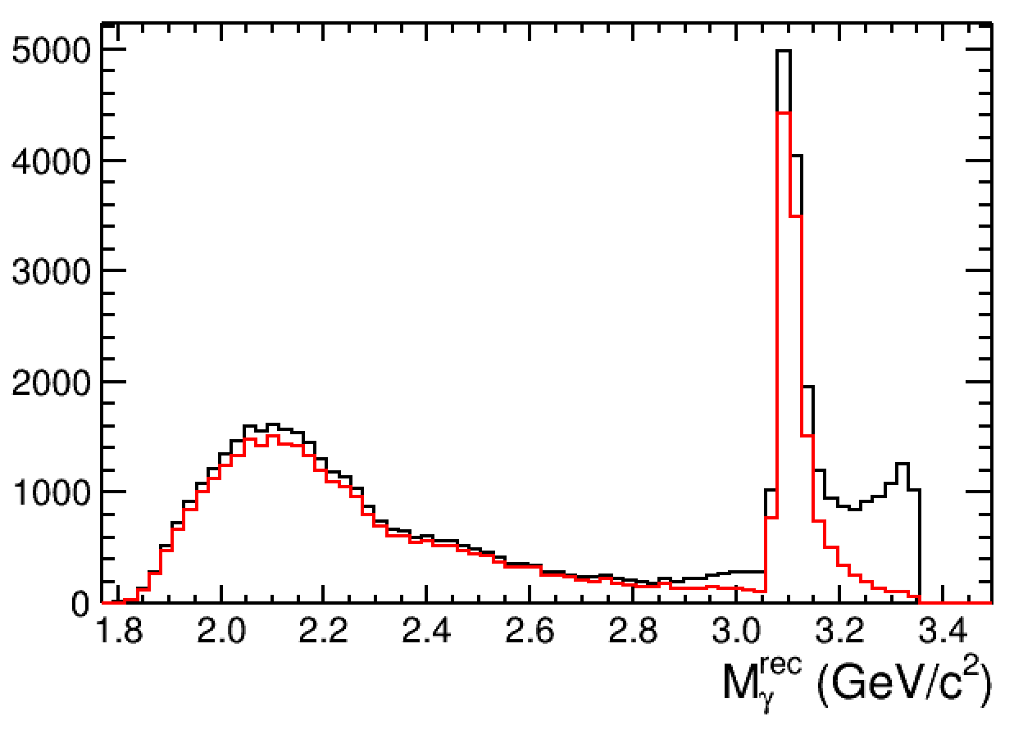
TOF time information

Slide 8
Efficiency comparison

Slide 9
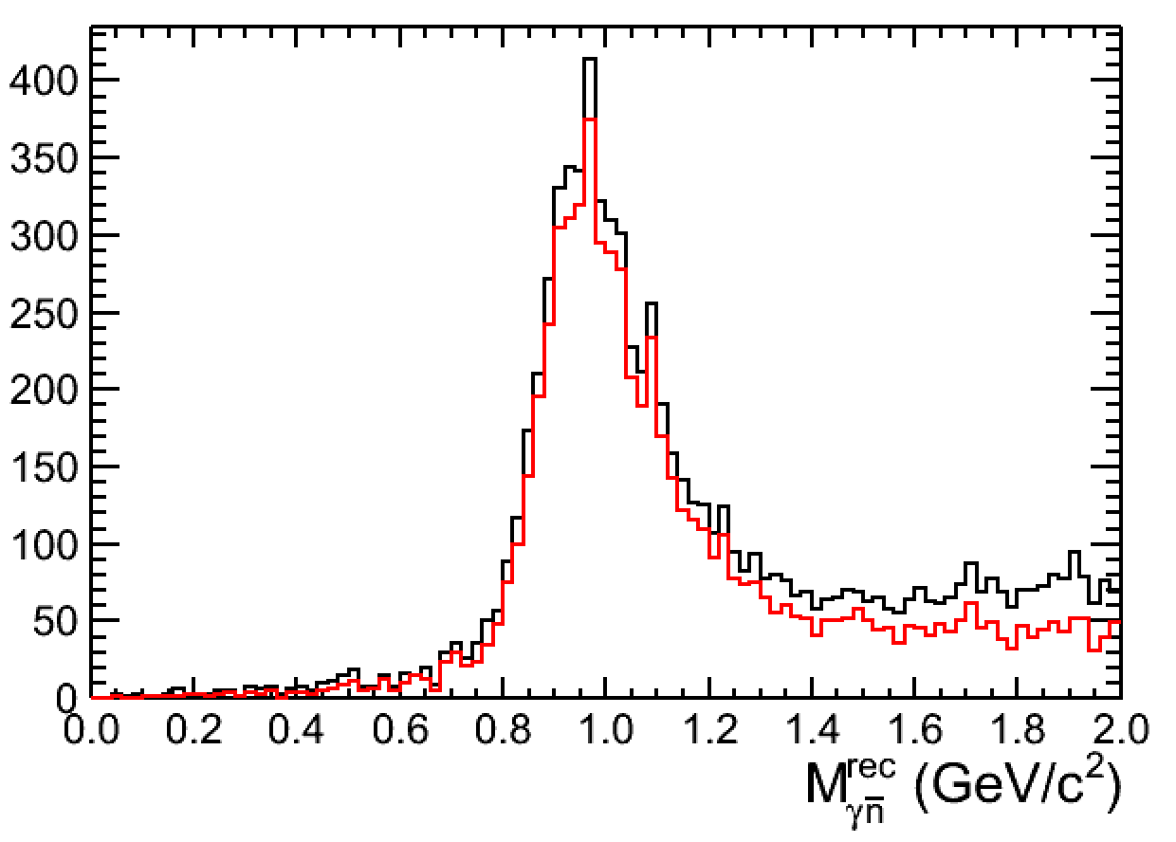
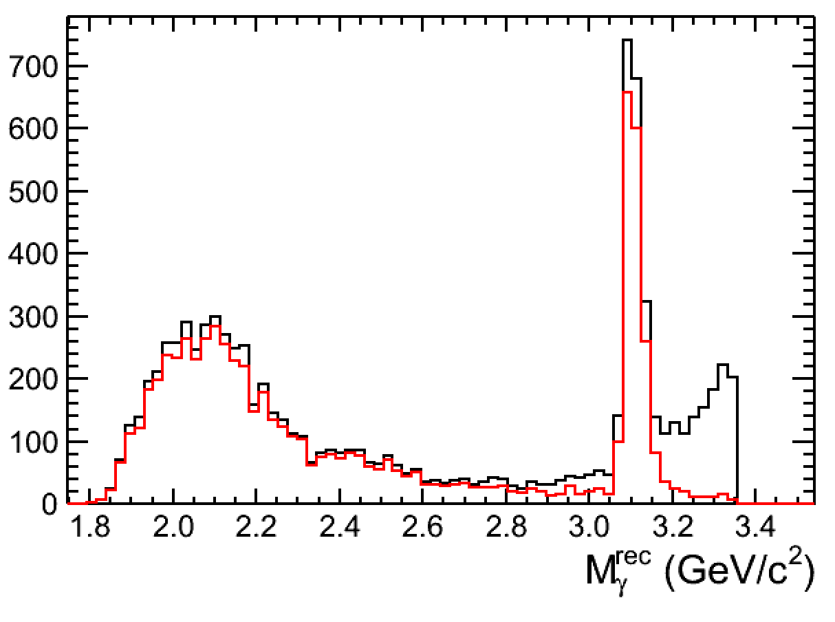
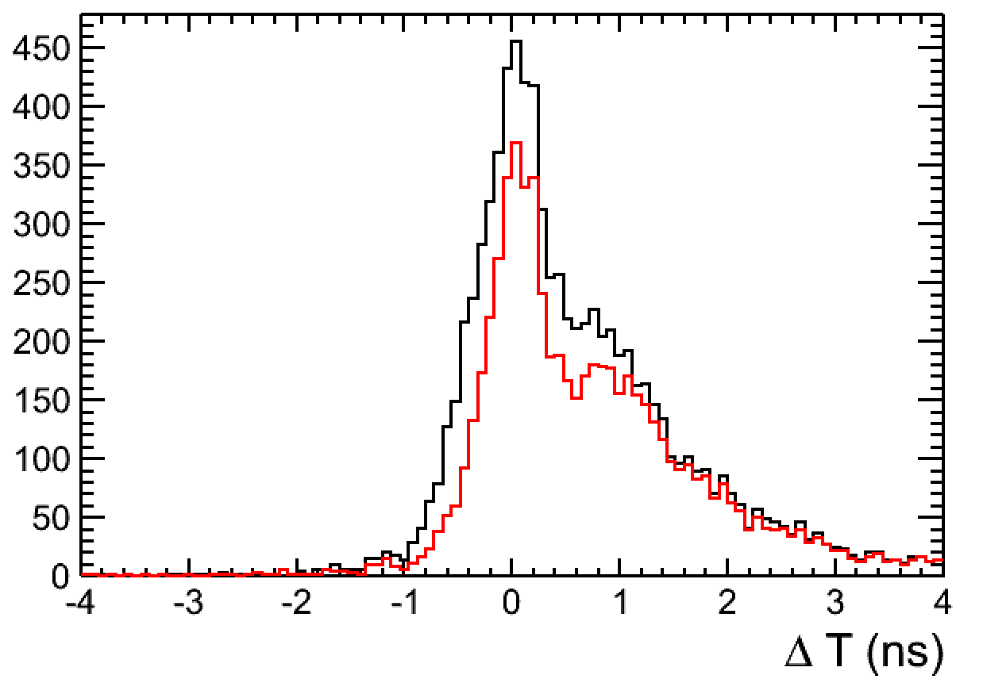
TOF time information
Determine time of flight in data:
in data, the T0 is random.
we need tof of gam to determine the T0 => 20% efficiency loose

Slide 10
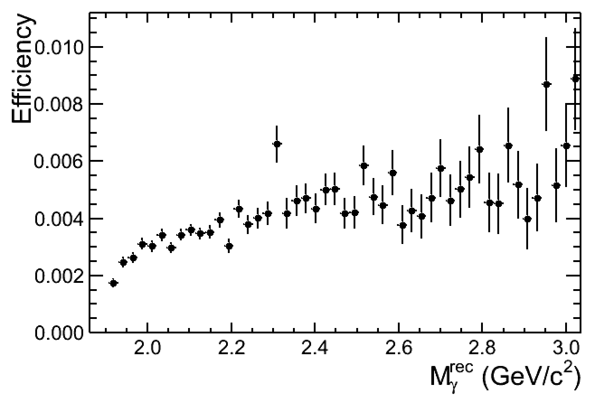
Efficiency in reality

Slide 11
data @ 3.773

Slide 12
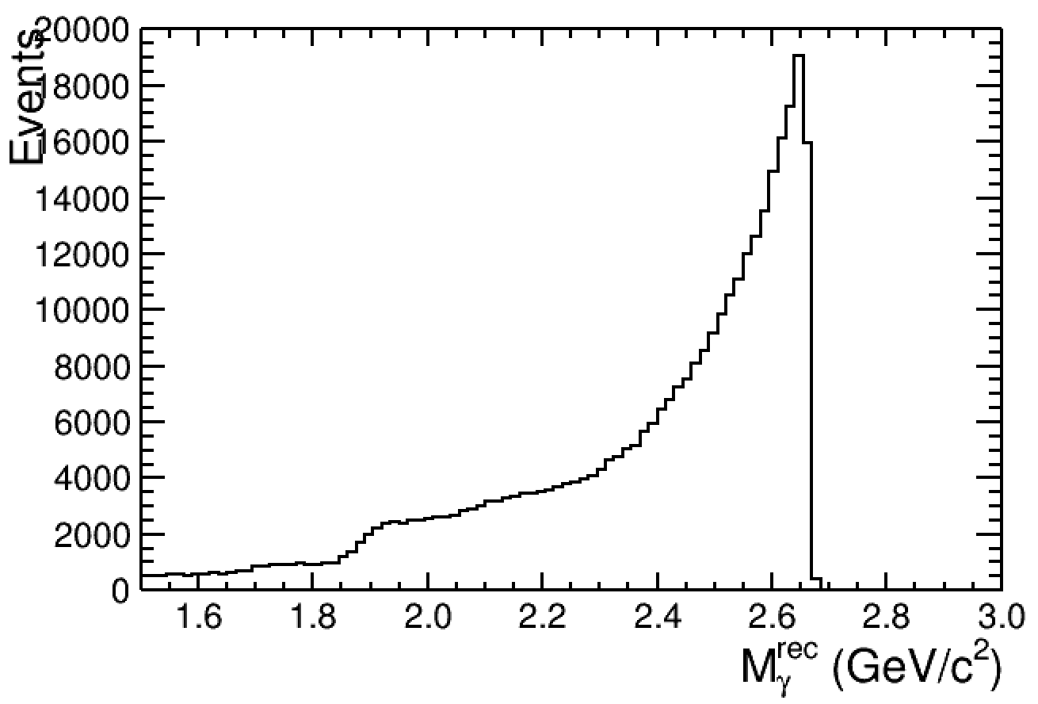
J/psi-> gam nnbar

Slide 15
Notes:
belongs to nbar_mom = 0

Slide 16
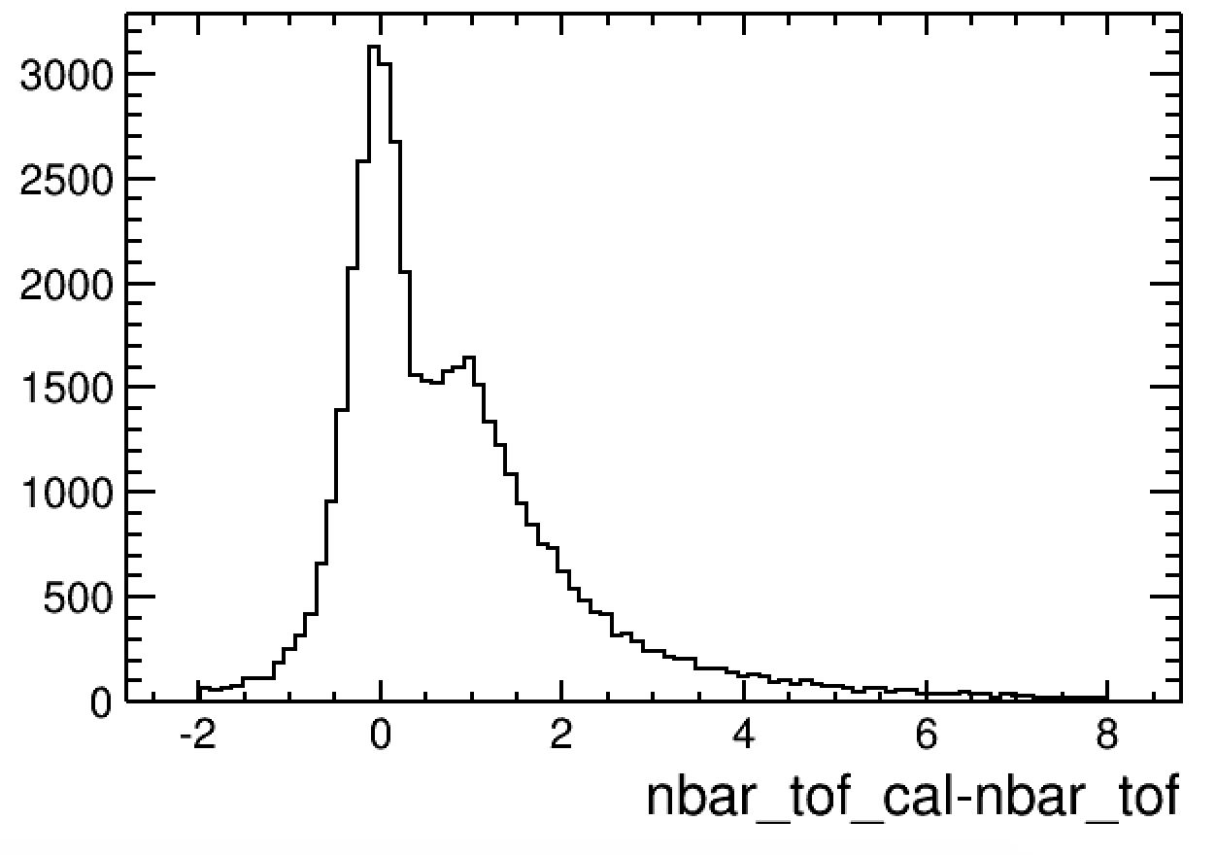
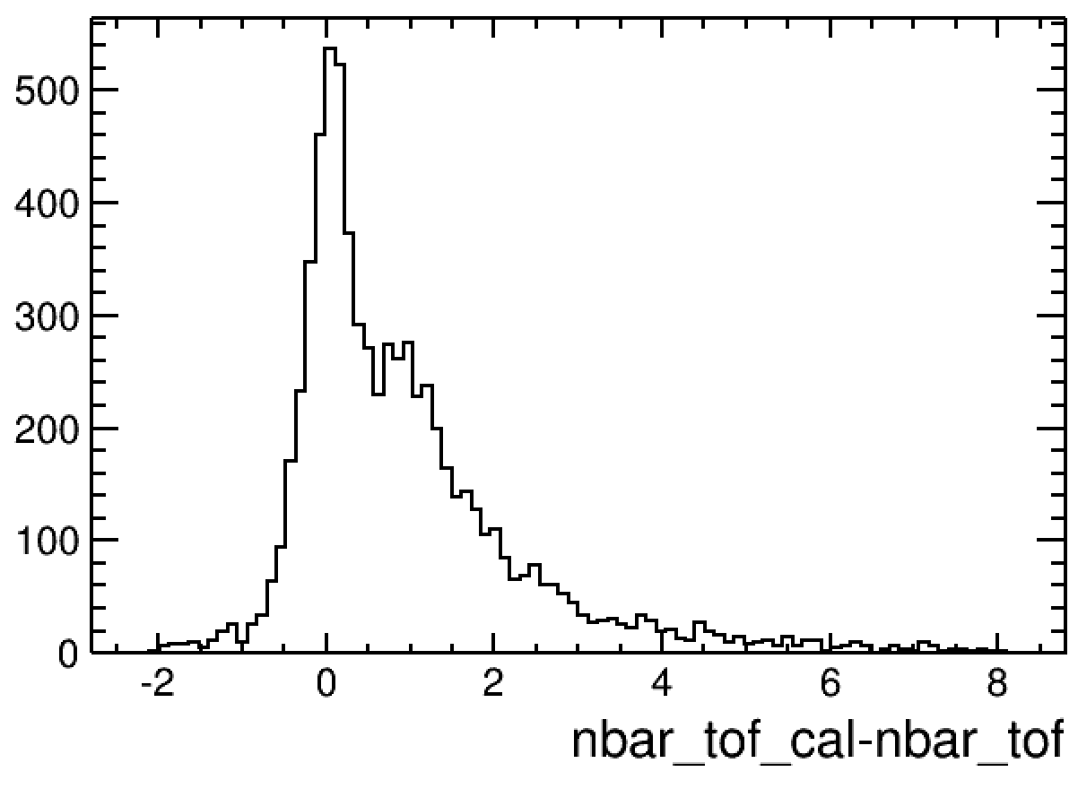
jpsi

Slide 17
nbar_tof_cal-nbar_tof (MC)

Slide 18
nbar_tof/nbar_tof_cal. (MC)

Slide 19
delta momentum (MC)

Slide 20
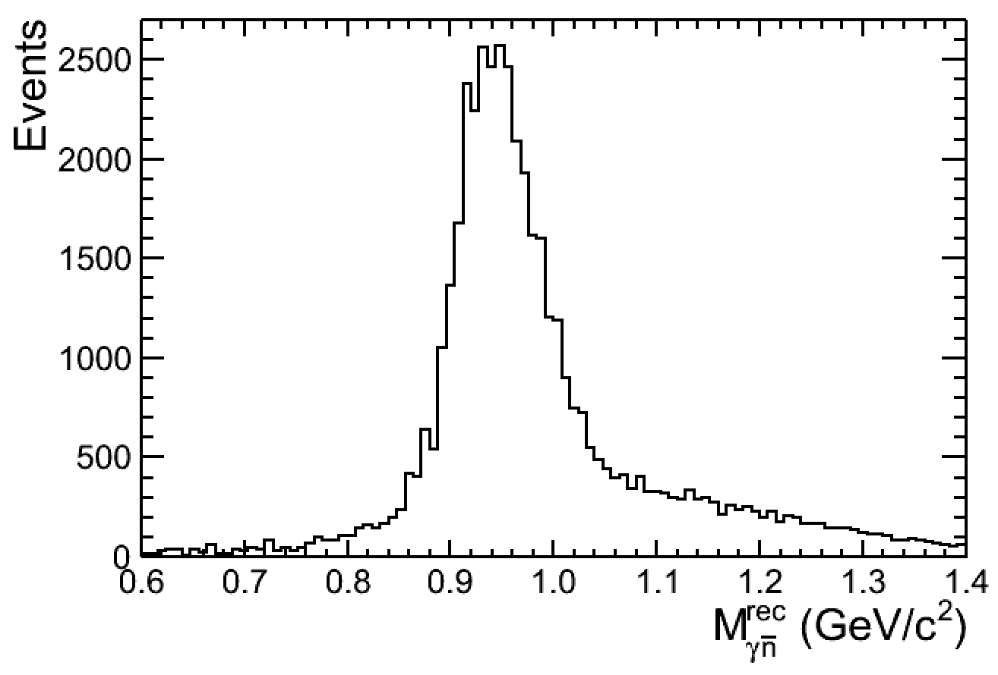
MC: After a simple weight (w=10 at low nnbar mass)

Slide 21
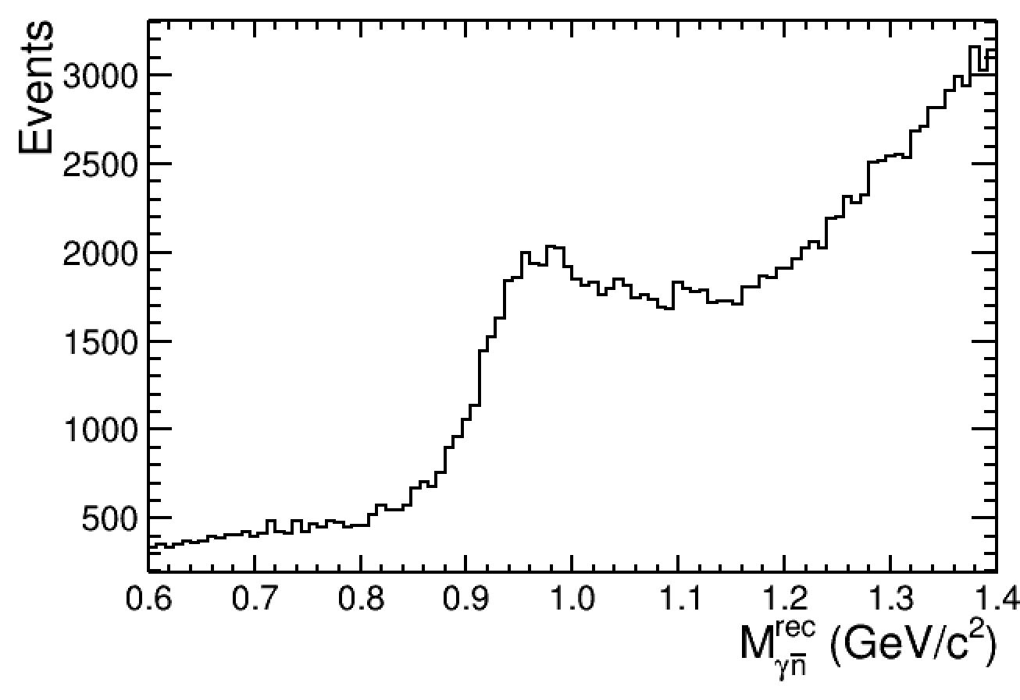
data, after veto cosmic / pi0 backgrounds

