Slide 1
USTC LGAD测试电子学
De Zhang,Jiajin Ge, Xiao Yang,Chihao Li,Xiangxuan Zheng, Yanwen Liu
University of Science and Technology of China
2023/5/12
https://doi.org/10.1016/j.nima.2021.165400
https://doi.org/10.1016/j.nima.2022.167222

Slide 2
Contents
1. Introduction
2. Digital switch boards
3. Ultra-fast low-noise preamplifier
4. Summary

Slide 3
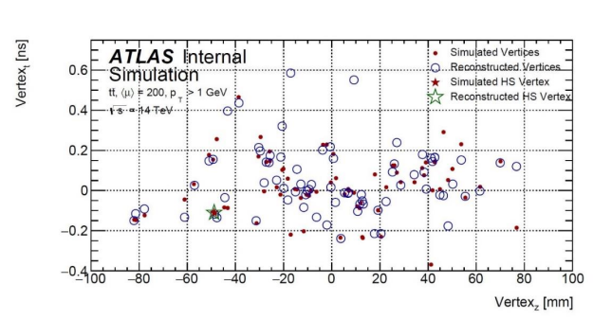
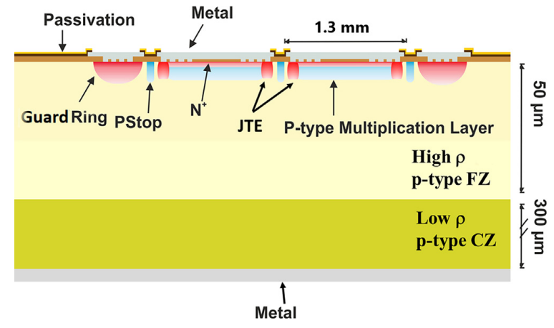
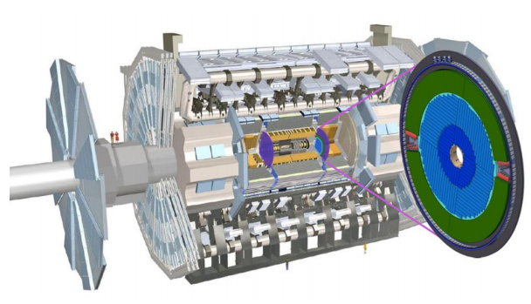
Introduction
1. A High-Granularity Timing Detector (HGTD), with up to 30 ps time resolution per track, is proposed for the ATLAS Phase II upgrade, to address the new challenge of greatly increased pile-up interactions.
2. The technology chosen for the HGTD sensors is Low Gain Avalanche Detector (LGAD) — a novel semiconductor detector.
Cross section of a 2 × 2 LGADs array.

Slide 4
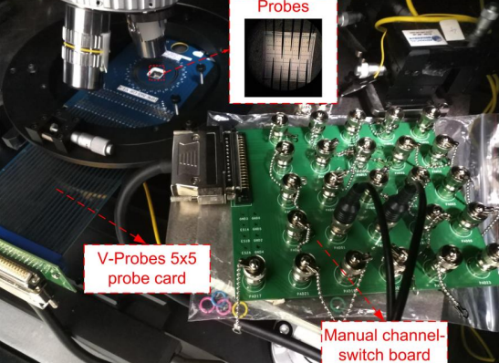
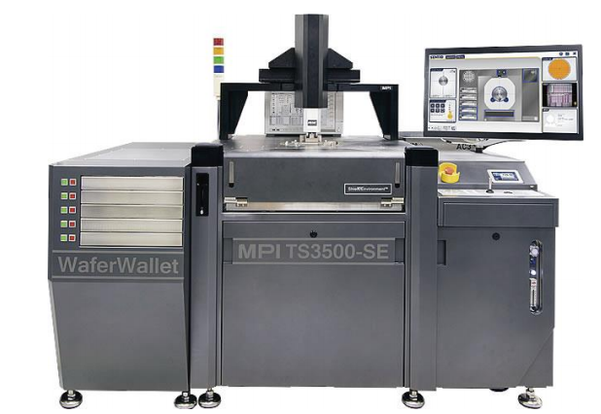
Introduction
The current-voltage (IV) and capacitance-voltage (CV) measurements are important methods to study the electrical characteristics of semiconductor devices, including LGADs .
For large-array LGADs, the channel under test should be connected to the LCR meter or pico-ammeter alternately for the measurements, while other channels are usually grounded.
Our manual channel-switch board for 5 × 5 LGADs array
Fully automatic probe station

Slide 5
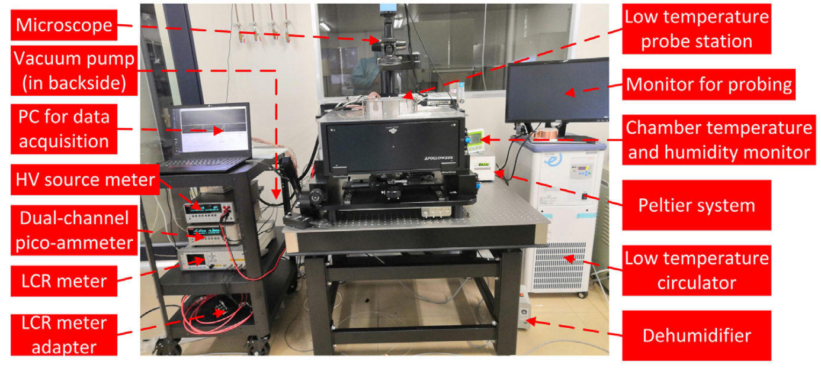
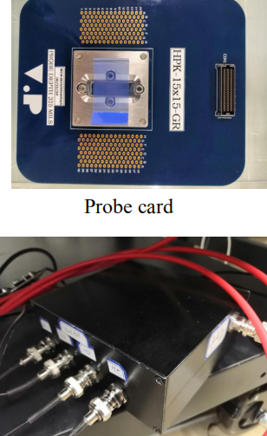
Setup for IV and CV measurements
Test platform for the IV and CV measurements of LGADs
LCR meter adapter
Setups for the IV (a) and CV (b) measurements of 5 × 5 and 15 × 15 LGADs arrays.

Slide 6
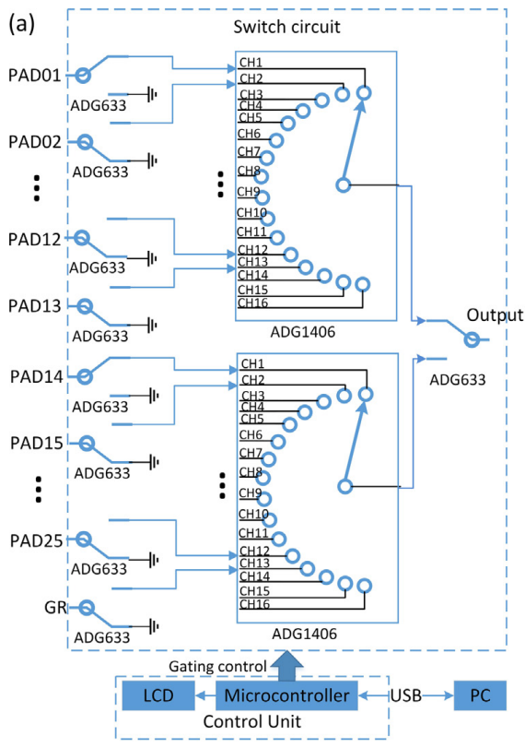
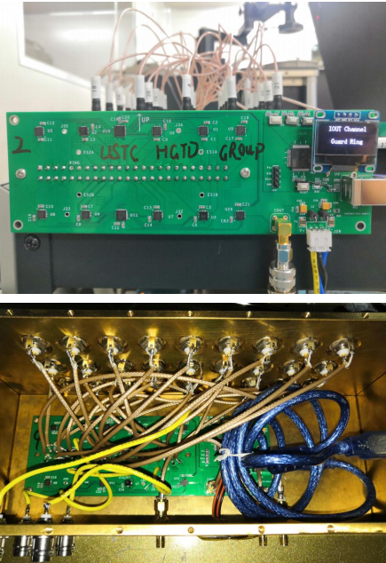
Digital switch boards
Digital switch board for the IV and CV measurements of 5 × 5 LGAD arrays
a copper shielding box can reduce noise

Slide 7
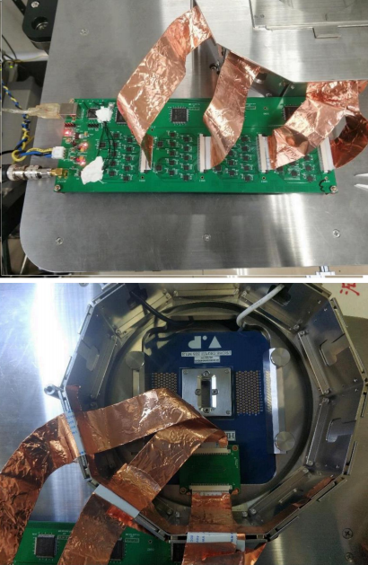
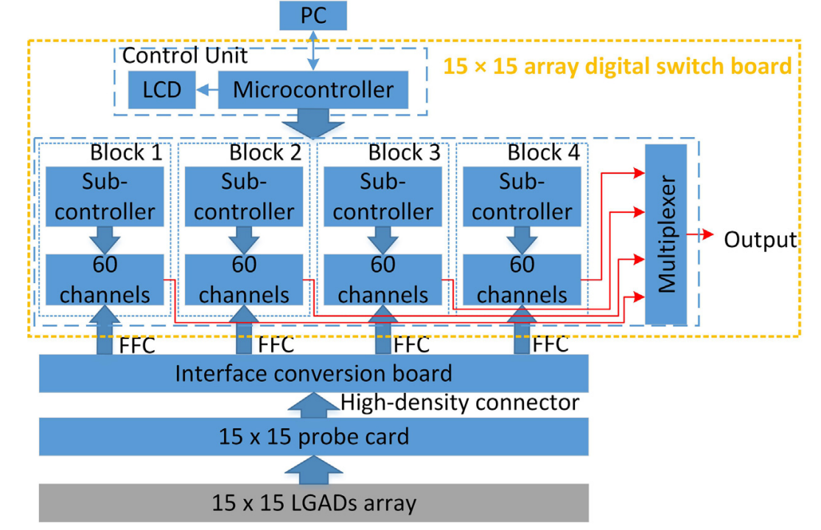
Digital switch boards
Digital switch board for the IV and CV measurements of 15 × 15 LGAD arrays
Block diagram of the digital switch board for the IV and CV measurements of 15 × 15 LGADs arrays.
The flexible flat cable (FFC) can fit our probe 9 station well.

Slide 8
Test for digital switch board
Test Methods: connect the digital switch board and the probe card, but left the needles on the probe cards floated
Results: the current noise caused by electronic and the background is basically in the order of pA, meeting the design requirements
The open-circuit currents of all channels on the 5 × 5 (a) and 15 × 15 (b) array digital switch boards

Slide 9
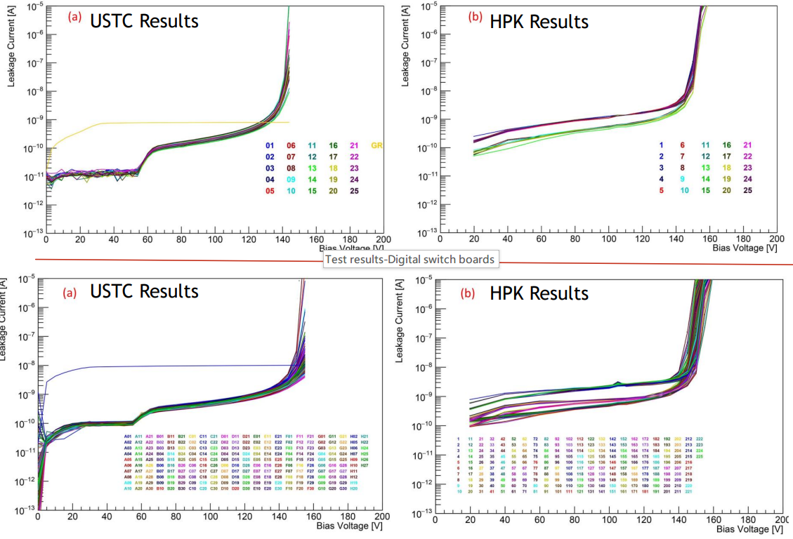
Test for digital switch board
IV measurement performance
IV curves of HPK Batch-2 W1- P1 5 × 5 LGADs array
measured by us with the 5 × 5 array digital switch board
measured by HPK with the automatic probe station
IV curves of HPK Batch-2 W1- P7 15 × 15 LGADs array
226 IV curves measured by us with the 15 × 15 array digital switch board
225 IV curves measured by HPK with the automatic probe station.

Slide 10
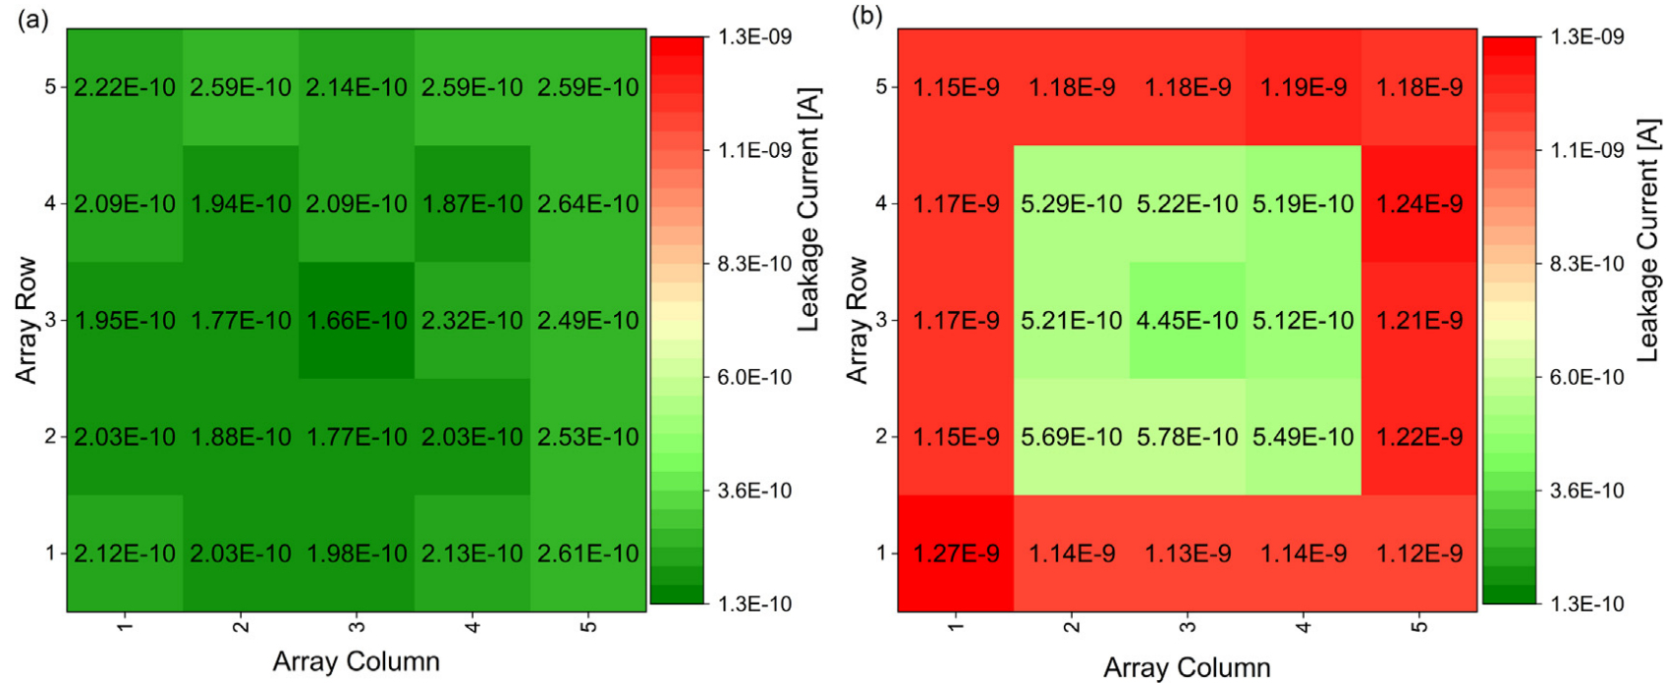
Test for digital switch board
The IV curves of the large-array sensor measured by our system have a similar leakage current and VBD to those measured by HPK (using automatic probe station), but show a better uniformity.
Distribution of leakage currents on the 5 × 5 LGADs array with 100 V bias voltage (a typical bias voltage when the sensor is fully depleted but not broken down), (a) measured by us with the 5 × 5 array digital switch board, (b) measured by HPK with the automatic probe station.

Slide 11
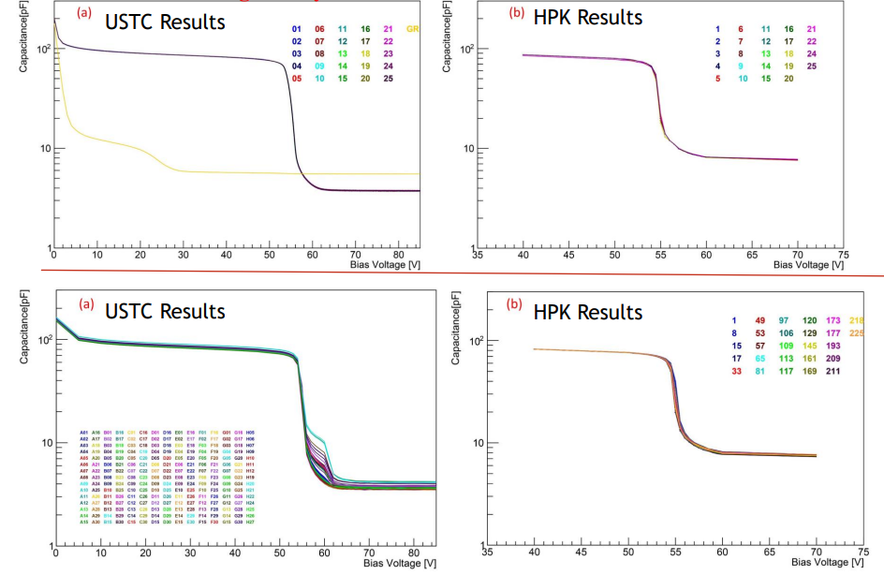
Test for digital switch board
CV measurement performance
CV curves of HPK Batch-2 W1- P1 5 × 5 LGADs array
measured by us with the 5 × 5 array digital switch board
measured by HPK with the automatic probe station.
CV curves of HPK Batch-2 W1- P7 15 × 15 LGADs array
225 CV curves measured by us with the 15 × 15 array digital switch board
27 CV curves of sampling channels measured by HPK with the automatic probe station

Slide 12
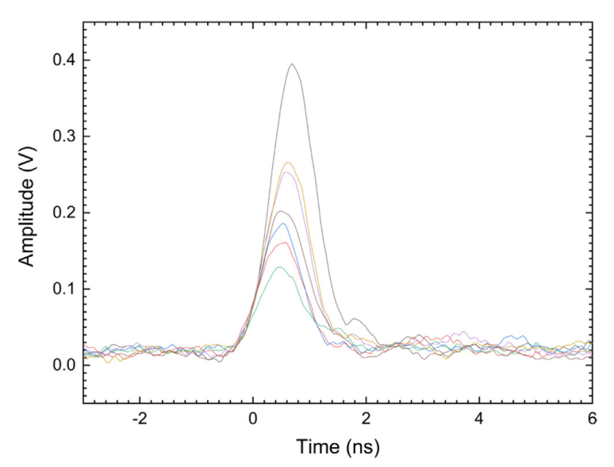
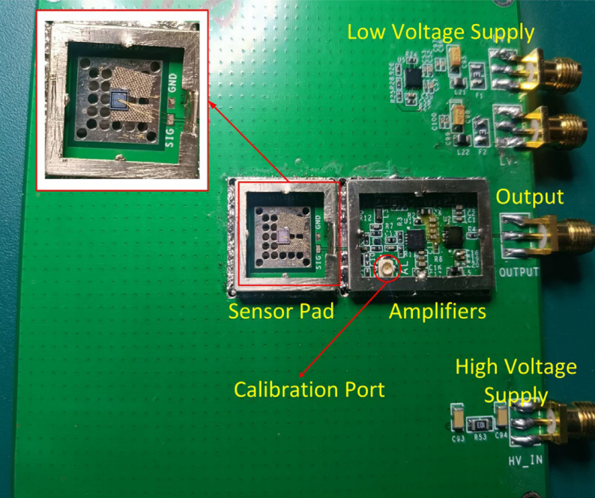
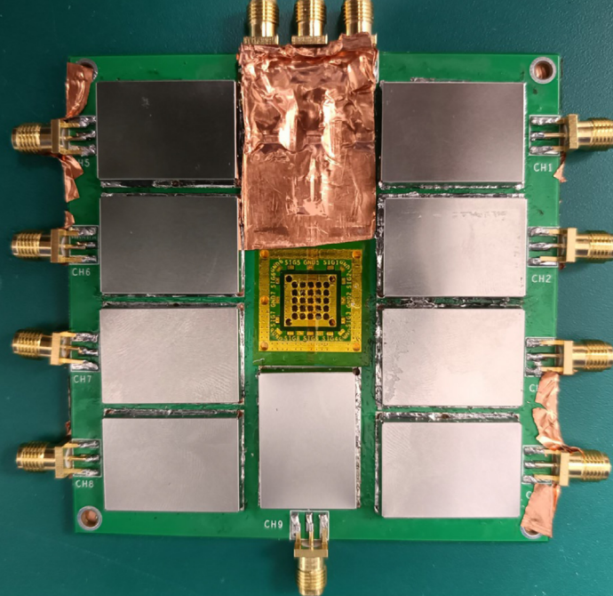
Ultra-fast low-noise preamplifier
Waveforms of the output from HPK Type 3.1 single LGADs
Picture of the single-channel LGAD preamplifier
Picture of the 9-channel LGAD preamplifier board
For LGADs with an active thickness of 50 μm, the rise time (10%–90%) and the duration of the signal current are approximately 500 ps and 1 ns .
The LGAD preamplifier needs to have low noise, low jitter, high gain, and enough bandwidth. Besides, a wide dynamic range of the amplifier is also demanded.
Currently the most widely used preamplifier board for LGAD readout in HGTD community is developed by University of California, Santa Cruz (UCSC).

Slide 13
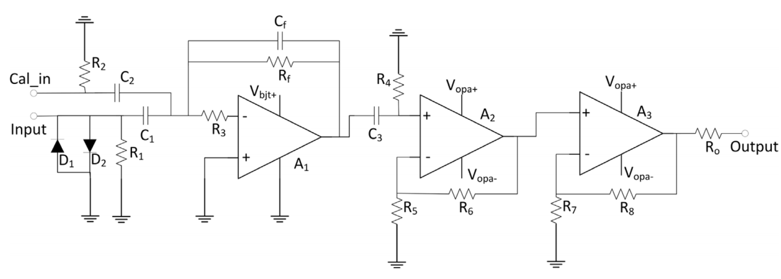
Ultra-fast low-noise preamplifier
1. Transimpedance Amplifiers(TIA) can take full advantage of the fast signal slew rate, and we choose SiGe:C RF transistor-BFR840L3RHESD,whose transition frequency is 75 GHz
2. A2 serves as an intermediate amplifier stage, requiring low noise and high gain.
3.As the output driver, A3 is characterized by wide dynamic range and strong load capacity.
Simplified schematic of the LGAD preamplifier

Slide 14
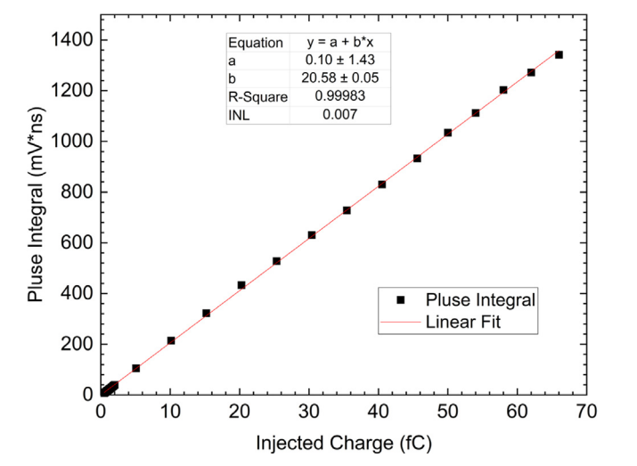
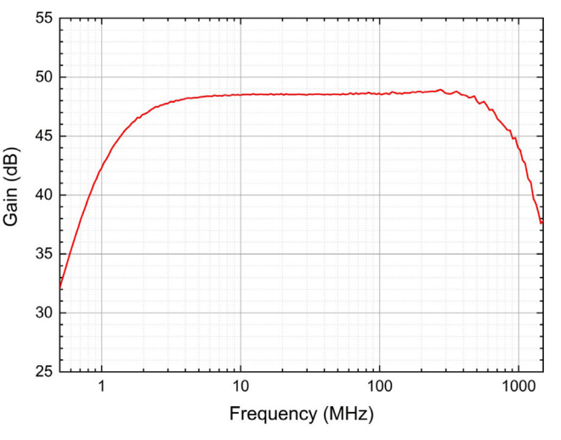
Test for ultra-fast low-noise preamplifier
Electronic performance tests
The charge gain is 20.58 mV ns/fC, the effective dynamic range is [0.7 fC, 66 fC]. The mean RMS noise is 4.81 mV
The measured bandwidth of the preamplifier is about [1.5 MHz, 872 MHz] ,and the gain on the passband is about 48.5 dB
Integration of the averaged output waveform versus equivalent injected charge.
Frequency response curve of the single-channel preamplifier.

Slide 15
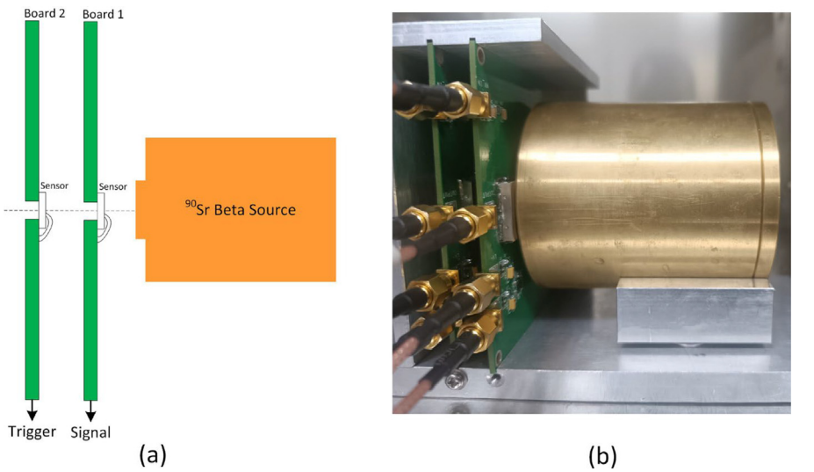
Test for ultra-fast low-noise preamplifier
𝛽-scope tests
Constructed for charge collection and time resolution studies with the LGADs mounted on our single-channel preamplifier boards
Two boards and the Sr 𝛽 source were fixed on a custom-made support structure for mechanical stability and correct alignment, and placed in a climate chamber
HPK Type 3.1 single LGADs, which have an active pad area of 1.3 × 1.3 mm2 and thickness of 50 μm.
The output of Board 1 and 2 are read out by an oscilloscope. Board 2 serves as a trigger, with a threshold of 70 mV, while voltage scans are performed on Board 1.

Slide 16
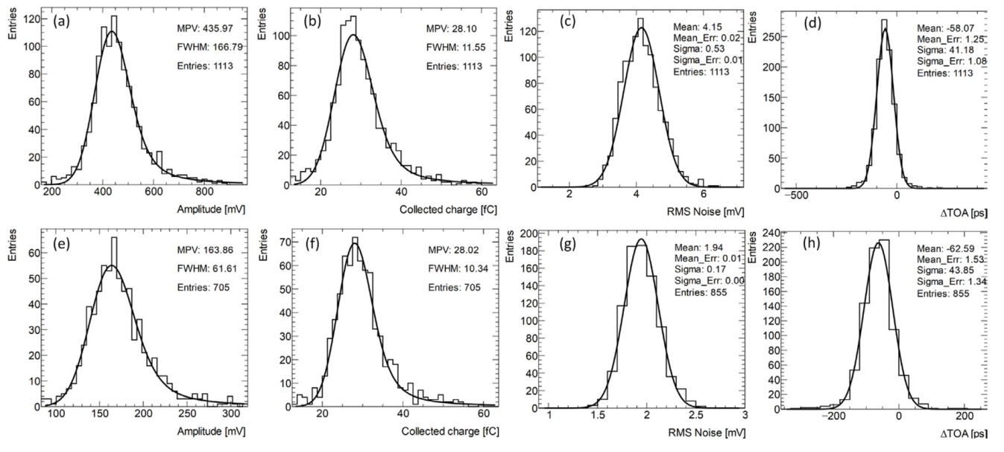
Test for ultra-fast low-noise preamplifier
Distributions of output amplitude (a), collected charges (b), RMS noises (c), and 𝛥TOA (d) measured with our single-channel boards and un-irradiated HPK Type 3.1 single LGADs at −180 V bias and 20 ◦C, and corresponding results (e–h) is measured with UCSC boards and the 2nd stage amplifiers.
Distributions of pulse amplitude (a), collected charges (b), RMS noises (c), and 𝛥TOA (d) measured with our single-channel boards and un-irradiated HPK Type 3.1 single LGADs at −180 V bias and −30 ◦C, and corresponding results (e–h) is measured with UCSC boards and the 2nd stage amplifiers.

Slide 17
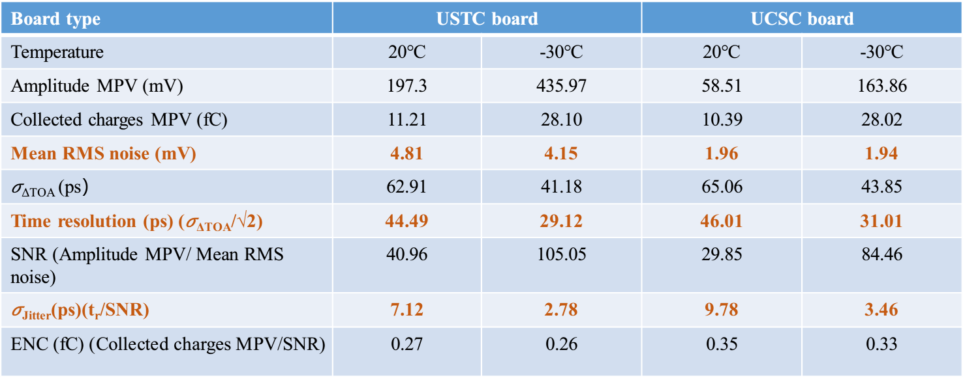
Test for ultra-fast low-noise preamplifier
𝛽-scope tests
𝛽-scope test results using our single-channel boards and UCSC boards (with 2nd stage amplifier) with un-irradiated HPK Type 3.1 single LGADs at 20 ◦C and −30 ◦C.
Sensor type: Un-irradiated HPK Type 3.1 single LGADs Bias Voltage: −180 V
The results show that our boards have a better noise and time performance.

Slide 18
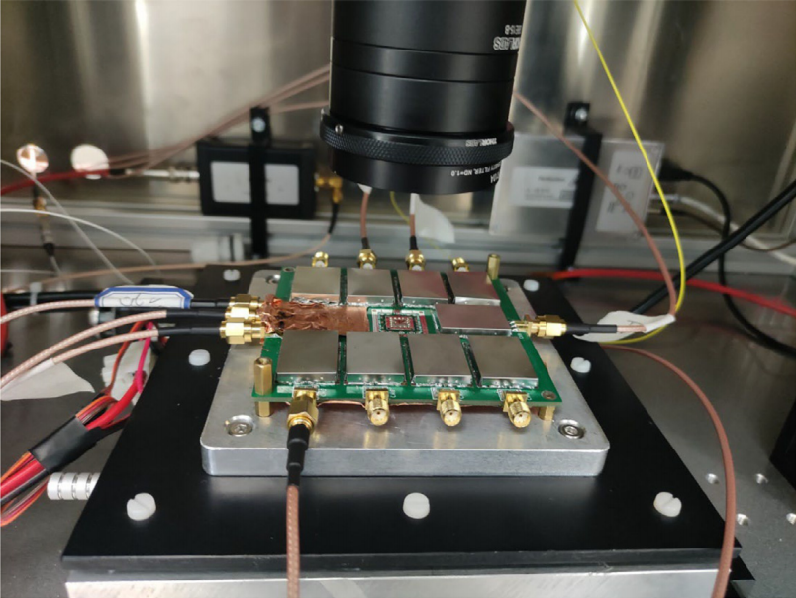
Test for ultra-fast low-noise preamplifier
Multi-channel preamplifier board tests
The average charge gains of the 9 channels are 18.35 mV ns/fC, and the standard deviation is 0.39 mV ns/fC, showing a good uniformity.
The overall jitter of the test system is about 15 ps. It suggests that the 9-channel board works well for the readout of multi-pad LGADs.
Setup for laser-scanning TCT tests

Slide 19
Summary
The digital switch boards can greatly improve the efficiency during the IV and CV measurements at a lower cost.
Compared with the HPK results measured by automatic probe station, the IV curves measured by our platform have better uniformity and accuracy.
Our ultra-fast low-noise LGAD preamplifier board has a larger charge gain, higher SNR(or lower ENC), lower jitter, and simpler structure，with good linearity，compared to the UCSC single-channel preamplifier board.The jitter caused by our preamplifier is about 7.12 ps.
For our 9-channel preamplifier board, the gain of each channel has a good uniformity. The noise and crosstalk are effectively suppressed.

Slide 20
THANKS!

